Slide 1
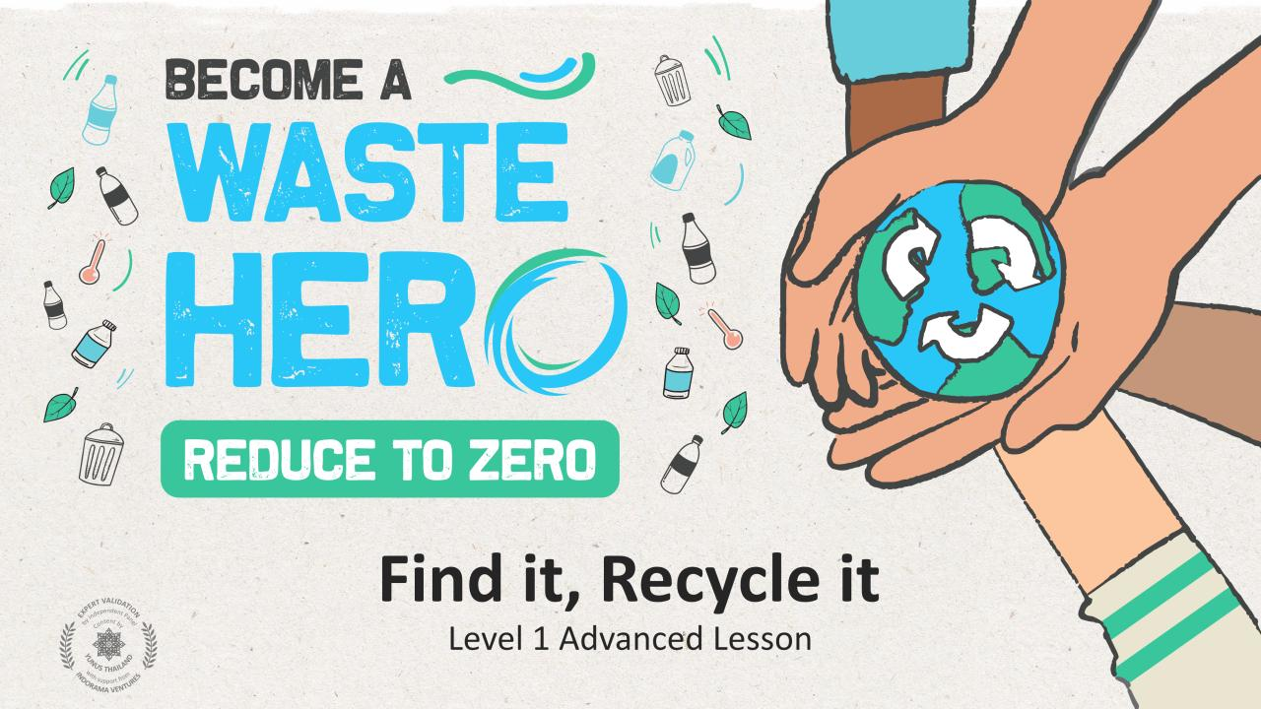

Slide 2
Lesson duration: 25 - 30 minutes
Lesson Prep & Curriculum Alignment
Lesson duration: 30-35 minutes
Students will take ownership of recycling by putting all they have learned into practice. Each day of the week, they will collect at least one PET plastic bottle at school or home to recycle. A tally will be taken each day to see how many bottles the class has collected. The lesson will kick off with a bottle hunt inside the classroom and a coloring page of a PET plastic bottle, then they will be asked to see how many bottles they can collect throughout the week and become a “Waste Hero”.
1
Display or print the “YES/NO” handout and distribute the bottle “Bottle Coloring” handout to the class.
2
Prepare a large container or recycling bin for the classroom. Something large enough to hold a week's worth of PET plastic bottles. Collect and prepare 10-20 PET plastic bottles. It is best to have students bring bottles from the cafeteria at school or from home.
3
Print and tape together the “Classroom Bottle Counter” for the board or somewhere the whole class can see.

Slide 3
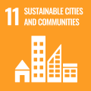
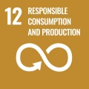
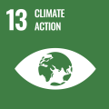
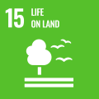
Lesson Prep & Curriculum Alignment
Key Learning Outcomes and Curriculum Alignment:
Science - Earth and Human Activity: Communicate solutions that will reduce the impact of humans on the land, water, air, and/or other living things in the local environment. Things that people do can affect the world around them. But they can make choices that reduce their impacts on the land, water, air, and other living things.
English Language Arts and Literacy: Participate in collaborative conversations with diverse partners about topics and texts. Follow agreed-upon rules for discussions. Use words and phrases acquired through conversations, reading and being read to, and responding to texts.
Math: Classify objects into given categories; count the numbers of objects in each category and sort the categories by count.
SDG Alignment
Flexible and adaptive lesson
Lesson plans are designed to be flexible and responsive to the evolving needs of your classroom. Lessons are editable and customizable to meet the different individual student and classroom contexts. A PowerPoint version with teacher instructions and a printable PDF lesson are available for download.

Slide 4
The Lesson
Lesson duration: 45 - 60 minutes
1
Before the students arrive to class, carefully hide 10-20 PET plastic bottles around the classroom.
2
Distribute the “YES/NO” handout and ask the class,
What do you remember about recycling?
What can be recycled?
Raise your hand and show me something that can be recycled on the handout?
What are the 1, 2, 3s of recycling?
3
Display and discuss the “3 Steps to Recycling” slides, then introduce the PET plastic bottle challenge final slide and let the students know they will be collecting PET plastic bottles for one week at school and at home to become a “Waste Hero”.
Use a class “Bottle Counter” on the board to see the daily progress.
Present the recycling box.
It is best to try and collect bottles at school if it is difficult for some kids to bring from home.
4
Give them 5 minutes to search the class for the hidden PET plastic bottles to put into the new bin and start the count.
lesson continued

Slide 5
The Lesson
Lesson duration: 45 - 60 minutes
5
Each day of the Bottle Challenge, count as a class the number of bottles collected and mark the total on the class “Bottle Counter”.
6
Distribute the PET plastic “Bottle Coloring” handout and ask questions like,
What kinds of drinks go inside these bottles?
Do you have a favorite drink? What color is it?
Where do you put these bottles when you are done?
7
At the end of the week, count the total bottles collected as a class and award the students with a “Waste Hero” certificate of achievement sticker.

Slide 6
Prepare the PowerPoint presentation
When you are ready to present the lessons to your class click on Slide Show on the top menu bar then select Presenter View. In Presenter view, you can see your notes as you present while the audience see only your slides.
The notes appear in a pane on the right. The text should wrap automatically, and a vertical scroll bar appears if necessary. You can also change the size of the text in the Notes pane by using the two buttons at the lower left corner of the Notes pane.

Slide 7
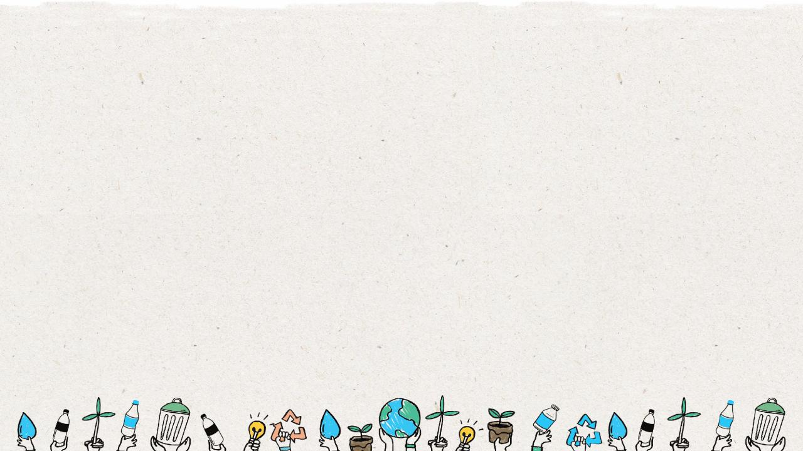
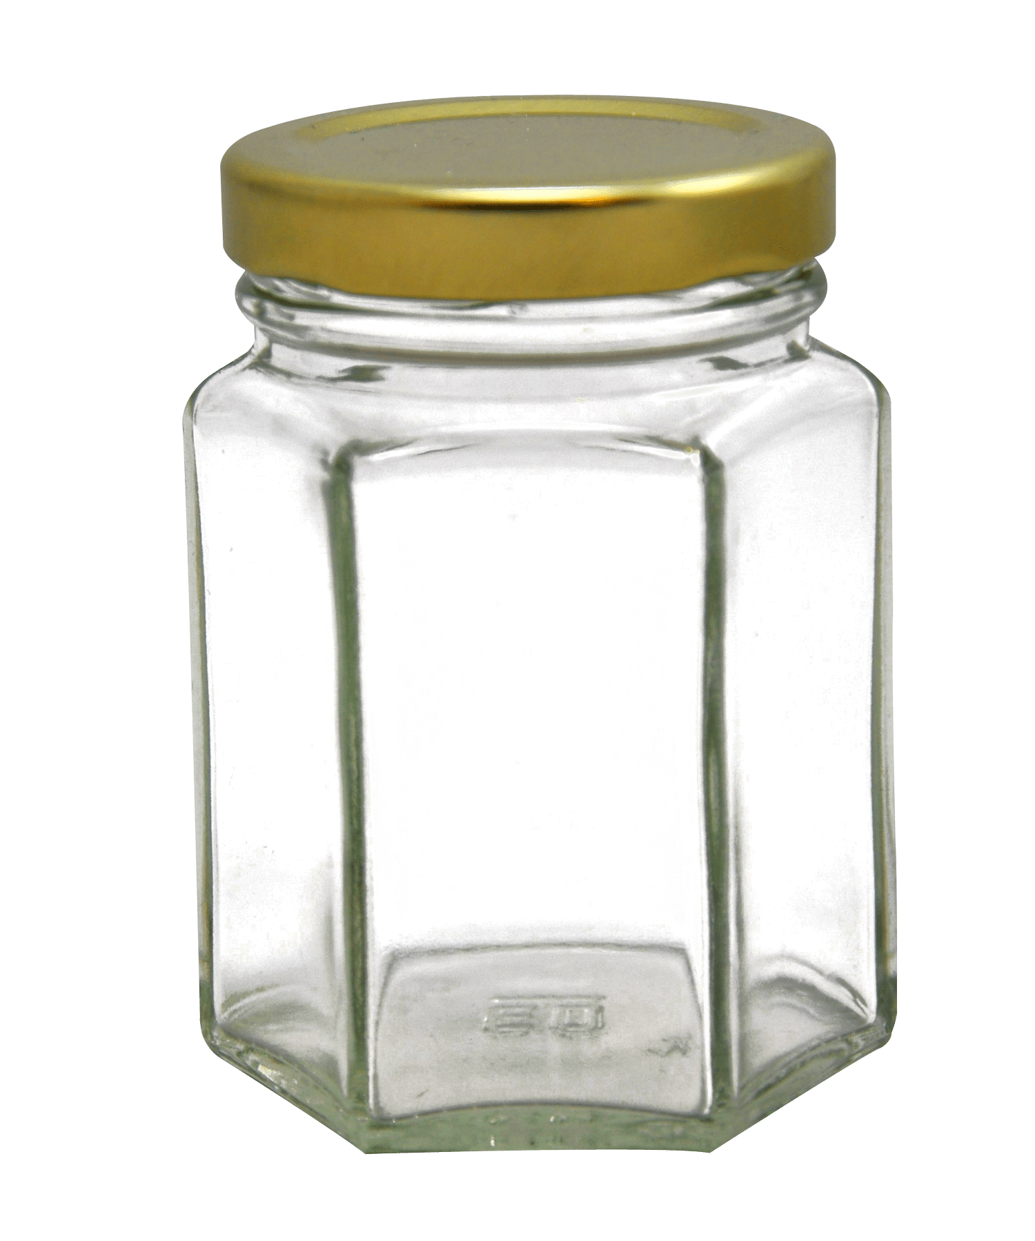
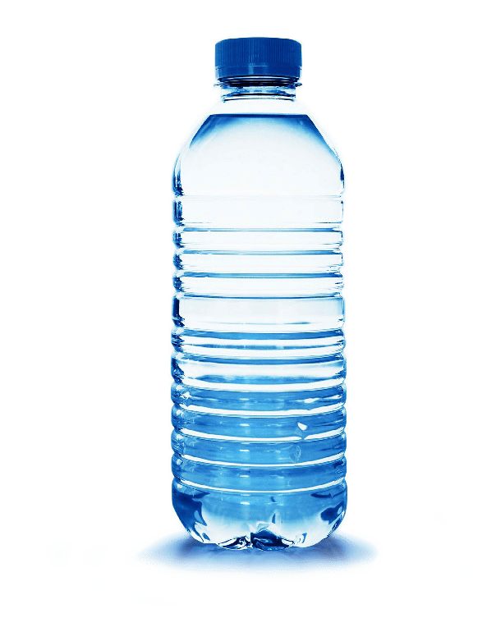
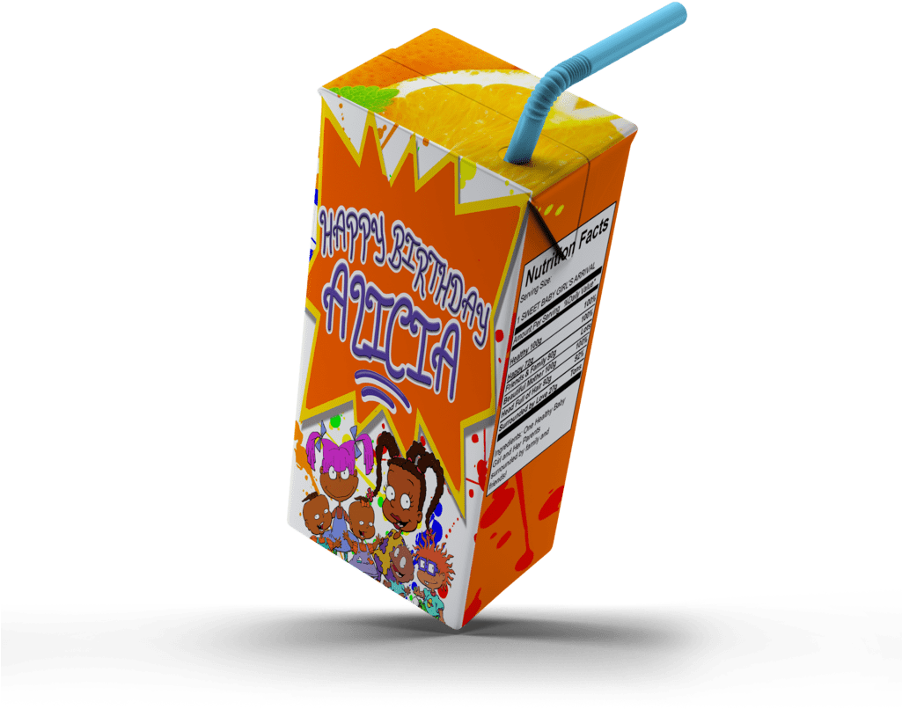
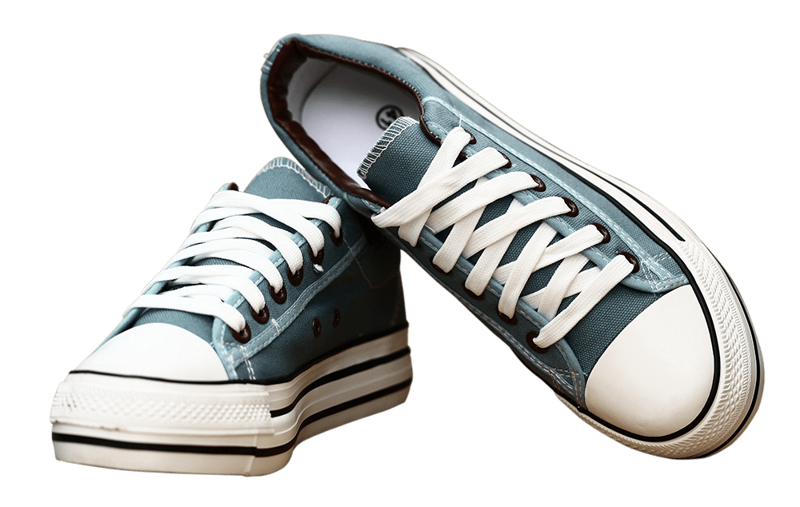
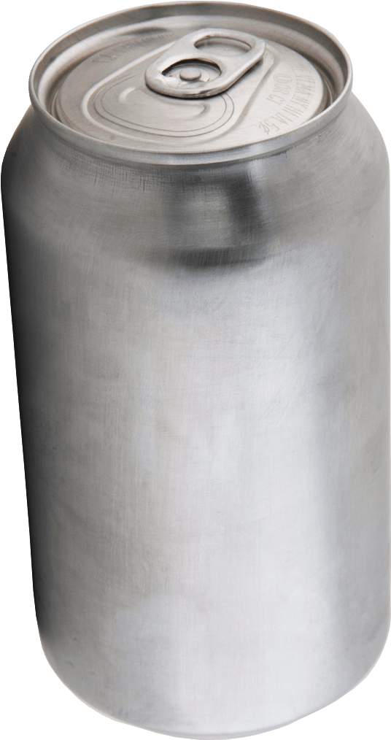
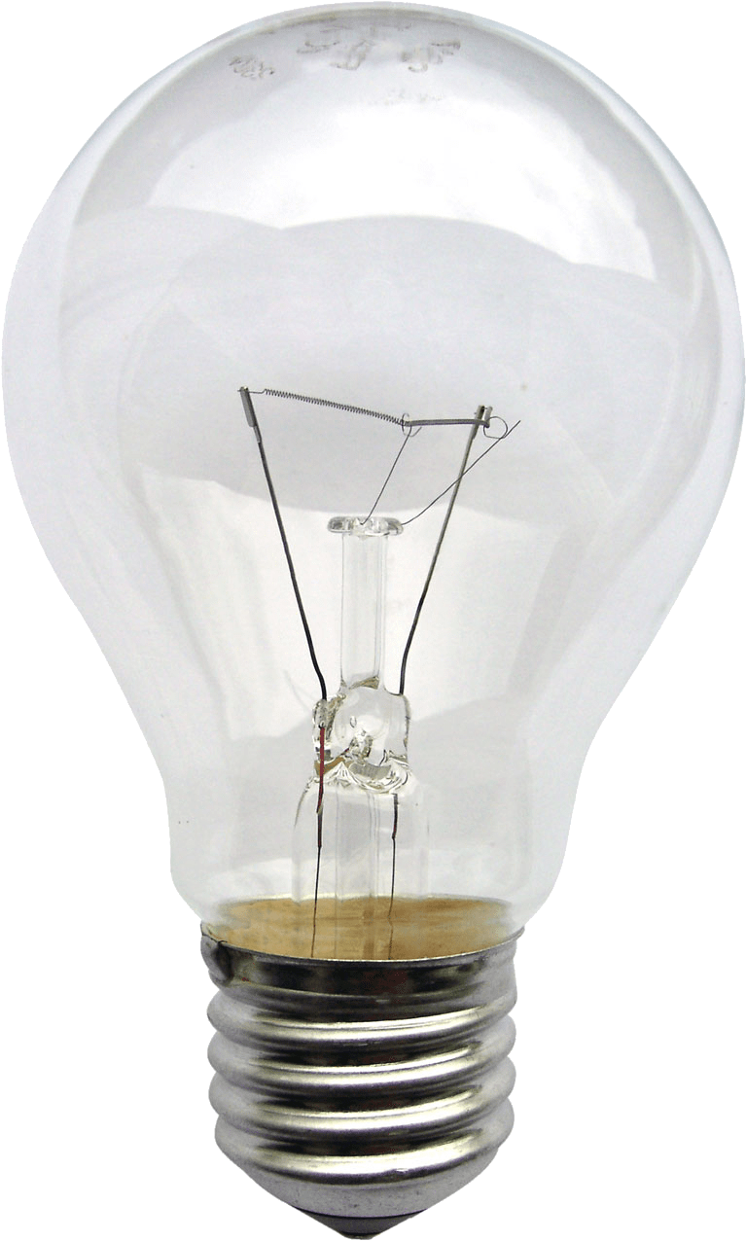
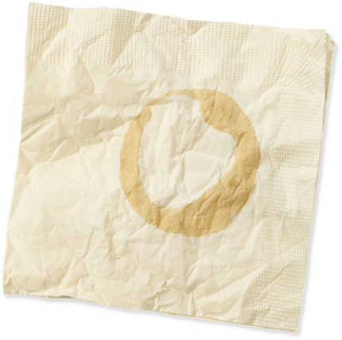
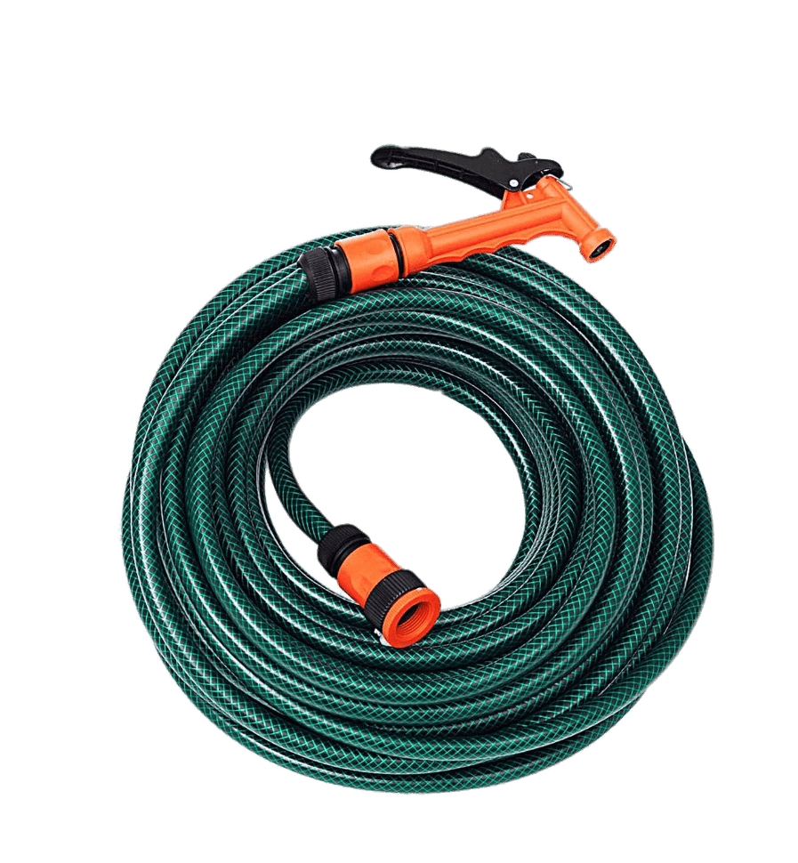
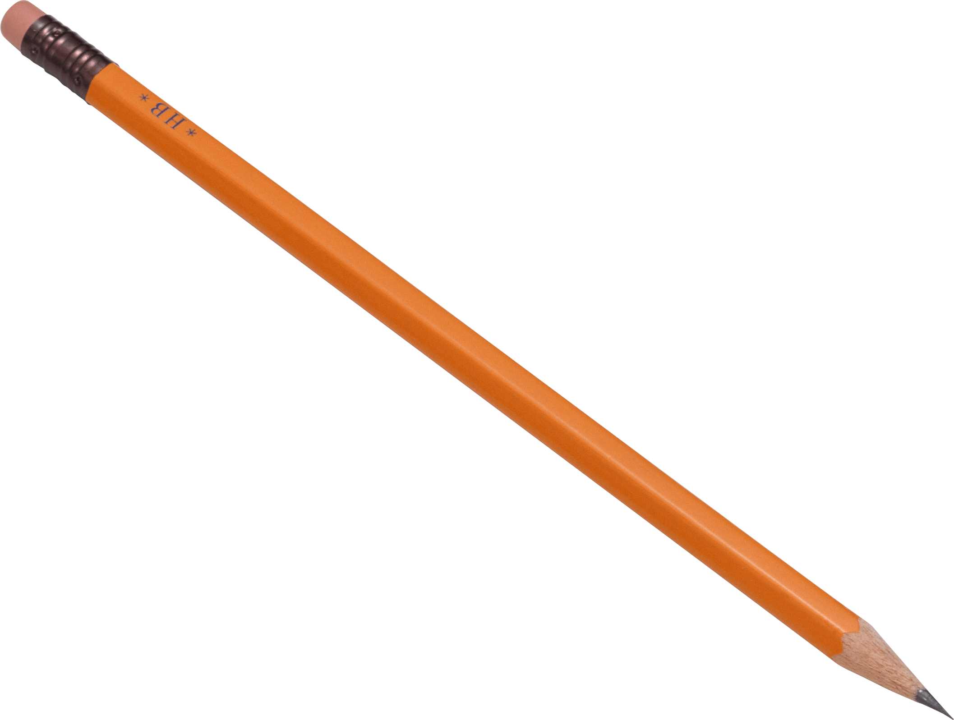
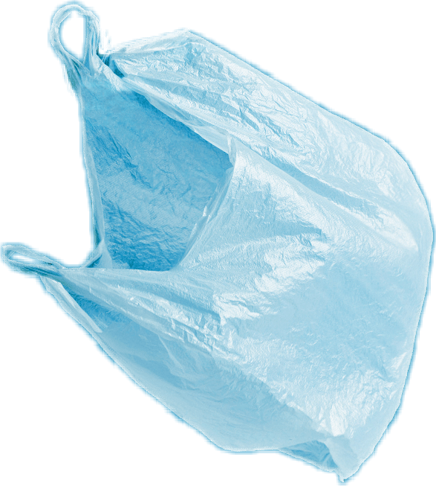
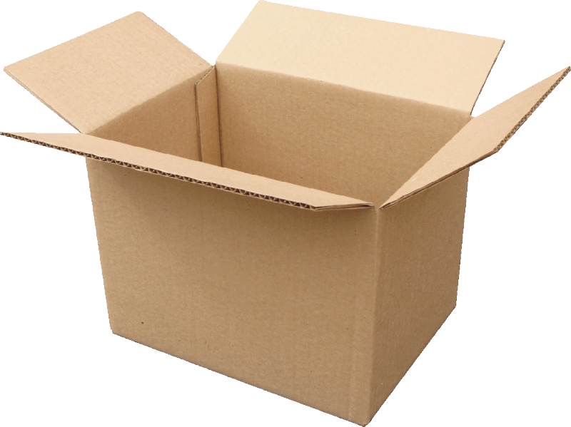
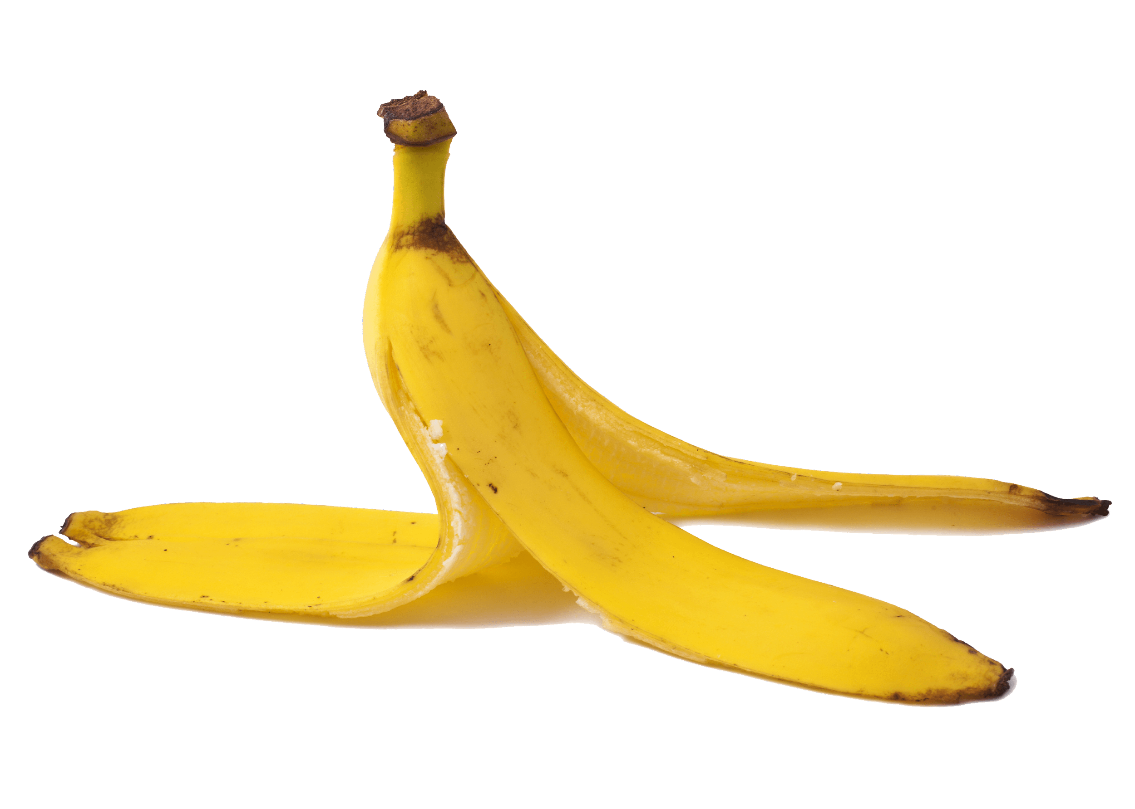
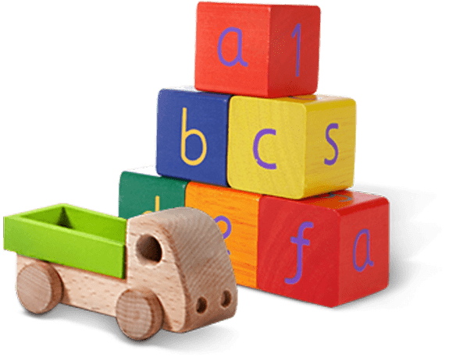
Glass jar
PET Plastic bottle
Shoes
Metal can
Light bulb
Juice box
Dirty napkin
Plastic bag
Toys
Pencil
Banana peel
Cardboard box
Garden hose
YES
NO
Notes:
(Slide duration: 3-5 minutes)
Pre-lesson Icebreaker Exercise
Ask students:
Has anyone heard of recycling? If yes, please share with the class what they know.
Tell students:
Recycling is the process of collecting and processing materials that would otherwise be thrown away as trash and turning them into new products. Recycling can benefit your community and the environment.
Now read off the images left to right starting on the top row to test their knowledge about what items displayed can and cannot be recycled.
Order of images that will appear with each click.
Click 1: Glass jar
Click 2: PET Plastic Bottle
Click 3: Shoes
Click 4: Metal can
Click 5: Light bulb
Click 6: Juice box
Click 7: Dirty napkin
Click 8: Pencil
Click 9: Plastic bag
Click 10: Toys
Click 11: Cardboard box
Click 12: Garden hose
Click 13: Banana peel

Slide 8
YES
NO
Always recycle:
Never recycle:
Banana peel
Dirty napkin
Garden hose
Glass jar
PET Plastic bottle
Light bulb
Juice box
Shoes
Cardboard box
Metal can
Toys
Plastic bag
Pencil
Notes:
(Slide duration: 3-5 minutes)
Pass out or display this YES/NO slide – there is a printable pdf handout available for students.
Open a discussion about where we put our garbage.
Ask Students: What do you do with waste at home? Where does it go? Does all waste belong in 1 bin?
Tell Students:
Not all waste goes into the same waste bin. Some items need to go into the recycling bin.
Ask Students:
The items on the left side of the page can be recycled, what are those items? What is the first picture you see?
*ask in this order (Glass jar, PET Plastic bottle, Cardboard box, Metal can)
Click 1: Glass Jar
What is it made from? Can it be recycled?
Answer: glass, yes
Click 2: PET Plastic bottle
What is it made from? Can it be recycled?
Answer: plastic, yes
Click 3: Cardboard box
What is it made from? Can it be recycled?
Answer: paper, yes
Click 4: Metal can
What is it made from? Can it be recycled?
Answer: metal, yes

Slide 9
The
3
Steps to
Recycling
Notes:
(Slide duration: 2 minutes)
Recycling is as easy as 1, 2, 3, and everyone can and should do it at home and at school.
Ask Students:
Does anyone remember the 3 steps to recycling?

Slide 10
Step
1
Know what you can recycle.
Glass Jar
PET Plastic bottle
Cardboard box
Metal can
Notes:
(Slide duration: 3-5 minutes)
Have the students guess the four main items we can recycle.
Click 1: Glass Jar
Click 2: PET Plastic bottle
Click 3: Cardboard box
Click 4: Metal can
Ask Students:
Can you give me an example of something we can recycle?
What is something we should never recycle?
Fun Fact:
PET Plastic bottles are the most recycled plastic in the world and is fully recyclable.
Expansion Questions:
Have you ever seen the #1 on the bottom of a water bottle? If you see it, you can fully recycle it!
Can you give another example of something we can recycle?

Slide 11
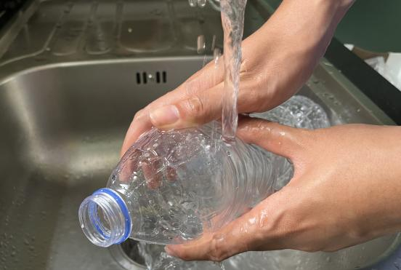
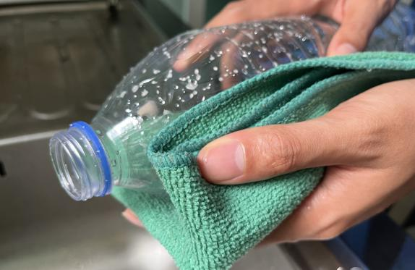
Step
2
Empty, clean, and dry before putting in the bin.
Notes:
(Slide duration: 3-5 minutes)
Ask Students:
1. Why is it important to clean our items for recycling?
2. What if there is a little bit of food or liquid on it?
You might suggest:
Dirty items cannot be recycled.
Wet and dirty items can get other clean items dirty, getting the whole recycling bin dirty.

Slide 12
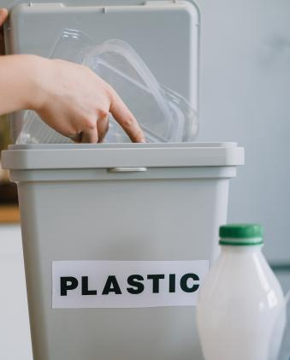
Step
3
Put recyclables into the correct recycling bin.
Notes:
(Slide duration: 3-5 minutes)
Recycling needs to be separated into the proper recycling bins. Click to reveal the recycling symbol. Let them know that this symbol indicates where to put your recycling.
Ask students:
Where have you seen this green symbol before?
What does this symbol mean?
Where do we put PET plastic bottles?

Slide 13
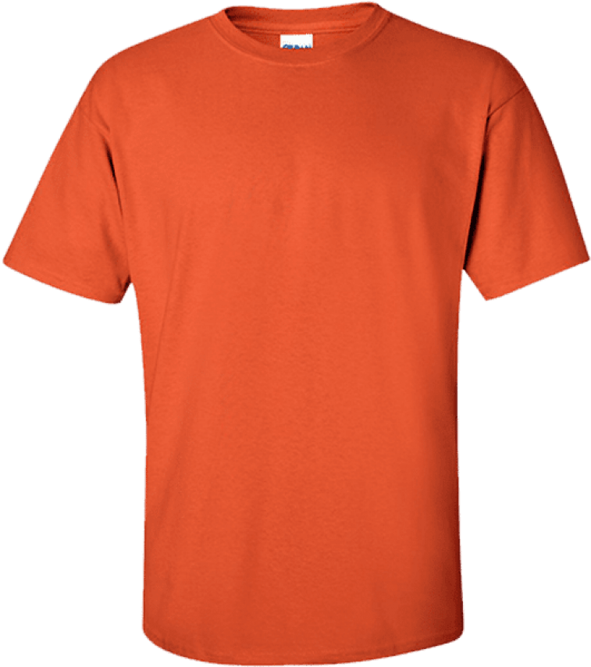
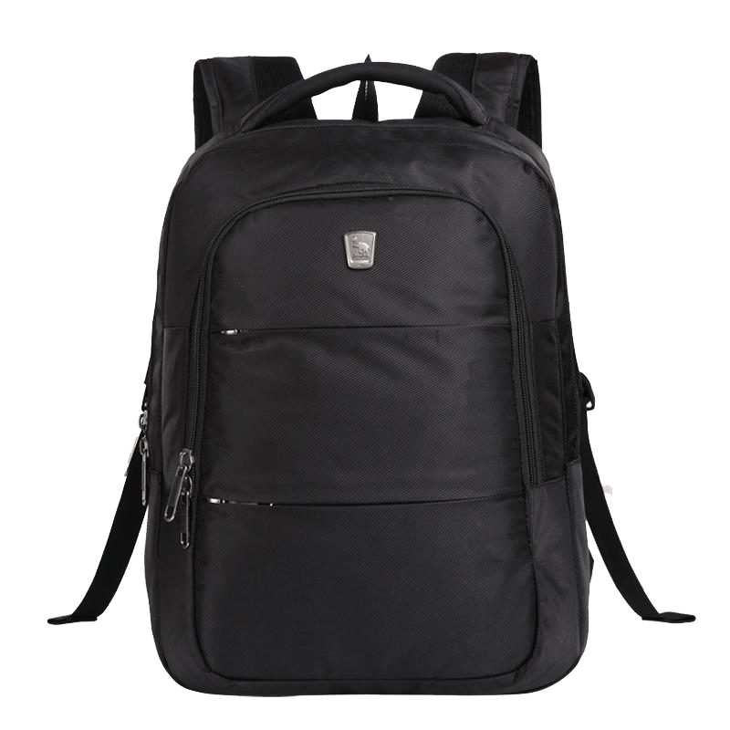
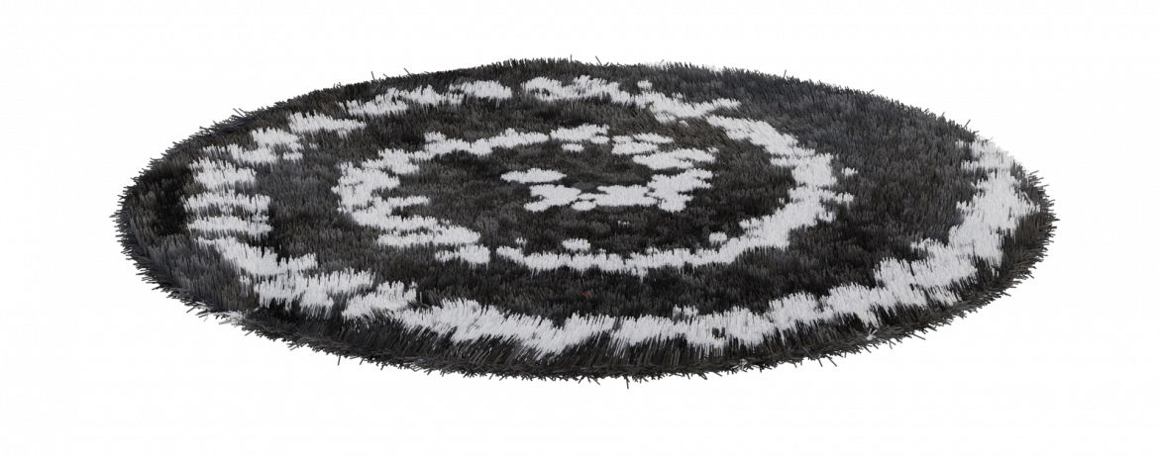
When we clean, dry, and recycle we can make new things.
Notes:
(Slide duration: 2-4 minutes)
Tell students:
When we follow the 3 steps of recycling we can recycle our waste into brand new things.
Example:
Click 1:
PET plastic bottles can be recycled back into new PET plastic bottles.
Click 2:
PET plastic bottles can also be made into thread that can make fabrics and textiles.

Slide 14
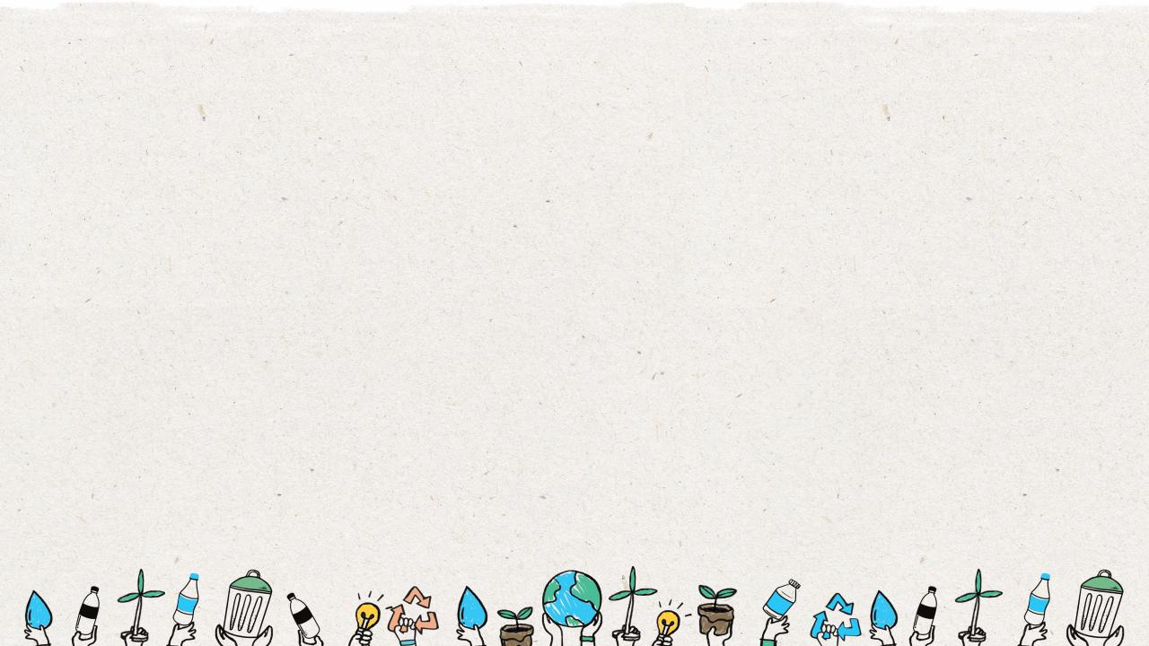
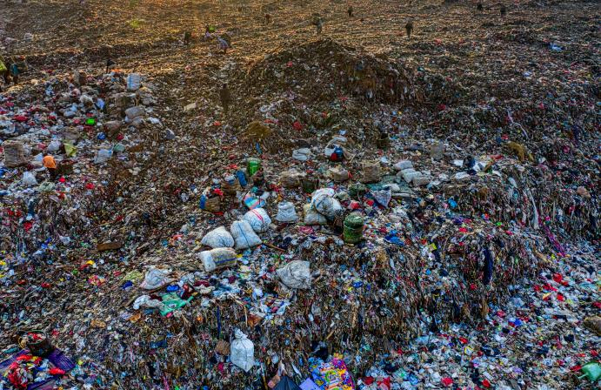
Landfill
When recyclables are not correctly prepared and sorted for recycling, they end up as garbage that goes to a landfill.
Notes:
(Slide duration: 3-5 minutes)
Ask students:
What is a landfill?
Do recycling items belong here? Why?
What does belong here?
Answers:
A landfill is a site where people dump their general waste materials into the ground or into a giant pile.
No, recycling does not belong here. It is only items that cannot be recycled which need to be put into the landfill.

Slide 15
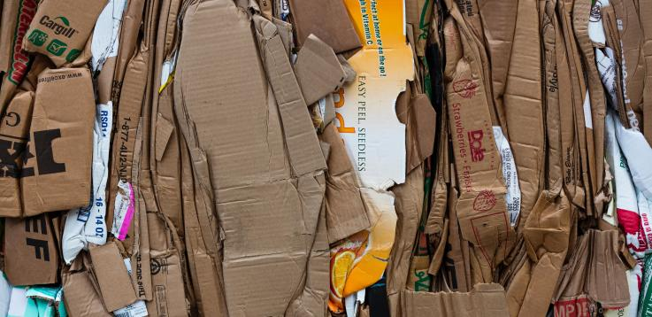
How long does it take a cardboard box to disappear in a landfill?
3 Months
Notes:
(Slide duration: 3 minutes)
Ask students:
Do you know how long it takes a cardboard box to disappear in a landfill?
*Click to activate the animation after asking the question
Answer: 3 Months
Ask students:
Can we recycle cardboard?
Answers:
Yes, cardboard is fully recyclable.

Slide 16
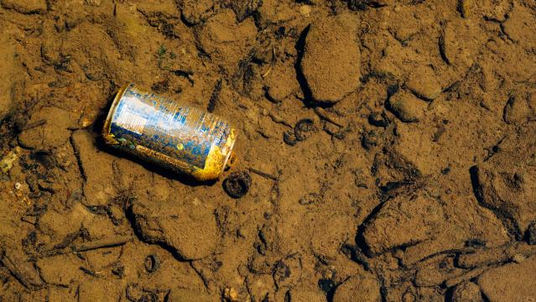
How long does it take a metal can to disappear in a landfill?
150 years
Notes:
(Slide duration: 3 minutes)
Ask students:
Do you know how long it takes a metal can to disappear in a landfill?
*Click to activate the animation after asking the question
Answer: 150 years
Ask students:
Can we recycle metal cans?
Answers:
Yes, metal cans are metal and are fully recyclable.

Slide 17
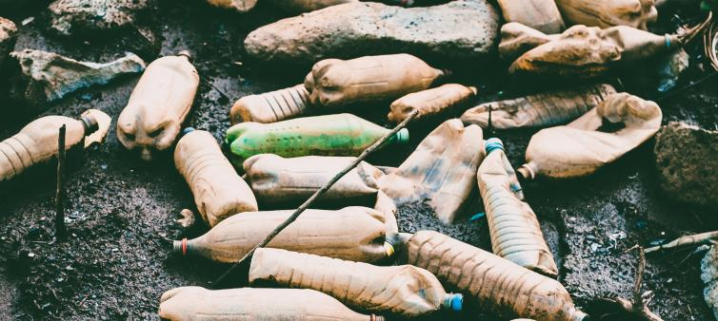
How long does it take a PET plastic bottle to disappear in a landfill?
450 years
Notes:
(Slide duration: 3 minutes)
Ask students:
Do you know how long it takes a PET plastic bottle to disappear in a landfill?
*Click to activate the animation after asking the question
Answer: 450 years
Ask students:
Can we recycle PET plastic bottles?
Answers:
Yes, PET plastic bottles are fully recyclable.

Slide 18
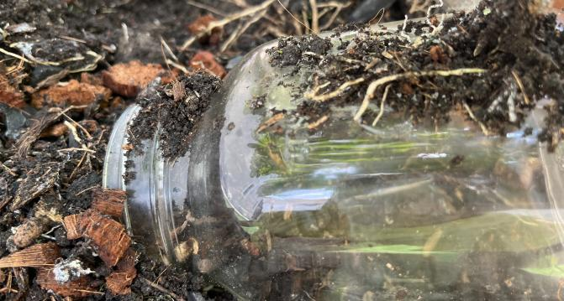
How long does it take a glass jar to disappear in a landfill?
4,000 years
Notes:
(Slide duration: 3 minutes)
Ask students:
Do you know how long it takes a glass jar to disappear?
*Click to activate the animation after asking the question
Answer: 4,000 years
Ask students:
Can we recycle glass jars?
Answers:
Yes, glass jars are fully recyclable.

Slide 19
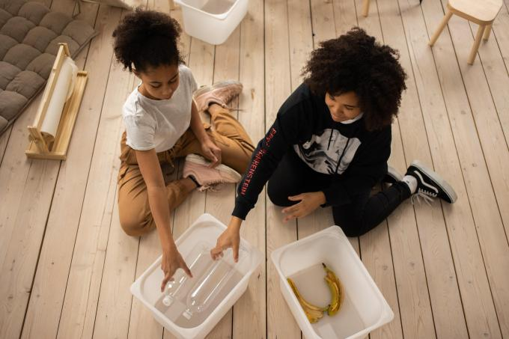
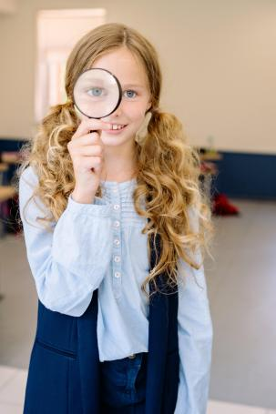
Can you find the PET plastic bottles in this classroom?
Notes:
(Slide duration: 3-5 minutes)
Prepare a container or recycling bin for the classroom. Something large enough to hold a week's worth of PET plastic bottles. Collect and hide 10 PET plastic bottles. If in doubt, look for the #1 on the bottom of the bottles.
Give them 5 minutes to search the class for the hidden PET plastic bottles.
After collection, have students sit in a circle and pass the bottles around asking them to find the #1 on the bottom on the bottle.
Tell the students to put the bottles into the designated bin.
Introduce the bottle counter printout and hang somewhere for everyone to see.
Fun Fact:
The PET bottle is the most common plastic bottle used for soft drinks, so visit the cafeteria and collect a few for this activity.
The PET bottle is the most recycled plastic in the world and is fully recyclable.

Slide 20
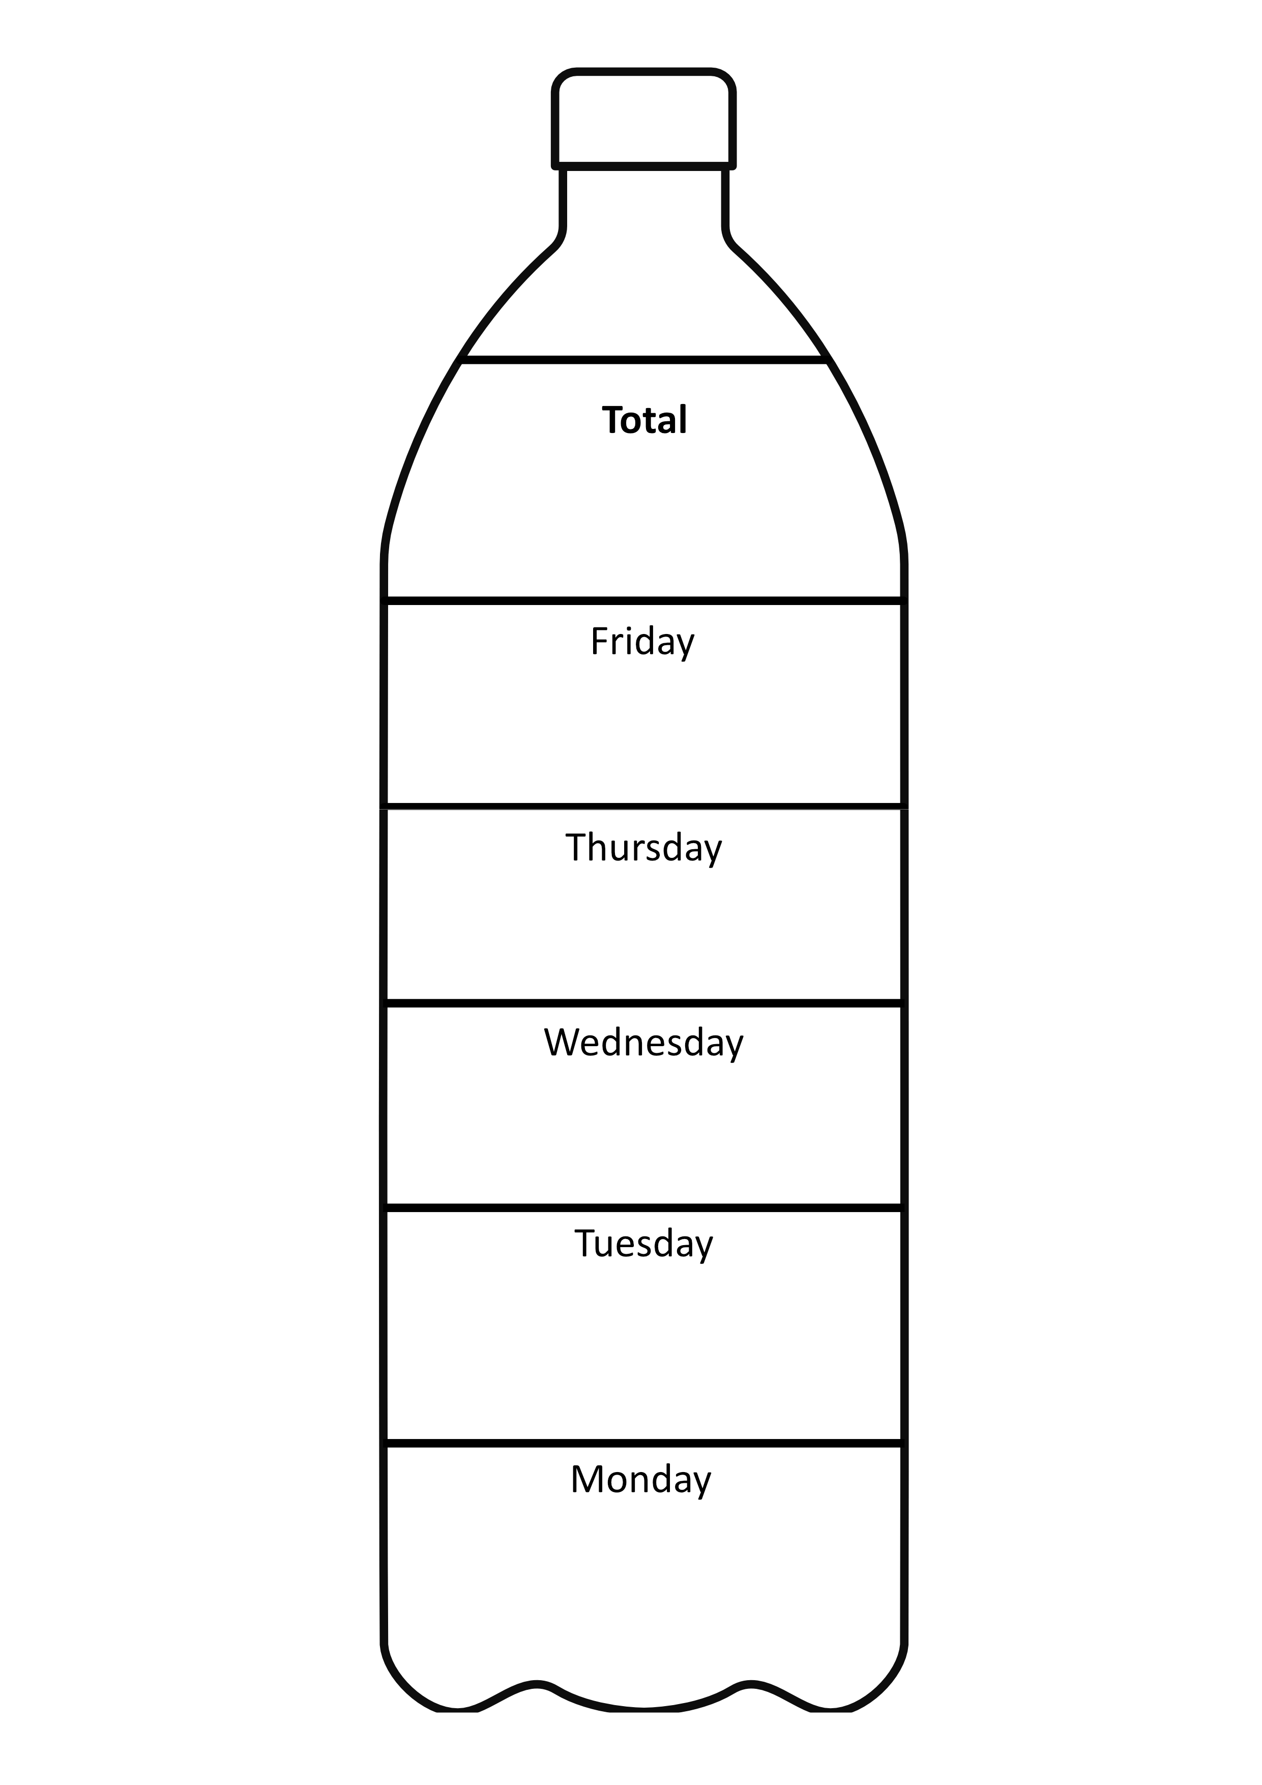
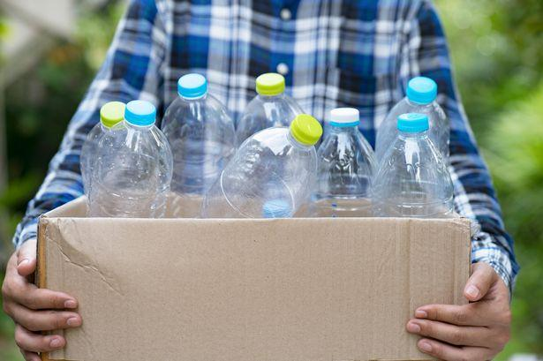
PET Plastic Bottle Classroom Challenge
41
9
6
9
10
7
Notes:
(Slide duration: 3 minutes)
Introduce the PET Plastic Bottle Challenge and let the students know they will be collecting PET plastic bottles for one week at school and at home to become a “Waste Hero”.
Start the bottle counter from the class scavenger hunt and count together as a class.
Present a recycling box large enough to hold a weeks worth of bottles.
Best to try and collect bottles at school if it is difficult for some kids to bring from home.
Let students know to clean and dry the bottles they bring to class.
Ask students:
1. How many bottles do you think we can all collect for a week?

Slide 21
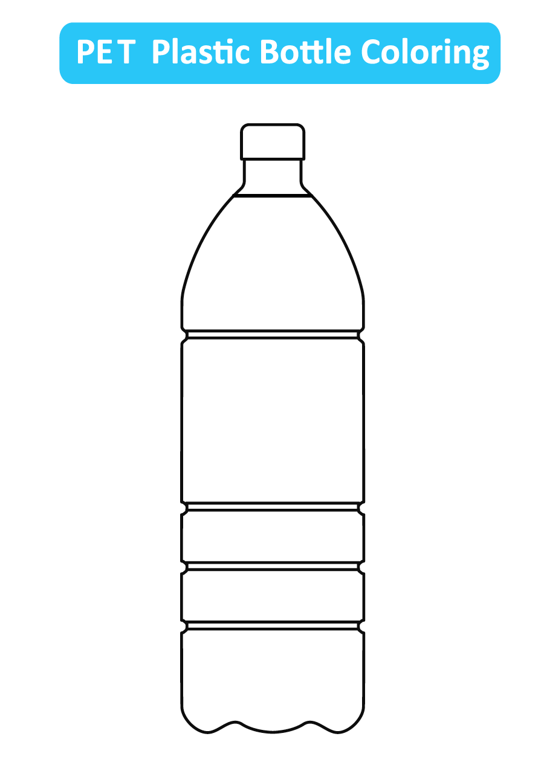
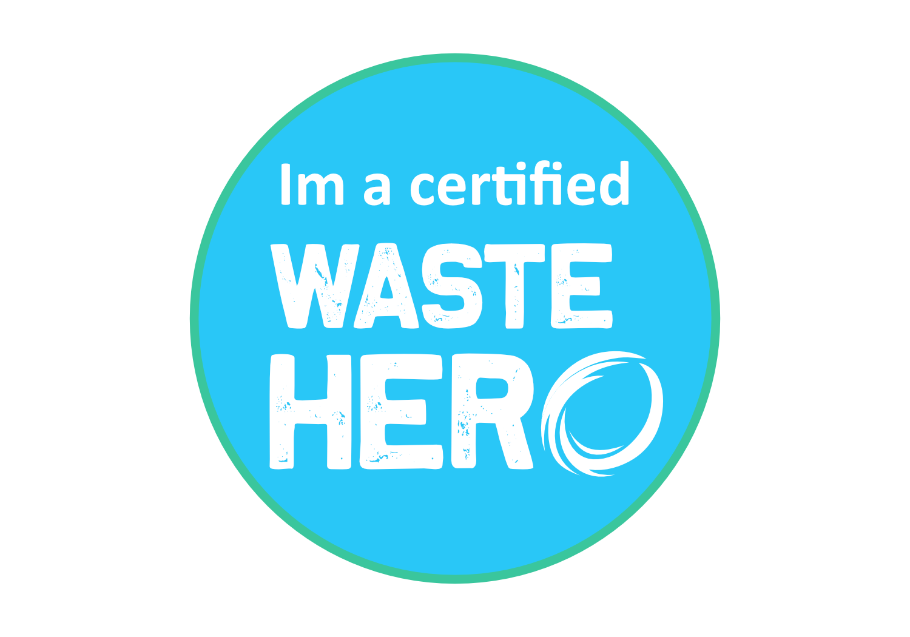
Lesson duration: 25 - 30 minutes
Next Steps
1
Print and pass out the “Bottle Coloring” handout at the end of the lesson or send home as homework. The coloring page is separate from the PowerPoint lesson and is a downloadable pdf file.
2
At the end of the week let the students know they are officially certified “Waste Hero’s” now and can teach their family how to recycle at home.
2
Notes:
Each day of the PET Plastic Bottle Challenge count as a class the collected PET plastic bottles and mark the total on the class “Bottle Counter”.
Distribute the PET plastic bottle coloring page and ask questions like,
What kinds of drinks go inside these bottles?
Do you have a favorite drink? What color is it?
Where do you put these bottles when you’re done?
At the end of the week count the total bottles collected as a class and award the students with a “Waste Hero” certificate of achievement sticker.

