Slide 1
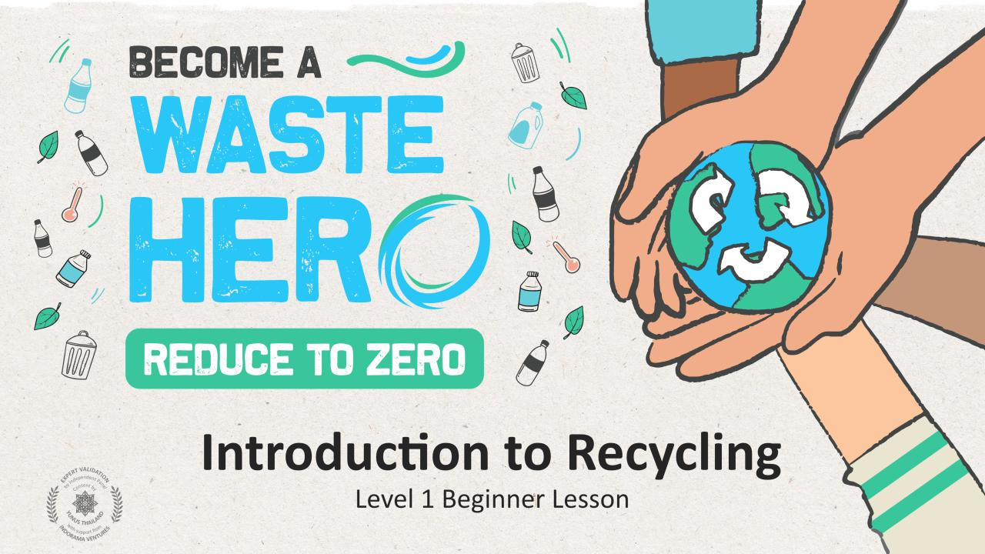

Slide 2
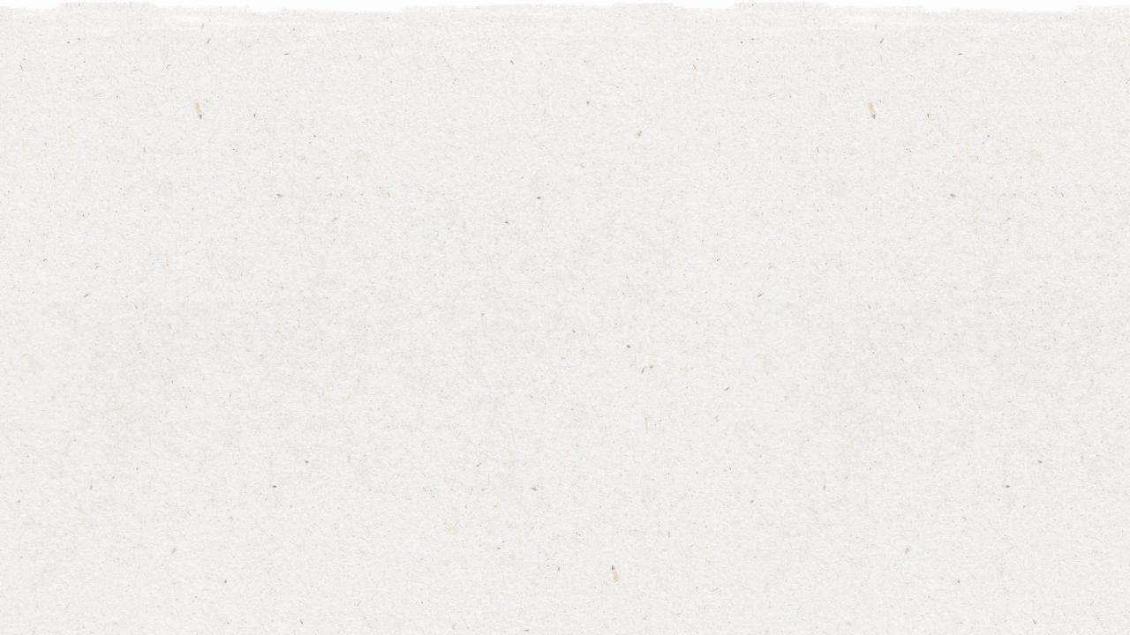





Lesson Prep & Curriculum Alignment
Prep time: 10 - 15 minutes
Students will learn the basics of recycling, why it is important, and how to do it. They listen and comment on a story about a family learning to recycle at home, and practice critical thinking skills. They will write or draw a picture about why they think recycling can help the world. They will receive a handout to indicate what can and cannot be recycled.
1
Display or print out the YES/NO slide to create a class discussion - story begins on slide #8.
2
Print out the “YES/NO”, Mark an “X”, and the Coloring Page handout. Pass out the YES/NO handout before the story to discuss recyclables and distribute the “Mark an X” handout at the end of the story. Distribute the coloring page after the “Mark an X” handout or send home as homework.
3
Bring in optional supportive prop materials: PET plastic bottle, glass bottle, cardboard box, metal can, and items that cannot be recycled like juice boxes or dirty napkins from lunch.
Key Learning Outcomes and Curriculum Alignment:
SDG Alignment
Science - Earth and Human Activity: Communicate solutions that will reduce the impact of humans on the land, water, air, and/or other living things in the local environment.
Social Studies - People, Places, and Environments: Students study people, places, and environments and enables them to understand the relationship between human populations and the physical world.
English Language Arts and Literacy: Able to ask and answer questions about details in a literature text. Add drawings or other visual displays to descriptions to clarify ideas, thoughts, and feelings.

Slide 3
The Lesson
Lesson duration: 45 - 60 minutes
1
Introduce the lesson to your students with a question.
Who knows what “recycling” means?
Has anyone seen this symbol before, and what does it mean?
4
Distribute the Mark an “X” handout
Ask students to look at the pictures and draw an X across the things that should not be recycled. Which of these items needed to be rinsed and dried before recycling?
2
Pass out or display the YES/NO handout
Discuss what we can and cannot recycle based on the items in the handout. There is a pdf printable version and is also included in the slideshow to display.
What do you do with garbage at home?
Where does it go?
If you put everybody’s garbage into a big pile, how much would there be? Would it be too much?
The following items should be crossed out on the worksheet:
Juice box
Banana peel
Toys
Pencil
Shoes
Plastic bag
Pizza box
Light bulb
3
Read aloud “Rachel Rabbit Learns to Recycle”
Encourage students to comment on the story.
What mistakes did Rachel make? Why is recycling important?
5
Distribute the coloring page and ask students to draw or write on the back of the worksheet how recycling can help the world.
Possible responses could be:
  Save animals from being hurt.
  Less garbage in the ocean.
  Recycling keeps our air and water clean.
You might suggest these as reasons that recycling is important:
Garbage can be harmful to our air and water and can hurt animals and fish.
When we use less paper, we save trees and animals in the forest.
When we recycle, we make less garbage.

Slide 4
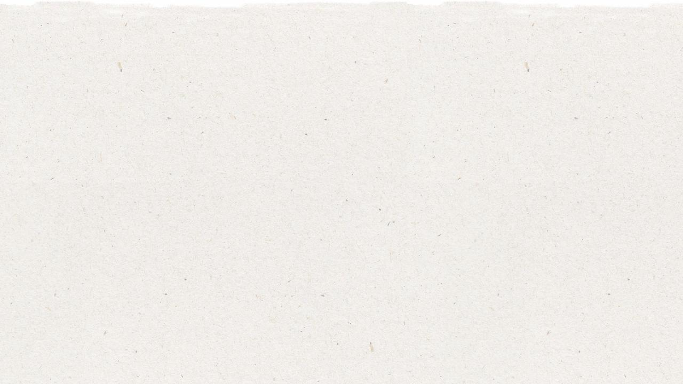
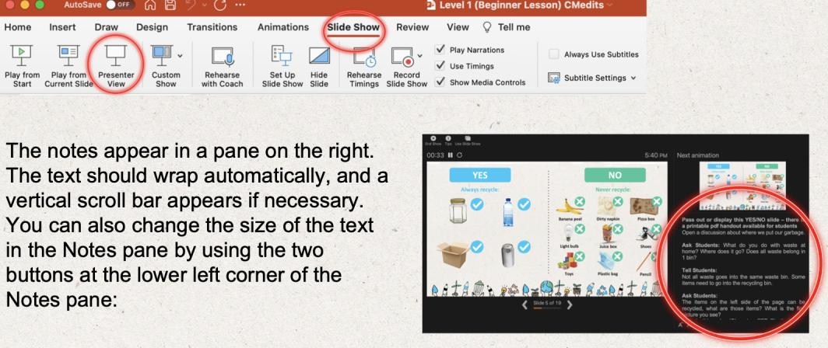
Prepare the PowerPoint presentation
When you are ready to present the lessons to your class click on Slide Show on the top menu bar then select Presenter View. In Presenter view, you can see your notes as you present while the audience see only your slides.
The notes appear in a pane on the right. The text should wrap automatically, and a vertical scroll bar appears if necessary. You can also change the size of the text in the Notes pane by using the two buttons at the lower left corner of the Notes pane.
Flexible and adaptive lesson
Lesson plans are designed to be flexible and responsive to the evolving needs of your classroom. Lessons are editable and customizable to meet the different individual student and classroom contexts. A PowerPoint version with teacher instructions and a printable PDF lesson are available for download.

Slide 5


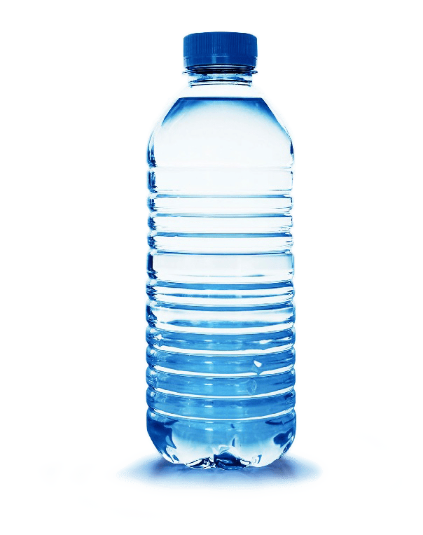
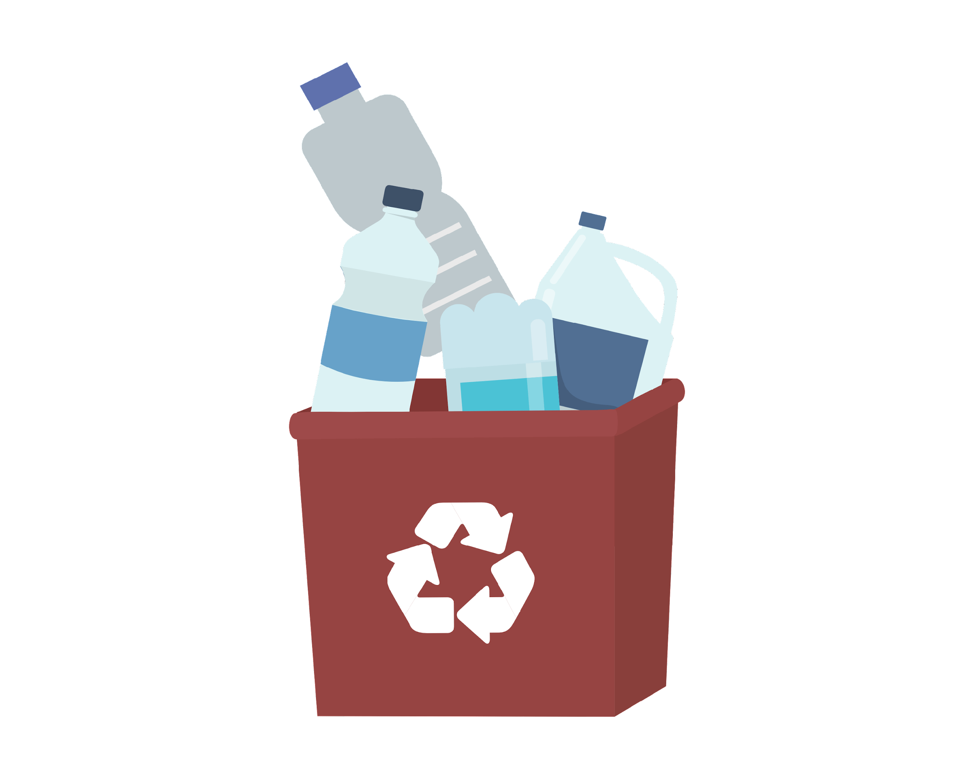
Have you seen this symbol before?
Notes:
(Slide duration: 3-5 minutes)
Click 1: Recycling symbol appears
Ask students:
Have you seen this symbol before? Where did you see it? Can anyone tell me what it means?
This symbol means “recycling”. What is recycling?
Click 2: PET plastic bottle appears Click 3: recycling bin appears Click 4: another PET plastic bottle appears
Tell students:
Recycling is the process of taking one product like a PET plastic bottle and turning it into another bottle.
Ask students:
Is recycling good or bad? Why?
Do you recycle? Please share…

Slide 6
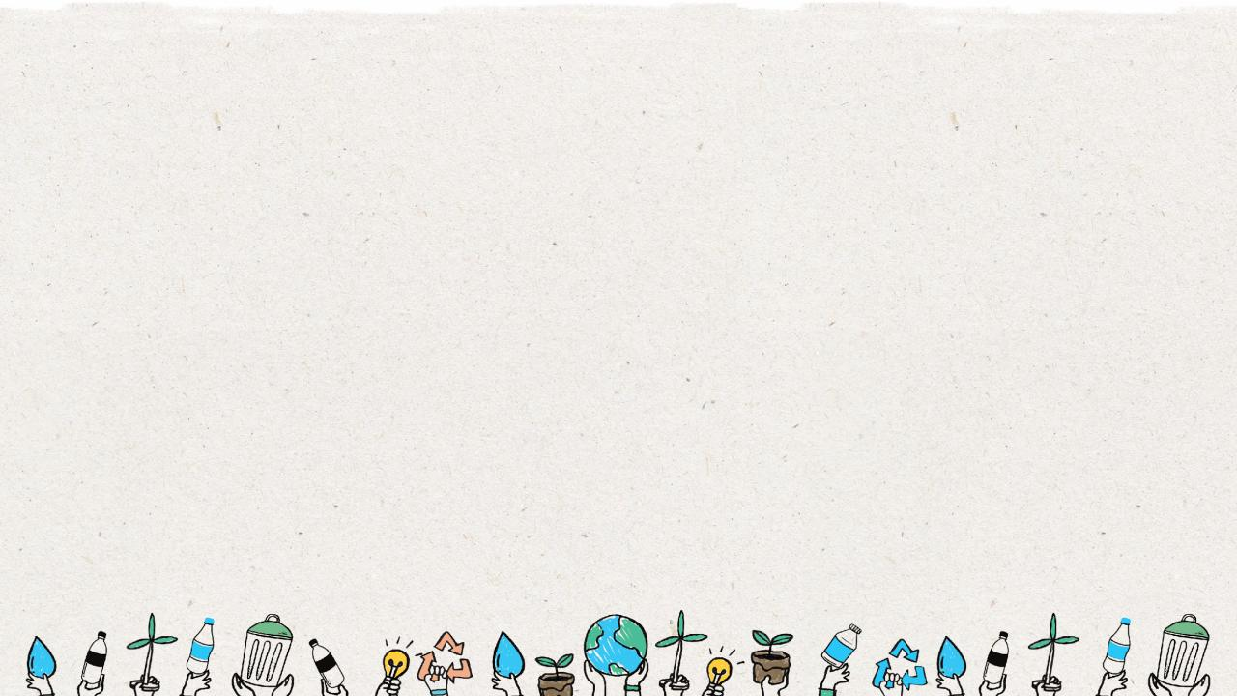
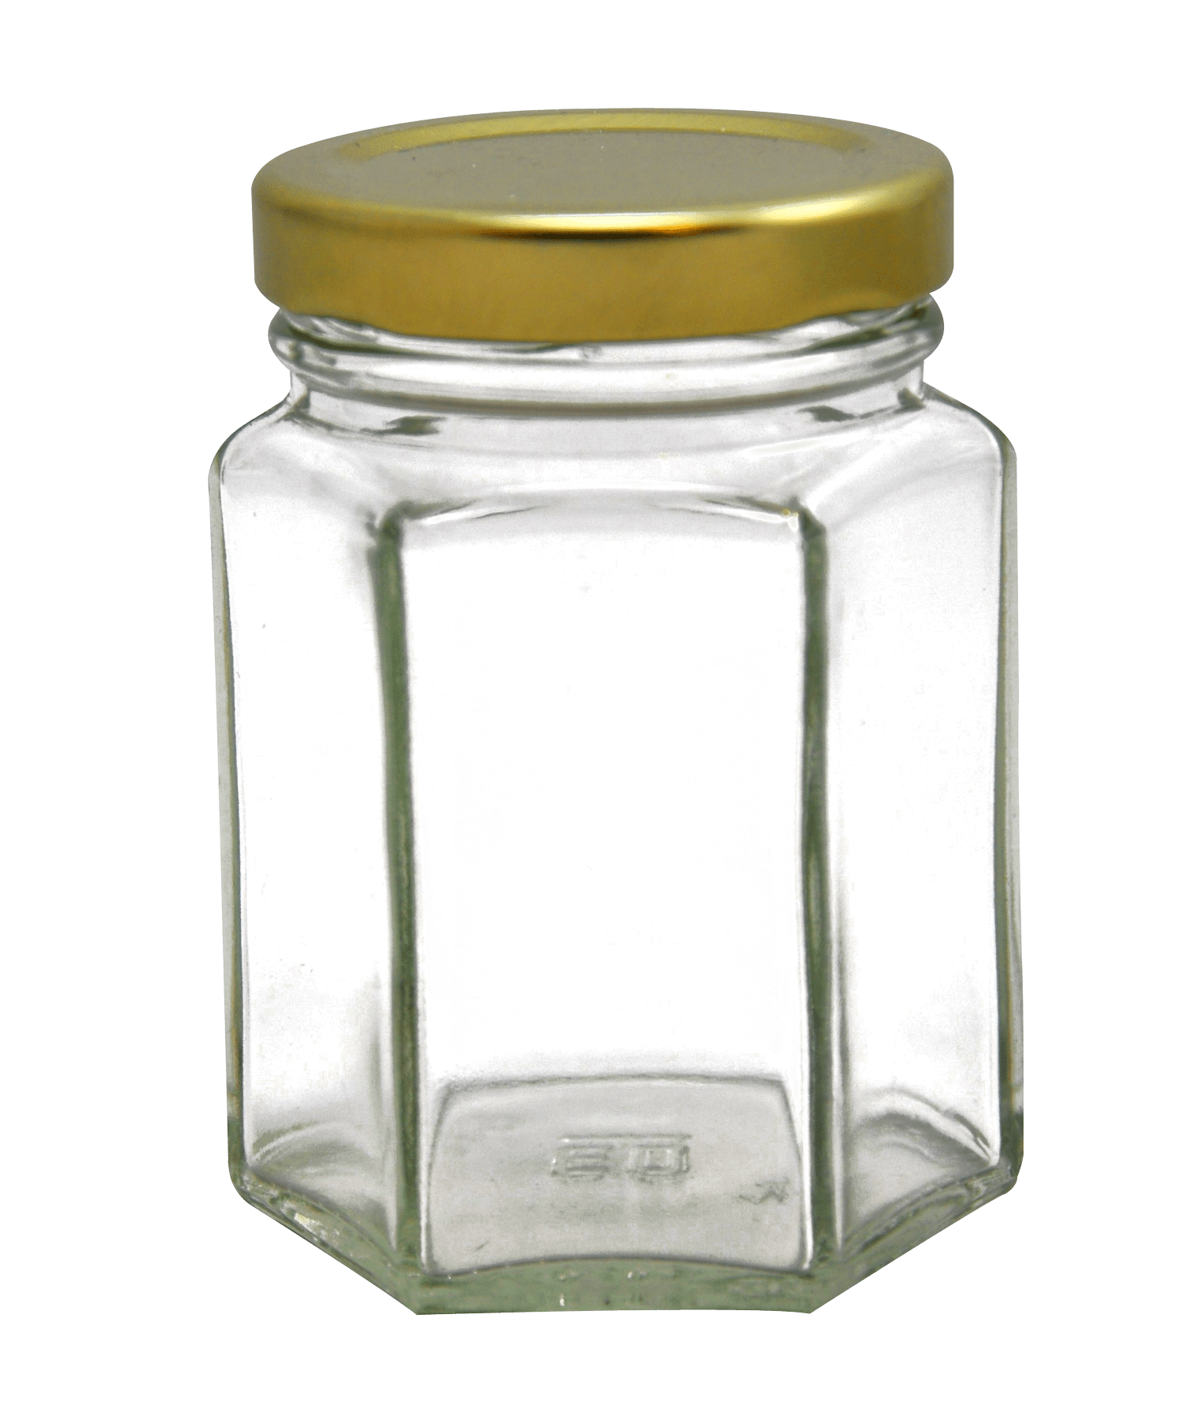
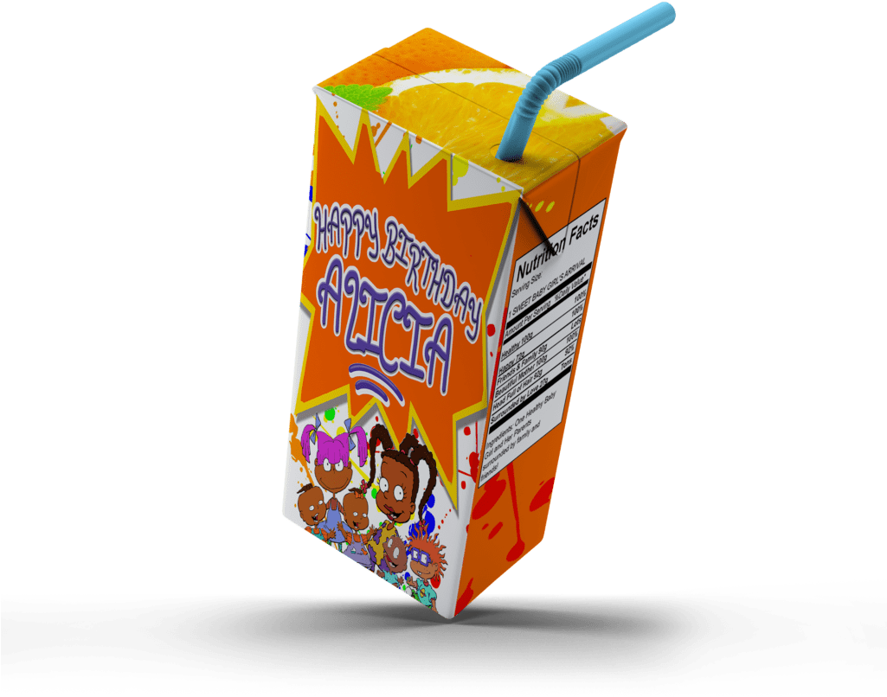
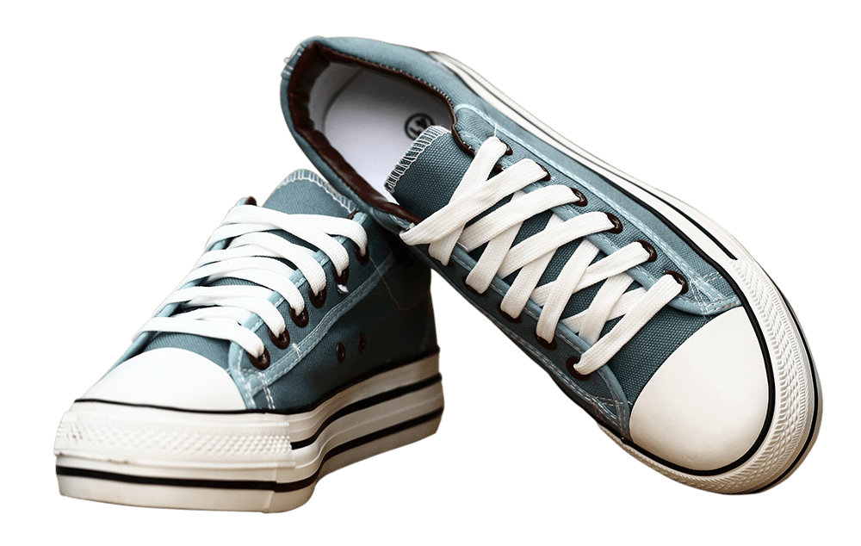
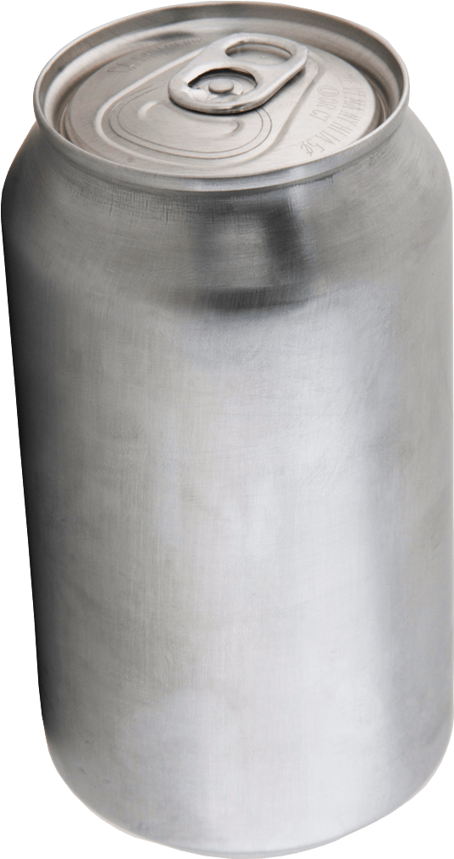
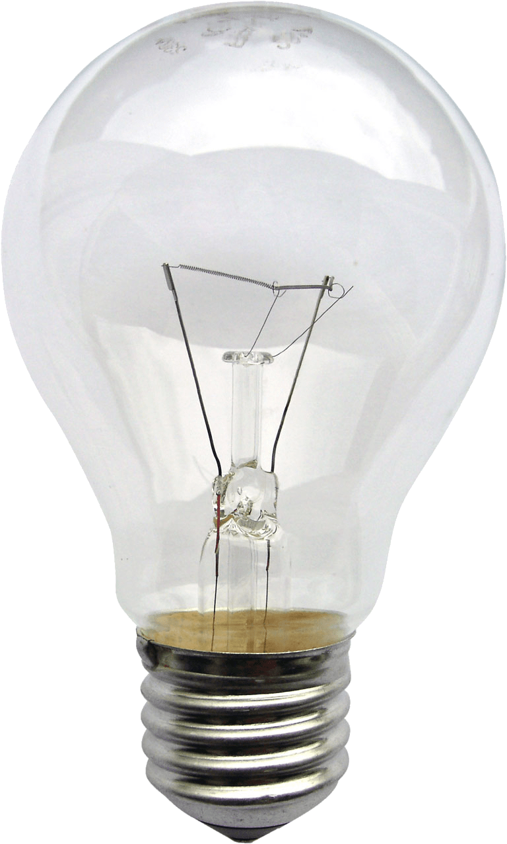
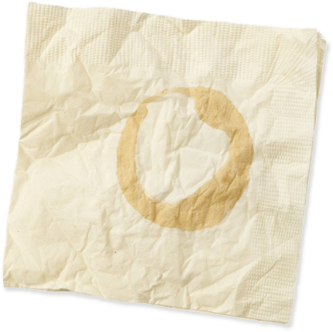
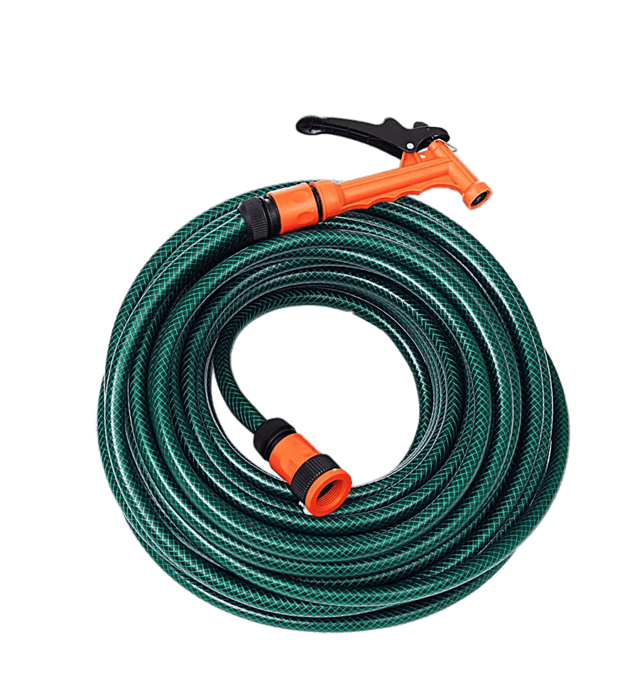
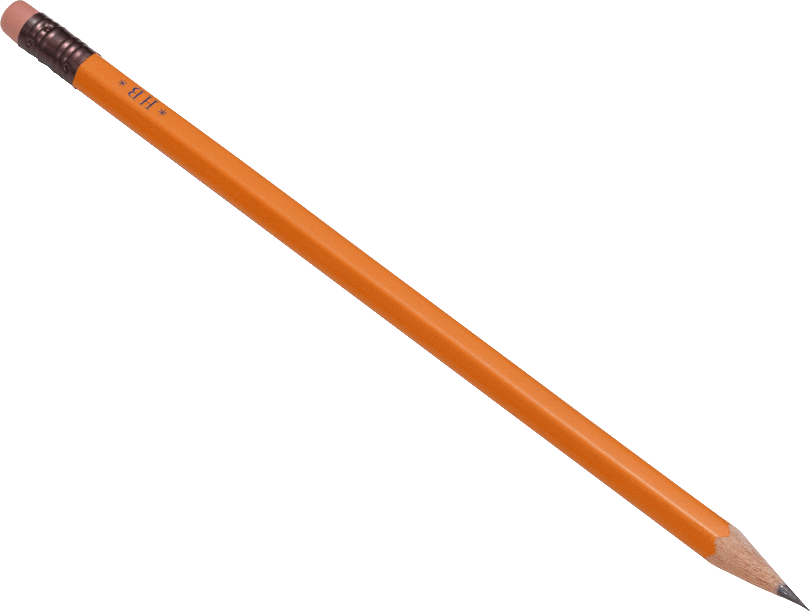
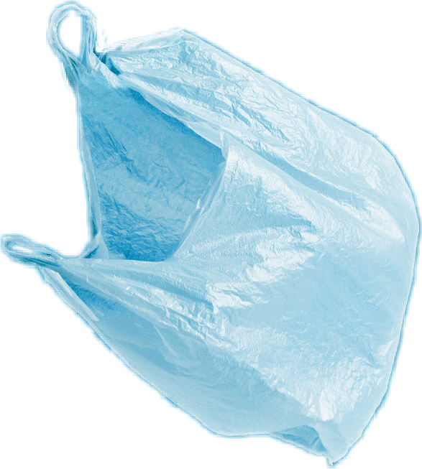
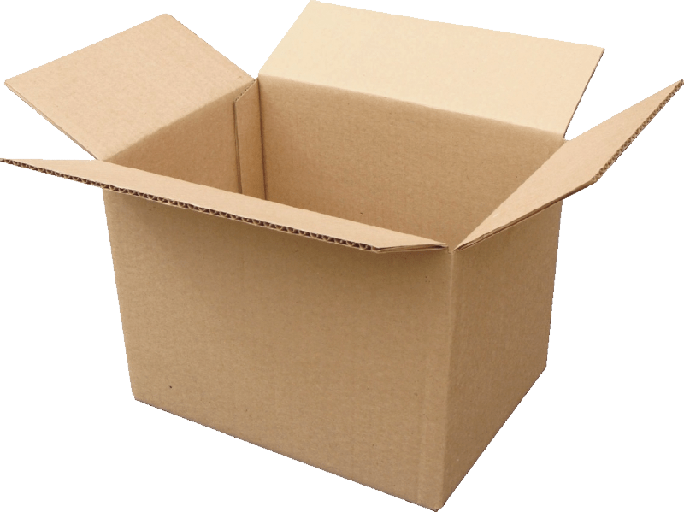
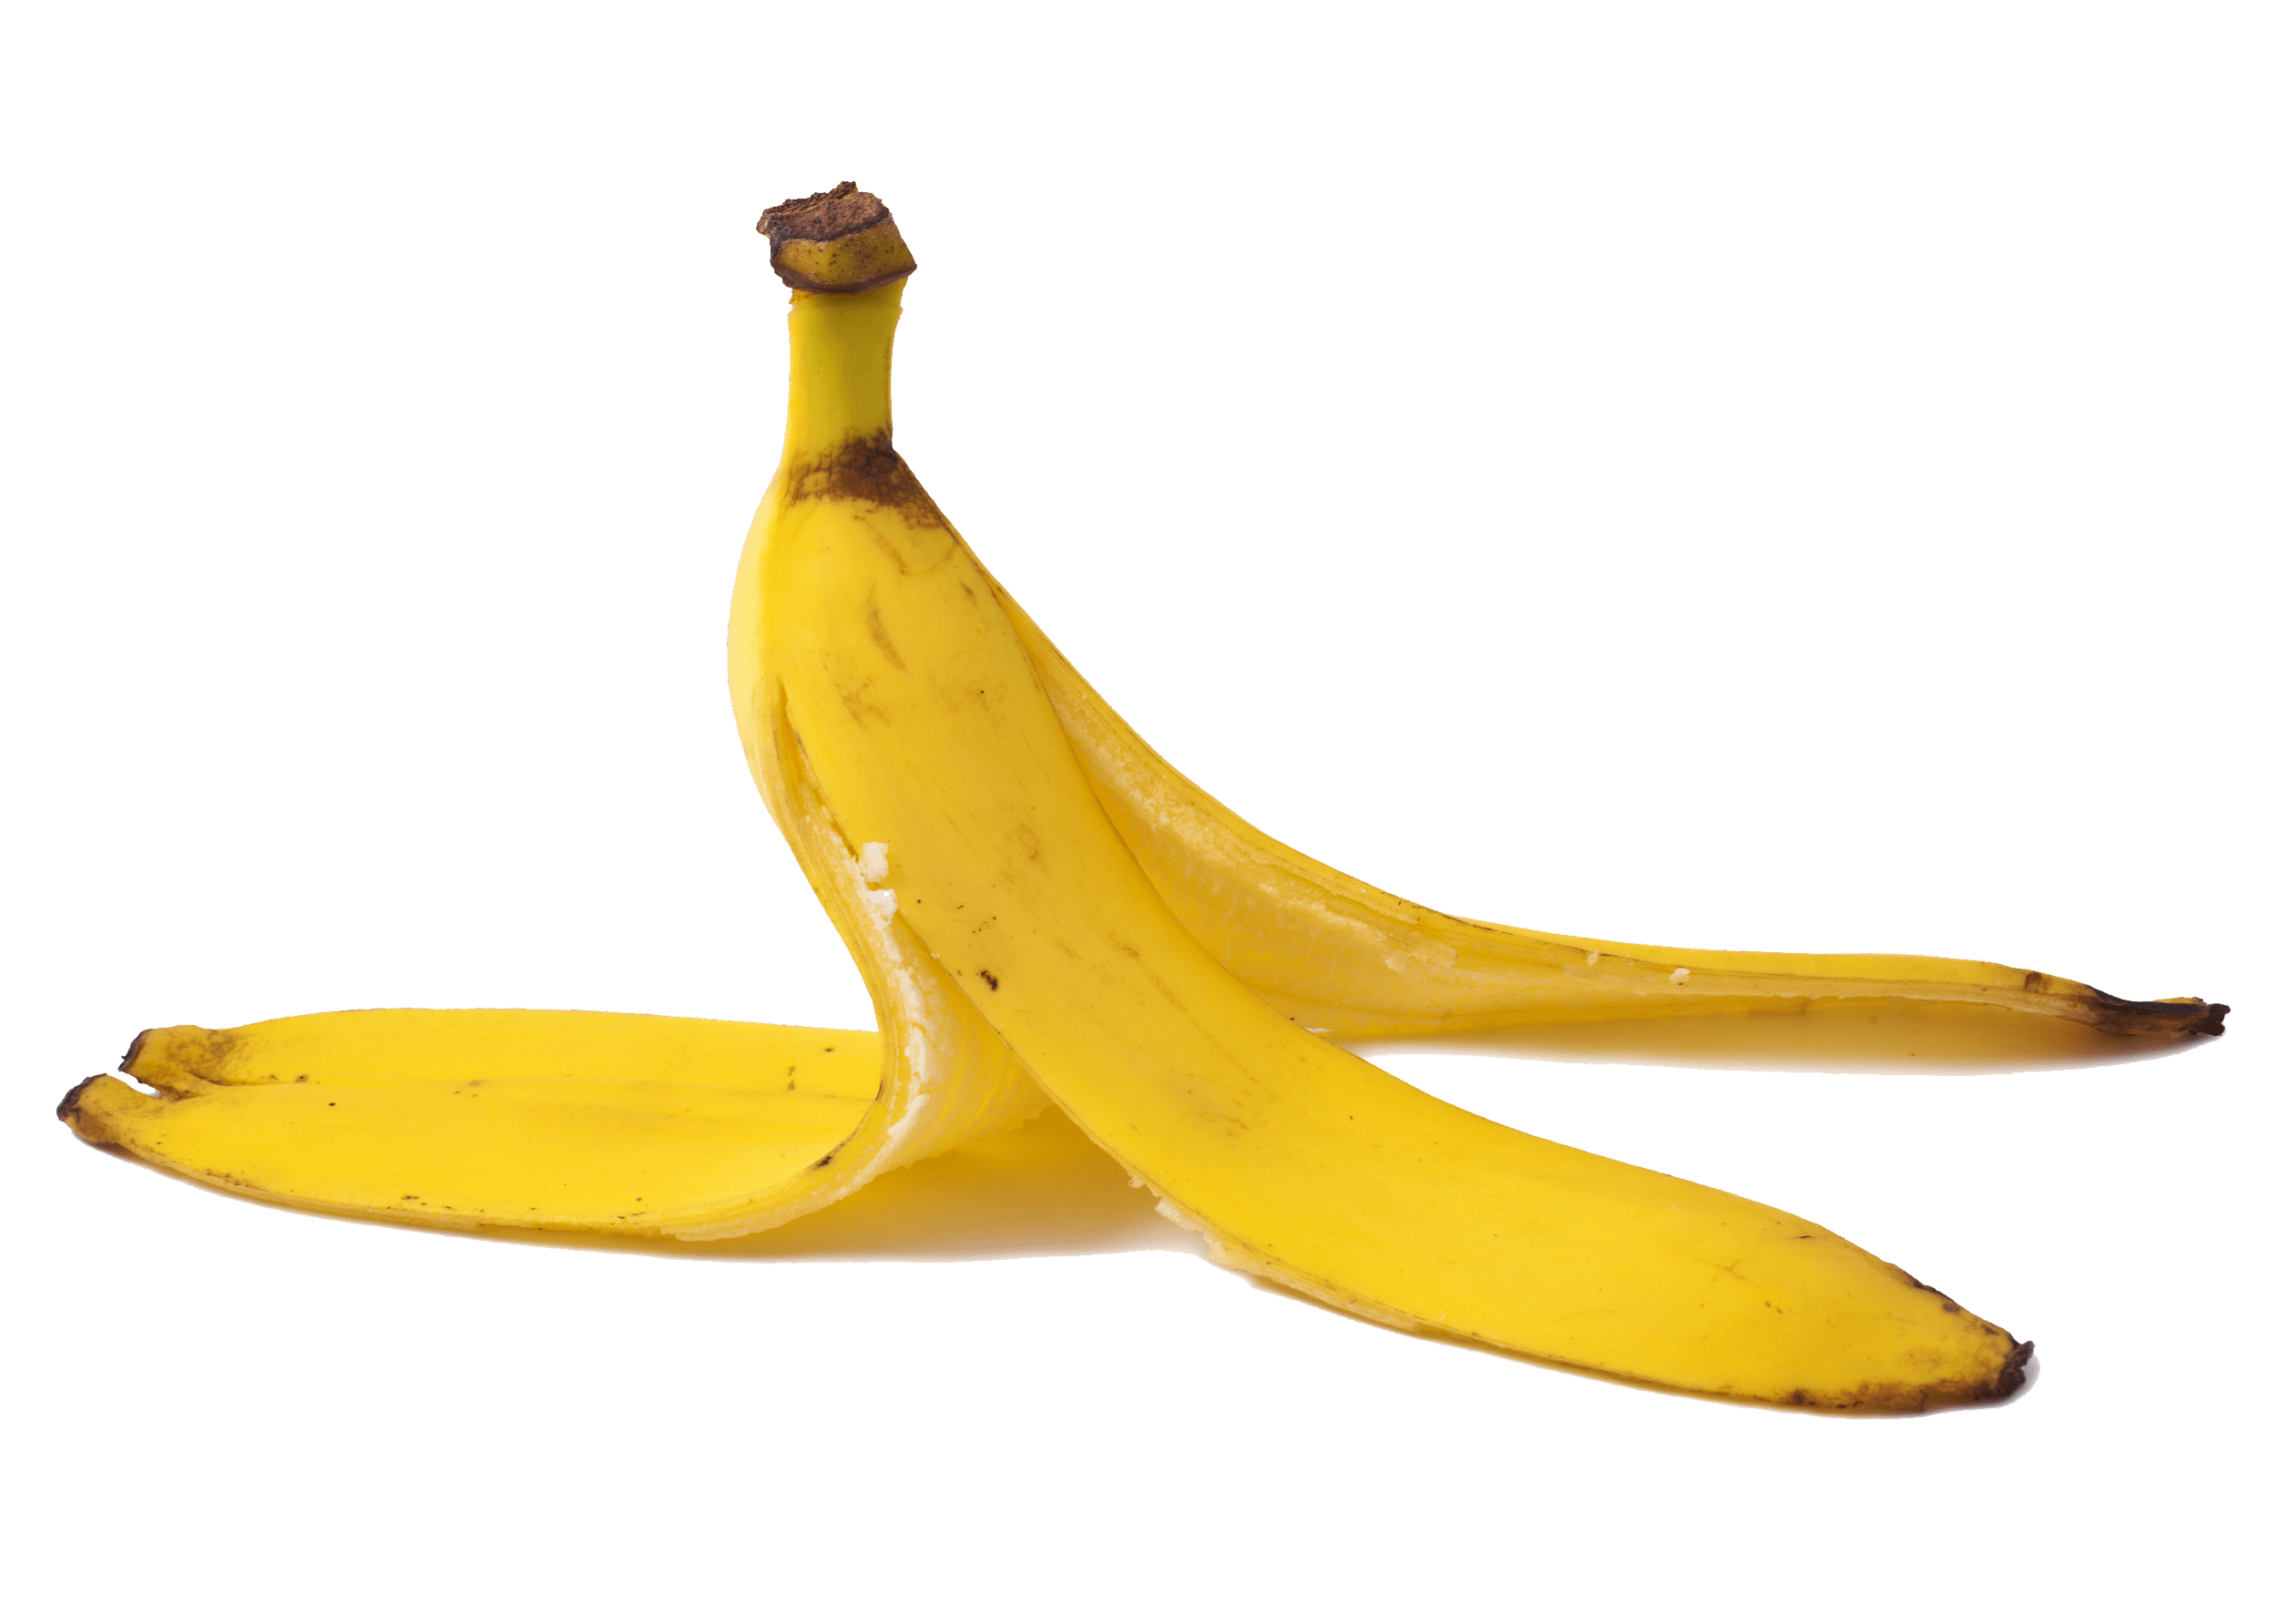
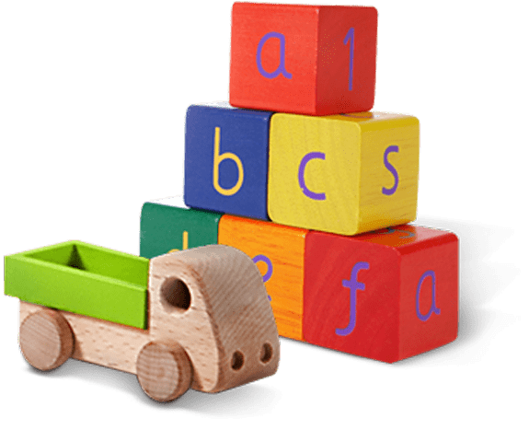
Glass jar
PET Plastic bottle
Shoes
Metal can
Light bulb
Juice box
Dirty napkin
Plastic bag
Toys
Pencil
Banana peel
Cardboard box
Garden hose
YES
NO
Notes:
(Slide duration: 3-5 minutes)
Pre-lesson Icebreaker Exercise
Ask students:
Has anyone heard of recycling? If yes, please share with the class what they know.
Tell students:
Recycling is the process of collecting and processing materials that would otherwise be thrown away as trash and turning them into new products. Recycling can benefit your community and the environment.
Now read off the images left to right starting on the top row to test their knowledge about what items displayed can and cannot be recycled. Ask them if each item can be recycled before you click to show the answer to them.
Order of images that will appear with each click.
Click 1: Glass jar
Click 2: PET Plastic Bottle
Click 3: Shoes
Click 4: Metal can
Click 5: Light bulb
Click 6: Juice box
Click 7: Dirty napkin
Click 8: Pencil
Click 9: Plastic bag
Click 10: Toys
Click 11: Cardboard box
Click 12: Garden hose
Click 13: Banana peel

Slide 7


YES
NO
Always recycle:
Never recycle:
Banana peel
Dirty napkin
Garden hose
Glass jar
PET Plastic bottle
Light bulb
Juice box
Shoes
Cardboard box
Metal can
Toys
Plastic bag
Pencil
Notes:
(Slide duration: 3-5 minutes)
Pass out or display this YES/NO slide – there is a printable pdf handout available for students
Open a discussion about where we put our garbage.
Ask Students: What do you do with waste at home? Where does it go? Does all waste belong in one bin?
Tell Students:
Not all waste goes into the same waste bin. Some items need to go into the recycling bin.
Ask Students:
The items on the left side of the page can be recycled, what are those items? What is the first picture you see?
*ask in this order (Glass jar, PET Plastic bottle, Cardboard box, Metal can)
Click 1: Glass Jar
What is it made from? Can it be recycled?
Answer: glass, yes
Click 2: PET Plastic bottle
What is it made from? Can it be recycled?
Answer: PET plastic, yes
Click 3: Cardboard box
What is it made from? Can it be recycled?
Answer: paper, yes
Click 4: Metal can
What is it made from? Can it be recycled?
Answer: metal, yes

Slide 8
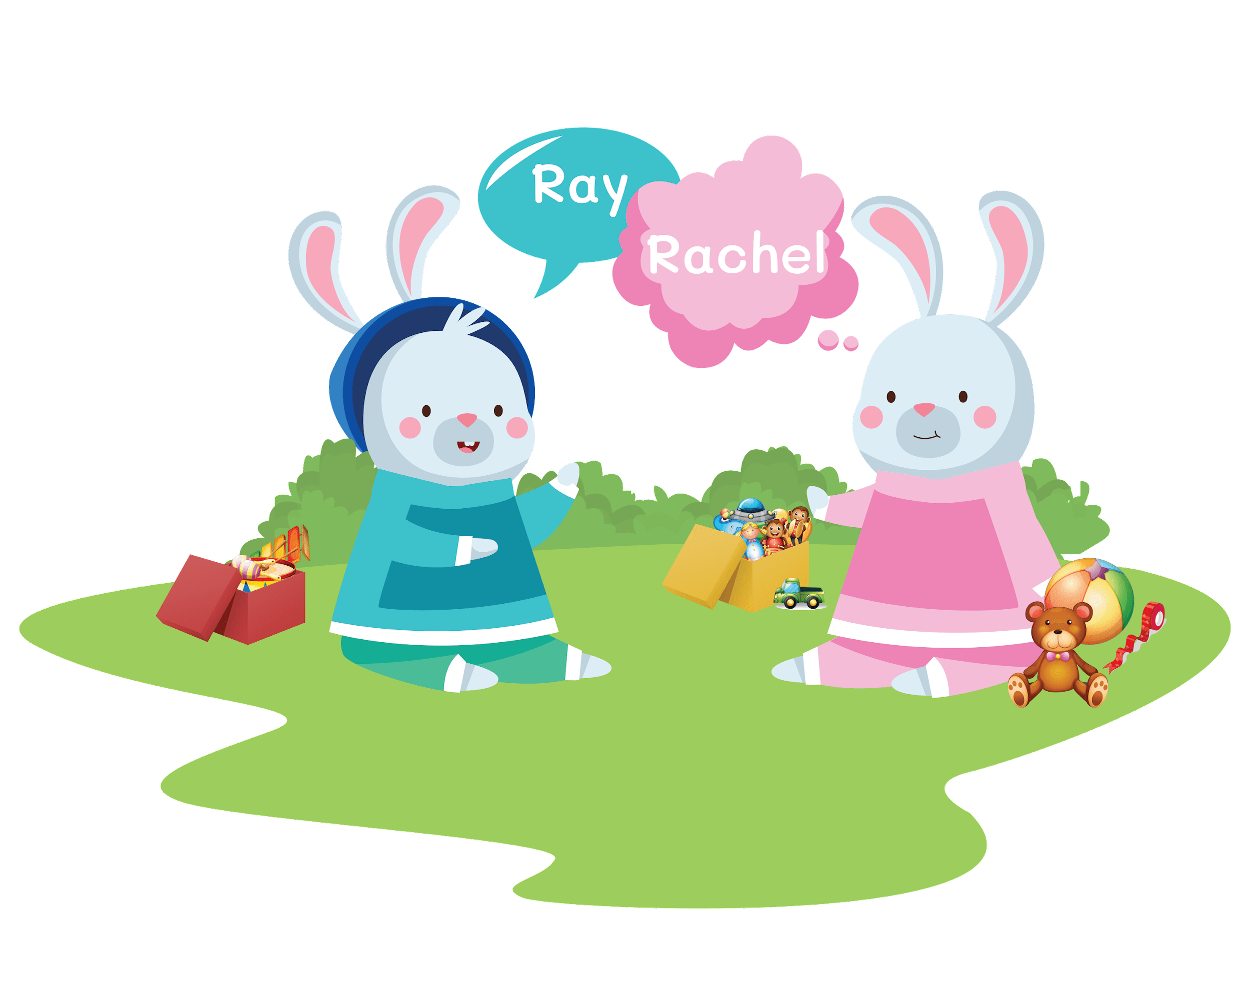
Rachel Rabbit Learns to Recycle
Once there were two little rabbits, a brother and a sister named Ray and Rachel Rabbit. Ray Rabbit was very good about cleaning up his toys after playing. But Rachel Rabbit was very messy and left her toys all over the house.
Notes:
(Slide duration: 2 minutes)
Ask Students:
Which Rabbit is Ray, and which one is Rachel?

Slide 9
Rachel Rabbit Learns to Recycle
Each morning before school, Ray and Rachel’s mom asks Ray to clean the kitchen. She also tells Rachel to take out the trash and the recycling.
Notes:
(Slide duration: 2 minutes)

Slide 10
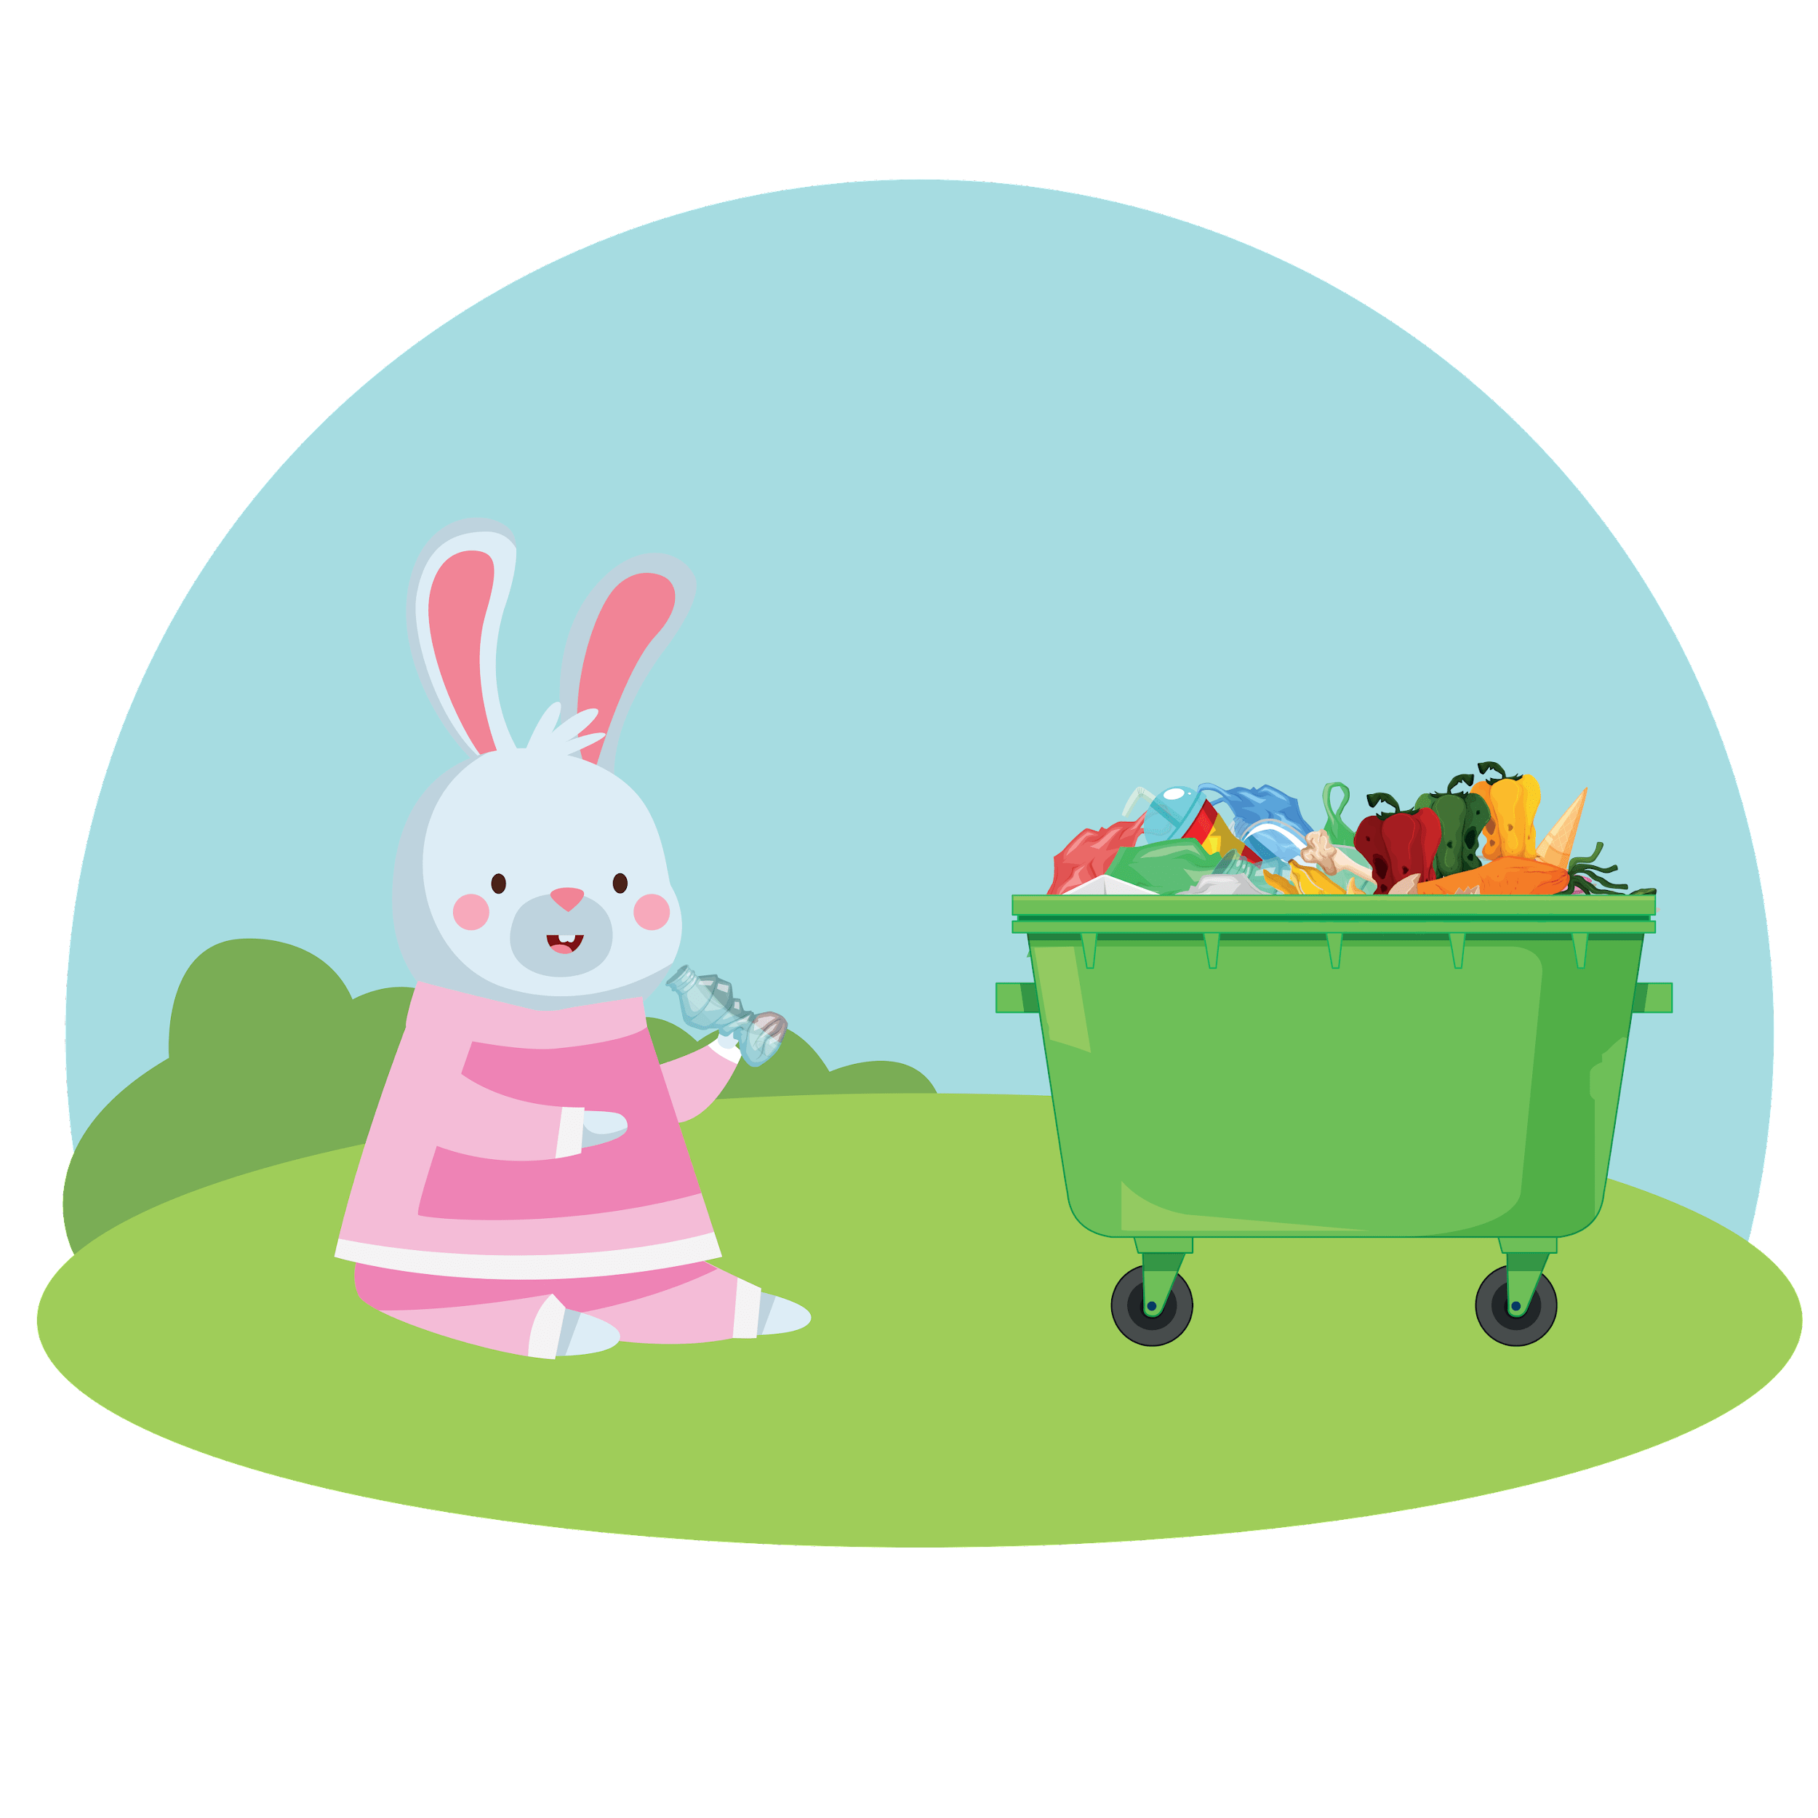
Rachel Rabbit Learns to Recycle
Ray washed the dishes and cleaned the kitchen floor. But Rachel took the trash and recycling and put it into one trash can. She did not think about things you cannot recycle.
Notes:
(Slide duration: 2-4 minutes)
Ask students:
What does trash smell like?
What do you think they saw in the trash can?
What mistake did Rachel make?

Slide 11



Rachel Rabbit Learns to Recycle
One day, mom asked, “What is that stinky smell?” She went outside to find the awful smell. “Oh no,” said Mom. “The smell is coming from the trash!” They all went outside - and you know what they saw? There was a GIANT pile of stinky garbage!
Notes:
(Slide duration: 2-4 minutes)
*Click to activate the animation when reading the last line “There was a GIANT pile of stinky smelly garbage.”
Ask students:
Have you seen a giant garbage pile before?
What kinds of things were in the pile?
How big was it?

Slide 12
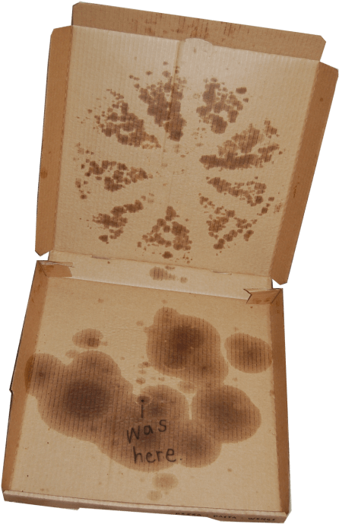
Rachel Rabbit Learns to Recycle
There was old food, PET plastic bottles, a pizza box with broken toys and a big glass jar. What else do you think was in the pile? “Oh, no,” said Mom. “What are we going to do with this mess?
Notes:
(Slide duration: 3-5 minutes)
Click 1: banana peel appears, click when you read the word “banana”
Click 2: PET plastic bottle appears, click when you read the word “PET plastic bottle”
Click 3: pizza box appears, click when you read the word “pizza box”
Click 4: broken toys appear, click when you read the word “broken toys”
Click 5: glass jar appears, click when you read the word “glass jar”
Ask students:
Can we recycle a banana peel? No
Can we recycle a PET plastic bottle? Yes

Slide 13
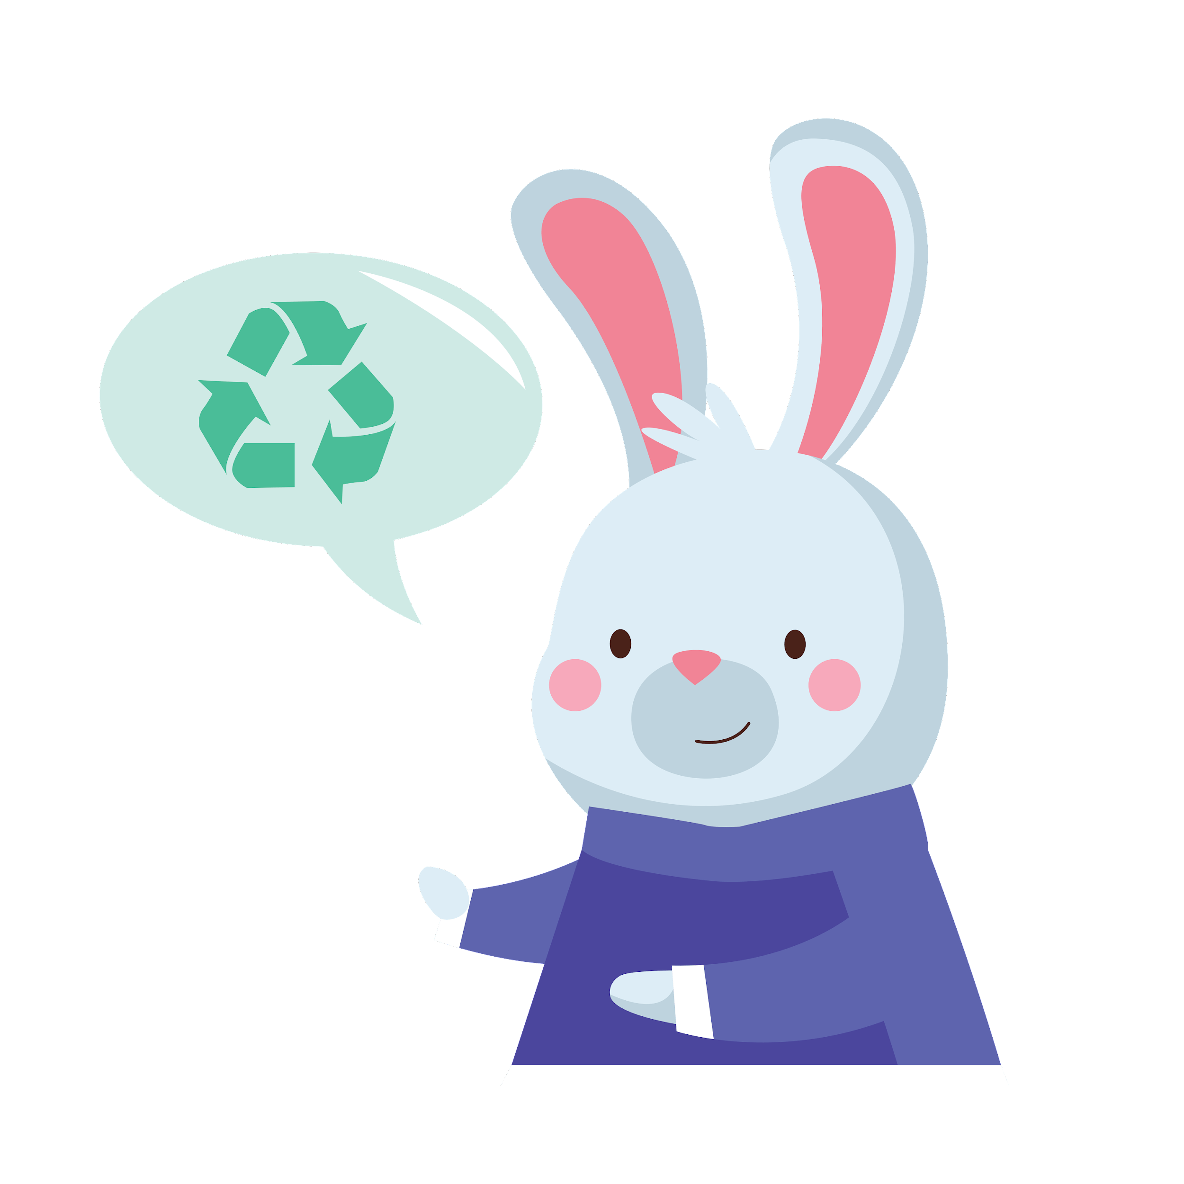
Rachel Rabbit Learns to Recycle
Rachel felt sad that she made a big mess. “I am sorry, Mommy,” she said. “No problem Rachel, we can clean it up by recycling.” said Ray. “I learned in school recycling is important. It helps the Earth and all the people and animals stay healthy.” Ray showed Rachel and Mom how to do it.
Notes:
(Slide duration: 2-4 minutes)
*Click to activate the animation when reading the last line “No problem Rachel, we can clean it up by recycling.”
Ask students:
Why is recycling important?
You might suggest these as reasons that recycling is important:
It helps stop waste from entering nature and keeps animals safe.

Slide 14
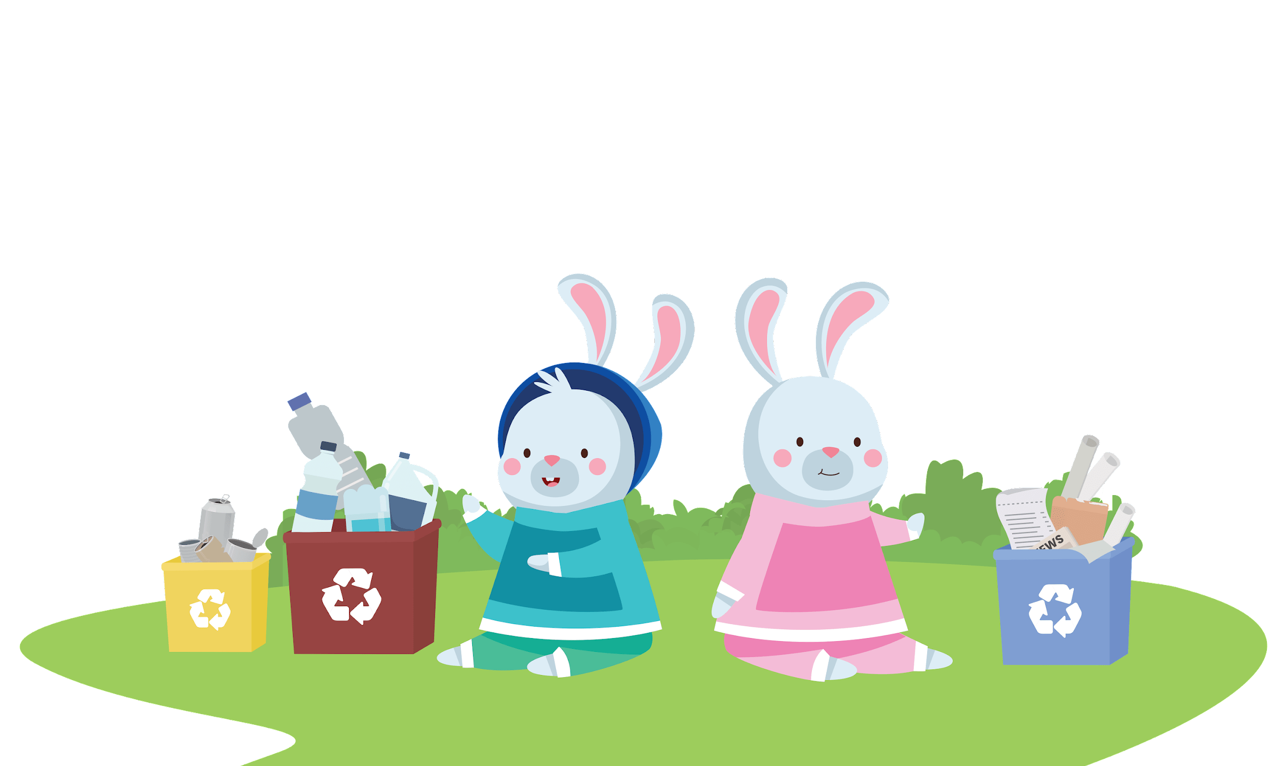
Rachel Rabbit Learns to Recycle
“All we recycle needs to be cleaned and dried,” Ray said. “because if we do not, it cannot be recycled.” Ray washed the bottles and set them aside to dry. Rachel piled up all the clean cardboard, notebooks, and cereal boxes. Mom put stuff you cannot recycle into the garbage can.
Notes:
(Slide duration: 2 minutes)

Slide 15
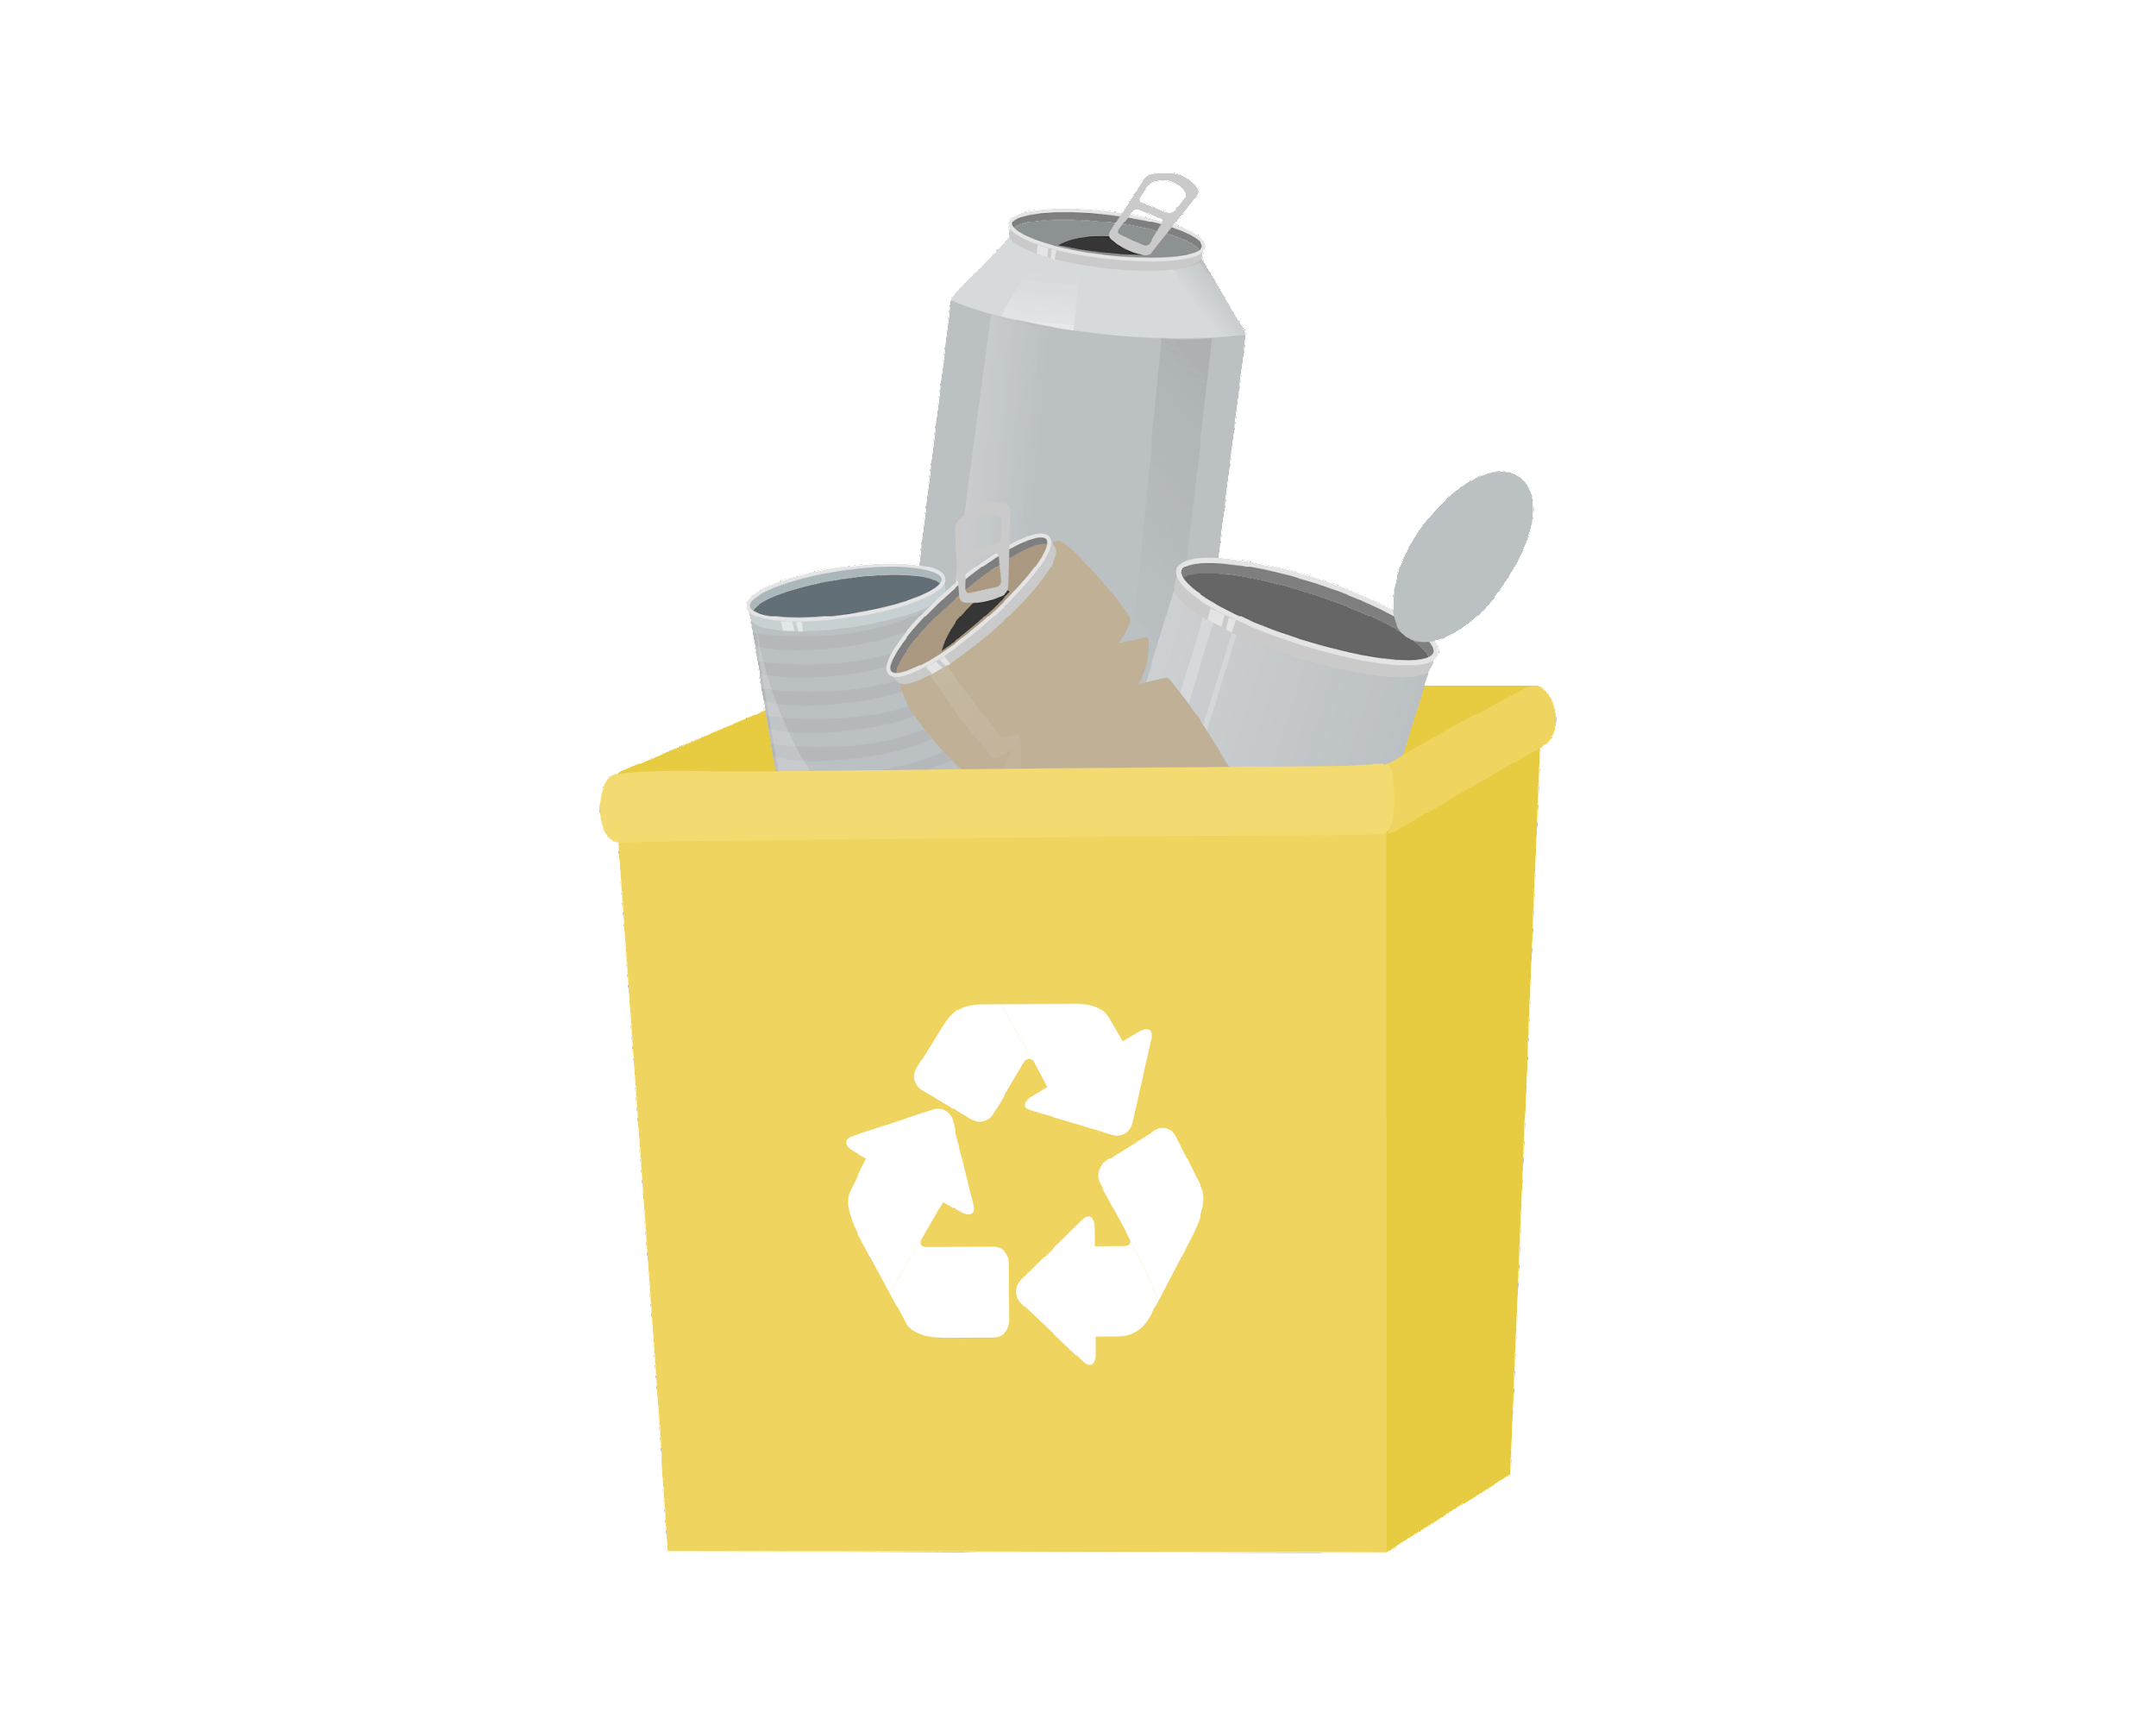
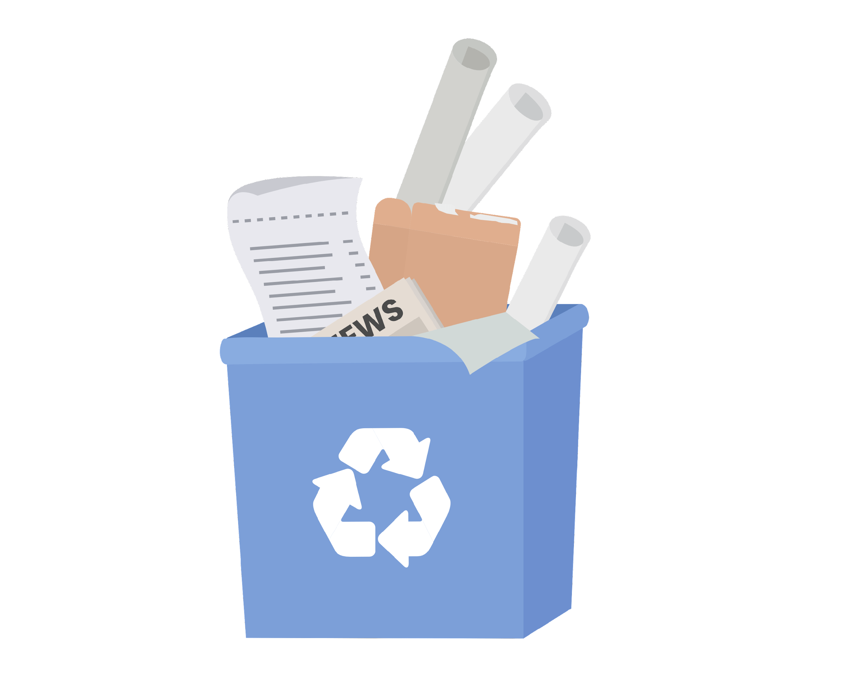
Rachel Rabbit Learns to Recycle
When they finished sorting the recycling everybody felt happy. All the garbage went into the garbage can. All the empty, clean and dry recycling items went into the recycling bin. “Ray,” said Rachel, “I want to learn all about recycling.” “Great, it is as simple as one, two, three,” said Ray.
Notes:
(Slide duration: 2 minutes)

Slide 16
Rachel Rabbit Learns to Recycle
Knowing what you can recycle and what you cannot recycle.
#1
Notes:
(Slide duration: 2 minutes)
Ask Students:
Can you give me an example of something we can recycle?
Click 1: cardboard box appears
Click 2: glass jars appear
Click 3: PET plastic bottle appears
Click 4: metal can appears

Slide 17
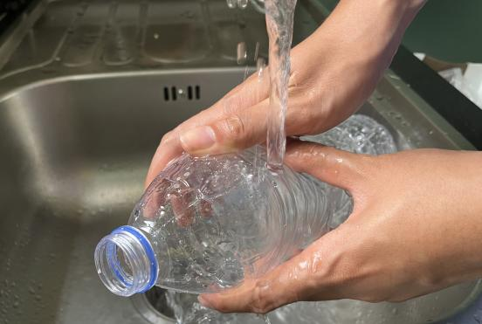
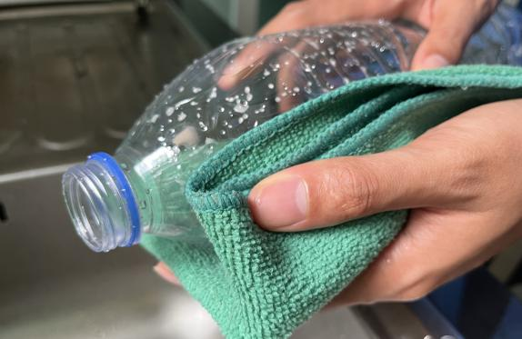
Step
2
Empty, clean, and dry before putting in the bin.
Notes:
(Slide duration: 2 minutes)
Ask Students:
1. Why is it important to clean our items for recycling?
2. What if there is a little bit of food or liquid on it?
You might suggest:
Dirty items cannot be recycled.
Wet and dirty items can get other clean items dirty, getting the whole bin dirty.

Slide 18
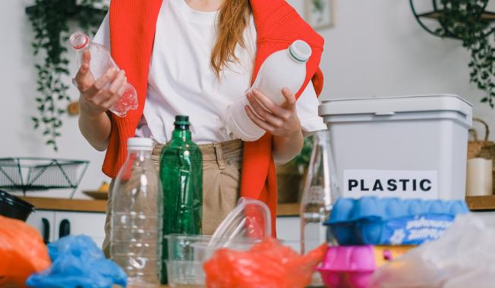

Rachel Rabbit Learns to Recycle
Put each recyclable item into the correct recycling bin.
#3
Notes:
(Slide duration: 2 minutes)
Click 1: Recycling symbol appears
Ask students:
Where should we put our PET plastic bottles?
Click 2: Arrow pointing to the recycle bin
Answers:
In the recycling bin.

Slide 19
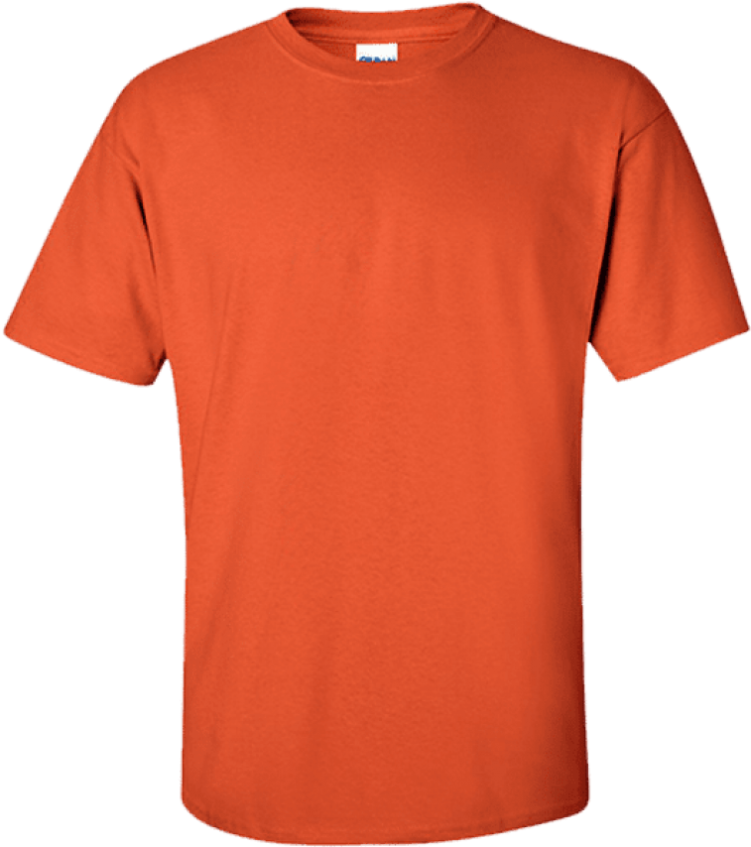
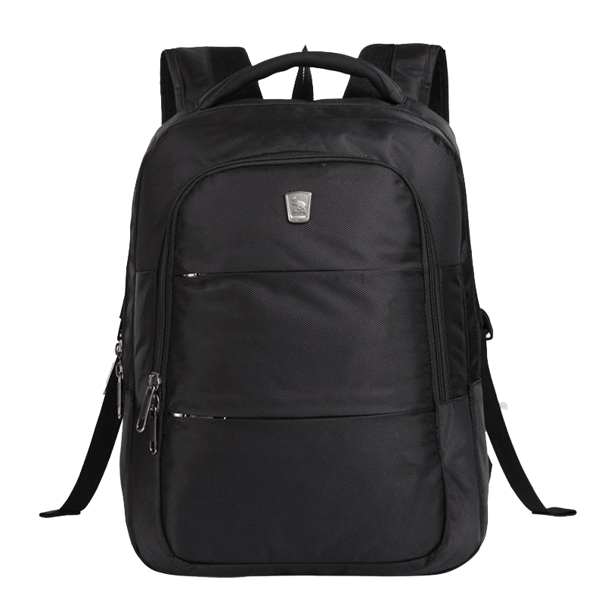
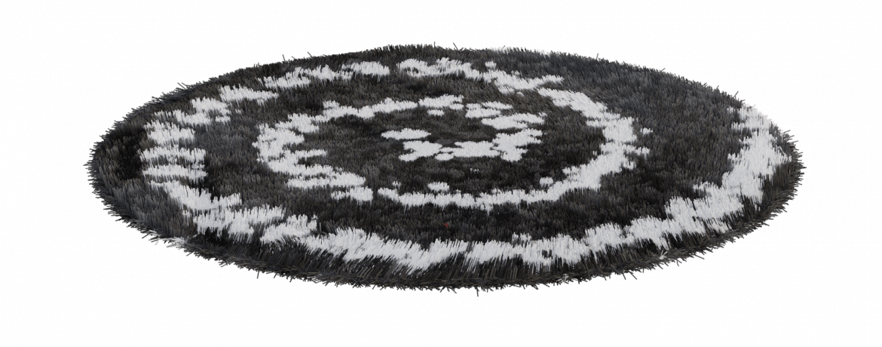
Rachel Rabbit Learns to Recycle
When we clean, dry, and recycle we can make new things.
Notes:
(Slide duration: 2-4 minutes)
Tell students:
When we follow the 3 steps of recycling we can recycle our waste into brand new things.
Example:
Click 1:
PET plastic bottles can be recycled back into new PET plastic bottles.
Click 2:
PET plastic bottles can also be made into thread that can be made into fabrics and textiles.

Slide 20
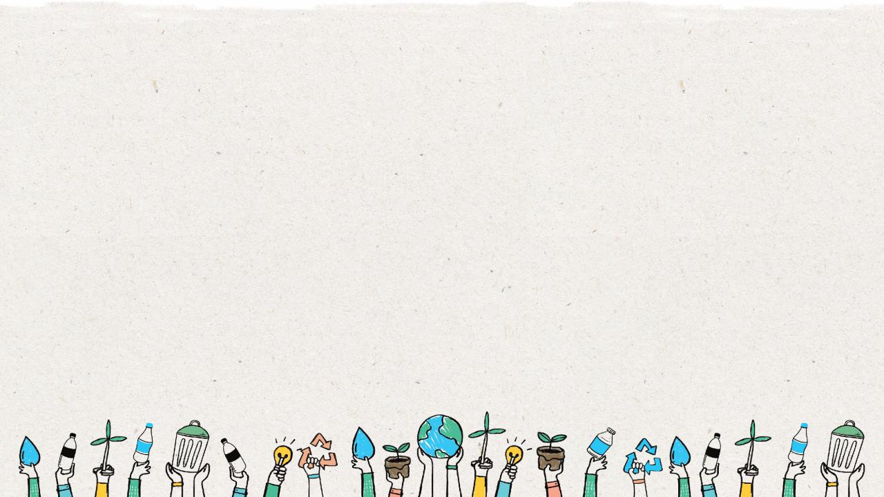
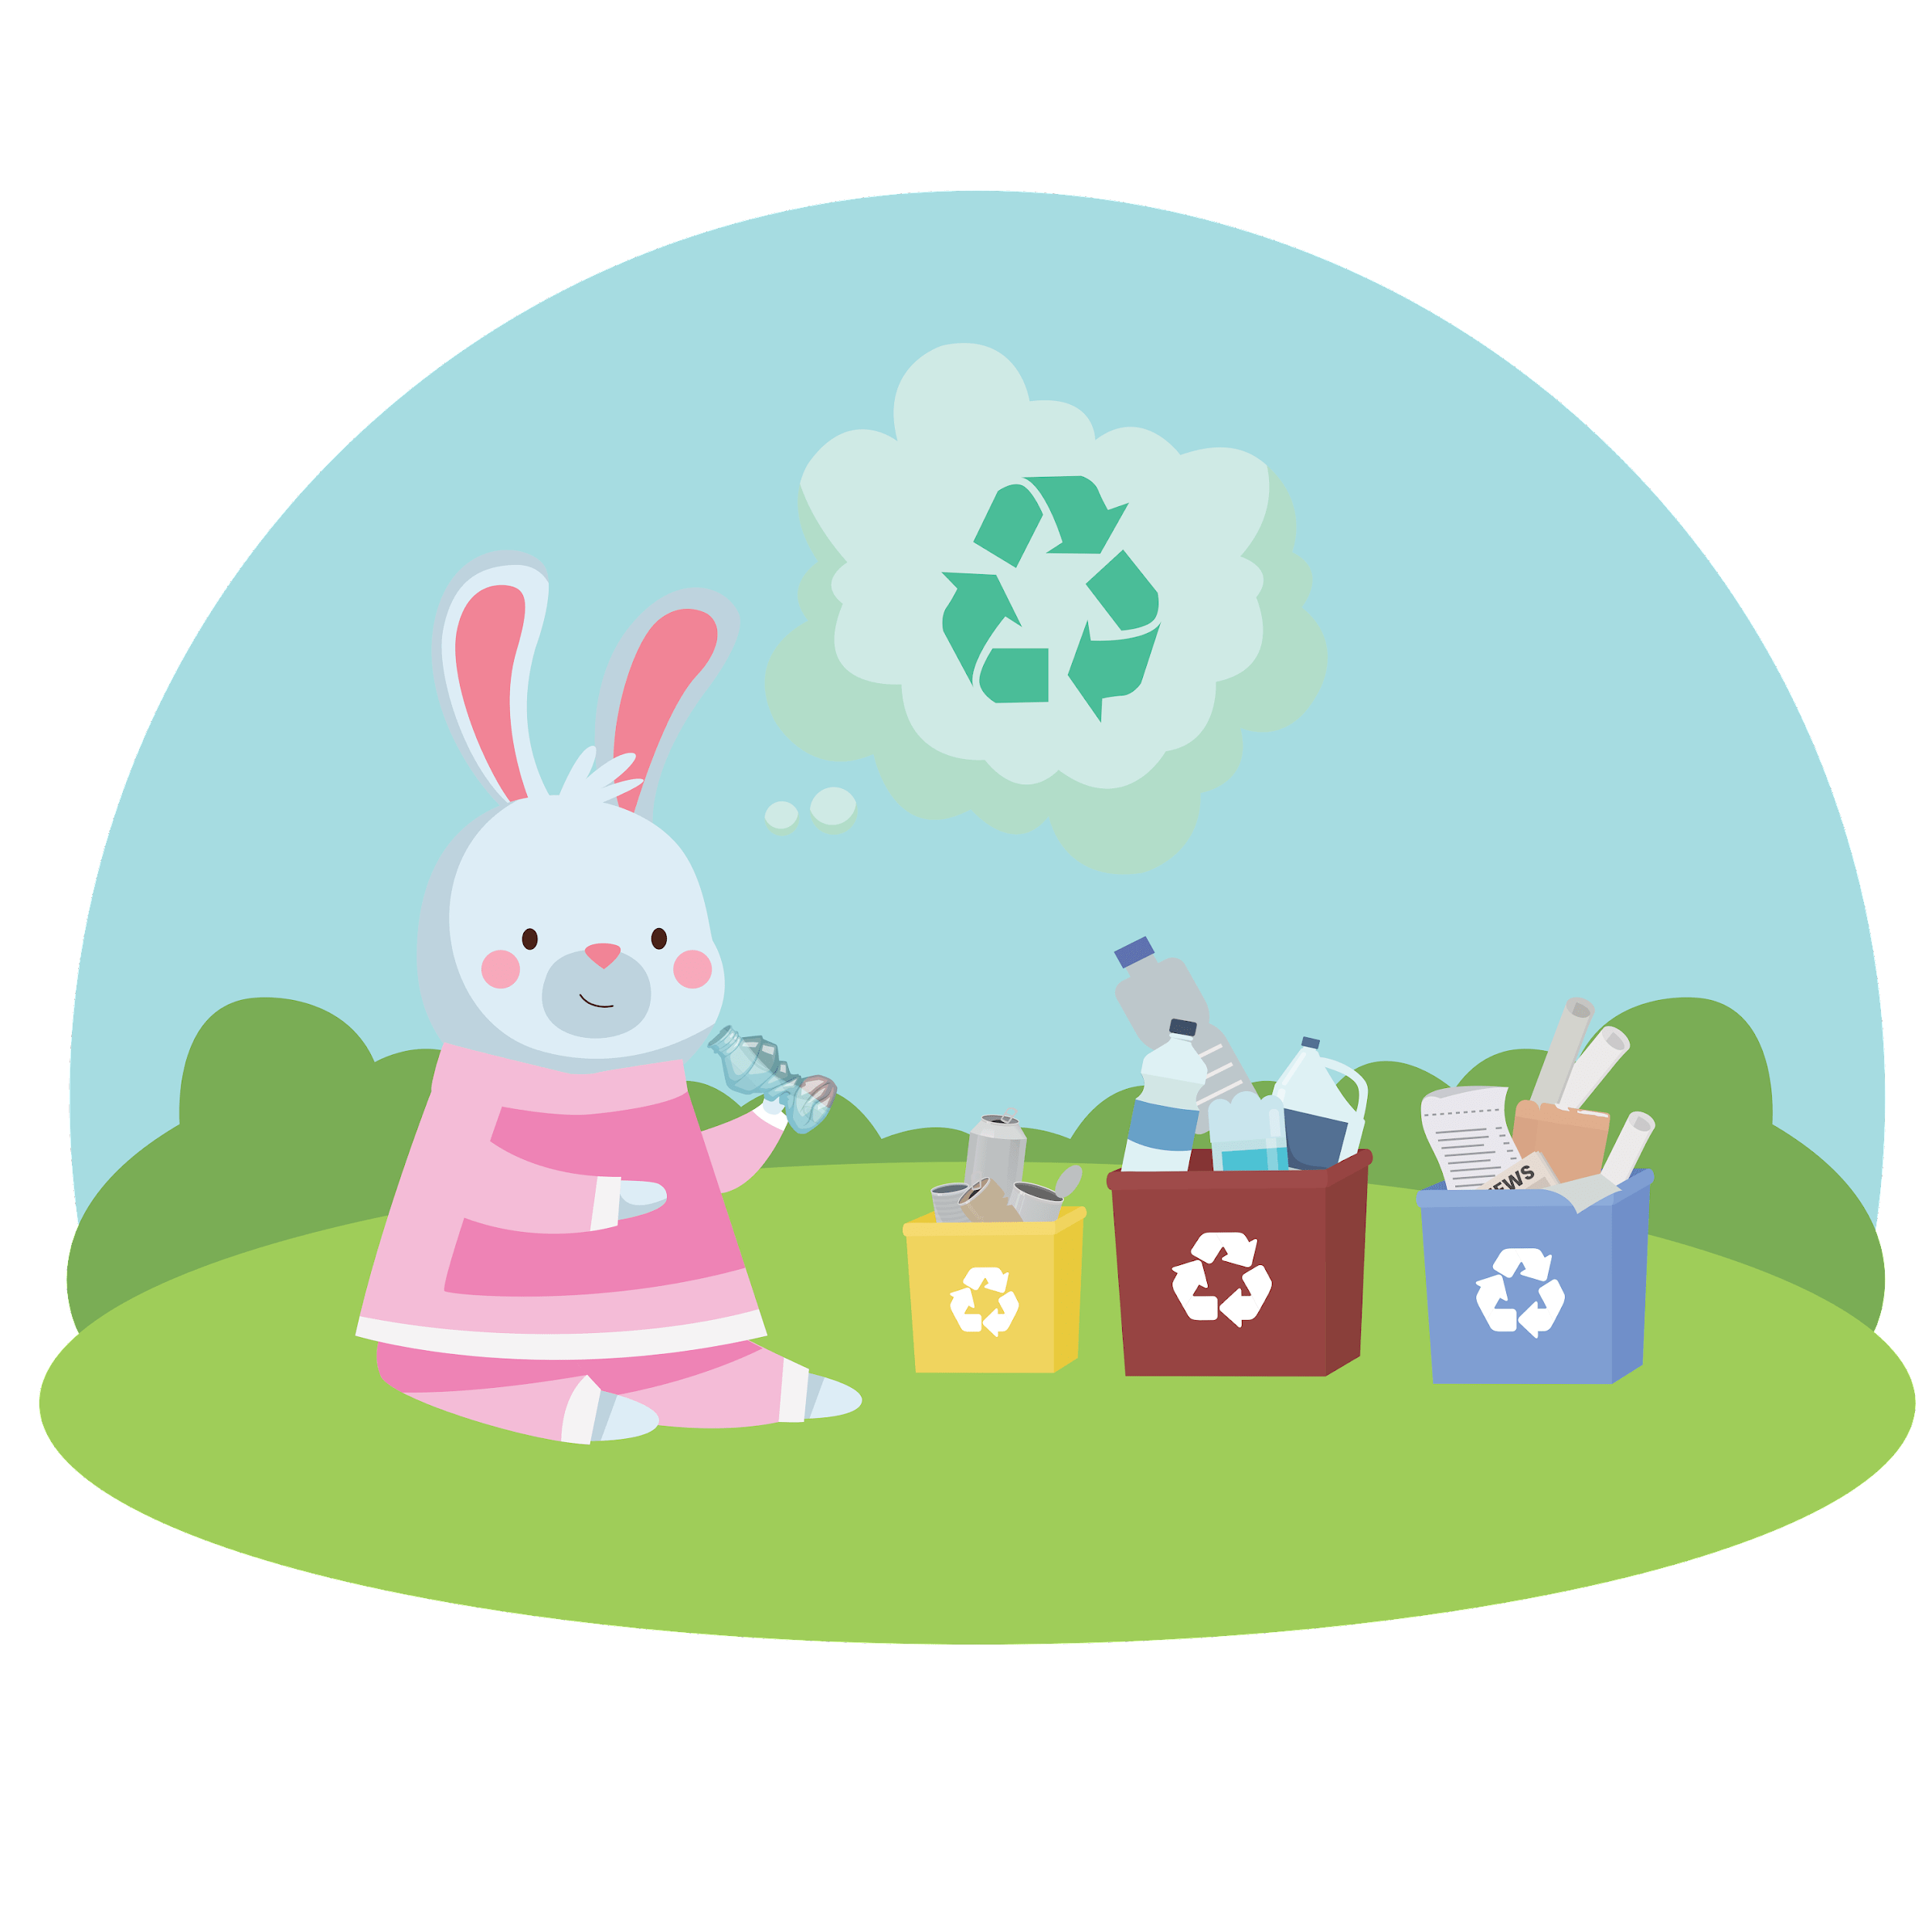
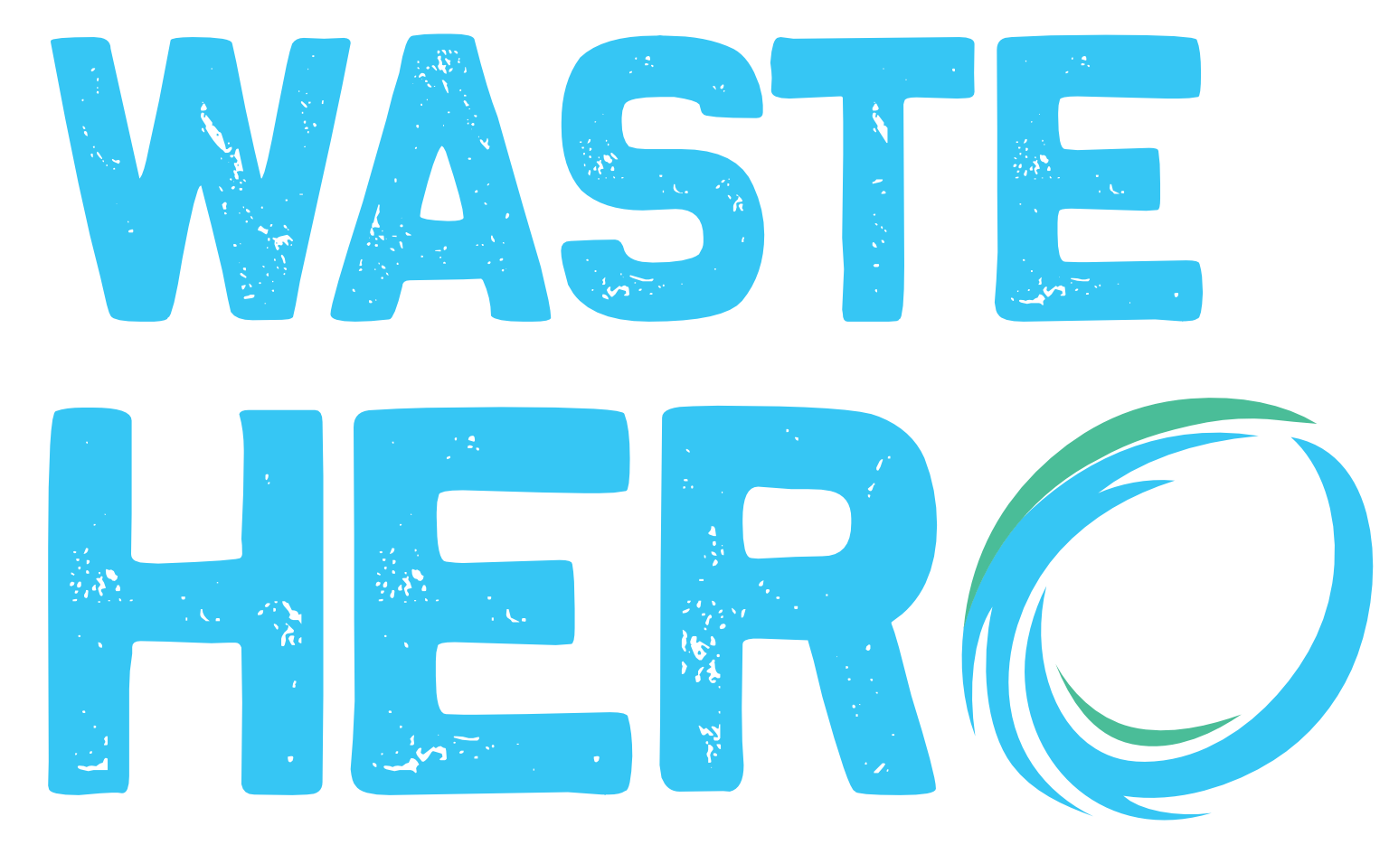
Rachel Rabbit Learns to Recycle
From that day on, Rachel became a
Recycling
She even started to clean up her toys!
Notes:
(Slide duration: 2-4 minutes)
Ask students:
What mistakes did Rachel make?
Why is recycling important?
Answers:
Rachel put all waste into one waste bin, she needed to separate the recyclable items into the recycling bin.
Garbage can be harmful to our air and water and can hurt animals and fish.
When we use less paper, we save trees and animals in the forest.
When we recycle, we make less garbage.

Slide 21
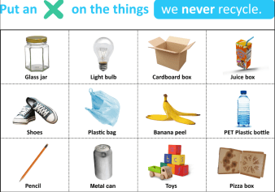
Next Steps
1
Distribute the Mark an “X” handout
Ask students to look at the pictures and draw an X across the things that cannot be recycled. Which of these items need to be rinsed and dried before recycling?
The following items should be crossed out on the worksheet:
Juice box
Banana peel
Toys
Pencil
Shoes
Plastic bag
Pizza box
Light bulb
3
Distribute the coloring page and ask students to draw or write on the back of the worksheet how recycling can help the world.
Possible responses could be:
  Save animals from being hurt.
  Less garbage in the ocean.
  Recycling keeps our air and water clean.

