Slide 1
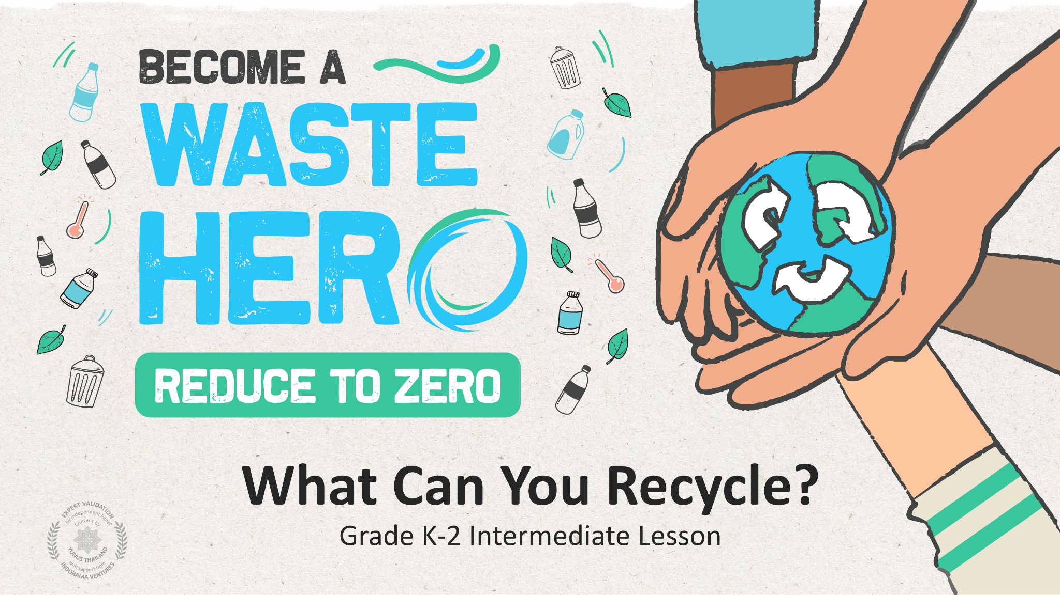
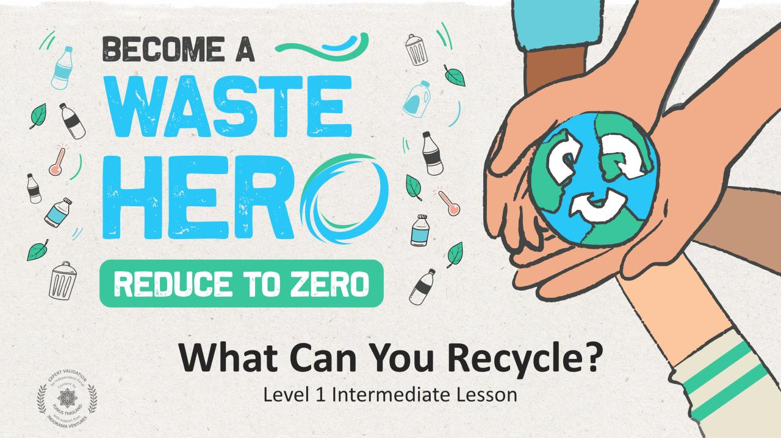

Slide 2
Lesson Prep & Curriculum Alignment
Prep time: 10 - 15 minutes
Students will learn what kind of items are and are not recyclable. In a hands-on activity, they will work in small groups to sort cards with pictures of common items into recyclables and non-recyclables, practicing their collaborative and critical thinking skills. They will receive a handout to share what they’ve learned with their family and encourage recycling at home.
1
Display or print out the YES/NO handout to create a class discussion about items that can and cannot be recycled. Print 1 deck of sorting cards per number of groups - before the lesson activity, you can have the students cut out the cards themselves. Print and pass out the “Coloring Page” at the end of the lesson or send home as homework.
2
Prepare 2 small empty boxes with an opening at the top to create a recycling and waste bin for the activity, 1 set of “bins” per group.
3
Display the Recycling Bin/Non-Recycling Bin slides for further discussion about why one bin is correct, and the other is not.

Slide 3
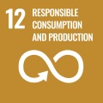
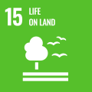
Lesson duration: 25 - 30 minutes
Lesson Prep & Curriculum Alignment
Prep time: 10 - 15 minutes
Key Learning Outcomes and Curriculum Alignment:
Science - Earth and Human Activity: Communicate solutions that will reduce the impact of humans on the land, water, air, and/or other living things in the local environment. Things that people do can affect the world around them. But they can make choices that reduce their impacts on the land, water, air, and other living things.
Social Studies - People, Places, and Environments: Students study people, places, and environments and enables them to understand the relationship between human populations and the physical world.
English Language Arts and Literacy: Able to ask and answer questions about details in a literature text. Participate in collaborative conversations with diverse partners about topics and texts. Follow agreed-upon rules for discussions. Use words and phrases acquired through conversations, reading and being read to, and responding to texts.
SDG Alignment
Flexible and adaptive lesson
Lesson plans are designed to be flexible and responsive to the evolving needs of your classroom. Lessons are editable and customizable to meet the different individual student and classroom contexts. A PowerPoint version with teacher instructions and a printable PDF lesson are available for download.

Slide 4
Lesson duration: 25 - 30 minutes
The Lesson
Lesson duration: 45 - 60 minutes
1
Introduce the lesson with a discussion of what students already know about recycling. Print or display YES/NO handout.
What is recycling?
Why do we recycle?
What kinds of things do you think can be recycled?
Are there things that cannot be recycled?
What things should not be put in the recycling bin?
What are the “1-2-3’s” of recycling?
Ask the students to get out their YES/NO handout.
Show Recycling Bin / Non-Recycling Bin slides and ask why is one bad and one good? Allow them to look and identify reasons for each picture based on their YES/NO handout.
2
Tell your students they are going to play a recycling “Fill The Right Bin” sorting game.
Divide them into groups and give each group one recycling box and one waste box you created and a shuffled deck of cards containing pictures of common recyclable and non-recyclable items. Have your students work as a group to decide which items are recyclable, and which are not.
When groups are done sorting the cards, they should put the ones showing recyclable items into their recycling box.
3
A whole-class activity.
Review the cards in each group’s recycling box. If any items were incorrectly identified as recyclable, explain why, or ask if any student knows why and have them explain. It may also be easier to write the correct answers on the board and have the groups check themselves. Confirm that students understand why an item is recyclable or non-recyclable. See the next page for an alternate version of the recycling sorting game.
alternate version on next slide

Slide 5
The Lesson
Lesson duration: 45 - 60 minutes
Alternative Version
1
Divide your students into 2 or 3 relay teams and have team members line up one behind the other.
On the opposite side of the room, designate a “recyclable” bin and a “non-recyclable” bin for each team.
2
Distribute one deck of shuffled cards per team evenly among the team members.
Explain how a relay works and that when it is their turn, each student on the team should cross the room and place a card into which space (“recyclable” or “non-recyclable”) they think it belongs in and get back to their team as quickly as possible for the next team member to take a turn.
You may want to put a twist on it – and keep things safe – by telling students they must hop or skip across the room rather than running.
3
When a designated amount of time is up or the first team has finished, the team with the most correctly identified cards wins.

Slide 6
Prepare the PowerPoint presentation
When you are ready to present the lessons to your class click on Slide Show on the top menu bar then select Presenter View. In Presenter view, you can see your notes as you present while the audience see only your slides.
The notes appear in a pane on the right. The text should wrap automatically, and a vertical scroll bar appears if necessary. You can also change the size of the text in the Notes pane by using the two buttons at the lower left corner of the Notes pane.

Slide 7
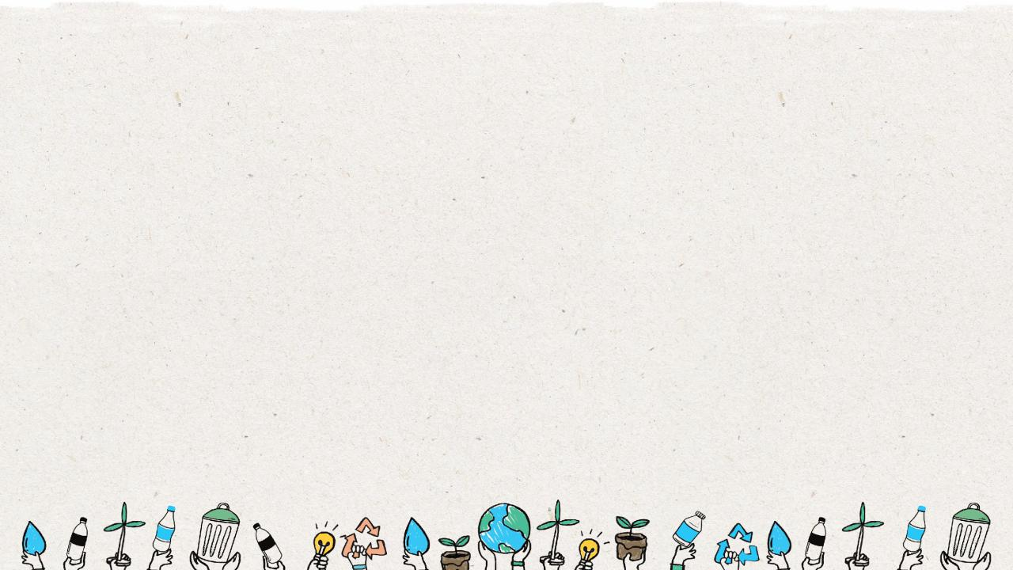
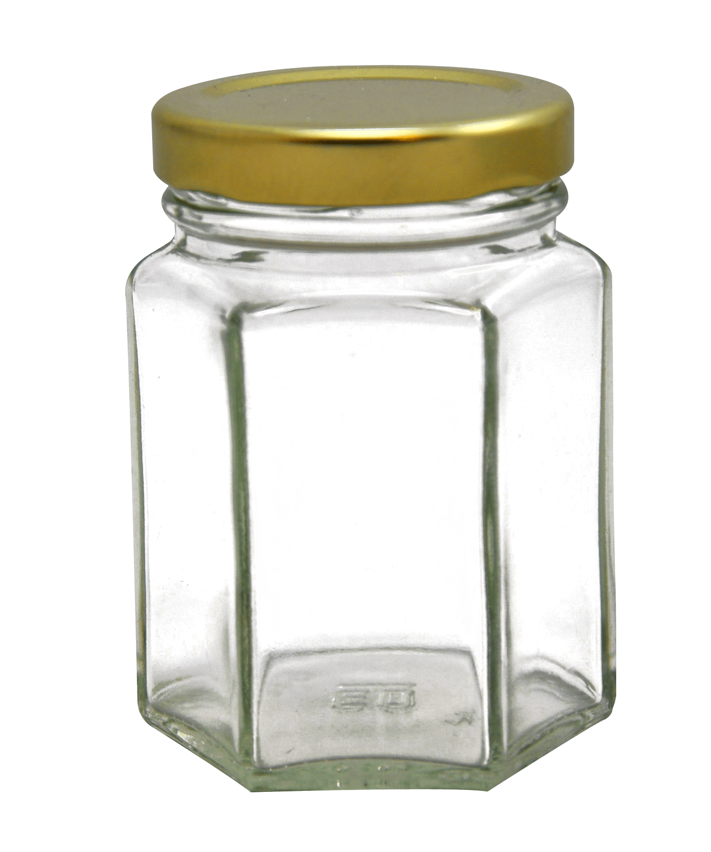
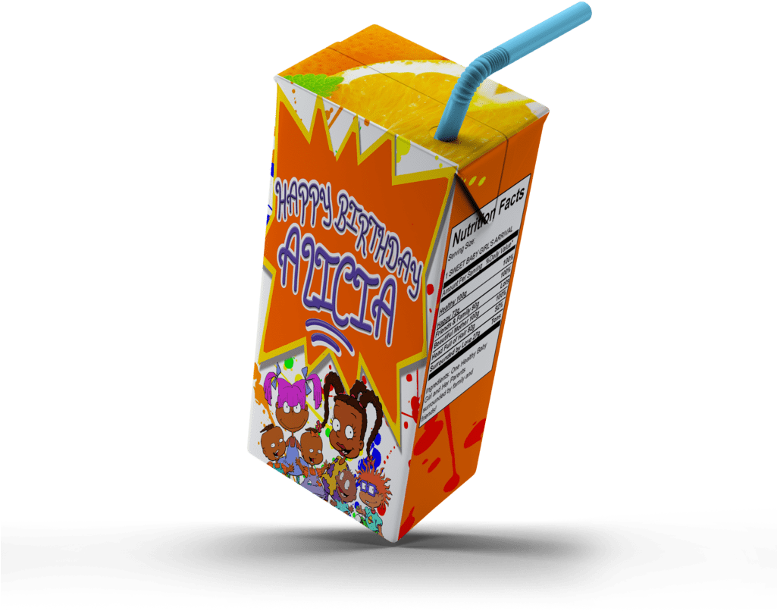
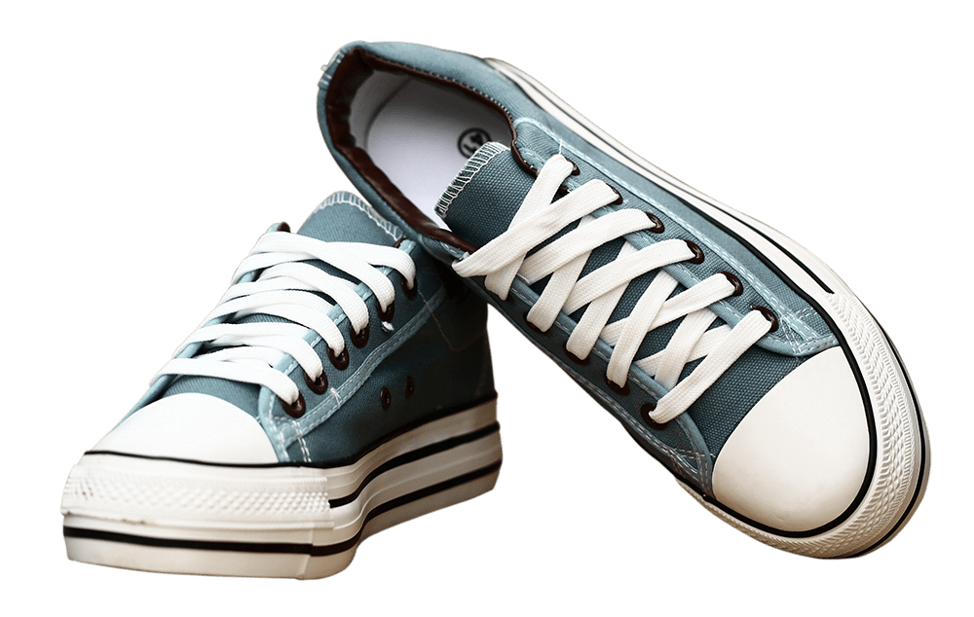
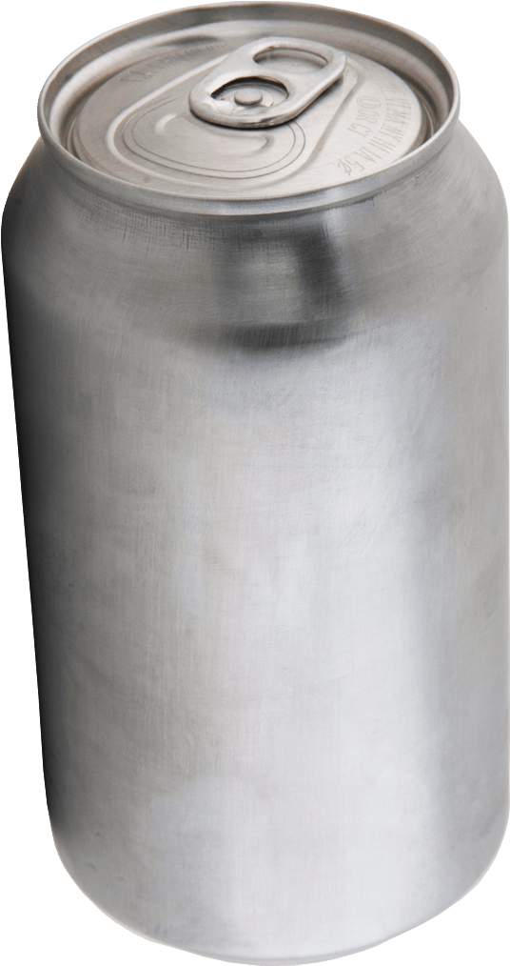
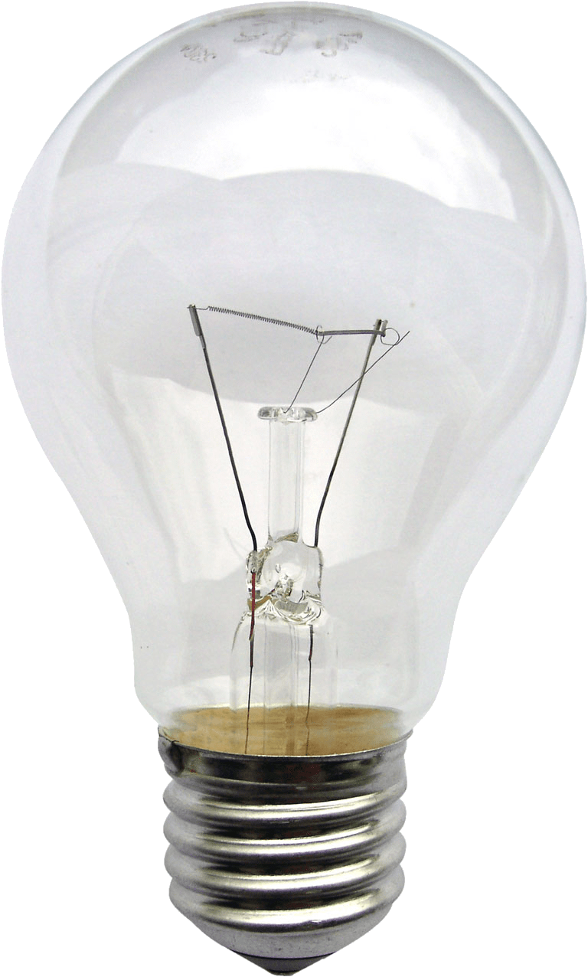
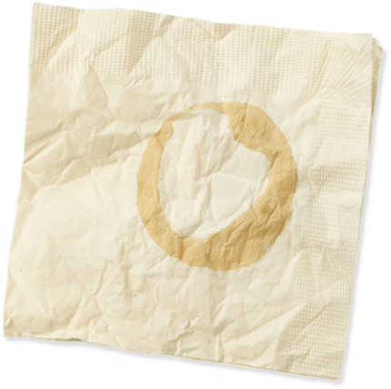
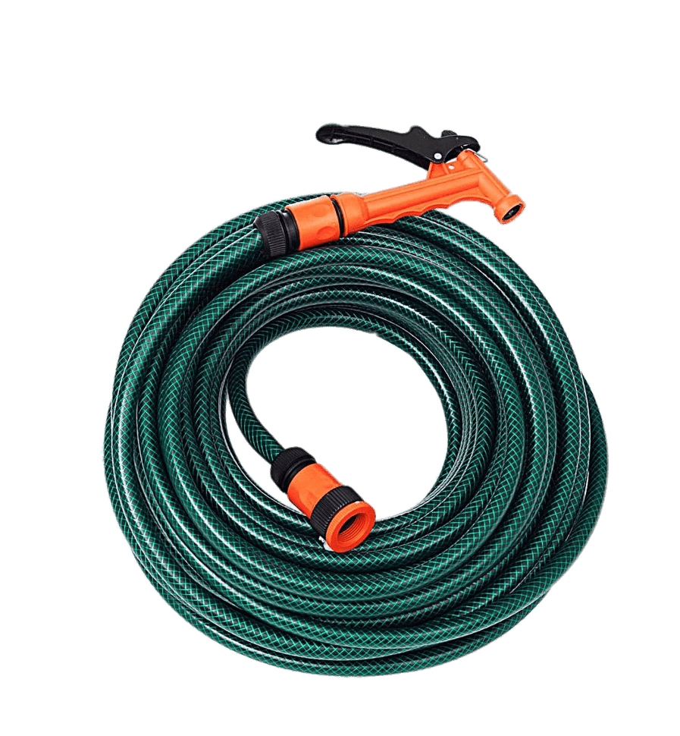
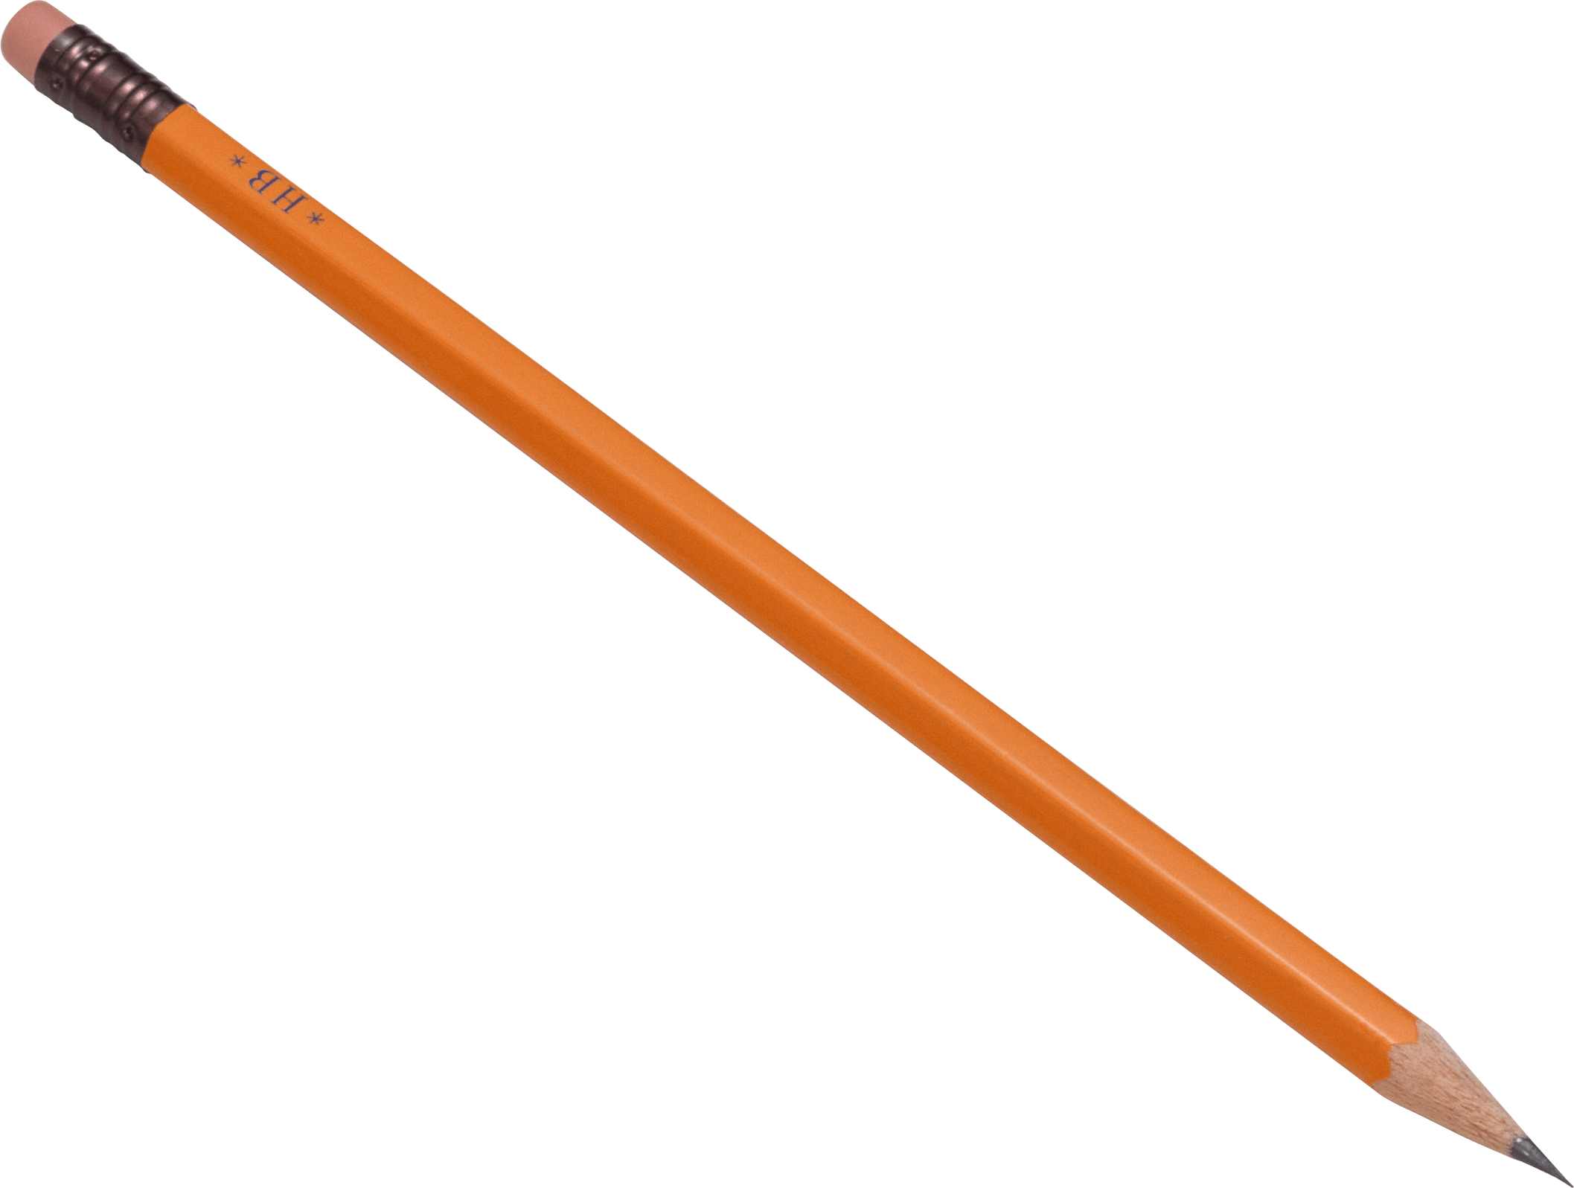
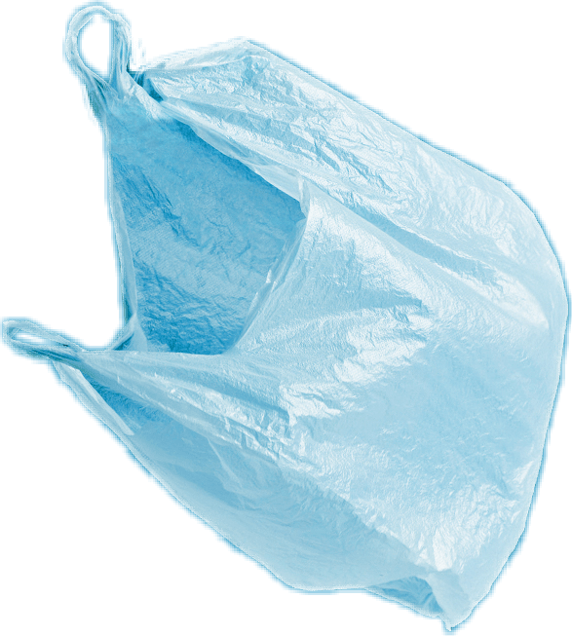
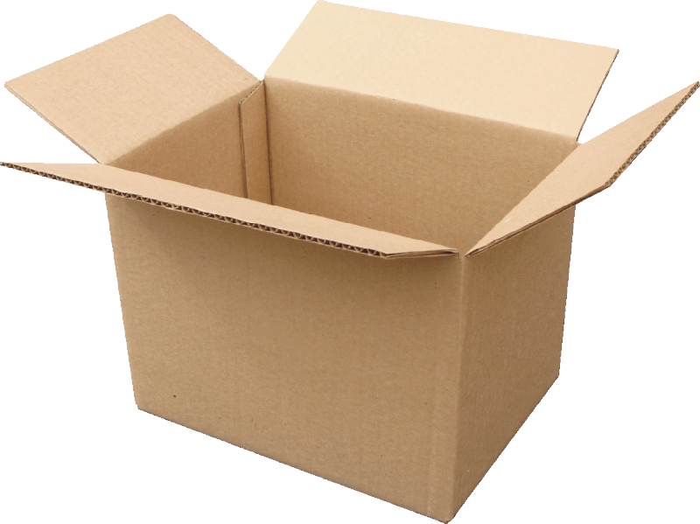
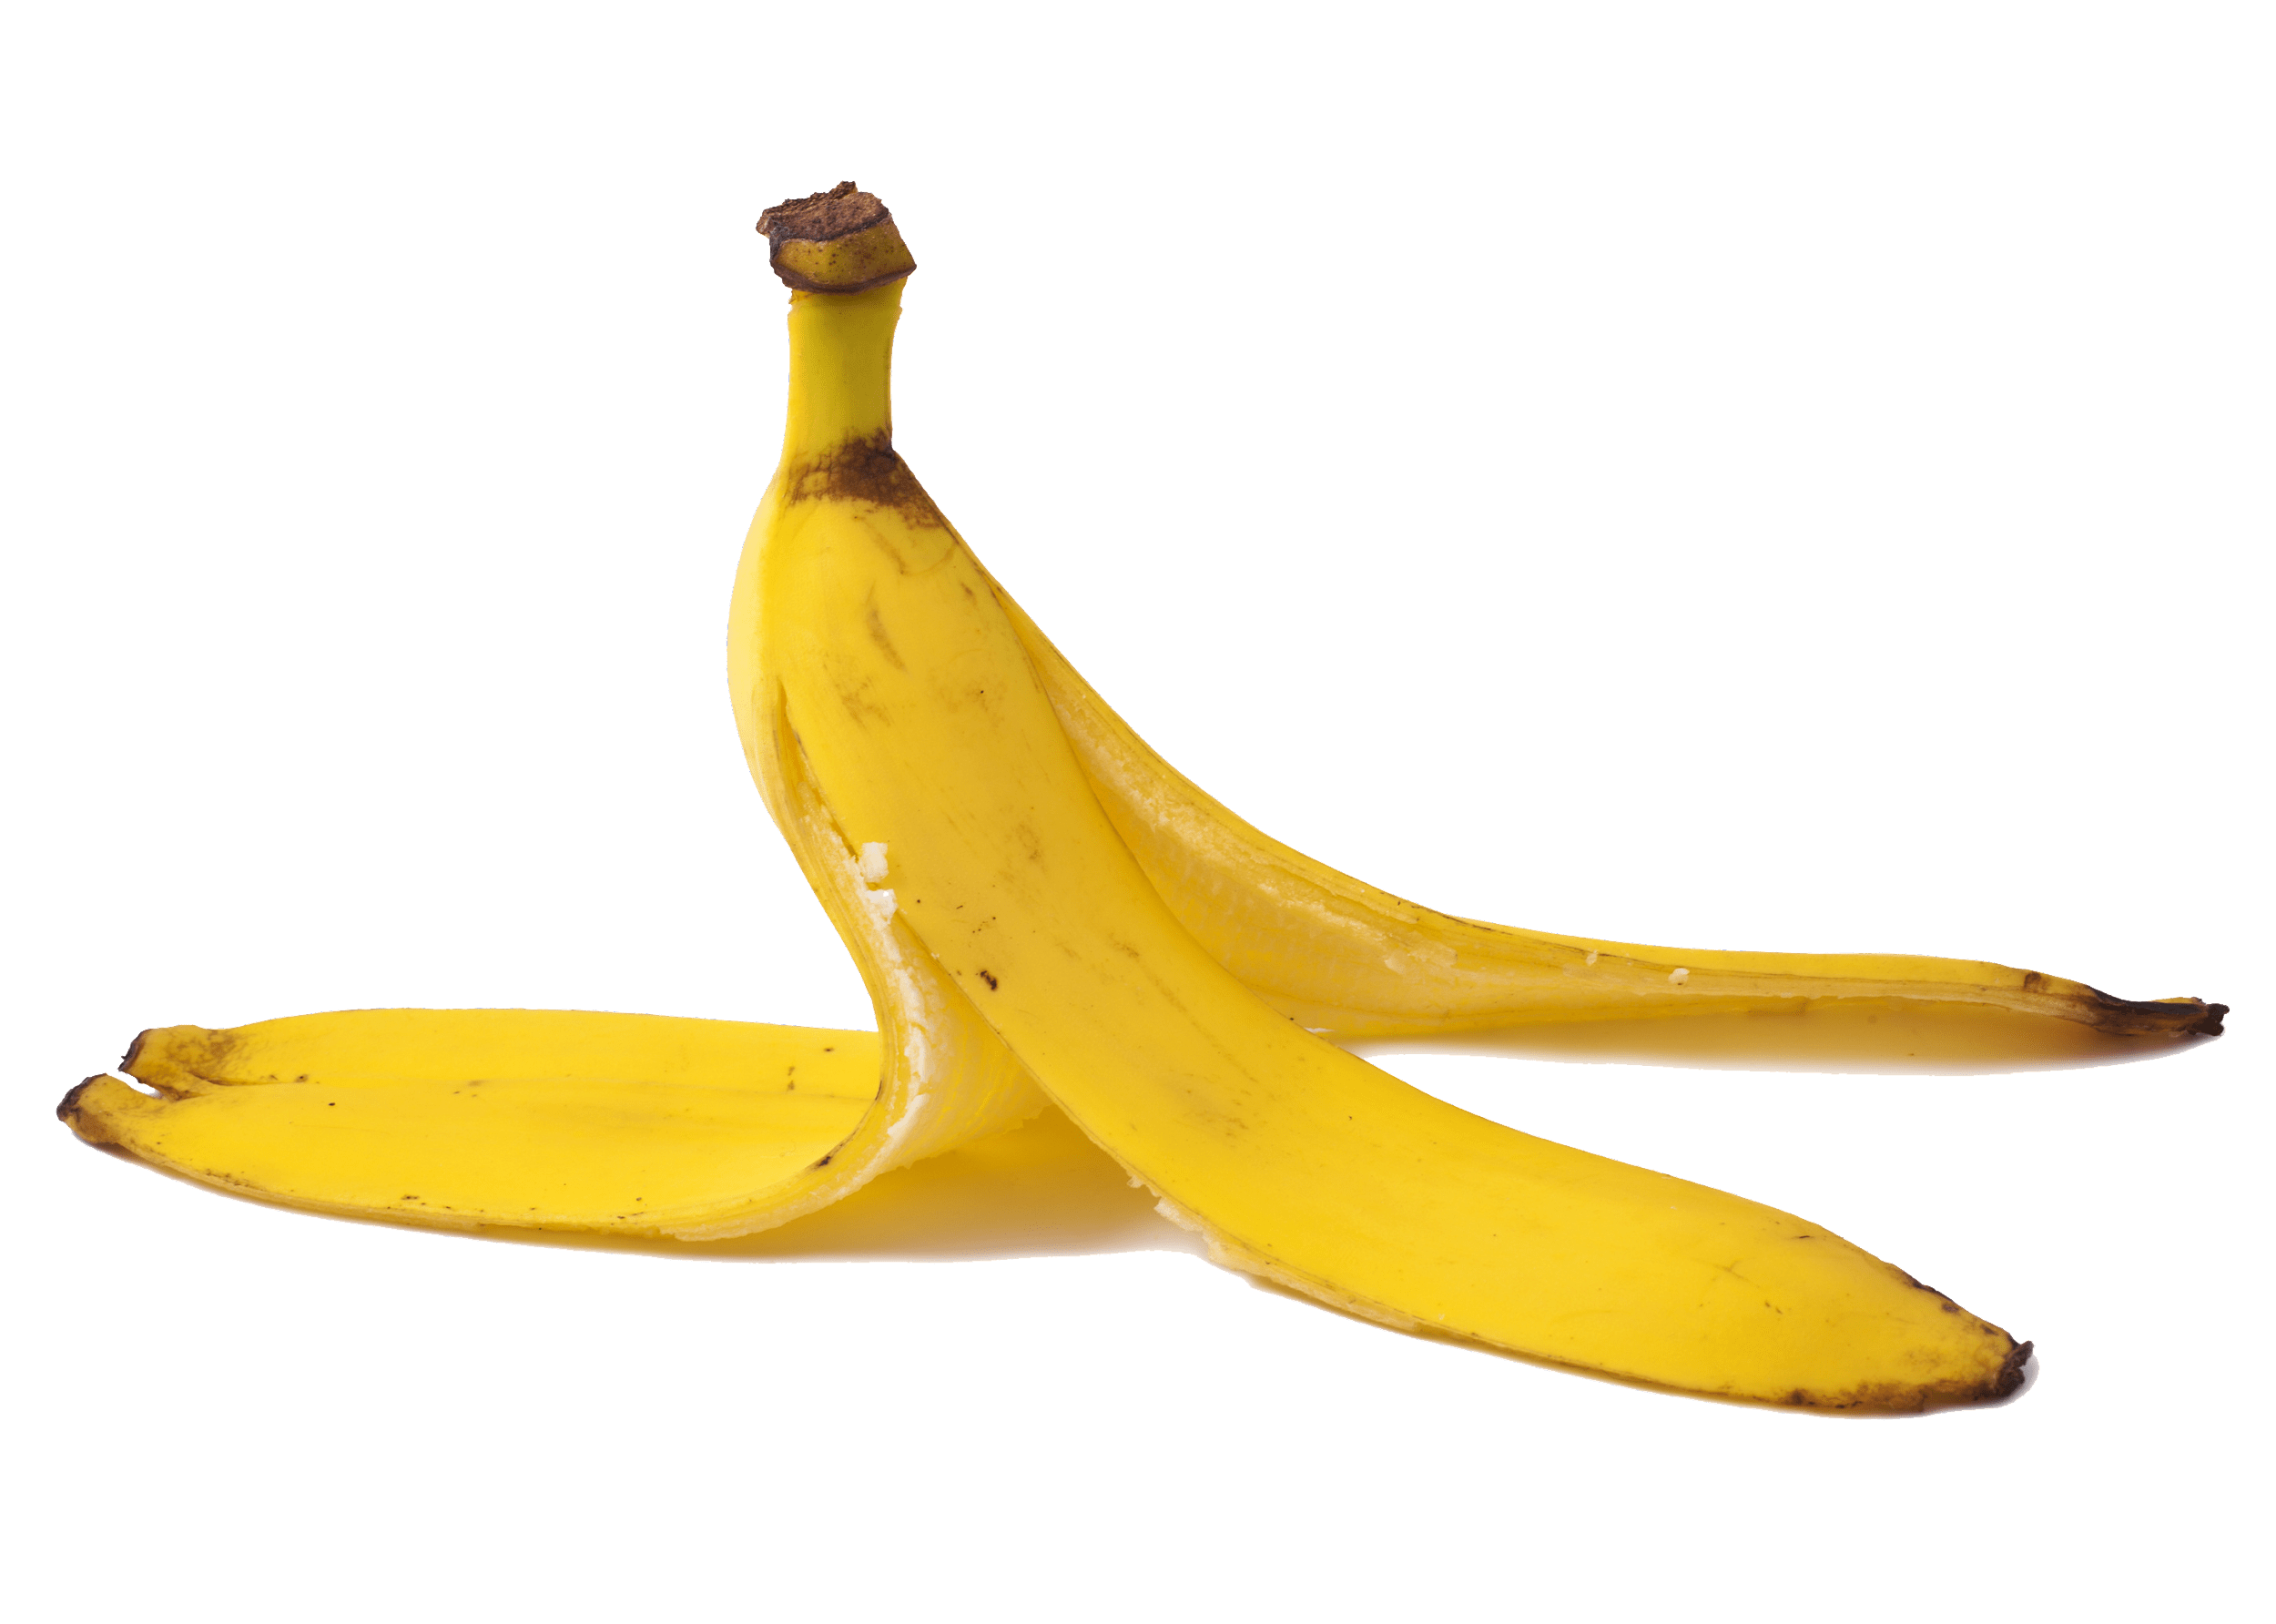
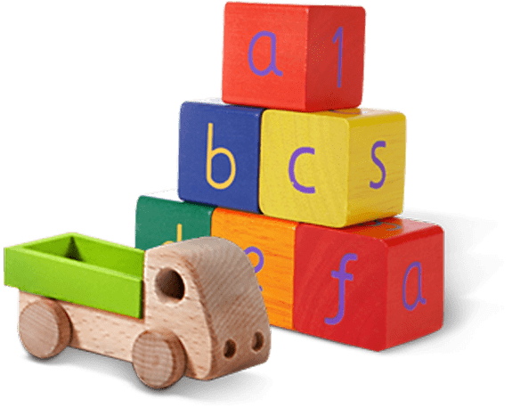
Glass jar
PET Plastic bottle
Shoes
Metal can
Light bulb
Juice box
Dirty napkin
Plastic bag
Toys
Pencil
Banana peel
Cardboard box
Garden hose
YES
NO
Notes:
(Slide duration: 3-5 minutes)
Pre-lesson Icebreaker Exercise
Ask students:
Has anyone heard of recycling? If yes, please share with the class what they know.
Tell students:
Recycling is the process of collecting and processing materials that would otherwise be thrown away as trash and turning them into new products. Recycling can benefit your community and the environment.
Now read off the images left to right starting on the top row to test their knowledge about what items displayed can and cannot be recycled.
Order of images that will appear with each click.
Click 1: Glass jar
Click 2: PET Plastic Bottle
Click 3: Shoes
Click 4: Metal can
Click 5: Light bulb
Click 6: Juice box
Click 7: Dirty napkin
Click 8: Pencil
Click 9: Plastic bag
Click 10: Toys
Click 11: Cardboard box
Click 12: Garden hose
Click 13: Banana peel

Slide 8
YES
NO
Always recycle:
Never recycle:
Banana peel
Dirty napkin
Garden hose
Glass jar
PET Plastic bottle
Light bulb
Juice box
Shoes
Cardboard box
Metal can
Toys
Plastic bag
Pencil
Notes:
(Slide duration: 3-5 minutes)
Pass out or display this YES/NO slide – there is a printable pdf handout available for students.
Open a discussion about where we put our garbage.
Ask Students: What do you do with waste at home? Where does it go? Does all waste belong in one bin?
Tell Students:
Not all waste goes into the same waste bin. Some items need to go into the recycling bin.
Ask Students:
The items on the left side of the page can be recycled, what are those items? What is the first picture you see?
*ask in this order (Glass jar, PET Plastic bottle, Cardboard box, Metal can)
Click 1: Glass Jar
What is it made from? Can it be recycled?
Answer: glass, yes
Click 2: PET Plastic bottle
What is it made from? Can it be recycled?
Answer: plastic, yes
Click 3: Cardboard box
What is it made from? Can it be recycled?
Answer: paper, yes
Click 4: Metal can
What is it made from? Can it be recycled?
Answer: metal, yes

Slide 9
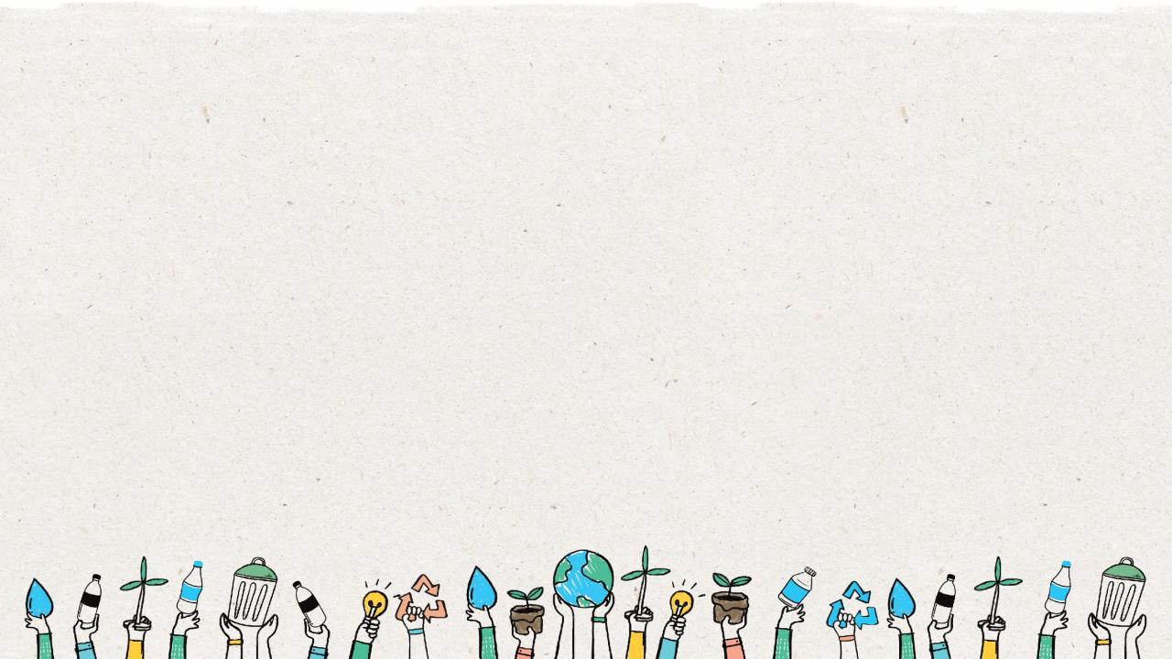
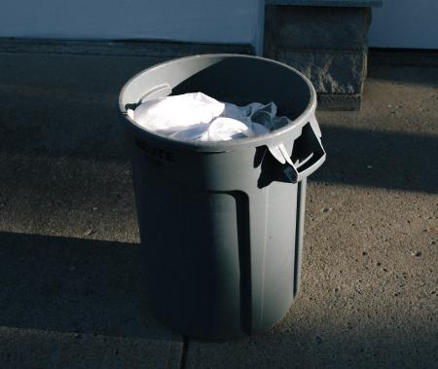
Recycling bin
Clean
Dry
No smell
No plastic bags
No non-recyclables
Notes:
(Slide duration: 3 minutes)
Ask students:
Why is this recycling bin good?
*Allow them to look and identify reasons for each picture based on their YES/NO handout.
Teachers will need to click 6 times to reveal the image and the 5 answers.
Answers:
Clean
Dry
No smell
No plastic bags
No non-recyclables

Slide 10
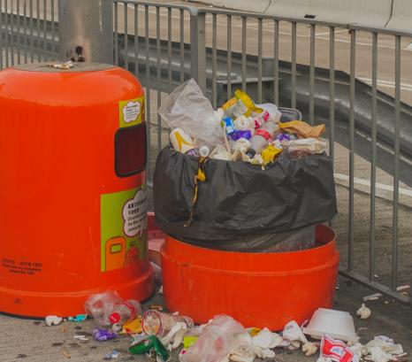
Non-recycling bin
Food
Dirty or wet paper and cardboard
Liquid in bottles
Dirty cups
Plastic bags
Notes:
(Slide duration: 3 minutes)
Ask students:
Why is this recycling bin bad?
*Allow them to look and identify reasons for each picture based on their YES/NO handout.
Teachers will need to click 6 times to reveal the image and the 5 answers.
Answers:
Food
Dirty or wet paper and cardboard
Liquid in bottles
Dirty cups
Plastic bags

Slide 11
The
3
Steps to
Recycling
Notes:
(Slide duration: 2 minutes)
Recycling is as easy as 1, 2, 3, and everyone can and should do it at home and at school.
Ask Students:
Does anyone remember the 3 steps to recycling?

Slide 12
Step
1
Know what you can recycle.
Glass Jar
PET Plastic bottle
Cardboard box
Metal can
Notes:
(Slide duration: 3-5 minutes)
Have the students guess the four main items we can recycle.
Click 1: Glass Jar
Click 2: PET Plastic bottle
Click 3: Cardboard box
Click 4: Metal can
Ask Students:
Can you give me an example of something we can recycle?
What is something we should never recycle?
Fun Fact:
PET Plastic bottles are the most recycled plastic in the world and are fully recyclable.
Expansion Questions:
Have you ever seen the #1 on the bottom of a water bottle? If you see it, you can fully recycle it.
Can you give another example of something we can recycle?

Slide 13
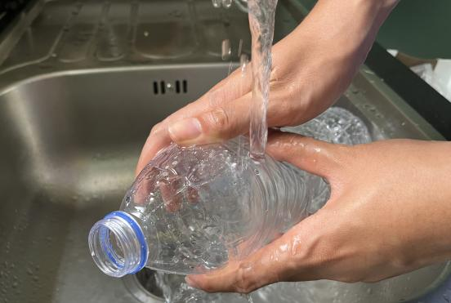
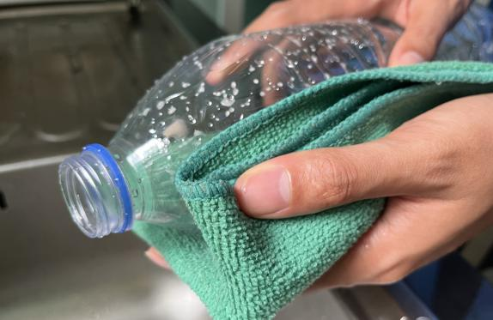
Step
2
Empty, clean, and dry before putting in the bin.
Notes:
(Slide duration: 3-5 minutes)
Ask Students:
1. Why is it important to clean our items for recycling?
2. What if there is a little bit of food or liquid on it?
You might suggest:
Dirty items cannot be recycled.
Wet and dirty items can get other clean items dirty, getting the whole recycling bin dirty.

Slide 14
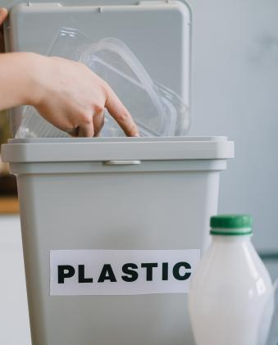
Step
3
Put recyclables into the correct recycling bin.
Notes:
(Slide duration: 3-5 minutes)
Recycling needs to be separated into the proper recycling bins. Click to reveal the recycling symbol. Let them know that this symbol indicates where to put your recycling.
Ask Students:
Where have you seen this green symbol before?
What does this symbol mean?
Where do we put PET plastic bottles for example?

Slide 15
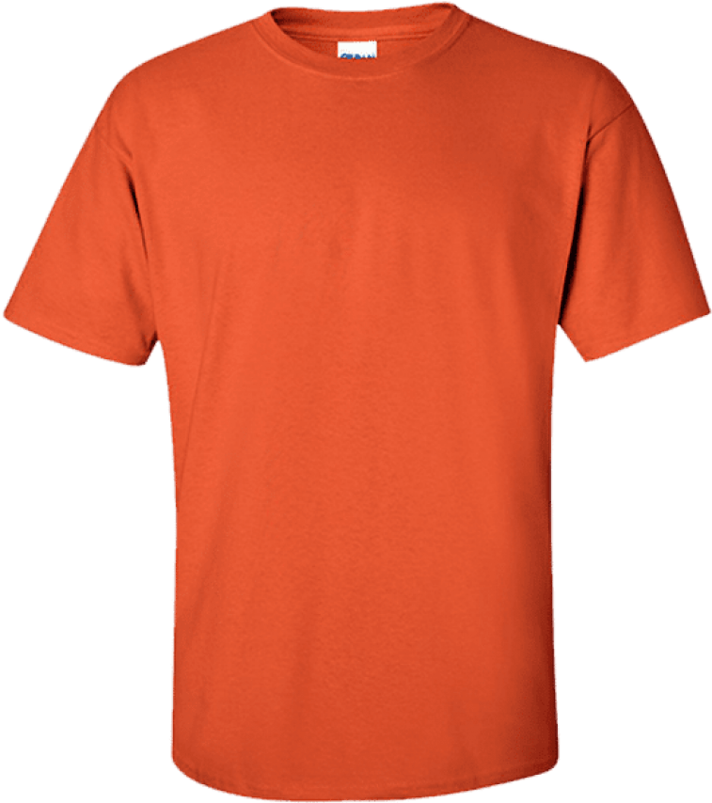
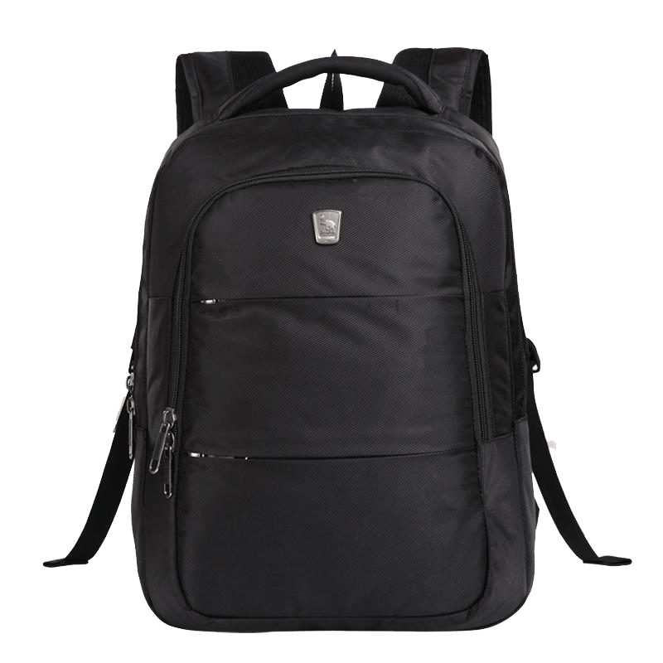
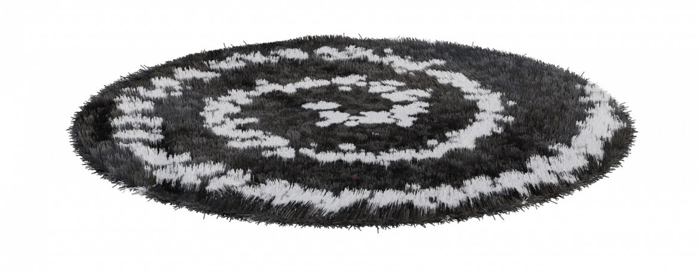
When we clean, dry, and recycle we can make new things.
Notes:
(Slide duration: 2-4 minutes)
Tell students:
When we follow the 3 steps of recycling we can recycle our waste into brand new things.
Example:
Click 1:
PET plastic bottles can be recycled back into new PET plastic bottles.
Click 2:
PET plastic bottles can also be made into thread that can make fabrics and textiles.

Slide 16
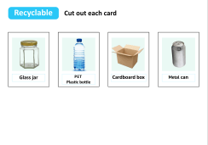
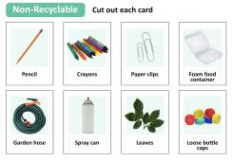
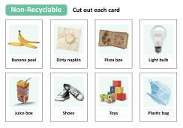
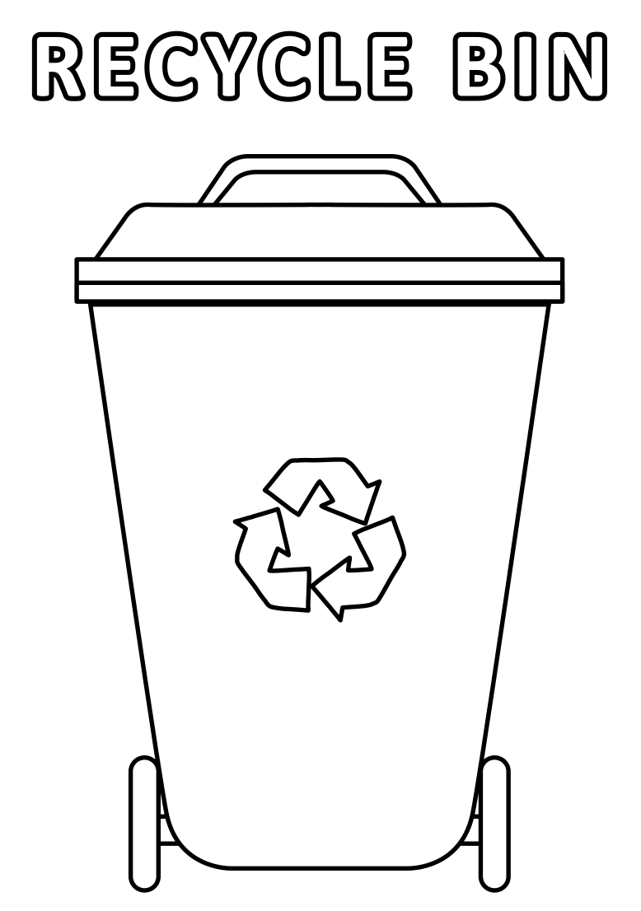
Lesson duration: 25 - 30 minutes
Next Steps
1
Tell your students they are going to play a recycling “Fill The Right Bin” sorting game.
Divide them into groups and give each group one “recycling box” (a shoebox works) and one “waste box” you created and distribute the deck of card handouts containing pictures of common recyclable and non-recyclable items for them to cut out.
Have students cut out the cards in their groups.
Have your students work as a group to decide which items are recyclable, and which are not.
2
Print and pass out the “Coloring Page” at the end of the lesson or send home as homework.
The coloring page is separate from the PowerPoint lesson and is a downloadable pdf file.
Notes:
“Fill The Right Bin” whole-class activity.
Review the cards in each group’s recycling box.
If any items were incorrectly identified as recyclable, explain why, or ask if any students know why and have them explain. It may also be easier to write the correct answers on the board and have the groups check themselves.
Confirm that students understand why an item is recyclable or non-recyclable. See below for an alternate version of the recycling sorting game.
When groups are done sorting their cards, they should put the ones showing recyclable items into their recycling box.
Alternate Version – “Relay Race”
Divide your students into 2 or 3 relay teams and have team members line up one behind the other.
Distribute one deck of shuffled cards per team evenly among the team members.
Explain how a relay works and that when it is their turn, each student on the team should cross the room and place a card into the space (“recyclable” or “non-recyclable”) they think it belongs in and get back to their team as quickly as possible for the next team member to take a turn.
You may want to put a twist on it – and keep things safe – by telling students they must hop or skip across the room rather than running.
When a designated amount of time is up or the first team has finished, the team with the most correctly identified cards wins.

