Slide 1
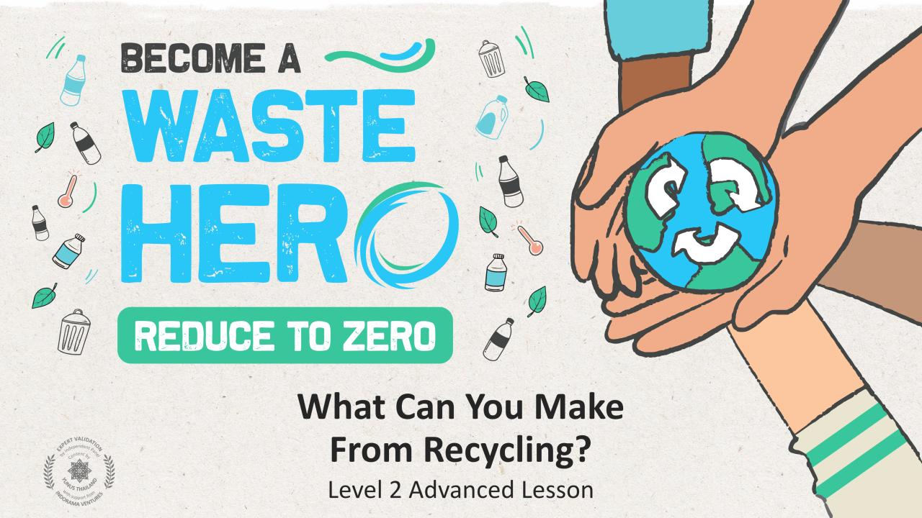

Slide 2
Lesson Prep & Curriculum Alignment
Prep time: 10 – 15 minutes
Students will deepen their understanding of how recycling benefits the environment by identifying new products from recycled materials. They will engage in a group activity using collaboration, critical thinking, and verbal presentation skills to learn what recyclable materials can be turned into. They will receive a handout to share what they have learned with their family and encourage recycling at home.
1
Display the lesson slides for the class to guide the instructions.
2
Print deck of cards for student groups, one set per group is fine.
3
Print the YES/NO take home handout to share with their family, and the “Waste Hero Stickers” of achievement.

Slide 3
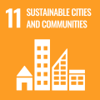
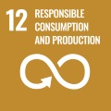
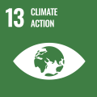
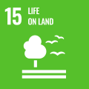
Lesson Prep & Curriculum Alignment
Prep time: 10 – 15 minutes
Key Learning Outcomes and Curriculum Alignment:
Science - Earth and Human Activity: Communicate solutions that will reduce the impact of humans on the land, water, air, and/or other living things in the local environment. Things that people do can affect the world around them. But they can make choices that reduce their impacts on the land, water, air, and other living things.
English Language Arts and Literacy: Engage effectively in collaborative conversations (one-on-one, in groups, and teacher-led) with diverse partners, building on others’ ideas and expressing their own clearly. Follow agreed-upon rules for discussions.
Social Studies: People, Places, and Environments The study of people, places, and environments enables us to understand the relationship between human populations and the physical world.
SDG Alignment
Flexible and adaptive lesson
Lesson plans are designed to be flexible and responsive to the evolving needs of your classroom. Lessons are editable and customizable to meet the different individual student and classroom contexts. A PowerPoint version with teacher instructions and a printable PDF lesson are available for download.

Slide 4
The Lesson
Lesson duration: 25 - 30 minutes
1
Introduce the lesson to your students by asking about their knowledge of recycling and if anyone recycles at home.
Display the “YES/NO” slide or print the handout.
Create an open discussion about the basics of recycling.
What exactly is recycling?
What can be recycled?
What can’t be recycled?
2
Go through the “Why recycling helps the environment” slides and create a discussion about recycling benefits to the environment by allowing us to produce numerous items from recycled materials. Recycling saves energy, conserves resources, and reduces pollution. Explain to students that recycled items can be turned into many different products and takes less energy and creates less pollution than manufacturing those products.
What are some examples of items that can be recycled?
What happens to those items when they are recycled?
Are they reused or do they get turned into other things?
What are some products that can be made using recyclable material?

Slide 5
The Lesson
Lesson duration: 25 - 30 minutes
3
Divide students into groups and give each group a deck of cards with pictures of recyclable/non recyclable items and pictures of products that can be made from recyclables. Tell students they will work as a team to match each product card with a recyclable card showing what it could be turned into through recycling.
4
Lead a discussion of the activity and help students with the correct pairings. If there are any pairings that students do not understand, explain the connection between the recyclables and their product.
5
Tell students to get a piece of paper and write down a recyclable material (PET plastic bottle) and have them draw a product they want to make from the recyclable item. Have them share with the class. Design the layout like the slides presented.

Slide 6
Prepare the PowerPoint presentation
When you are ready to present the lessons to your class click on Slide Show on the top menu bar then select Presenter View. In Presenter view, you can see your notes as you present while the audience see only your slides.
The notes appear in a pane on the right. The text should wrap automatically, and a vertical scroll bar appears if necessary. You can also change the size of the text in the Notes pane by using the two buttons at the lower left corner of the Notes pane.

Slide 7
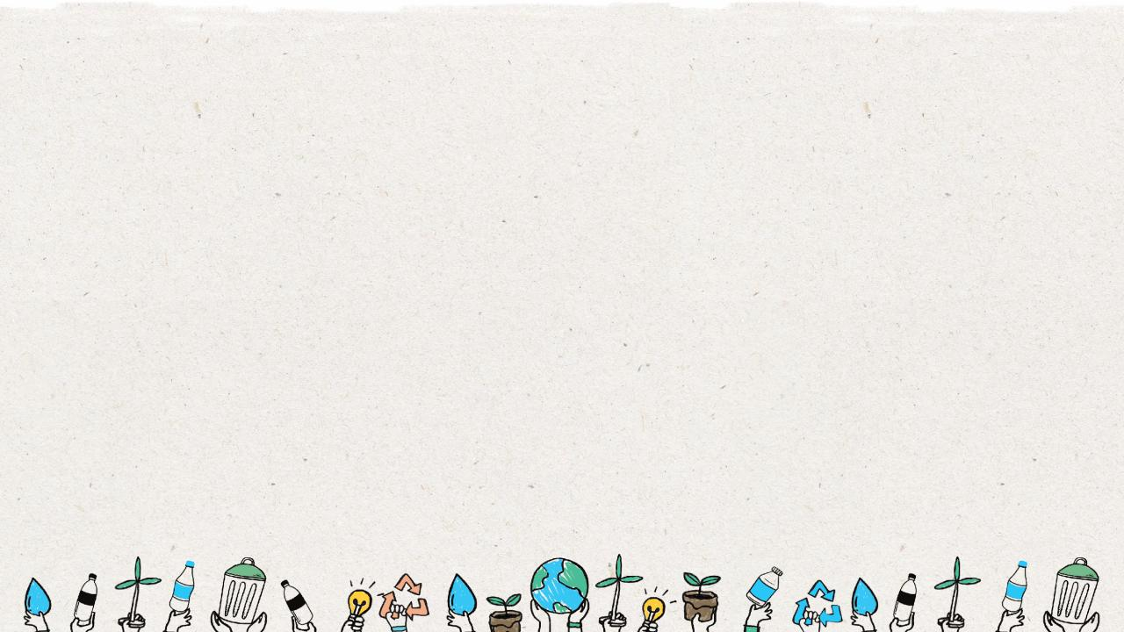
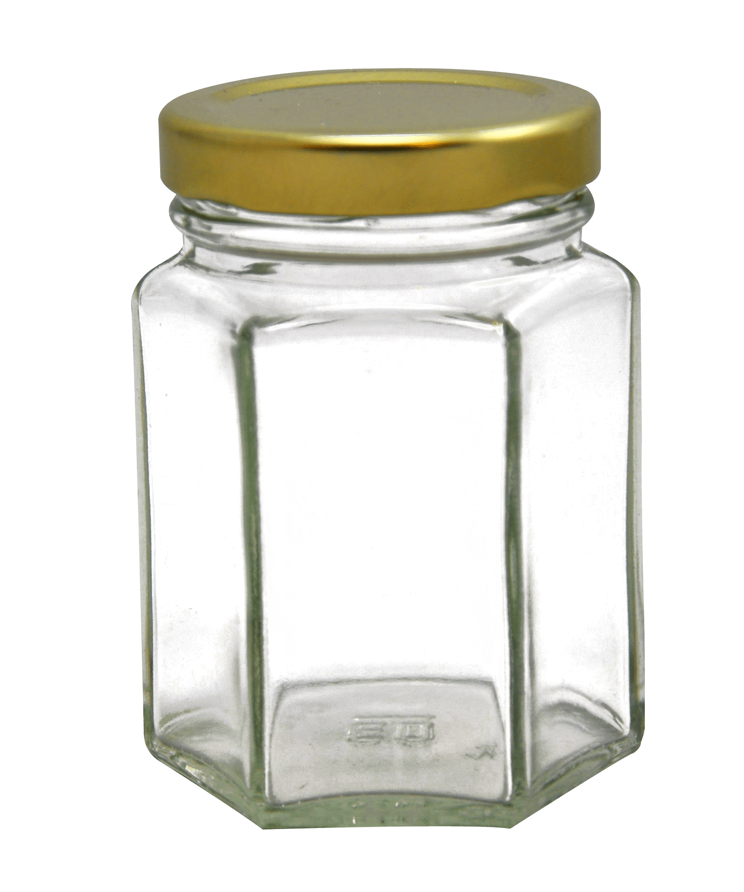
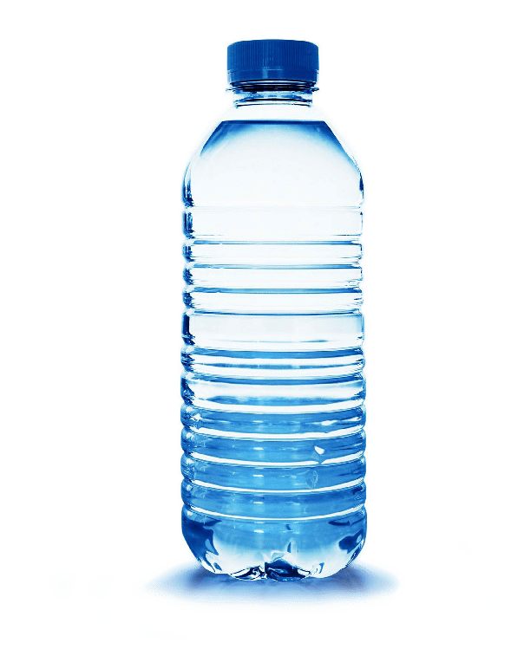
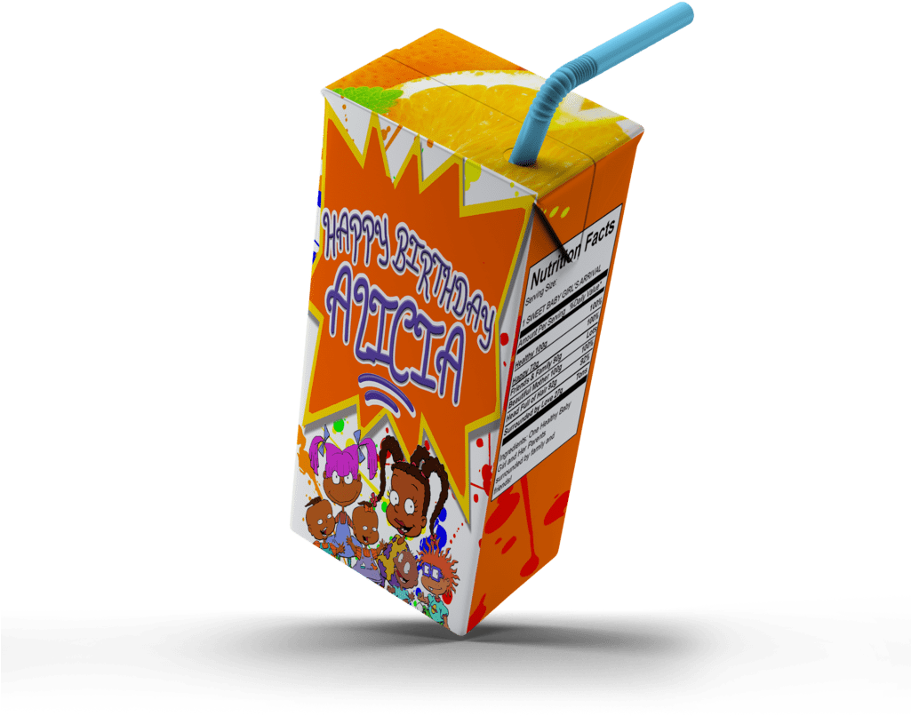
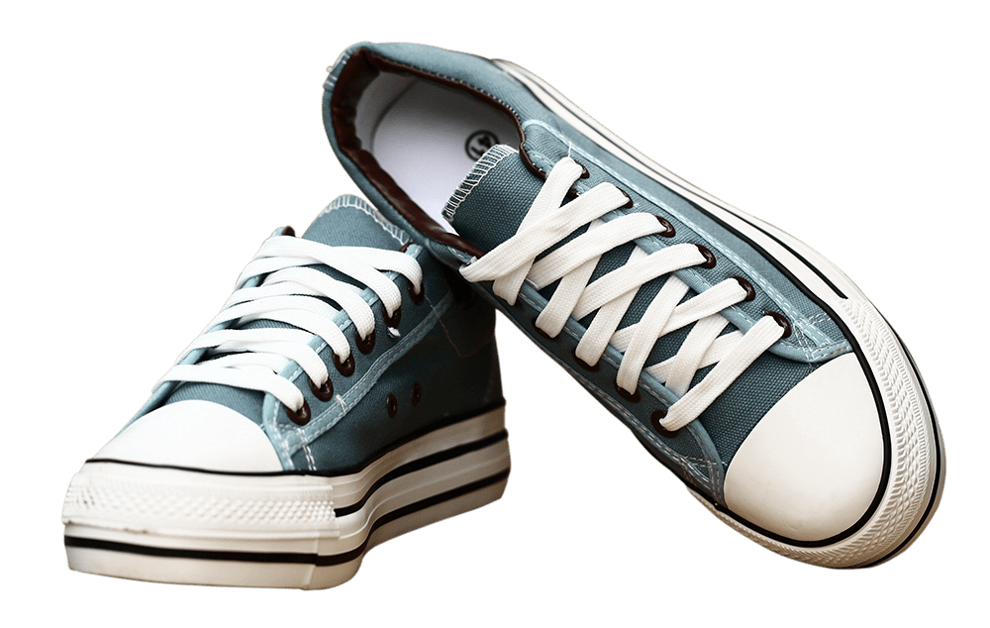
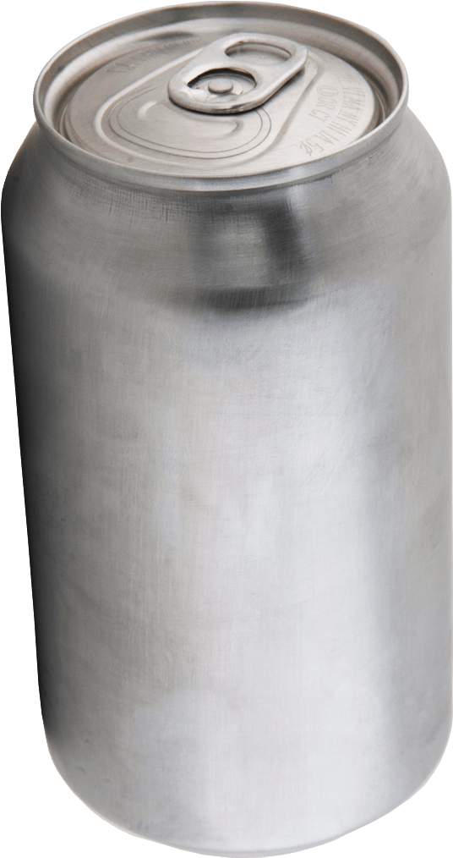
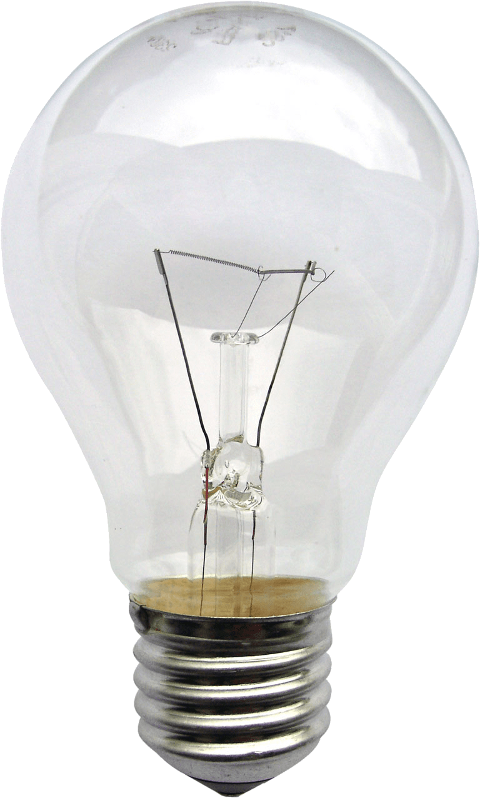
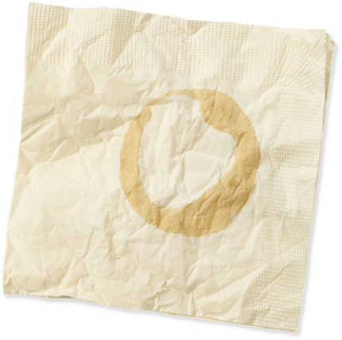
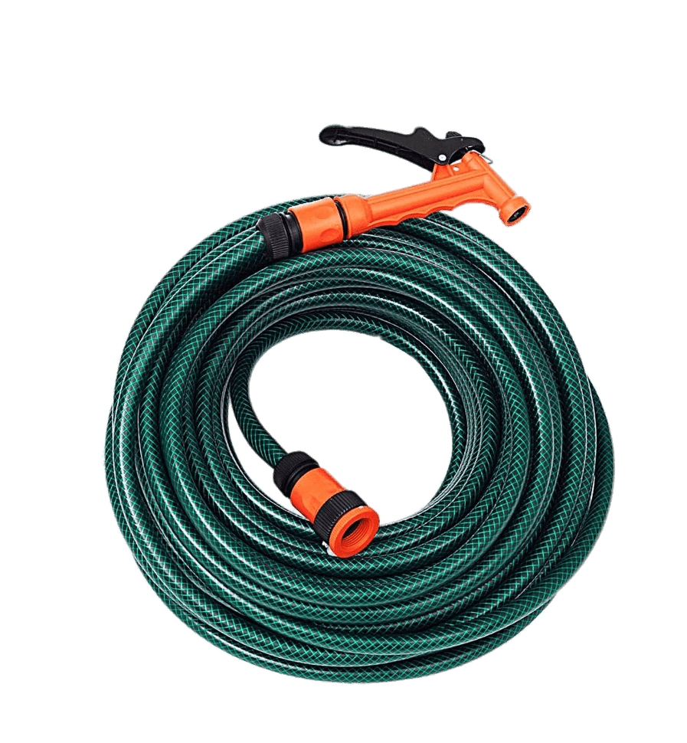
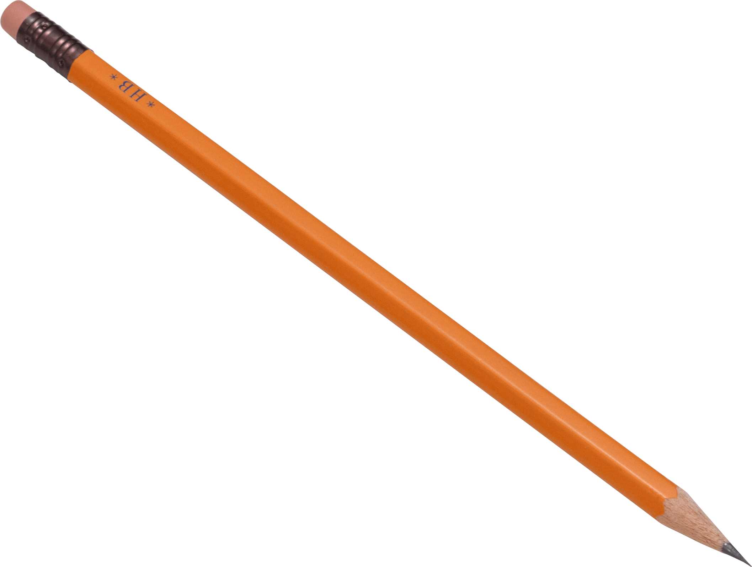
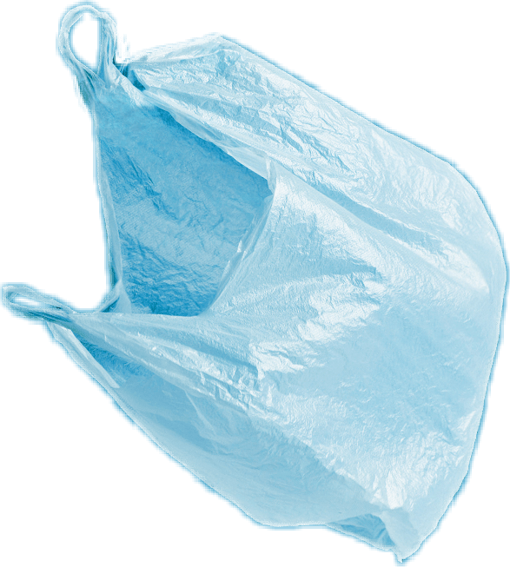
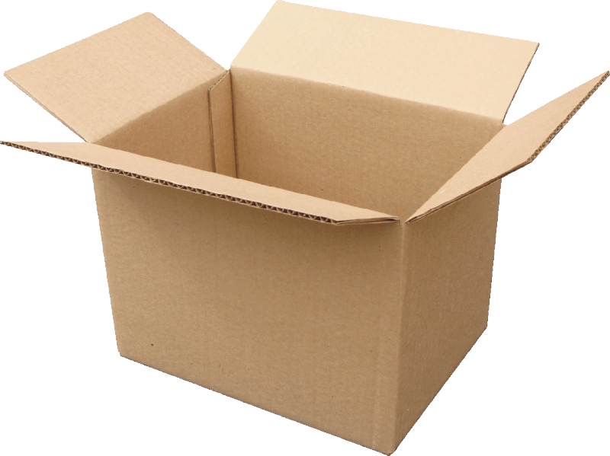
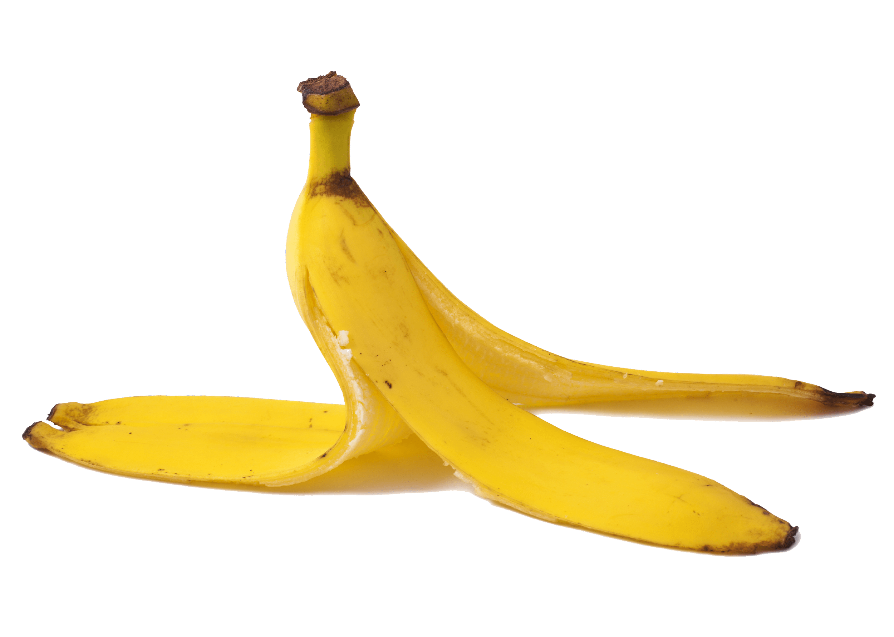
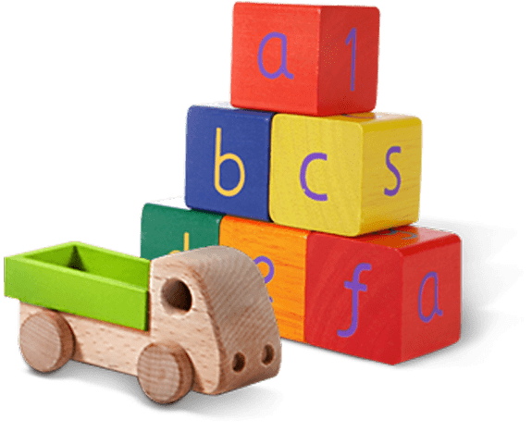
Glass jar
PET Plastic bottle
Shoes
Metal can
Light bulb
Juice box
Dirty napkin
Plastic bag
Toys
Pencil
Banana peel
Cardboard box
Garden hose
YES
NO
Notes:
(Slide duration: 3-5 minutes)
Pre-lesson Icebreaker Exercise
Ask students:
Has anyone heard of recycling? If yes, please share with the class what they know.
Tell students:
Recycling is the process of collecting and processing materials that would otherwise be thrown away as trash and turning them into new products. Recycling can benefit your community and the environment.
Now read off the images left to right starting on the top row to test their knowledge about what items displayed can and cannot be recycled.
Order of images that will appear with each click.
Click 1: Glass jar
Click 2: PET Plastic Bottle
Click 3: Shoes
Click 4: Metal can
Click 5: Light bulb
Click 6: Juice box
Click 7: Dirty napkin
Click 8: Pencil
Click 9: Plastic bag
Click 10: Toys
Click 11: Cardboard box
Click 12: Garden hose
Click 13: Banana peel

Slide 8
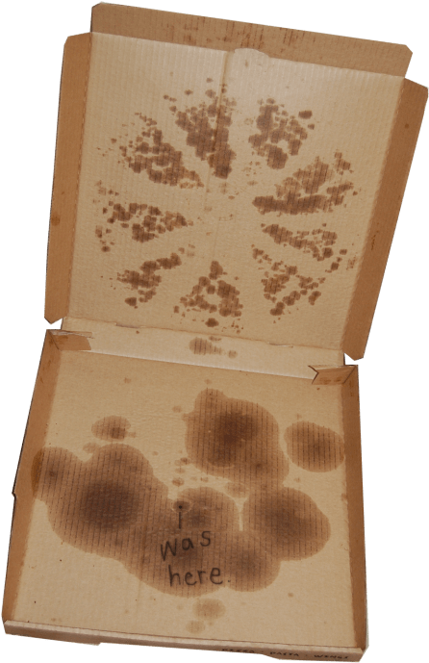
YES
NO
Always recycle:
Never recycle:
Banana peel
Dirty napkin
Pizza box
Glass jar
PET Plastic bottle
Light bulb
Juice box
Shoes
Cardboard box
Metal can
Toys
Plastic bag
Pencil
Notes:
(Slide duration: 3-5 minutes)
Pass out or display this YES/NO handout – there is a printable pdf handout available for students.
Discuss what we can and cannot recycle based on the items in the worksheet.
What do you do with garbage at home?
Where does it go?
If you put everybody’s garbage into a big pile, how much would there be? Would it be too much?

Slide 9
The
3
Steps to
Recycling

Slide 10
Step
1
Know what you can recycle.
Glass jar
PET Plastic bottle
Cardboard box
Metal can
Notes:
(Slide duration: 3-5 minutes)
Have the students guess the four main items we can recycle.
Click 1: Glass Jar
Click 2: PET Plastic bottle
Click 3: Cardboard box
Click 4: Metal can
Ask students:
Can you give me an example of something we can recycle?
What is something we should never recycle? Food waste
Fun Fact:
PET plastic bottles are the most recycled plastic in the world and is fully recyclable.
Expansion Questions:
Have you ever seen the #1 on the bottom of a water bottle? If you see it, you can fully recycle it.
Can you give another example of something we can recycle?

Slide 11
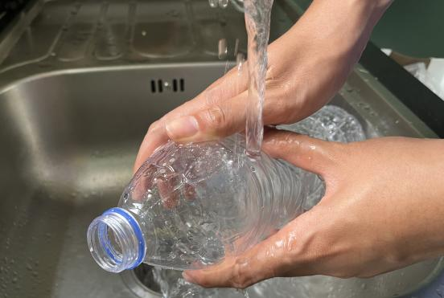
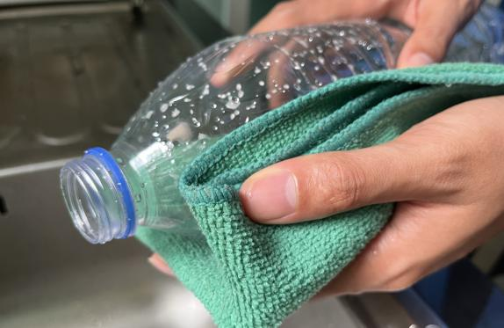
Step
2
Empty, clean, and dry before putting in the bin.
Notes:
(Slide duration: 3 minutes)
Ask Students:
1. Why is it important to clean our items for recycling?
2. What if there is a little bit of food or liquid on it?
You might suggest:
Dirty items cannot be recycled.
Wet and dirty items can get other clean items dirty, getting the whole bin dirty.

Slide 12
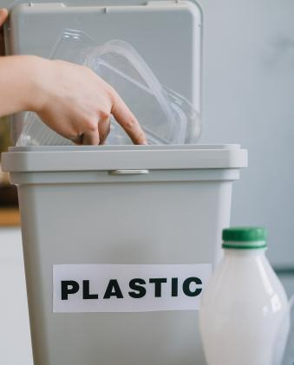
Step
3
Put recyclables into the correct recycling bin.
Notes:
(Slide duration: 3 minutes)
Tell students:
Recycling needs to be separated into the proper recycling bins. Click to reveal the recycling symbol. Let them know that this symbol indicates where to put your recycling.
Ask students:
Where have you seen this green symbol before?
What does this symbol mean?
Where do we put those PET plastic bottles?

Slide 13
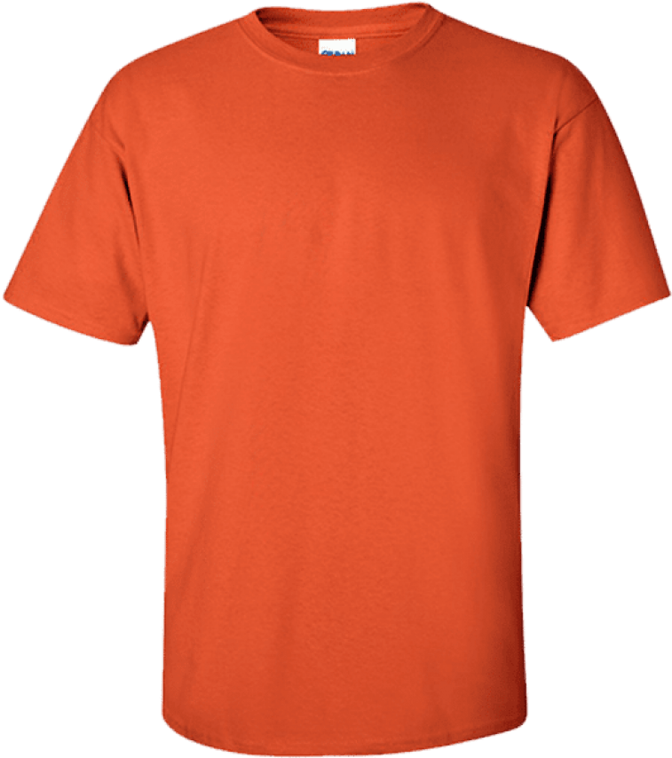
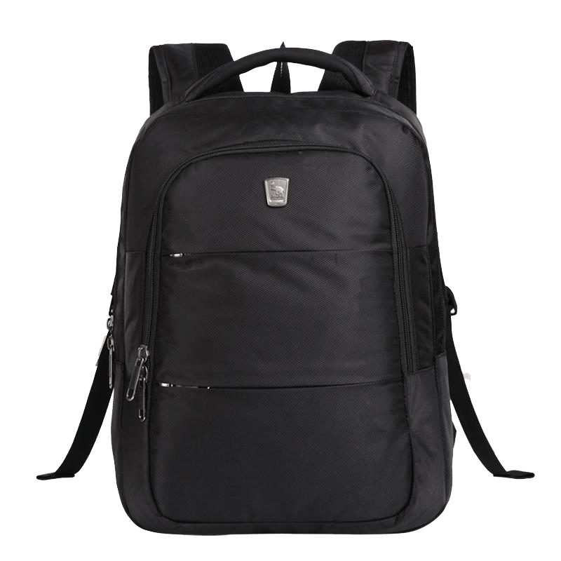
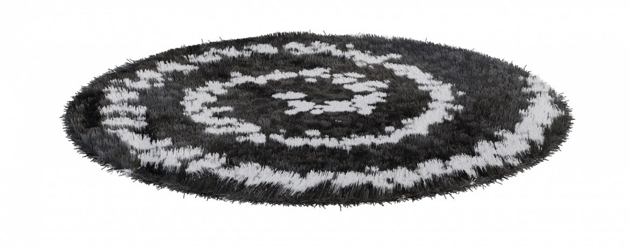
When we clean, dry, and recycle we can make new things.
Notes:
(Slide duration: 2-4 minutes)
Tell students:
When we follow the 3 steps of recycling we can recycle our waste into brand new things.
Example:
Click 1:
PET plastic bottles can be recycled back into new PET plastic bottles.
Click 2:
PET plastic bottles can also be made into thread that can make fabrics and textiles.

Slide 14
How does recycling help the environment?
400 years
Notes:
(Slide duration: 3 minutes)
Tell students:
If we want to preserve Earth for future generations, recycling is very important. Since we are making new products from the old products which are of no use to us, it is good for the environment. If waste is not recycled, it can negatively impact our environment in many ways.
Can you think of some reasons why recycling helps the environment?
Answers:
Saves energy
Reduces the amount of natural resources needed to make new products
Protects our natural world (animals and plants)
Reduces pollution
Helps fight climate change

Slide 15
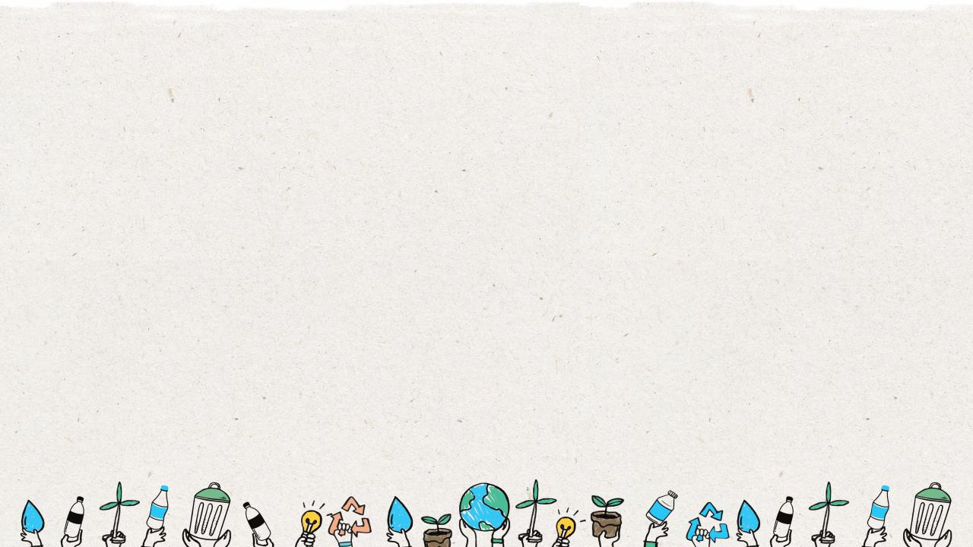
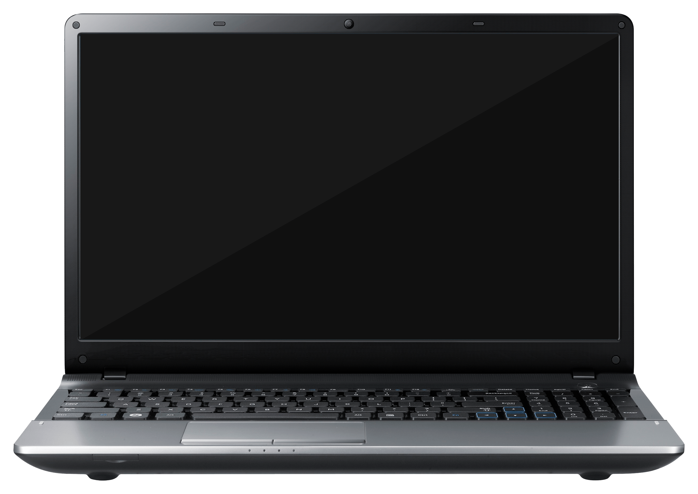
Why recycling helps the environment?
10 PET Plastic bottles
Saves Energy
Did you know if you recycle ten PET plastic bottles,
you can save enough energy to power your laptop for an entire day.
Notes:
(Slide duration: 3 minutes)
Click 1 and 2: PET plastic bottles appear
Tell students:
Extracting and processing raw materials (wood, oil, ore) to make usable materials (paper, plastic, metal) requires a lot of energy. Recycling often saves energy because the products being recycled usually require much less processing to turn them into usable materials.
Ask students:
How many PET plastic bottles do we need to recycle to power our laptops for 1 week, 1 month, 1 year?
Answers:
70 bottles = 1 week
300 bottles = 1 month
3,650 bottles = 1 year

Slide 16
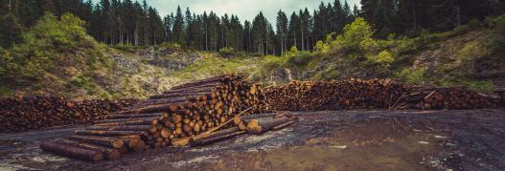
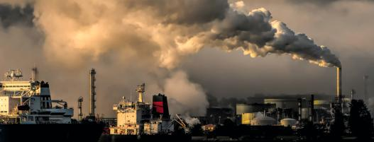
Why recycling helps the environment?
We use less natural resources.
Recycling conserves natural resources, such as wood, water, minerals, and fossil fuels, because materials can be reused.
Notes:
(Slide duration: 3 minutes)
Tell students:
Trees play a big role in keeping mother nature alive. However, every single day trees are cut down to make paper and more paper. Recycling of paper helps in restoring forests, thus protecting our environment.
Ask students:
Why is using less resources important?
What happens if we used all our natural resources?
Answer:
Natural resources are not infinite and once we use them all up, they are gone forever.
If we used all our natural resources on this planet all life wouldn’t be able to survive.

Slide 17
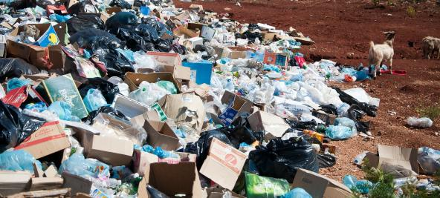
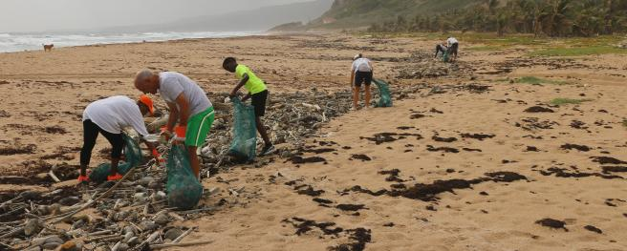
Why recycling helps the environment?
Reduces pollution and protects animals.
Notes:
(Slide duration: 3 minutes)
Tell students:
Improper waste disposal emits different greenhouse gases like carbon dioxide, nitrogen, and sulfur, which contribute to global warming. As the recycling process involves minimal waste disposal, burns little fossil fuels with most chemicals being reused, there is less greenhouse gases being emitted.
Waste can cause loss of natural habitats and contributes to negative impacts like climate change and global warming, which can also destroy animals’ natural habitats. When animals and other biological organisms lose their habitats, they can die off or starve.
Ask students:
What are some examples you have seen of waste in our environment? (on the street, at the beach, in the river or lake)
Have you ever seen a recyclable item in nature? (PET plastic bottle, cardboard, metal can, glass jar)

Slide 18
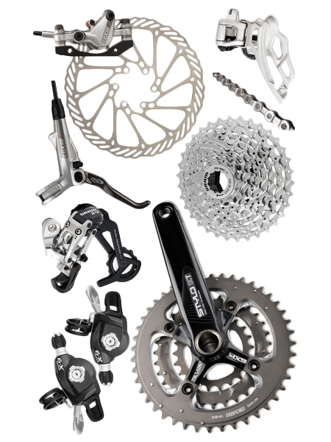
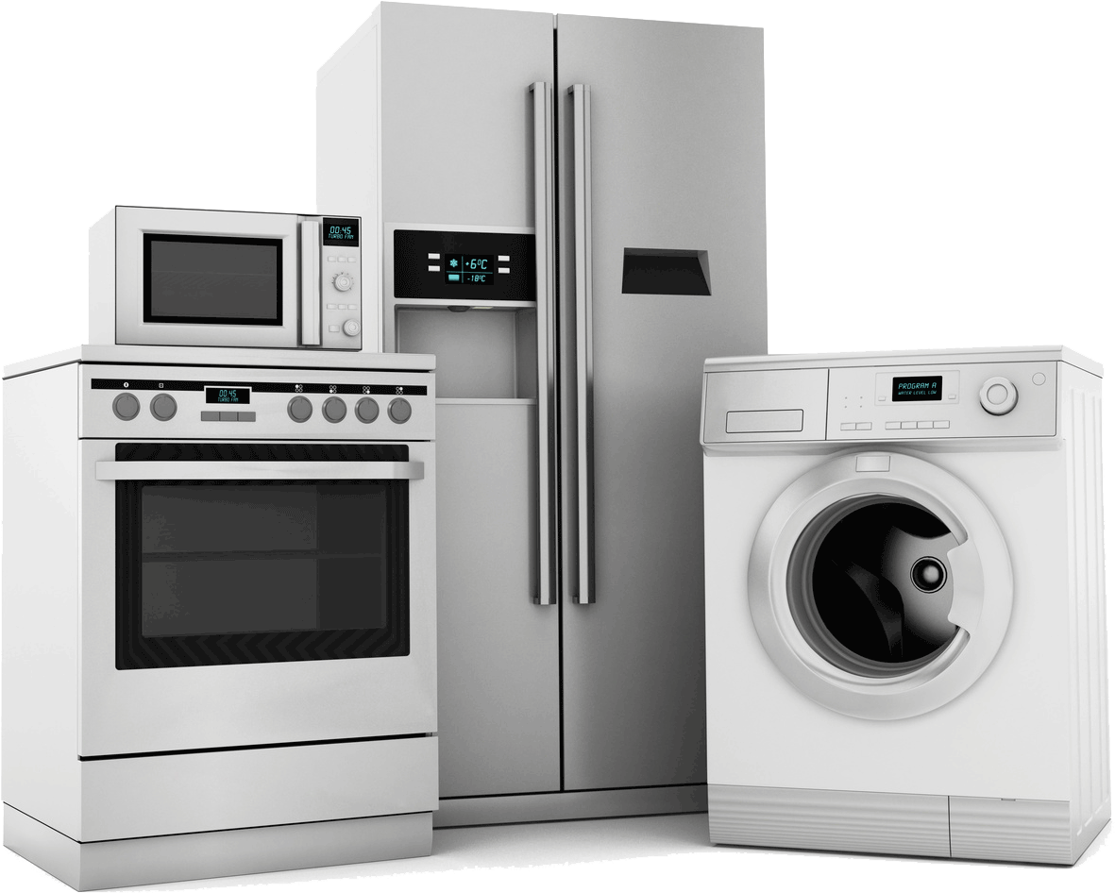
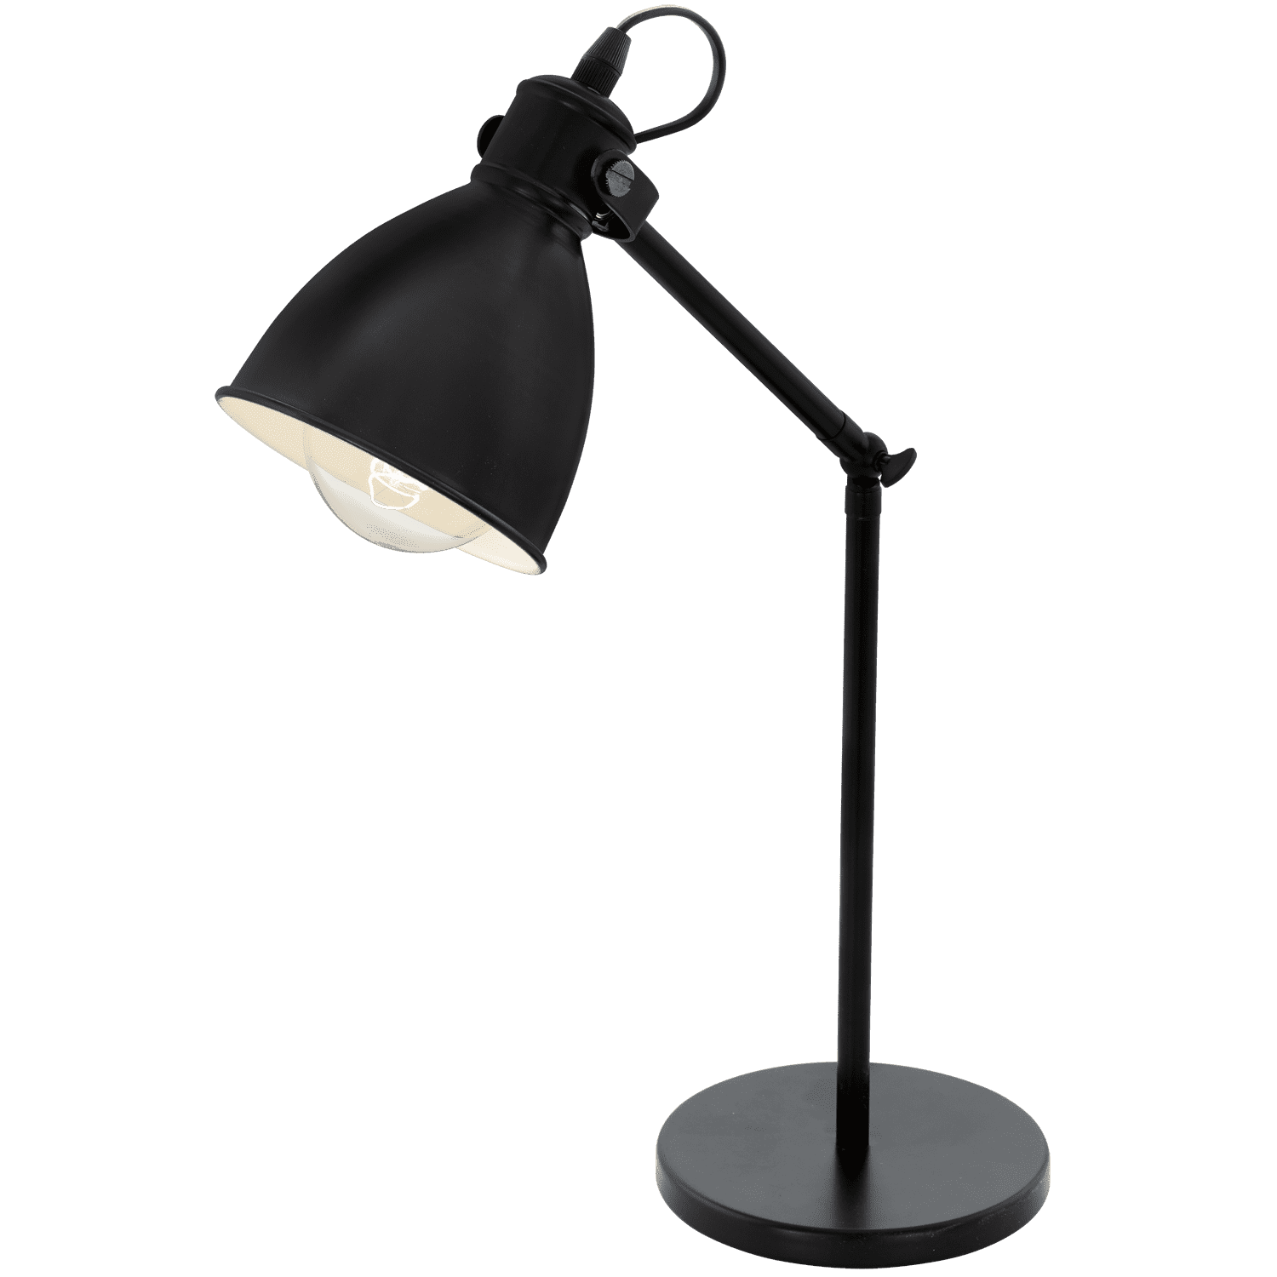
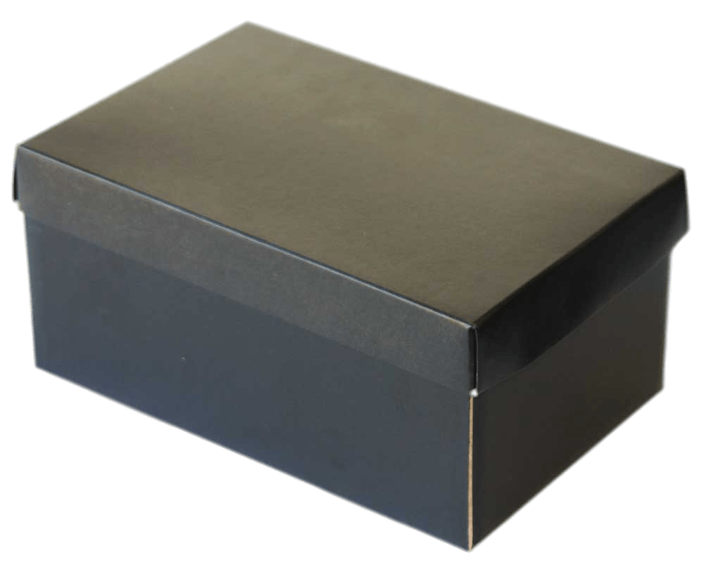
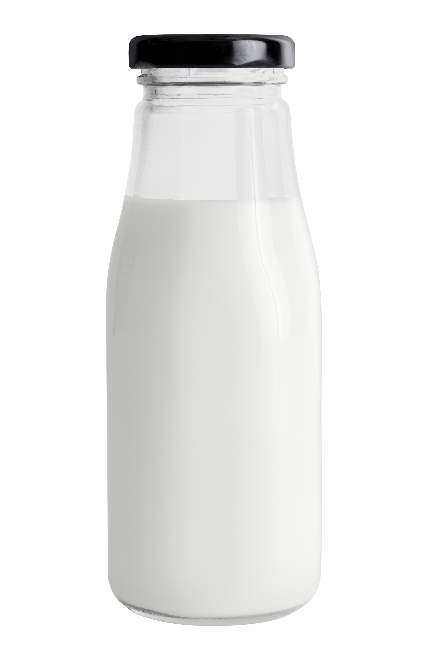
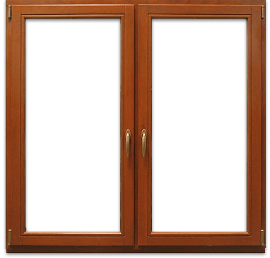
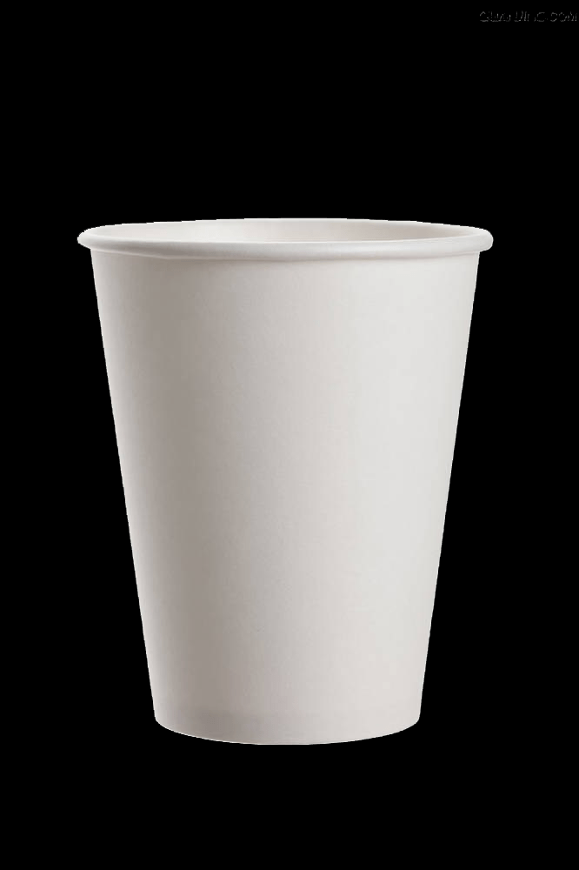
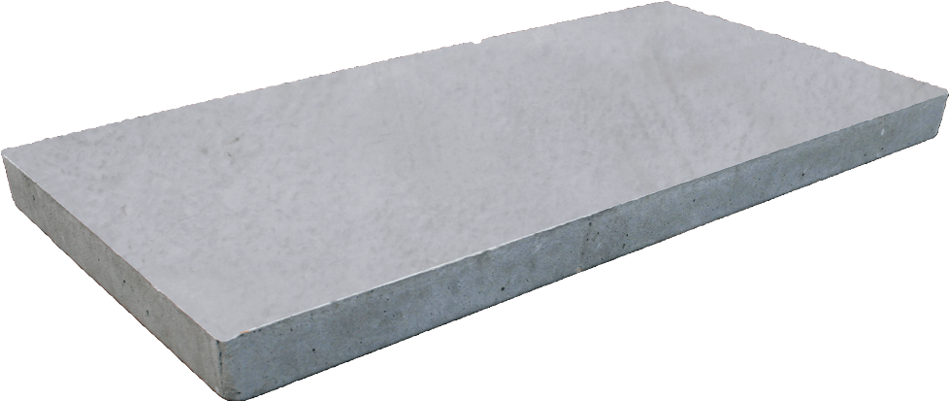
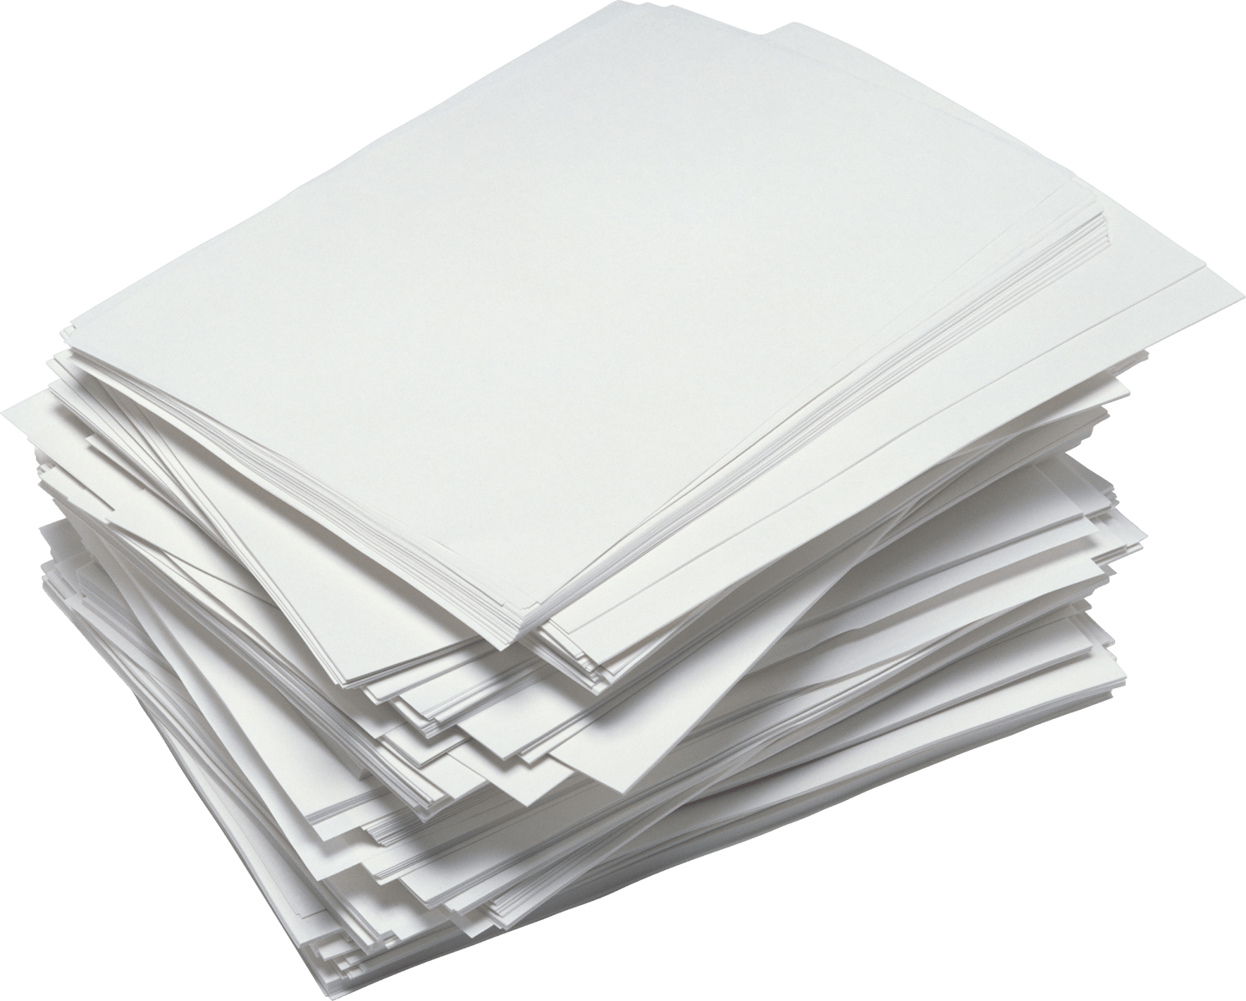
Many recyclables can be remade into new products. What products can be remade from recyclables into something new?
Notes:
(Slide duration: 3 minutes)
Ask students:
What can be made with recycled metal cans?
What can be made from recycled PET plastic bottles?
What can be made from recycled cardboard?
What can be made from recycled glass?
Answer:
Allow them to think and answer on their own. The correct answers will be presented in the following slides.

Slide 19
Metal Cans
Metal cans can be recycled into cans, bike parts, appliances, and lamps.
Notes:
(Slide duration: 3 minutes)
Ask students:
What are some other products that can be made from recycled metal? Can you think of any other items we use daily?
Answer:
Click 1: Metal cans can be made into the same can.
Click 2: Home appliances like refrigerators or lamps can also be made from recycled metal.
*Ask them for additional examples.

Slide 20
Cardboard
Cardboard can be recycled into boxes, paper cups, shoe boxes and printer paper.
Notes:
(Slide duration: 3 minutes)
Ask students:
Think of all the different types of paper products you use in your daily life from cups, paper towels, toilet paper, printer paper, cardboard boxes, and books. What are some other products that can be made from recycled metal?
Answer:
Click 1: Cardboard can be made into the same cardboard box.
Click 2: Shoe boxes, paper cups, printer paper, and books can all be made from recycled cardboard.
*Ask them for additional examples.

Slide 21
PET Plastic bottle
PET Plastic bottles can be recycled into more PET bottles and textiles
Notes:
(Slide duration: 3 minutes)
PET plastic, or the drink bottles with the #1 on them, are the most widely recycled plastic in the world.
Ask students:
What can we make using recycled PET plastic?
Answer:
Click 1: PET bottles can be made into the same PET plastic bottle.
Click 2: PET can also be made into yarn used to make clothes and carpets.
*Ask them for additional examples.

Slide 22
Glass
Glass can be recycled into glass milk bottles, new windows, and even mixed concrete.
Notes:
(Slide duration: 3 minutes)
Glass can be heated at high temperatures turning the material into a liquid. The liquid is then put into molds and cooled, ready to become new products.
Glass is fully recyclable and can be recycled endlessly without loss in quality or purity. Glass is made up of readily available materials including limestone, soda ash and sand.
Ask students:
What can we make with recycled glass jar?
Answer:
Recycled glass can be made back into the same jar.
Answer:
Recycled glass can also be made into windows and even concrete.
*Ask them for some additional examples.

Slide 23
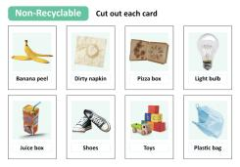
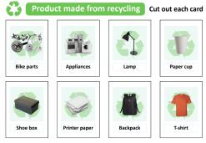
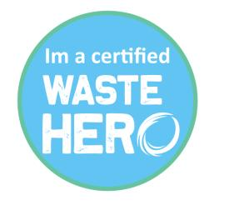
Next Steps
1
Divide students into groups and give each group a deck of cards with pictures of recyclable/non-recyclable items and pictures of products that can be made from recyclables. Tell students they will work as a team to match each product card with a recyclable card showing what it could be turned into through recycling.
3
At the end of the week let the students know they are officially a certified “Waste Heros” now and can teach their family how to recycle at home.
2
Tell students to get a piece of paper and write down a recyclable material (PET plastic bottle) and have them draw a product they want to make from the recyclable item. Have them share with the class. Design the layout like the slides presented.

