Slide 1
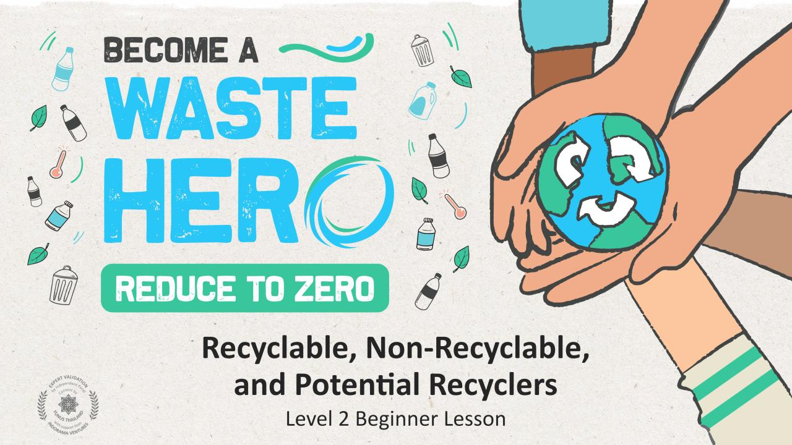
s

Slide 2
Lesson Prep & Curriculum Alignment
Prep time: 10 – 15 minutes
Students will learn about the recycling process and how improperly recycled items can cause problems or contaminate other recyclables. They will work in small groups, practicing collaborative and critical thinking skills, to sort cards with pictures of common items into recyclables, non-recyclables, and potential recyclables, then decide how some of the potential recyclables can be made fully recyclable.
1
Print or display as many as needed of the following materials:
Deck of Cards, one deck per student group
The handouts (“YES/NO”, “Can it be recycled?”)
2
Use the presentation slides for this lesson to guide a class discussion about what can and cannot be recycled and also the steps to prepare an item to be recycled.

Slide 3
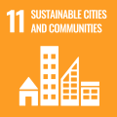
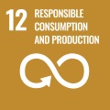
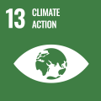
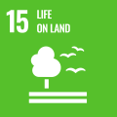
Lesson Prep & Curriculum Alignment
Prep time: 10 – 15 minutes
Key Learning Outcomes and Curriculum Alignment:
Science - Earth and Human Activity: Communicate solutions that will reduce the impact of humans on the land, water, air, and/or other living things in the local environment. Things that people do can affect the world around them. But they can make choices that reduce their impacts on the land, water, air, and other living things.
Social Studies - People, Places, and Environments: Students study people, places, and environments which enables them to understand the relationship between human populations and the physical world.
English Language Arts and Literacy: Able to ask and answer questions about details in a literature text. Participate in collaborative conversations with diverse partners about topics and texts. Follow agreed-upon rules for discussions. Use words and phrases acquired through conversations, reading and being read to, and responding to texts.
SDG Alignment
Flexible and adaptive lesson
Lesson plans are designed to be flexible and responsive to the evolving needs of your classroom. Lessons are editable and customizable to meet the different individual student and classroom contexts. A PowerPoint version with teacher instructions and a printable PDF lesson are available for download.

Slide 4
The Lesson
Lesson duration: 45 - 60 minutes
1
Introduce the lesson with the slideshow and a brief discussion on what students already know about recycling.
What is recycling?
Why do we recycle?
What kinds of things do you think can be recycled?
Are there things that cannot be recycled?
What things shouldn’t be put in the recycling bin?
What are the “1-2-3’s” of recycling?
Display or ask the students to get out their YES/NO handout.
Display slides and ask why the recycling bins are bad or good? Allow them to identify reasons for each picture based on their YES/NO handout.
Discuss how some items can be recycled but because they are dirty, they cannot (contamination makes other recyclables dirty and unable to be recycled). Review examples and the 1,2,3 steps to recycling correctly.
Show Recycling Bin / Non-Recycling Bin slides and ask why is one bad and one good? Allow them to look and identify reasons for each picture based on their YES/NO handout.

Slide 5
The Lesson
Lesson duration: 45 - 60 minutes
2
Explain to students that sometimes it is difficult to figure out if an item is recyclable or not. Tell them they will need to be a “Waste Hero” and divide them into groups and sort a deck of cards showing three kinds of items: recyclables, non-recyclables, and items that are potentially recyclable – that is, we need to do something to each one of those items to recycle it correctly.
Recycling Tips: Discuss these commonly seen potentially recyclable items and tips for recycling them correctly.
Items made of a single recyclable material may need an extra step to recycle them correctly. Can you think of anything this applies to?
Here are some examples:
We all know that cardboard is recyclable. But with things like a used pizza box, we can only recycle the part that is clean. We need to throw away any part that is greasy or has food residue because it can contaminate a whole load of recyclables.
That goes for plastic containers too, like bottles and jugs, we need to rinse them out so there is no food or liquid left inside, and then let them dry.
And if we have the cap, we should put it back on after it is rinsed and dried, before putting the bottle or jug in our recycling container. Remind students that we always want to recycle as much as we can, but we do not want to let things be recycled that can contaminate other recyclables or cause problems at the recycling center.
Here is another tip: Items that are smaller than an ID card or credit card can get jammed in recycling machinery, so things like loose, small plastic caps and lids should be put in the trash, if they are not screwed on the original bottle or jug.
4
Give them 5min to search the class for plastic bottles to put into the new bin.

Slide 6
The Lesson
Lesson duration: 45 - 60 minutes
3
Give each group a worksheet and a shuffled deck of cards containing intermingled pictures of recyclable, non-recyclable, and potentially recyclable items.
4
Tell the groups that their task is to sort their deck of cards into three piles: recyclable items, non-recyclable items, and five items that are potentially recyclable. Once they have finished sorting, each group should work together to complete the worksheet by listing the five items they identified as potentially recyclable and, for each one, writing a brief explanation of what needs to be done to make it recyclable.
5
Have each group present one potential recyclable item and what must be done for it to be recyclable. Discuss any items that were incorrectly identified as potential recyclables and any that were overlooked.

Slide 7
Prepare the PowerPoint presentation
When you are ready to present the lessons to your class click on Slide Show on the top menu bar then select Presenter View. In Presenter view, you can see your notes as you present while the audience see only your slides.
The notes appear in a pane on the right. The text should wrap automatically, and a vertical scroll bar appears if necessary. You can also change the size of the text in the Notes pane by using the two buttons at the lower left corner of the Notes pane.

Slide 8
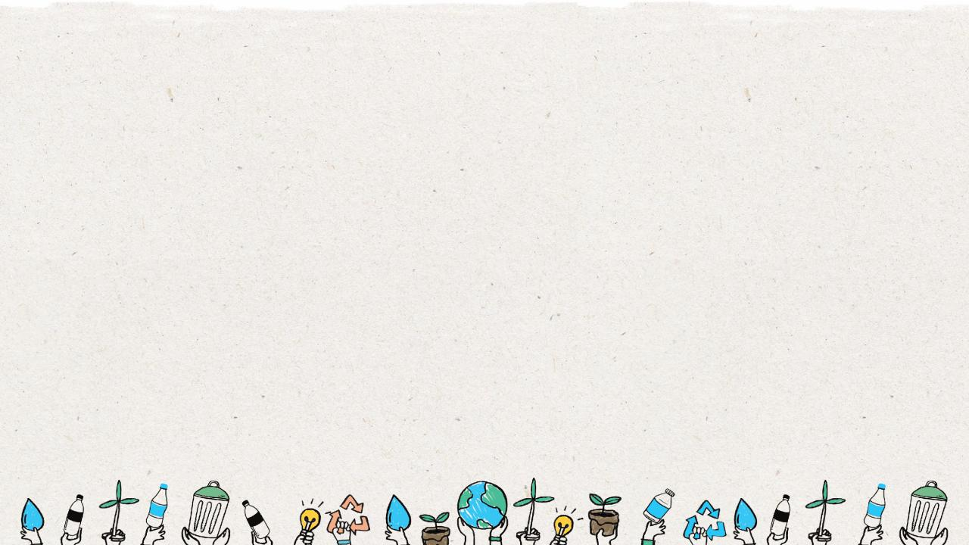
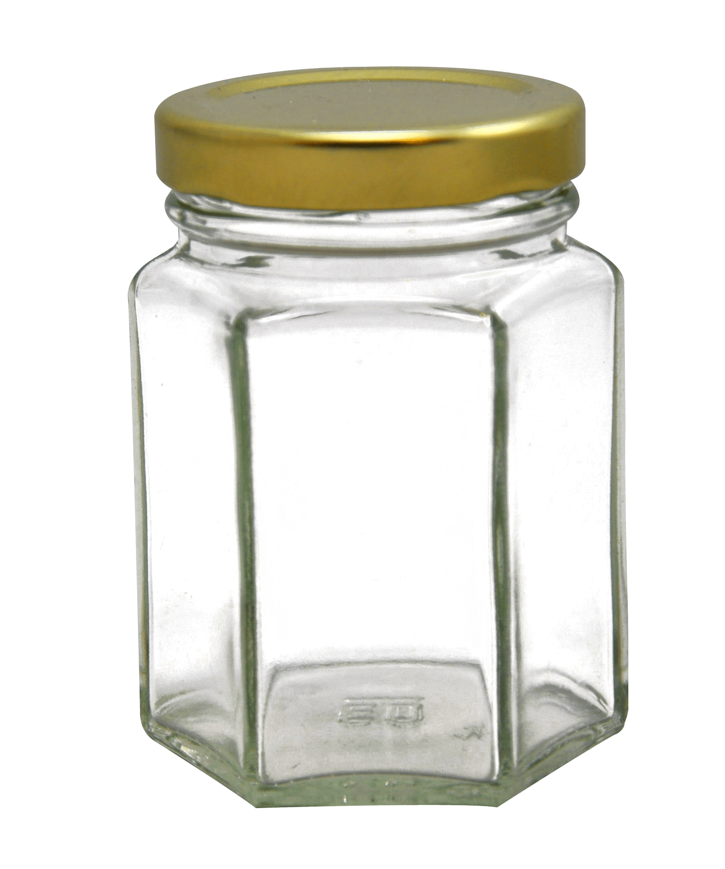
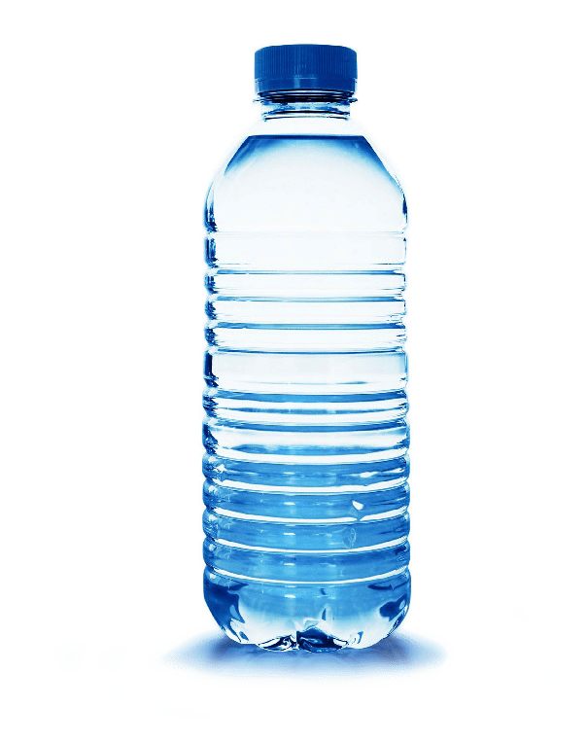
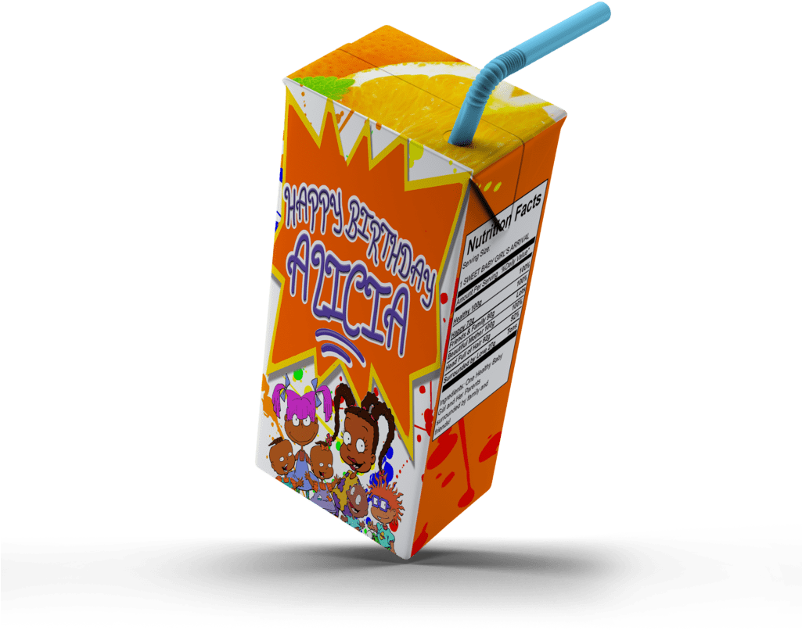
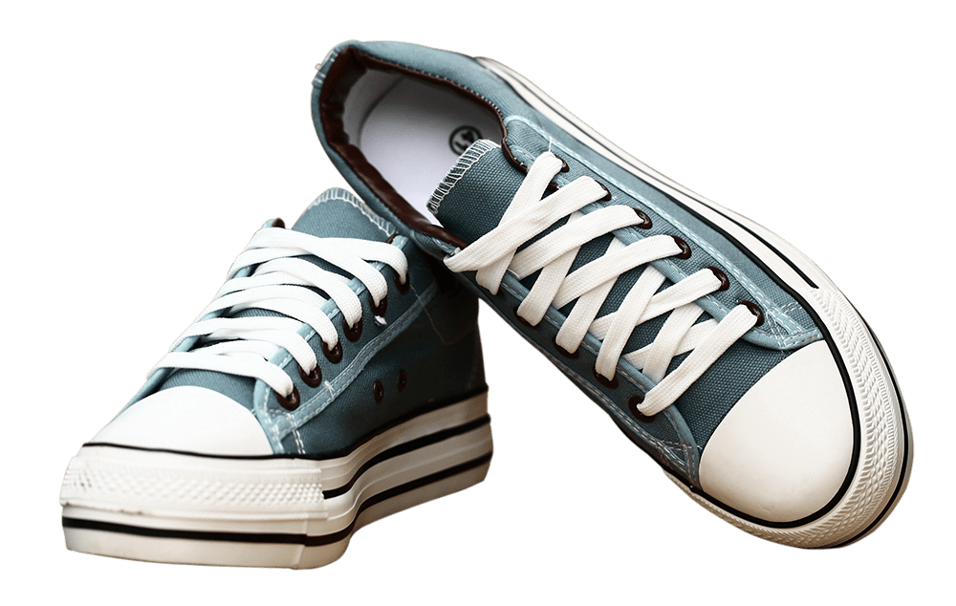
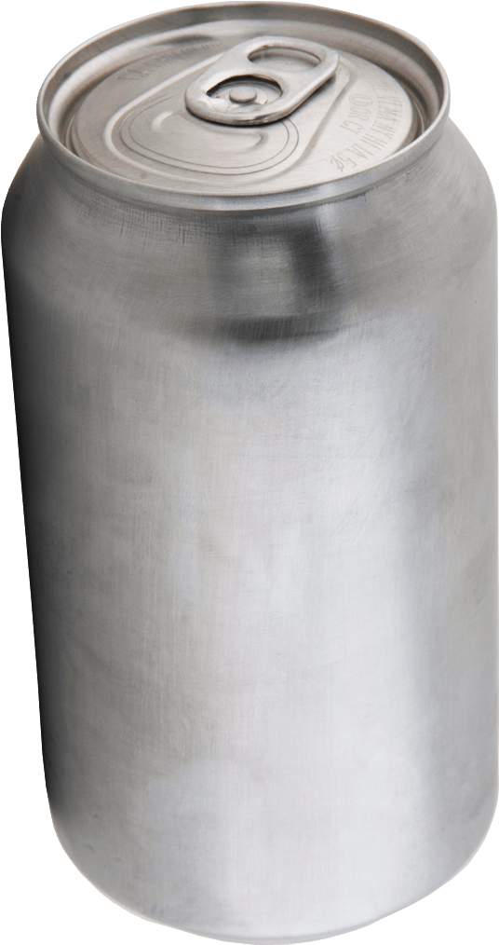
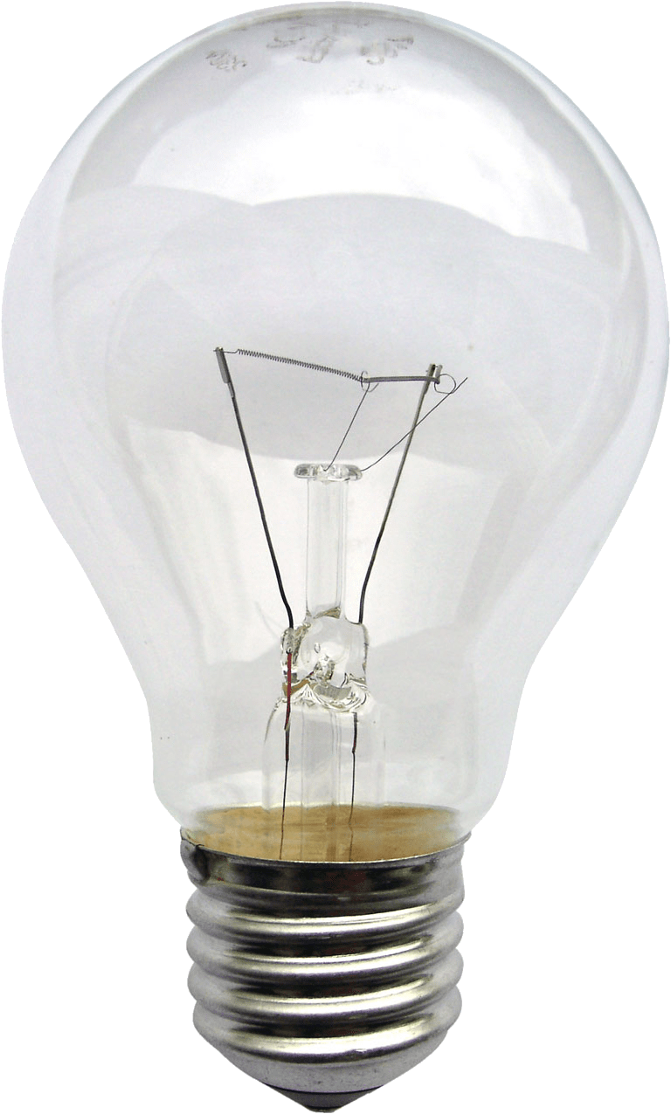
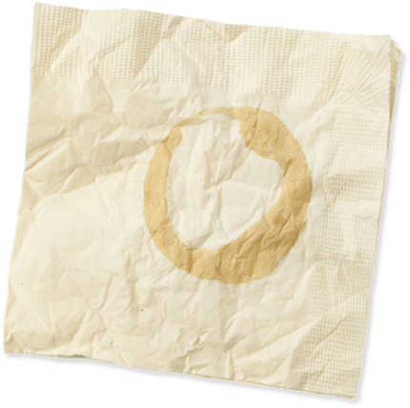
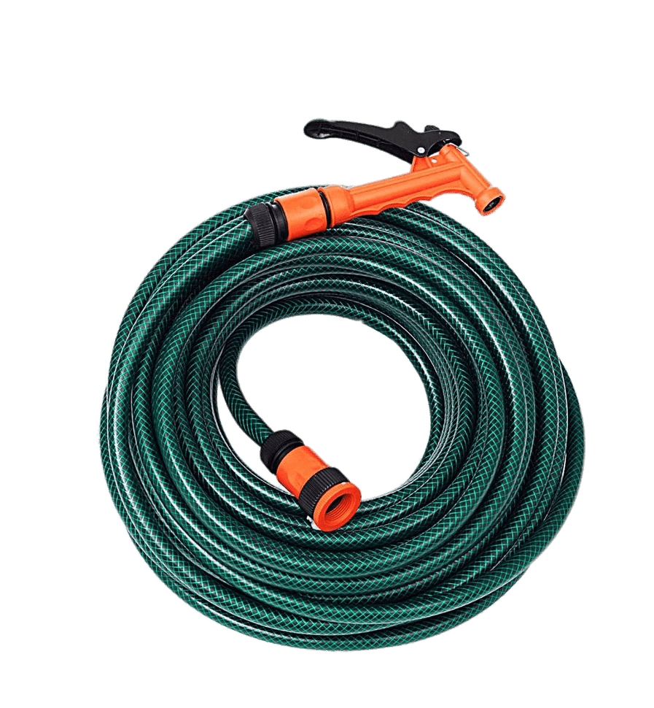
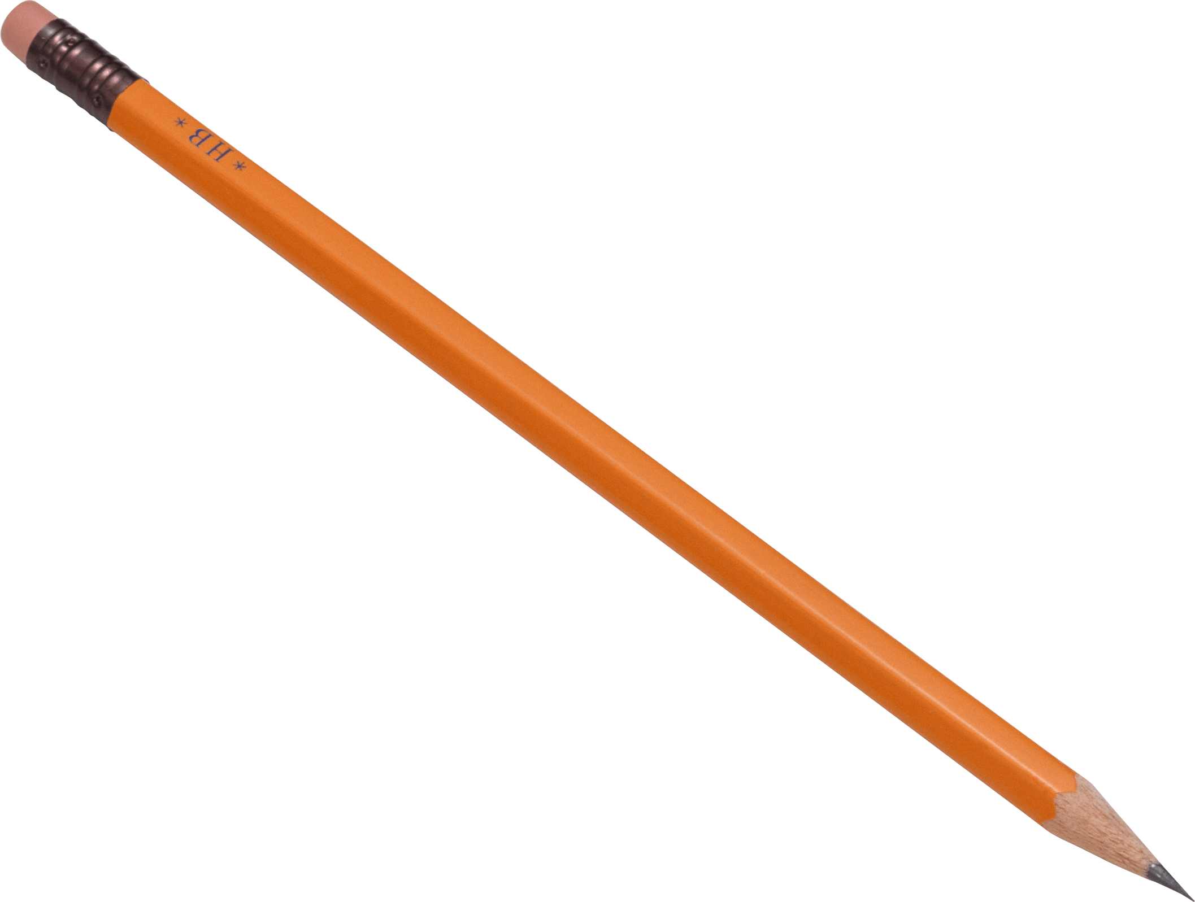
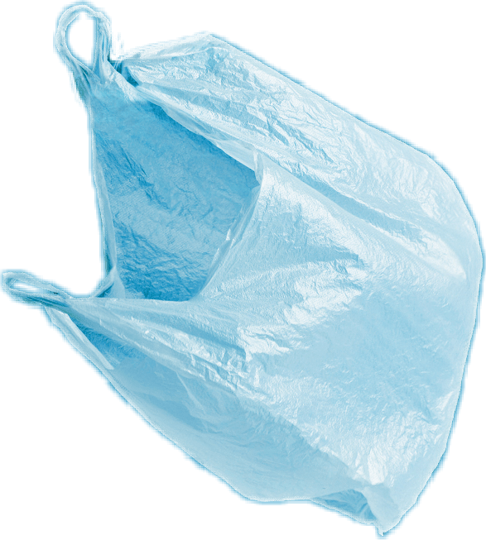
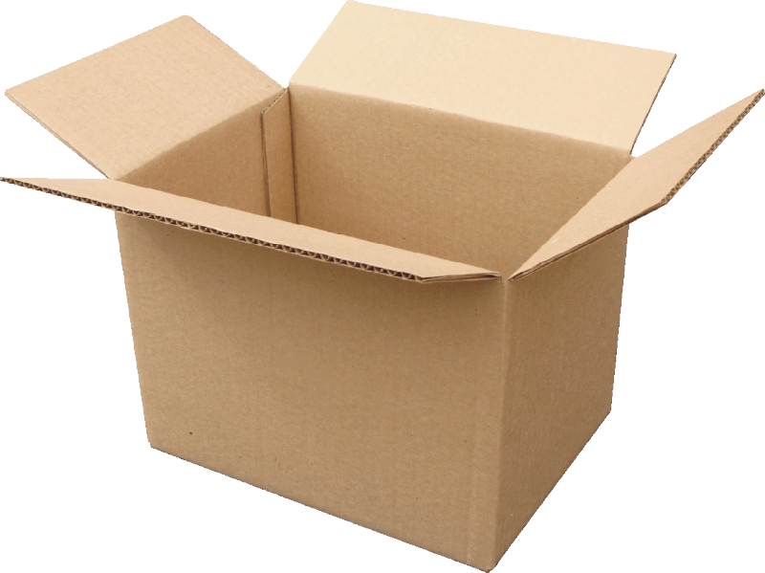
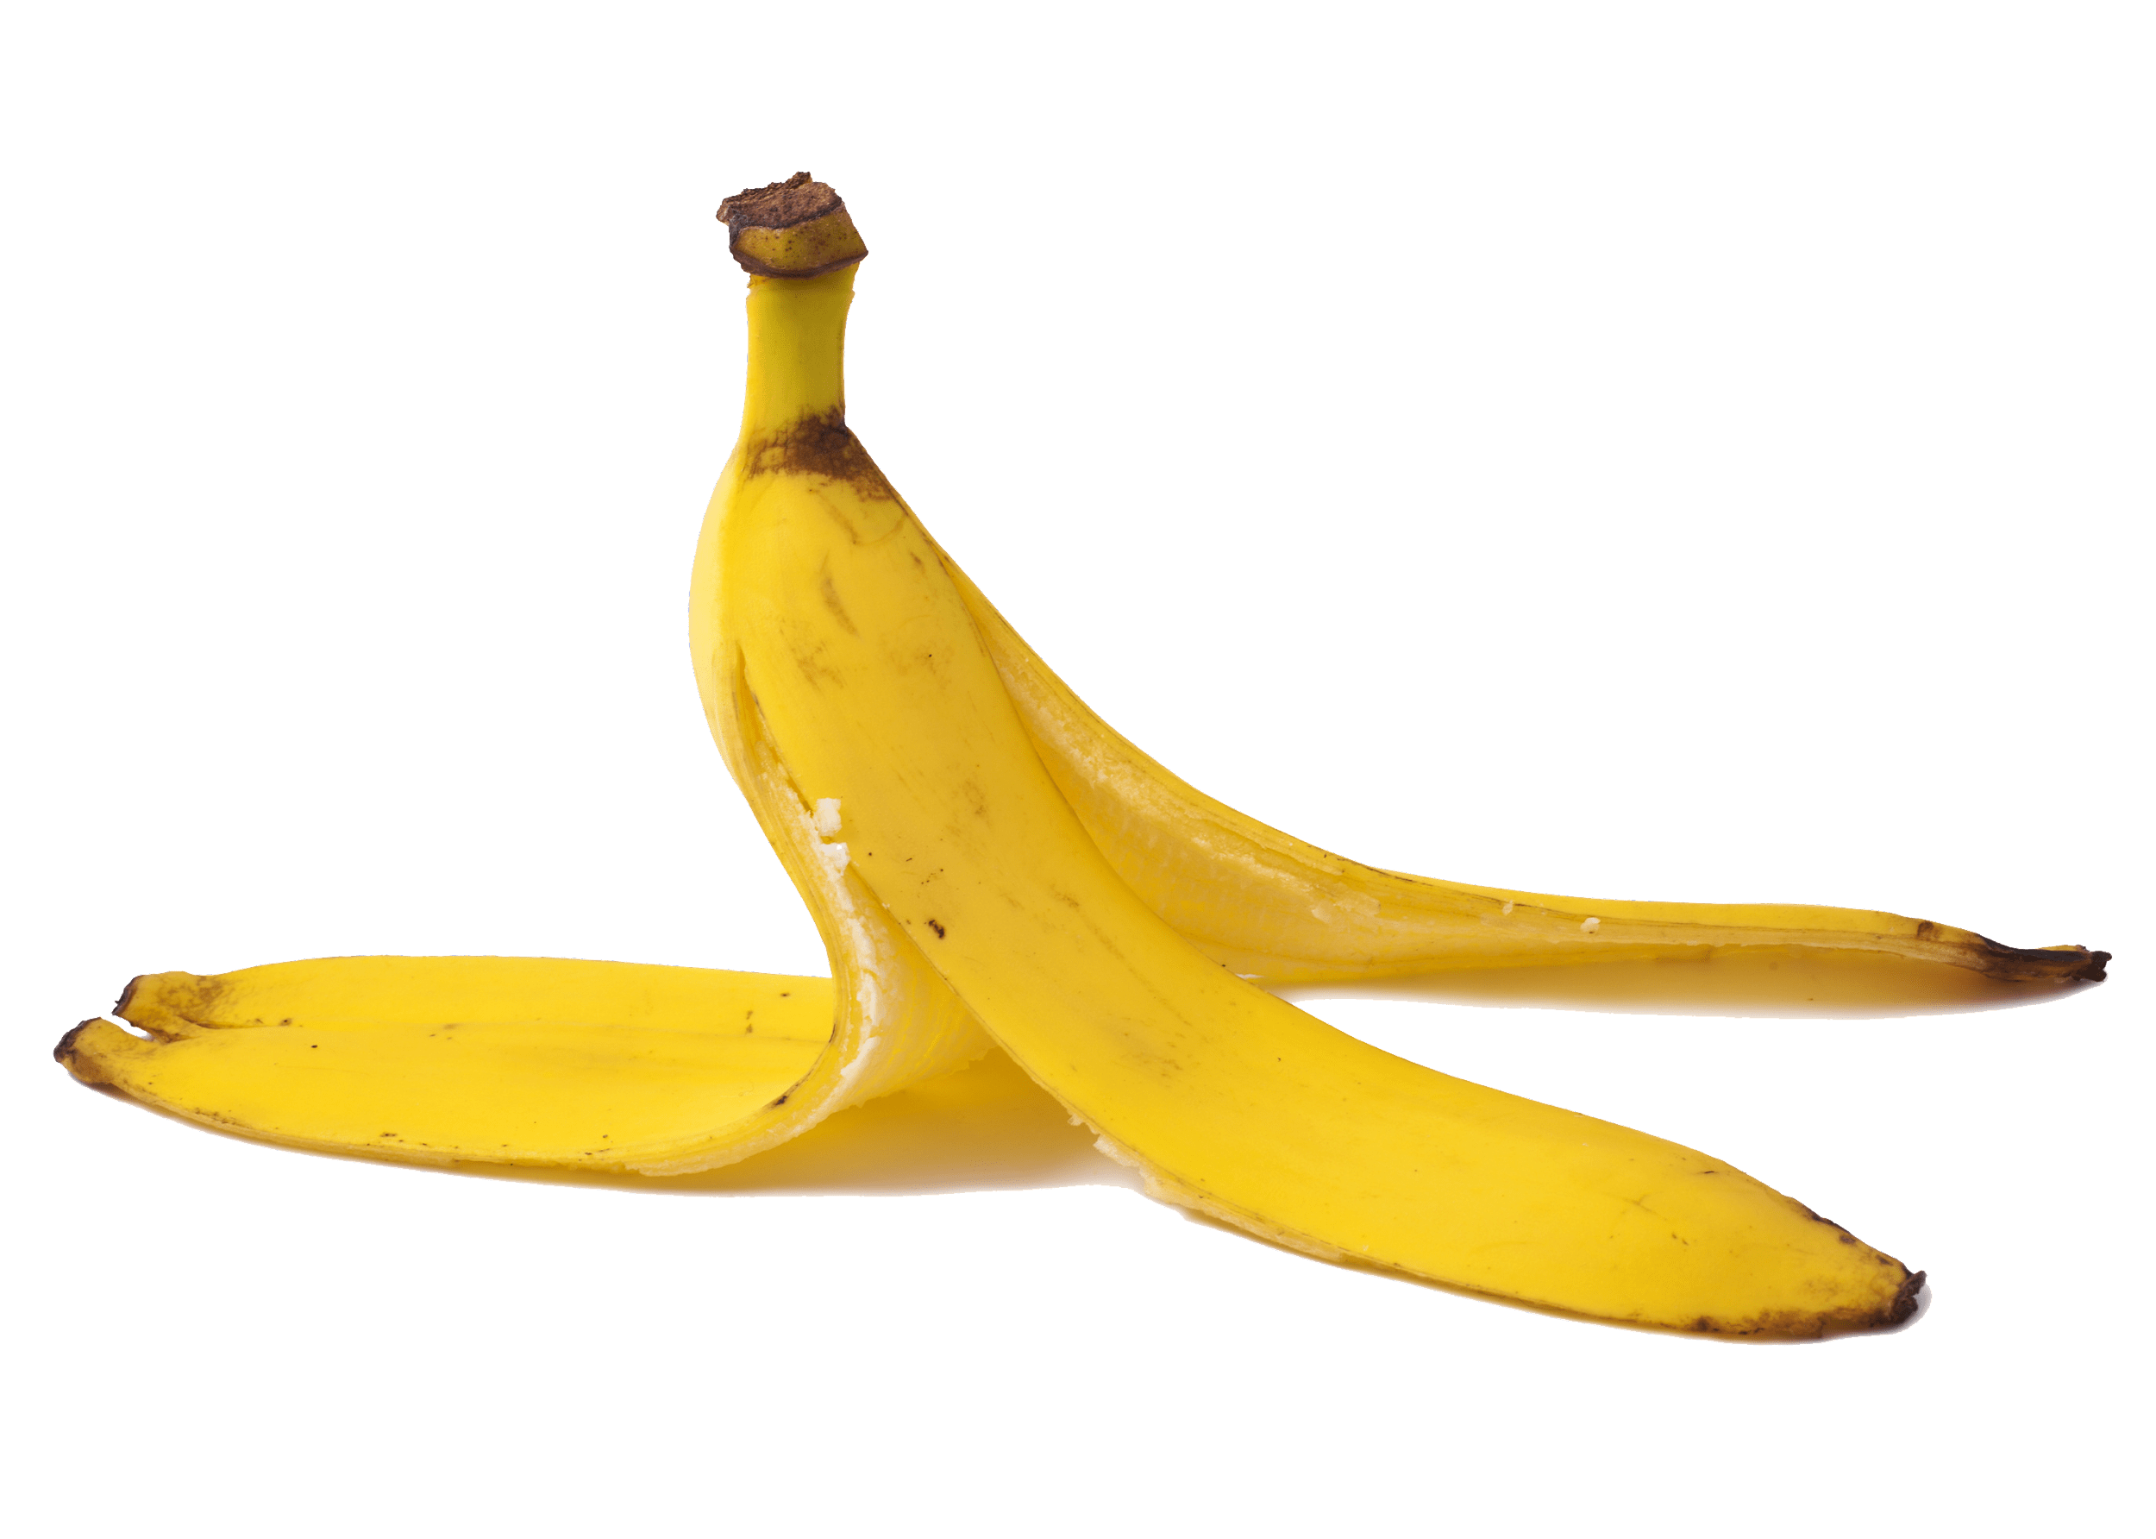
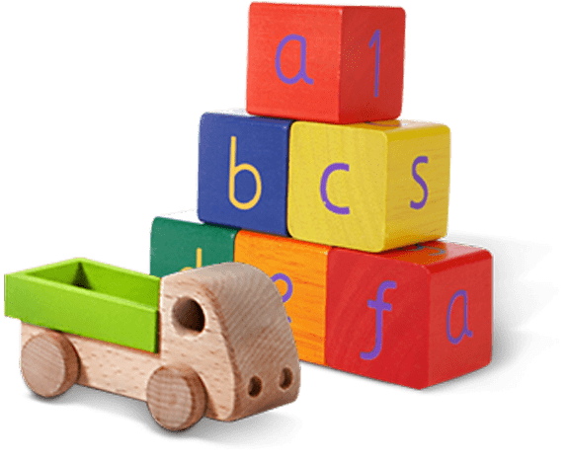
Glass jar
PET Plastic bottle
Shoes
Metal can
Light bulb
Juice box
Dirty napkin
Plastic bag
Toys
Pencil
Banana peel
Cardboard box
Garden hose
YES
NO
Notes:
(Slide duration: 3-5 minutes)
Pre-lesson Icebreaker Exercise
Ask students:
Has anyone heard of recycling? If yes, please share with the class what they know.
Tell students:
Recycling is the process of collecting and processing materials that would otherwise be thrown away as trash and turning them into new products. Recycling can benefit your community and the environment.
Now read off the images left to right starting on the top row to test their knowledge about what items displayed can and cannot be recycled.
Order of images that will appear with each click.
Click 1: Glass jar
Click 2: PET Plastic Bottle
Click 3: Shoes
Click 4: Metal can
Click 5: Light bulb
Click 6: Juice box
Click 7: Dirty napkin
Click 8: Pencil
Click 9: Plastic bag
Click 10: Toys
Click 11: Cardboard box
Click 12: Garden hose
Click 13: Banana peel

Slide 9
YES
NO
Always recycle:
Never recycle:
Banana peel
Dirty napkin
Garden hose
Glass jar
PET Plastic bottle
Light bulb
Juice box
Shoes
Cardboard box
Metal can
Toys
Plastic bag
Pencil
Notes:
(Slide duration: 3-5 minutes)
Pass out or display this YES/NO slide – there is a printable pdf handout available for students
Open a discussion about where we put our garbage.
Ask Students: What do you do with waste at home? Where does it go? Does all waste belong in one bin?
Tell Students:
Not all waste goes into the same waste bin. Some items need to go into the recycling bin.
Ask Students:
The items on the left side of the page can be recycled, what are those items? What is the first picture you see?
*ask in this order (Glass jar, PET Plastic bottle, Cardboard box, Metal can)
Click 1: Glass Jar
What is it made from? Can it be recycled?
Answer: glass, yes
Click 2: PET Plastic bottle
What is it made from? Can it be recycled?
Answer: plastic, yes
Click 3: Cardboard box
What is it made from? Can it be recycled?
Answer: paper, yes
Click 4: Metal can
What is it made from? Can it be recycled?
Answer: metal, yes

Slide 10
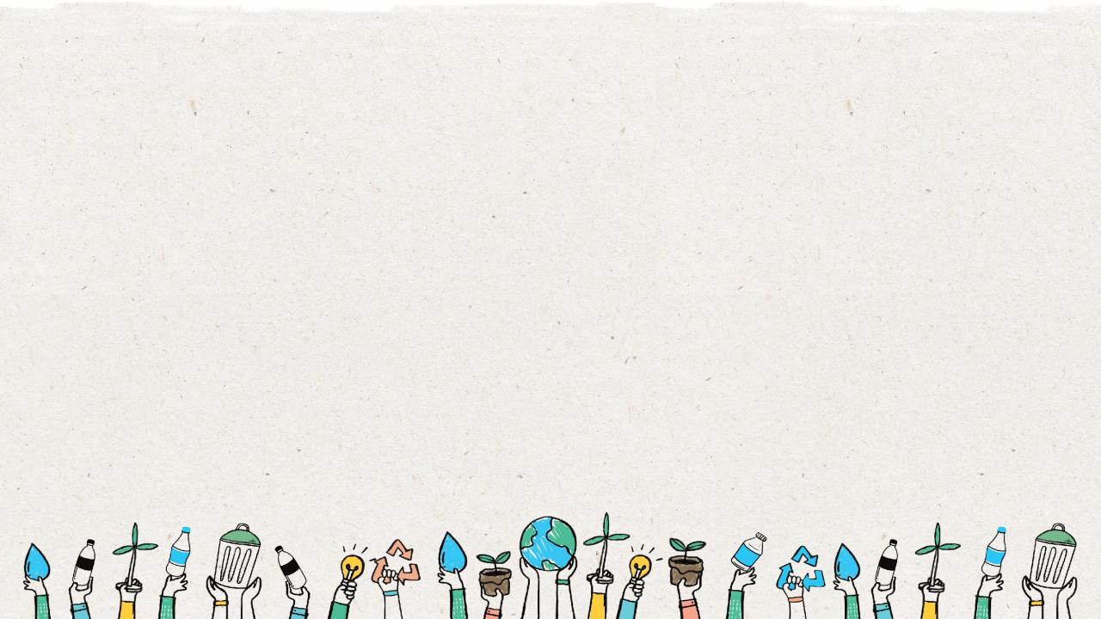
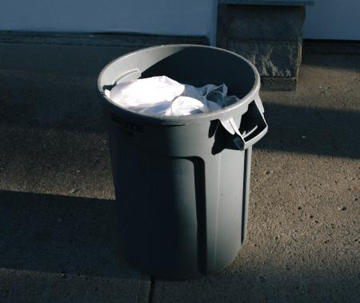
Recycling bin
Clean
Dry
No smell
No plastic bags
No non-recyclables
Notes:
(Slide duration: 2 minutes)
Ask students:
Why is this bin good?
*Allow them to look and identify reasons for each picture based on their YES/NO handout.
Teachers will need to click 6 times to reveal the image and the 5 answers.
Answers:
Clean
Dry
No smell
No plastic bags
No non-recyclables

Slide 11
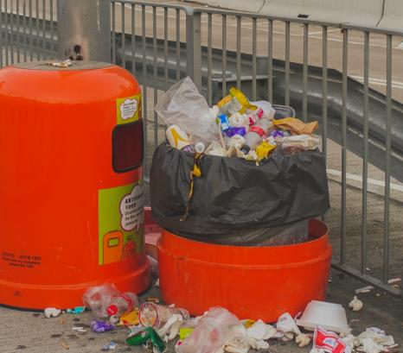
Non-recycling bin
Food
Dirty or wet paper and cardboard
Liquid in bottles
Dirty cups
Plastic bags
Notes:
(Slide duration: 2 minutes)
Ask students:
Why is this bin bad?
*Allow them to look and identify reasons for each picture based on their YES/NO handout.
Teachers will need to click 6 times to reveal the image and the 5 answers.
Answers:
Food
Dirty or wet paper and cardboard
Liquid in bottles
Dirty cups
Plastic bags

Slide 12
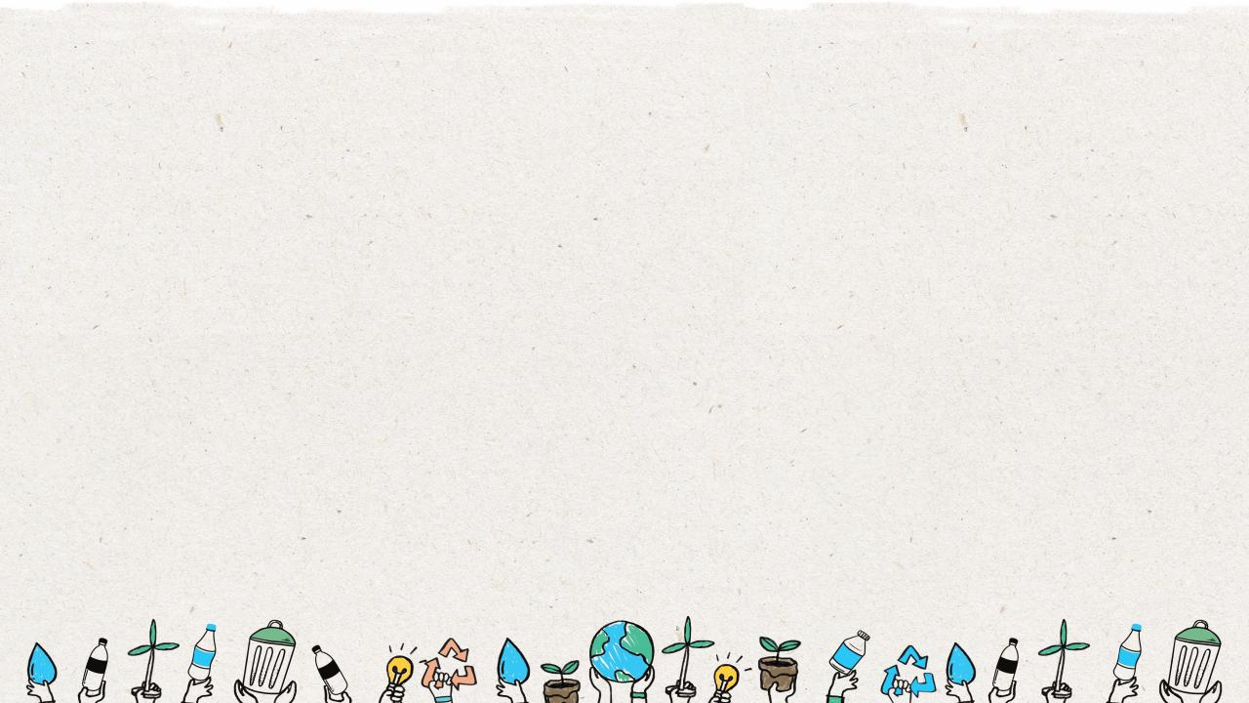
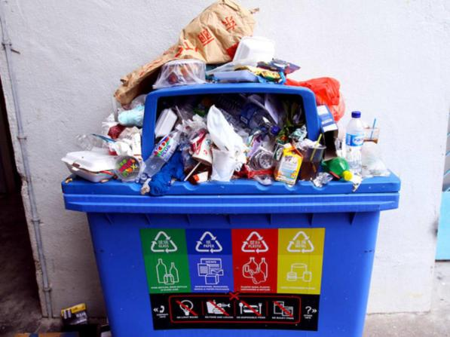
Recycling Contamination
Recycling contamination occurs when waste is sorted into the wrong recycling bin (placing a banana peel into a mixed paper recycling bin for example), or when PET plastic bottles are not properly emptied and cleaned leaving the whole bin wet.
Notes:
(Slide duration: 2 minutes)
Tell students:
Not all waste goes into the same bin. When wet or other dirty waste is placed into the recycling bin it makes all the other items dirty, and unable to be recycled. This makes for a Bad Bin.

Slide 13
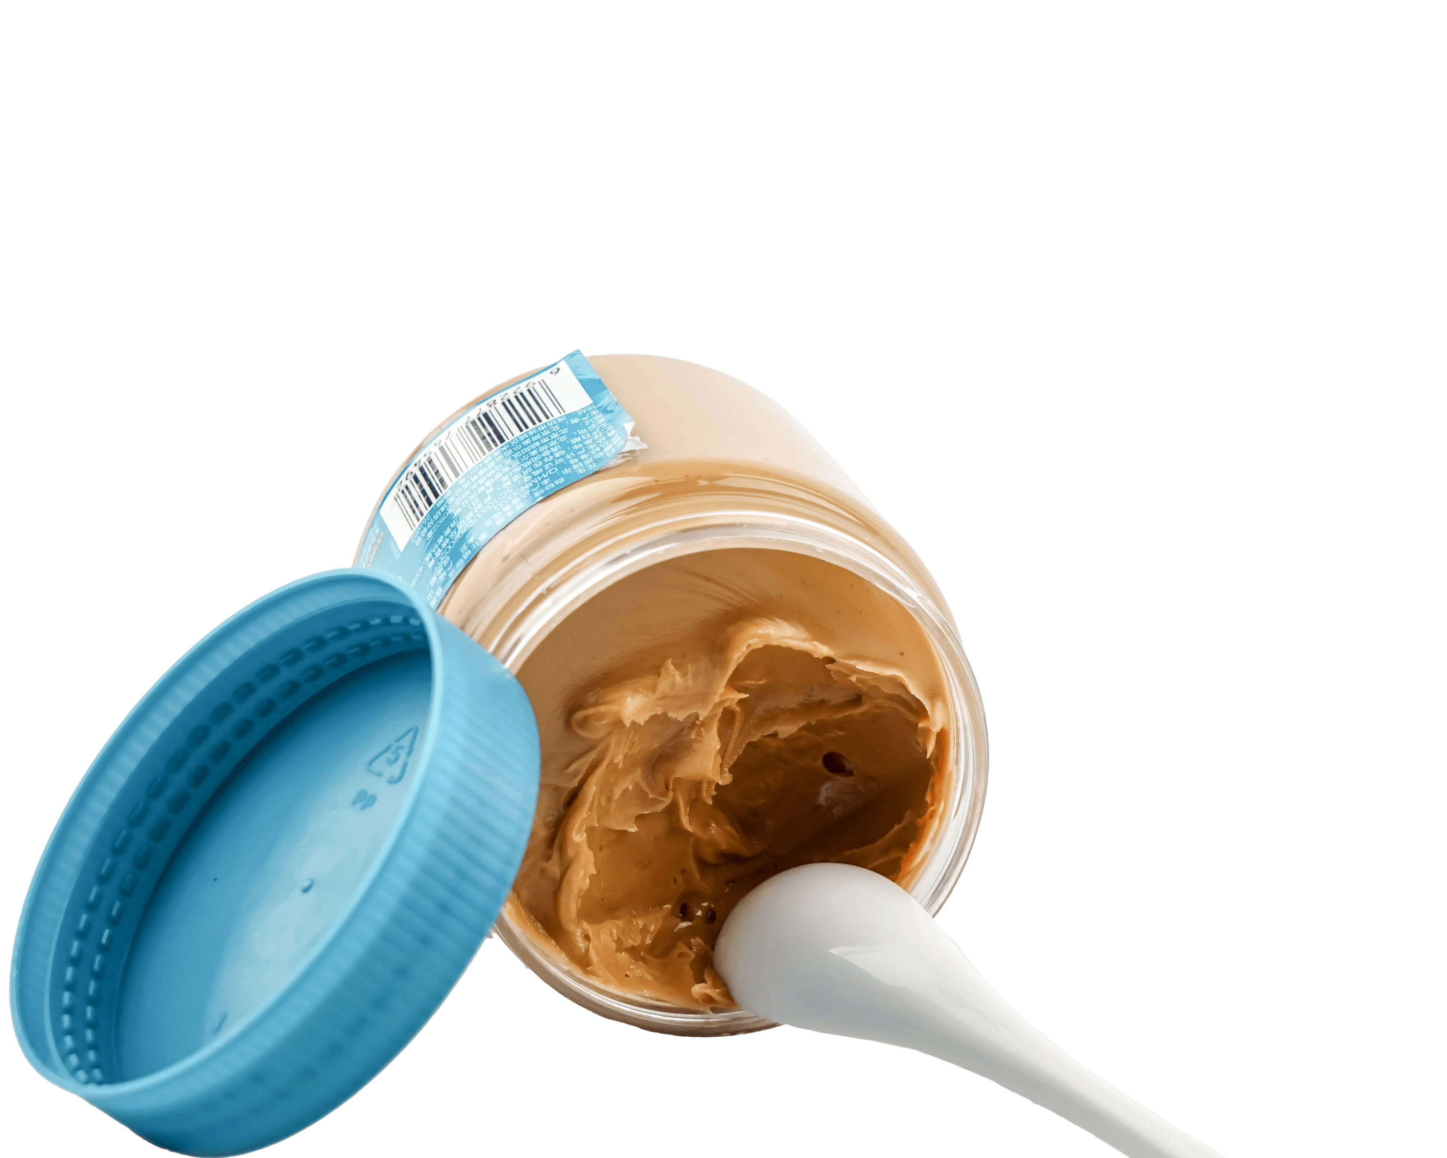
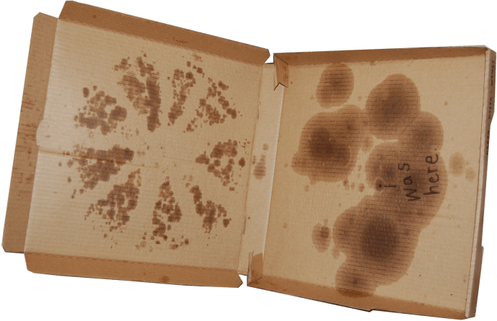
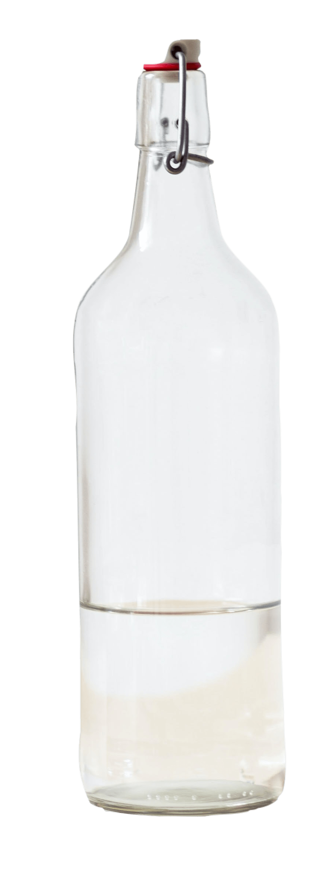
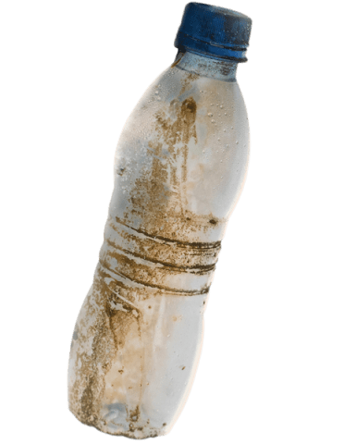
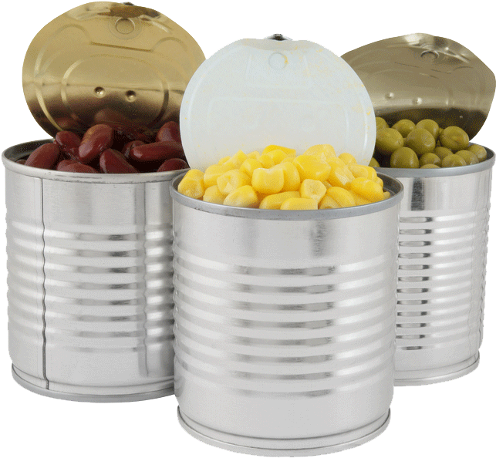
What can be recycled but sometimes is not? Why?
Greasy pizza boxes with
food still inside cannot be recycled.
Jars with food still inside cannot be recycled.
Dirty bottles
with grease, pesticides, or other chemicals
Solid food inside the tin can cannot be recycled.
Bottles with even a little liquid cannot be recycled.
Notes:
(Slide duration: 3-5 minutes)
After each click an image of an item that cannot be recycled appears. Typically, all these items can be recycled, but when they are contaminated or dirty they cannot be recycled. Each pictured includes a reason why it sometimes can not be recycled.
Click 1: Pizza box
Click 2: Glass jar
Click 3: PET Plastic bottle
Click 4: Metal can
Click 5: Glass bottle
Ask students:
What can be done to these items so they can be recycled?
Answers:
1. Clean the grease and the cheese off the pizza box then dry.
2. Remove all peanut butter from the jar, soak in water overnight to remove completely then dry.
3. Clean off all the dirt from the bottle then dry.
4. Make sure all food has been removed from the can.
5. Pour out any remaining liquid in the bottle.

Slide 14
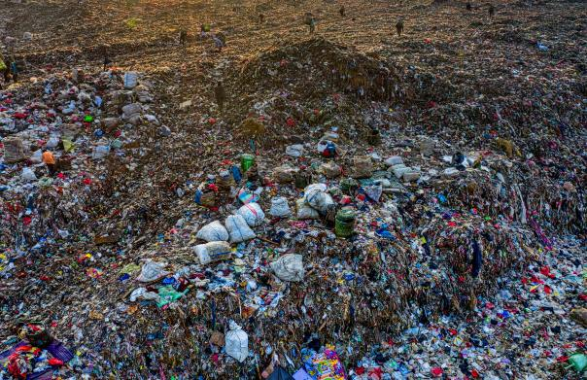
Landfill
When recyclables are contaminated, they end up as garbage that goes to a landfill.
Notes:
(Slide duration: 3 minutes)
Ask students:
What is a landfill?
Do recycling items belong here? Why?
What does belong here?
Answers:
A landfill is a site where people dump their general waste materials into the ground or into a giant pile.
No, recycling does not belong here. It is only items that cannot be recycled which need to be put into the landfill.

Slide 15
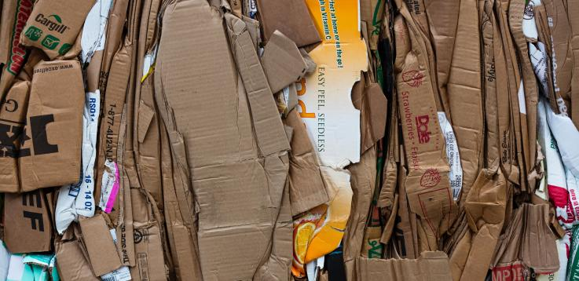
How long does it take a cardboard box to disappear in a landfill?
3 Months
Notes:
(Slide duration: 3 minutes)
Ask students:
Do you know how long it takes a cardboard box to disappear in a landfill?
*Click to activate the animation after asking the question
Answer: 3 Months
Ask students:
Can we recycle cardboard?
Answers:
Yes, cardboard is fully recyclable.

Slide 16
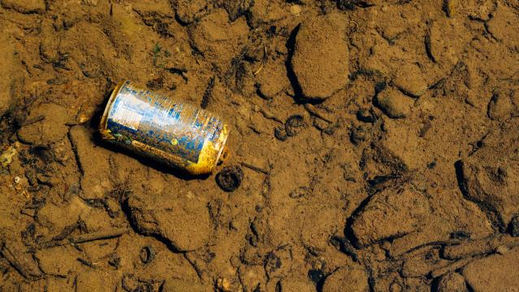
How long does it take a metal can to disappear in a landfill?
150 years
Notes:
(Slide duration: 3 minutes)
Ask students:
Do you know how long it takes a metal can to disappear in a landfill?
*Click to activate the animation after asking the question
Answer: 150 years
Ask students:
Can we recycle metal cans?
Answers:
Yes, metal cans are metal and are fully recyclable.

Slide 17
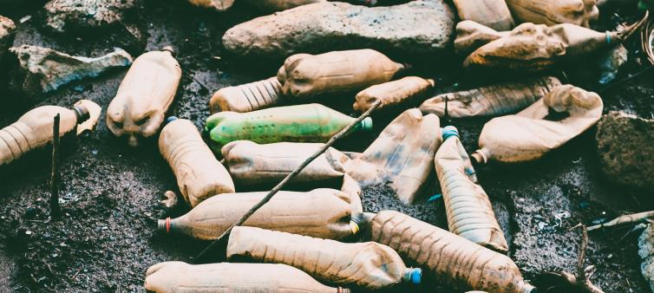
How long does it take a PET plastic bottle to disappear in a landfill?
450 years
Notes:
(Slide duration: 3 minutes)
Ask students:
Do you know how long it takes a PET plastic bottle to disappear in a landfill?
*Click to activate the animation after asking the question
Answer: 450 years
Ask students:
Can we recycle PET plastic bottles?
Answers:
Yes, PET plastic bottles are fully recyclable.

Slide 18
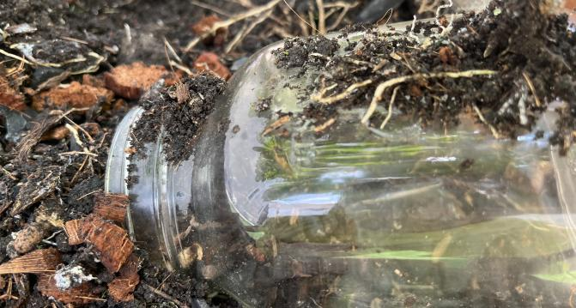
How long does it take a glass jar to disappear in a landfill?
4,000 years
Notes:
(Slide duration: 3 minutes)
Ask students:
Do you know how long it takes a glass jar to disappear?
*Click to activate the animation after asking the question
Answer: 4,000 years
Ask students:
Can we recycle glass jars?
Answers:
Yes, glass jars are fully recyclable.

Slide 19
The
3
Steps to
Recycling

Slide 20
Step
1
Know what you can recycle.
Glass Jar
PET Plastic bottle
Cardboard box
Metal can
Notes:
(Slide duration: 3-5 minutes)
Have the students guess the four main items we can recycle.
Click 1: Glass Jar
Click 2: PET Plastic bottle
Click 3: Cardboard box
Click 4: Metal can
Ask students:
Can you give me an example of something we can recycle?
What is something we should never recycle? Food waste, when it is mixed in with our recyclables.
Fun Fact:
PET plastic bottles are the most recycled plastic in the world and is fully recyclable.
Expansion Questions:
Have you ever seen the #1 on the bottom of a water bottle? If you see it, you can fully recycle it!
Can you give another example of something we can recycle?

Slide 21
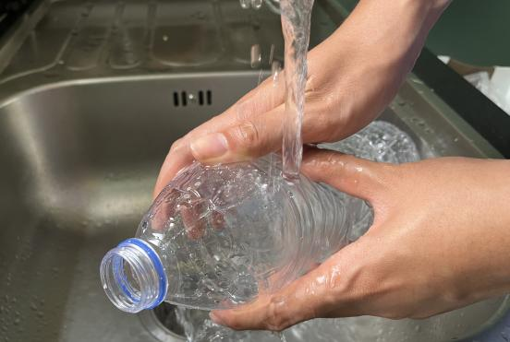
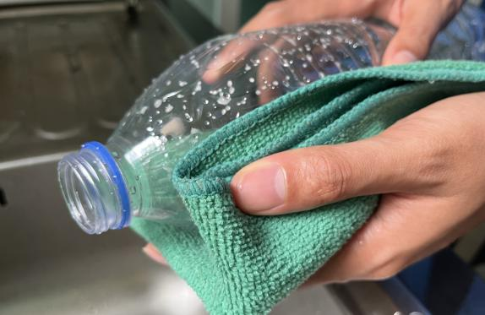
Step
2
Empty, clean, and dry before putting in the bin.
Notes:
(Slide duration: 3-5 minutes)
Ask Students:
1. Why is it important to clean our items for recycling?
2. What if there is a little bit of food or liquid on or in it?
You might suggest:
Dirty items cannot be recycled.
Wet and dirty items can get other clean items dirty, getting the whole bin dirty.

Slide 22
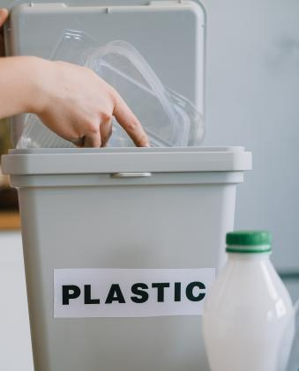
Step
3
Put recyclables into the correct recycling bin.
Notes:
(Slide duration: 3-5 minutes)
Recycling needs to be separated into the proper recycling bins. Click to reveal the recycling symbol. Let them know that this symbol indicates where to put your recycling.
Ask students:
Where have you seen this green symbol before?
What does this symbol mean?
Where do we put those PET plastic bottles?

Slide 23
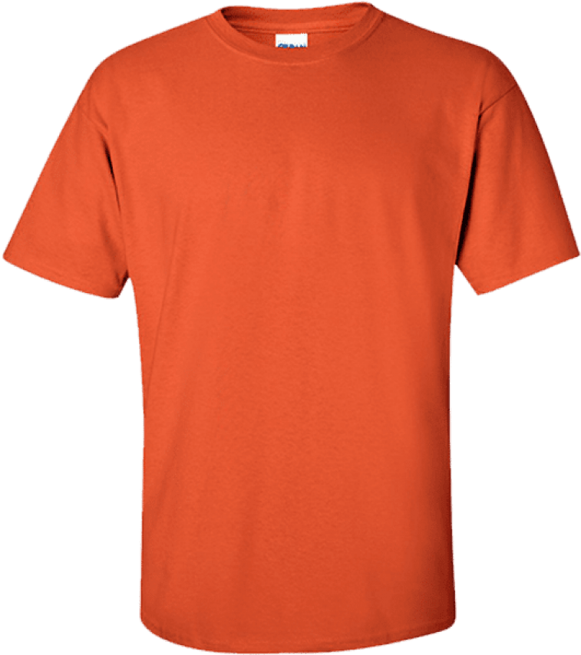
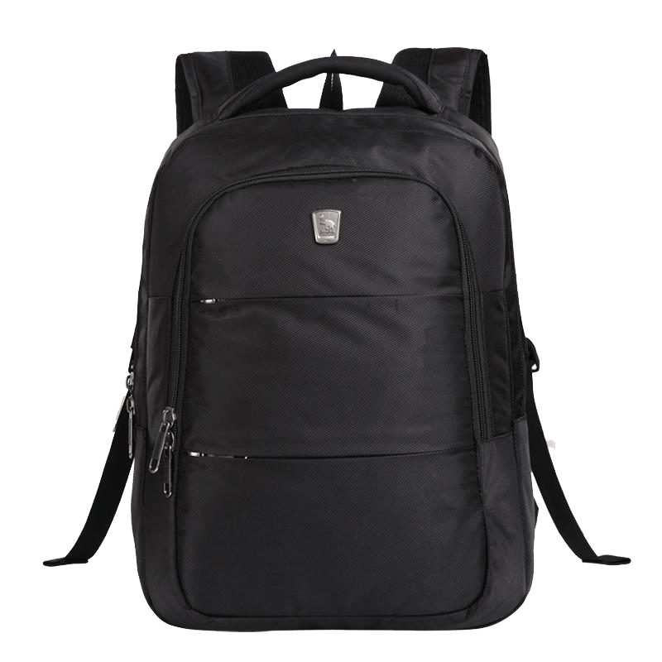
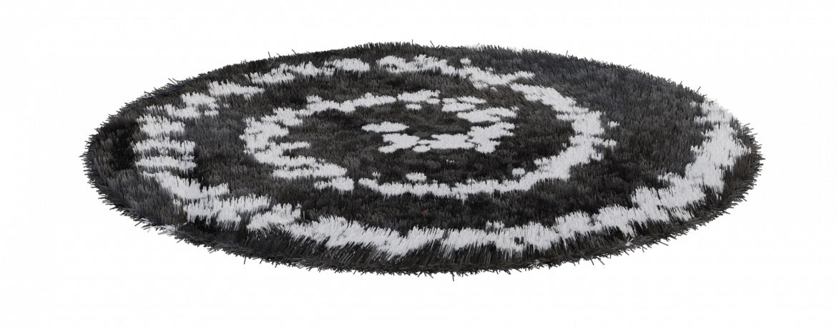
When we clean, dry, and recycle we can make new things.
Notes:
(Slide duration: 2-4 minutes)
Tell students:
When we follow the 3 steps of recycling we can recycle our waste into brand new things.
Example:
Click 1:
PET plastic bottles can be recycled back into new PET plastic bottles.
Click 2:
PET plastic bottles can also be made into thread that can make fabrics and textiles.

Slide 24
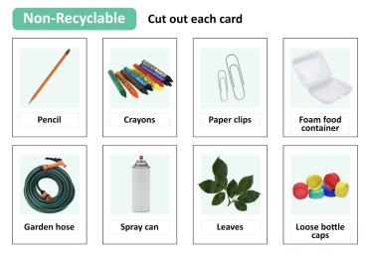
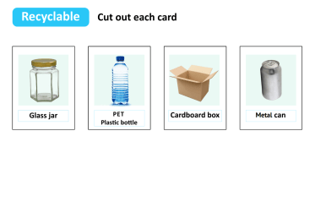
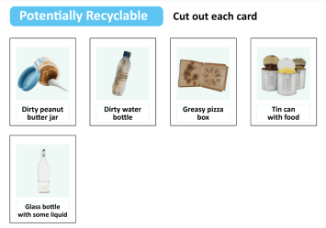
Next Steps
1
Explain to students that sometimes it is difficult to figure out if an item is recyclable or not. Tell them they will need to be a “Waste Hero” and divide them into groups and sort a deck of cards showing three kinds of items: recyclables, non-recyclables, and items that are potentially recyclable – that is, we need to do something to each one of those items to recycle it correctly.
Print out the following and have the students cut out each card for the activity. Give each group a worksheet and a shuffled deck of cards containing intermingled pictures of recyclable, non-recyclable, and potentially recyclable items.
Notes:
Recycling Tips: Discuss these commonly seen potentially recyclable items and tips for recycling them correctly.
Items made of a single recyclable material may need an extra step to recycle them correctly. Can you think of anything this applies to?
Here are some examples:
We all know that cardboard is recyclable. But with things like a used pizza box, we can only recycle the part that’s clean. We need to throw away any part that is greasy or has food residue because it can contaminate a whole load of recyclables.
That goes for plastic containers too, like bottles and jugs. We need to rinse them out so there is no food or liquid left inside, and then let them dry.
And if we have the cap, we should put it back on after it is rinsed and dried, before putting the bottle or jug in our recycling container. Remind students that we always want to recycle as much as we can, but we do not want to let things be recycled that can contaminate other recyclables or cause problems at the recycling center.

Slide 25
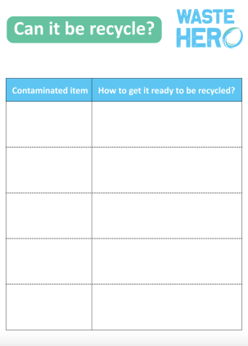
Next Steps
2
Tell the groups that their task is to sort their deck of cards into three piles: recyclable items, non-recyclable items, and five items that are potentially recyclable. Once they have finished sorting, each group should work together to complete the worksheet by listing the five items they identified as potentially recyclable and, for each one, write a brief explanation of what needs to be done to make it recyclable.
3
Have each group present one potentially recyclable item and what must be done for it to be recyclable. Discuss any items that were incorrectly identified as potential recyclables and any that were overlooked.
4
Notes:
Review the cards in each group’s recycling box.
If any items were incorrectly identified explain why or ask if any students know why and have them explain. It may also be easier to write the correct answers on the board and have the groups check themselves.
Confirm that students understand why an item is recyclable, non-recyclable, and potentially recyclable. Use the original pages provided as an answer key to identify where which item go.
When groups are done sorting their cards, they will list the 5 contaminated items on the worksheet with an explanation of how they can get the item ready for recycling.

