Slide 1
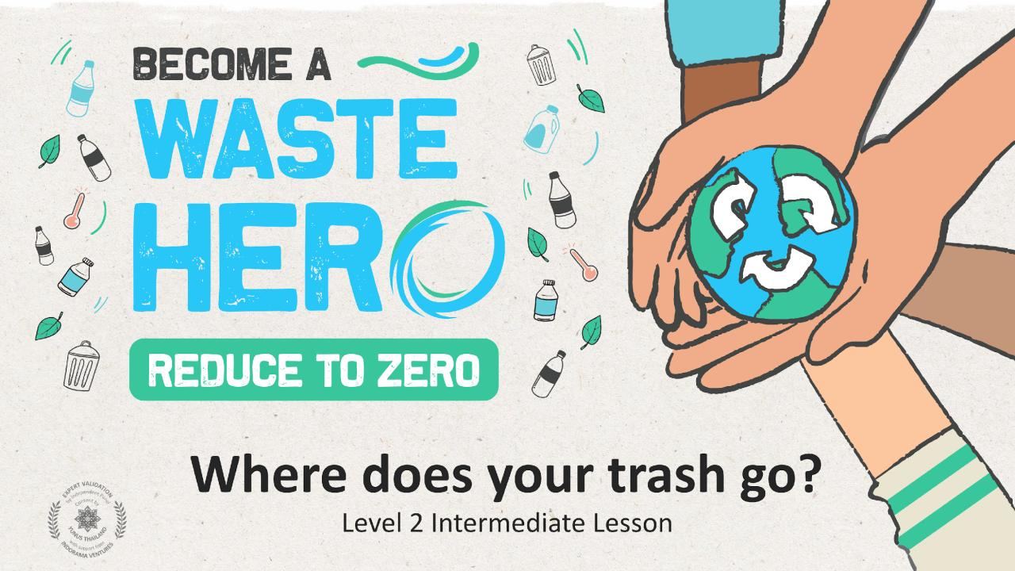
D
Y
T
G

Slide 2
Lesson Prep & Curriculum Alignment
Prep time: 10 – 15 minutes
Students will learn how to recycle and about the relationship between recycling and the environment. They will work in small groups to create a poster about why and how to recycle correctly. Students will present their posters and hang them in the classroom.
1
Print or display lesson slides for the class.
2
Print out the “YES/NO” handout as a reference guide for the lesson.
3
Gather all kinds of art supplies and posterboard (1 per group) but provide more if needed.

Slide 3
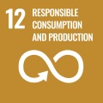
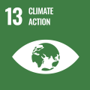
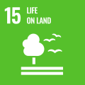
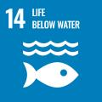
Lesson Prep & Curriculum Alignment
Prep time: 10 – 15 minutes
Key Learning Outcomes and Curriculum Alignment:
Science - Earth and Human Activity: Communicate solutions that will reduce the impact of humans on the land, water, air, and/or other living things in the local environment. Things that people do can affect the world around them. But they can make choices that reduce their impacts on the land, water, air, and other living things. Report on a topic or text with appropriate facts and relevant, descriptive details, speaking clearly at an understandable pace.
English Language Arts and Literacy: Participate in collaborative conversations with diverse partners about topics and texts. Follow agreed-upon rules for discussions. Use words and phrases acquired through conversations, reading and being read to, and responding to texts.
SDG Alignment

Slide 4
The Lesson
Lesson duration: 45 - 60 minutes
1
Introduce the lesson to your students by asking about their knowledge of recycling and if anyone recycles at home.
Display the “YES/NO” slide or print the handout.
Create an open discussion about the basics of recycling.
What exactly is recycling?
What can be recycled?
What can’t be recycled?
2
Move through the slides asking them:
Why is recycling important?
What happens to garbage?
What do you think about landfills?
What do you think about pollution in the oceans and seas?
How do you recycle?
3
Have students write one or two sentences about the most important thing they learned from the slides. Ask them to share what they wrote and why.

Slide 5
The Lesson
Lesson duration: 45 - 60 minutes
4
Next, ask students to count off from 1 to 4. Provide art supplies to each of the four groups.
Ask all the 1s to team up to create one or more posters about the 3 steps to recycling. (1. know what to throw 2. clean and dry 3. place in right bin)
Ask all the 2s to team up to create one or more posters about what we can and cannot recycle.
Ask all the 3s to team up to create one or more posters about how waste ends up in a landfill and our ocean. (recyclables do not belong in the landfill)
Ask all the 4s to team up to create one or more posters about why recycling is important to the environment. (keep out of the ocean)
5
Have the groups present their posters to the class and hang them in the classroom.
Flexible and adaptive lesson
Lesson plans are designed to be flexible and responsive to the evolving needs of your classroom. Lessons are editable and customizable to meet the different individual student and classroom contexts. A PowerPoint version with teacher instructions and a printable PDF lesson are available for download.
4
Give them 5min to search the class for plastic bottles to put into the new bin.

Slide 6
Prepare the PowerPoint presentation
When you are ready to present the lessons to your class click on Slide Show on the top menu bar then select Presenter View. In Presenter view, you can see your notes as you present while the audience see only your slides.
The notes appear in a pane on the right. The text should wrap automatically, and a vertical scroll bar appears if necessary. You can also change the size of the text in the Notes pane by using the two buttons at the lower left corner of the Notes pane.

Slide 7
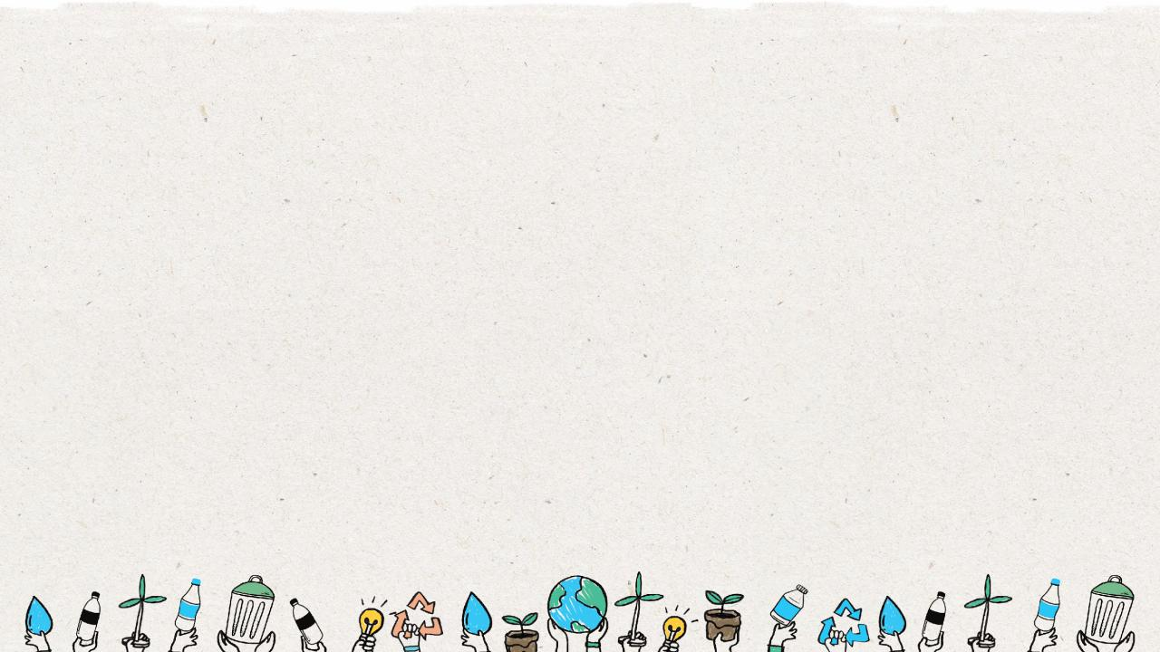
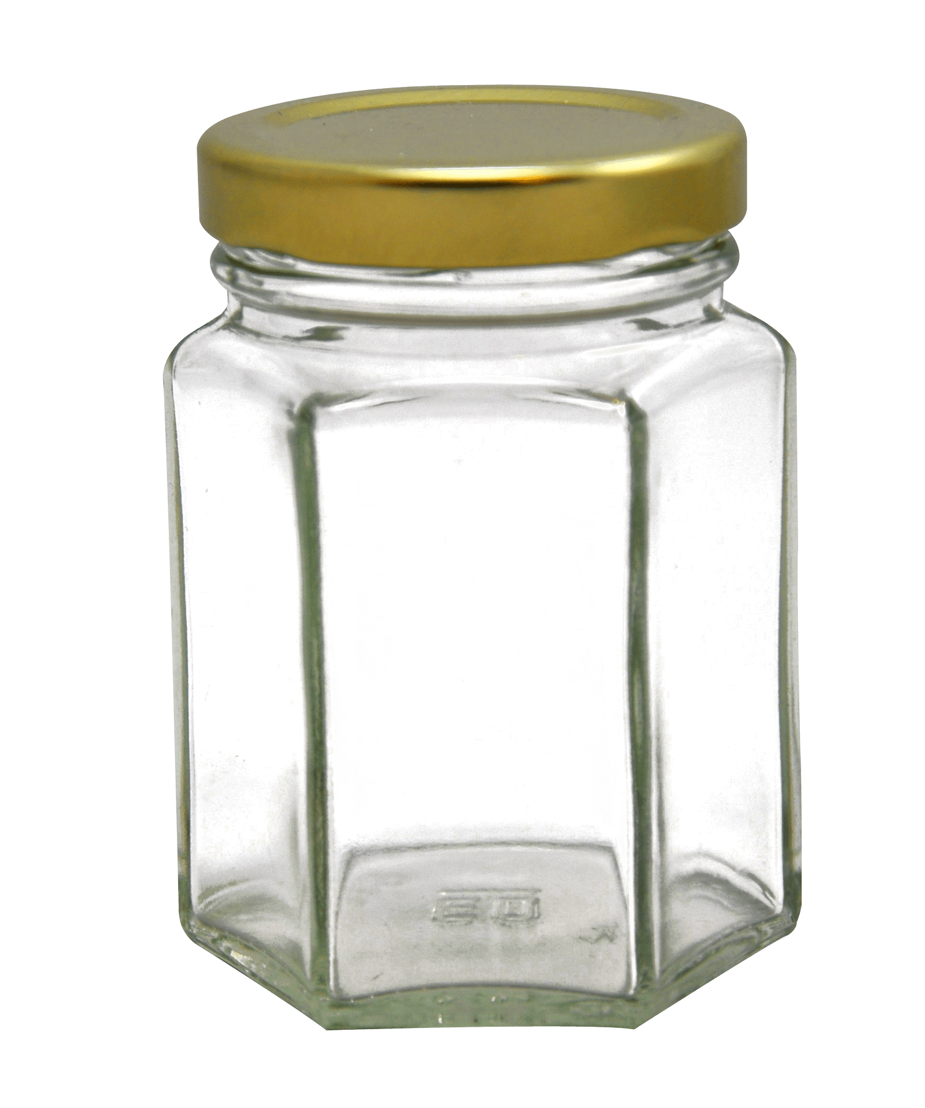
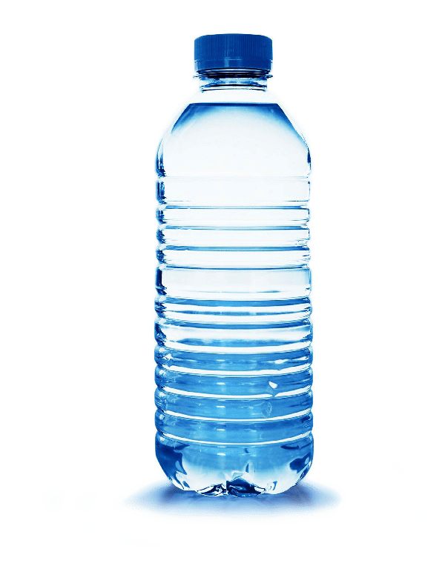
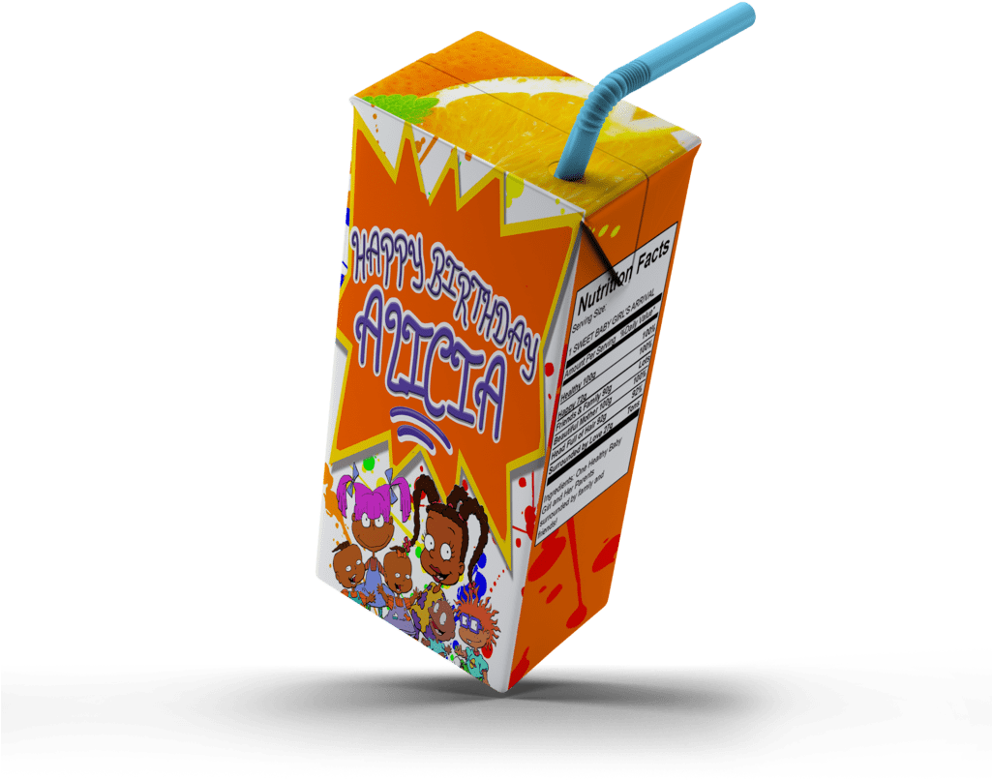
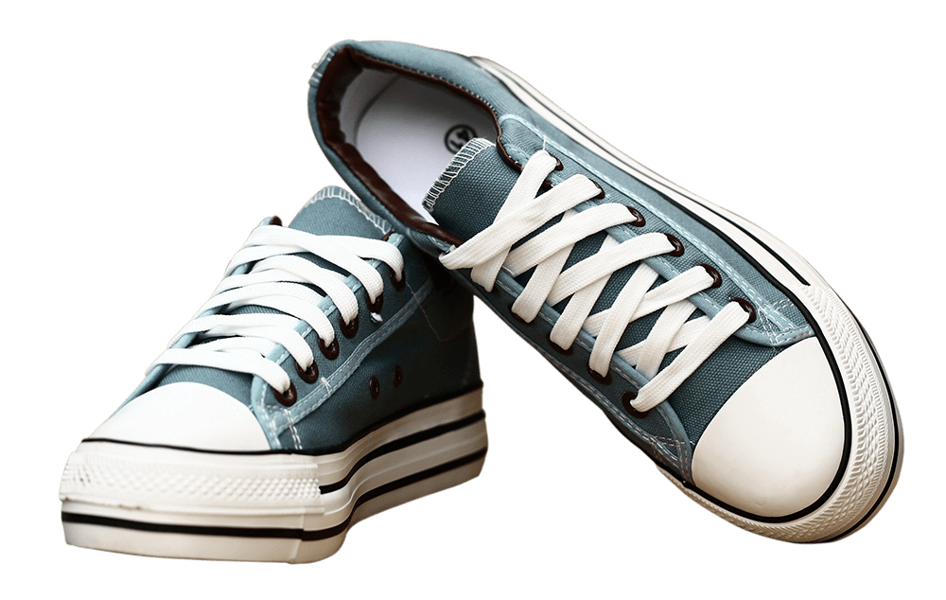
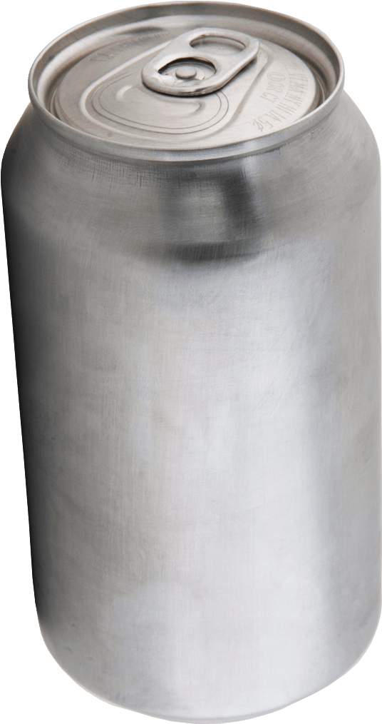
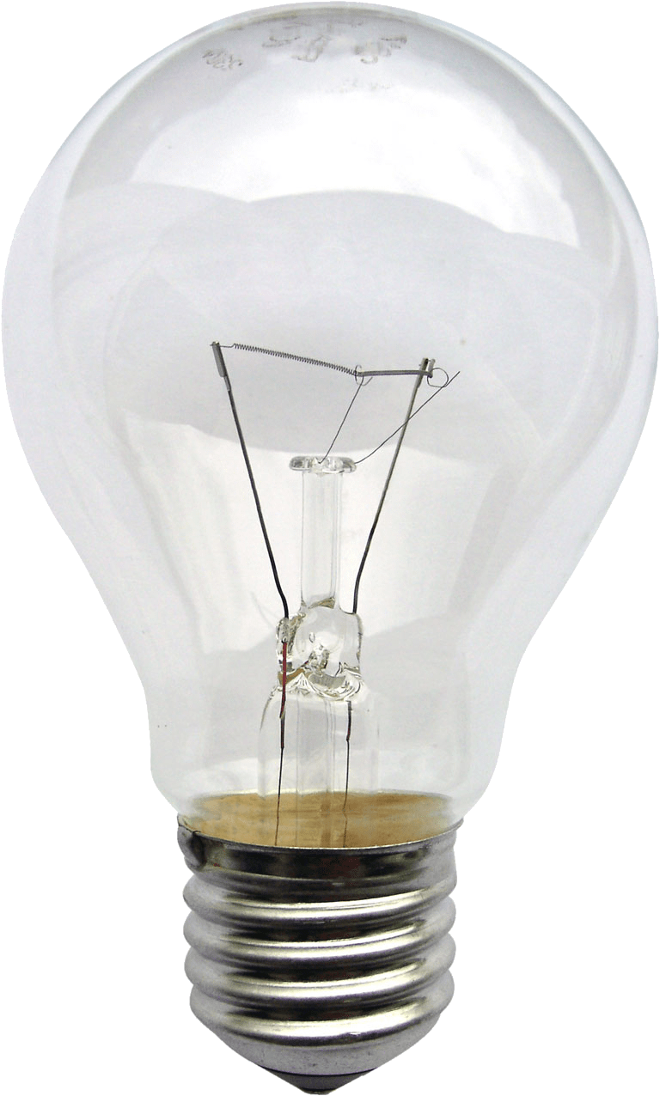
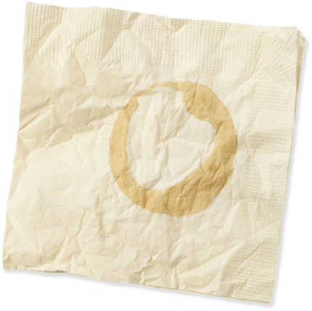
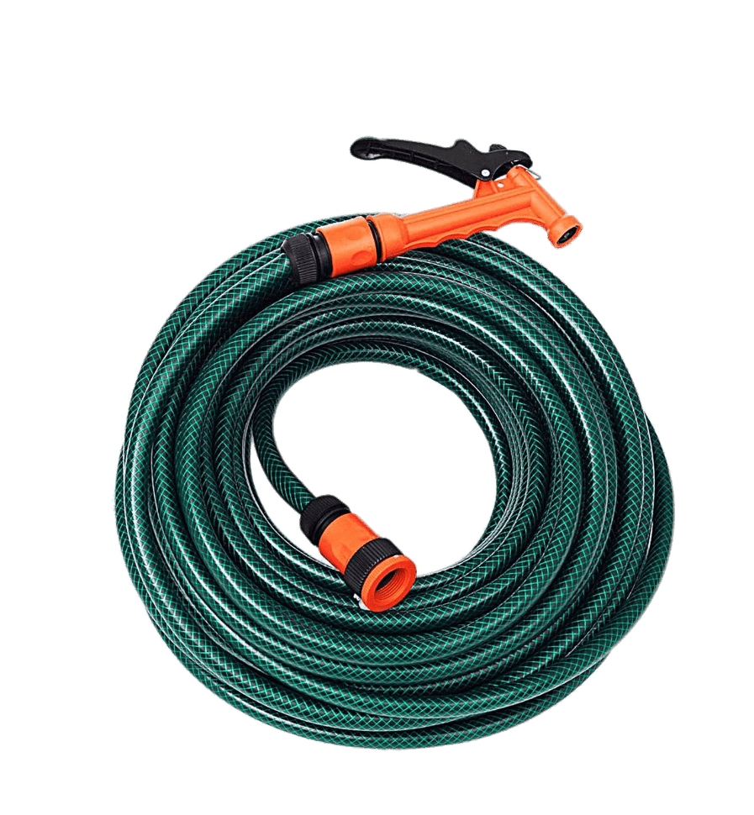
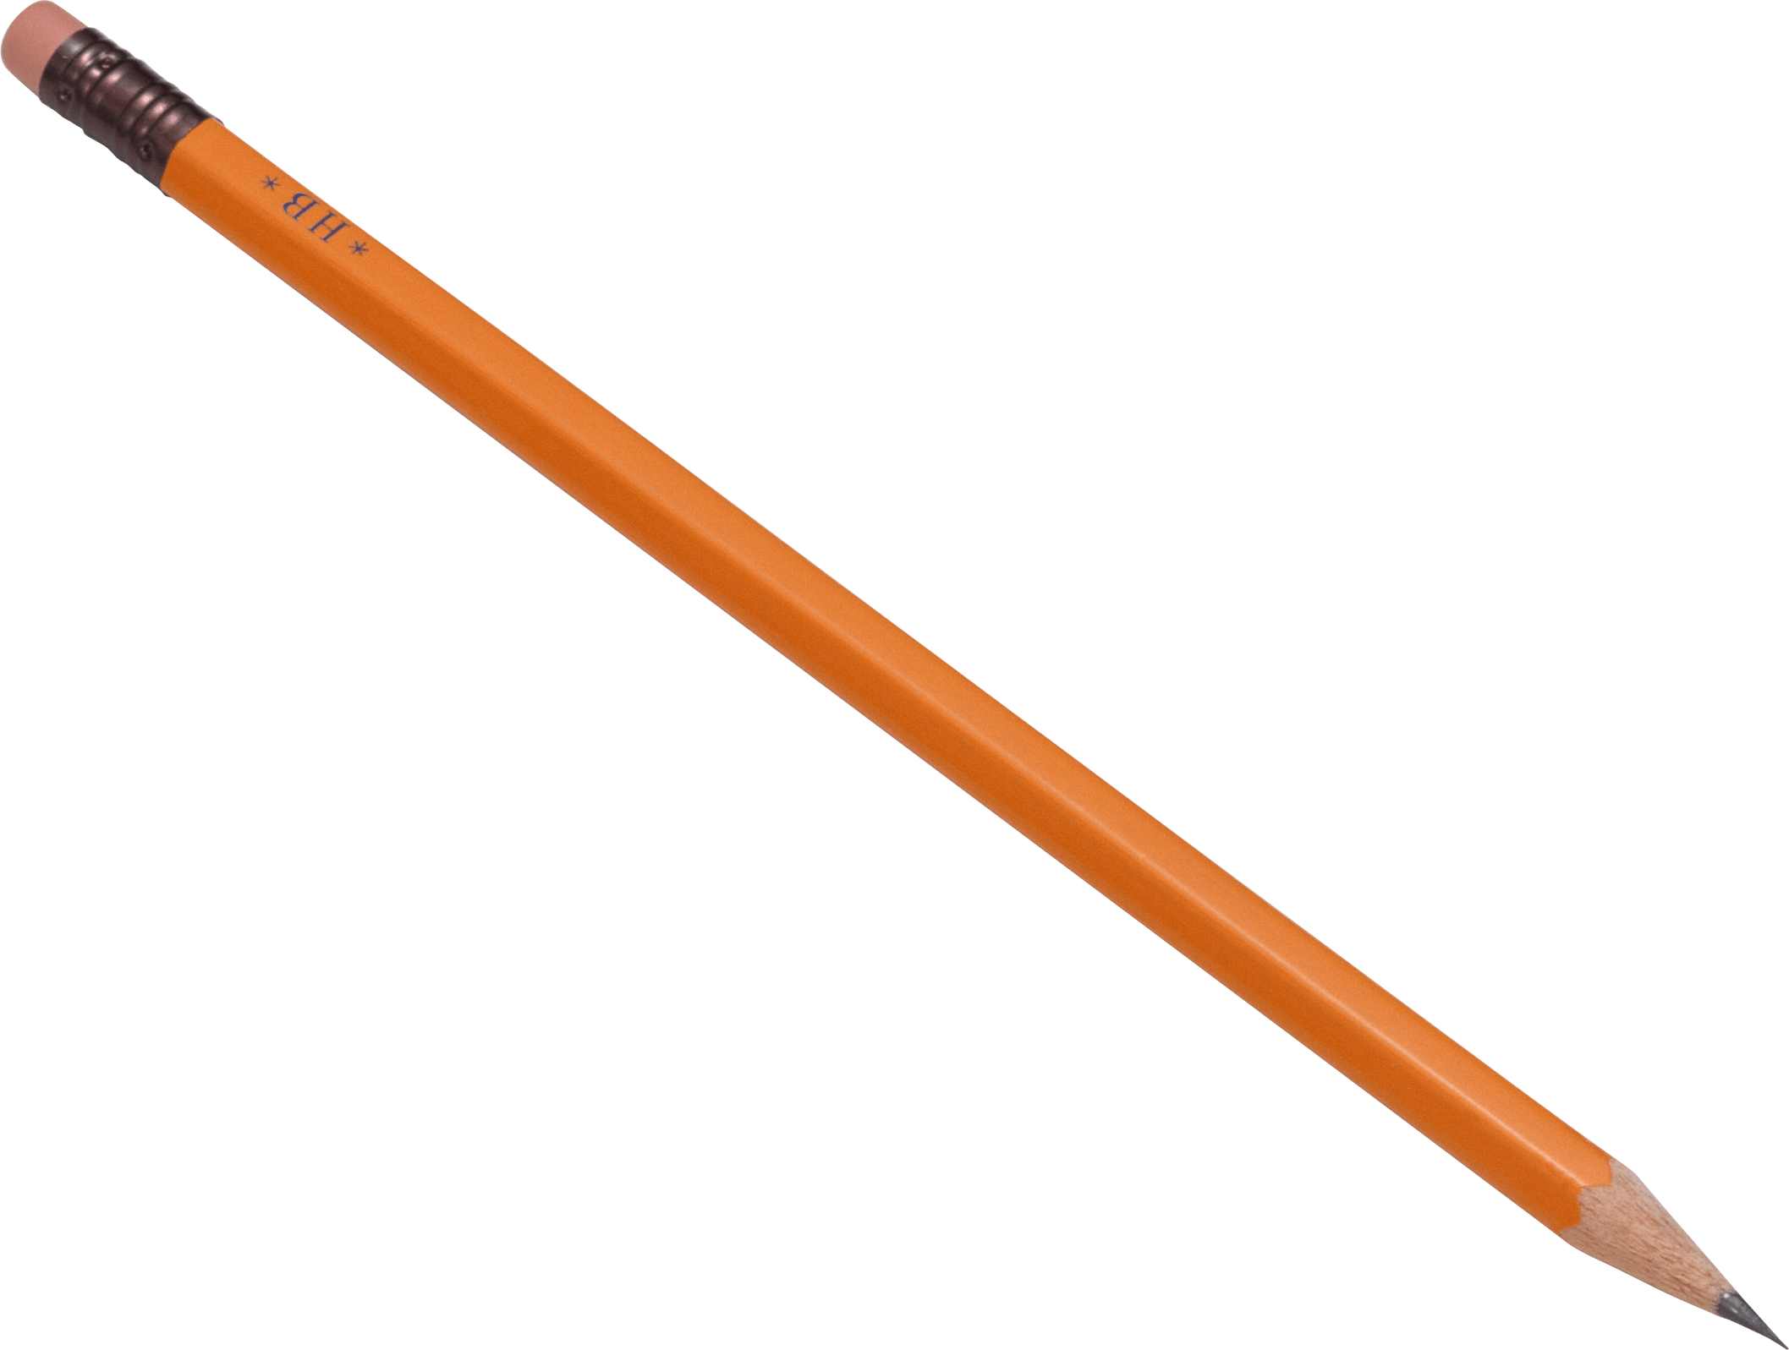
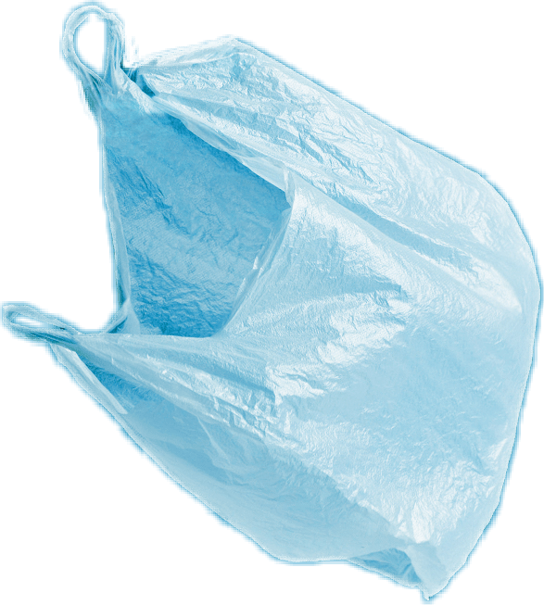
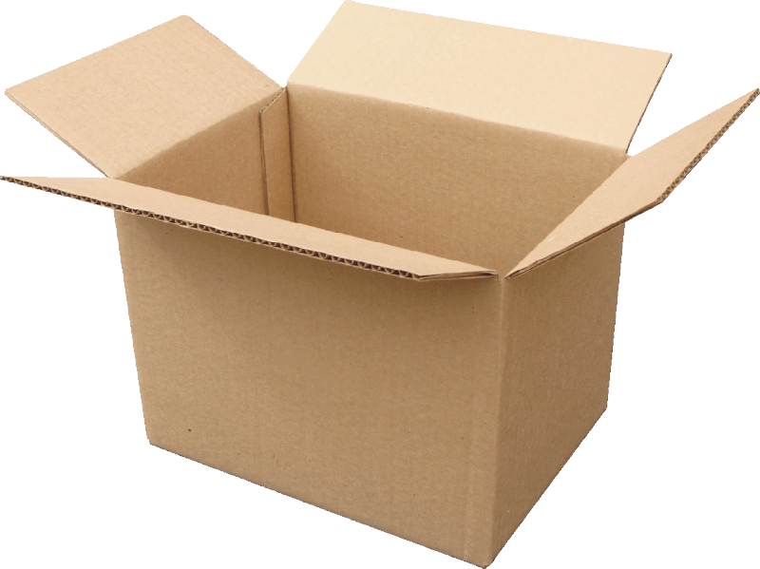
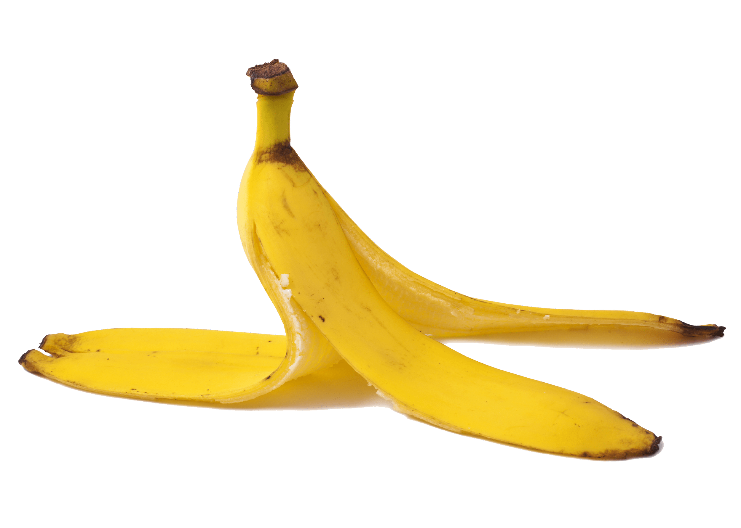
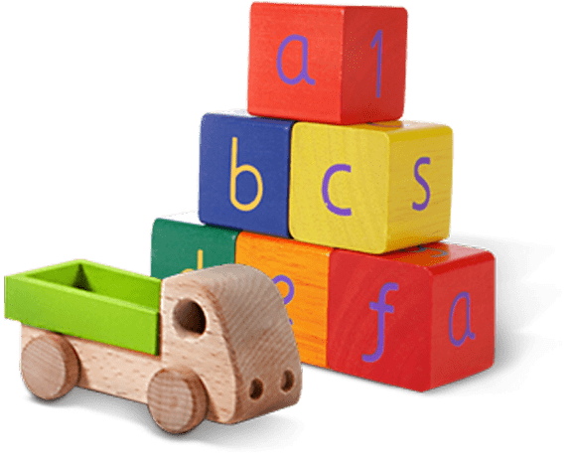
Glass jar
PET Plastic bottle
Shoes
Metal can
Light bulb
Juice box
Dirty napkin
Plastic bag
Toys
Pencil
Banana peel
Cardboard box
Garden hose
YES
NO
Notes:
(Slide duration: 3-5 minutes)
Pre-lesson Icebreaker Exercise
Ask students:
Has anyone heard of recycling? If yes, please share with the class what they know.
Tell students:
Recycling is the process of collecting and processing materials that would otherwise be thrown away as trash and turning them into new products. Recycling can benefit your community and the environment.
Now read off the images left to right starting on the top row to test their knowledge about what items displayed can and cannot be recycled.
Order of images that will appear with each click.
Click 1: Glass jar
Click 2: PET Plastic Bottle
Click 3: Shoes
Click 4: Metal can
Click 5: Light bulb
Click 6: Juice box
Click 7: Dirty napkin
Click 8: Pencil
Click 9: Plastic bag
Click 10: Toys
Click 11: Cardboard box
Click 12: Garden hose
Click 13: Banana peel

Slide 8
YES
NO
Always recycle:
Never recycle:
Banana peel
Dirty napkin
Garden hose
Glass jar
PET Plastic bottle
Light bulb
Juice box
Shoes
Cardboard box
Metal can
Toys
Plastic bag
Pencil
Notes:
(Slide duration: 3-5 minutes)
Pass out or display this YES/NO slide – there is a printable pdf handout available for students
Open a discussion about where we put our garbage.
Ask Students: What do you do with waste at home? Where does it go? Does all waste belong in one bin?
Tell Students:
Not all waste goes into the same waste bin. Some items need to go into the recycling bin.
Ask Students:
The items on the left side of the page can be recycled, what are those items? What is the first picture you see?
*ask in this order (Glass jar, PET Plastic bottle, Cardboard box, Metal can)
Click 1: Glass Jar
What is it made from? Can it be recycled?
Answer: glass, yes
Click 2: PET Plastic bottle
What is it made from? Can it be recycled?
Answer: plastic, yes
Click 3: Cardboard box
What is it made from? Can it be recycled?
Answer: paper, yes
Click 4: Metal can
What is it made from? Can it be recycled?
Answer: metal, yes

Slide 9
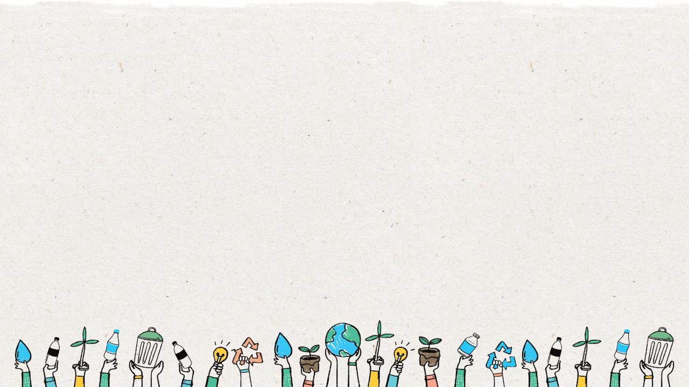
Where does your
waste go if you
do not recycle?
Notes:
(Slide duration: 3 minutes)
Answers:
Waste either ends up in a landfill or leaks into the environment as litter.
Ask students:
Have you seen waste in places it should not be?
How do you think waste got there?
Answers:
Yes, I have seen plastic bags on the beach. I think plastic bags can easily fall from a waste bin and blow onto a beach.
*Ask them for additional examples.

Slide 10
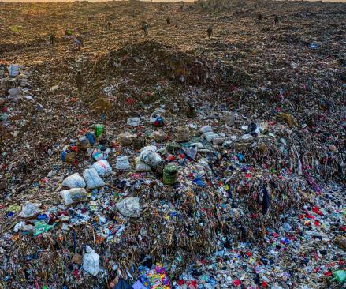
Where does our trash go?
Most of our garbage goes to local landfills
Landfills hold layers of different kinds of waste, but some of this waste does not belong here and will take hundreds of years to disappear.
Landfills bring hazards such as odor, smoke, noise, bugs, and water supply contamination.
Notes:
(Slide duration: 3-5 minutes)
Ask students:
What is a landfill?
Does recycling items belong here? Why?
What does belong here?
Using your 5 senses, what would you experience? (smell, touch, taste, see, hear)
Answers:
A landfill is a site where people dump their general waste materials into the ground or into a giant pile.
No, recycling does not belong here. Only items that cannot be recycled need to be put into the landfill.

Slide 11
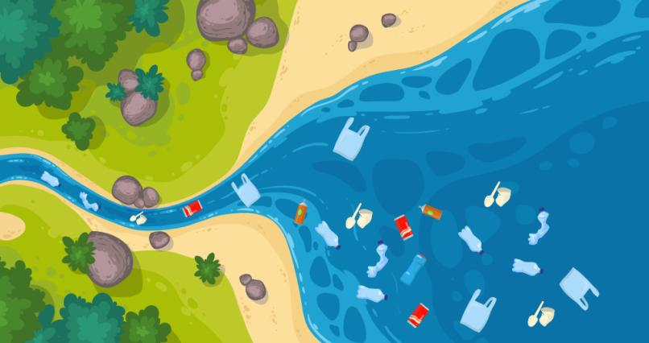
Where does our trash go?
Most waste in
the ocean comes
from humans on land.
Notes:
(Slide duration: 3-5 minutes)
Ask students:
Where does waste in our ocean come from?
What can we do to prevent waste getting into nature?
Answers:
If waste does not get recycled or is not properly disposed of, it can leak into our rivers and waterways that flow into the ocean.
Proper disposal and recycling can help prevent waste from entering our natural world.

Slide 12
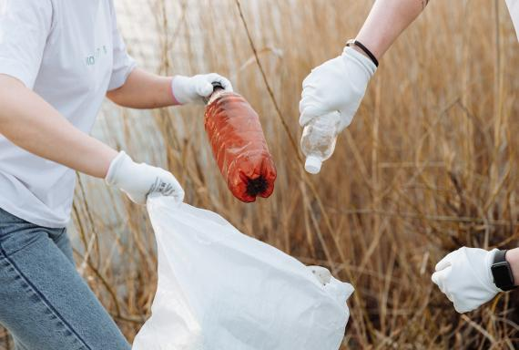
How can we reduce our waste?
We can recycle many things and it is a great way to help keep our environment clean. If we recycle, we create less waste. How do you recycle?
Notes:
(Slide duration: 3-5 minutes)
Ask students:
How do we recycle?
Why is it important to know what you can and cannot recycle?
Answers:
We recycle in 3 Steps: 1. Know what we can recycle 2. Clean and dry before putting into the bin 3. Make sure to only put the correct recyclables into the right bin.
If we do not recycle correctly, we can contaminate other recyclables and make the whole bin dirty and unable to be recycled. This waste then will end up in a landfill or enter the natural world as litter.

Slide 13
The
3
Steps to
Recycling

Slide 14
Step
1
Know what you can recycle.
Glass jar
PET Plastic bottle
Cardboard box
Metal can
Notes:
(Slide duration: 3-5 minutes)
Have the students guess the four main items we can recycle.
Click 1: Glass Jar
Click 2: PET Plastic bottle
Click 3: Cardboard box
Click 4: Metal can
Ask Students:
Can you give me an example of something we can recycle?
What is something we should never recycle? Food waste
Fun Fact:
PET plastic bottles are the most recycled plastic in the world and is fully recyclable.
Expansion Questions:
Have you ever seen the #1 on the bottom of a PET water bottle? If you see it, you can fully recycle it!
Can you give another example of something we can recycle?

Slide 15
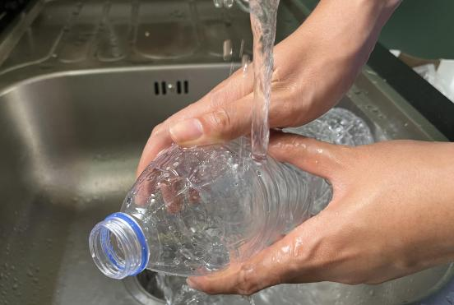
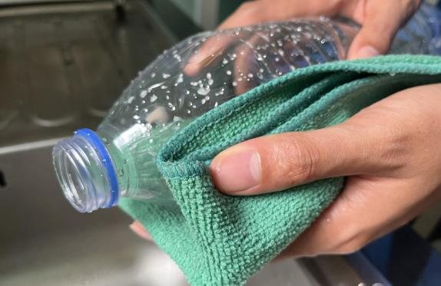
Step
2
Empty, clean, and dry before putting in the bin.
Notes:
(Slide duration: 3 minutes)
Ask Students:
1. Why is it important to clean our items for recycling?
2. What if there is a little bit of food or liquid on it?
You might suggest:
Dirty items cannot be recycled.
Wet and dirty items can get other clean items dirty, getting the whole bin dirty.

Slide 16
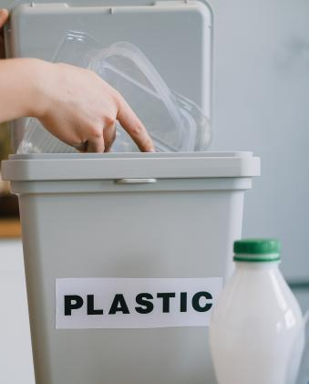
Step
3
Put recyclables into the correct recycling bin.
Notes:
(Slide duration: 3 minutes)
Recycling needs to be separated into the proper recycling bins. Click to reveal the recycling symbol. Let them know that this symbol indicates where to put your recycling.
Ask Students:
Where have you seen this green symbol before?
What does this symbol mean?
Where do we put those PET plastic bottles?

Slide 17
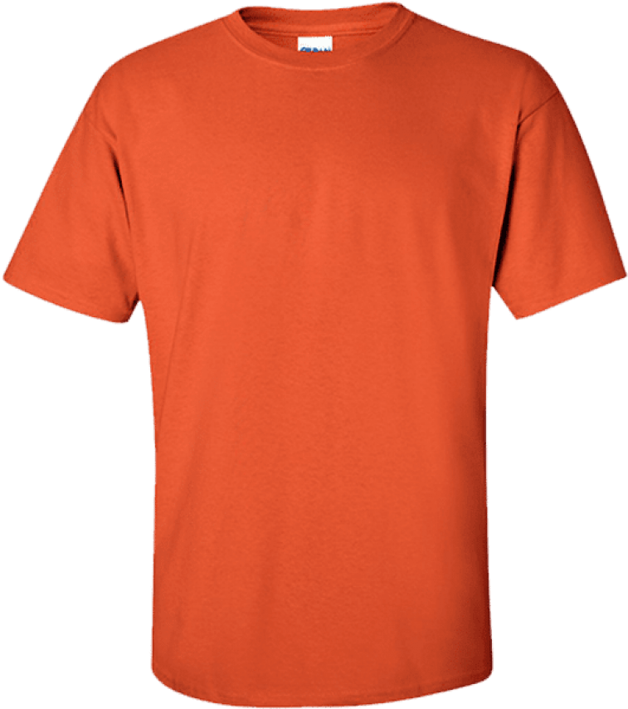
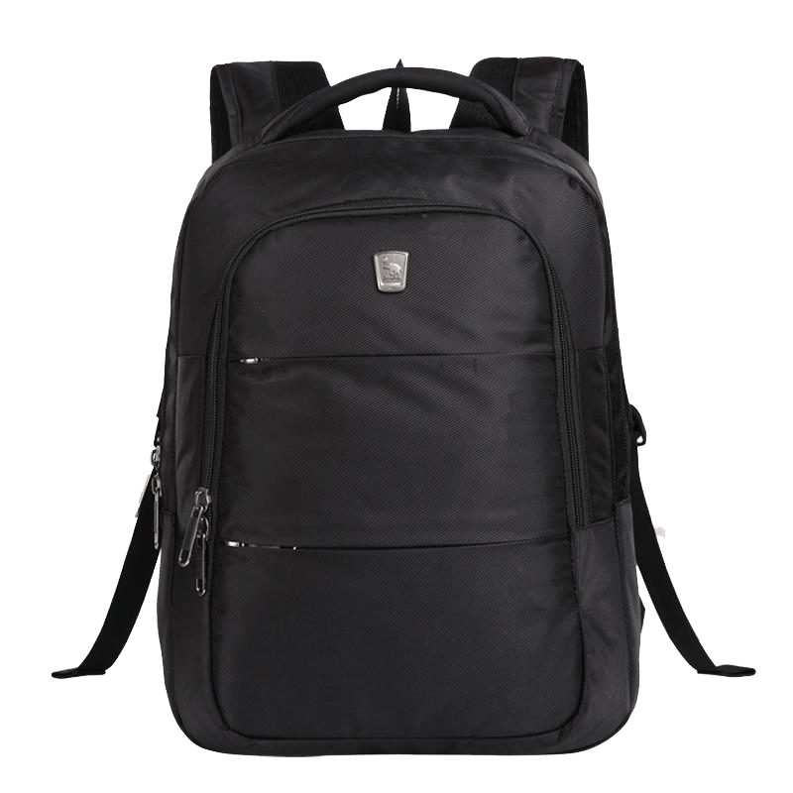
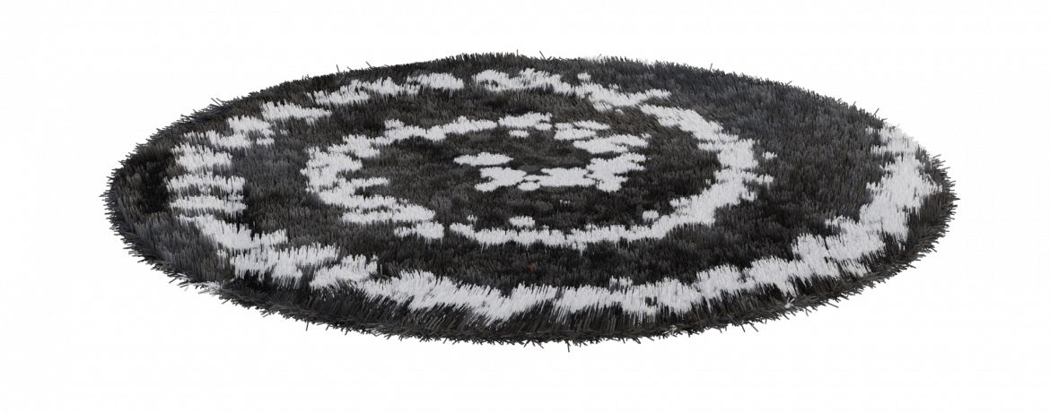
When we clean, dry, and recycle we can make new things.
Notes:
(Slide duration: 2-4 minutes)
Tell students:
When we follow the 3 steps of recycling we can recycle our waste into brand new things.
Example:
Click 1:
PET plastic bottles can be recycled back into new PET plastic bottles.
Click 2:
PET plastic bottles can also be made into thread that can make fabrics and textiles.

Slide 18
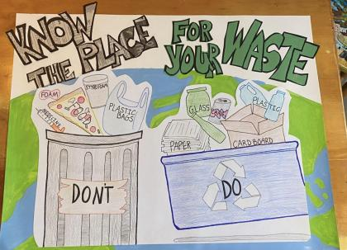
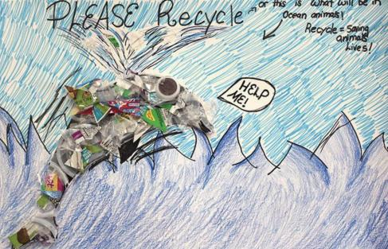
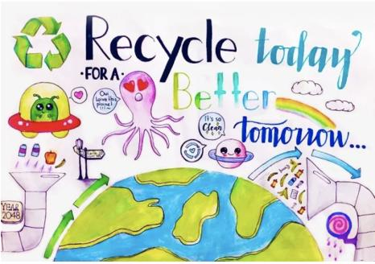
Make a recycling poster
Notes:
Tell students:
Explain to the class that for the in-class activity they will be making a recycling poster to motivate and inspire their fellow classmates to recycle more.
Let students know they will get into groups to create a recycling poster based on 4 different aspects of recycling. Please provide art materials and a large posterboard. They can either draw or cut out images from magazines or newspaper or use actual materials that can be recycled. Let them get creative with how they want to create their recycling poster.
Have them include one fun fact from the slides in their poster. Allow them to present their poster to the class and hang it around the room.
Group topics
The 3 Steps of recycling
What can and cannot be recycled
How waste ends up in the landfill or the ocean
How recycling can save the environment

Slide 19
Next Steps
1
Next, ask students to count off from 1 to 4. Provide art supplies to each of the four groups. Tell students they will be making posters about recycling topics.
Ask all the 1s to team up to create one or more posters about the 3 steps to recycling. (1. know what to throw 2. clean and dry 3. place in right bin)
Ask all the 2s to team up to create one or more posters about what we can and cannot recycle. (use the YES/NO handout as a reference)
Ask all the 3s to team up to create one or more posters about how waste ends up in a landfill and our ocean. (reference slide #10, what does a landfill look like?)
Ask all the 4s to team up to create one or more posters about how recycling can save the planet. (protect ocean animals, save energy, fight climate change)
2
Have the groups present their posters to the class and hang them in the classroom.

