Slide 1
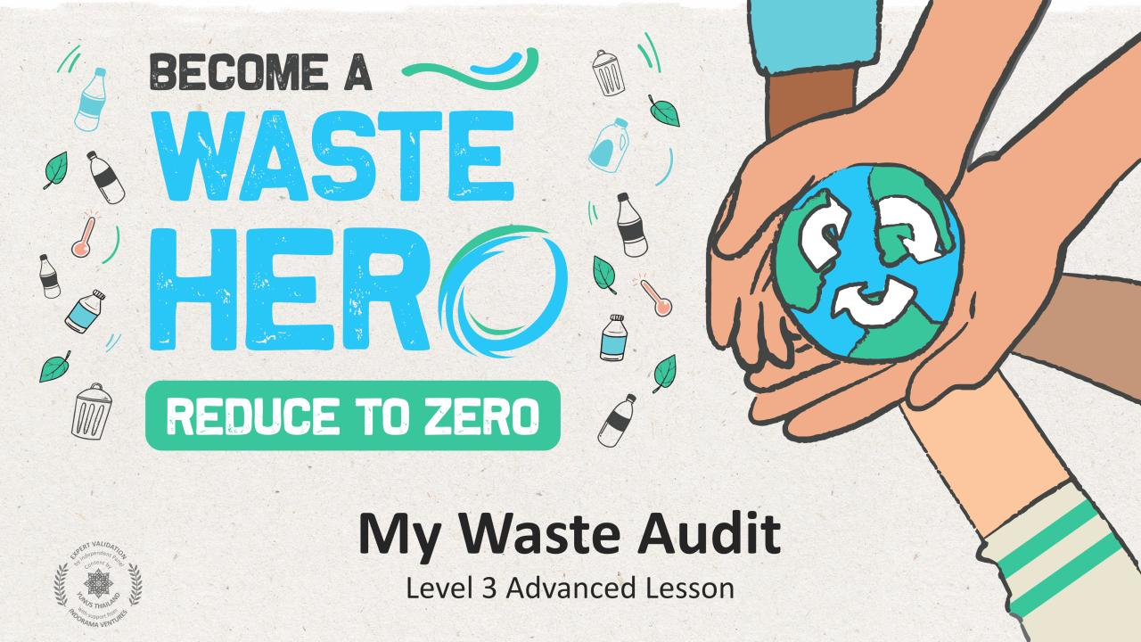

Slide 2
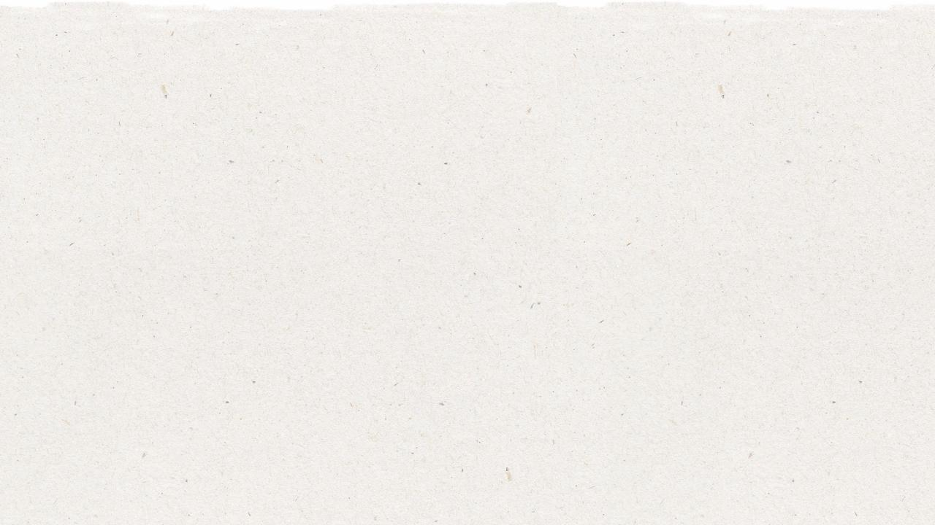
Lesson Prep & Curriculum Alignment
Prep time: 10 – 15 minutes
Students will consider how much waste they personally and as a class generate each day, and the portion that is recyclable and non-recyclable by conducting a “waste audit” at home. They will analyze their personal contribution to the waste stream and develop ideas on how they can reduce the amount of waste they make. Using the data collected from their waste audits,
students will calculate the amount of recyclable and non-recyclable material they produce in a day.
1
Display the lesson slides for the class and create a discussion about what they already know about recycling and introduce the concept of an audit.
2
Print out the “YES/NO” handout and the “Waste Audit Form” handout.
3
Prepare a standard home scale to weigh items students will bring to class.

Slide 3
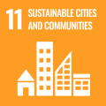
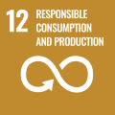
Lesson Prep & Curriculum Alignment
Prep time: 10 – 15 minutes
Key Learning Outcomes and Curriculum Alignment:
Science - Earth and Human Activity: Communicate solutions that will reduce the impact of humans on the land, water, air, and/or other living things in the local environment. Things that people do can affect the world around them. But they can make choices that reduce their impacts on the land, water, air, and other living things.
English Language Arts and Literacy: Participate in collaborative conversations with diverse partners about topics and texts. Follow agreed-upon rules for discussions. Use words and phrases acquired through conversations, reading and being read to, and responding to texts.
Mathematics: Make sense of problems and persevere to make sense of them by counting and multiplying to reach a conclusion on the quantity of something.
SDG Alignment
Flexible and adaptive lesson
Lesson plans are designed to be flexible and responsive to the evolving needs of your classroom. Lessons are editable and customizable to meet the different individual student and classroom contexts. A PowerPoint version with teacher instructions and a printable PDF lesson are available for download.

Slide 4
The Lesson
Lesson duration: 25 - 30 minutes
1
Assess students' understanding of recycling, its benefits, and the impact on the environment by not recycling. Display the “YES/NO”, “1,2,3 Steps”, and “Best Practices” slides to assess their understanding of how to effectively recycle and how much waste we produce each day.
2
Display the lesson slides and introduce the concept of the waste stream through a guided discussion about the flow of our waste.
3
Introduce the concept of an audit and tell students they are going to conduct a one-day waste audit at home to find out:
how much their family recycles?
how much trash they produce?
how much of the trash they produce could be recycled?
4
Depending on your school’s current recycling practices, you might wish to discuss the possibility of sharing their findings with the school and starting or improving a recycling program.

Slide 5
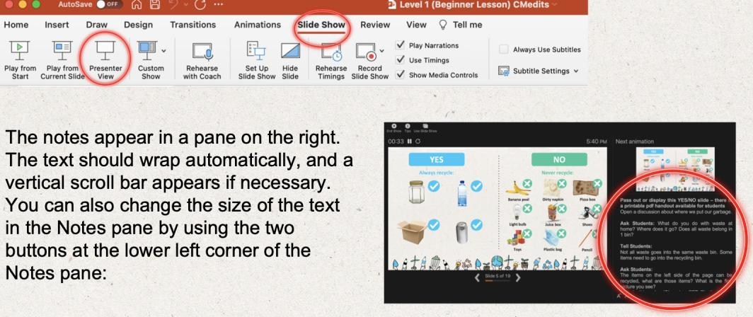
Prepare the PowerPoint presentation
When you are ready to present the lessons to your class click on Slide Show on the top menu bar then select Presenter View. In Presenter view, you can see your notes as you present while the audience see only your slides.
The notes appear in a pane on the right. The text should wrap automatically, and a vertical scroll bar appears if necessary. You can also change the size of the text in the Notes pane by using the two buttons at the lower left corner of the Notes pane.

Slide 6
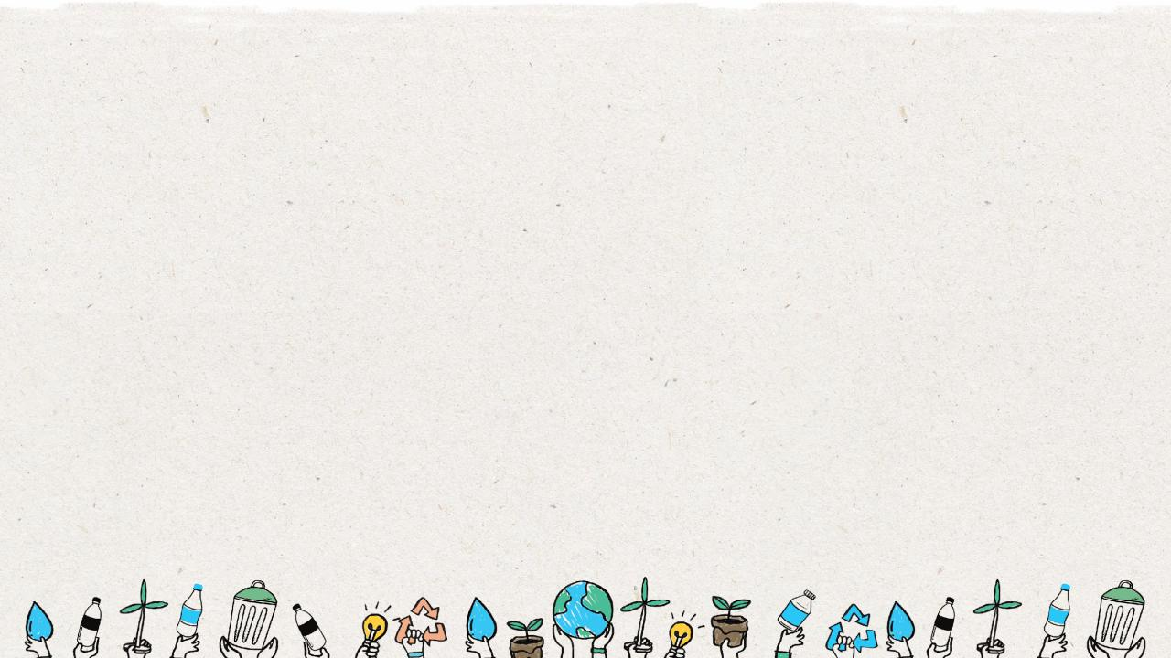
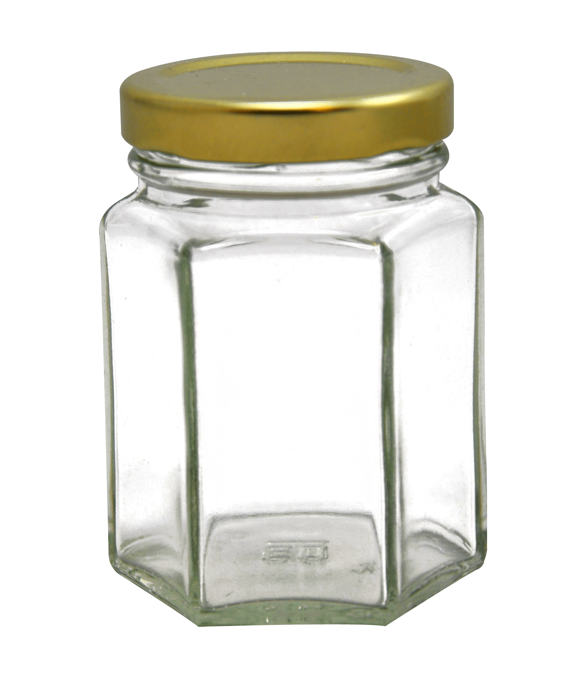
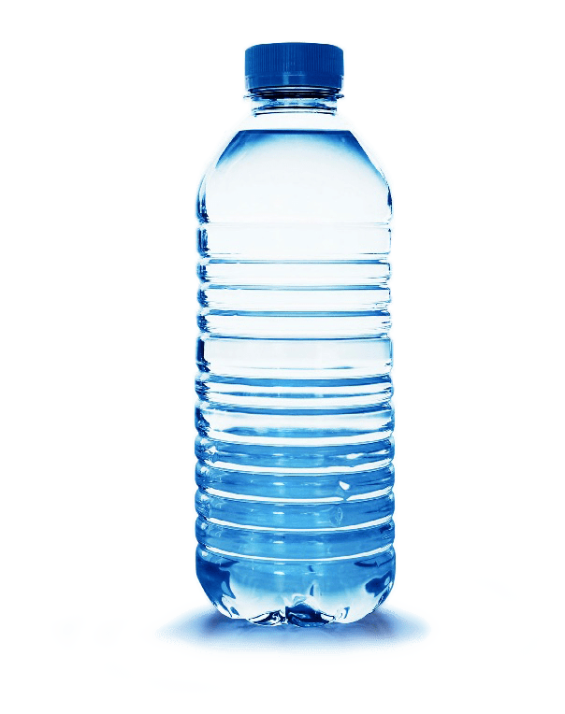
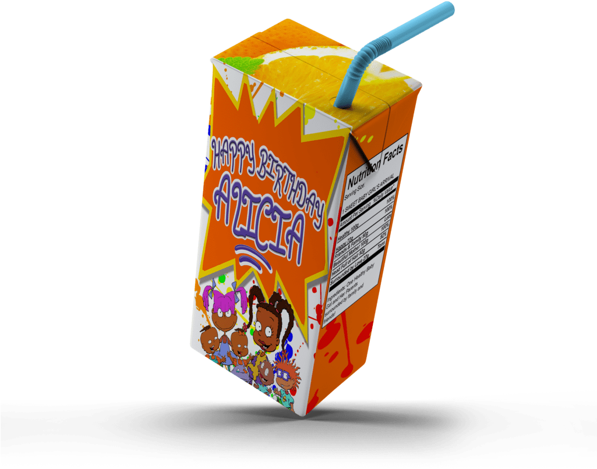
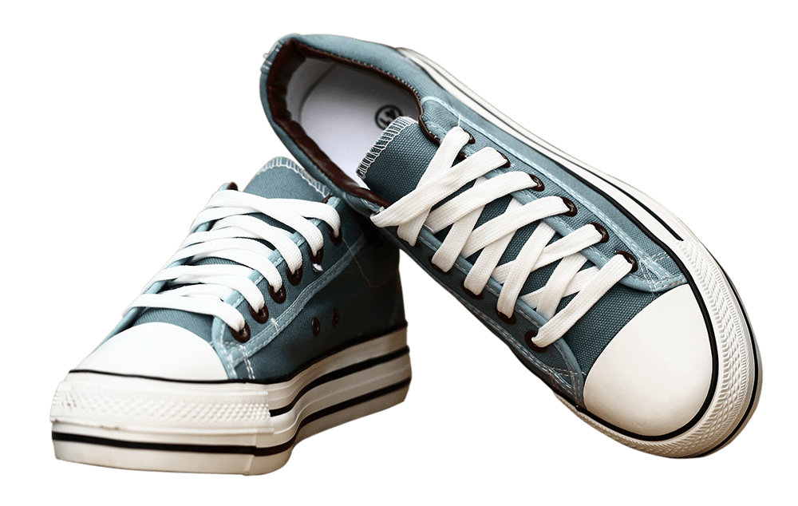
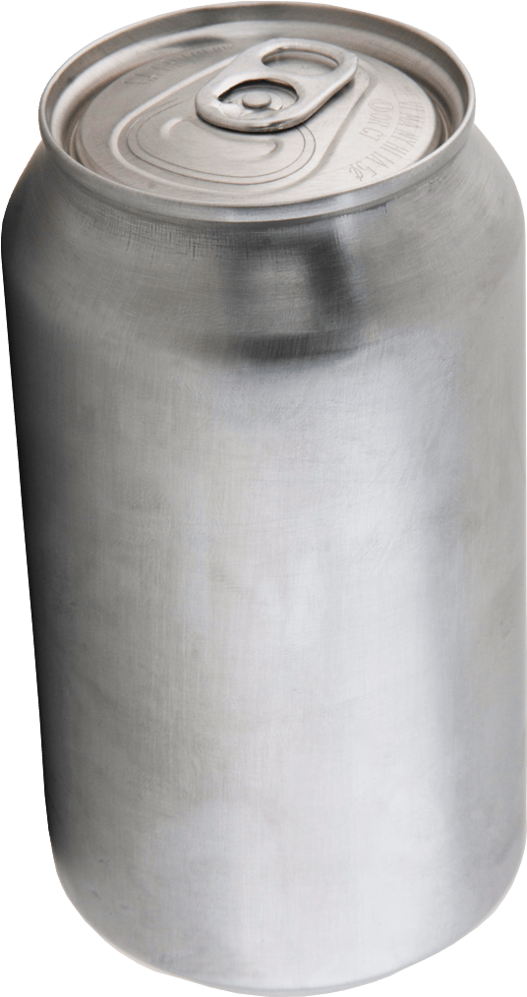
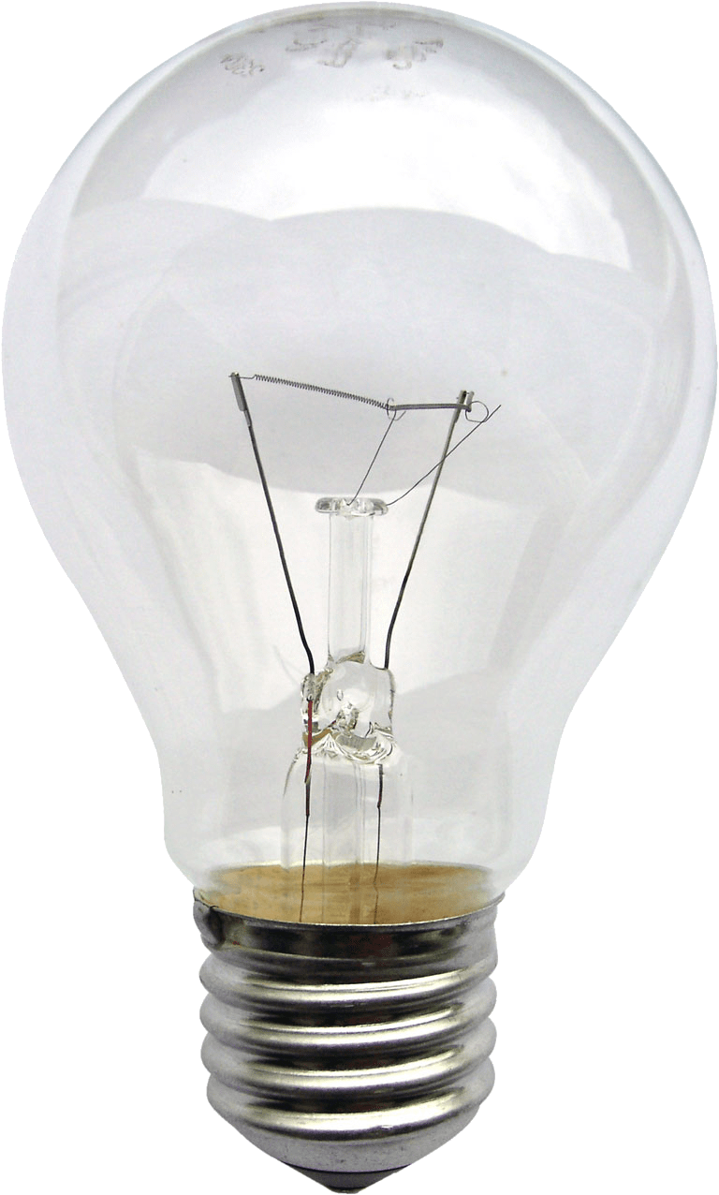
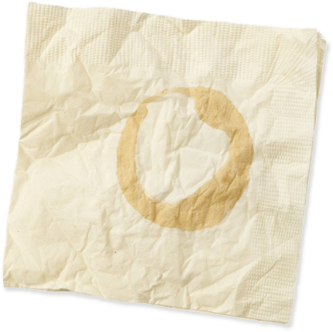
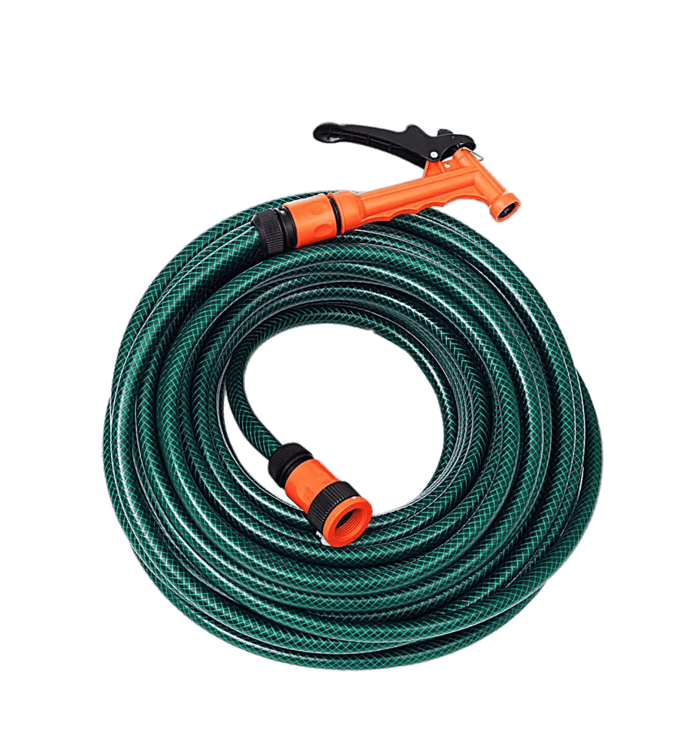
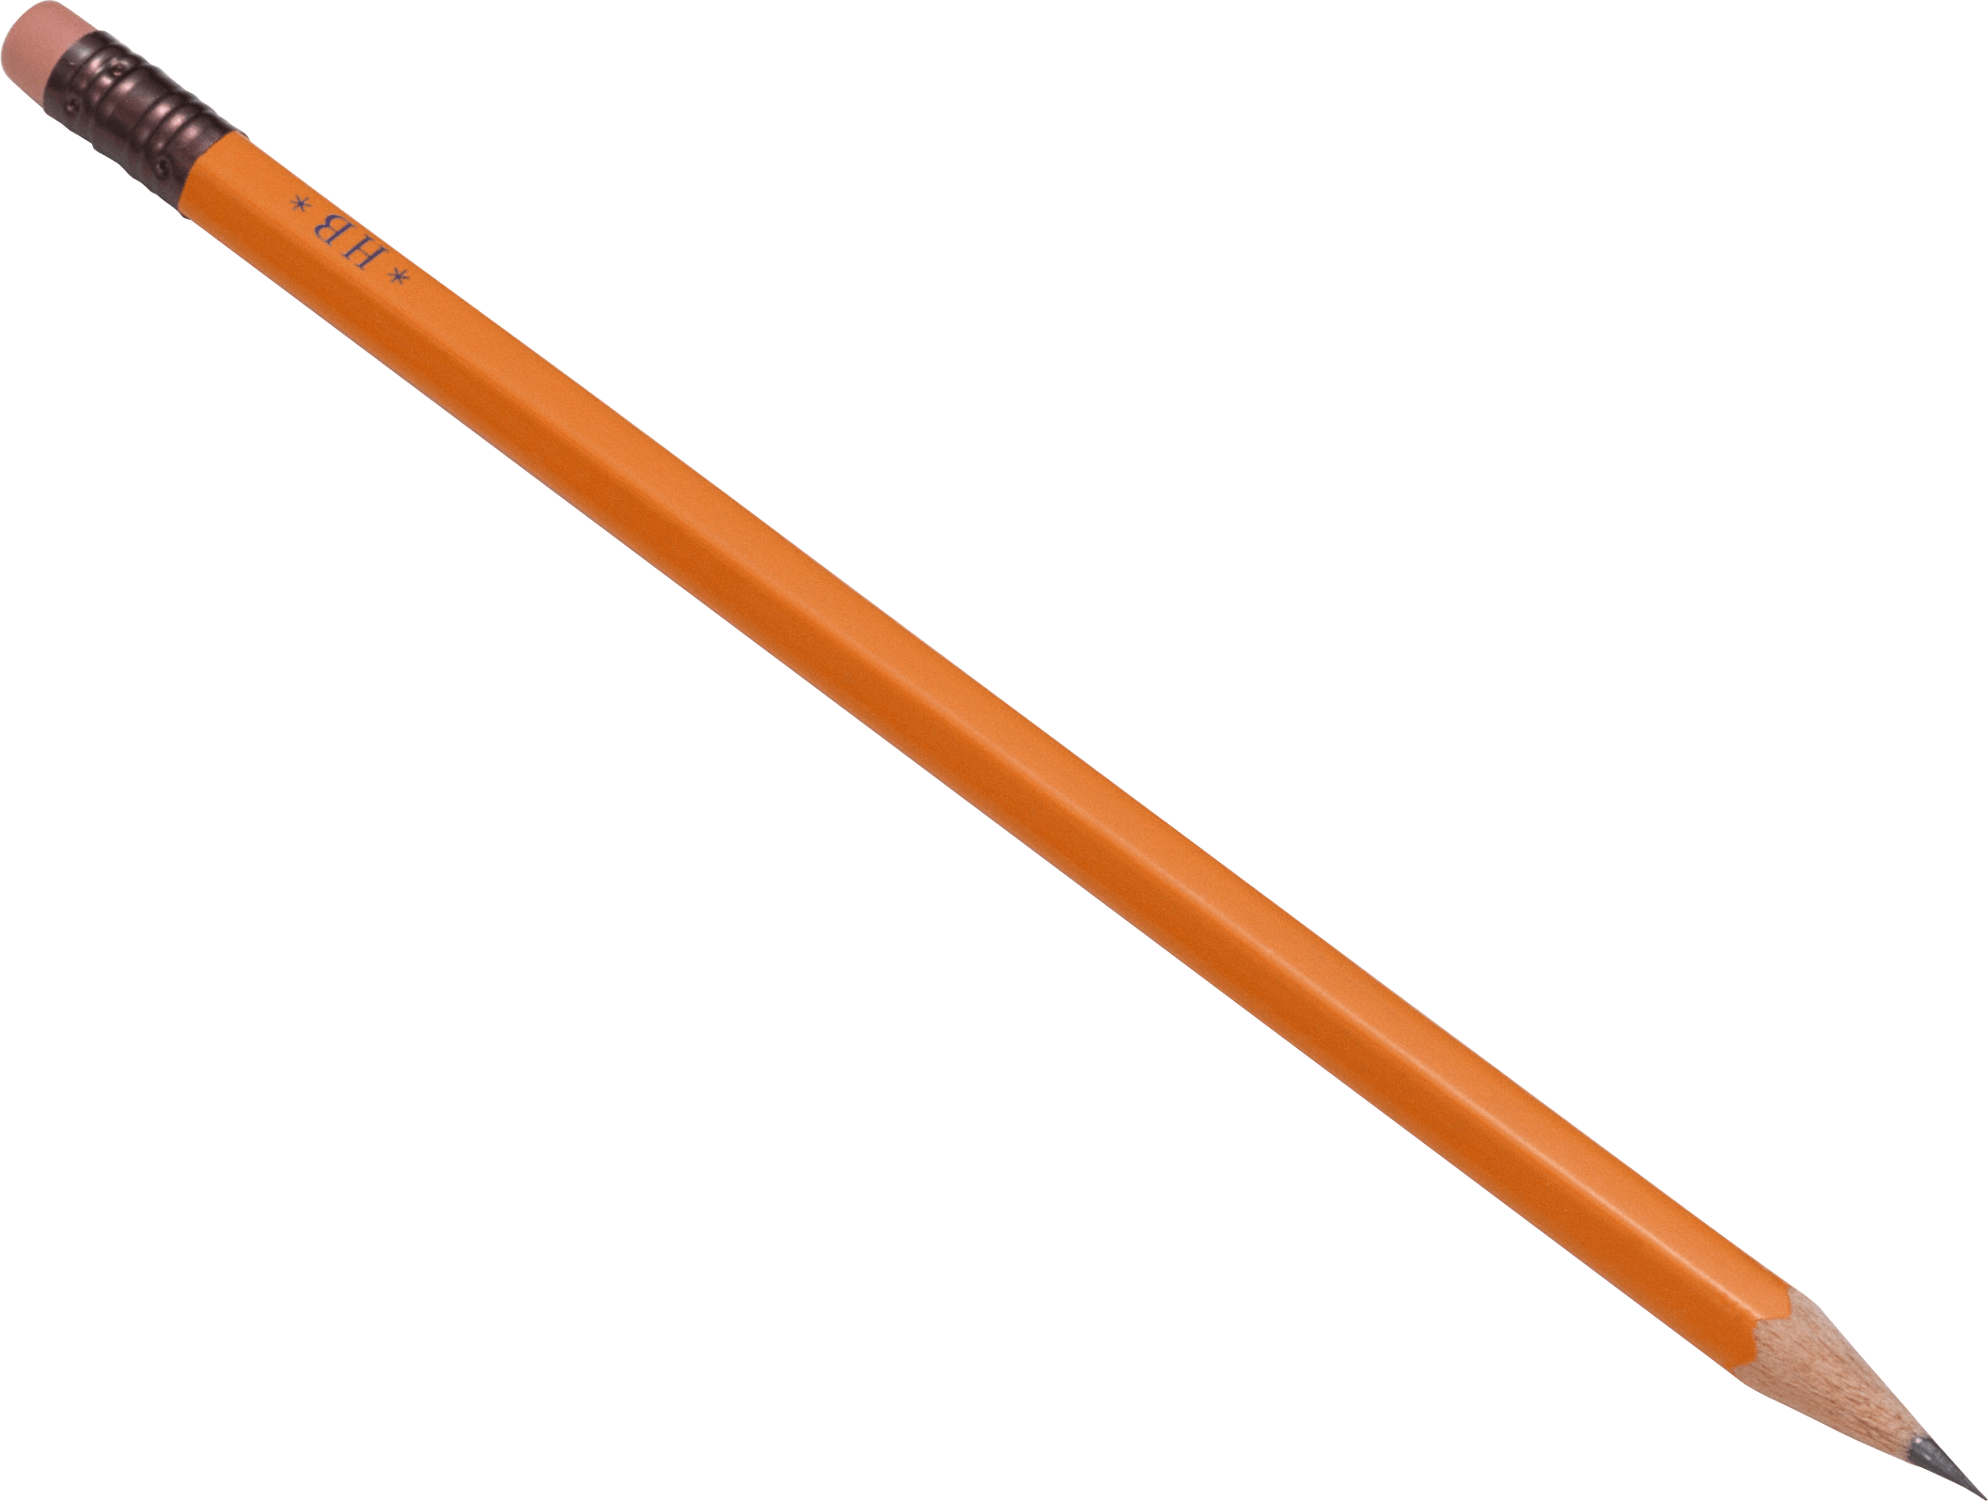
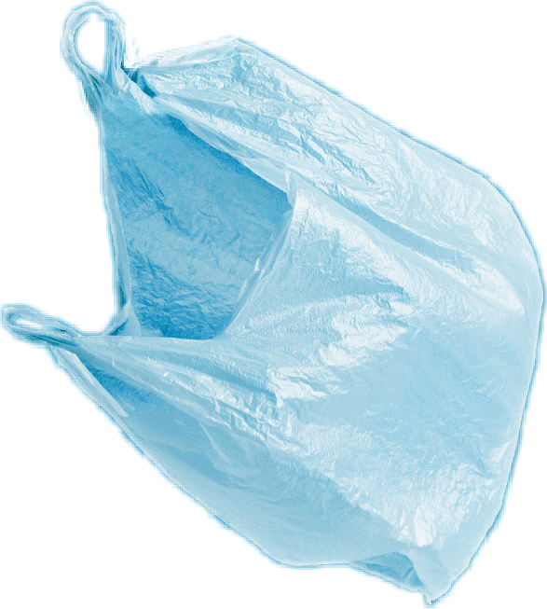
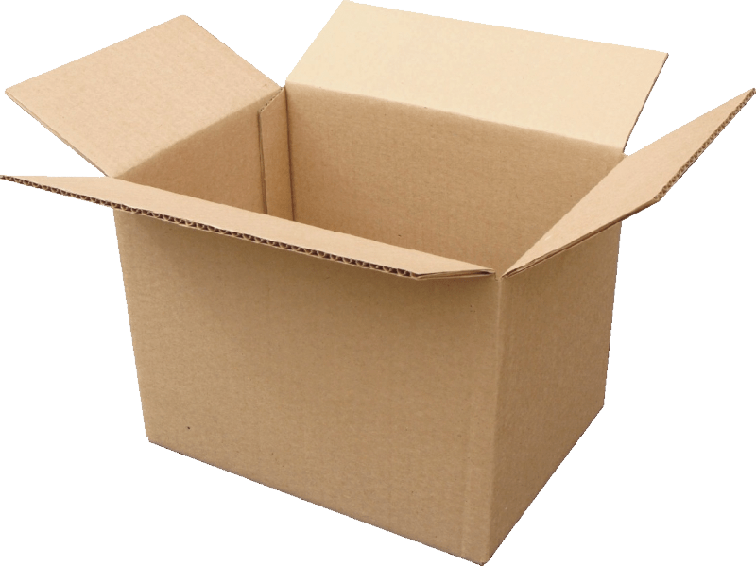
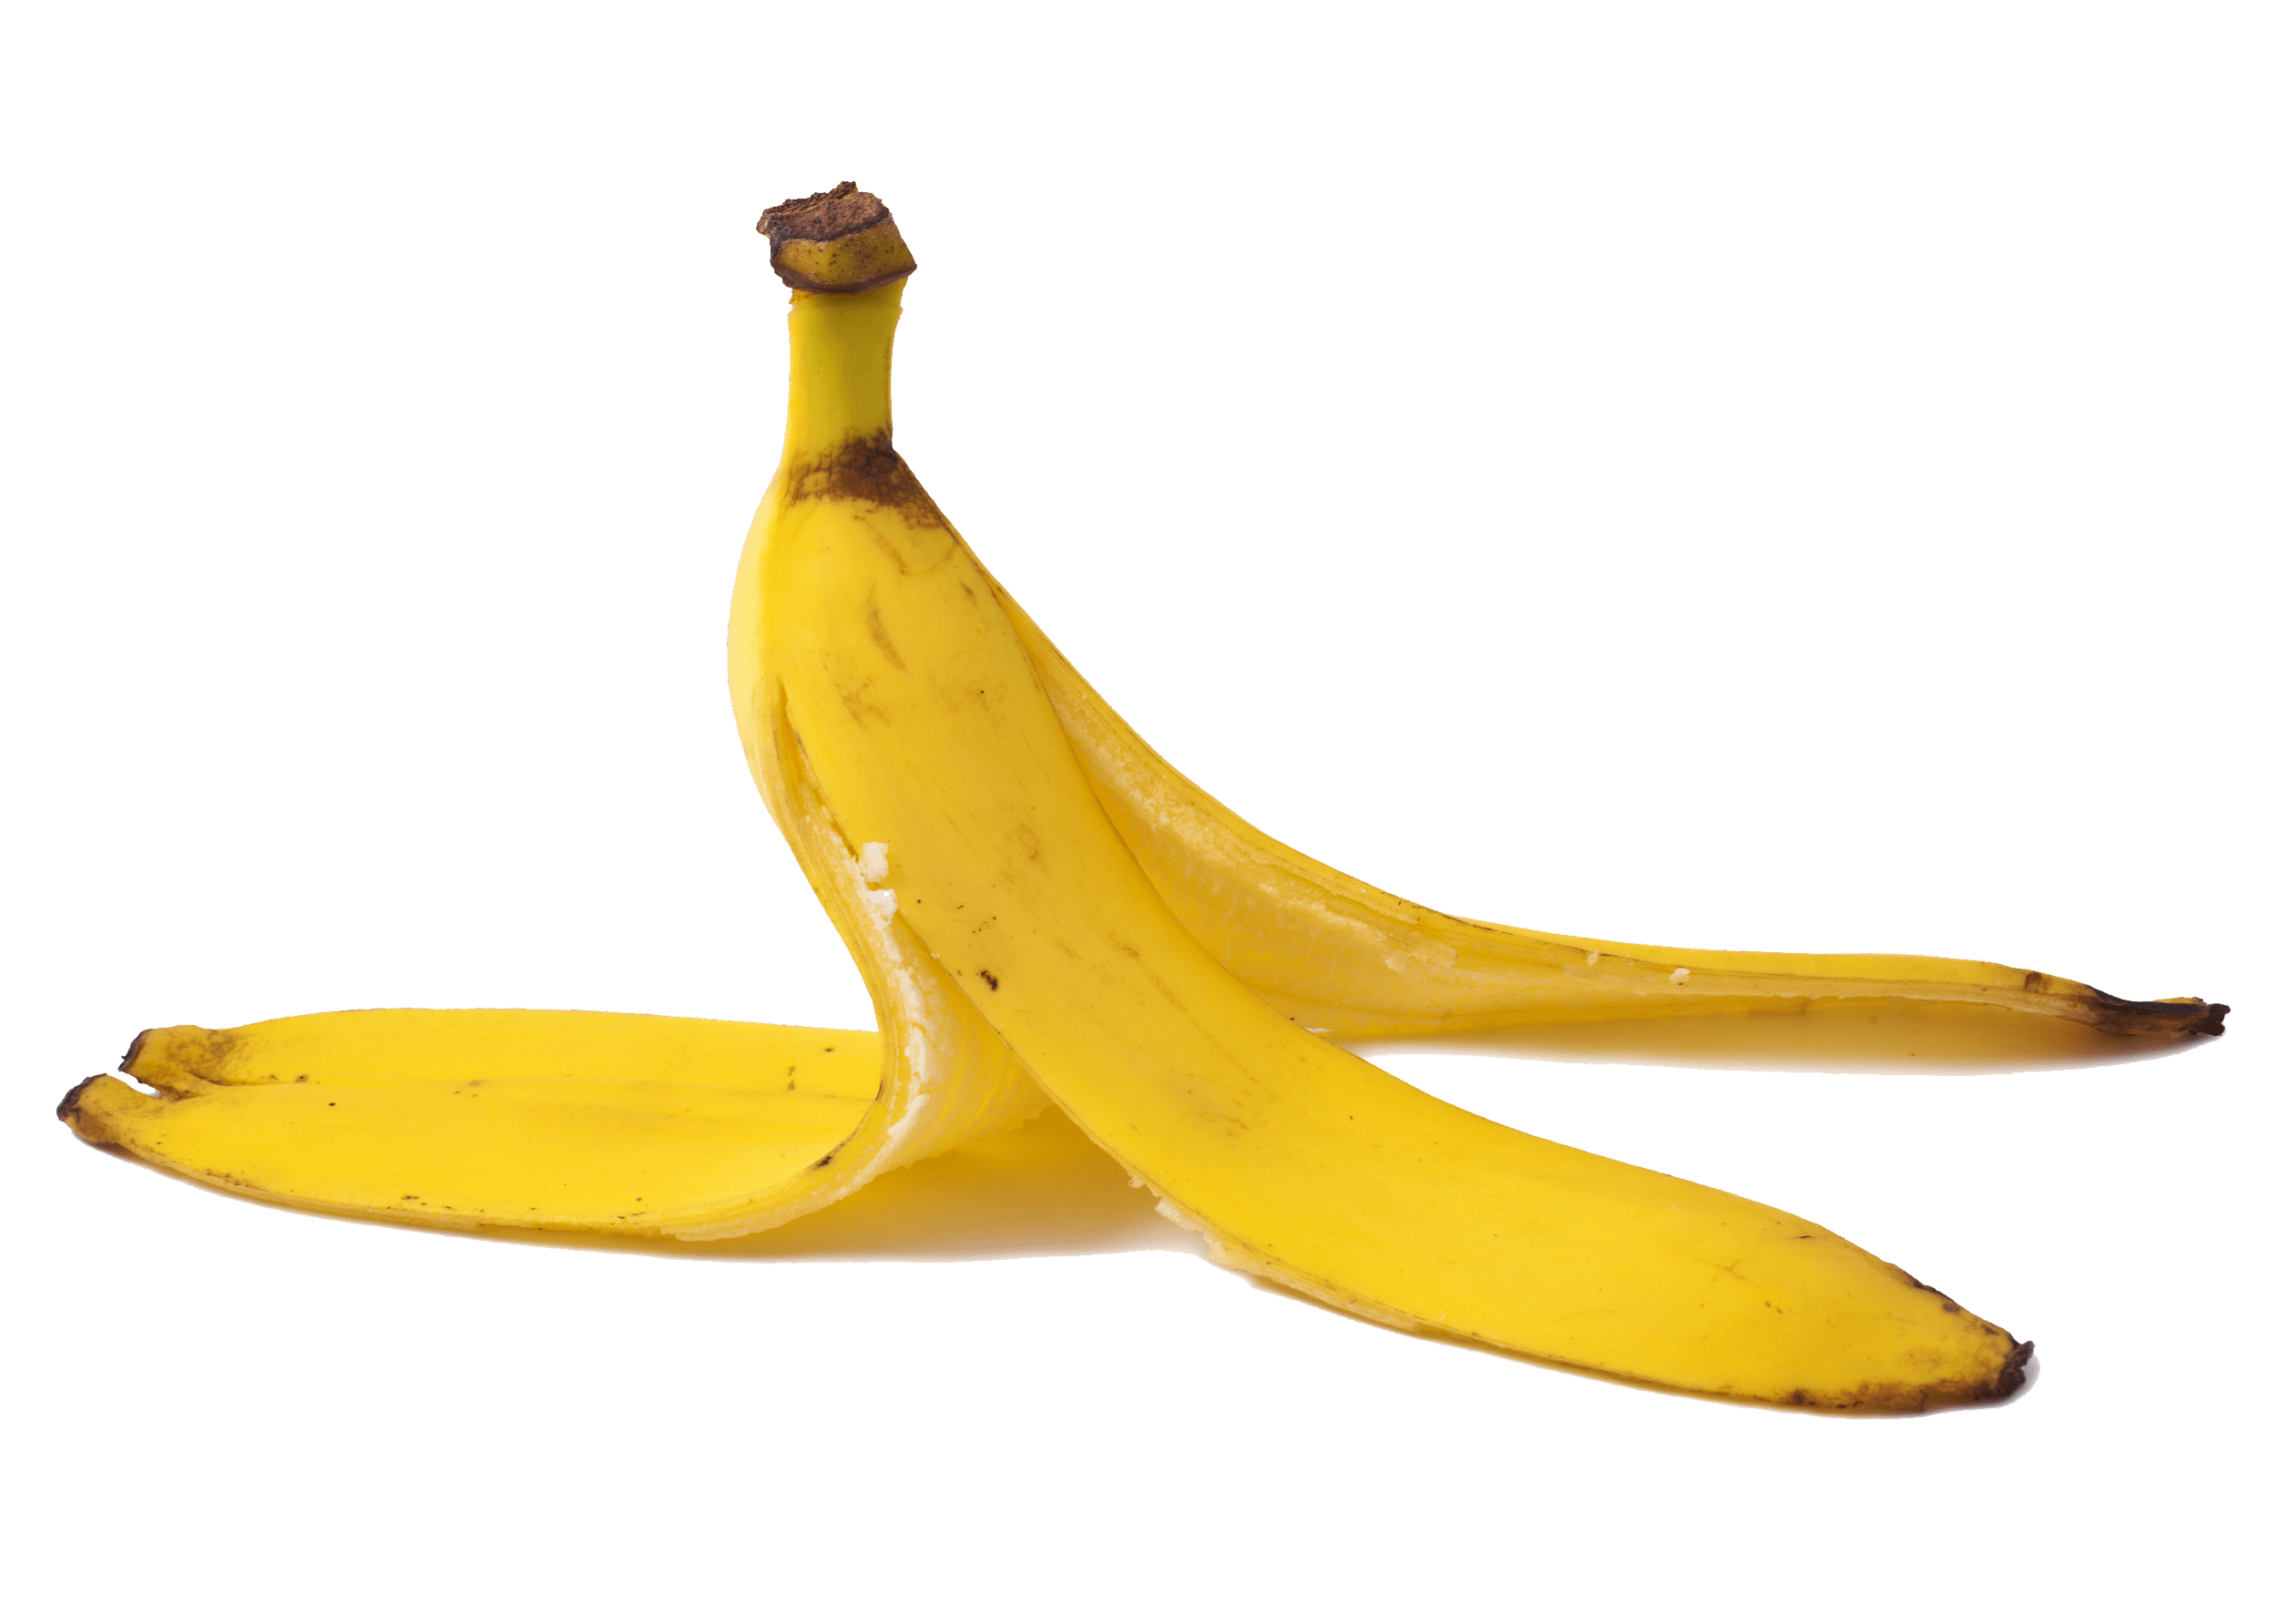
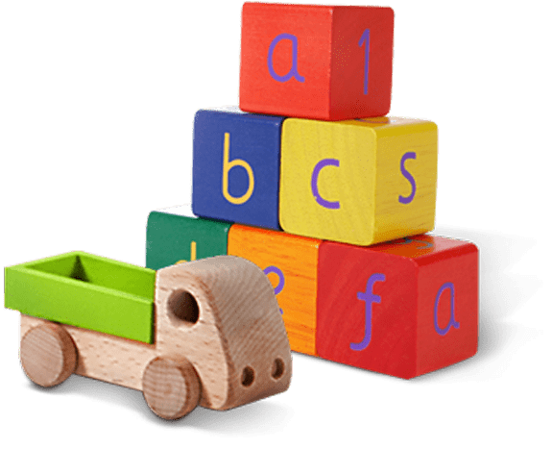
Glass jar
PET Plastic bottle
Shoes
Metal can
Light bulb
Juice box
Dirty napkin
Plastic bag
Toys
Pencil
Banana peel
Cardboard box
Garden hose
YES
NO
Notes:
(Slide duration: 3-5 minutes)
Pre-lesson Icebreaker Exercise
Ask students:
Has anyone heard of recycling? If yes, please share with the class what they know.
Tell students:
Recycling is the process of collecting and processing materials that would otherwise be thrown away as trash and turning them into new products. Recycling can benefit your community and the environment.
Now read off the images left to right starting on the top row to test their knowledge about what items displayed can and cannot be recycled.
Order of images that will appear with each click.
Click 1: Glass jar
Click 2: PET Plastic Bottle
Click 3: Shoes
Click 4: Metal can
Click 5: Light bulb
Click 6: Juice box
Click 7: Dirty napkin
Click 8: Pencil
Click 9: Plastic bag
Click 10: Toys
Click 11: Cardboard box
Click 12: Garden hose
Click 13: Banana peel

Slide 7


YES
NO
Always recycle:
Never recycle:
Banana peel
Dirty napkin
Garden hose
Glass jar
PET Plastic bottle
Light bulb
Juice box
Shoes
Cardboard box
Metal can
Toys
Plastic bag
Pencil
Notes:
(Slide duration: 3 minutes)
Pass out or display this YES/NO slide – there is a printable pdf handout available for students.
Discuss what we can and cannot recycle based on the items in the worksheet.
What do you do with garbage at home?
Where does it go?
If you put everybody’s garbage into a big pile, how much would there be? Would it be too much?

Slide 8
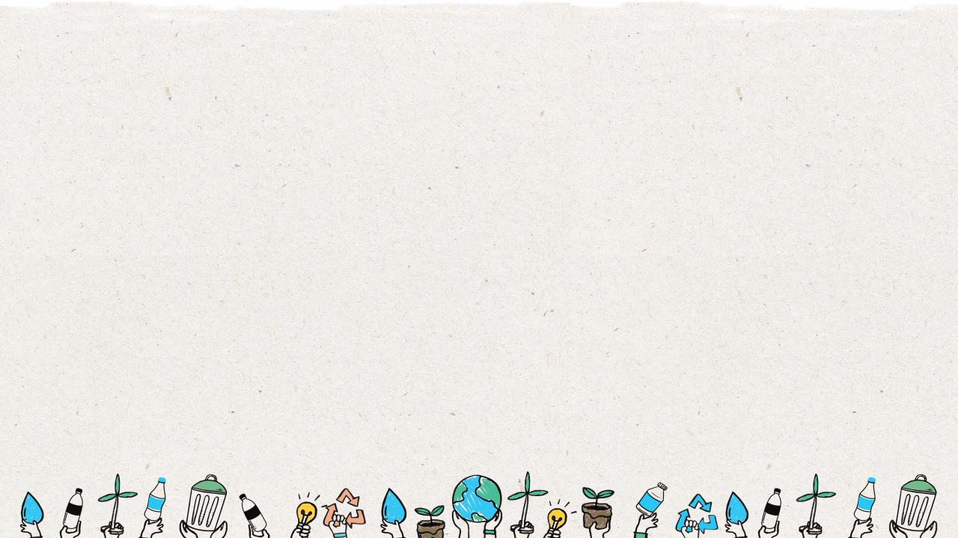
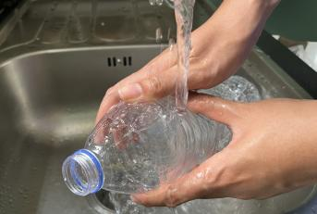
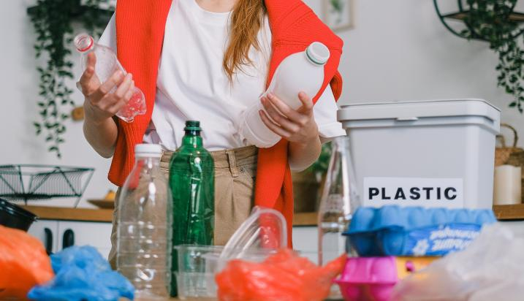

How do we prevent waste leakage into our environment?
Practice The 3 Steps to Recycling
1
Know what you can recycle.
2
Empty, clean, and dry before putting in the bin.
3
Put recyclables into the correct recycling bin.
Notes:
(Slide duration: 3 minutes)
Ask students:
So how can we help to prevent waste leakage on land so that our waste and recyclables do not enter the ocean?
How do we properly recycle?
What can we recycle? Examples?
Answers:
Practice the 3 steps to recycling.
We can recycle PET plastic bottles (find the #1 on the bottom of the bottle), metal, paper, and glass.

Slide 9
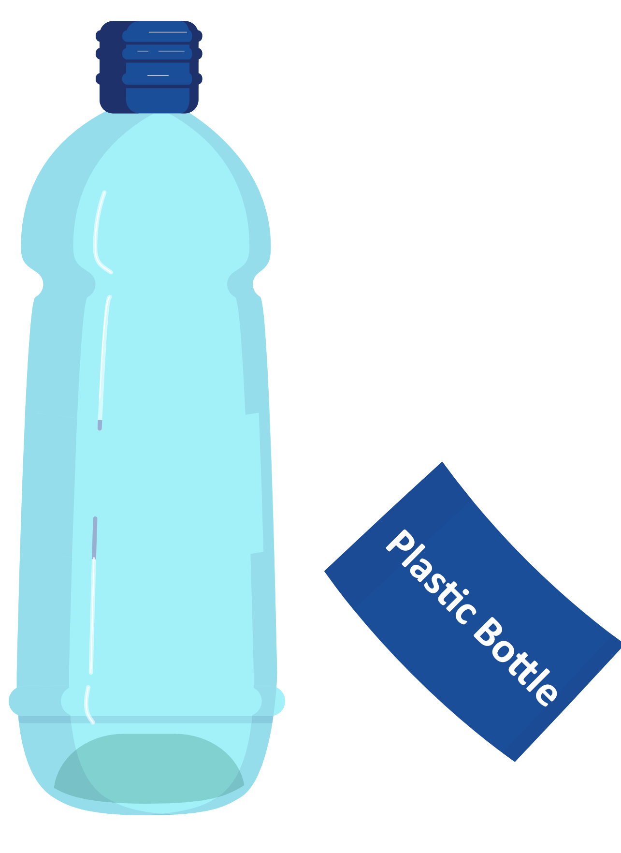

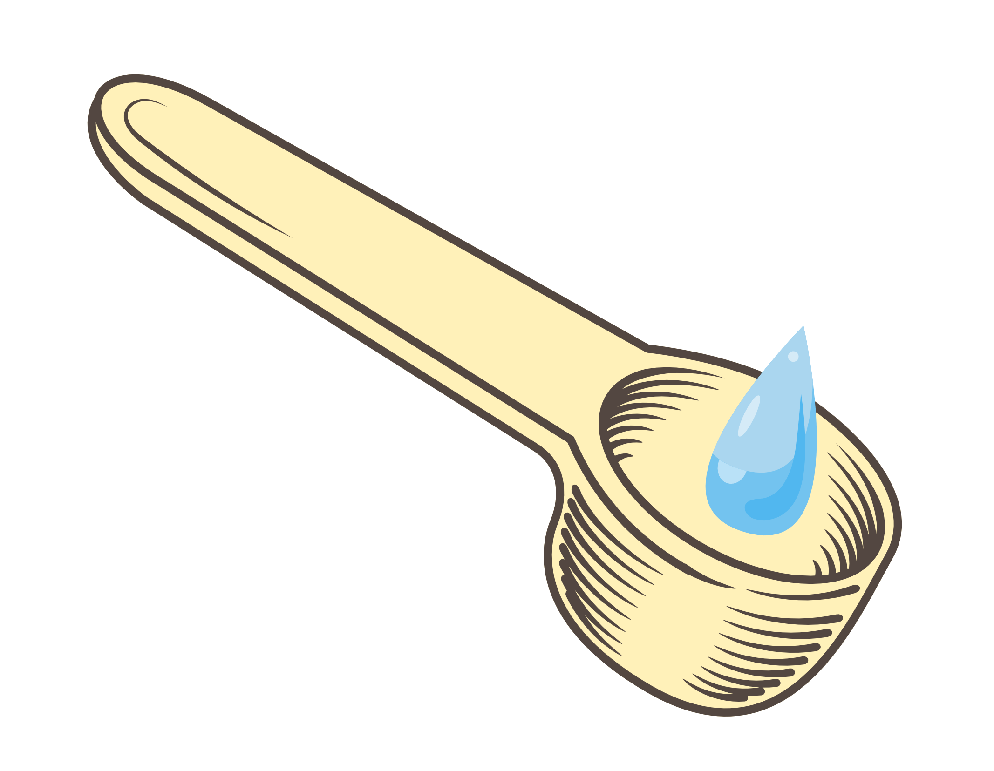

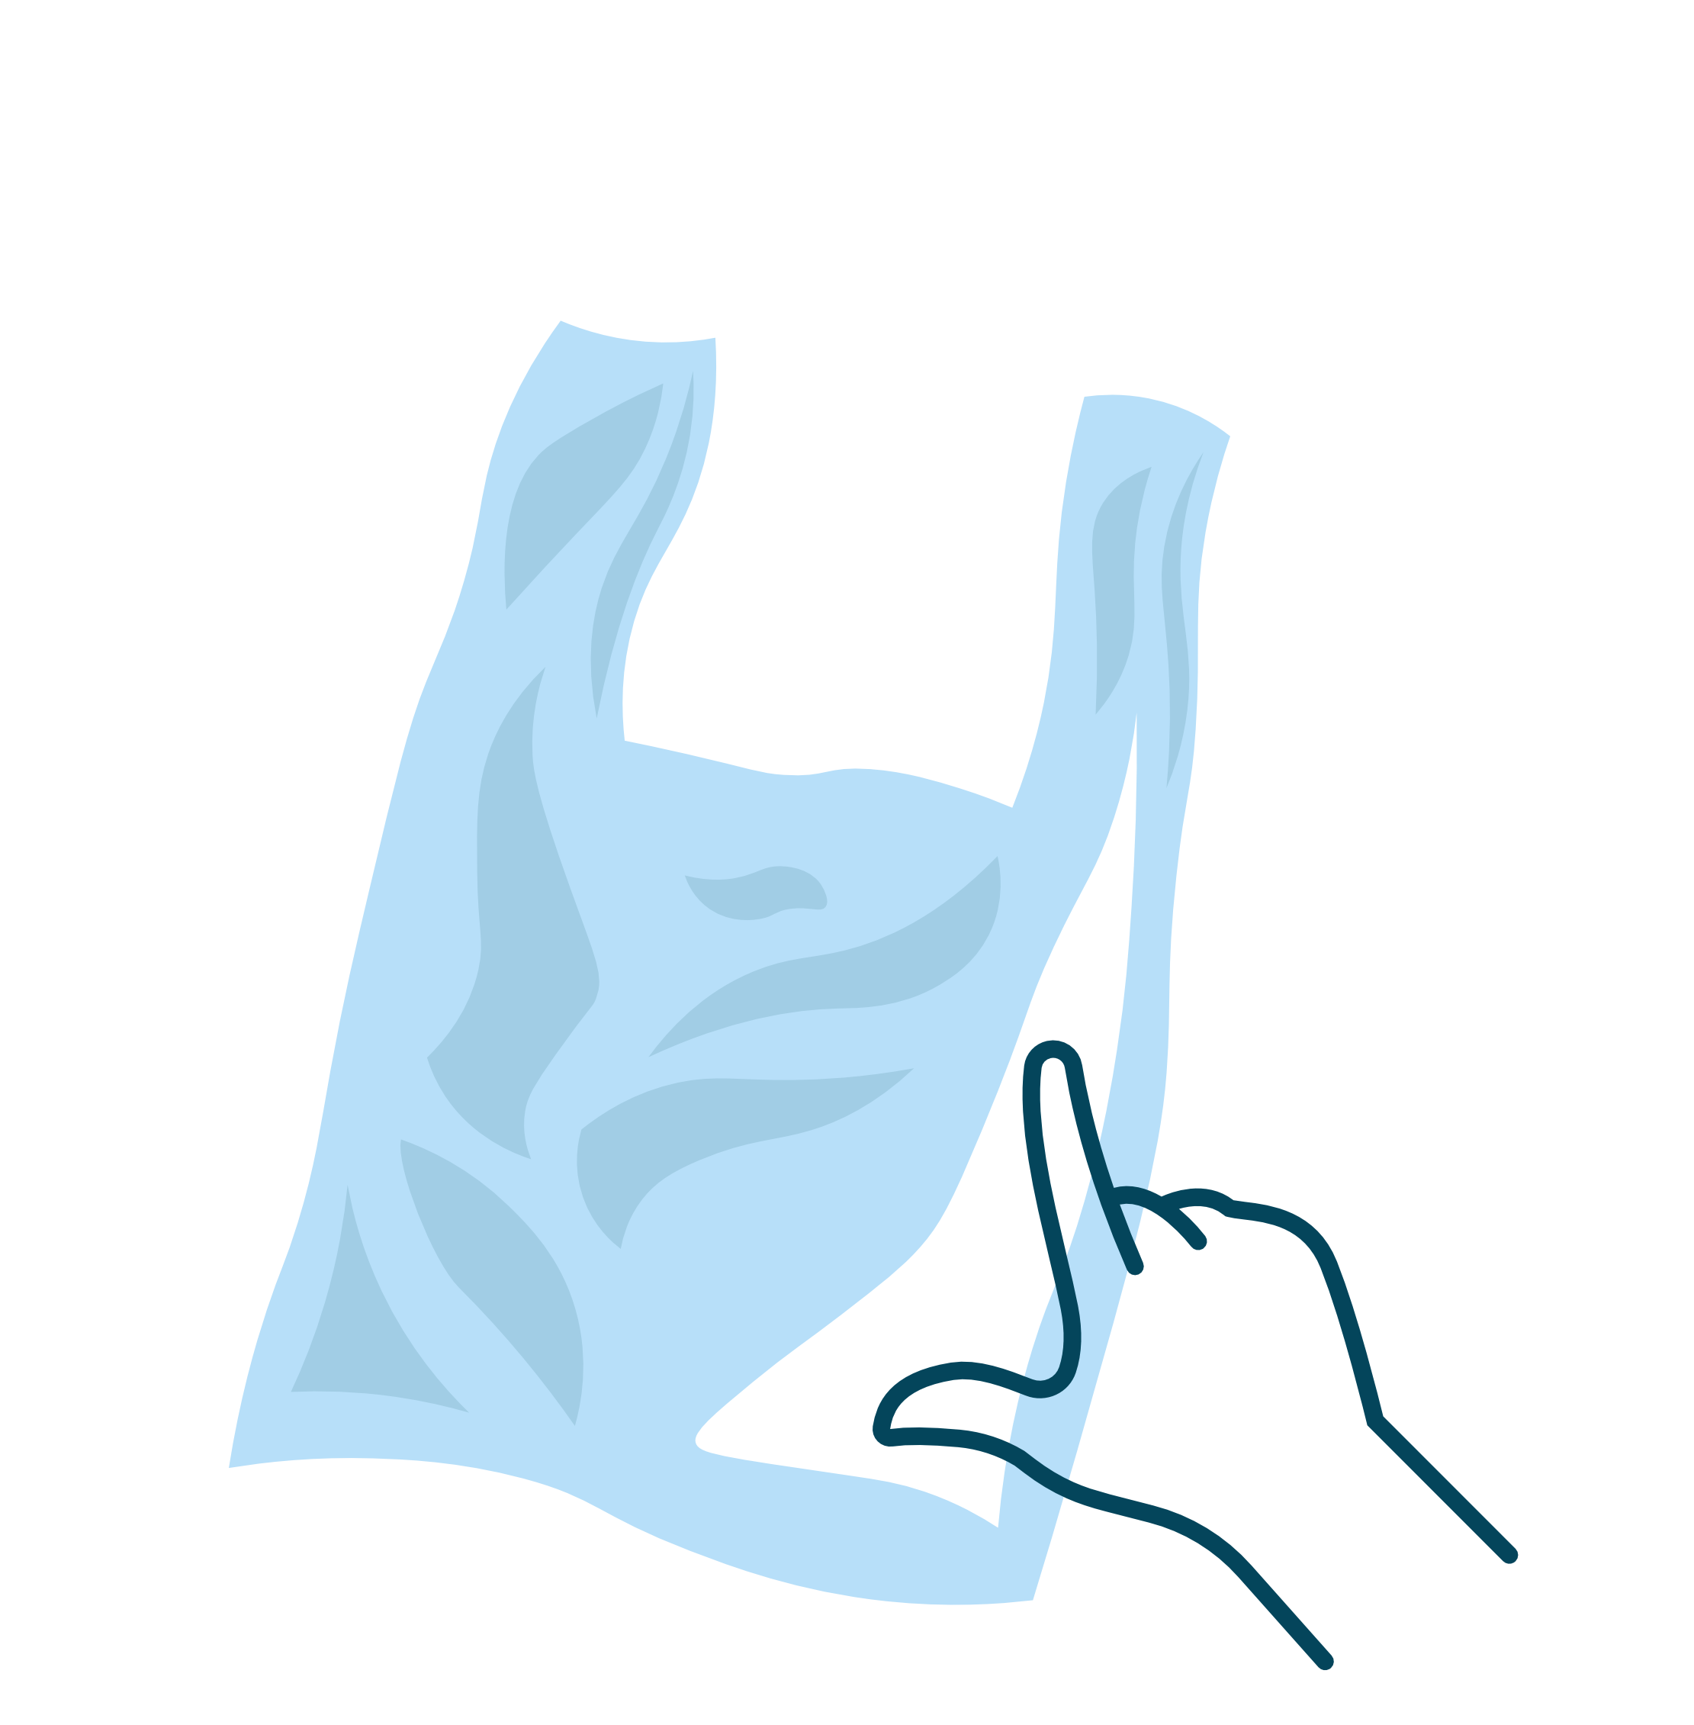
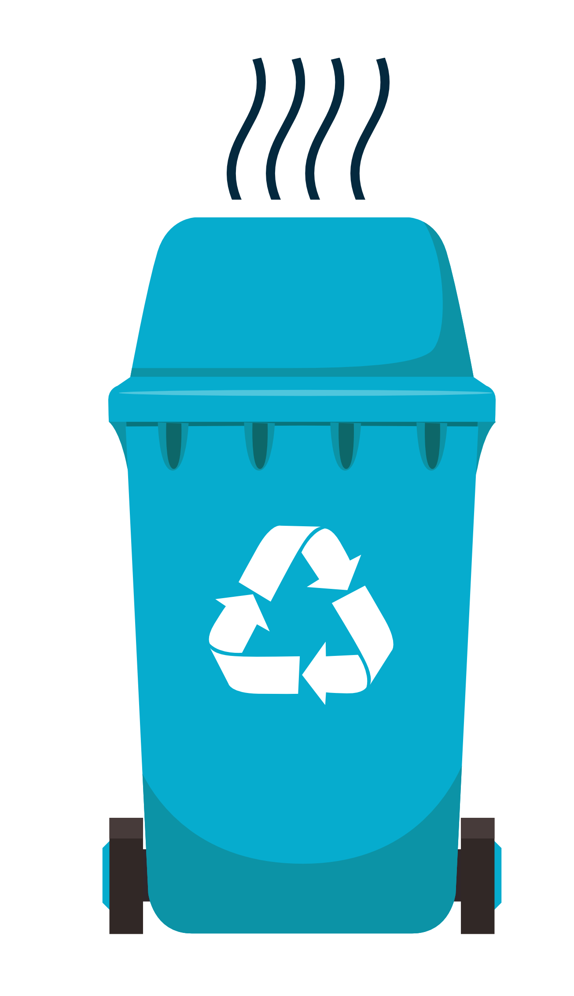
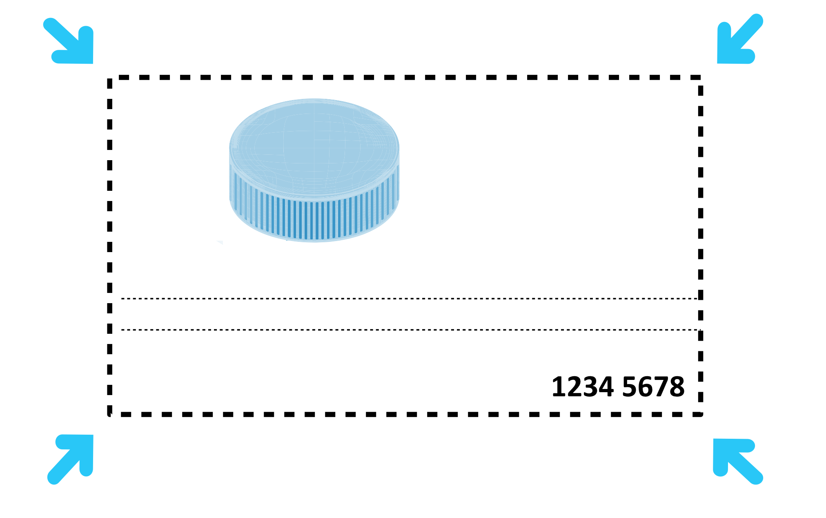
What is your Waste Hero’s Message to Inform and Inspire?
Recycling Best
Practices & Tips
Keep your recyclables dry – less than a teaspoon of liquid
Separate
combined materials
If your recycling container smells, it is contaminated
If you can poke your finger through it,
do not recycle it
Never recycle anything smaller than an ID card
Notes:
(Slide duration: 3-5 minutes)
Tell students:
Learn to avoid common recycling mistakes, tell the difference between what is recyclable and what is not, and use best practices to keep your recycling clean and simple. You can really make a difference using these tips and best practices.
Separate multilayered objects like some food packaging labels or labels on bottles.
Keep recycling dry, preferably less than a teaspoon of liquid.
If your recycling bin smells bad, there is a good change there is rotting food or liquid inside and the bin is contaminated, do not recycle it.
If you can poke your finger through a piece of plastic, it cannot be recycled, like plastic bags or food wrapping.
Anything smaller than an ID card should not be recycled.

Slide 10
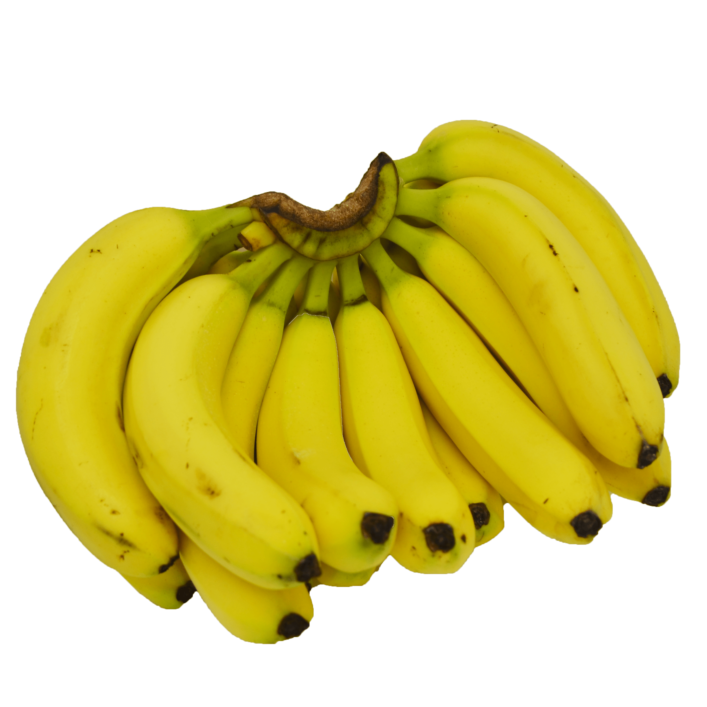
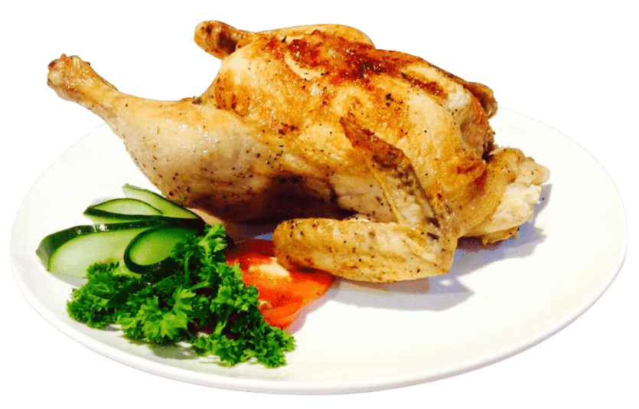
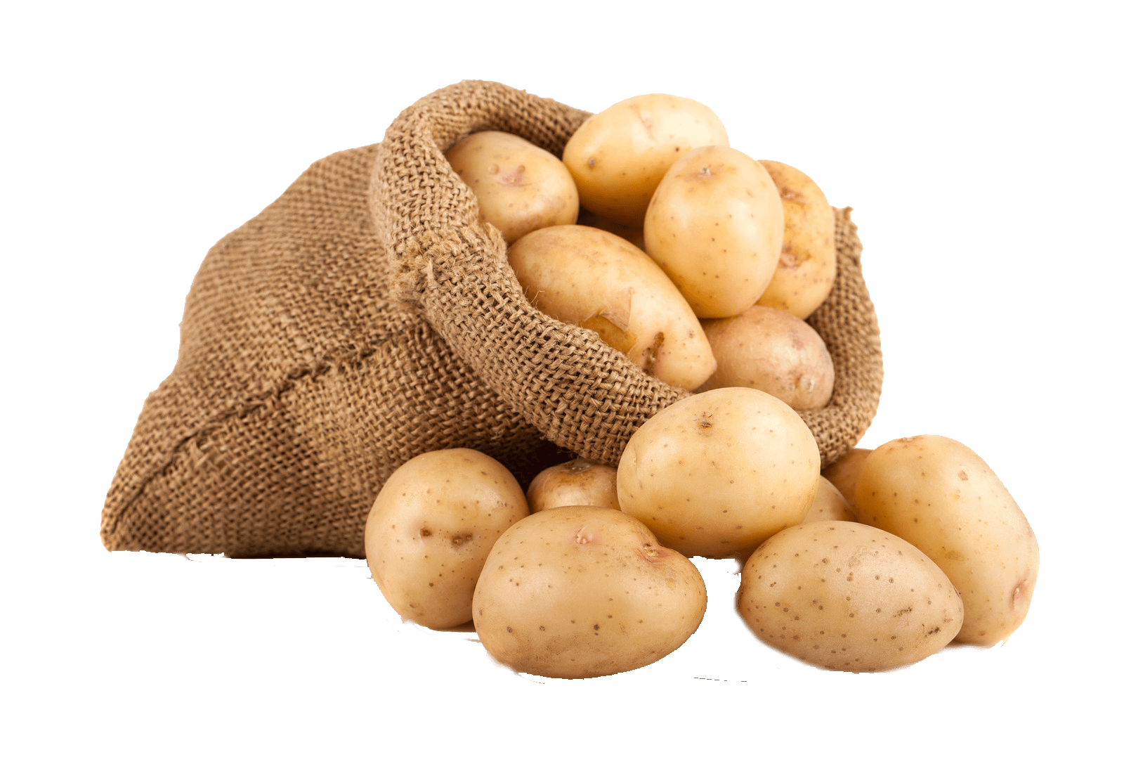

How much waste does the average person create each day?
4 bundles of bananas
= 4.5lbs/2kg
2 full rotisserie chickens = 4.5lbs/2kg
Sack of potatoes = 4.5lbs/2kg
Small dog = 4.5lbs/2kg
Notes:
(Slide duration: 3 minutes)
Tell students:
The world generates at least 3.5 million tons of solid waste a day, 10 times the amount a century ago. The current average global population increase is estimated at 81 million people per year. With more people comes more consumption, and as a result there will be even more waste being created.
Ask students:
Do you know how much waste the average person creates each day?
Tell students:
Click 1: 4 bundles of bananas
Click 2: 2 full rotisserie chickens
Click 3: 1 sack of potatoes
Click 4: a small dog
Ask students:
How much waste is that per week? Per month? Per year?
Answers:
Week = 31.5lbs/14kg
Month = 135lbs/60kg
Year = 1,642.5lbs/730kg

Slide 11
What is the waste stream?
1
We clean, separate, and place our recyclables at home and at school for pick up.
Notes:
(Slide duration: 3 minutes)
Ask students:
Have you heard of the waste stream? What do you think it means?
Tell students:
The waste stream is the complete flow of waste from its source to its recovery, recycling or final disposal. It is the complete lifecycle of the material from your home to its end-of-life destination.
The waste stream begins when we consume a product like soda from a PET plastic bottle. Once we finish our drink the PET bottle needs to enter the waste stream.
Ask students:
Where should the PET bottle can go to next?
Answers:
The correct recycling bin that is properly labeled to accept items made from PET plastic.

Slide 12
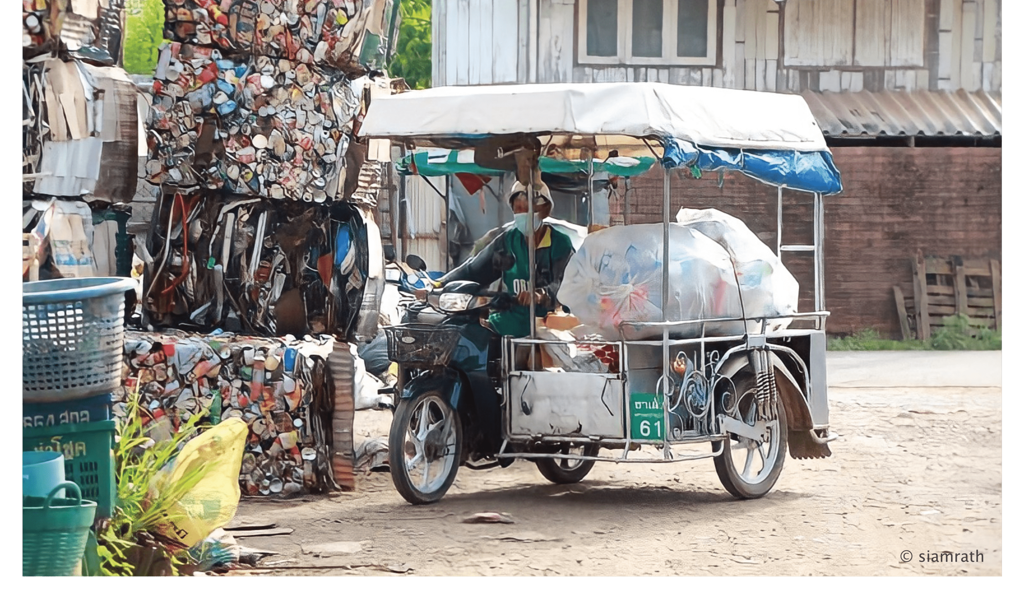
What is the waste stream?
2
Recycling trucks pick up and deliver your recyclables and drop them off at the recycling facility.
Notes:
(Slide duration: 3 minutes)
Ask students:
What is the next step in the waste stream for our PET bottle?
Answers:
Our PET bottle in the recycling bin will be picked up by a waste collector.
Ask students:
Where do you think the PET bottle goes to next?

Slide 13
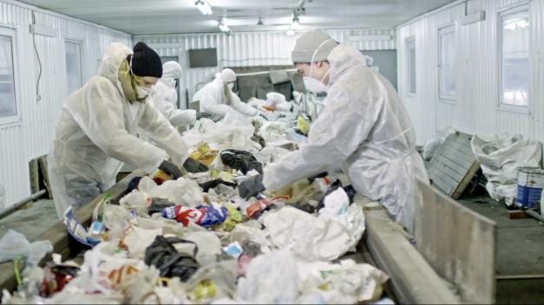
What is the waste stream?
3
Assembly line workers hand separate all the items delivered. They remove any food, plastic bags and other items that do not belong.
Notes:
(Slide duration: 3 minutes)
Tell students:
After the PET bottle has been collected, it is transported to a recycling facility. At the facility, assembly workers separate the different materials and remove anything that does not belong.
Ask students:
What kinds of items do not belong in recycling and are removed? What items do belong here?
Answers:
Food waste, plastic bags, broken toys, juice boxes, pencils, and old clothes do not belong in the recycling.
Glass, metal, plastic bottles, paper, and metal belong here.
Ask students:
Where does our PET bottle go to next?

Slide 14
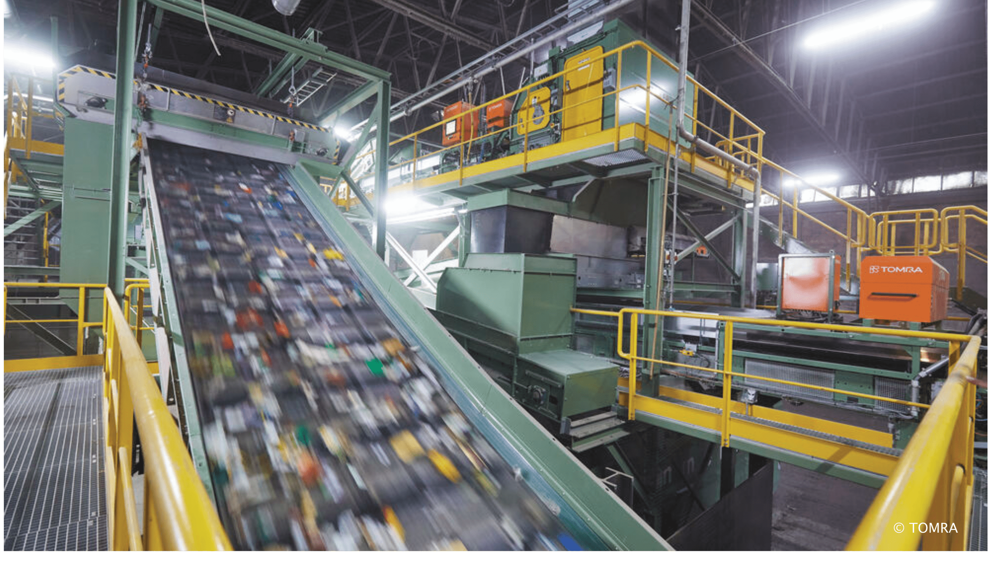
What is the waste stream?
4
Machines use high technology to further sort and separate paper, cardboard, plastic
and metal.
Notes:
(Slide duration: 2 minutes)
Tell students:
Next recyclables are further separated into their same material type for processing like our PET bottle. High tech machinery is used to do this separation automatically.

Slide 15
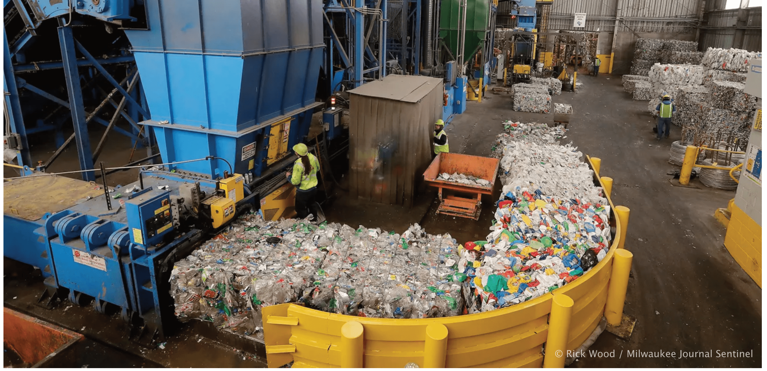
What is the waste stream?
5
Once these 4 materials are properly separated, the items are flattened and packed into bales. Bales look like giant blocks of recyclables.
Notes:
(Slide duration: 3 minutes)
Tell students:
Now that our PET bottle has been separated along with thousands of other items, heavy machinery is used again to flatten the bottles into giant cubes and baled together.
Ask students:
Why are PET bottles flattened into giant cubes?
Answers:
Baling PET plastic items into giant cubes makes it very easy to organize, weigh, and transport along the next steps in the recycling waste stream.

Slide 16
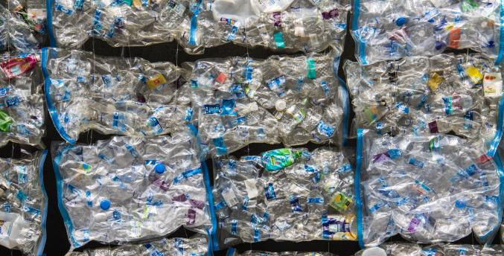
What is the waste stream?
6
These bales of recyclable material are sold to companies who will process these materials into new products.
$
Notes:
(Slide duration: 2 minutes)
Tell students:
Once PET bottles are baled into giant cubes they are sold as raw material to big companies that will turn them into other products.
Ask students:
What kinds of things will be made from these bales of PET bottles?
Answers:
PET bottles are often made back into more PET bottles, but they can also be made into many things like fabric and textiles.

Slide 17
Class Activity: 1 Day Waste Audit
Notes:
Tell students:
Now you will evaluate your own waste you create each day at home and you will conduct a waste audit. You will examine your waste and document your findings within your waste audit form.

Slide 18
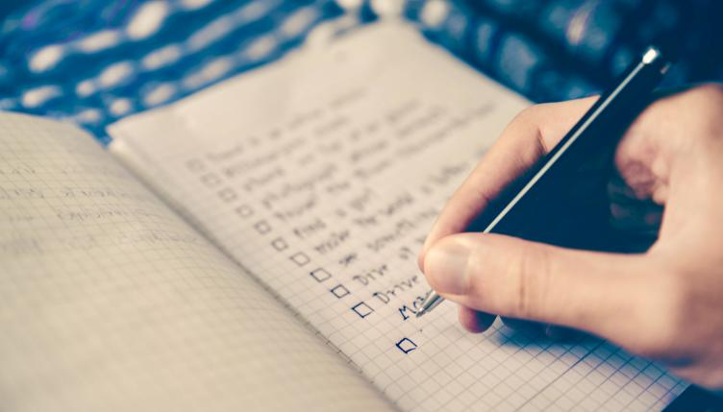
What is an audit?
Notes:
Ask students:
What is an audit, specifically a waste audit?
Answers:
An audit is an examination of information and the collection of evidence to analyze a situation. We can conduct a waste audit by keeping track of all the waste we produce, by keeping a record of it, and by analyzing this information to see what our own impact is on the environment.
We can do this with our waste inventory as well, to better inform ourselves on how much waste we are contributing to the waste stream.

Slide 19
1
Steps for the Day
Home Audit
Notes:
Tell students:
Students will conduct a home audit of their waste in 5 easy steps.

Slide 20
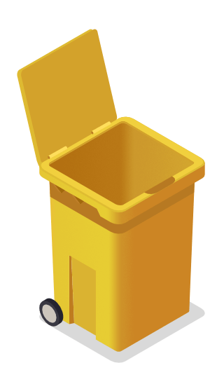
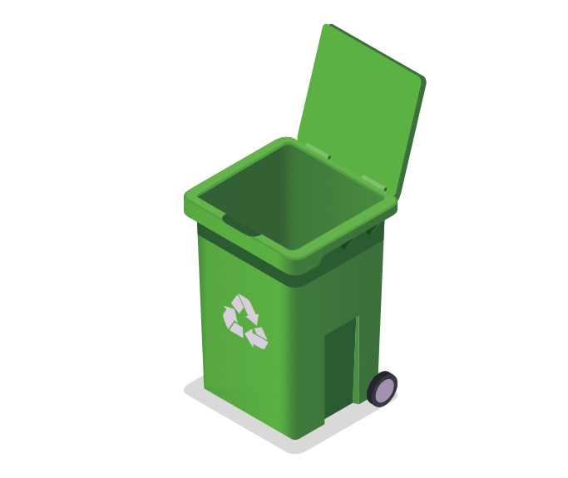
Step
1
Check with your parents to pick a day for the home waste audit. The day of the audit, make sure to choose 2 containers for non-recyclable waste and recyclable waste, and make sure both are empty before you begin.
1
2
Non-recyclable Waste
Recyclable Waste
Notes:
Tell students:
Check with your parents to pick a day for the home waste audit. The day of the audit, make sure to choose 2 containers for non-recyclable waste and recycling waste, and make sure both are empty. Work with your parents to begin collecting your waste at breakfast and you will finish collecting after dinner that evening.

Slide 21
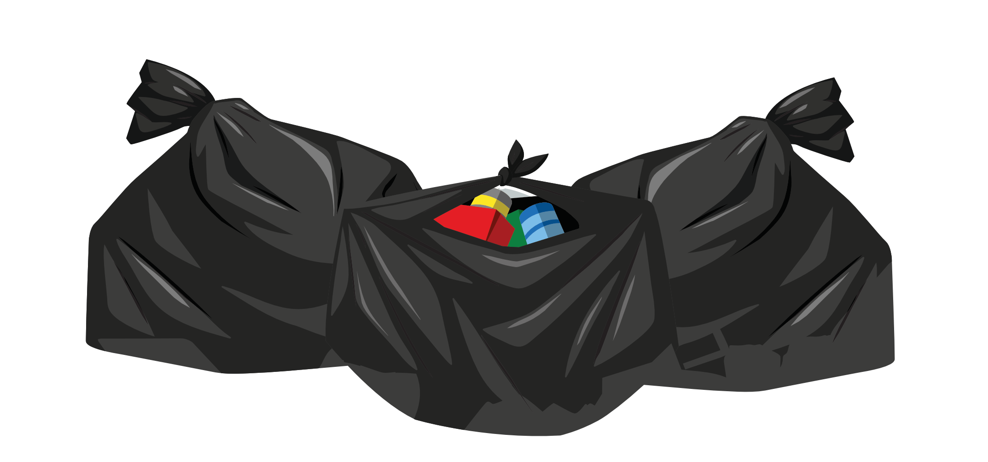

Step
2
After collecting the last bit of waste, set out three trash bags to sort the three types of waste collected: (1) Recycling, (2) Food Waste, (3) Non-recyclable items. Wear protective gloves!
Food waste bag
Non-recyclable bag
Recycling bag
!
Notes:
Tell students:
After collecting the last bit of waste after dinner, work with your parents to set out three trash bags to sort the three types of waste collected: (1) Recycling (2) Food Waste, (3) Non-recyclable. With your parents, begin separating the waste collected from the two bins into the three bags. Be sure to wear some protective gloves and label the bags. You can reference the Yes/No handout to guide you in sorting the waste correctly.
*Use 2 trash bags for their food waste to prevent any leaking.

Slide 22
As you carefully go through the waste containers separating your waste into the three bags, record on your “Waste Audit Form” the individual recyclable items you collect and how many.
Step
3
Notes:
Tell students:
You will be given a waste audit handout which you will use to count the types of recyclables you collect. You will count the individual recyclable items and place food waste and non-recyclables in the labeled bags and bring to class to be weighed. Record each recyclable item individually and tally how many of each you have collected.

Slide 23
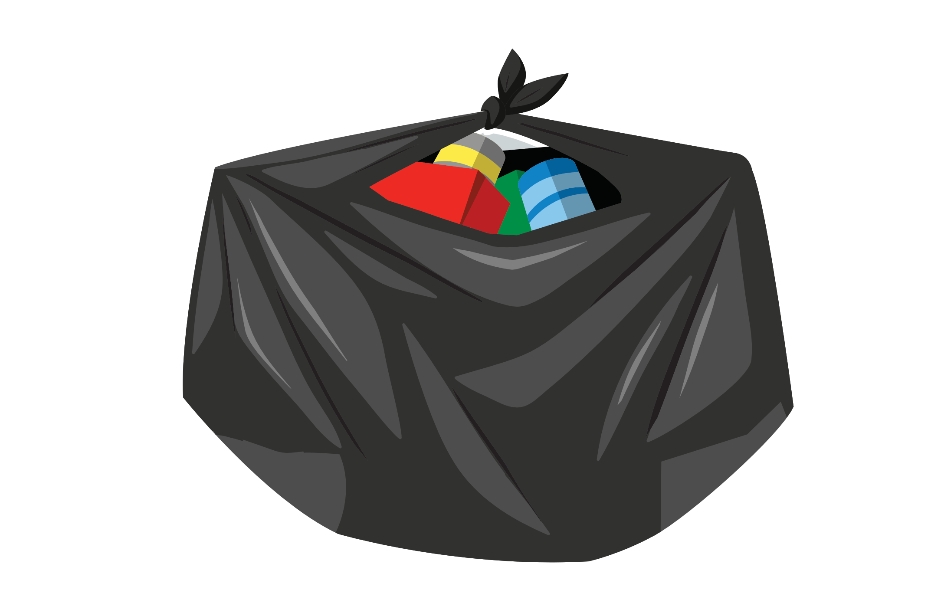
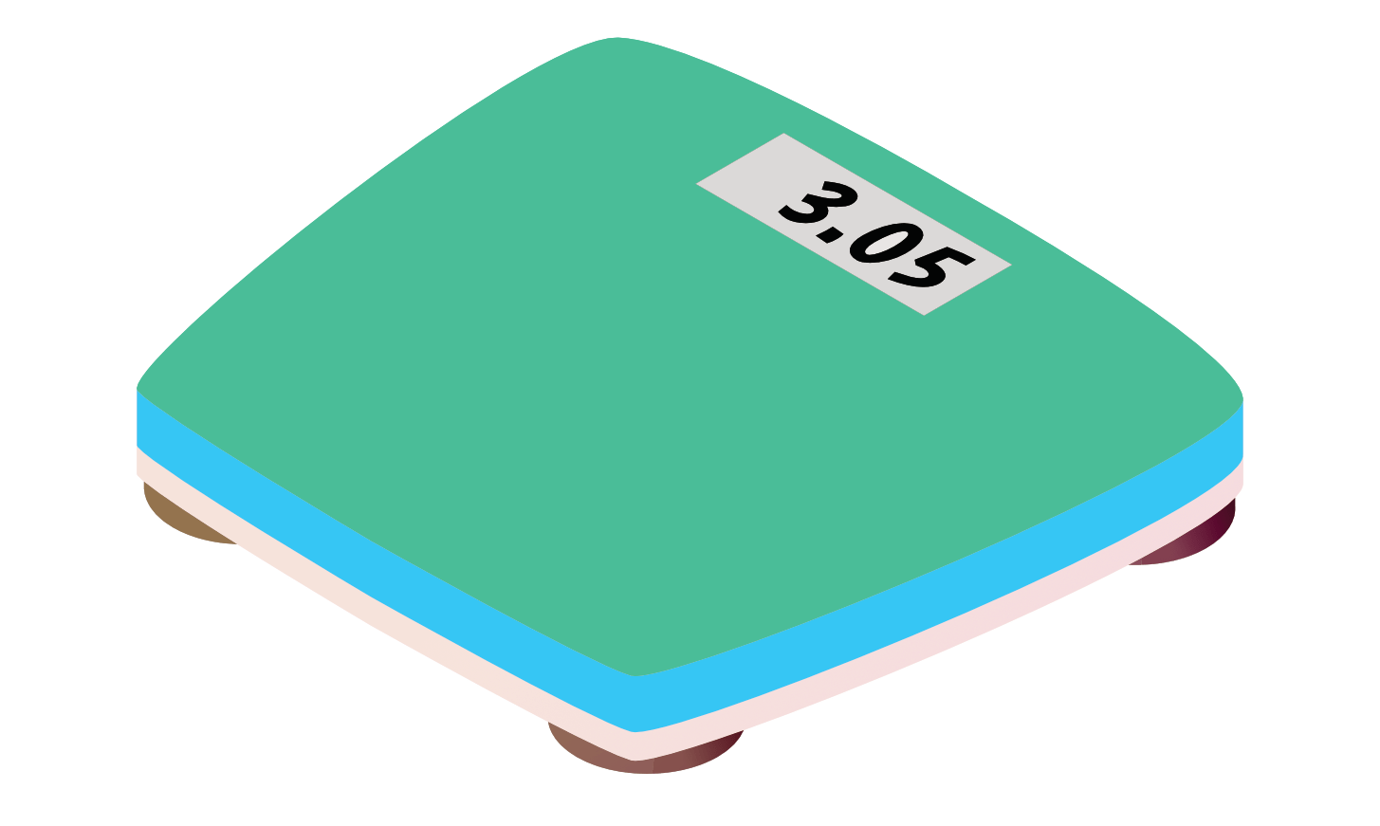
4
Bring your three bags to school. Using a standard scale, record the weight of each individual recyclable and the total weight of each of the three bags.
Step
Notes:
Schedule a class “weigh in” day and have students bring in their 3 bags with their audit handout. Using a standard scale, record the weight of each bag and the individual weight of their recyclables on the “Waste Audit Form”. To save time have students who have similar items in their recycling bag write in the weight on their form as items are being weighed as a class.
Next weigh each of their food waste and non-recyclable bags and have them write the weight on their audit forms.

Slide 24
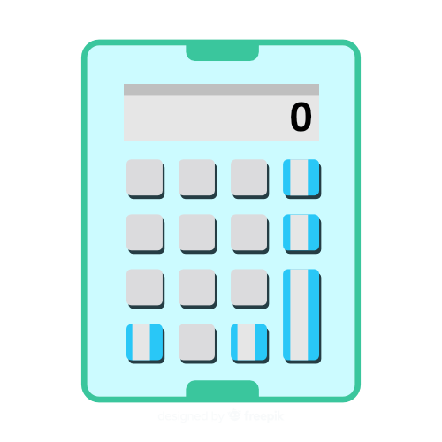
5
How much total waste did the class create? Now calculate how much total waste you are likely to create in a week (7 days), a month (30 days), and a year (365 days).
Step
Notes:
Tell students:
Get out your calculators and as a class calculate the class total. Try to calculate the potential waste you may create over the next week, month, and year.
Ask students:
What do you think about all that waste? Is it more or less than what you thought? Why?
What are some ways you think you can reduce this number?

Slide 25
Notes:
Introduce the waste audit form and answer any questions they may have.

