Slide 1
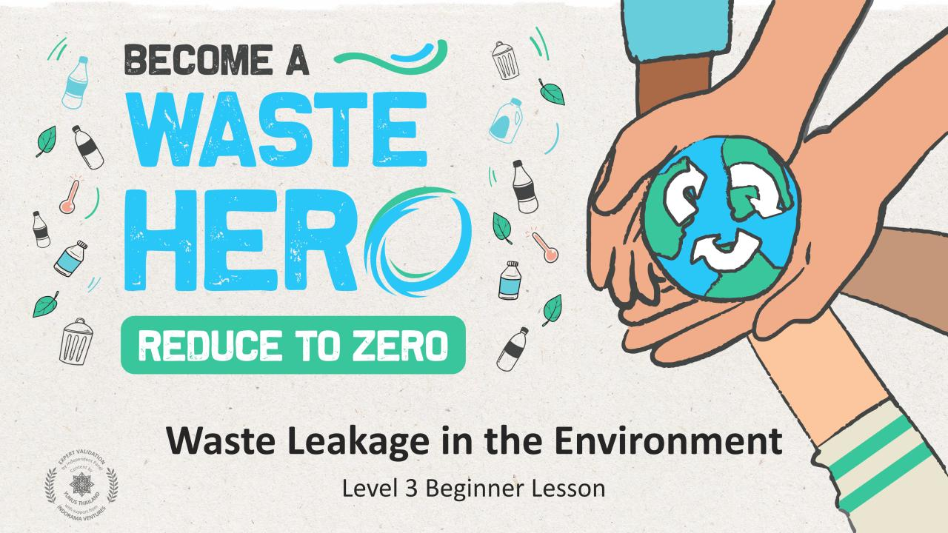

Slide 2

Lesson Prep & Curriculum Alignment
Prep time: 10 – 15 minutes
Students will review and refresh their knowledge of recycling and the negative effects on the environment without recycling best practices. They will also be introduced to the concept of “waste leakage” as a result of not recycling and mismanagement of recyclables. They will work in small groups or individually to create a “Waste Hero” character and design a poster that will be used to convey a PSA (Public Service Announcement) message to inform, inspire, and encourage recycling at school.
Students will receive a handout to create their character, then design their PSA poster and place the message around the school.
1
Display the lesson slides for the class and create a discussion about what they already know about recycling and introduce the concept or waste leakage and ocean bound waste. Ask students the guiding questions in the PowerPoint slide notes.
2
Print out the “YES/NO” handout and the “Create Your Waste Hero” handout.
Gather all kinds of art supplies and posterboards or A3 size paper (1 per group or per student).

Slide 3
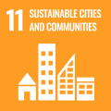
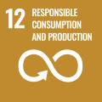
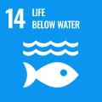
Lesson Prep & Curriculum Alignment
Prep time: 10 – 15 minutes
Key Learning Outcomes and Curriculum Alignment:
Science - Earth and Human Activity: Communicate solutions that will reduce the impact of humans on the land, water, air, and/or other living things in the local environment. Things that people do can affect the world around them. But they can make choices that reduce their impacts on the land, water, air, and other living things.
English Language Arts and Literacy: Participate in collaborative conversations with diverse partners about topics and texts. Follow agreed-upon rules for discussions. Use words and phrases acquired through conversations, reading and being read to, and responding to texts.
SDG Alignment
Flexible and adaptive lesson
Lesson plans are designed to be flexible and responsive to the evolving needs of your classroom. Lessons are editable and customizable to meet the different individual student and classroom contexts. A PowerPoint version with teacher instructions and a printable PDF lesson are available for download.

Slide 4
The Lesson
Lesson duration: 45 - 60 minutes
1
Introduce the lesson to your students by asking about their knowledge of what can and cannot be recycled and do the icebreaker exercise. Display the “YES/NO” slide or print the handout as a reference.
Create an open discussion about the basics of recycling.
Do you recycle?
What can be recycled?
What cannot be recycled?
Ask for them to give a few examples of each.
2
Introduce the concept of waste leakage and create a discussion about how our waste can enter the ocean, even if we do not live by the ocean. Display the slides explaining how waste enters our oceans from land.
3
Let students know they will create a “Waste Hero” superhero, and a posterboard PSA (Public Service Announcement) to be hung up at their school. Break into groups or work independently to create a school PSA (Public Service Announcement) message to inspire and empower people to recycle at school.

Slide 5
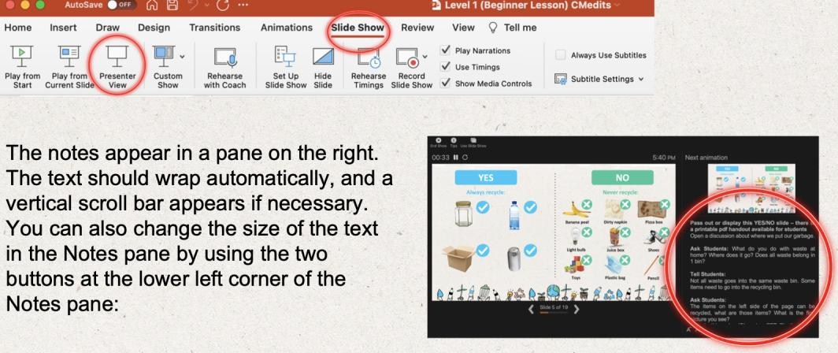
Prepare the PowerPoint presentation
When you are ready to present the lessons to your class click on Slide Show on the top menu bar then select Presenter View. In Presenter view, you can see your notes as you present while the audience see only your slides.
The notes appear in a pane on the right. The text should wrap automatically, and a vertical scroll bar appears if necessary. You can also change the size of the text in the Notes pane by using the two buttons at the lower left corner of the Notes pane.

Slide 6
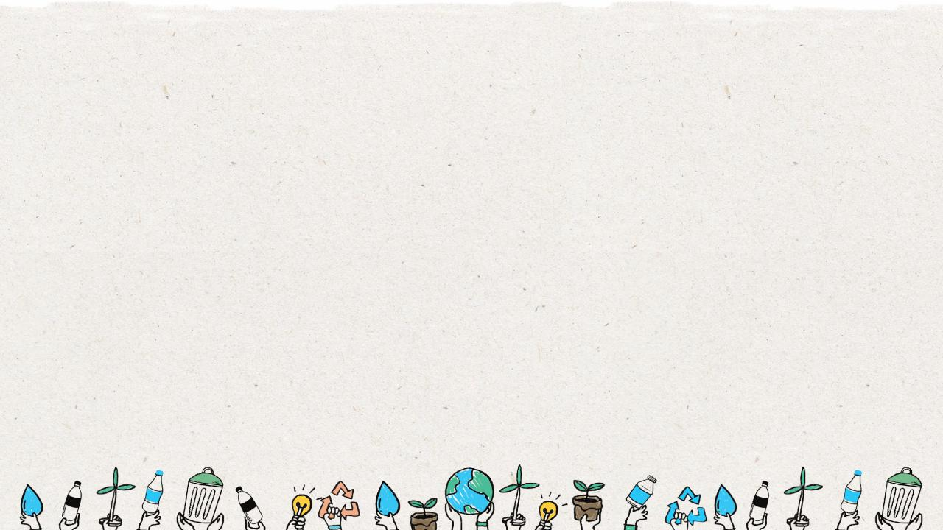
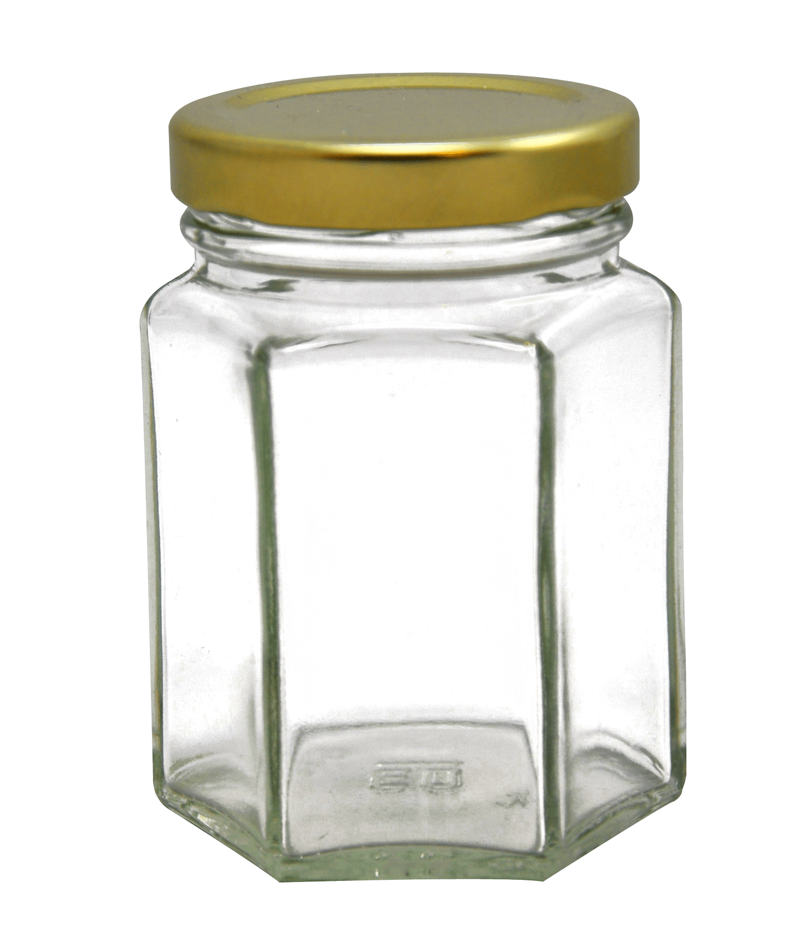
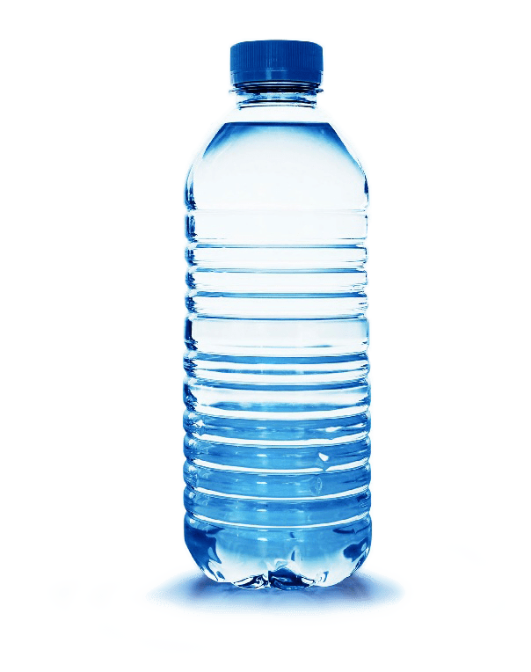
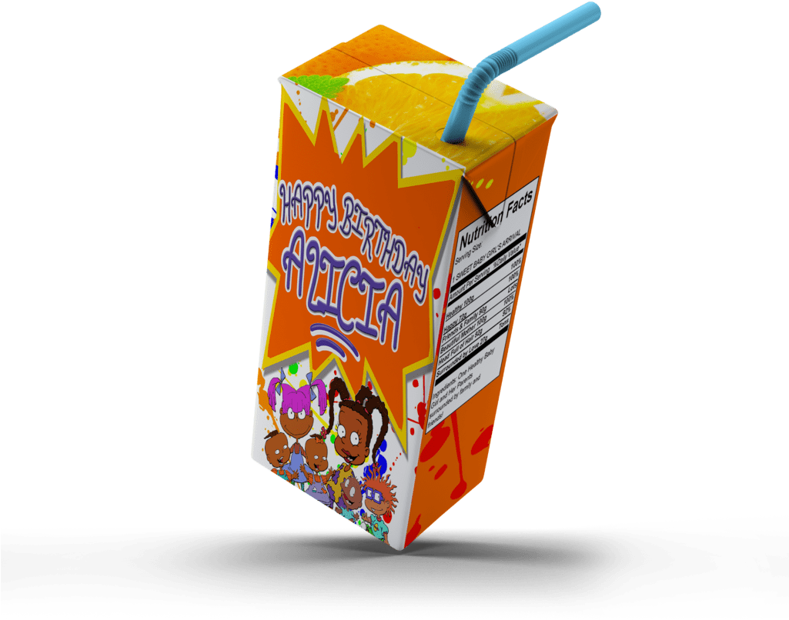
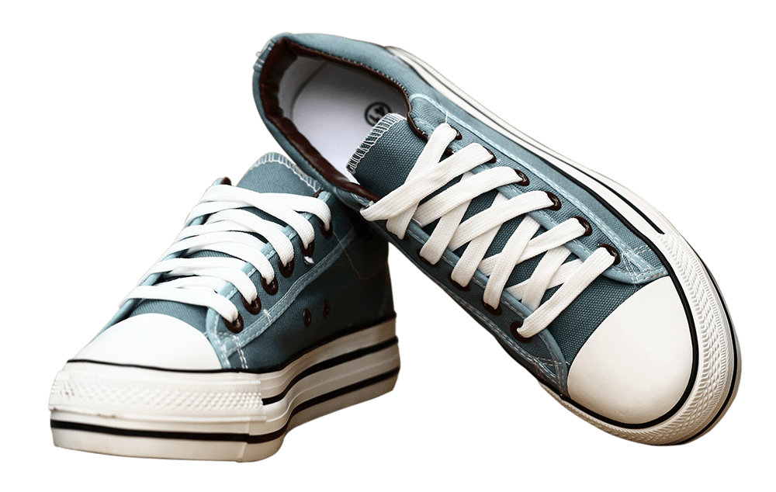
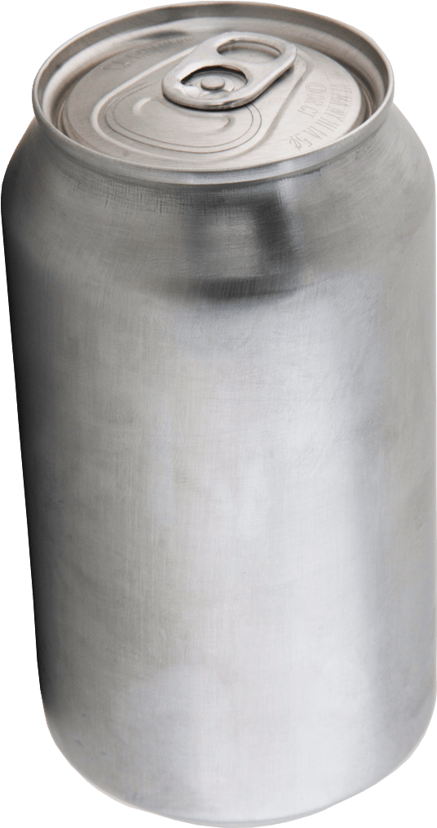
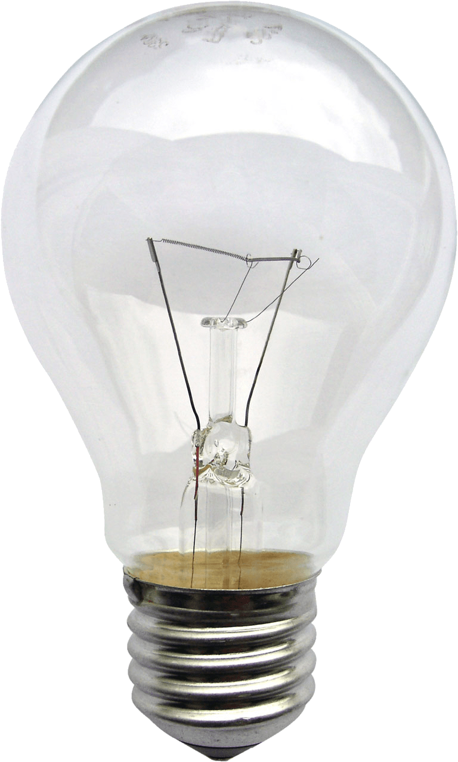
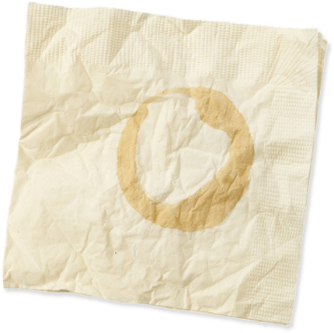
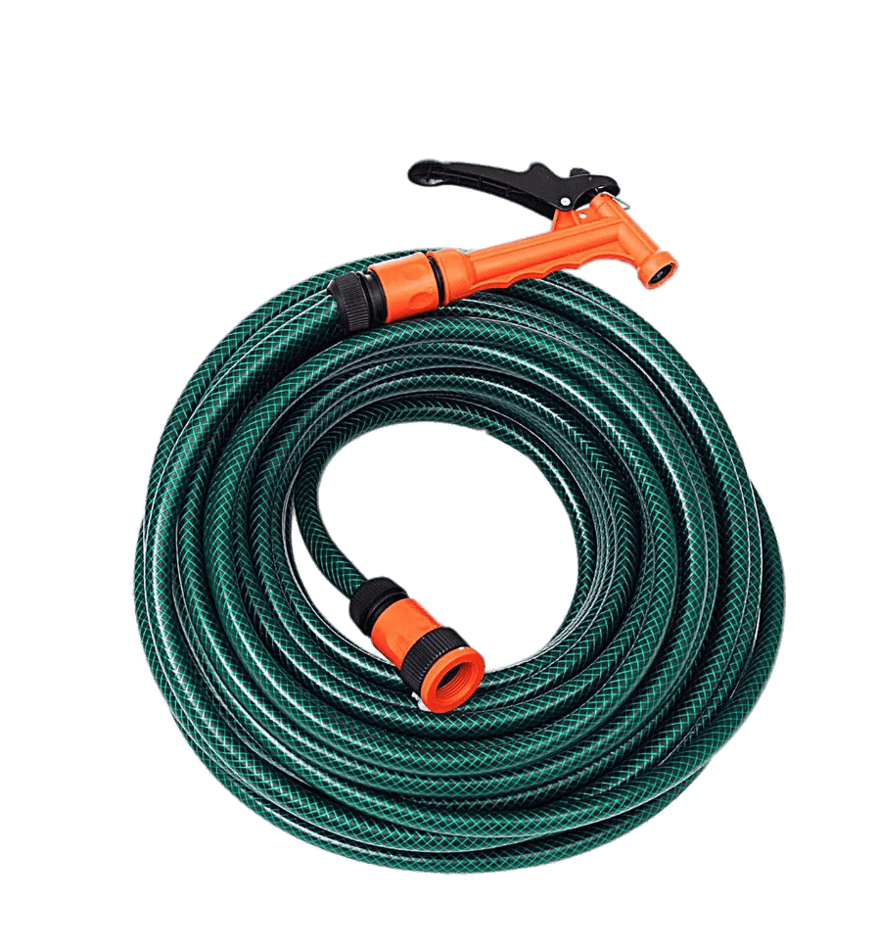
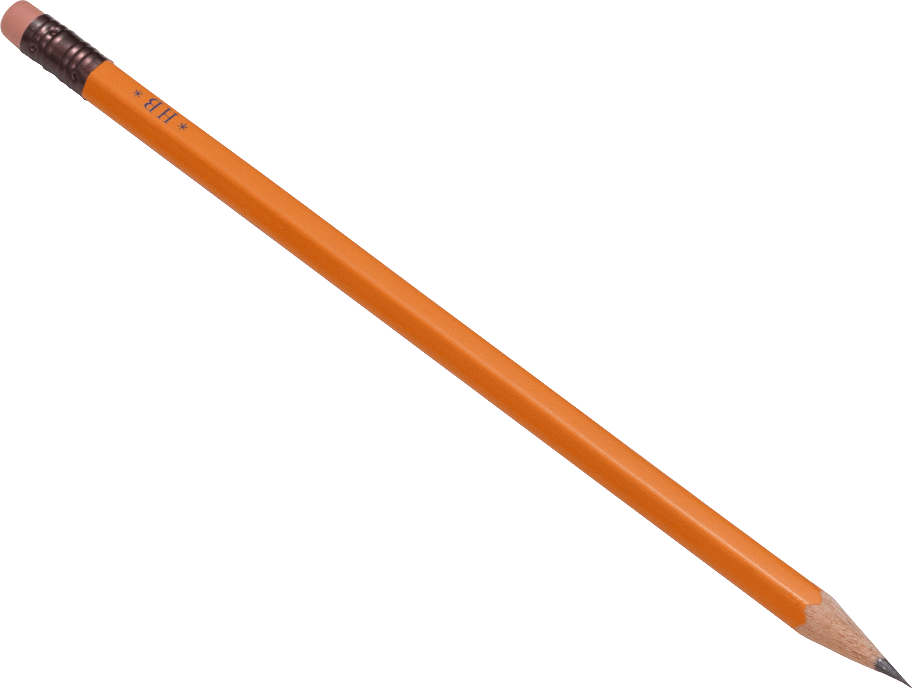
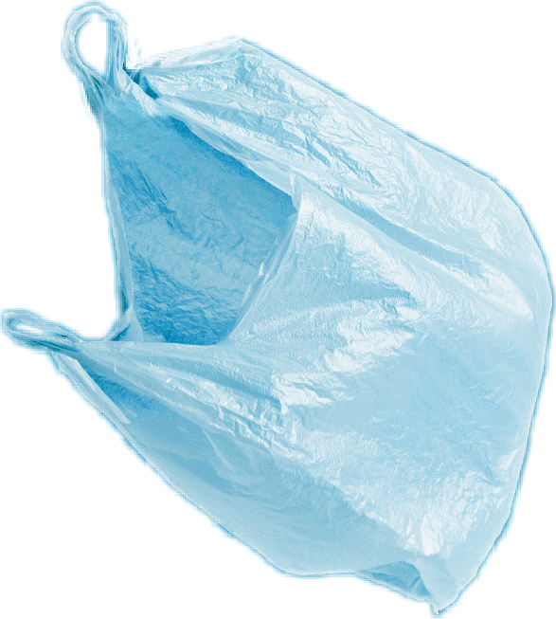
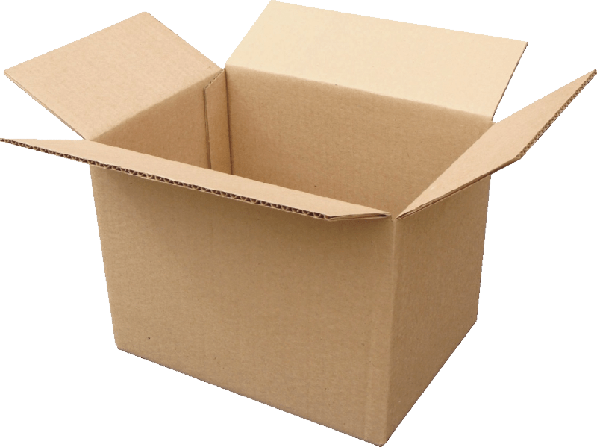
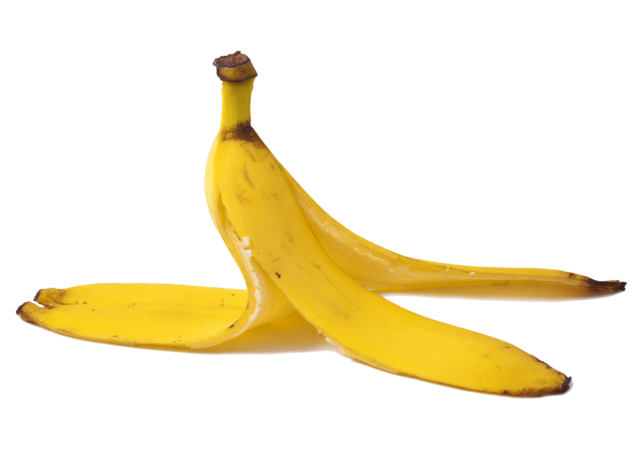
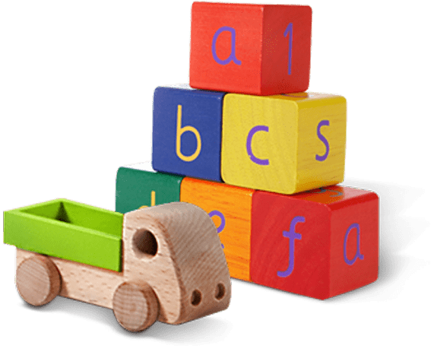
Glass jar
PET Plastic bottle
Shoes
Metal can
Light bulb
Juice box
Dirty napkin
Plastic bag
Toys
Pencil
Banana peel
Cardboard box
Garden hose
YES
NO
Notes:
(Slide duration: 3-5 minutes)
Pre-lesson Icebreaker Exercise
Ask students:
Has anyone heard of recycling? If yes, please share with the class what they know.
Tell students:
Recycling is the process of collecting and processing materials that would otherwise be thrown away as trash and turning them into new products. Recycling can benefit your community and the environment.
Now read off the images left to right starting on the top row to test their knowledge about what items displayed can and cannot be recycled.
Order of images that will appear with each click.
Click 1: Glass jar
Click 2: PET Plastic Bottle
Click 3: Shoes
Click 4: Metal can
Click 5: Light bulb
Click 6: Juice box
Click 7: Dirty napkin
Click 8: Pencil
Click 9: Plastic bag
Click 10: Toys
Click 11: Cardboard box
Click 12: Garden hose
Click 13: Banana peel

Slide 7


YES
NO
Always recycle:
Never recycle:
Banana peel
Dirty napkin
Garden hose
Glass jar
PET Plastic bottle
Light bulb
Juice box
Shoes
Cardboard box
Metal can
Toys
Plastic bag
Pencil
Notes:
(Slide duration: 3 minutes)
Pass out or display this YES/NO slide – there is a printable pdf handout available for students. Another version is to ask the students to write Yes and No in two columns on a page and to list the items they think are recyclable and have them reference this slide to check their work.
Opportunity for open class discussion.
Discuss what we can and cannot recycle based on the items in the worksheet.
What do you do with garbage at home?
Where does it go?

Slide 8
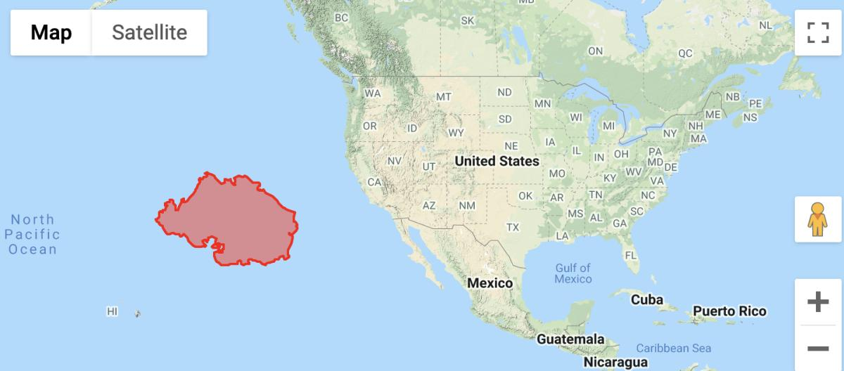
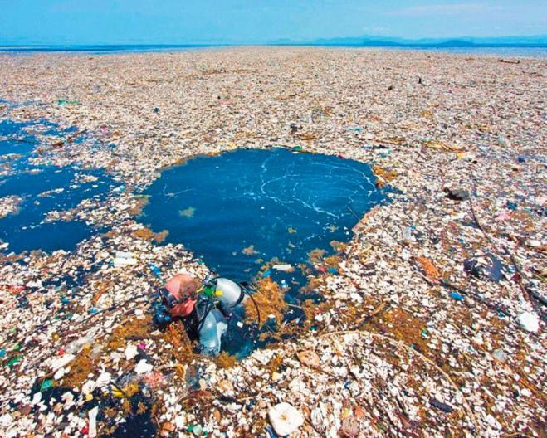
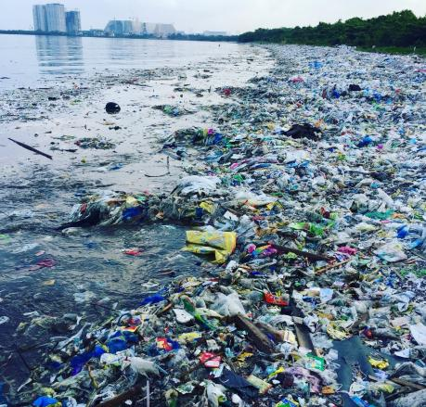
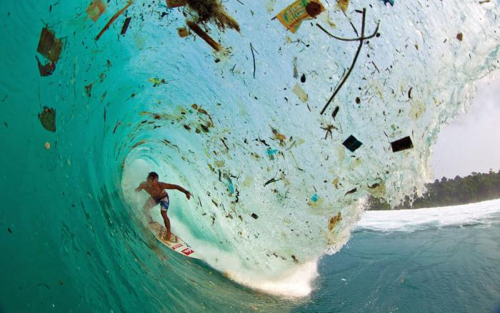
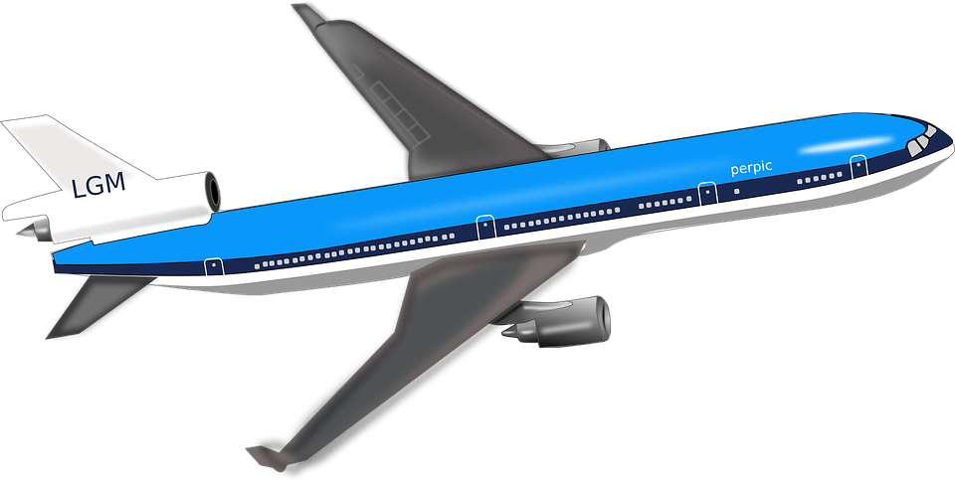
Ocean Waste
Notes:
(Slide duration: 3-5 minutes)
Tell students:
Waste accumulating in our oceans and on our beaches has become a global crisis. Billions of pounds of waste can be found in swirling convergences around our oceans. At current rates waste is expected to outweigh all the fish in the sea by 2050.
Pollution has a direct and deadly effect on wildlife. Thousands of seabirds and sea turtles, seals and other marine mammals are killed each year after ingesting waste or getting entangled in it.
Click 1:
There is so much ocean waste that it collects along shorelines and accumulates in huge garbage patches in the middle of the ocean. The south pacific garbage patch seen here in red is the world’s largest accumulation of waste. It is 2x times the size of the American state of Texas. This is a result of human generated waste entering the ocean and getting caught in currents that sends the waste flowing in circles in the middle of the ocean.
Click 2:
There is an estimated 80,000 metric tons of waste in this one garbage patch, which is the equivalent to…
Click 3:
500 jumbo jets.
Ask students:
Why is there so much waste in our oceans?
What do you think about the pacific garbage patch?

Slide 9

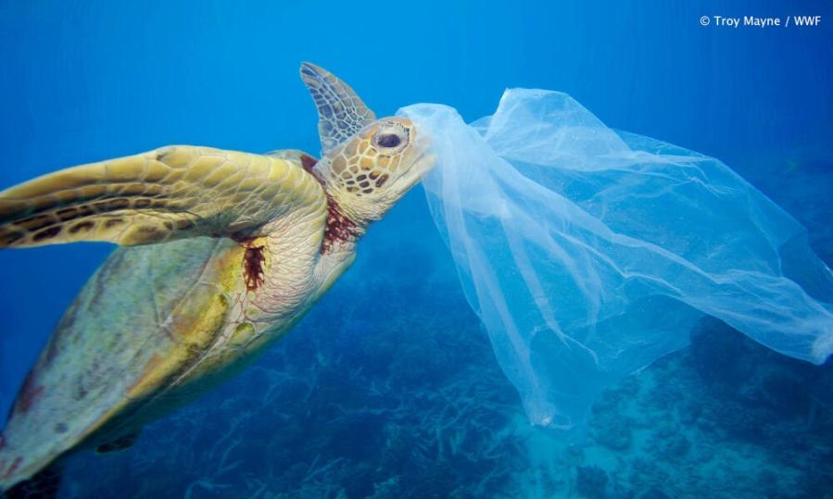
How much ocean waste is mistakenly eaten by ocean animals?
Nearly half of the world's turtles have eaten plastic waste.
Notes:
(Slide duration: 3 minutes)
Ask students:
Because so much waste leaks into the ocean, how much waste would you guess is mistakenly eaten by ocean animals?
Click1:
Research suggests that nearly half of the world's turtles have eaten human produced waste.
Click 2: sea turtle image appears
Ask students:
Why do sea turtles and other ocean animals eat waste?
Answers:
The reasons are simple: a floating plastic bag can look a lot like jellyfish, algae, or other species that make up a large component of the sea turtles' diets. All sea turtle species are at risk from ocean waste.

Slide 10
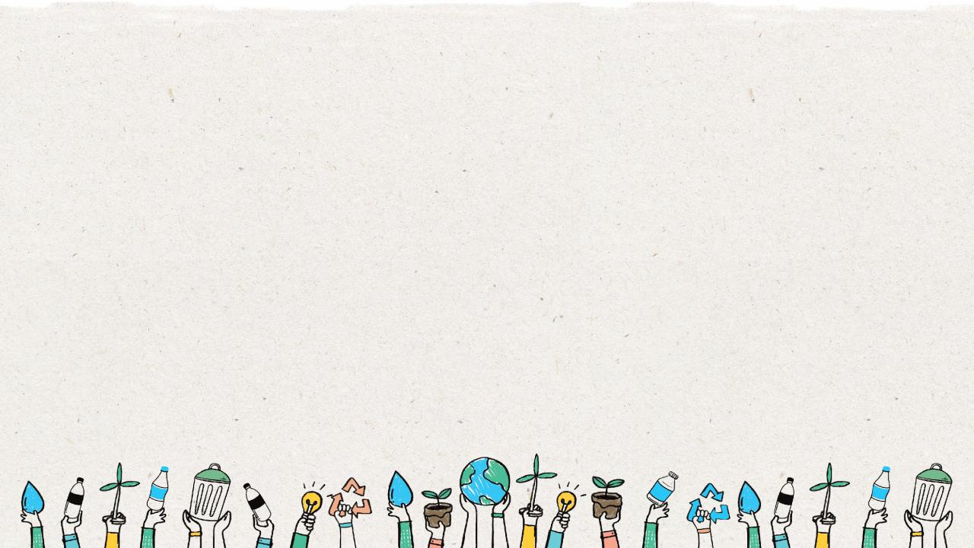
How does waste enter the ocean?
Notes:
(Slide duration: 3 minutes)
Ask student:
How does waste enter the ocean?
Where does waste come from?
Answers:
Most pollutants that make their way into the ocean come from human activities along the coastlines and far inland. One of the main reasons waste from land makes its way to our oceans is due to littering, poor waste management practices, storm water discharge, and extreme natural events such as tsunamis and hurricanes.

Slide 11
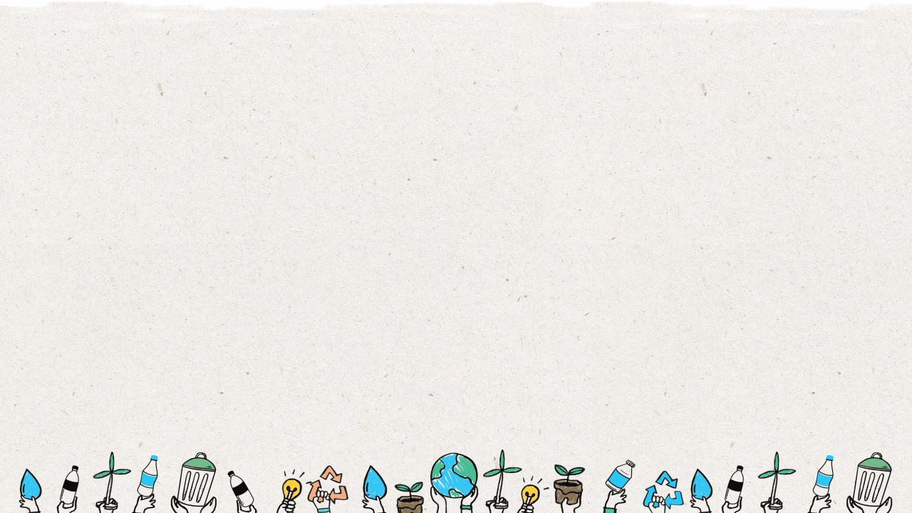

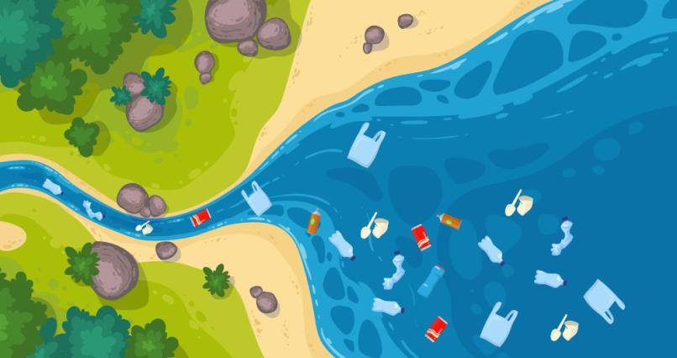
Waste leakage is when our waste does not get recycled or enter a landfill and leaks into our natural environment.
Most waste in
the ocean comes
from humans on land.
Notes:
(Slide duration: 3-5 minutes)
Tell students:
Leakage happens when waste escapes the systems that are designed to either keep it in the recycling loop, to dispose of waste in the landfill, or incinerate (burn) it. Waste that exits these systems then enters land-based environments and flows into waterways that feed directly into our oceans. Even if you live far far away from the ocean, your mismanaged waste will eventually flow into it.
Ask students:
Where does ocean waste come from?
Click 1: answer appears.
Answers:
Most of the waste in the ocean comes from humans and land-based sources. Let’s examine how land-based waste can enter the ocean in the following slides.

Slide 12
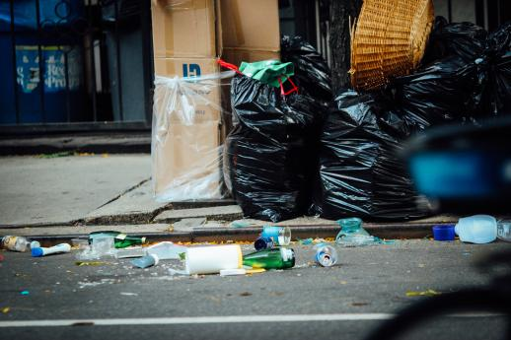
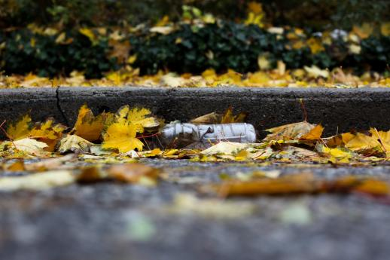
1. People leave waste on the ground
or it falls from a trash bin.
2. When it rains waste flows into
storm drains.
Notes:
(Slide duration: 2 minutes)
Tells students:
Let’s now follow the journey of human food packaging that accidently enters the ocean in 6 steps.
People leave food packaging on the ground called “litter” or it can fall from trash bins.
The food packaging on the ground then flow into storm drains along the street.

Slide 13
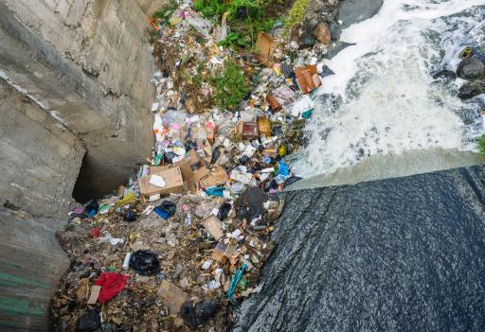
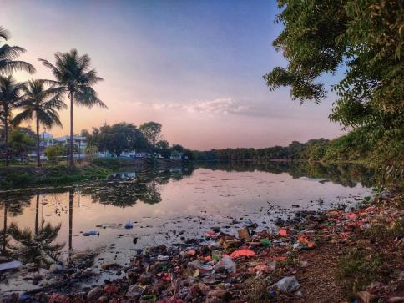
3. The storm drain feeds into
local waterways.
4. Those waterways then feed
into local rivers.
Notes:
(Slide duration: 2 minutes)
Tell students:
3. Once the food packaging enters the storm drain it is then flushed into local waterways.
4. Waterways are access points to rivers where all that drainage water and everything in it like our food packaging flows into local river systems.

Slide 14
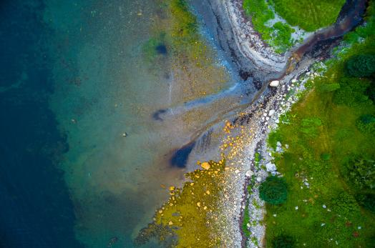
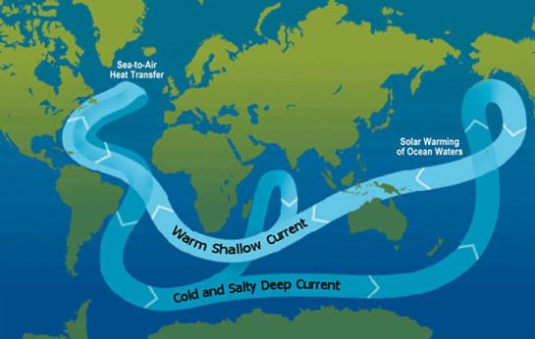
6. Ocean currents send waste around the world and create “waste islands”.
5. Rivers flow into the ocean.
Notes:
(Slide duration: 3 minutes)
Tell students:
5. Those smaller river systems converge together into larger rivers that feed directly into the ocean.
6. Ocean currents are all connected and send millions of pieces of waste to large ”waste islands” like the south pacific garbage patch. The waste island is not actually an island with a beach, but a large garbage pile floating in the ocean that is so large it looks like an actual island.
Click 1:
Image of waste island appears

Slide 15

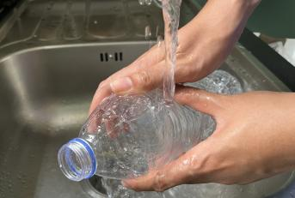
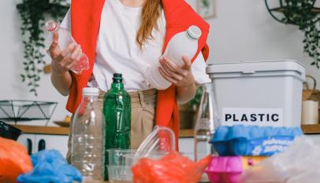

How do we prevent ocean waste?
Practice The 3 Steps to Recycling
1
Know what you can recycle
2
Empty, clean, and dry before putting in the bin.
3
Put recyclables into the correct recycling bin.
Notes:
(Slide duration: 3-5 minutes)
Ask students:
So how can we help to prevent waste leakage on land so that our waste and recyclables do not enter the ocean?
Click 1:
Recycling symbols appear.
Answers:
Recycling helps prevent waste leaking into the environment.
Ask students:
How do we properly recycle?
Answers:
Practice the 3 steps to recycling.
Ask students:
What can we recycle? Examples?
Answers:
We can recycle PET plastic bottles (find the #1 on the bottom of the bottle), metal, paper, and glass.

Slide 16
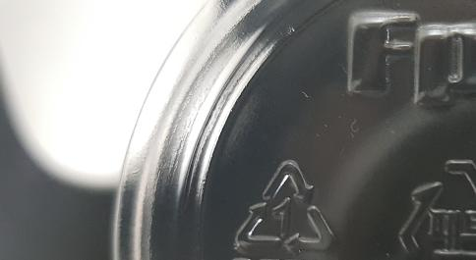


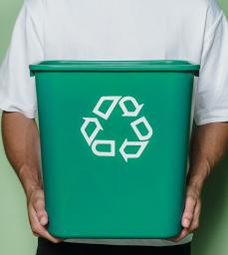
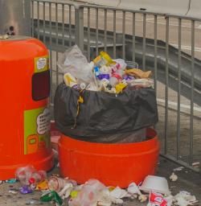
Recycling Tips we can share to inspire others to recycle.
Find the #1 on the bottom of plastic bottles and recycle it. #1 PET plastic bottles are fully recyclable.
Recycle items into the correct recycling bin where you see the recycling symbol.
Notes:
(Slide duration: 3 minutes)
Let's go over a few more recycling tips.
Tell students:
PET plastic bottles are fully recyclable. There will be a 3-arrow triangle with a #1 inside the triangle. This number is to inform you that this bottle should be recycled.
Depending on where you live, your local recycling company will have rules about what they can and cannot accept. Check with your local community about what you can recycle. Because if you do not know what you can recycle, you can potentially contaminate other potential recyclables and then none of it can enter the system.
Ask students:
Have you seen a #1 on the bottom of a bottle before? What did you do with it?

Slide 17
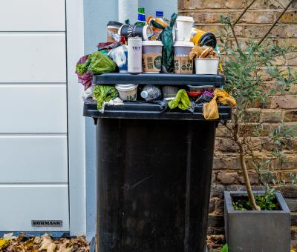
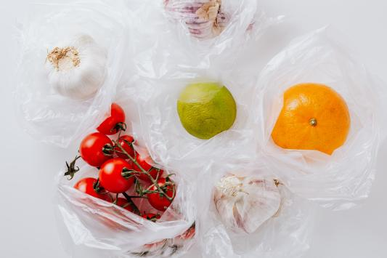
Recycling Tips we can share to inspire others to recycle.
Do not put food in the recycling bin. Wet and dirty recycling items cannot be collected.
Use less single use materials like plastic bags and plastic straws we only use one time.
Notes:
(Slide duration: 3 minutes)
Ask students:
What is one major reason why recycling can become contaminated and not picked up?
Answers:
Putting food items into the recycling bin or putting recyclables like a pizza box that has grease and cheese left inside contaminates items, meaning they cannot be recycled.

Slide 18
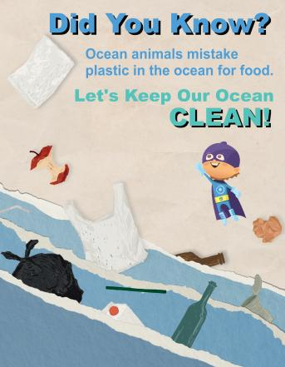
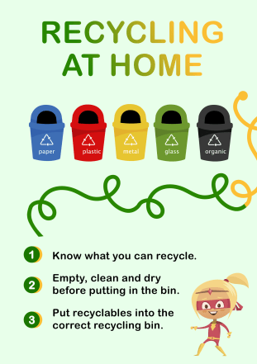
Create a “Waste Hero” Superhero
and a “Call to Action” Poster
Notes:
Tell students:
Now it is time to share with others what we have learned about recycling, and the threat to our world if we do not manage our waste better.
They will work in small groups or individually to create a “Waste Hero” character and design a poster that will be used to convey a PSA (Public Service Announcement) message to inform, inspire, and encourage recycling at school. Students will receive a handout to create their character, then design their PSA poster and place the message around the school.
A “call to action” is a message to prompt an immediate response or encourage an immediate action. An example could be to “recycle more” or “keep the oceans clean”.

Slide 19
How to create your “Waste Hero” PSA for your school.
Steps
1
Identify your audience. Who will see your poster at school?
Steps
2
Create your “Waste Hero” superhero. “Recycle Man or Bottle Woman?”
Steps
3
Create your message about why we need to recycle (Problem & Recycling Tip).
Steps
4
Identify where to post the posterboard PSA message at school to inspire others to recycle.
Notes:
Tell students:
Introduce the class exercise and follow the 4 steps to create a “Waste Hero” public service announcement to motivate and inspire students in the school to take action. The ”Waste Hero” they create will have a main message about recycling they want to share with the class to get them to change their behavior for the betterment of the planet. Here is how they will create their “Waste Hero” superhero:
Step 1: Who do you want to communicate your recycling message to at school? Other students? Teachers and staff? Who will see your poster? Communicate your message with them in mind.
Step 2: Think of Spiderman or Batman and create your character based on their mission. What do they represent? Spiderman is influenced by spiders and Batman bats. What about your waste hero? Recycleman? Bottlewoman? Wastefighter?
Step 3: What message do you want to spread? Are you sharing recycling tips? Do you want to share how waste in the environment is hurting the planet and animals we eat?
Some ideas: Teach people the 3 steps to recycling. Prevent plastic from entering the oceans through recycling. Use less single use materials.
Step 4: Where in your school can you hang your poster where your target audience will see it?

Slide 20
Notes:
Tell students:
They will use this form to identify a recycling message for their target audience and begin designing a “waste hero” and their superpower to help spread the positive message to influence people and help save the world. After using the ”Create Your Waste Hero” page, they can then draw their Waste Hero on a separate posterboard or A3 size paper.

Slide 21
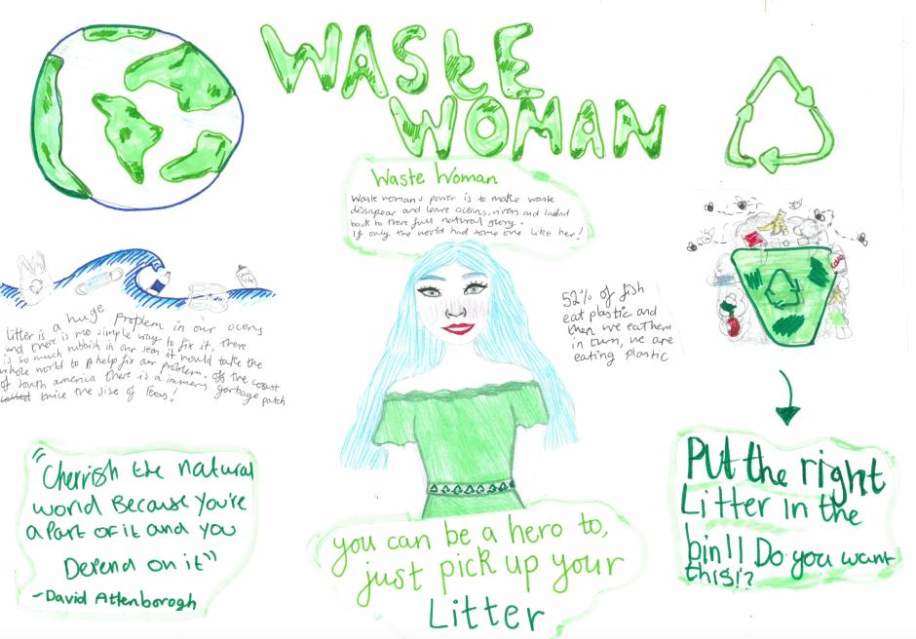
Notes:
Tell students:
This is a real example from a student in the United Kingdom. Her waste hero is “Waste Woman” – you can be a hero too, just pick up your litter.

