Slide 1
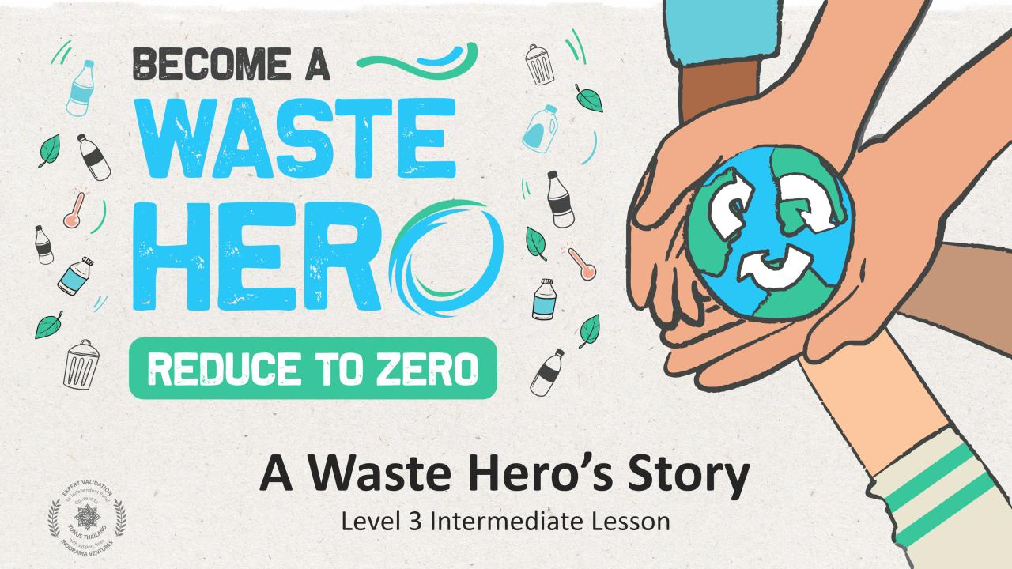

Slide 2
Lesson Prep & Curriculum Alignment
Prep time: 10 – 15 minutes
Students will review and refresh their knowledge of recycling and the negative effects on the environment without recycling best practices. They will also be introduced to the concept of “waste leakage” as a result of not recycling and mismanagement of recyclables.
They will work in small groups or individually to create a “Waste Hero” story with a message to inform, inspire, and encourage others to take action against waste in our environment. Students will move through a series of exercises to help them think through and develop the core message of their story to help inspire others to take action.
1
Display the lesson slides for the class and create a discussion about what they already know about recycling and introduce the concept or waste leakage and ocean bound waste. Ask students the guiding questions in the PowerPoint slide notes.
2
Print out the “YES/NO” handout, the “Storyboard“, and the “Story Planner” handout.
Gather all kinds of art supplies and poster boards (1 per group or per student)

Slide 3
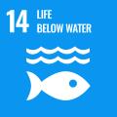
Lesson Prep & Curriculum Alignment
Prep time: 10 – 15 minutes
Key Learning Outcomes and Curriculum Alignment:
Science - Earth and Human Activity: Communicate solutions that will reduce the impact of humans on the land, water, air, and/or other living things in the local environment. Things that people do can affect the world around them. But they can make choices that reduce their impacts on the land, water, air, and other living things.
English Language Arts and Literacy: Participate in collaborative conversations with diverse partners about topics and texts. Follow agreed-upon rules for discussions. Use words and phrases acquired through conversations, reading and being read to, and responding to texts.
SDG Alignment
Flexible and adaptive lesson
Lesson plans are designed to be flexible and responsive to the evolving needs of your classroom. Lessons are editable and customizable to meet the different individual student and classroom contexts. A PowerPoint version with teacher instructions and a printable PDF lesson are available for download.

Slide 4
The Lesson
Lesson duration: 25 - 30 minutes
1
Introduce the lesson to your students by asking about their knowledge of what can and cannot be recycled. Display the “YES/NO” slide or print the handout as a reference.
Create an open discussion about the basics of recycling.
Do you recycle?
What can be recycled?
What cannot be recycled?
Ask for them to give a few examples of each.
2
Students will create a Waste Hero story to inspire and influence others to take action against waste in the environment. Students will take notes of recycling best practices, waste statistics and facts to support the main message of their story. Use the story design slides and the Story Planner and Storyboard handouts to help them create their story.
3
Print out the “Story Planner” and the “Storyboard” handouts for the students to fill out in class. Students will likely need 4 or more storyboard handouts to create their story. They can work in a group or individually and you can also extend the lesson by having them write out their story from their storyboard and share it with the class.
4
Give them 5min to search the class for plastic bottles to put into the new bin.

Slide 5
Prepare the PowerPoint presentation
When you are ready to present the lessons to your class click on Slide Show on the top menu bar then select Presenter View. In Presenter view, you can see your notes as you present while the audience see only your slides.
The notes appear in a pane on the right. The text should wrap automatically, and a vertical scroll bar appears if necessary. You can also change the size of the text in the Notes pane by using the two buttons at the lower left corner of the Notes pane.

Slide 6
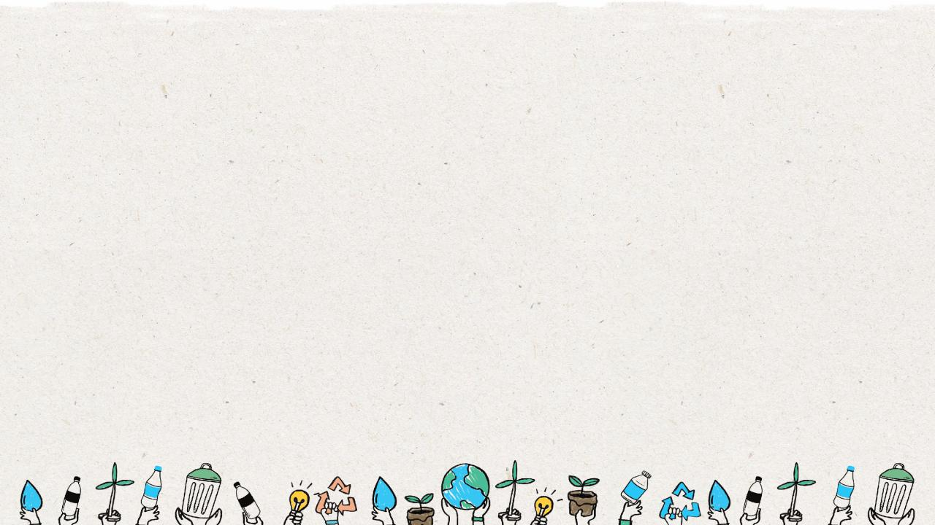
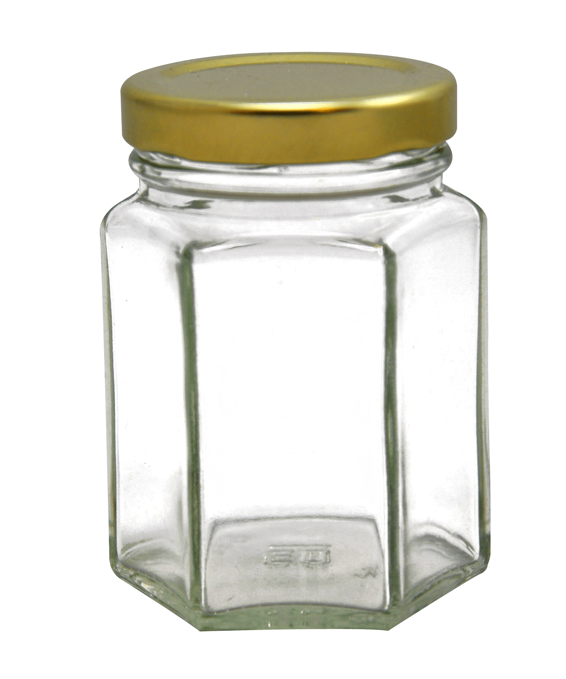
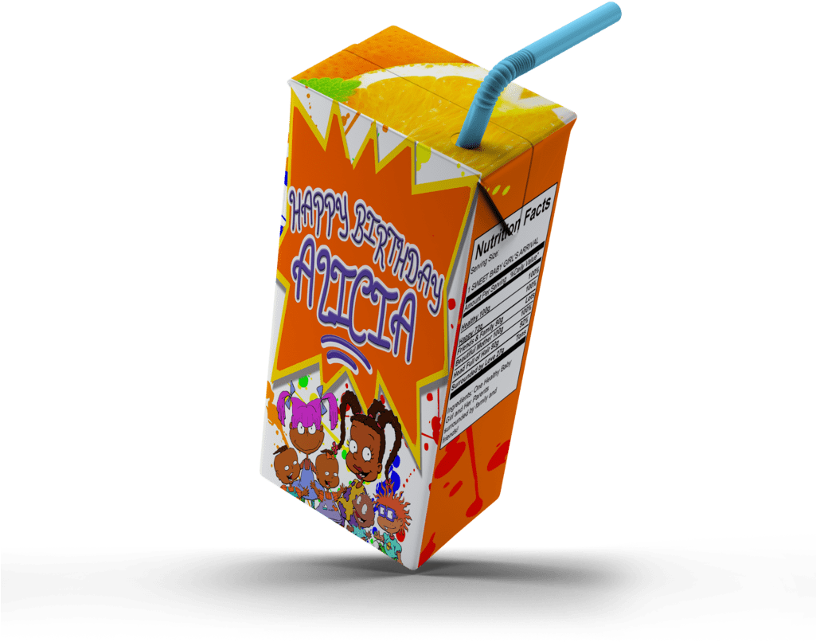
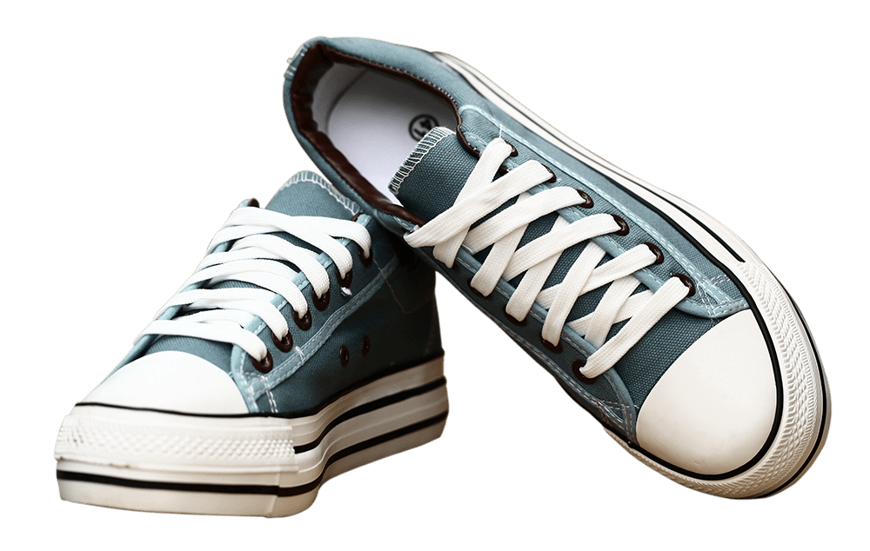
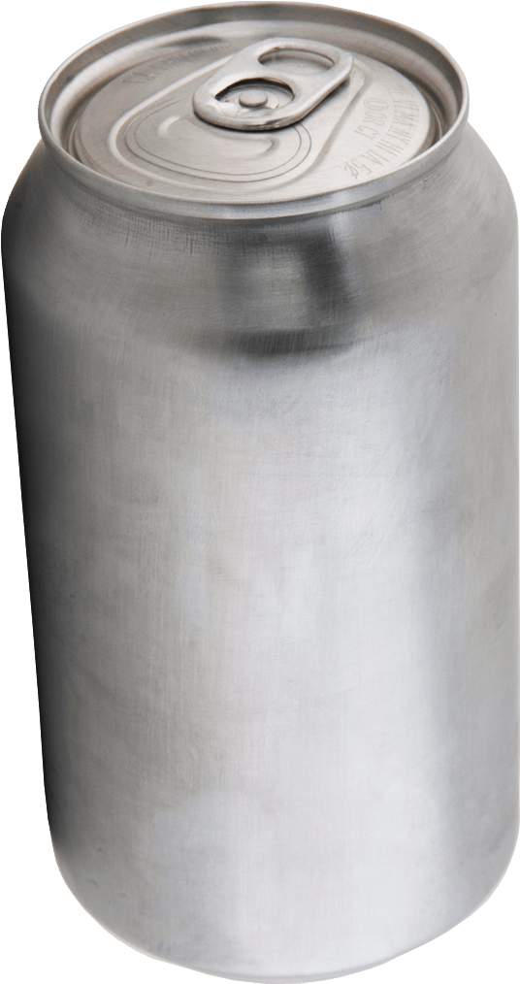
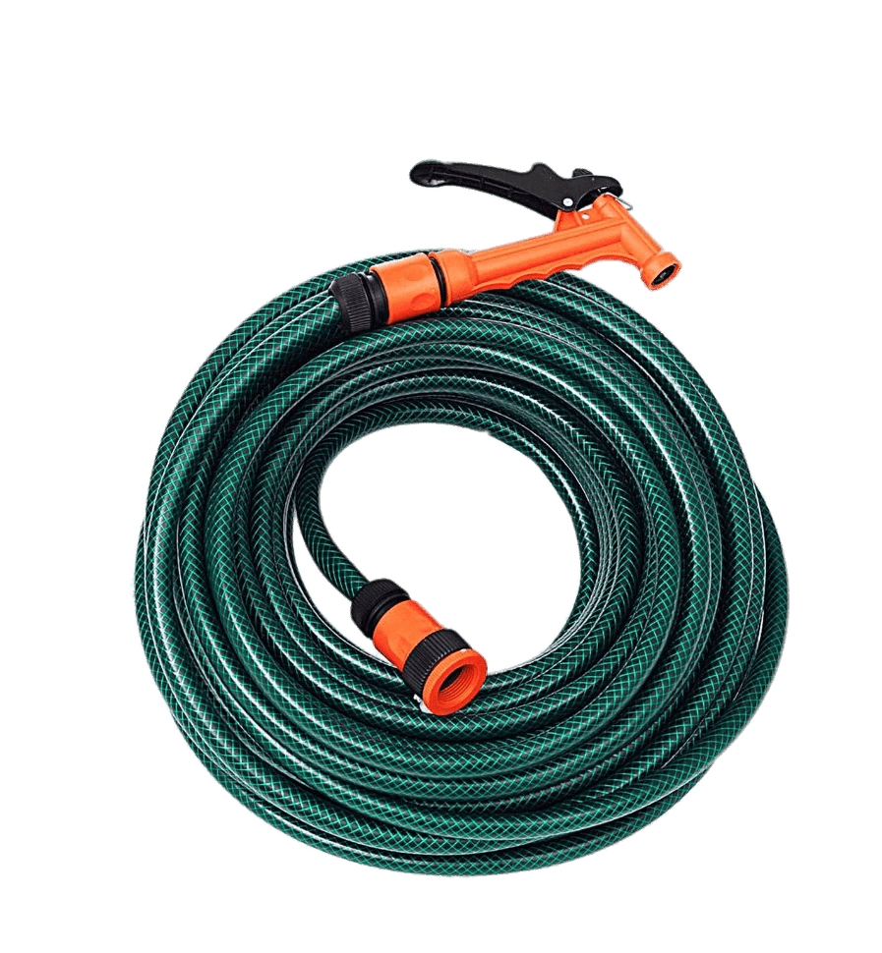
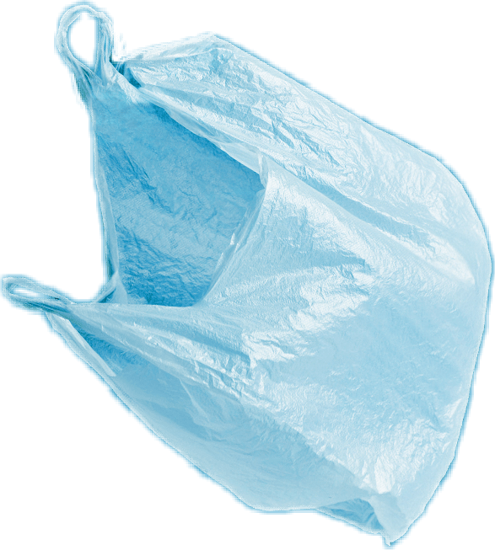
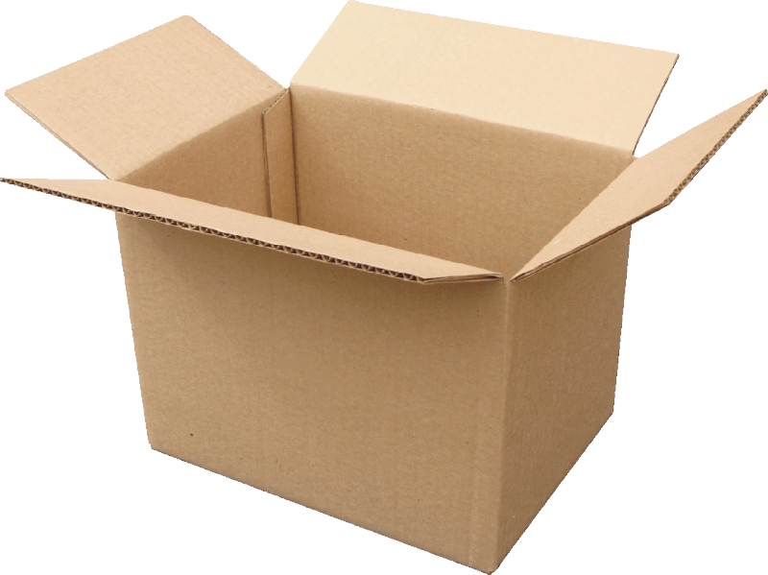
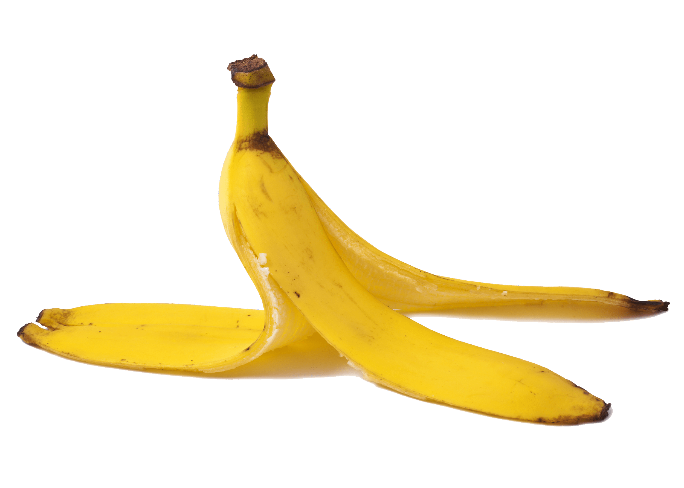
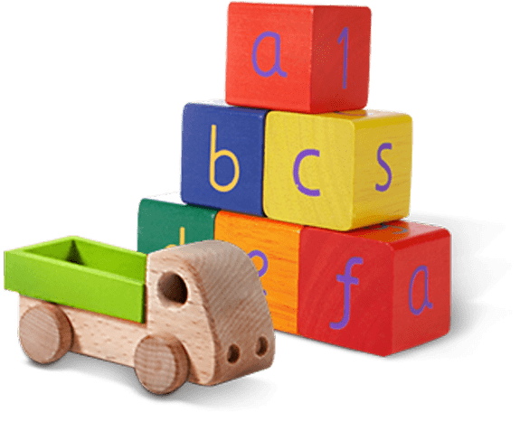
Glass jar
PET Plastic bottle
Shoes
Metal can
Light bulb
Juice box
Dirty napkin
Plastic bag
Toys
Pencil
Banana peel
Cardboard box
Garden hose
YES
NO
Notes:
(Slide duration: 3-5 minutes)
Pre-lesson Icebreaker Exercise
Ask students:
Has anyone heard of recycling? If yes, please share with the class what they know.
Tell students:
Recycling is the process of collecting and processing materials that would otherwise be thrown away as trash and turning them into new products. Recycling can benefit your community and the environment.
Now read off the images left to right starting on the top row to test their knowledge about what items displayed can and cannot be recycled.
Order of images that will appear with each click.
Click 1: Glass jar
Click 2: PET Plastic Bottle
Click 3: Shoes
Click 4: Metal can
Click 5: Light bulb
Click 6: Juice box
Click 7: Dirty napkin
Click 8: Pencil
Click 9: Plastic bag
Click 10: Toys
Click 11: Cardboard box
Click 12: Garden hose
Click 13: Banana peel

Slide 7
YES
NO
Always recycle:
Never recycle:
Banana peel
Dirty napkin
Garden hose
Glass jar
PET Plastic bottle
Light bulb
Juice box
Shoes
Cardboard box
Metal can
Toys
Plastic bag
Pencil
Notes:
(Slide duration: 3 minutes)
Pass out or display this YES/NO handout – there is a printable pdf handout available for students.
Discuss what we can and cannot recycle based on the items in the worksheet.
What do you do with garbage at home?
Where does it go?
If you put everybody’s garbage into a big pile, how much would there be? Would it be too much?

Slide 8
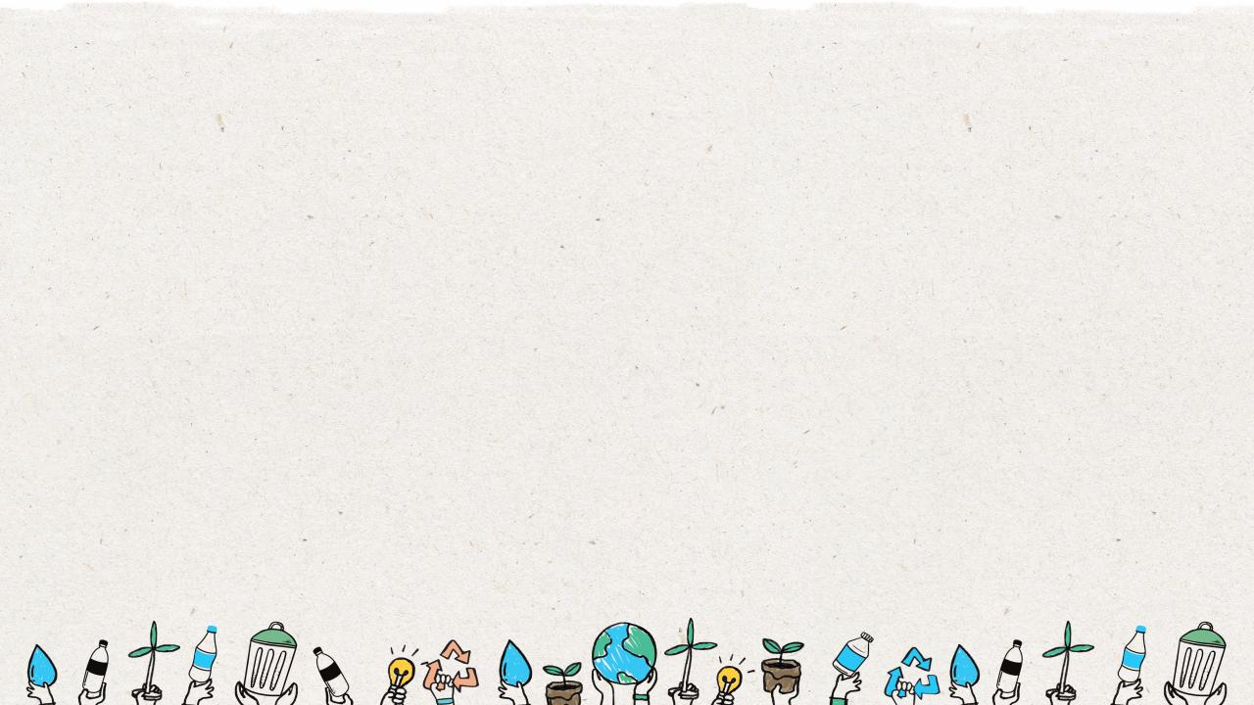
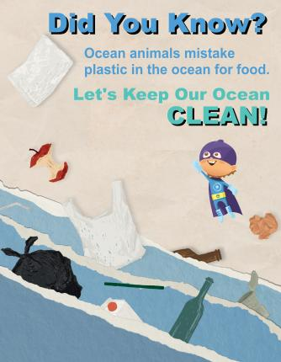
Create A “Waste Hero” Story
Create a story based on your Waste Hero and a “call to action” to inspire and inform others to reduce waste in the environment and to save the world.
Your story should:
Inform others about what can be recycled in your area
Inspire your audience to recycle more and how to do it better
Create a storyboard that can be made into a written story or film
Your main character should be your “Waste Hero”
Notes:
(Slide duration: 3-5 minutes)
Tell students:
They will create a story for their waste hero to inspire and inform others to reduce waste in the environment and to save the world. They will need a core message as a Call-to-Action, e.g. “Let’s keep our oceans clean”, supported with facts and statistics they learn in this lesson like “PET plastic is the most recycled plastic in the world”.
They will move through a series of exercises to help them think about their story and how to create it like a Hollywood movie producer.
Have them take notes over the next few slides so they have some interesting facts about recycling and waste in the environment to support their story. The later slides will introduce the storyboard and other writing exercises to help guide them in creating their Waste Hero story.

Slide 9
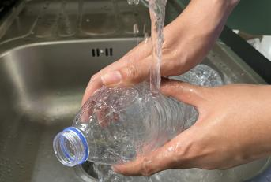
How do we prevent waste leakage into our environment?
Practice The 3 Steps to Recycling
1
Know what you can recycle
2
Empty, clean, and dry before putting in the bin.
3
Put recyclables into the correct recycling bin.
Notes:
(Slide duration: 3 minutes)
Ask students:
So how can we help to prevent waste leakage on land so that our waste and recyclables do not enter the ocean?
How do we properly recycle?
What can we recycle? Examples?
Answers:
Practice the 3 steps to recycling.
We can recycle PET plastic bottles (find the #1 on the bottom of the bottle), metal, paper, and glass.

Slide 10
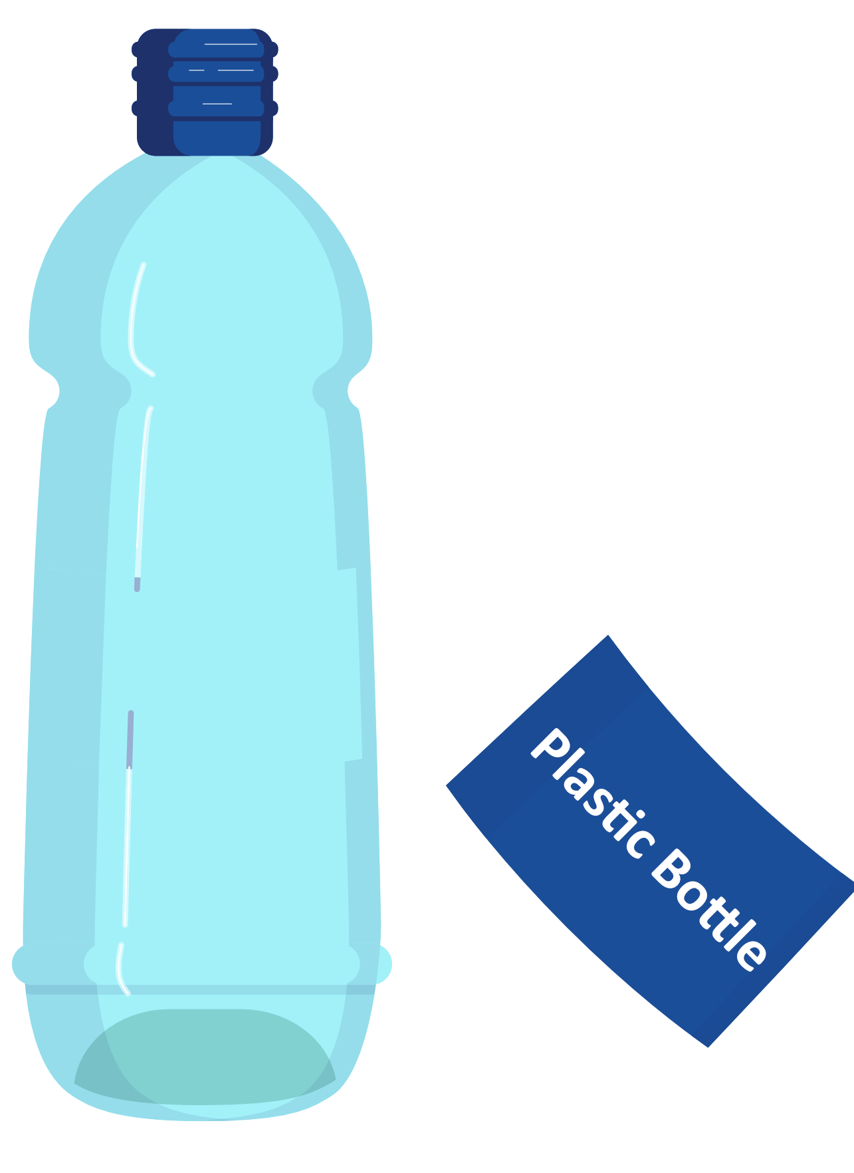
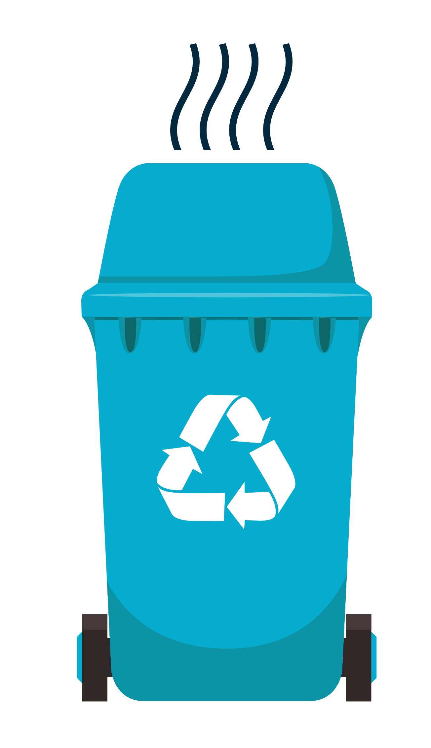
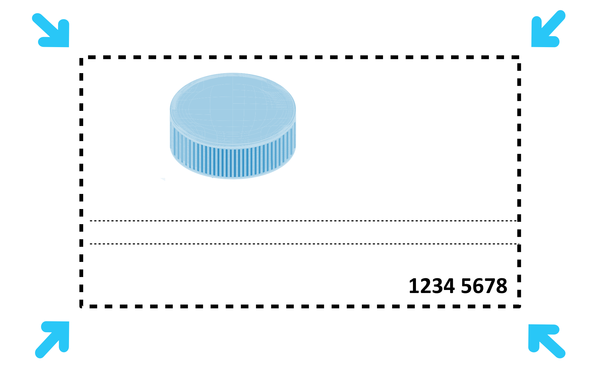
What is your Waste Hero’s Message to Inform and Inspire?
Recycling Best
Practices & Tips
Keep your recyclables dry – less than a teaspoon of liquid
Separate
combined materials
If your recycling container smells, it is contaminated
If you can poke your finger through it,
do not recycle it
Never recycle anything smaller than an ID card
Notes:
(Slide duration: 3-5 minutes)
Tell students:
Learn to avoid common recycling mistakes, tell the difference between what is recyclable and what is not, and use best practices to keep your recycling clean and simple. You can really make a difference using these tips and best practices.
Separate multilayered objects like some food packaging labels or labels on bottles.
Keep recycling dry, preferably less than a teaspoon of liquid.
If your recycling bin smells bad, there is a good change there is rotting food or liquid inside and the bin is contaminated, do not recycle it.
If you can poke your finger through a piece of plastic, it cannot be recycled, like plastic bags or food wrapping.
Anything smaller than an ID card should not be recycled.

Slide 11
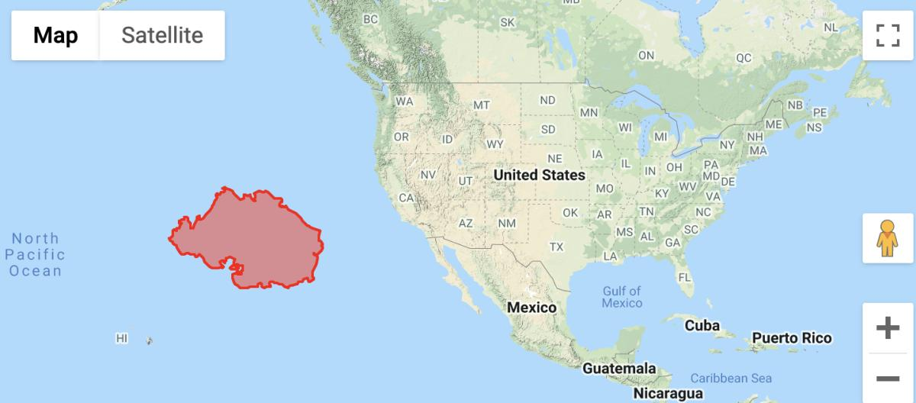
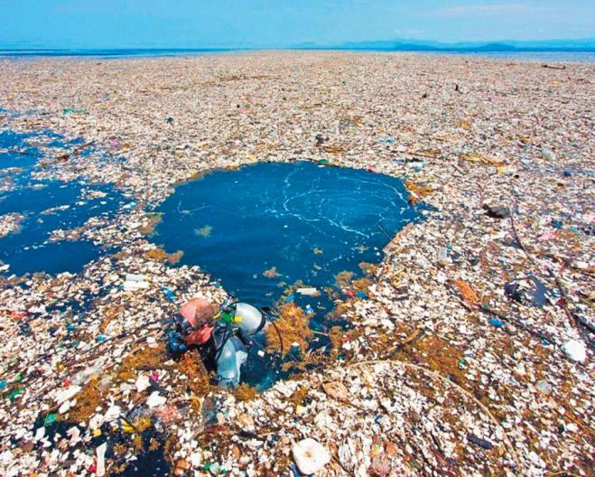
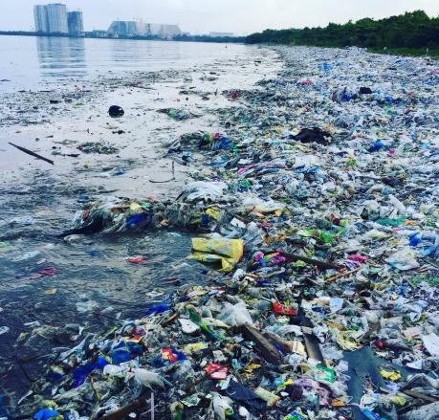
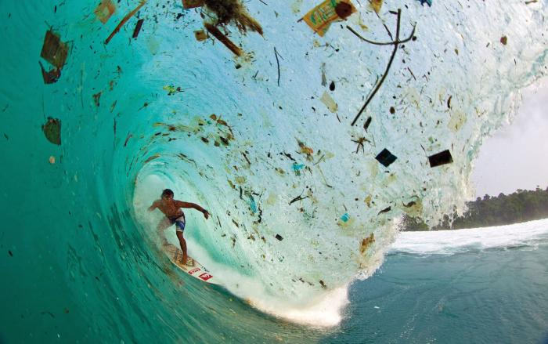
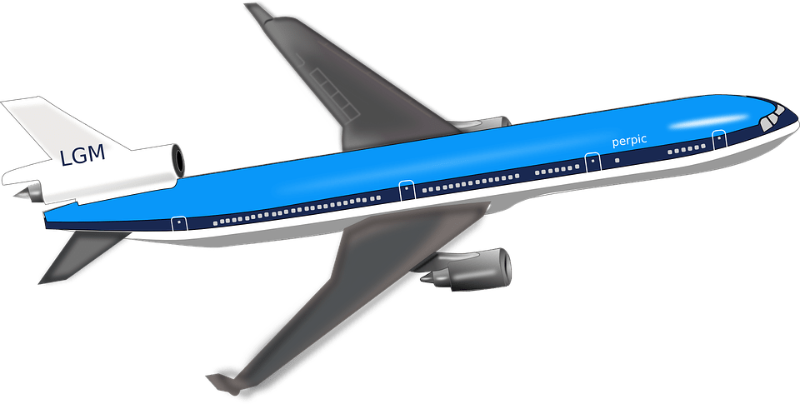
Ocean Waste
Notes:
(Slide duration: 3-5 minutes)
Tell students:
Waste accumulating in our oceans and on our beaches has become a global crisis. Billions of pounds of waste can be found in swirling convergences around our oceans. At current rates waste is expected to outweigh all the fish in the sea by 2050.
Pollution has a direct and deadly effect on wildlife. Thousands of seabirds and sea turtles, seals and other marine mammals are killed each year after ingesting waste or getting entangled in it.
Click 1:
There is so much ocean waste that it collects along shorelines and accumulates in huge garbage patches in the middle of the ocean. The south pacific garbage patch seen here in red is the world’s largest accumulation of waste. It is 2x times the size of the American state of Texas. This is a result of human generated waste entering the ocean and getting caught in currents that sends the waste flowing in circles in the middle of the ocean.
Click 2:
There is an estimated 80,000 metric tons of waste in this one garbage patch, which is the equivalent to…
Click 3:
500 jumbo jets.
Ask students:
Why is there so much waste in our oceans?
What do you think about the pacific garbage patch?

Slide 12
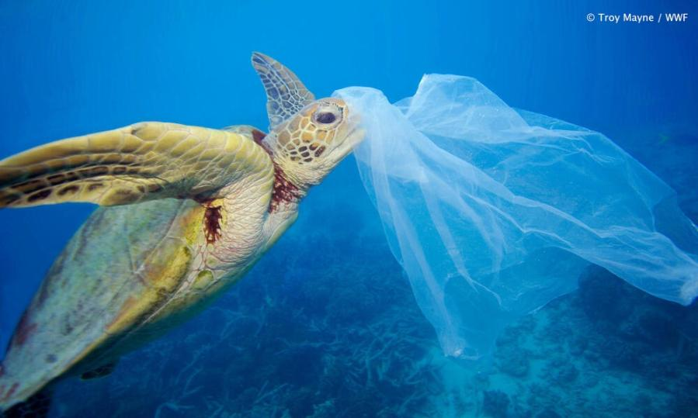
How much ocean waste is mistakenly eaten by ocean animals?
Nearly half of the world's turtles have eaten plastic waste.
Notes:
(Slide duration: 3 minutes)
Ask students:
Because so much waste leaks into the ocean, how much waste would you guess is mistakenly eaten by ocean animals?
Click1:
Research suggests that nearly half of the world's turtles have eaten human produced waste.
Click 2: sea turtle image appears
Ask students:
Why do sea turtles and other ocean animals eat waste?
Answers:
The reasons are simple: a floating plastic bag can look a lot like jellyfish, algae, or other species that make up a large component of the sea turtles' diets. All sea turtle species are at risk from ocean waste.

Slide 13
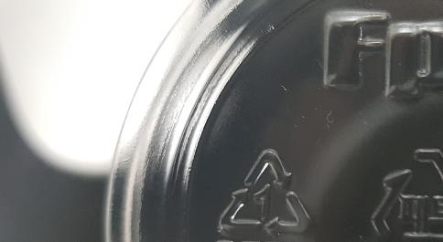
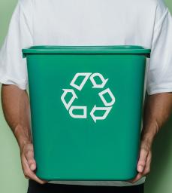
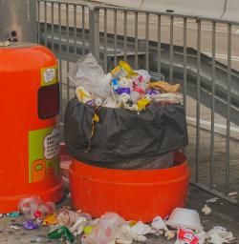
Recycling Tips we can share to inspire others to recycle.
Find the #1PET on the bottom of plastic bottles and recycle it. PET plastic bottles are fully recyclable.
Recycle items into the correct recycling bin where you see the recycling symbol.
Notes:
(Slide duration: 3 minutes)
Tell students:
Let’s go over a few more recycling tips. PET plastic bottles are fully recyclable. There will be a 3-arrow triangle with a #1 inside the triangle. This number is to inform you that this bottle should be recycled.
Depending on where you live, your local recycling company will have rules about what they can and cannot accept. Check with your local community about what you can recycle. Because if you do not know what you can recycle, you can potentially contaminate other potential recyclables and then none of it can enter the system.
Ask students:
Have you seen a #1 on the bottom of a bottle before? What did you do with it?

Slide 14
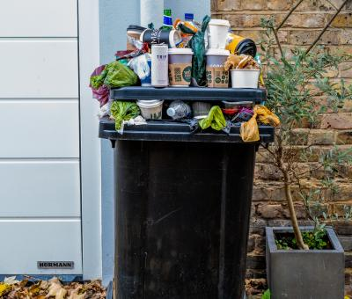
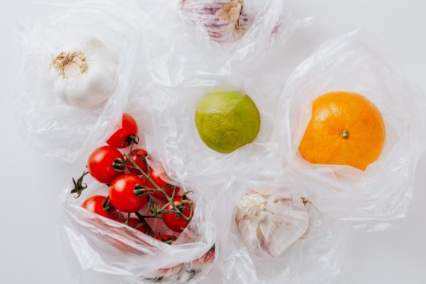
Recycling Tips we can share to inspire others to recycle.
Do not put food in the recycling bin. Wet and dirty recycling items cannot be collected.
Use less single use materials like plastic bags and plastic straws we only use one time.
Notes:
(Slide duration: 3 minutes)
Ask student:
What is one major reason why some recycling can become contaminated and not picked up?
Answers:
Putting food items into the recycling bin or putting recyclables like a pizza box that has grease and cheese left inside is contaminated and cannot be recycled.

Slide 15
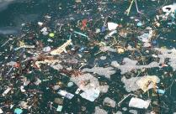
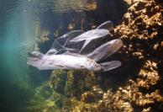
More facts for inspiration
1
It takes nearly 450 years for a plastic bottle to decompose in a landfill.
2
It takes glass about 4,000 years to decompose in a landfill.
3
There is a huge “garbage island” floating in the ocean 2x the size of the state of Texas.
4
Human generated waste has been found in the deepest part of the ocean, and at the tallest mountain peak in the world.
5
PET Plastic is the most recycled plastic in the world.
Notes:
(Slide duration: 3 minutes)

Slide 16
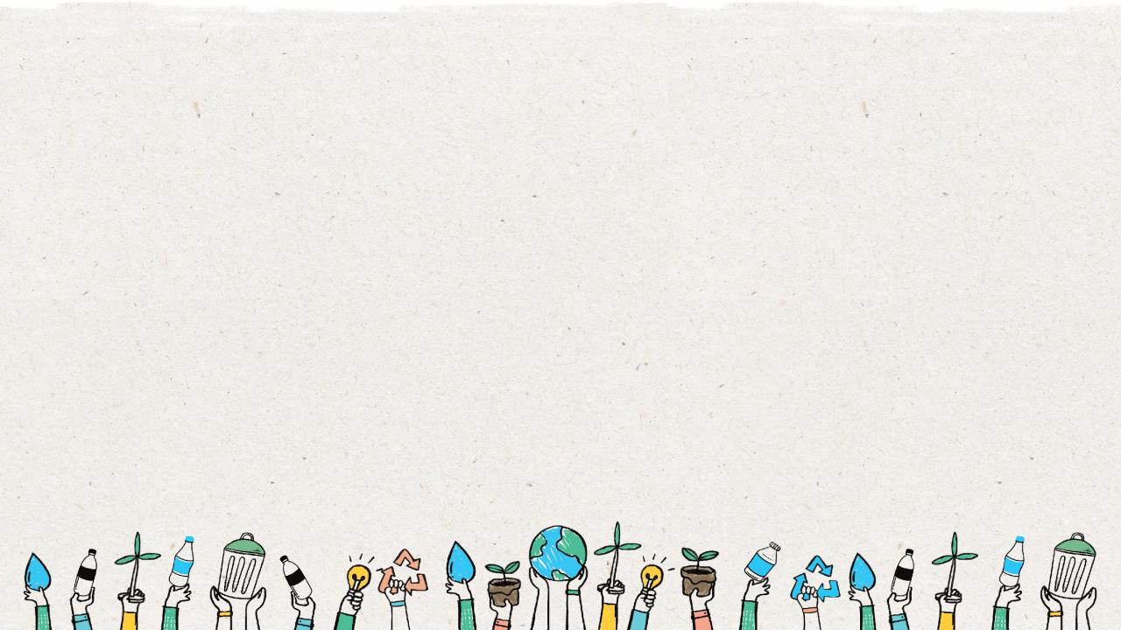
What is your “Waste Hero’s” message to inspire?
Notes:
Tell students:
For the class activity they will create a story for their waste hero. They will use fun facts and recycling tips to support their story. Encourage them to use their story to inspire other students to recycle.

Slide 17
How to design your story
Setting: Introduce your setting with a short paragraph
Where are your characters?
What is the time?
What can they see
Title: Give your story a title.
Make it short and catchy
Characters: Write two sentences to introduce your character(s).
e.g. Recycleman is from the planet Plasto 5 lightyears from earth. He can fly at the speed of light and travels to earth to help children at schools learn about recycling plastic.
Dialogue: Write your character’s name before they speak
Indicate when your characters are speaking with parenthesis. e.g. “We should recycle more” said Mark.
Main message:
Do not try to say too much at once.
Choose one or two simple main messages to encourage people to recycle.
Support your message with interesting stats and facts from this lesson.
Notes:
(Slide duration: 3-5 minutes)
Tell student:
Let the students know they will now take the information they have learned and create their “Waste Hero” story with a main message to inspire others to change their behavior. There are 4 main aspects to designing your story you will need to consider.
The setting: Identify the characters, a place, the time period and any other details to introduce the story to give your audience some context.
Dialogue: This is going to be the conversation between your characters, and you can indicate when and what they are saying by using “parenthesis”. Example: “I love to recycle” said Brian.
Characters: Who is in your story? Your main character will be your “Waste Hero” but maybe you have an evil villain who wants to end recycling, or a sidekick like Batman and Robin to help you save the world. Create a few characters to make your story more interesting.
Main message: You don not need a complicated message, keep it simple. But support your main message with facts and statistics that give your message more power. Example: Keep plastic out of the ocean through recycling best practices.
Title: Do some research on other superhero movie titles you have seen in the past. Keep it short, but catchy.

Slide 18
Map Out Your Ideas
Trashman sneaks into schools to tell students they do not need to recycle and to just throw all waste in the same trash bin
Does Recycleman need a side kick?
Possible titles:
Recycleman and the Landfill of Doom
The Age of Waste
Trashman Attacks
Twist in the story:
Recycleman was captured and locked deep inside the stinky and toxic landfill by Trashman
Recycleman fights to keep the world recycling and to keep the environment healthy.
Recycleman faces many challenges such as people who litter, their poor recycling knowledge, and Trashman who wants all waste to go to his secret, scary landfill.
Recycleman must avoid his biggest enemy Trashman
Notes:
(Slide duration: 3-5 minutes)
Tell students:
A mind map is a great exercise to begin organizing your ideas. What will happen in your story? Who is in your story? What is the climax or plot twist in your story?
Have students get out a blank piece of paper to create their mind map. In the middle of your mind map you can write your main message and then build your story around this core theme. This will help you stay on track and ensure that people who read your story will understand your message.

Slide 19
Make a List of the Key Events
1
It was a cold dark night on planet Plastico when Recycleman got a call from earth.
4
Recycleman found a select group of student activists to set up more recycling around the world’s schools.
2
Trashman has invaded local schools to tell
kids not to recycle.
5
Recycleman fought Trashman at the secret, scary landfill and was captured and buried deep below the trash.
3
Recycleman had to fly to earth and wage a battle against Trashman.
6
The student activists found enough recycling to build a giant shovel to uncover and save Recycleman.
Notes:
(Slide duration: 3 minutes)
Tell students:
Now take your mind map and begin making a list of the main events that will happen in your story. Read the example slide here to help give you an idea about how to think about the events in your story. Again, ensure that the events ultimately lead to support your core message and to inspire your audience.

Slide 20
Write Your Story To Persuade
A relatable story
Use facts to support the message
Get your audience to understand the problems of not recycling through your Waste Hero story.
Using facts and figures is an effective way to validate your message. Some data points can really help illustrate the problem.
e.g., If Trashman wins the battle more waste will harm our environments we live in.
e.g., It takes a glass jar 4,000 years to decompose in a landfill.
Repeat your message
Use some humor
Repeating your message throughout your story is an effective way to ensure your audience remembers.
Grab the reader’s attention with humor which can make them more open to your message.
e.g., Reduce, Reuse, Recycle.
Notes:
(Slide duration: 3 minutes)
Tell students:
If you want your message to inspire people to take action, you need to persuade them. So how do you do that? Here are 4 techniques that we can use when writing our story to try and persuade the reader to take action.

Slide 21
Story Planner
Title of your story:
Use this story planner to help create your story
Audience
Who will read your story?
Key characters
List your main character(s) below. Write a sentence to describe your character(s).
Write one thing your audience needs to know about recycling to help them recycle more and better.
Setting
Main message
Describe the location of where your story takes place.
What is the overall message in your story to influence your audience to recycle more?
Notes:
(Slide duration: 2 minutes)
Tell students:
They will receive the story planner handout and they will begin to define the key aspects of their story. Have them fill in each section, starting with the main message and build the story around it.

Slide 22
Create A Storyboard
Draw a picture in each box of the events in your story. Write a description under each picture.
Notes:
Tell Students:
Lastly, students will create their story scene-by-scene using a storyboard. A storyboard is a tool that allows you to frame your story using both images of the scene and a text box below to write out the setting and the dialogue.
Students may need about 4 or 5 storyboard templates for their story so prepare enough. This can be done in groups or individually.
Extend the lesson:
Have students use their completed storyboard to write out their story. Have students read their stories aloud to the class.

Slide 23
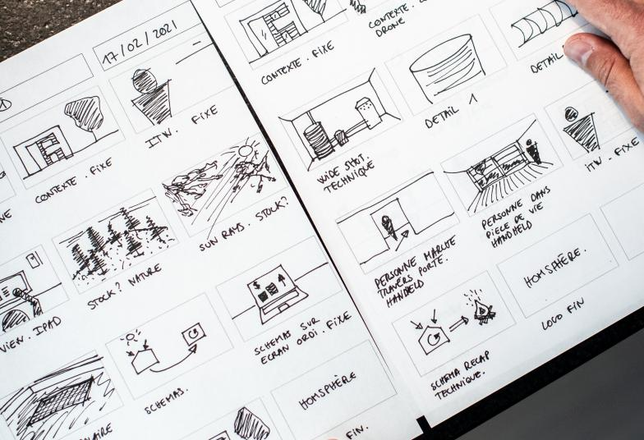
Example Storyboard

