Slide 1
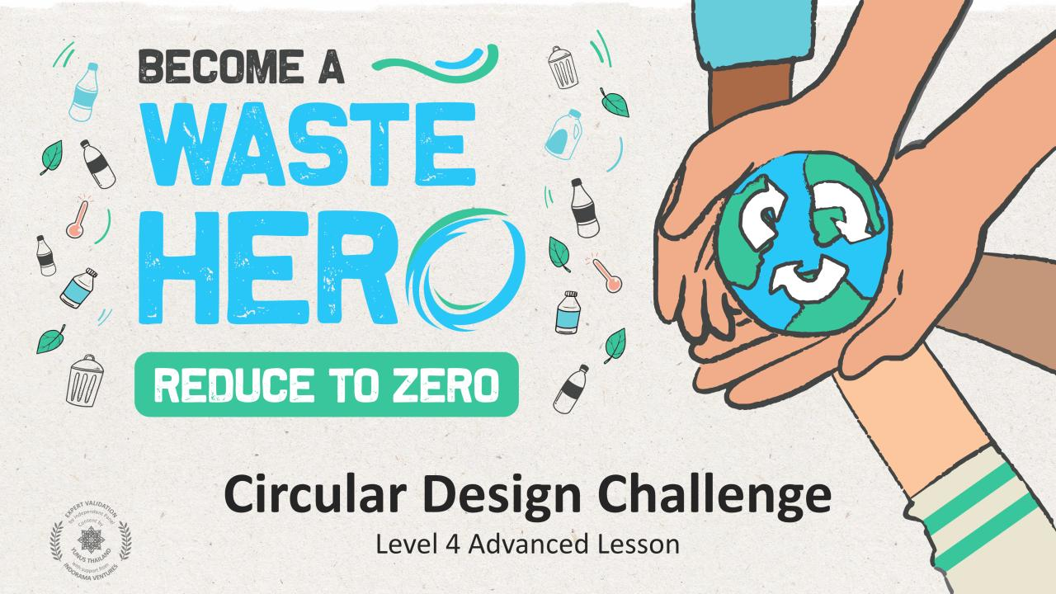
TORNE-SE UM
Desafio de Design Circular
Aula Avançada de Nível 4

Slide 2
Preparação da Aula e Alinhamento Curricular
Tempo de preparação: 10 – 15 minutos
Os alunos aplicarão as estratégias circulares para resolver um problema linear de um produto cotidiano. Eles trabalharão através de um exercício de design thinking para identificar oportunidades circulares, refletindo sobre as necessidades funcionais e emocionais do cliente.
1
Exiba os slides da aula e crie uma discussão sobre o que eles já sabem sobre modelos de negócios circulares e introduza o design thinking para identificar soluções para os problemas do cliente. Faça aos alunos as perguntas orientadoras nas anotações do slide do PowerPoint.
2
Imprima os 5 folhetos: 1. Design Thinking 2. Áreas de Circularidade 3. Mapa do Ciclo de Vida Circular 4. Solução Circular 5. Desafio de Design Circular
3
Siga as etapas no próximo slide e nas anotações do professor nos slides 20 a 24 para conduzir a atividade da classe.

Slide 3
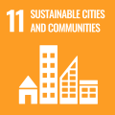
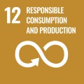
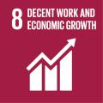
Preparação da Aula e Alinhamento Curricular
Tempo de preparação: 10 – 15 minutos
Principais Resultados de Aprendizagem e Alinhamento Curricular:
Ciência - Terra e Atividade Humana: Comunicar soluções que reduzam o impacto dos seres humanos na terra, água, ar e / ou outros seres vivos no ambiente local. As coisas que as pessoas fazem podem afetar o mundo ao seu redor. Mas elas podem fazer escolhas que reduzam seus impactos na terra, água, ar e outros seres vivos.
Artes da Língua Inglesa e Alfabetização: Participe de conversas colaborativas com diversos parceiros sobre tópicos e textos. Seguir regras acordadas para as discussões. Use palavras e frases adquiridas através de conversas, lendo e sendo lido e respondendo a textos.
Estudos Sociais - Pessoas, Lugares e Ambientes: O estudo de pessoas, lugares e ambientes nos permite compreender o relação entre as populações humanas e o mundo físico
Alinhamento dos ODS
Aula flexível e adaptativa
CIDADES E COMUNIDADES SUSTENTÁVEIS
CONSUMO E PRODUÇÃO RESPONSÁVEIS
TRABALHO DECENTE E CRESCIMENTO ECONÔMICO
Os planos de aula são projetados para serem flexíveis e responsivos às necessidades em evolução da sua sala de aula. As aulas são editáveis e personalizáveis para atender aos diferentes contextos individuais dos alunos e da sala de aula. Uma versão do PowerPoint com instruções do professor e uma lição em PDF imprimível estão disponíveis para download.

Slide 4
A Aula
Duração da aula: 25 - 30 minutos
1
Divida em grupos de 3 a 5 e prepare um cartaz ou use o folheto de design thinking. É aconselhável fazer o exercício de design thinking em um grande cartaz com notas adesivas.
2
Escolher um dos seguinte produtos
Sache de ketchup
Laptop caro ou telefone celular
Roupas de bebê
Embalagem de alimento
Embalagens pequenas descartáveis para nozes ou legumes
Chinelos
3
Use o folheto de design thinking e mapa de ciclo de vida para desenvolver sua solução circular para o produto.
4
Aplique um ou mais modelos de design circular ao produto. Quando terminar, incentive os alunos a compartilhar suas inovações circulares com a classe.

Slide 5
Preparar a Apresentação do PowerPoint
Quando estiver pronto para apresentar as aulas à sua turma, clique em Apresentação de Slides na barra de menus superior e selecione Modo de Exibição do Apresentador. No modo de exibição do Apresentador, você pode ver suas anotações enquanto o público vê apenas seus slides.
As anotações aparecem em um painel à direita. O texto deve aparecer automaticamente e uma barra de rolagem vertical será exibida, se necessário. Você também pode alterar o tamanho do texto no painel Anotações usando os dois botões no canto inferior esquerdo do painel Anotações.

Slide 6
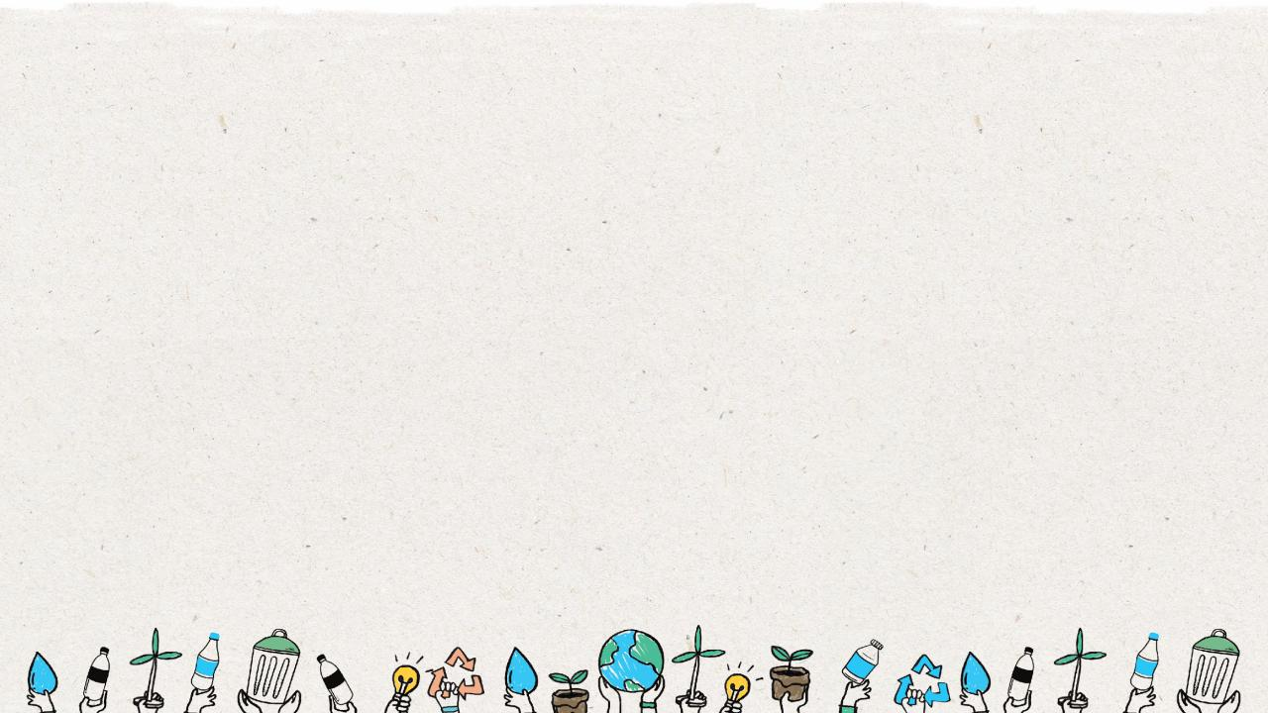
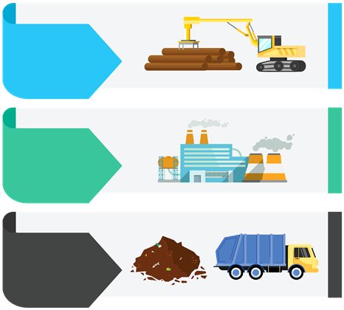
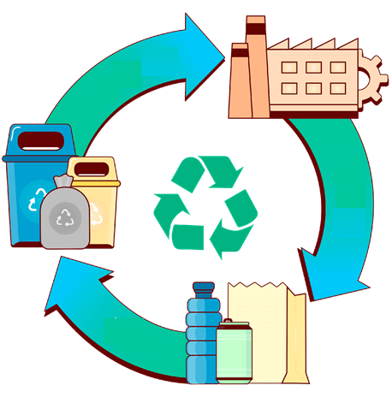
Economia Linear
VS
Economia Circular
PEGAR
FAZER
DESCARTE
RECICLAR
FAZER
USO
Notes:
(Slide duration: 5min)
Tell students:
How we approach our systems of production and consumption is important to understand when discussing how to fight climate change and to become a more sustainable world. The planet’s resources are finite, so it is crucial that people, governments and companies work together to use them more responsibly.
A linear economy is our traditional model that follows the “take-make-dispose” model where raw materials are collected, then manufactured and transformed into products we use until they are finally discarded as waste either in a landfill or into our natural environment. This model gives no concern for their ecological footprint and its consequences. It prioritizes profit over sustainability, with products made to be thrown away once they have been used.
A circular economy (also referred to as circularity and CE) is a model of production and consumption which involves sharing, leasing, reusing, repairing, refurbishing and recycling existing materials and products for as long as possible. It is a model designed to have as little impact as possible on the environment by leaving less of a footprint through keeping items in a closed loop system.
Questions for Students:
1. What is an example of a product from the linear and circular economies?
ANSWER: Linear = Food packaging film on broccoli, Circular: Car ride-sharing or PET plastic bottle recycling.
2. How is the linear model harming the planet?
ANSWER: Waste accumulates in the landfills or leaks into the environment as litter. Finite natural resources are depleted.
3. How can the circular economy help fight climate change?
ANSWER: It keeps natural resources in use with no need to extract more. It also reduces waste leakage into the environment as litter.

Slide 7
Mapeamento do Ciclo de Vida
Reciclar
Remanufacturado
Reutilizar
1. Extração 2. Produção 3. Distribuição 4. Uso 5. Descarte
Recarga
Retornar
Reparar
Reaproveitar
Reutilizar
Composto
Notes:
(Slide duration: 5min)
Tell students:
The major stages of a product’s life can be mapped in both linear and circular ways. We can assess the life cycle by identifying the 5 key stages of a product’s life:
Material extraction is how and where raw materials are removed from natural sources.
Production of the raw materials into a product.
Finished products are distributed to places where customers can purchase the product.
Customers use the product.
The product is then disposed of after use.
By looking at a product's entire life cycle, from materials extraction to end-of-life management, we can find new opportunities to reduce environmental impacts, conserve resources, and reduce costs. Instead of the linear “take-make-waste” system of the 5 stages, we can build in circularity through closed loops that keep these materials and products in use.
Circularity means rethinking the linear use cycle of a product or service with a beginning, middle, and end. If a product or service is truly circular, it will never actually have an end to its life, but continuously take a new form. Mapping this journey will ensure that your product is staying in a useful state for as long as possible and adds value at every stage.
It is not only about recycling; it is really about redesigning the entire product or service delivery model so that human beings get the things they need without negatively impacting the natural systems that sustain us all.
The exciting thing is that this is happening all around the world; people of all types are changing their lifestyles and companies are redesigning their products to be more circular. These types of changes mean designing products to be reused and rethinking the way we deliver functionality to the market. They also include encouraging repair through better support services, return or take-back programs, refill services that encourage the use of the same container more than once, and products being designed to be remanufactured to be returned to nature through composting.
Ask students:
Can you give me an example of a product designed under one of the “Re” models of a circular product or service?
Tell students:
Click 1: -PET plastic bottles can be recycled back into the same plastic bottle over and over.
Click 2:
-Bed frames are designed into key main parts and if one breaks the manufacturer can easily disassemble the parts and replace that single part and remanufacture the bed, preventing the customer from having to buy a whole new one. The old part can be broken down and reused into a new part.
Click 3:
-Buying clothes secondhand is a way to reuse old discarded clothes giving new value and extending its life.
Click 4:
-Shops can offer refill options for household items like shampoo and soap, allowing customers to bring their own container instead of buying shampoo in a new bottle each time.
Click 5:
-Old jeans could be brought back to a store for a discount on their next purchase, in exchange the brand can repair and repurpose the material to be remade into new clothes.
Click 6:
-Using compostable seaweed-based film on fresh produce at the grocery store to replace single use packaging.

Slide 8
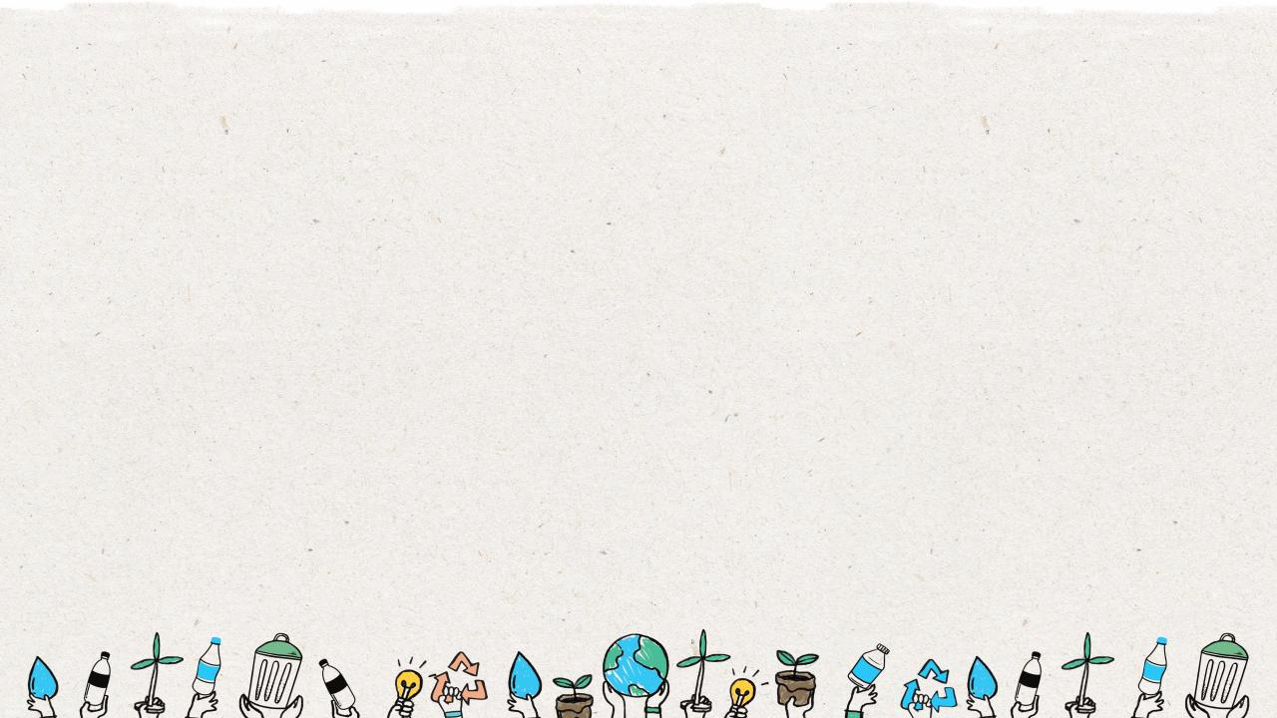
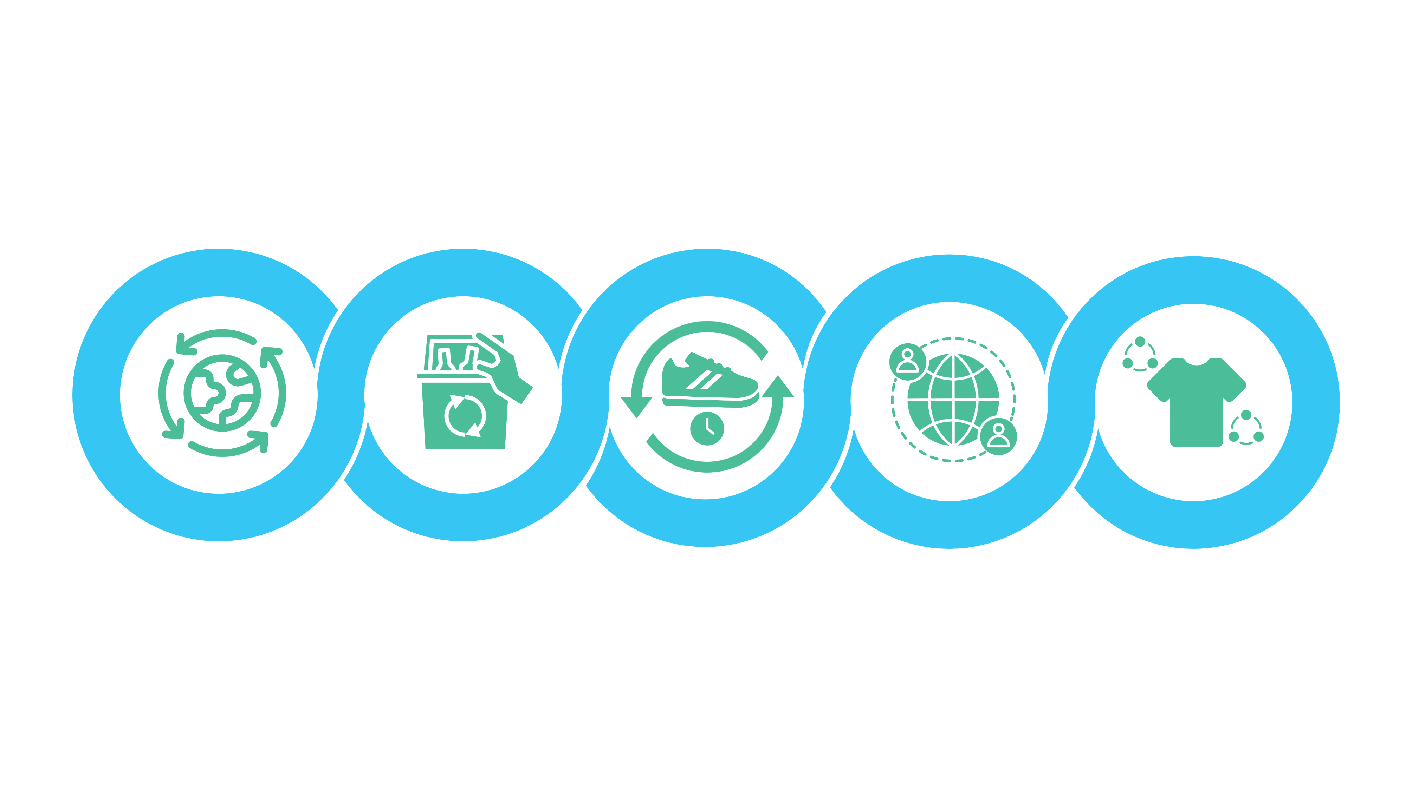
Cinco Modelos de Negócios de Circularidade
Extensão da Vida útil do Produto
Plataforma de Compartilha mento
Produto como um Serviço
Suprimentos Circulares
Recuperação de Recursos
Produtos feitos de totalmente renováveis, recicláveis, ou insumos de recursos biodegradáveis.
Serviços que trabalham para eliminar recursos, materiais ou desperdícios de vazar para o meio ambiente e maximizando o valor dele para reentrar no circuito.
Serviços que oferecem prolongar a vida útil de um produto descartado através da reparação, atualizando ou revendendo de volta para ao circuito.
As plataformas de compartilhamento permitem que as pessoas colaborem e compartilhem um produto entre si
sem propriedade singular por parte do cliente.
Produtos que são usados por um ou mais clientes na forma de pague conforme o uso.
Notes:
(Slide duration: 5min)
Ask students:
How are businesses creating more circularity?
Tell students:
There are five core business models that are creating the circular economy.
Circular Supplies: Products made from fully renewable, recyclable, or biodegradable resource inputs.
Resource Recovery: Services that work to eliminate resources, materials, or waste from leaking into the environment and maximizing the value of it to reenter the loop.
Product Life Extension: Services that offer to extend the life of an otherwise discarded product through repairing, upgrading, or reselling it back into the loop.
Sharing Platform: Sharing platforms allow people to collaborate and share a product amongst themselves without singular ownership by the customer.
Product As A Service: Products that are used by one or more customers through a pay-as-you-use arrangement.
The next slides will highlight some real-world examples of each circular business model in practice.

Slide 9
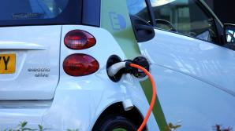
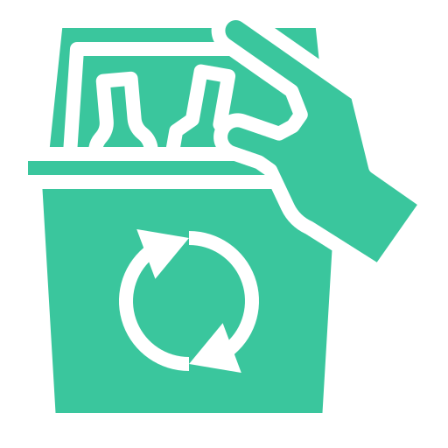
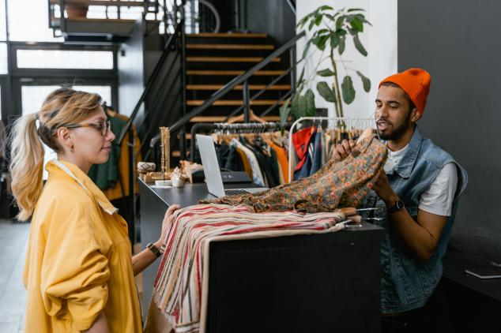
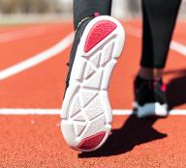
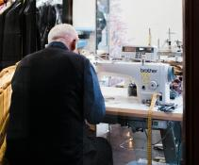
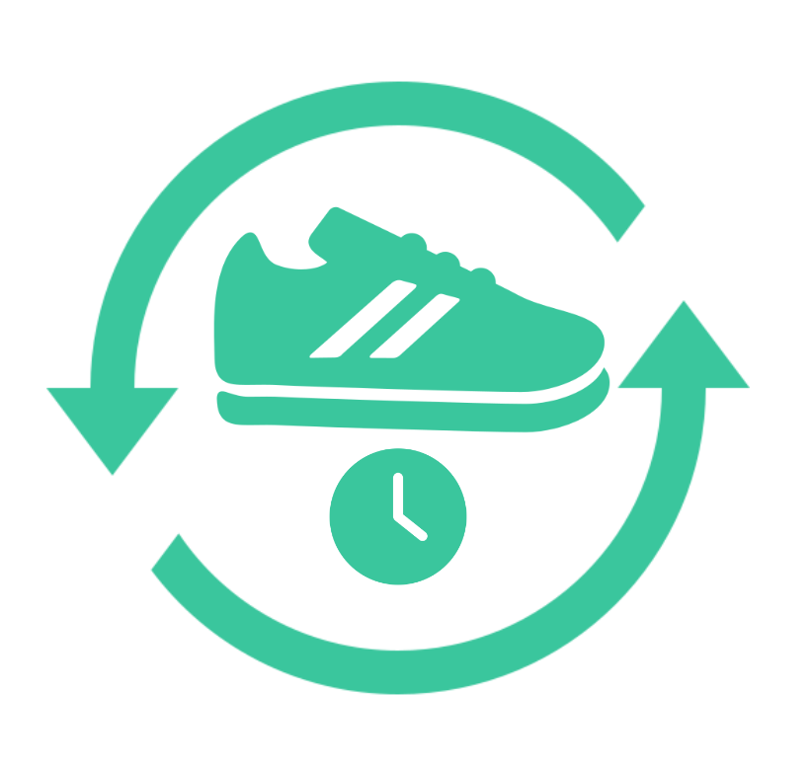
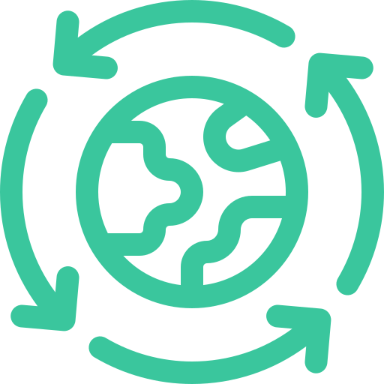
Cinco Modelos de Negócios de Circularidade
Plataforma de Compartilhamento: Compartilhamento de Carona
Recuperação de Recursos: Resíduos para energia
Extensão da Vida útil do Produto:
Serviço de devolução e conserto
Produto como um Serviço: Aluguel de roupa
Suprimentos Circular: Calçado feito de plástico
Notes:
(Slide duration: 3min)
Ask students:
What are some real examples of each business model? Can you think of any companies practicing any of these circular principles?
Answers:
Circular Supplies:. Shoes made from fully recycled PET plastic.
Resource Recovery: Waste that cannot be recycled is diverted from the landfill to a waste to energy plant where it is processed into energy.
Product Life Extension: A company will repair your clothes or accept them as donations and those items are then repaired and sold again.
Sharing Platform: An online platform where homeowners can rent their homes to short term renters for a fee, allowing them to make money from unused living space and providing renters with alternatives to a hotel.
Product As A Service: Renting clothes gives customers the flexibility to affordably wear the fashion they want without having to buy the item and own it themselves.

Slide 10
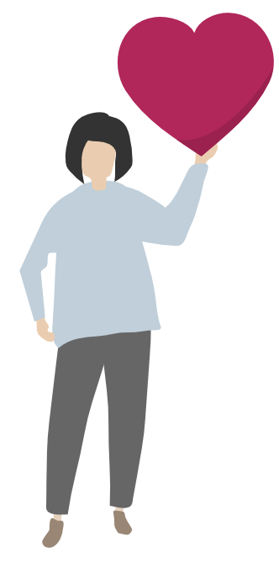
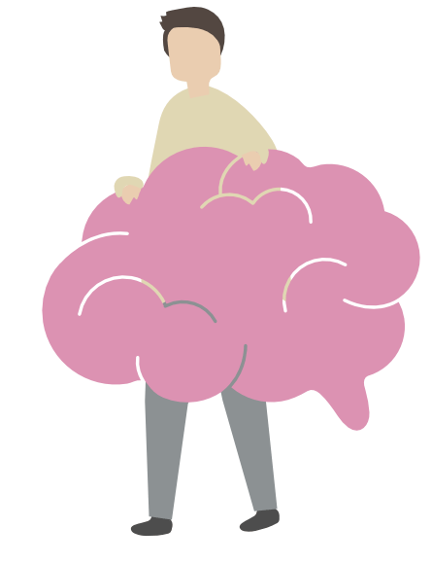
Emocional vs Funcional
Os benefícios funcionais são baseados em um atributo de produto que fornece ao cliente utilidade funcional.
Os benefícios emocionais proporcionam aos clientes um sentimento positivo quando compram ou usam uma determinada marca.
Notes:
(Slide duration: 5min)
Tell students:
When designing a new product or service we need to understand the target audience. People buy and use products for a variety of reasons, and it is our job as designers to understand their problems and help resolve them. Their motivation to buy a product or use a service will fall into two aspects: emotional and functional. Identifying their needs and desires help shape the benefits we will create for them.
Emotional benefits provide customers with a positive feeling when they purchase or use a particular brand. They add richness and depth to the experience of owning and using the brand.
-Examples of emotional benefits include the “feel-good” factor when purchasing groceries carrying a fair-trade label or when donating to charities such as the Red Cross Foundation. Buying local has also started to carry emotional benefits, although most brands in these areas are niche brands that are currently not well known other than to their enthusiasts.
Functional benefits are based on a product attribute that provides the customer with functional utility. The goal is to select functional benefits that have the greatest impact with customers and support a strong position relative to competitors. However, it is important to keep in mind that functional benefits often fail to differentiate, can be easy to copy, and may reduce strategic flexibility.
-Examples of functional benefits include the computing capability of a smartphone, the thirst-quenching offered by a bottle of water, and the warmth of a wool sweater.

Slide 11
Design para Circularidade
Design Thinking
Saiba mais sobre o público.
Faça um brainstorm e crie soluções.
Teste a ideia e obtenha feedback do usuário.
Empatia
Defina
Idealize
Protótipo
Teste
Aperfeiçoe as perguntas-chave.
Crie representações de uma ou mais ideias.
Notes:
(Slide duration: 5min)
Tell students:
So how do we design new products and services for people? Innovative solutions help resolve customer pain points related to their emotional and functional needs. In creating these new solutions for customers, we can use a design process called “design thinking”.
Design thinking is a design methodology that provides a solution-based approach to solving problems. It is extremely useful in tackling complex problems by understanding the human needs involved, by re-framing the problem in human-centric ways, by creating many ideas in brainstorming sessions, and by adopting a hands-on approach in prototyping and testing.
The five stages:
Emphasize: This is the stage where we learn about our target audience. Who will use our product or service?
Define: Identify the key questions and problems you plan to address in your design process.
Ideate: With your target audience in mind, freely brainstorm your ideas to help solve their problems.
Prototype: Put together a minimum viable product you can test.
Test: Test your ideas and get feedback directly from the customers whose problems you are trying to solve.

Slide 12
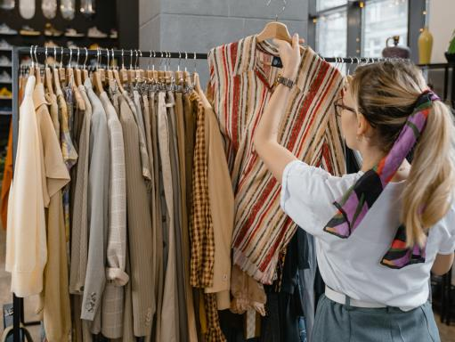
Produto como um Serviço: Aluguel de roupas
Notes:
(Slide duration: 5min)
Tell students:
Let us examine a circular business model of (clothing rental) and move through the 5 stages of the design thinking process to understand it a little better.
Example: Clothing rental
Nearly half of young people said they would like to be more eco-friendly in their approach to fashion, yet most said prices are a priority. Users in the United States typically buy at least one item per week from high-street fashion and spend $35. By combining a rental model at an accessible price point allows customers to spend less while preventing them from having a wardrobe filled with unused clothes. The service gives customers flexibility by allowing them to select multiple outfits and decide how long to keep them.
Ask students:
What are the emotional aspects and functional aspects of this service?
Answers:
People want to be more eco-friendly but also dress the way they want without spending too much money. A rental service allows them to gain access to the clothes they wish to wear without the price tag or having to buy more clothes they will use only a few times. This also reduces clutter in their wardrobe.

Slide 13
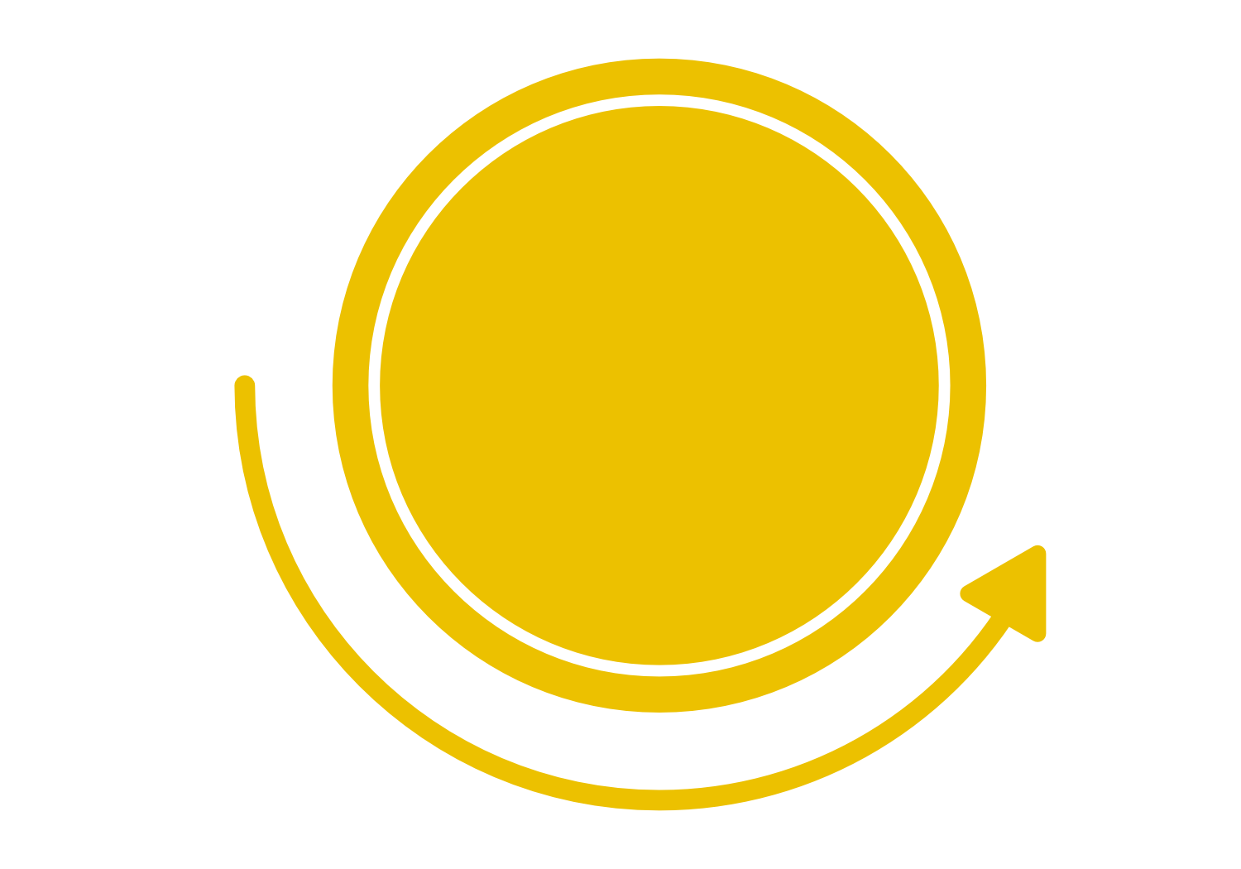
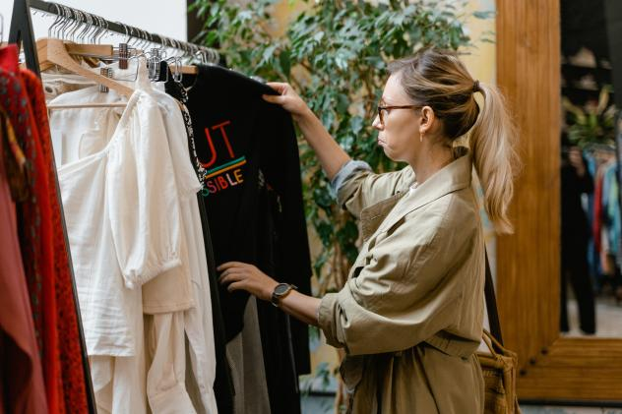
Aprenda sobre o público para quem você está projetando, por observação e entrevista.
Quem é meu usuário?
O que importa para essa pessoa?
Estágio de Empatia
Notes:
(Slide duration: 3min)
Tell students:
The first stage of the design thinking process is to gain an empathetic understanding of the problem you are trying to solve. This involves consulting experts to find out more about the area of concern through observing, engaging and empathizing with people to understand their experiences and motivations, as well as immersing yourself in the physical environment so you can gain a deeper personal understanding of the issues involved. Empathy is crucial to a human-centered design process such as design thinking, and empathy allows design thinkers to set aside their own assumptions about the world in order to gain insight into users and their needs.
Depending on time constraints, a substantial amount of information is gathered at this stage to use during the next stage and to develop the best possible understanding of the users, their needs, and the problems that underlie the development of that product.
Ask students:
For our clothing rental example, who would be the ideal customer and what is their motivation to use this service?
Answers:
They are motivated to save money and gain access to the clothes they want to wear that make them feel good. This type of customer also is cost sensitive and does not want to constantly spend a lot of money to buy new clothes and clutter their wardrobe.

Slide 14
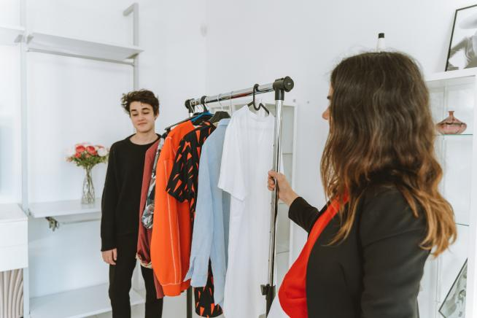
Crie um ponto de vista baseado nas necessidades e pensamentos do usuário.
Quais são as suas necessidades?
Definir
Estágio
Notes:
(Slide duration: 3min)
Tell students:
In the Define stage you put together the information you have created and gathered during the Empathize stage. This is where you will analyze your observations and synthesize them in order to define the core problems that you and your team have identified up to this point. You should seek to define the problem as a single problem statement in a human-centered manner that is not too complicated.
The Define stage will help designers gather great ideas to establish features, functions, and any other elements that will allow them to solve the problems or, at the very least, allow users to resolve issues themselves with minimal difficulty. In the Define stage you will start to progress to the third stage, Ideate, by asking questions which can help you look for ideas for solutions by asking some guiding questions.
Ask students
What are their needs?
Answers:
Want access to trendy clothes on a budget without having to own them.

Slide 15
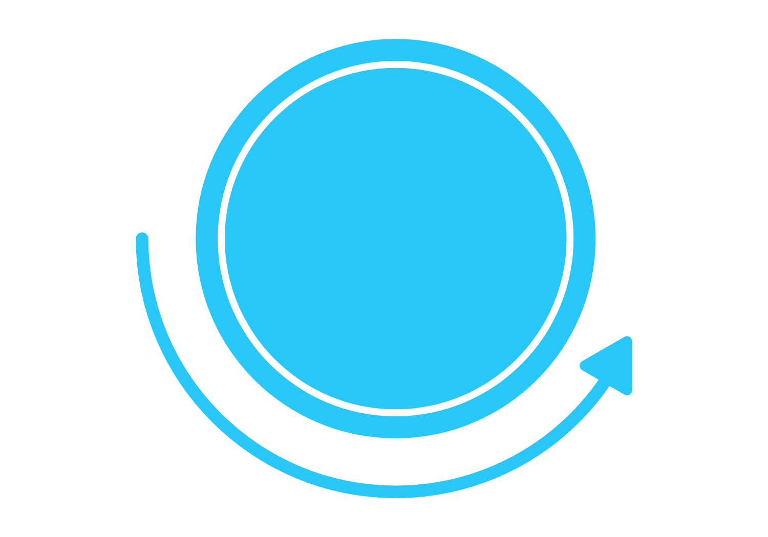
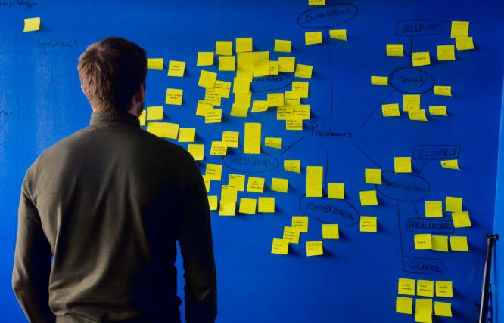
Faça um brainstorm e crie o maior número possível de soluções criativas.
Ideias malucas incentivadas!
Estágio
Ideal
Notes:
(Slide duration: 3min)
Tell students:
Now, you as designers are ready to start generating ideas. You have grown to understand your users and their needs in the Empathize stage, and you have analyzed and synthesized your observations in the Define stage and ended up with a human-centered problem statement. With this solid background, you and your team members can start to "think outside the box" to identify new solutions to the problem statement you have created, and you can start to look for alternative ways of viewing the problem.
It is important to get as many ideas or problem solutions as possible at the beginning of the Ideation phase. All ideas are good and will help get the brainstorm flowing. There are no bad ideas, and any one idea can lead to the winning idea.
It is helpful to do this with sticky notes on a posterboard.

Slide 16
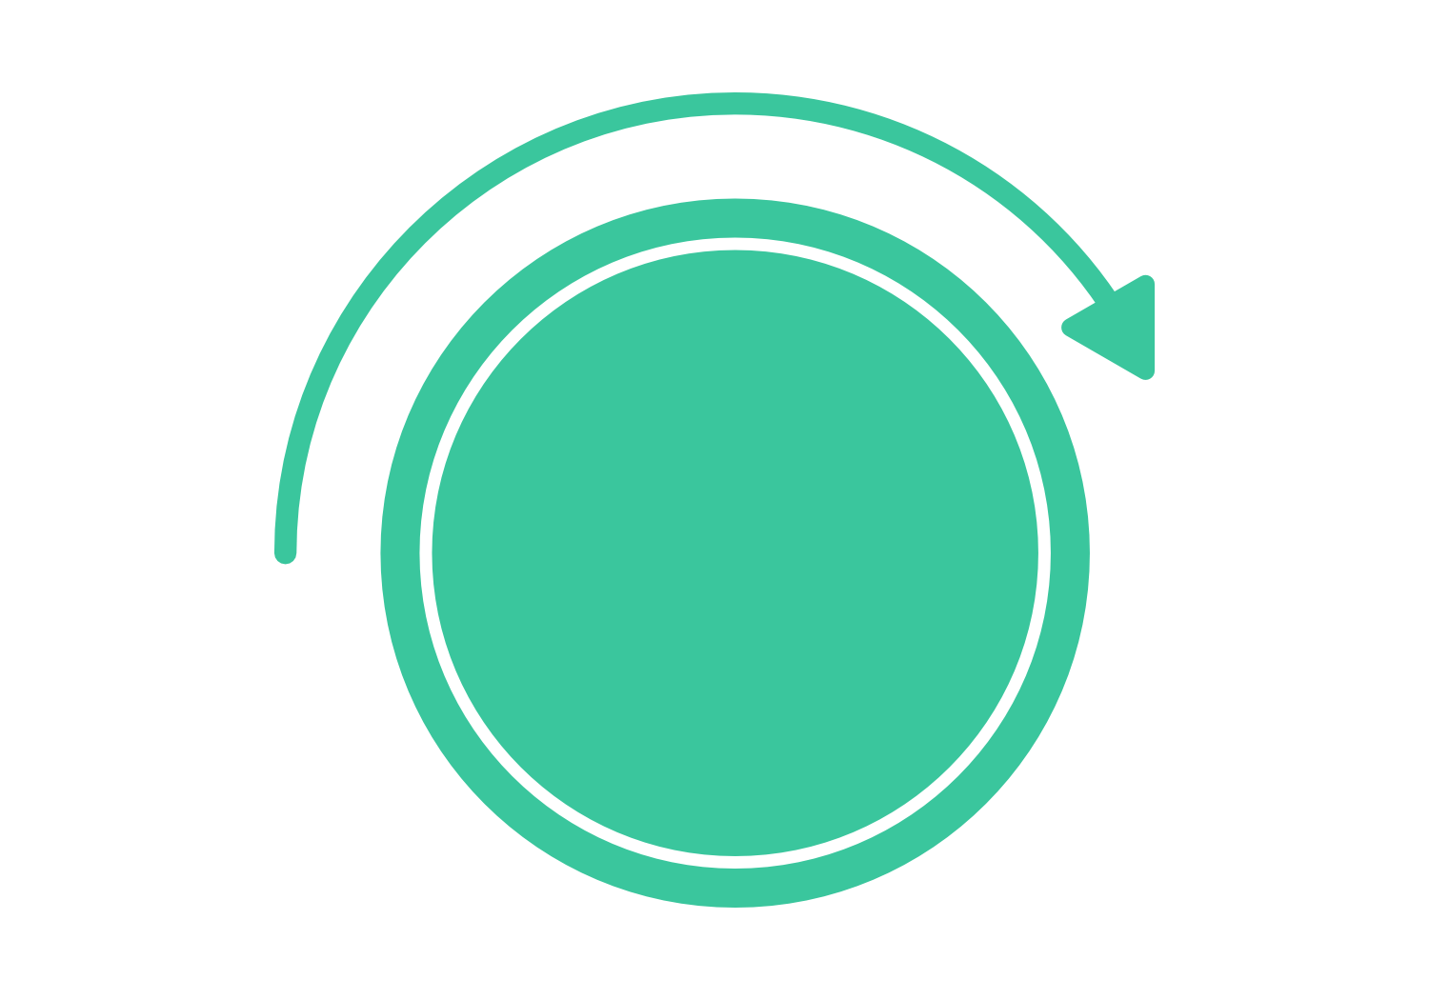
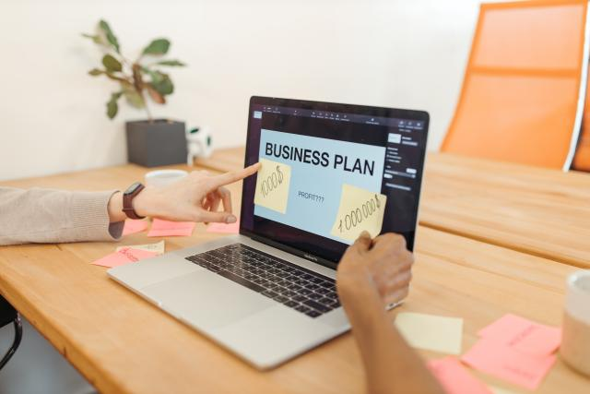
Construa uma representação de uma ou mais de suas ideias para mostrar aos outros.
Como posso mostrar a minha ideia?
Lembre-se: um protótipo é apenas um rascunho!
Estágio de Protótipo
Notes:
(Slide duration: 3min)
Tell students:
The design team will now produce a number of inexpensive, scaled down versions of the product or specific features found within the product, so they can investigate the problem solutions generated in the previous stage. Prototypes may be shared and tested within the team and with small groups of people outside the design team. For our exercise we can present these ideas to the class to get feedback.
This is an experimental phase and the aim is to identify the best possible solution for each of the problems identified during the first three stages. The solutions are implemented within the prototypes and, one by one, they are investigated and either accepted, improved and re-examined, or rejected on the basis of the users’ experiences. By the end of this stage, the design team will have a better idea of the constraints inherent to the product and the problems that are present and have a clearer view of how real users would behave, think, and feel when interacting with the end product.

Slide 17
Compartilhe sua ideia prototipada com seu usuário original para obter feedback.
O que funcionou?
O que não fez?
Estágio de Teste
Notes:
(Slide duration: 5min)
Tell students:
Designers or evaluators rigorously test the complete product using the best solutions identified during the prototyping phase. This is the final stage of the 5 stage-model, but it is an iterative process and the results generated during the testing phase are often used to redefine one or more problems and inform the understanding of the users, the conditions of use, how people think, behave, and feel, and to empathize. Even during this phase, alterations and refinements are made in order to rule out problem solutions and derive as deep an understanding of the product and its users as possible. This is where we really need to bridge the product/market fit.

Slide 18
Estágio de Empatia
Definir
Estágio
Estágio
Ideal
Estágio de Protótipo
Estágio de Teste
Comprador com orçamento limitado
Peça roupas emprestadas de amigos para alugar para outros amigos e cobre uma pequena taxa
Não quer bagunçar seu guarda-roupa com itens não utilizados
Alugue roupas para Clientes
Veste as mais recente tendências da moda
Quer acesso a roupas da moda
Crie uma pequena loja de aluguel de roupas off-line entre amigos e familiares
Venda roupas da moda baratas
Notes:
(Slide duration: 5min)
Tell students:
From our design thinking exercise, we were able to determine some key points at each stage of the design thinking process.
Ask students:
Can you add some more points to the blank sticky notes:
Answers:
Empathize: Has a cluttered wardrobe with too many clothes
Define: Does not want to own clothes for long periods of time
Ideate: Repair and resell program
Prototype: Create a micro shop out of your bedroom, on social media, or for as cheap as possible
Testing: Try to sell your prototype product or service to real potential customers and get real feedback

Slide 19
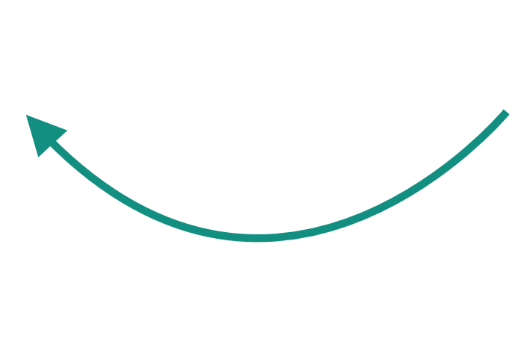
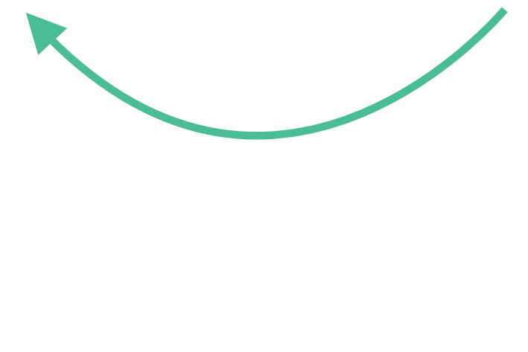
Áreas de aluguel de roupas de circularidade
Alugar
1. Extração 2. Produção 3. Distribuição 4. Uso 5. Descarte
Retornar
Reparar
Reaproveitar
Notes:
(Slide duration: 3min)
Tell students:
Where along the lifecycle map has our clothing rental company created circularity?
Ask students:
What circular models are used with our clothing company?
Clothing owners repurpose their old clothes by selling or donating to the store and not disposing of them.
The store offers the clothes available for rent to customers.
After the customer is finished using the clothes, they return them to the store for the store to rent to another customer.

Slide 20
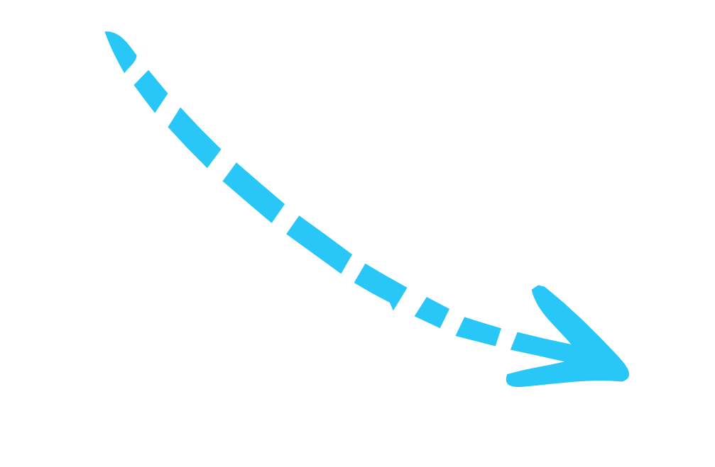
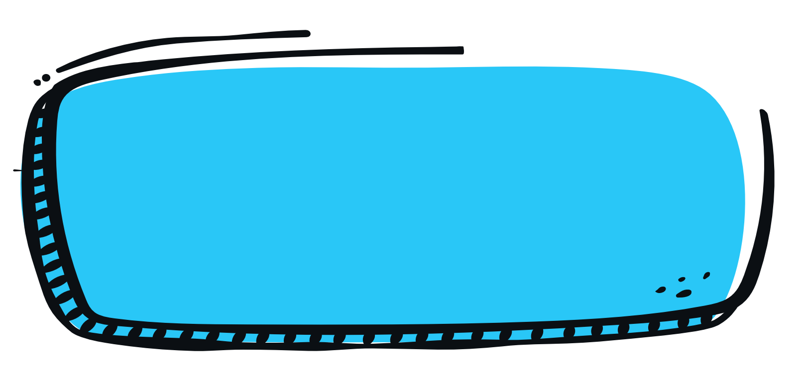
1
Divida em grupos de 3 a 5 e prepare um cartaz ou use o folheto de design thinking.
3
Use o folheto de design thinking para desenvolver sua solução circular para o produto.
Atividade de Aula
4
Aplique um ou mais modelos de design circular ao seu produto.
2
Escolha um dos seguintes produtos
Sache de ketchup
Laptop caro ou telefone celular
Roupas de bebê
Embalagem de alimentos
Embalagens pequenas descartáveis para nozes ou legumes
Chinelos
5
Compartilhe suas ideias para redesenhar para a economia circular.
Notes:
Tell students:
For this exercise students will work in groups to redesign an existing product with a more circular solution. They will apply the design thinking process and use one of the circular design models to build a product or service solution for their product of choice. They will choose from one of the linear products and consider how to redesign it to be more circular.

Slide 21
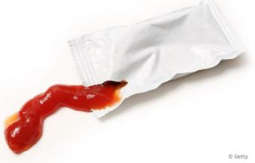
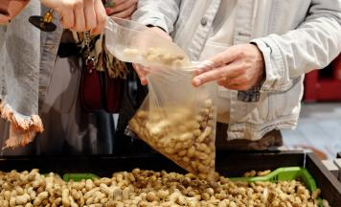
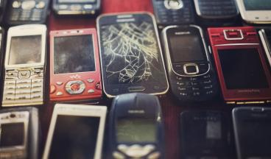
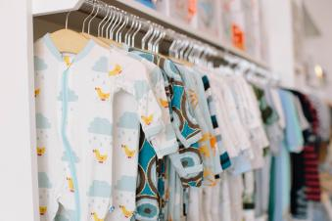
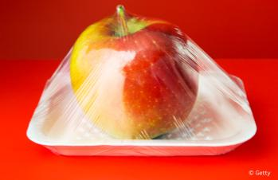
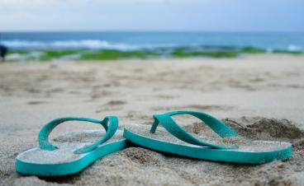
Escolha um produto para redesenhar para circularidade
Notes:
Tell students:
Have the students choose one of the products that need a circular solution. Explain the linear problem of each product.
1. Single use ketchup packets:
Problem: These are only used one time then thrown away. They cannot be recycled because it is made with multilayered materials. Is there a better way to offer ketchup to customers without all the waste?
2. Expensive laptop or cell phone:
Problem: Computers and cell phones sometimes break down for a variety of reasons and often are not simply repaired, resulting in people buying a new one. Computers also have valuable metals and recyclable materials within the devices, but they cannot easily be recycled. This is called “e-waste”. How can we extend or build a product that would last longer, and in which those recyclable parts can be used again?
3. Baby clothes:
Problem: Babies grow fast and grow out of their clothes much quicker than adults, leaving parents with a lot of baby clothes they cannot use any longer. Is there a way to reduce waste with baby clothes through a service that could share them with another family?
4. Food wrapping:
Problem: Food wrapping is used at grocery stores on fresh produce to preserve the shelf life of the food and prevent food waste. This thin material cannot be recycled and is discarded once the customer buys the produce and brings it home. This wrapping is thrown away and not recycled. Is there another way we can maintain the shelf life of our food and prevent food waste without using thin food wrapping?
5. Single use packaging used when buying nuts or produce at the grocery store:
Problem: Grocery stores offer single use packaging to buy certain items that is only intended to be used one time. Is there a better way to buy nuts or other produce at the grocery without single use packaging?
6. Rubber flip flops:
Problem: Flip flops are made from rubber and cannot be recycled. Is there a better end-of-life solution? Is there a way to conserve the rubber and use it for something else?

Slide 22
Estágio de Empatia
Definir Estágio
Estágio
Ideal
Estágio de Teste
Estágio de Protótipo
Notes:
Tell students:
They will get a design thinking handout but, if possible, create the design thinking layout on a large posterboard and use sticky notes for this part of the exercise.

Slide 23
Mapa do Ciclo de Vida Circular
Reciclar
Remanufacturado
Reutilizar
1. Extração 2. Produção 3. Distribuição 4. Uso 5. Descarte
Recarga
Retornar
Reparar
Reaproveitar
Reutilizar
Composto
Notes:
Tell students:
Students will use the linear life cycle map to draw in the arrows of circularity they create with their proposed business model.

Slide 24
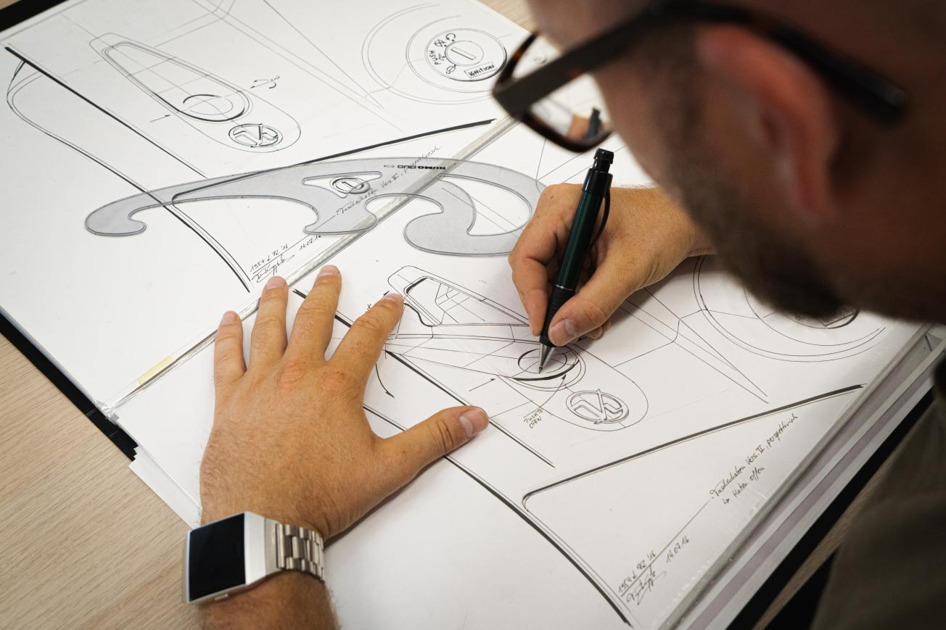
Notes:
Tell students:
Students will sketch their final circular product design idea on the Circular Solutions handout. Have each group present their new product to the class.

