Slide 1
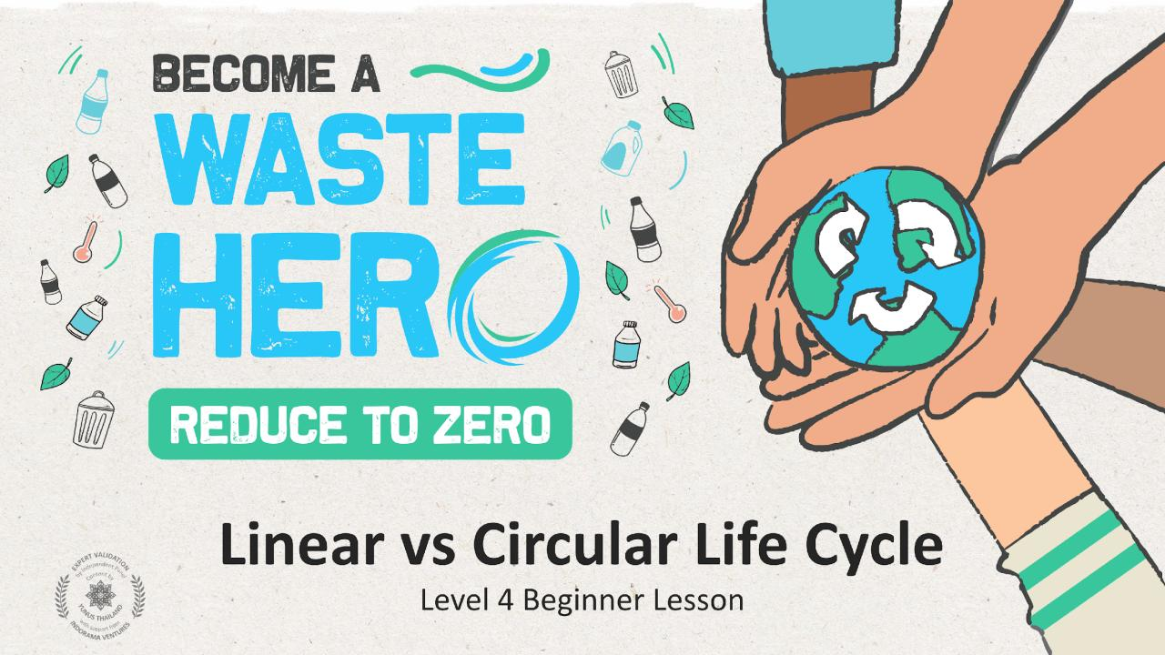

Slide 2
Lesson Prep & Curriculum Alignment
Prep time: 10 – 15 minutes
Students will understand the differences between the linear and circular economies and how products and materials move through a life cycle. They will develop the ability to think about the full life of the things that we use in our daily lives and set the groundwork for being able to redesign systems. Everyday objects are fascinating in their complexity, and this helps us conceptualize the way the linear system works and how to start making the products we use more circular.
1
Display the lesson slides for the class and create a discussion about what they already know about the linear vs circular economies and introduce the concept of product lifecycle mapping. Ask students the guiding questions in the PowerPoint slide notes.
2
Print out the 4 handouts: 1. Product Cards 2. Product Lifecycle Map 3. Circular Lifecycle Map 4. Example Lifecycle Map
3
Follow the steps on the next slide and in the teacher notes in slides 17 and 20 to conduct the class activity

Slide 3
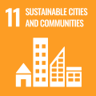
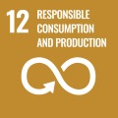
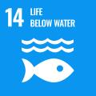
Lesson Prep & Curriculum Alignment
Prep time: 10 – 15 minutes
Key Learning Outcomes and Curriculum Alignment:
Science - Earth and Human Activity: Communicate solutions that will reduce the impact of humans on the land, water, air, and/or other living things in the local environment. Things that people do can affect the world around them. But they can make choices that reduce their impacts on the land, water, air, and other living things.
English Language Arts and Literacy: Participate in collaborative conversations with diverse partners about topics and texts. Follow agreed-upon rules for discussions. Use words and phrases acquired through conversations, reading and being read to, and responding to texts. Participate in collaborative discussion in groups with diverse partners on topics and issues, expressing ideas clearly.
Social Studies - People, Places, and Environments: The study of people, places, and environments enables us to understand the relationship between human populations and the physical world.
SDG Alignment
Flexible and adaptive lesson
Lesson plans are designed to be flexible and responsive to the evolving needs of your classroom. Lessons are editable and customizable to meet the different individual student and classroom contexts. A PowerPoint version with teacher instructions and a printable PDF lesson are available for download.

Slide 4
The Lesson
Lesson duration: 45 - 60 minutes
1
Organize into groups of 3-5 and choose a product card from the deck or use any product the group knows a little about.
2
Each group has a large piece of paper or uses the lifecycle map handout provided and lists the 5 different life cycle stages: 1. Material extraction; 2. Production; 3. Distribution; 4. Usage; 5. Disposal.
3
Each group will document with sticky notes (some will draw pictures, others write lists) the entire life cycle of the product, from start to finish. Groups can use the completed handout of the soft drink bottle as an example. There should be a time limit of 20 minutes.
4
Start your life cycle map with the list of materials used to make the product and find out how they are extracted and processed. When consumers buy it how many times do they use it? Use the Internet to research this or have the students make some good guesses. When you get to the end-of-life, think through all the possibilities such as landfill, littering and recycling. Think critically about where the item will likely end up.
5
Lastly, identify one or more circular opportunities for this product. Could this product be reused in some way? Can it be recycled, if so, what can it be recycled into? What would you change about this product to allow it to be more circular?

Slide 5
Prepare the PowerPoint presentation
When you are ready to present the lessons to your class click on Slide Show on the top menu bar then select Presenter View. In Presenter view, you can see your notes as you present while the audience see only your slides.
The notes appear in a pane on the right. The text should wrap automatically, and a vertical scroll bar appears if necessary. You can also change the size of the text in the Notes pane by using the two buttons at the lower left corner of the Notes pane.

Slide 6
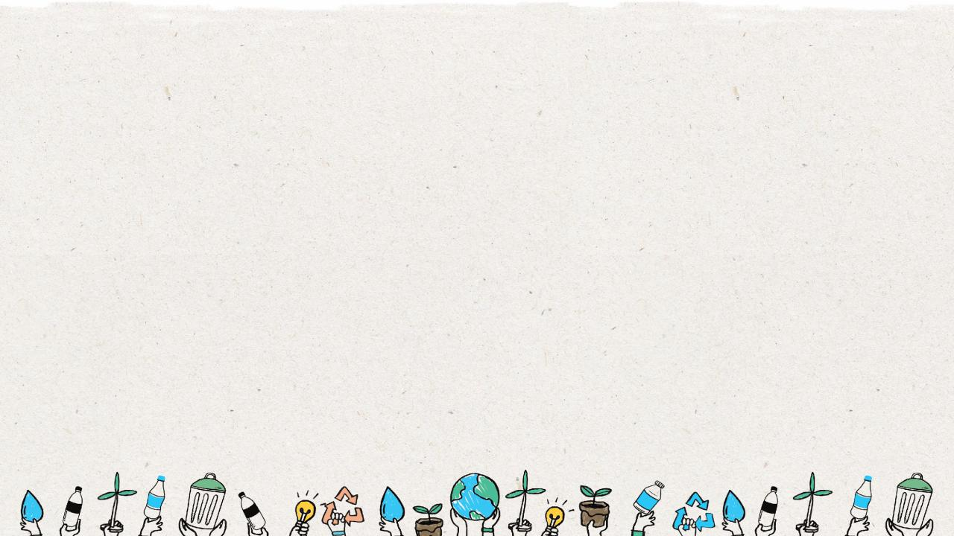
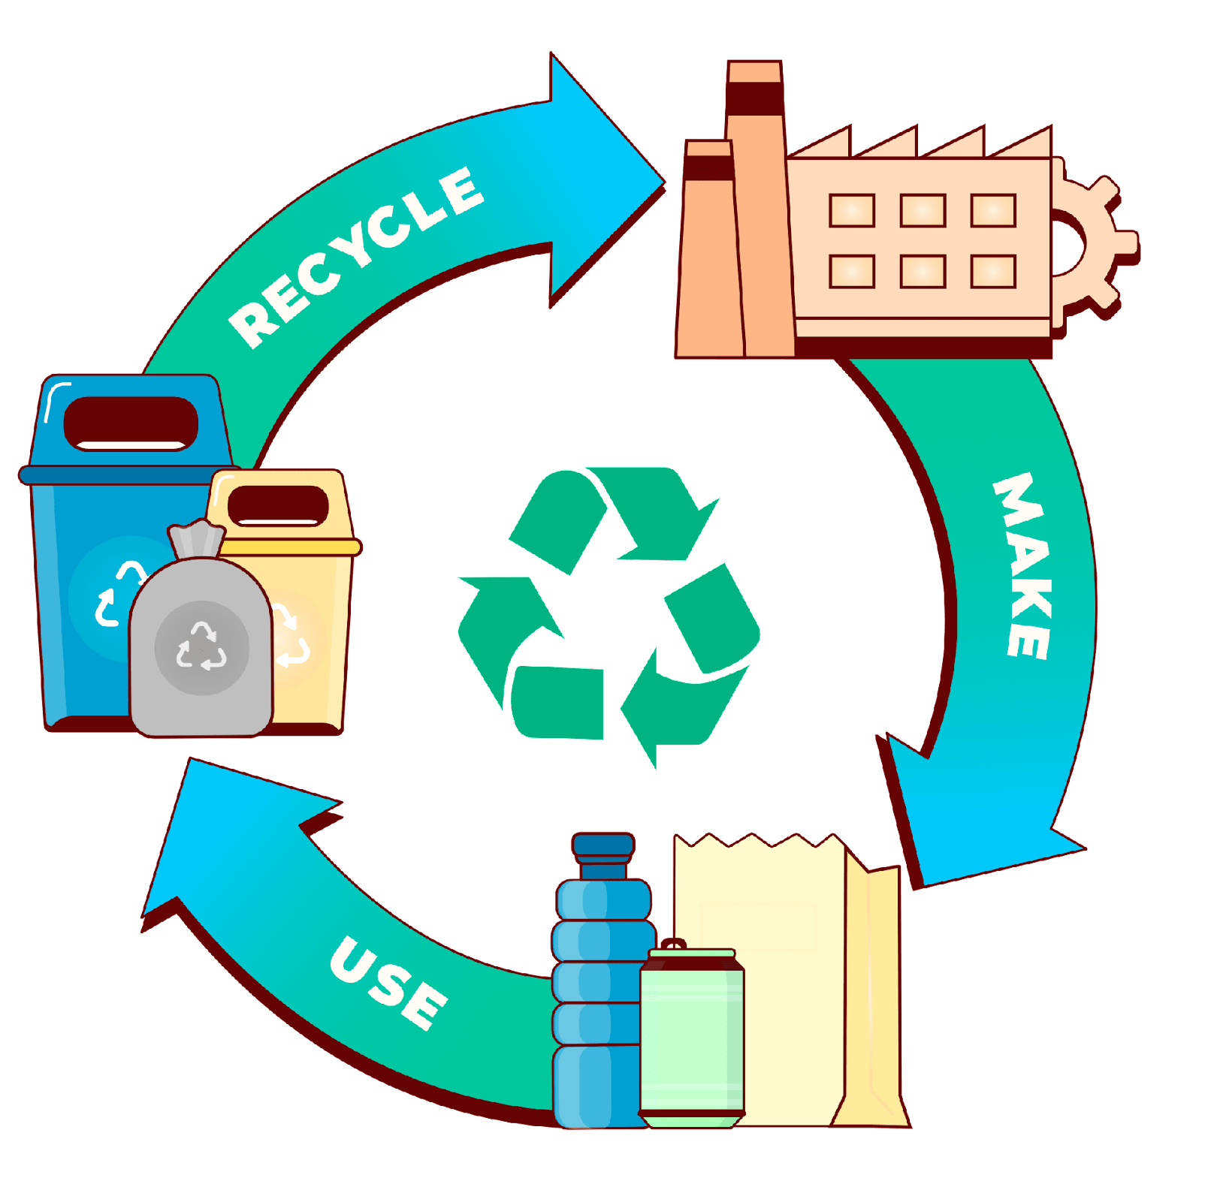
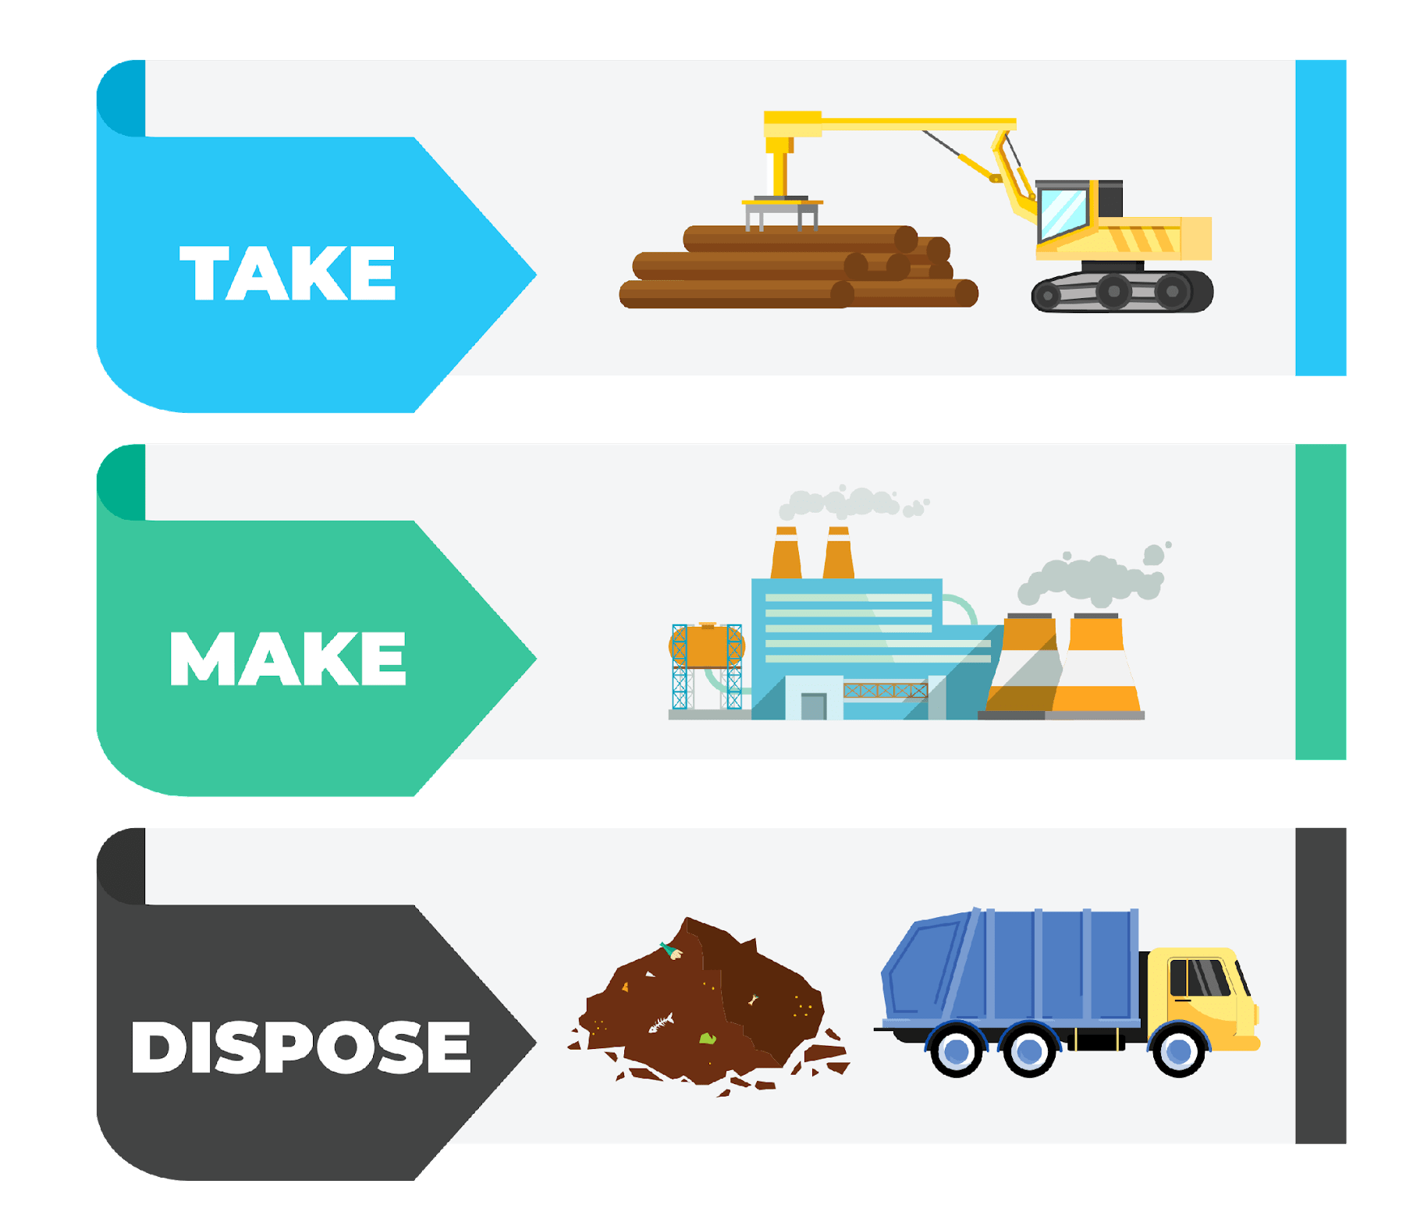
Linear Economy
VS
Circular Economy
Notes:
(Slide duration: 5min)
Tell students:
How we approach our systems of production and consumption is important to understand when discussing how to fight climate change and to become a more sustainable world. The planet’s resources are finite, so it is crucial that people, governments and companies work together to use them more responsibly.
A linear economy is our traditional model that follows the “take-make-dispose” model where raw materials are collected, then manufactured and transformed into products we use until they are finally discarded as waste either in a landfill or into our natural environment. This model gives no concern for their ecological footprint and its consequences. It prioritizes profit over sustainability, with products made to be thrown away once they have been used.
A circular economy (also referred to as circularity and CE) is a model of production and consumption which involves sharing, leasing, reusing, repairing, refurbishing and recycling existing materials and products for as long as possible. It is a model designed to have as little impact as possible on the environment by leaving less of a footprint through keeping items in a closed loop system.
Questions for students:
1. What is an example of a product from the linear and circular economies?
ANSWER: Linear = Food packaging film on broccoli, Circular: Car ride-sharing or PET plastic bottle recycling.
2. How is the linear model harming the planet?
ANSWER: Waste accumulates in the landfills or leaks into the environment as litter. Finite natural resources are depleted.
3. How can the circular economy help fight climate change?
ANSWER: It keeps natural resources in use with no need to extract more. It also reduces waste leakage into the environment as litter.

Slide 7
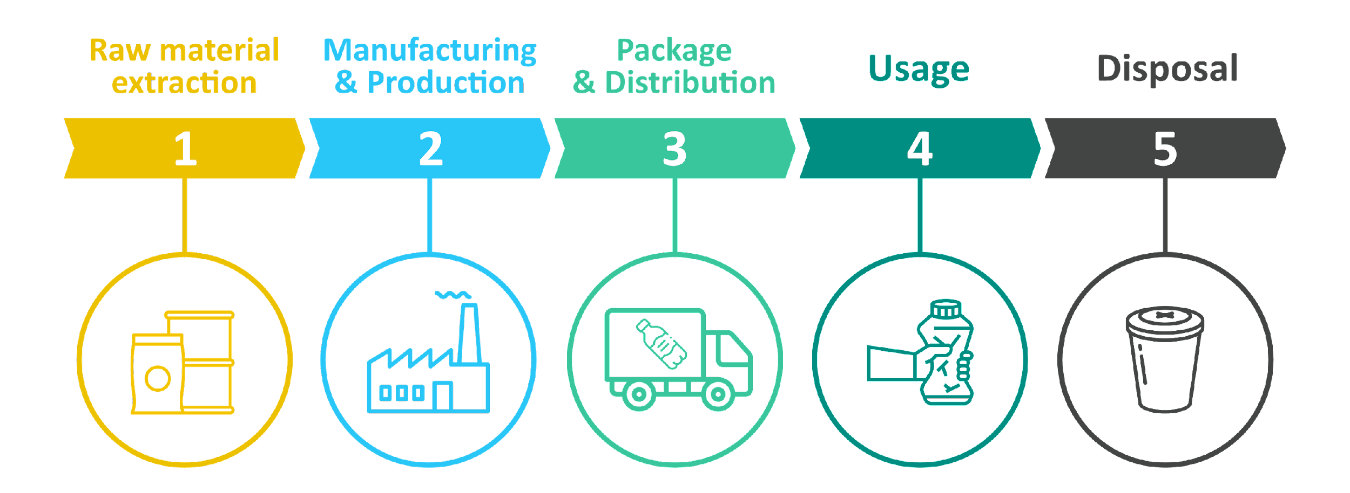
Linear Economy
Notes:
(Slide duration: 5min)
Tell students:
The linear economy is designed to extract raw materials from nature, process them into usable goods, and then discard them either into a landfill, burned in an incinerator or leaked somewhere in nature (usually by accident and considered litter). This linear system can be wasteful, and the losses result in negative environmental impacts, which is not currently accounted for in any of our economic measurement tools. When we consume a product we should consider the end-of-life options for it. If the product ends up in a landfill, is that a bad thing? Can it be recycled? Can I reuse this? Can I repurpose it in some way?
Questions for students:
Why would a system be designed in this way?
ANSWER: Value is created in the current economic system by producing and selling as many products as possible. Profit over the planet.
What is a problem with this model?
ANSWER: It creates a lot of waste which often enters the environment as litter. Landfills release large amounts of methane gas, which contribute to global warming.

Slide 8
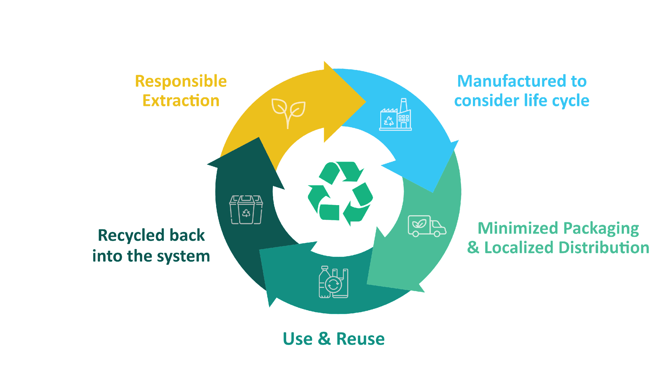
Circular Economy
Notes:
(Slide duration: 5min)
Tell students:
The circular economy is a systems solution framework that tackles global challenges like climate change, biodiversity loss, waste, and pollution. A model of production and consumption which involves sharing, leasing, reusing, repairing, refurbishing and recycling existing materials and products for as long as possible. Companies who want to be more circular should aim to design and make products that:
Eliminate waste
Keep materials in use
Regenerate natural systems
Ask students:
What is an example of a circular product or service?
Answer: Refill stations (shops where you bring your bottle to refill with shampoo or soap)

Slide 9
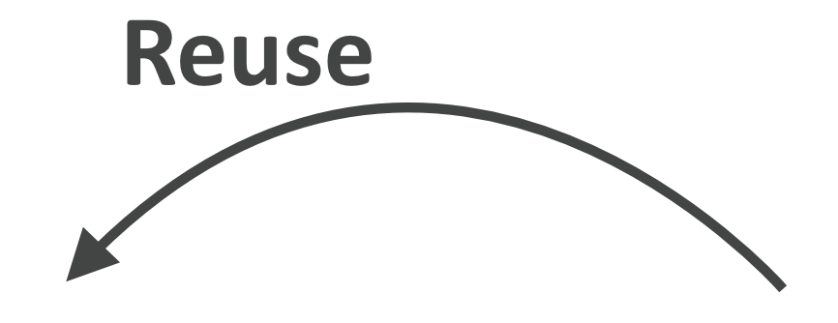
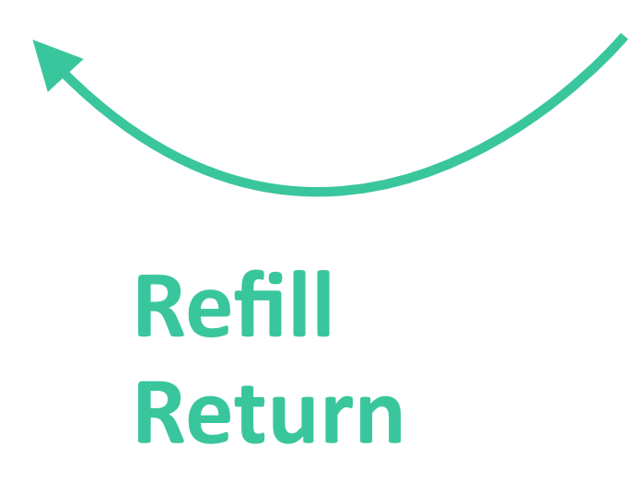
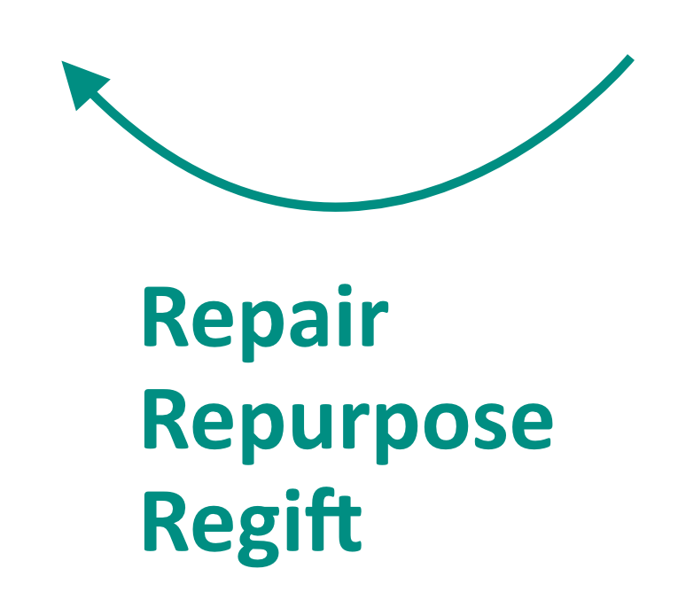
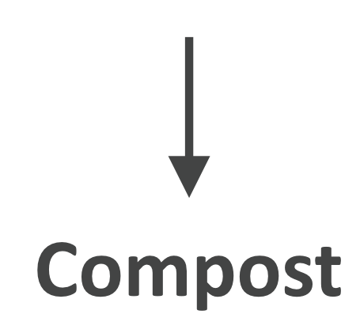
Life Cycle Mapping
Notes:
(Slide duration: 5min)
Tell students:
The major stages of a product’s life can be mapped in both linear and circular ways. We can assess the life cycle by identifying the 5 key stages of a product’s life:
Material extraction is how and where raw materials are removed from natural sources.
Production of the raw materials into a product.
Finished products are distributed to places where customers can purchase the product.
Customers use the product.
The product is then disposed of after use.
By looking at a product's entire life cycle, from materials extraction to end-of-life management, we can find new opportunities to reduce environmental impacts, conserve resources, and reduce costs. Instead of the linear “take-make-waste” system of the 5 stages, we can build in circularity through closed loops that keep these materials and products in use.
Circularity means rethinking the linear use cycle of a product or service with a beginning, middle, and end. If a product or service is truly circular, it will never actually have an end to its life, but continuously take a new form. Mapping this journey will ensure that your product is staying in a useful state for as long as possible and adds value at every stage.
It is not only about recycling; it is really about redesigning the entire product or service delivery model so that human beings get the things they need without negatively impacting the natural systems that sustain us all.
The exciting thing is that this is happening all around the world; people of all types are changing their lifestyles and companies are redesigning their products to be more circular. These types of changes mean designing products to be reused and rethinking the way we deliver functionality to the market. They also include encouraging repair through better support services, return or take-back programs, refill services that encourage the use of the same container more than once, and products being designed to be remanufactured to be returned to nature through composting.
Ask students:
Can you give me an example of a product designed under one of the “Re” models of a circular product or service?
Tell students:
Click 1: -PET plastic bottles can be recycled back into the same plastic bottle over and over.
Click 2:
-Bed frames are designed into key main parts and if one breaks the manufacturer can easily disassemble the parts and replace that single part and remanufacture the bed, preventing the customer from having to buy a whole new one. The old part can be broken down and reused into a new part.
Click 3:
-Buying clothes secondhand is a way to reuse old discarded clothes giving new value and extending its life.
Click 4:
-Shops can offer refill options for household items like shampoo and soap, allowing customers to bring their own container instead of buying shampoo in a new bottle each time.
Click 5:
-Old jeans could be brought back to a store for a discount on their next purchase, in exchange the brand can repair and repurpose the material to be remade into new clothes.
Click 6:
-Using compostable seaweed-based film on fresh produce at the grocery store to replace single use packaging.

Slide 10
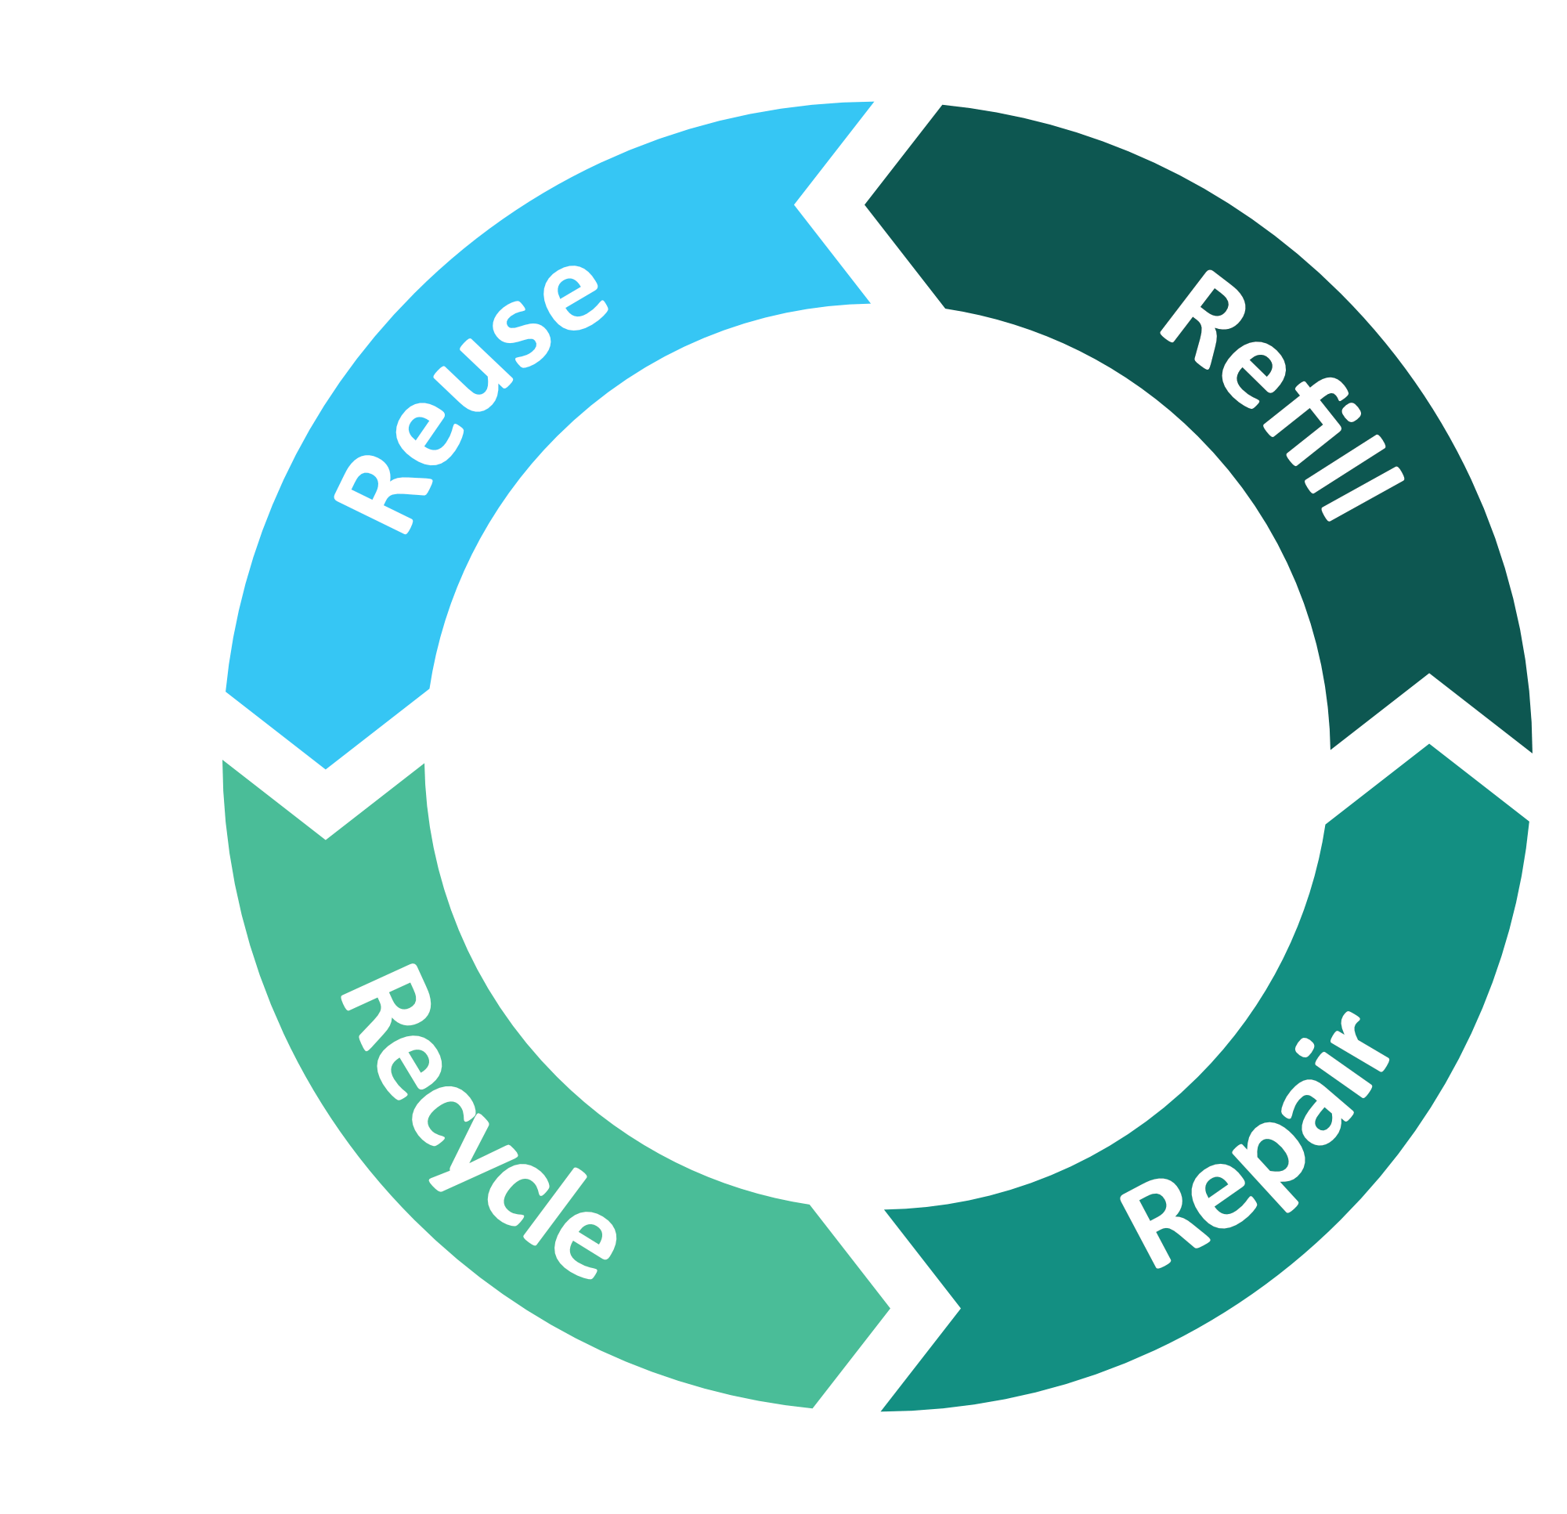
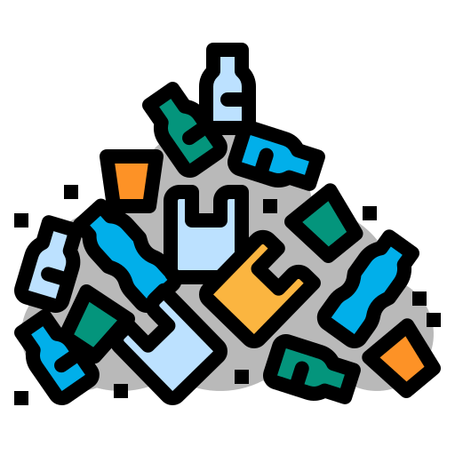
Circular products can end up in linear systems
Mismanaged
Waste
Landfill
Nature
Incinerator
Notes:
(Slide duration: 5min)
Tell students:
Sometimes products that are intended to be circular can end up in the linear system. This means that even though the product was intended to remain in the circular economy loop, it somehow ends up being improperly disposed. When waste is not managed properly it will either end up in a landfill, incinerated (burned), or leaked into nature.
Ask students:
What are some examples of how an item intended to stay in the “closed loop” of the circular economy can end up being disposed of in the linear economy?
Answers:
Littering : incorrect disposal of waste in the open environment
Open dumping: the intentional and illegal dumping of waste
Contamination: organic waste and other types of containments make it impossible to recycle materials that are intended to be recyclable
Lack of sorting and collection at the source: by not separating waste items into the proper waste and recycle bins prevent circular items from staying in the loop
Being wasteful: overusing and consuming carelessly, extravagantly, or to no purpose
Tell students:
The mismanagement of waste can result in waste leakage, which is when waste materials find a way into our natural environment and move along our natural systems. Sometimes those materials move all the way from land to sea making it challenging to recover. Let’s examine the flow of waste on the next slides.

Slide 11
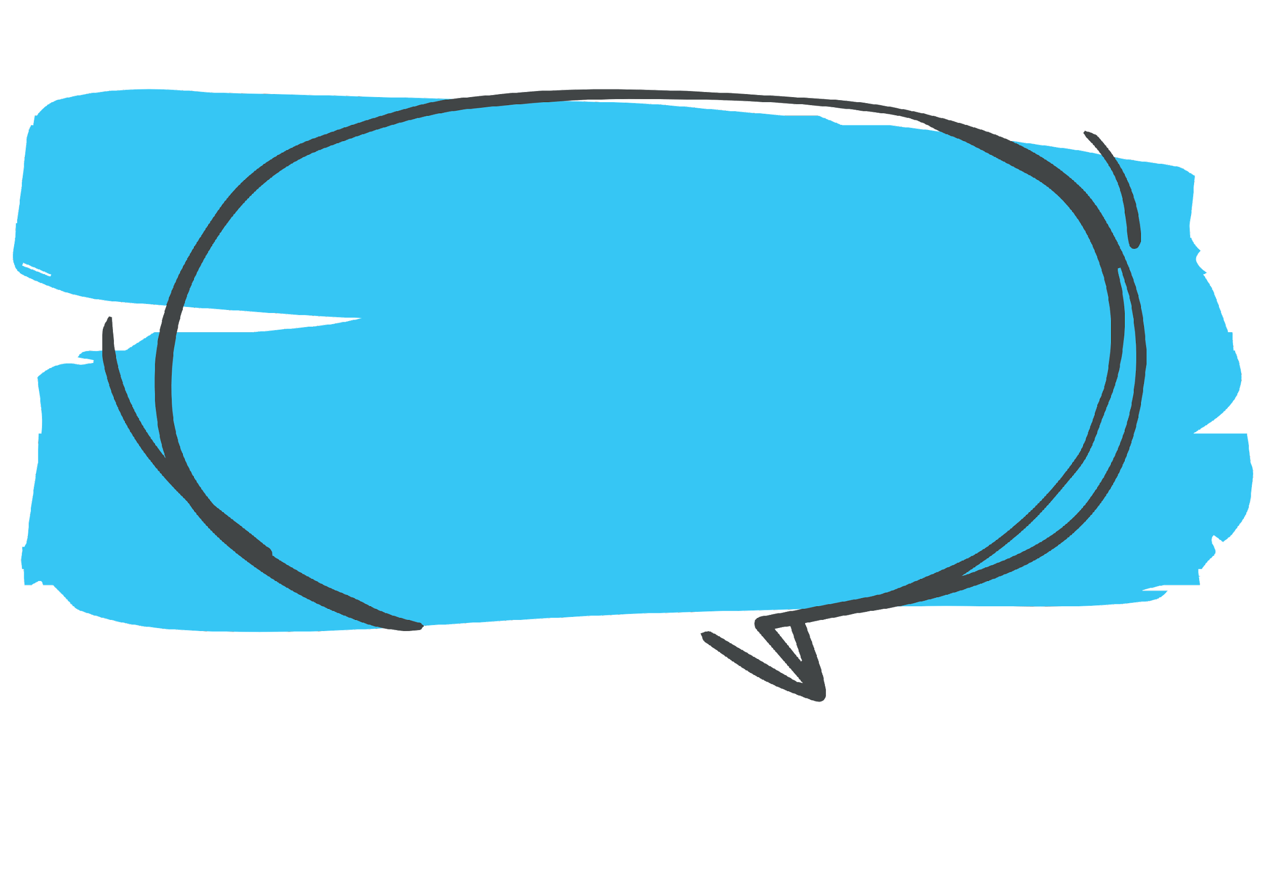
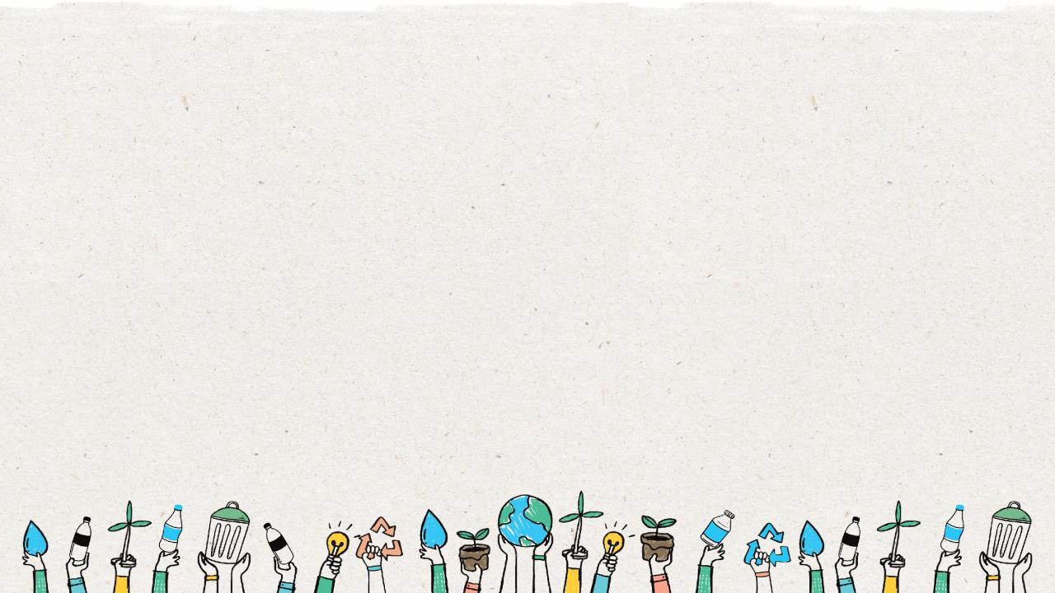
Where does your
waste go if you
do not recycle?
Notes:
(Slide duration: 3 minutes)
Answers:
Waste either ends up in a landfill or leaks into the environment as litter.
Ask students:
Have you seen waste in places it should not be?
How do you think waste got there?
Answers:
Yes, I have seen plastic bags on the beach. Plastic bags can easily fall from a waste bin and blow onto the beach.
*Ask them for additional examples.

Slide 12
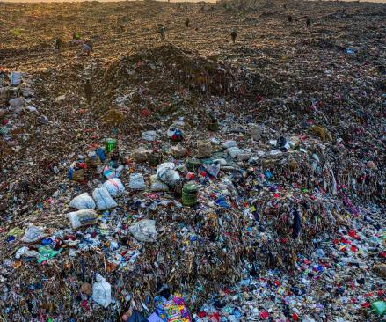
Where does our waste go?
Most of our garbage goes to local landfills
Landfills hold layers of different kinds of waste, but some of this waste does not belong here and will take hundreds of years to disappear.
Landfills bring hazards such as odor, smoke, noise, bugs, and water supply contamination.
Notes:
(Slide duration: 3-5 minutes)
Ask students:
What is a landfill?
Do recyclable items belong here? Why?
What does belong here?
Using your 5 senses, what would you experience? (smell, touch, taste, see, hear)
Answers:
A landfill is a site where people dump their general waste materials into the ground or into a giant pile.
No, recycling does not belong here. Only items that cannot be recycled need to be put into the landfill.

Slide 13
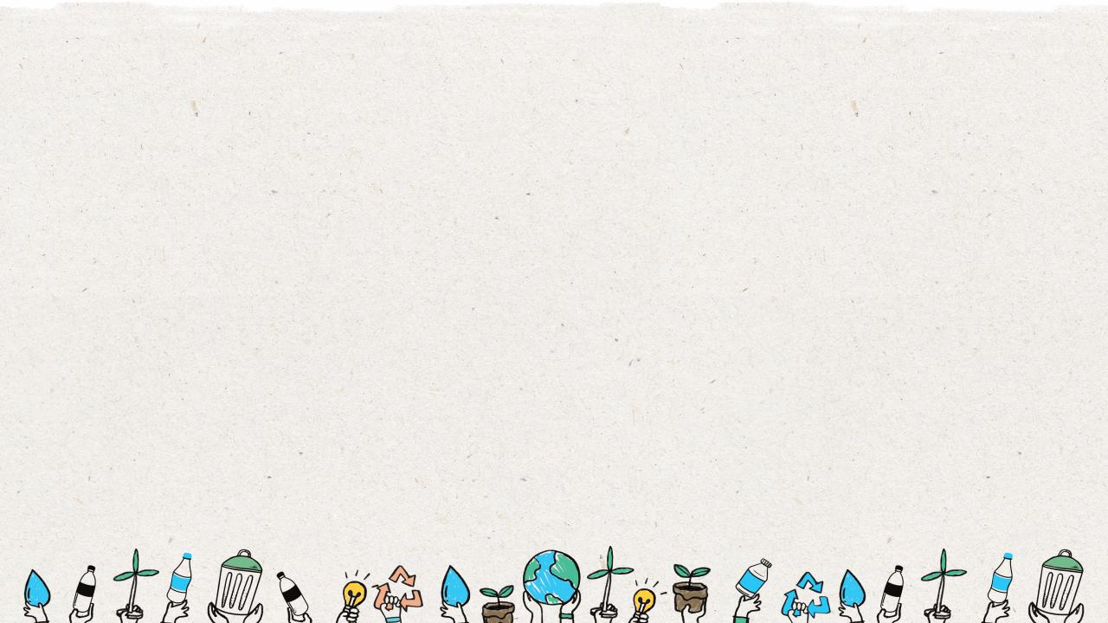
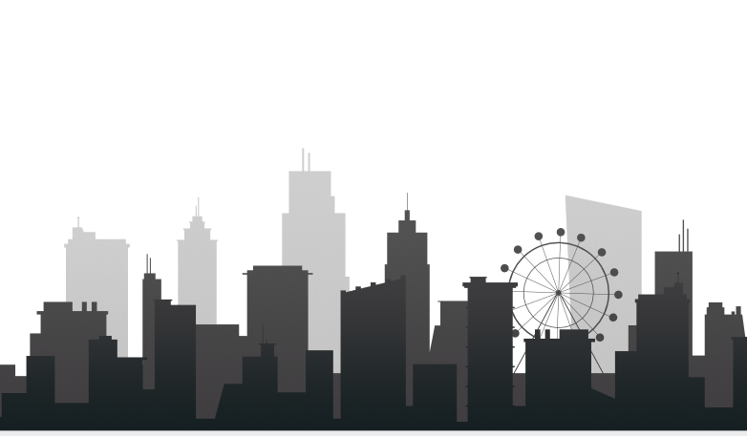
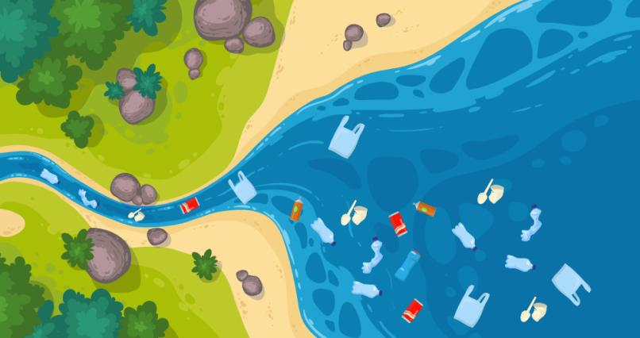
Where does our waste go?
Most waste in
the ocean comes
from humans on land.
Notes:
(Slide duration: 3-5 minutes)
Ask students:
Where does waste in our ocean come from?
What can we do to prevent waste getting into nature?
Answers:
If waste does not get recycled or is not properly disposed of, it can leak into our rivers and waterways that flow into the ocean. Proper disposal and recycling can help prevent waste from entering our natural world.

Slide 14
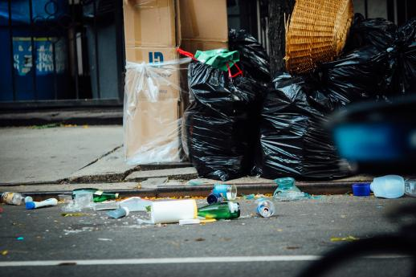
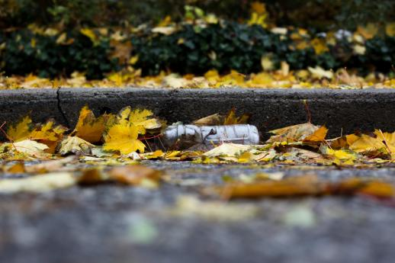
1. People leave waste on the ground
or it falls from a trash bin.
2. When it rains waste flows into
storm drains.
Notes:
(Slide duration: 3-5 minutes)
Tells students:
Let’s now follow the journey of littered food packaging that was not properly recycled, which entered the ocean in 6 steps.
When people leave food packaging on the ground it is called “litter”. It can also fall from trash bins by accident.
Packaging on the ground then can flow into storm drains along the street.

Slide 15
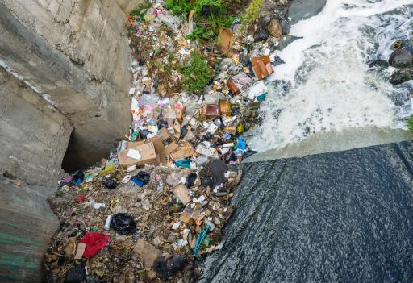
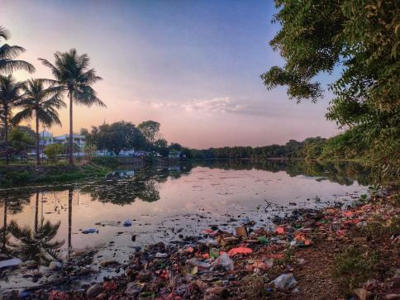
3. The storm drain feeds into
local waterways.
4. Those waterways then feed
into local rivers.
Notes:
(Slide duration: 3-5 minutes)
Tell students:
3. Once the littered food packaging enters the storm drain it is then flushed into local waterways.
4. Waterways are access points to rivers where the drainage water and everything in it flows into local river systems, such as our littered food packaging.

Slide 16
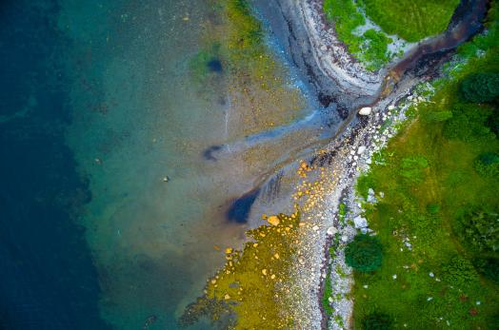
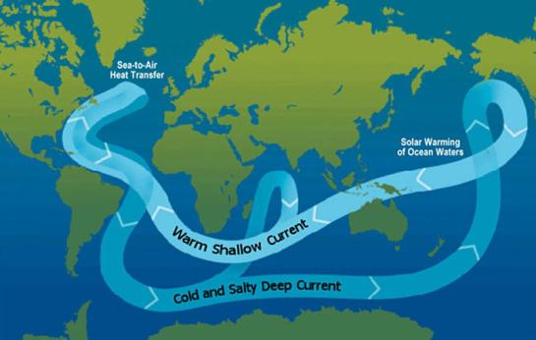
6. Ocean currents send waste around the world and create “waste islands”.
5. Rivers flow into the ocean.
Notes:
(Slide duration: 3-5 minutes)
Tell students:
5. Those smaller river systems converge together into larger rivers that feed directly into the ocean.
6. Ocean currents are all connected and send all waste to large ”waste islands” like the south pacific garbage patch (a giant area of floating waste that resembles an island). A waste island is not an island with beaches and land, rather a waste island is an accumulation of waste that forms a giant floating garbage patch that resembles a floating waste island.
Understanding how systems work and how materials flow in the linear system is important in building the circular economy.

Slide 17
Class Activity: Life Cycle Map
Group:
Product:
Opportunities for Circularity
Notes:
Tell students:
For the class activity students will organize into groups to create a life cycle map for an everyday product.
Step 1: Organize into groups of 3-5 and choose a product card from the deck or any product your group knows a little about.
Step 2: Each group has a large piece of paper or uses the handout provided and lists out the 5 different life cycle stages: 1. Material extraction; 2. Production; 3. Distribution; 4. Usage; and 5. Disposal.

Slide 18
3
12oz Soft drink bottle
Group:
Product:
Oil and bio-feedstock is extracted from the earth. It is then cleaned and refined into small pellets for new products.
The factory melts
the pellets into a
mold that creates
the bottles. Soft
drink bottles are
brought to the
bottling factory
where they are
filled.
The soft drink
bottles are
transported to
stores for customers
to purchase.
Customers
purchase the soft
drink bottles from
the store for
consumption.
After consumption,
the bottles are
disposed of by the
consumer.
Opportunities for Circularity
#1 Recycle to make new bottles or yarn.
#2 Use the old bottle at a refill station for your shampoo or bath soap.
Notes:
Step 3: Each group will document with sticky notes (some will draw pictures, others write lists) the entire life cycle of the product, from start to finish. Groups can use the completed handout of the soft drink bottle as an example. There should be a time limit of 20 minutes.
Step 4: Start your life cycle map with the list of materials used to make the product and find out how they are extracted and processed. When consumers buy it how many times do they use it? Use the Internet to research this or make some good guesses. When you get to the end-of-life, think through all the possibilities such as landfill, littering and recycling. Think critically about where the item will likely end up.
Step 5: Lastly, identify one or more circular opportunities for this product. Could this product be reused in some way? Can it be recycled? If so, what can it be recycled into? What would you change about this product to allow it to be more circular?
When the groups complete their maps, everyone will share what was discovered about their product’s life cycle.
*Teachers may want to display or print out the example soft drink bottle life cycle map while students are doing the exercise.

Slide 19
Notes:
Tell students:
Show students the product options to choose from. Pass out the handout and allow them to choose.

Slide 20
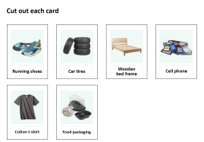
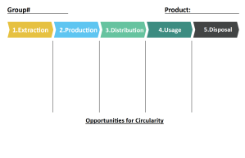
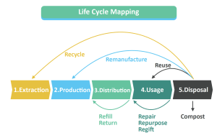
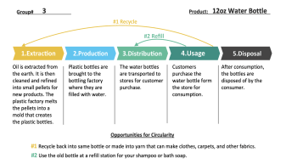
Next Steps
Step 1: Organize into groups of 3-5 and choose a product card from the deck or any product your group knows a little about. Give out each of the four handouts to each group.
Step 2: Each group has a large piece of paper or uses the handout provided and list the 5 different life cycle stages 1. Material extraction 2. Production 3. Distribution 4. Usage 5. Disposal
Step 3: Each group will document with sticky notes (some will draw pictures, others write lists) the entire life cycle of the product, from start to finish.
Step 4: Use the lifecycle water bottle example as a key to help guide students.
Step 5: Lastly, identify one or more circular opportunities for this product.
When the groups complete their maps, everyone will share what was discovered about their product’s life cycle.
*Teachers may want to display or print out the example plastic bottle life cycle map while students are doing the exercise.

