Slide 1
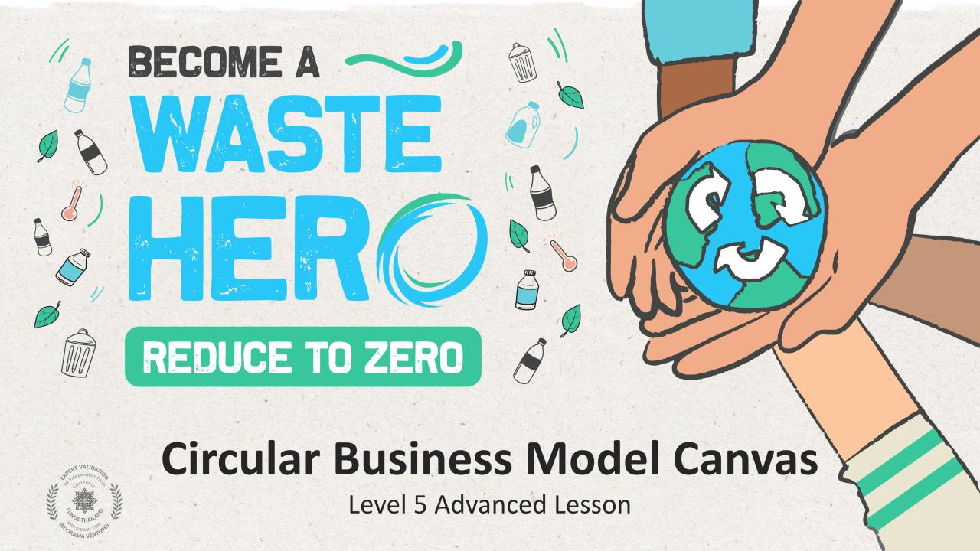
TORNE-SE UM
Economia Circular Canvas do Modelo
Aula Avançada de Nível 5

Slide 2
Preparação da Aula e Alinhamento Curricular
Tempo de preparação: 10 – 15 minutos
Os alunos aplicarão uma estratégia de design circular para resolver um problema de negócios lineares. Eles aprenderão o que é a ferramenta Canvas no modelo de negócios circulares e como usar uma para criar seu próprio modelo de negócio circular. Eles trabalharão em equipes de sua escolha para resolver um desafio de negócios existente e redesenharão o negócio usando a tela circular do modelo de negócios. Eles esboçarão seu modelo final de negócios para dar uma visão de como sua ideia de negócio é circular e, em seguida, compartilharão com o resto da classe.
1
Exiba os slides da aula e crie uma discussão sobre o que eles já sabem sobre modelos de negócios circulares e como identificar soluções para os problemas dos clientes. Faça aos alunos as perguntas orientadoras das anotações do slide do PowerPoint.
2
Imprima o "Canvas do Modelo de Negócios Circular" e a "Solução Circular", um para cada equipe, juntamente com o folheto "Redesenho para Circularidade".
3
Siga as instruções na aula sobre como preencher cada seção do "Canvas do Modelo de Negócios Circular". As anotações do slide na parte inferior de cada um deles terão instruções sobre como preencher a secção.

Slide 3
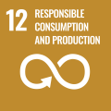
Preparação da Aula e Alinhamento Curricular
Tempo de preparação: 10 – 15 minutos
Principais Resultados de Aprendizagem e Alinhamento Curricular:
Ciência - Terra e Atividade Humana: Comunicar soluções que reduzam o impacto dos seres humanos na terra, água, ar e / ou outros seres vivos no ambiente local. As coisas que as pessoas fazem podem afetar o mundo ao seu redor. Mas elas podem fazer escolhas que reduzam seus impactos na terra, água, ar e outros seres vivos.
Artes da Língua Inglesa e Alfabetização: Participe de conversas colaborativas com diversos parceiros sobre tópicos e textos. Siga regras acordadas para as discussões. Use palavras e frases adquiridas através de conversas, lendo e sendo lido e respondendo a textos. Apresente informações, descobertas e evidências de apoio de forma clara, concisa e lógica, de modo que os ouvintes possam seguir a linha de raciocínio.
Estudos Sociais - Pessoas, Lugares e Ambientes: O estudo de pessoas, lugares e ambientes nos permite entender a relação entre as populações humanas e o mundo físico.
Alinhamento dos ODS
Aula flexível e adaptativa
CIDADES E COMUNIDADES SUSTENTÁVEIS
CONSUMO E PRODUÇÃO RESPONSÁVEIS
TRABALHO DECENTE E CRESCIMENTO ECONÔMICO
Os planos de aula são projetados para serem flexíveis e responsivos às necessidades em evolução da sua sala de aula. As aulas são editáveis e personalizáveis para atender aos diferentes contextos individuais dos alunos e da sala de aula. Uma versão do PowerPoint com instruções do professor e uma lição em PDF imprimível estão disponíveis para download.

Slide 4
A Aula
Duração da aula: 90 minutos
1
Percorra os slides usando os exemplos para orientar os alunos pelo "Canvas do Modelo de Negócios Circular" para que eles possam se familiarizar com cada um dos segmentos e elementos do negócios.
2
Divida em grupos de 3 a 5 e prepare um cartaz ou use a apostila de "Canvas do Modelo de Negócios Circular" para o exercício. Recomenda-se o uso de notas adesivas em um grande cartaz.
3
Escolha um dos cenários do folheto "Redesenhar para circularidade" a utilizar para a tela.
4
Preencha o "Canvas do Modelo de Negócios Circular" no seu grupo e aplique um ou mais modelos de design circular ao seu modelo de negócio.
5
Quando terminar a tela, esboce seu produto circular e o modelo de negócio e compartilhe suas inovações circulares com a classe.

Slide 5
Preparar a Apresentação do PowerPoint
Quando estiver pronto para apresentar as lições à sua turma, clique em Apresentação de Slides na barra de menu superior e selecione Modo de Exibição do Apresentador. No modo de exibição do Apresentador, você pode ver suas anotações enquanto o público vê apenas seus slides.
As anotações aparecem em um painel à direita. O texto deve ser quebrado automaticamente e uma barra de rolagem vertical será exibida, se necessário. Você também pode alterar o tamanho do texto no painel Anotações usando os dois botões no canto inferior esquerdo do mesmo.

Slide 6
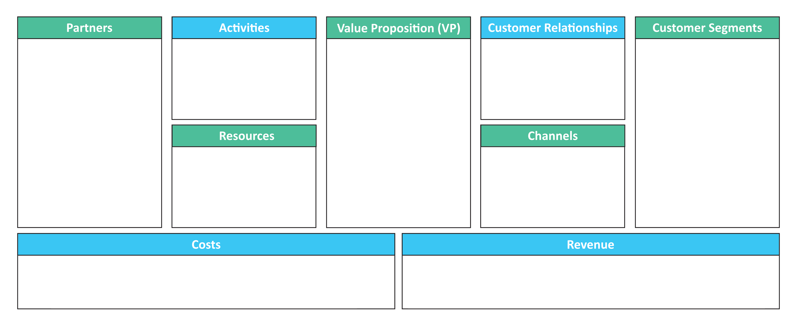
Modelo de Negócio Canvas
Parceiros
Atividades
Proposta de Valor (PV)
Relacionamento com o Cliente
Segmentos de Clientes
Recursos
Canais
Custos
Receita
Notes:
(Slide Duration: 5 mins) Ask Students:
Has anyone heard of the Business Model Canvas? If so, what is it, and what is it used for?
Tell students:
The business model canvas is a visual representation of a business model, highlighting all key strategic factors. In other words, it is a general, holistic and complete overview of the company’s workings, customers, revenue streams and more.
The business model canvas is a great tool to help you understand a business model in a straightforward, structured way. Using this canvas will lead to insights about the customers you serve, what value propositions are offered through what channels, and how your company makes money. You can also use the business model canvas to understand your own business model or that of a competitor.
The business model canvas is a shared language for describing, visualizing, assessing and changing business models. It describes the rationale of how an organization creates, delivers and captures value. The canvas consists of 9 key segments of a business:
1. Customer segments: List the top three types of customers. Look for the segments that provide the most revenue.
2. Value proposition: What are your products and services? What is the job you get done for your customer?
3. Revenue: List your top three revenue streams. If you do things for free but they could be monetized in the future, add them here too.
4. Channels: How do you communicate with your customer? How do you deliver your product or service to them?
5. Customer relationships: How our relationships and interactions are created and how do you maintain the relationship?
6. Activities: What do you do every day to run your business model?
7. Resources: The people, knowledge, means, and money you need to run your business.
8. Partners: List the partners that you cannot do business without.
9. Cost : List your top costs by looking at activities and resources.

Slide 7
Exemplo de Modelo de Negócio Canvas: Plataforma de Compartilhamento Doméstico
Parceiros
Atividades
Proposta de Valor (PV)
Relacionamento com o Cliente
Segmentos de Clientes
Fotógrafos companhias de seguros
Desenvolvimento de plataformas, suporte ao cliente
Ganhe dinheiro com quartos não utilizados e fique convenientemente em lugares únicos
Autoatendimento, suporte ao cliente
Anfitriões e Convidados
Recursos
Canais
Plataforma online, propriedades listadas
Local e aplicativo
Custos
Receita
Funcionários, plataforma tecnológica, marketing e suporte ao cliente
Taxas de hospedagem e taxas de hóspedes
Notes:
(Slide Duration: 10 mins)
Tell students:
Let’s use a home sharing platform as an example to fill in the business model canvas.
Ask Students:
1. Customer Segments: Who are their customers?
There are two customer segments that define the home sharing platform business model.
-Hosts: The people who have spaces available for rent and want to make money from that. In the app, they can include their properties under certain conditions, such as available period, check-in and out times, and other “rules”.
-Guests: The people who are looking for a place to stay. They can search by location, type of property, price, among other filters that the app offers. They book and pay through the sharing platform.
2. Value Proposition: What value does the company offer their customers?
Their value proposition is different for each segment:
-For Hosts: The biggest value proposition here is being able to make money through the platform. In addition, there are the benefits of doing so comfortably and safely, with total control over bookings and even insurance against damage and accidents. It also has the advantage of being able to check the profile of those who are requesting a reservation and the option to decline offers. All this with 24/7 support via phone, email and chat with company.
-For Guests: The biggest value proposition here is to save money on hotel rooms or holiday rentals. In addition, the convenience of being able to choose a place according to all your preferences through your phone or computer and without having to negotiate with anyone. Furthermore, the traveler can also check the owner’s profile and, in some cases, exchange experiences with them during the stay. And finally, you have payment security through the platform.
3. Channels: How does the sharing platform reach their customers?
Its primary channels are the website and the app itself. In addition, the company uses social media, digital marketing, an affiliate model, and, of course, it benefits substantially from word of mouth.
4. Customer Relationships: What kind of relationship does the company have with their customers?
The sharing platform’s customer relationships are based on a high level of trust in transactions carried out through the company’s website and app. For this reason, the company acts strongly in the communication between the segments, to avoid damaging its name and reputation. If the brand is tarnished by any inconsistency, it will be easy for a competitor to take the lead. In this way, the company works to avoid conflicts, manages bad behavior and risks, ensures the protection of data and private information, and offers support to answer questions and solve problems. Its greatest customer relationship tool is the platform itself, which provides personalized recommendations and 24/7 customer service support.
5. Revenue Streams: How do they make money?
Host’s fees
Travelers’ fees
6. Key Resources: What does the sharing platform need to run the business?
Among the company's key resources are the platform and mobile app itself, the content generated by the partners, both the properties available and the assessments and reviews, its human resources including coders, marketing professionals, and other key personnel, and its algorithm.
7. Key Activities: What does the company do to operate their business?
Their main activity is the development and maintenance of the platform itself, where customer experiences takes place. Aside from that, other key activities include sales and marketing for acquiring new hosts and guests, information security for all partners and users, and customer service (on both sides), including conflict intermediation.
8. Key Partners: Who does company need to help them operate?
The company’s biggest key partners are its hosts, which can be private owners or hotels and inns, for example. If there were not any people interested in listing their rooms and properties in the app, the platform has no reason to exist. Other partners include professional photographers, who provide their services for the platform, insurance companies that secure the rental properties, as well as investors, who have made it possible to build the entire sharing platform structure.
9. Cost Structure: What does it cost to run their business?
The cost structure includes investment in all of its key activities and resources, as well as its channels. To name a selection: software maintenance and development, marketing, salaries, customer acquisition, insurance, credit card fees, and legal and administrative costs.

Slide 8
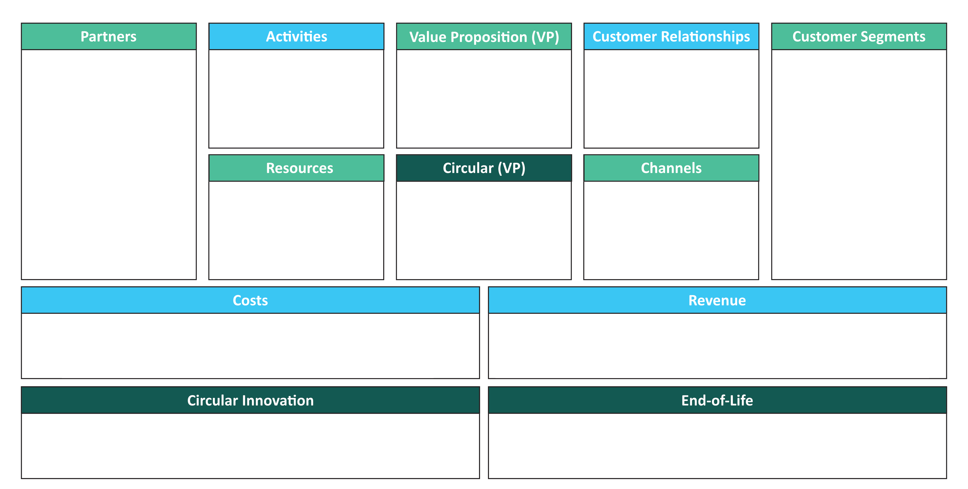
Canvas do Modelo de Negócios Circular
Parceiros
Atividades
Proposta de Valor (PV)
Relacionamento com o Cliente
Segmentos de Clientes
Recursos
Circular (PV)
Canais
Custos
Receita
Inovação Circular
Fim da Vida Útil
Notes:
(Slide Duration: 5 mins) Tell students:
The Circular Business Model Canvas is the same as the more well-known Business Model Canvas but includes three additional segments that define what makes your business model circular. The principles of the Circular Economy (CE) aim to maintain the value of products, components, materials, and resources in the economy for as long as possible.
The Circular Innovation segment defines the circular solution you are applying to a linear problem.
The End-of-Life segment indicates what happens next once the product or service has been used.
The Circular Value Proposition is the added value created from the Circular Innovation.

Slide 9
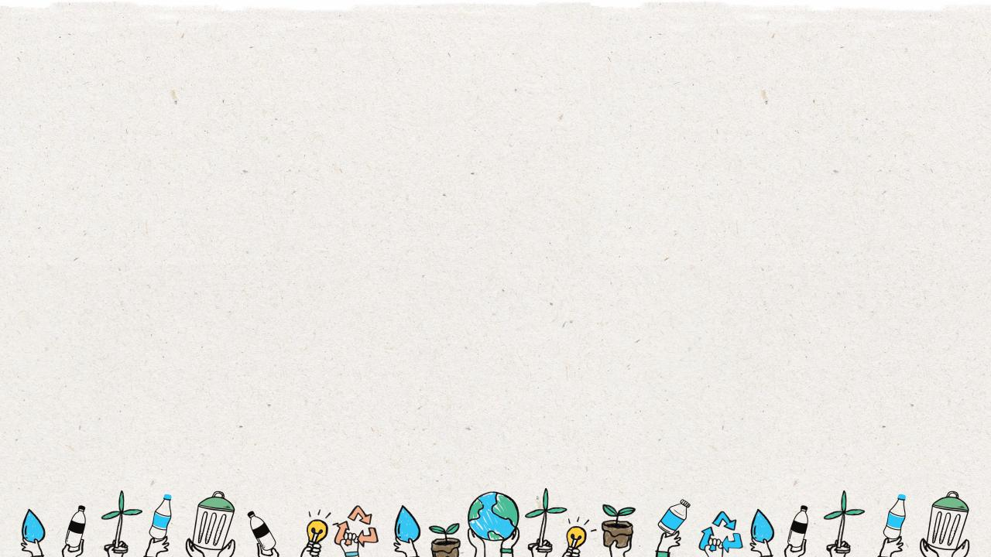
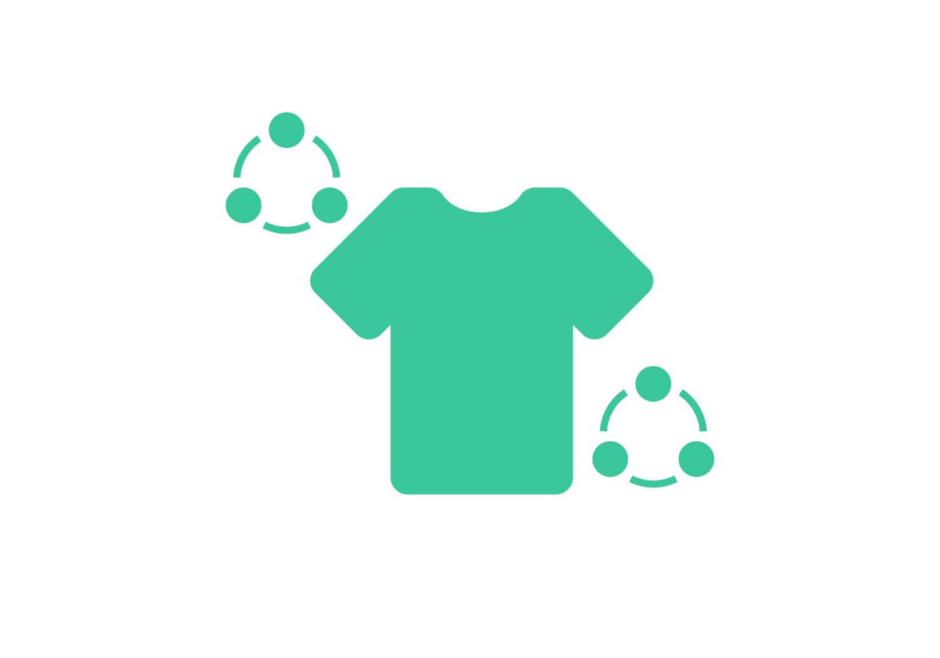
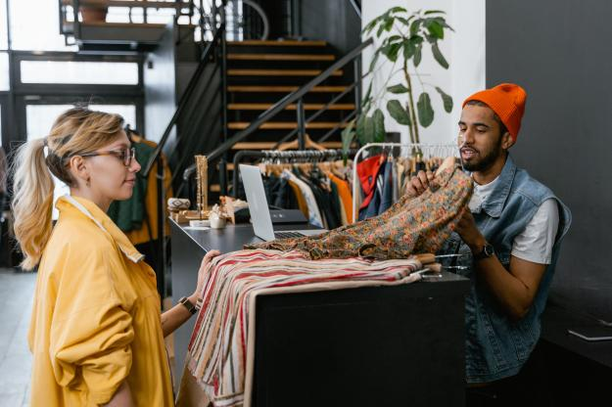
Produto como um Serviço: Aluguel de roupas
Notes:
(Slide Duration: 5 mins)
Tell students:
Let's go through a Circular Business Model Canvas using one of the circular business model examples: Clothing Rental (Product as a Service)
Clothing rental models can provide customers access to a variety of clothes while decreasing the demand for new clothing production. Short-term rental models offer a compelling value proposition, particularly when taking changing customer needs into consideration - examples include short term use, practical requirements, or fast evolving fashion preferences. New short-term and subscription rental models are already emerging within the industry.
Let’s begin to fill in the business model canvas for our clothing business.

Slide 10
Canvas do Modelo de Negócios Circular
Parceiros
Atividades
Proposta de Valor (PV)
Relacionamento com o Cliente
Segmentos de Clientes
Comunidades de estudantes universitários com baixa renda
mercado de Massa e clientes segmentados (masculino/feminino)
Recursos
Circular (PV)
Canais
Custos
Receita
Inovação Circular
Fim da vida útil
Notes:
(Slide Duration: 3 mins)
Tell students:
The Customer Segments section identifies the groups of people or companies that you are trying to target and sell your product or service to. There are different customer segments a business model can target.
Mass market: A business model that focuses on mass markets does not group its customers into segments. Instead, it focuses on the general population or a large group of people with similar needs. For example, a product like a phone.
Niche market: Here the focus is centered on a specific group of people with unique needs and traits. Here the value propositions, distribution channels, and customer relationships should be customized to meet their specific requirements. An example would be buyers of sports shoes.
Segmented: Based on slightly different needs, there could be different groups within the main customer segment. Accordingly, you can create different value propositions, distribution channels, etc. to meet the different needs of these segments.
Diversified: A diversified market segment includes customers with very different needs.
Multi-sided markets: this includes interdependent customer segments. For example, a credit card company caters to both their credit card holders as well as merchants who accept those cards.
Ask students:
Who are the customers of our clothing rental company?
Answers:
We will appeal to the mass market but will segment customers based on income, lifestyle, and shopping behavior. A specific example of one customer segment may be university students who are socially active and fashion-conscious, ecologically aware, and living on a budget.

Slide 11
Canvas do Modelo de Negócios Circular
Parceiros
Atividades
Proposta de Valor (PV)
Relacionamento com o Cliente
Segmentos de Clientes
Roupas da moda em um orçamento sem ter que possuir roupas que você dificilmente vai usar.
Comunidades de estudantes universitários com baixa renda
mercado de Massa e clientes segmentados (masculino/feminino)
Recursos
Circular (PV)
Canais
Custos
Receita
Inovação Circular
Fim da Vida Útil
Notes:
(Slide Duration: 3 mins)
Tell students:
The Value Proposition (VP) segment is the building block that is at the heart of the business model canvas. It represents your unique solution (product or service) for a problem faced by a customer segment, or that creates value for the customer segment. A value proposition should be unique or should be different from that of your competitors. If you are offering a new product, it should be innovative and disruptive. If you are offering a product that already exists in the market, it should stand out with new features and attributes.
Value propositions can be either quantitative (price and speed of service) or qualitative (customer experience or design).
A value proposition should also be crucial, compelling, concrete, and credible. This means that it should solve a customer pain point, it should have an ‘emotional pull’ for a customer, it should be tangible, and your business should be able to deliver it.
Ask students:
What is our clothing rental company’s value proposition?
Answers:
We offer stylish and trendy fashion on a budget without having to own clothes you will hardly wear.

Slide 12
Canvas do Modelo de Negócios Circular
Parceiros
Atividades
Proposta de Valor (PV)
Relacionamento com o Cliente
Segmentos de Clientes
Roupas da moda em um orçamento sem ter Que possuir roupas Que você dificilmente vai usar.
Comunidades de estudantes universitários com baixa renda
mercado de Massa e clientes segmentados (masculino/feminino)
Recursos
Circular (PV)
Canais
Roupas para pessoas de baixa renda, reduz o desperdício têxtil
Custos
Receita
Inovação Circular
Fim da Vida Útil
Notes:
(Slide Duration: 3 mins)
Tell students:
The Circular Value Proposition (VP) is the value added as a result of the circularity of your business model. It represents your unique solution (product or service) for a problem faced by a customer segment or added benefits for the customer segment. A circular value proposition should be innovative or should be different from that of your competitors and it should have social and environmental benefits.
Circular Value Propositions can be either social (services to people with low-income and/or society) and/or environmental (regenerates ecosystems, diverts waste from the environment, etc.). Ideally, they should incorporate both!
Ask Students:
What is the Circular (VP) of our clothing rental business?
Answers:
We offer clothing options to communities with low-income and consumers, shipped to their door. Keeping clothes in circulation diverts textile waste from landfills and reduces the production of new textiles and ultimately future waste.

Slide 13
Canvas do Modelo de Negócios Circular
Parceiros
Atividades
Proposta de Valor (PV)
Relacionamento com o Cliente
Segmentos de Clientes
Roupas da moda em um orçamento sem ter Que possuir roupas Que você dificilmente vai usar.
Suporte on-line costume
Comunidades de estudantes universitários com baixa renda
mercado de Massa e clientes segmentados (masculino/feminino)
Recursos
Circular (PV)
Canais
Roupas para pessoas de baixa renda, reduz o desperdício têxtil
Custos
Receita
Inovação Circular
Fim da Vida Útil
Notes:
(Slide Duration: 3 mins)
Tell students:
The Customer Relationships segment is where you need to establish the type of relationship you will have with each of your customer segments and how you will interact with them throughout their journey with your company. There are several types of customer relationships:
Personal assistance: You interact with the customer in person or by email, through phone call, or other means.
Dedicated personal assistance: You assign a dedicated customer representative to an individual customer.
Self-service: Here you maintain no relationship with the customer but provide what the customer needs to help themselves.
Automated services: This includes automated processes or machinery that helps customers perform services themselves.
Communities: These include online communities where customers can help each other solve their own problems with regards to the product or service.
Co-creation: Here the company allows the customer to get involved in the designing or development of the product. For example, YouTube has given its users the opportunity to create content for its audience.
Ask students:
What are the customer relationships that exist with our clothing rental company?
Answers:
We will have personalized relationships with customers communicating with them directly via email/phone/online chat to assist them.

Slide 14
Canvas do Modelo de Negócios Circular
Parceiros
Atividades
Proposta de Valor (PV)
Relacionamento com o Cliente
Segmentos de Clientes
Roupas da moda em um orçamento sem ter que possuir roupas que você dificilmente vai usar.
Suporte on-line costume
Comunidades de estudantes universitários com baixa renda
mercado de Massa e clientes segmentados (masculino/feminino)
Recursos
Circular (PV)
Canais
Roupas para pessoas de baixa renda, reduz o desperdício têxtil
Plataforma online, mídias sociais, influenciadores
Custos
Receita
Inovação Circular
Fim da Vida Útil
Notes:
(Slide Duration: 3 mins)
Tell students:
The Channels section is to describe how your company will communicate with and reach out to your customers. Channels are the touchpoints that let your customers connect with your company. Channels play a role in raising awareness of your product or service among customers and enable you to deliver your value propositions and products to them. Channels can also be used to allow customers the avenue to buy products or services and offer post-purchase support.
There are two types of channels:
Owned channels: company website, social media sites, in-house sales, etc.
Partner channels: partner-owned websites, wholesale distribution, retail, etc.
Ask students:
What are the channels that we will use with our clothing rental company?
Answers:
We will rent our clothes to customers through our website and linked social media platforms, as well as through our partner influencers.

Slide 15
Canvas do Modelo de Negócios Circular
Parceiros
Atividades
Proposta de Valor (PV)
Relacionamento com o Cliente
Segmentos de Clientes
Roupas da moda em um orçamento sem ter que possuir roupas que você dificilmente vai usar.
Comunidades de estudantes universitários com baixa renda
mercado de Massa e clientes segmentados (masculino/feminino)
Alugar roupas para Clientes Suporte ao cliente
Suporte on-line costume
Recursos
Circular (PV)
Canais
Roupas para pessoas de baixa renda, reduz o desperdício têxtil
Plataforma online, mídias sociais, influenciadores
Custos
Receita
Inovação Circular
Fim da Vida Útil
Notes:
(Slide Duration: 3 mins)
Tell students:
The Activities segment indicates the things you do to run your business each day. These key activities should focus on fulfilling the value proposition, reaching customer segments and maintaining customer relationships, as well as generating revenue.
Ask Students:
What are the activities of our clothing rental business?
Answers:
Rent clothes to customers and provide them with the support they need.

Slide 16
Canvas do Modelo de Negócios Circular
Parceiros
Atividades
Proposta de Valor (PV)
Relacionamento com o Cliente
Segmentos de Clientes
Roupas da moda em um orçamento sem ter que possuir roupas que você dificilmente vai usar.
Pessoas que doam ou vendem suas roupas antigas.
Brechós
Alugar roupas para Clientes Suporte ao cliente
Suporte on-line costume
Comunidades de estudantes universitários com baixa renda
mercado de Massa e clientes segmentados (masculino/feminino)
Recursos
Circular (PV)
Canais
Roupas para pessoas de baixa renda, reduz o desperdício têxtil
Plataforma online, mídias sociais, influenciadores
Custos
Receita
Inovação Circular
Fim da Vida Útil
Notes:
(Slide Duration: 3 mins)
Tell students:
The Partners segment indicates the external companies or suppliers that will help you carry out your key activities. These partnerships are made in order to reduce risks and acquire resources.
Who are the key partners of our clothing rental business?
Answers:
People who donate or sell their old clothes to us, and thrift stores who also provide clothing inventory.

Slide 17
Canvas do Modelo de Negócios Circular
Parceiros
Atividades
Proposta de Valor (PV)
Relacionamento com o Cliente
Segmentos de Clientes
Roupas da moda em um orçamento sem ter que possuir roupas que você dificilmente vai usar.
Pessoas que doam ou vendem suas roupas antigas.
Brechós
Alugar roupas para Clientes Suporte ao cliente
Suporte on-line costume
Comunidades de estudantes universitários com baixa renda
mercado de Massa e clientes segmentados (masculino/feminino)
Recursos
Circular (PV)
Canais
Inventário, Sites e plataforma de compras
Roupas para pessoas de baixa renda, reduz o desperdício têxtil
Plataforma online, mídias sociais, influenciadores
Custos
Receita
Inovação Circular
Fim da Vida Útil
Notes:
(Slide Duration: 3 mins)
Tell students:
The Resources segment indicates the main inputs you need to carry out your key activities in order to create your value proposition. There are several types of key resources:
-Human (employees)
-Financial (cash, lines of credit, etc.)
-Intellectual (brand, patents, IP, copyright)
-Physical (equipment, inventory, buildings)
What are the key resources for our clothing rental business?
Answers:
The clothing inventory we carry and the online shopping platform where we rent out our clothes.

Slide 18
Canvas do Modelo de Negócios Circular
Parceiros
Atividades
Proposta de Valor (PV)
Relacionamento com o Cliente
Segmentos de Clientes
Roupas da moda em um orçamento sem ter que possuir roupas que você dificilmente vai usar.
Comunidades de estudantes universitários com baixa renda
mercado de Massa e clientes segmentados (masculino/feminino)
Pessoas que doam ou vendem suas roupas antigas.
Brechós
Alugar roupas para Clientes Suporte ao cliente
Suporte on-line costume
Recursos
Circular (PV)
Canais
Inventário, Sites e plataforma de compras
Roupas para pessoas de baixa renda, reduz o desperdício têxtil
Plataforma online, mídias sociais, influenciadores
Custos
Receita
Desenvolvimento e manutenção Plataforma Teia
Desenvolvimento e manutenção Plataforma Teia
Inovação Circular
Fim da Vida Útil
Notes:
(Slide Duration: 3 mins)
Tell students:
In the Costs segment you identify all the things you need to spend money on associated with operating your business model. You will need to focus on evaluating the cost of creating and delivering your value propositions, creating revenue streams, and maintaining customer relationships. And this will be easier to do so once you have defined your key resources, activities, and partners.
Businesses can either be cost-driven (focuses on minimizing costs whenever possible) and value-driven (focuses on providing maximum value to the customer). You should always try to do both.
Ask students:
What are the costs we will face with our clothing rental company?
Answers:
We will spend money on developing and maintaining our website. We will also spend money on marketing and staff salaries. An additional example is logistics and delivery costs for shipping out the clothes and ensuring they are returned.

Slide 19
Canvas do Modelo de Negócios Circular
Parceiros
Atividades
Proposta de Valor (PV)
Relacionamento com o Cliente
Segmentos de Clientes
Roupas da moda em um orçamento sem ter que possuir roupas que você dificilmente vai usar.
Pessoas que doam ou vendem suas roupas antigas.
Brechós
Alugar roupas para Clientes Suporte ao cliente
Suporte on-line costume
Comunidades de estudantes universitários com baixa renda
mercado de Massa e clientes segmentados (masculino/feminino)
Recursos
Circular (PV)
Canais
Inventário, Sites e plataforma de compras
Roupas para pessoas de baixa renda, reduz o desperdício têxtil
Plataforma online, mídias sociais, influenciadores
Custos
Receita
Desenvolvimento e manutenção Plataforma Teia
Desenvolvimento e manutenção Plataforma Teia
Assinaturas
Receita gerada pelo aluguel de roupas
Inovação Circular
Fim da Vida Útil
Notes:
(Slide Duration: 3 mins)
Tell students:
The Revenue segment is the source from which a company generates money by selling their product or service to the customers. And in this block, you should describe how you will earn revenue from your value propositions. A revenue stream can belong to one of the following revenue models:
Transaction-based revenue: made from customers who make a one-time payment
Recurring revenue: made from ongoing payments for continuing services or post-sale services
Ask students:
What are the sources of revenue for our clothing rental company?
Answers:
We will generate revenue from renting clothes as well as through a subscription model, where customers can have a set number of rentals per month or unlimited access to clothes for rent based on a monthly subscription payment.

Slide 20
Canvas do Modelo de Negócios Circular
Parceiros
Atividades
Proposta de Valor (PV)
Relacionamento com o Cliente
Segmentos de Clientes
Roupas da moda em um orçamento sem ter que possuir roupas que você dificilmente vai usar.
Pessoas que doam ou vendem suas roupas antigas.
Brechós
Alugar roupas para Clientes Suporte ao cliente
Suporte on-line costume
Comunidades de estudantes universitários com baixa renda
mercado de Massa e clientes segmentados (masculino/feminino)
Recursos
Circular (PV)
Canais
Inventário, Sites e plataforma de compras
Roupas para pessoas de baixa renda, reduz o desperdício têxtil
Plataforma online, mídias sociais, influenciadores
Custos
Receita
Desenvolvimento e manutenção Plataforma Teia
Desenvolvimento e manutenção Plataforma Teia
Assinaturas
Receita gerada pelo aluguel de roupas
Inovação Circular
Fim da Vida Útil
Produto como um serviço
Notes:
(Slide Duration: 3 mins)
Tell students:
The Circular Innovation segment is the type of circular economy strategy your business has created that sets you apart from the competition. There are 5 core circular models that can be implemented into a product or service:
Circular Supplies: Products made from fully renewable, recyclable, or biodegradable resource inputs.
Resource Recovery: Services that work to eliminate resources, materials, or waste from leaking into the environment and maximizing the value of it to reenter the loop.
Product Life Extension: Services that offer to extend the life of an otherwise discarded product through repairing, upgrading, or reselling back into the loop.
Sharing Platform: Service platforms that allow people to collaborate and share a product amongst themselves without singular ownership by the customer.
Product as a Service: Products that are used by one or more customers through a pay-as-you-use arrangement.
Ask Students:
What is the Circular Innovation of our clothing rental business?
Answers:
In the textile industry most businesses follow the linear model of ”make, take, and dispose”. By implementing a rental and repair model, clothes transition from being a product to a service, a sharing platform is created between fashion consumers, and the life of clothes are extended through repairs.

Slide 21
Canvas do Modelo de Negócios Circular
Parceiros
Atividades
Proposta de Valor (PV)
Relacionamento com o Cliente
Segmentos de Clientes
Roupas da moda em um orçamento sem ter que possuir roupas que você dificilmente vai usar.
Pessoas que doam ou vendem suas roupas antigas.
Brechós
Alugar roupas para Clientes Suporte ao cliente
Suporte on-line costume
Comunidades de estudantes universitários com baixa renda
mercado de Massa e clientes segmentados (masculino/feminino)
Recursos
Circular (PV)
Canais
Inventário, Sites e plataforma de compras
Roupas para pessoas de baixa renda, reduz o desperdício têxtil
Plataforma online, mídias sociais, influenciadores
Custos
Receita
Desenvolvimento e manutenção Plataforma Teia
Desenvolvimento e manutenção Plataforma Teia
Assinaturas
Receita gerada pelo aluguel de roupas
Inovação Circular
Fim da Vida Útil
Produto como um serviço
Os locatários devolvem as roupas, reparam, se necessário, e depois alugam novamente para outros clientes
Notes:
(Slide Duration: 3 mins)
Tell students:
The End-of-Life segment outlines ”how” we are going to keep resources in the circular loop model. You can think of this as a reverse logistics segment where you define how those products or services keep items in the loop.
Ask Students:
What is the End-of-Life scenario of our clothing rental business model?
Answers:
In the textiles industry most businesses follow the linear model of ”make, take, and dispose”. By renting clothes instead of selling them we need a way to ensure the renters give us the clothes back. We will incentivize renters to return clothes through a subscription service or a deposit scheme without a subscription, and with each item returned, customers can earn store credit on their next rental. The shop will repair the clothes as needed to maintain their rental inventory.

Slide 22
A Atividade
Duração da atividade: 30 minutos
1
Divida em grupos de 3 a 5 e prepare um cartaz ou use a apostila "Modelo de Negócio Circular Canvas" para o exercício. Recomenda-se o uso de notas adesivas em um grande cartaz.
2
Escolha um dos cenários do folheto "Redesenhar para circularidade" a utilizar para a tela.
3
Preencha o "Modelo de Negócio Circular Canvas" no seu grupo e aplique um ou mais modelos de design circular ao seu modelo de negócio.
4
Quando terminar, esboce seu produto circular e modelo de negócios e compartilhe suas inovações circulares com a classe.
Notes:
Tell Students:
Read through the “Redesign for Circularity” handout and pick a business you would like to focus on to create a circular business model. Start to fill out your “Circular Business Model Canvas” with rough ideas in each of the boxes.
A good tip is to start with the customer segment box so your work is user-focused, then move to the value proposition and circular value proposition.
When you have a rough draft of your canvas finished, sketch your new product out and present it to the class.

Slide 23
Canvas do Modelo de Negócios Circular
Parceiros
Atividades
Proposta de Valor (PV)
Relacionamento com o Cliente
Segmentos de Clientes
Recursos
Circular (PV)
Canais
Custos
Receita
Inovação Circular
Fim da Vida Útil
Notes:
Example of the Circular Business Model Canvas

