Slide 1
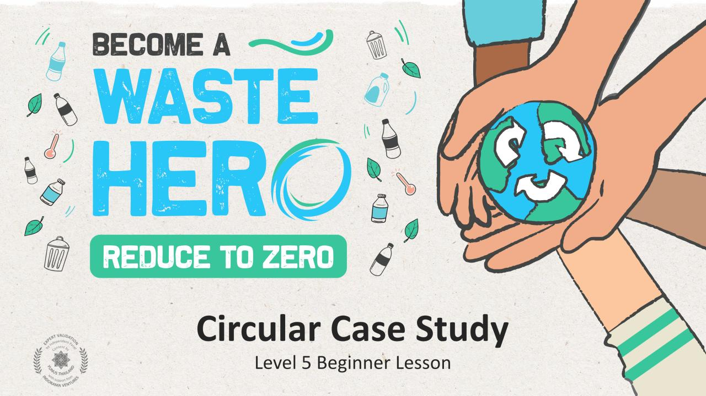

Slide 2
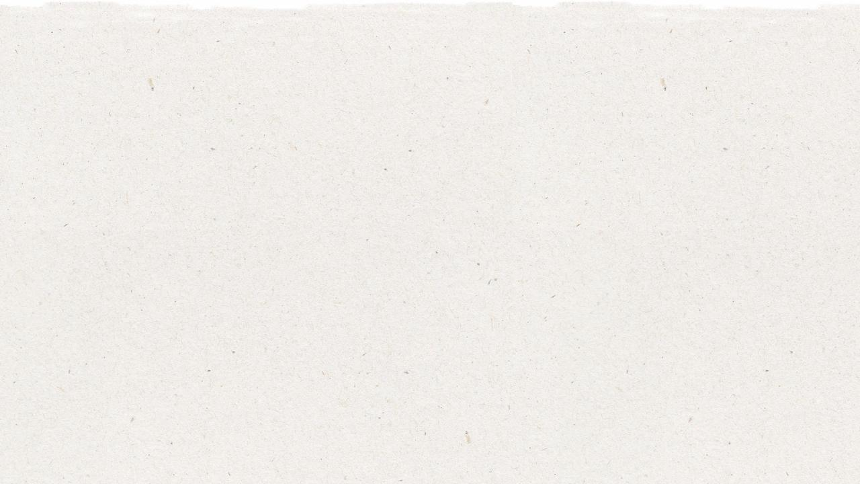
Lesson Prep & Curriculum Alignment
Prep time: 10 – 15 minutes
Students will understand the differences between the linear and circular economies and will develop the ability to think about the full life of the products that we use in our daily lives and set the groundwork for being able to redesign systems. Students will understand the 5 different types of circular economy business models and identify how these models practice the 3 principles of the circular economy based on a business case study analysis.
1
Display the lesson slides for the class and create a discussion about what they already know about the linear vs circular economies and introduce the concept of product lifecycle mapping. Ask students the guiding questions in the PowerPoint slide notes.
2
Print out the 4 handouts: 1. Circular Business Cards; 2. Circular Business Case Study; 3. Areas of Circularity; 4. Circular Lifecycle Map.
3
Follow the steps on the next slide an in the teacher notes in slides 19 to 21 to conduct the class activity.

Slide 3
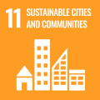
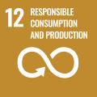
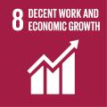
Lesson Prep & Curriculum Alignment
Prep time: 10 – 15 minutes
Key Learning Outcomes and Curriculum Alignment:
Science - Earth and Human Activity: Communicate solutions that will reduce the impact of humans on the land, water, air, and/or other living things in the local environment. Things that people do can affect the world around them. But they can make choices that reduce their impacts on the land, water, air, and other living things.
English Language Arts and Literacy: Participate in collaborative conversations with diverse partners about topics and texts. Follow agreed-upon rules for discussions. Use words and phrases acquired through conversations, reading and being read to, and responding to texts. Use words and phrases acquired through conversations, reading and being read to, and responding to texts. Participate in collaborative discussion in groups with diverse partners on topics and issues, expressing ideas clearly.
Social Studies - People, Places, and Environments: The study of people, places, and environments enables us to understand the relationship between human populations and the physical world.
SDG Alignment
Flexible and adaptive lesson
Lesson plans are designed to be flexible and responsive to the evolving needs of your classroom. Lessons are editable and customizable to meet the different individual student and classroom contexts. A PowerPoint version with teacher instructions and a printable PDF lesson are available for download.

Slide 4
The Lesson
Lesson duration: 25 - 30 minutes
1
They will receive the Circular Business Case Study handout with nine questions that they will answer based on the circular business card they choose. Allow them to do their own research online if they need.
2
Distribute the circular business card handout and have students select one of the five circular businesses they will use for their case analysis.
3
Once they have answered all the questions for the case study they will map the areas of circularity found in their business case. The handout will consist of the 5 linear stages of a products lifecycle and have them draw in the arrows indicating the kinds of circularity used in their business case.

Slide 5
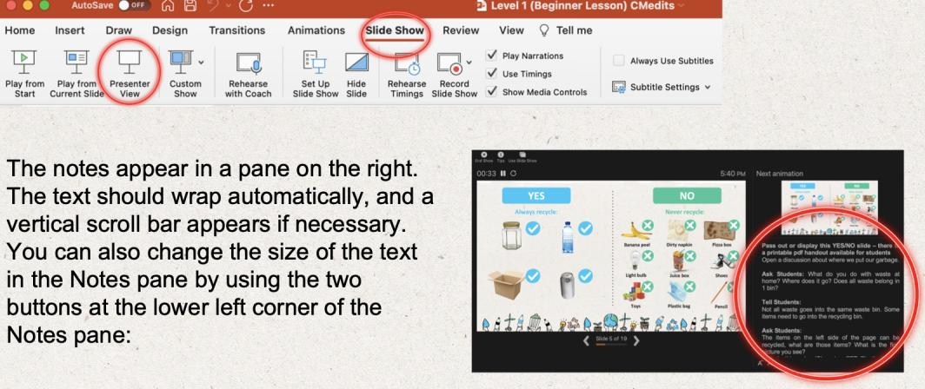
Prepare the PowerPoint presentation
When you are ready to present the lessons to your class click on Slide Show on the top menu bar then select Presenter View. In Presenter view, you can see your notes as you present while the audience see only your slides.
The notes appear in a pane on the right. The text should wrap automatically, and a vertical scroll bar appears if necessary. You can also change the size of the text in the Notes pane by using the two buttons at the lower left corner of the Notes pane.

Slide 6
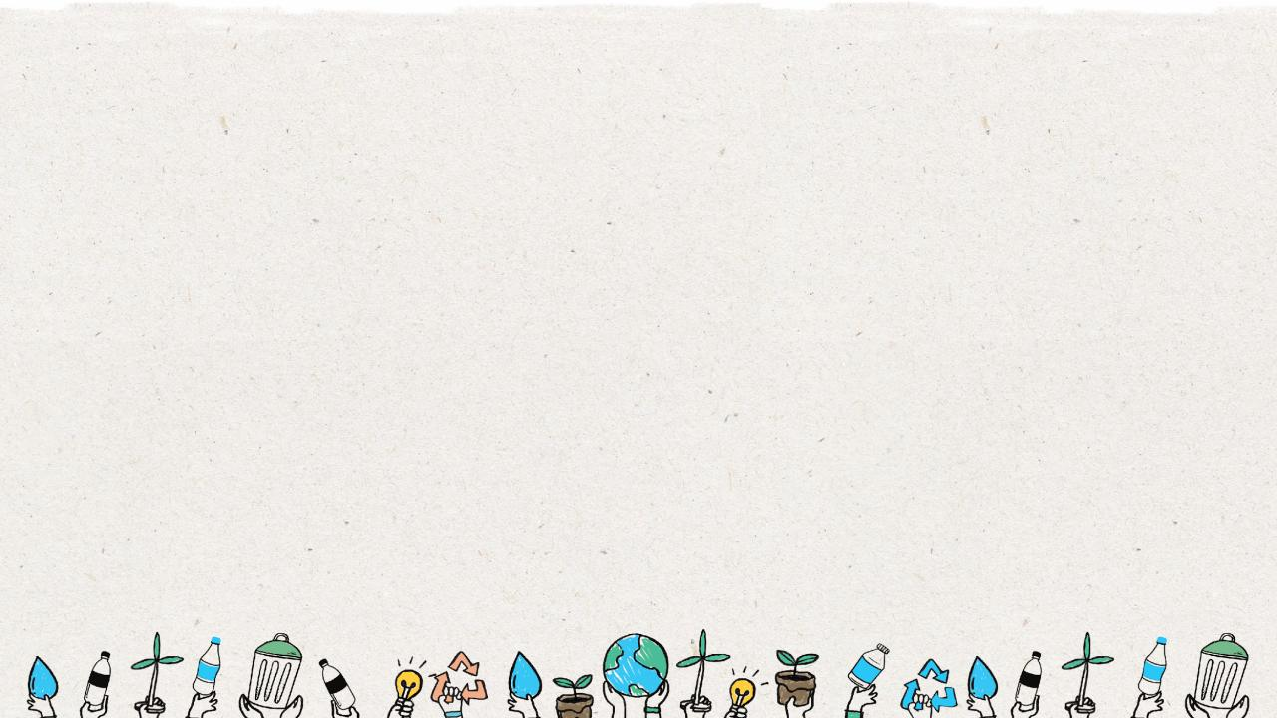
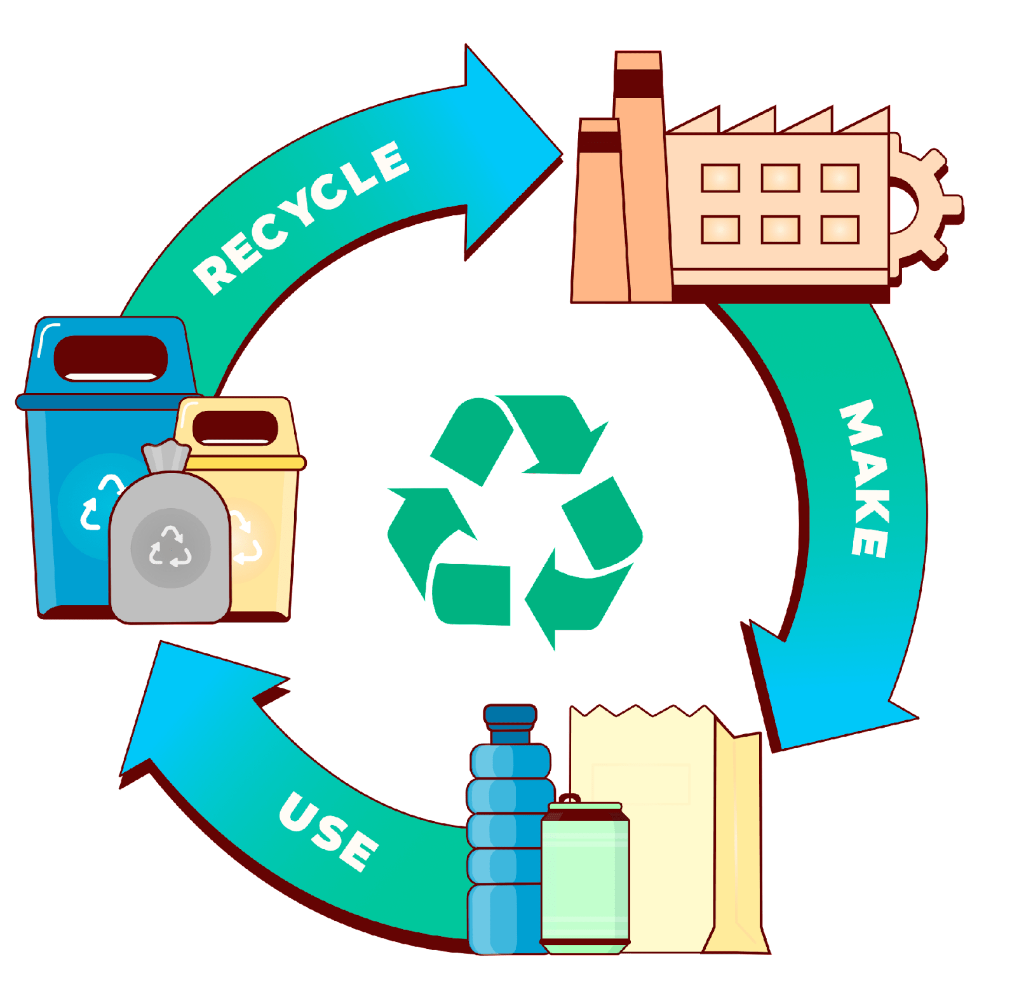
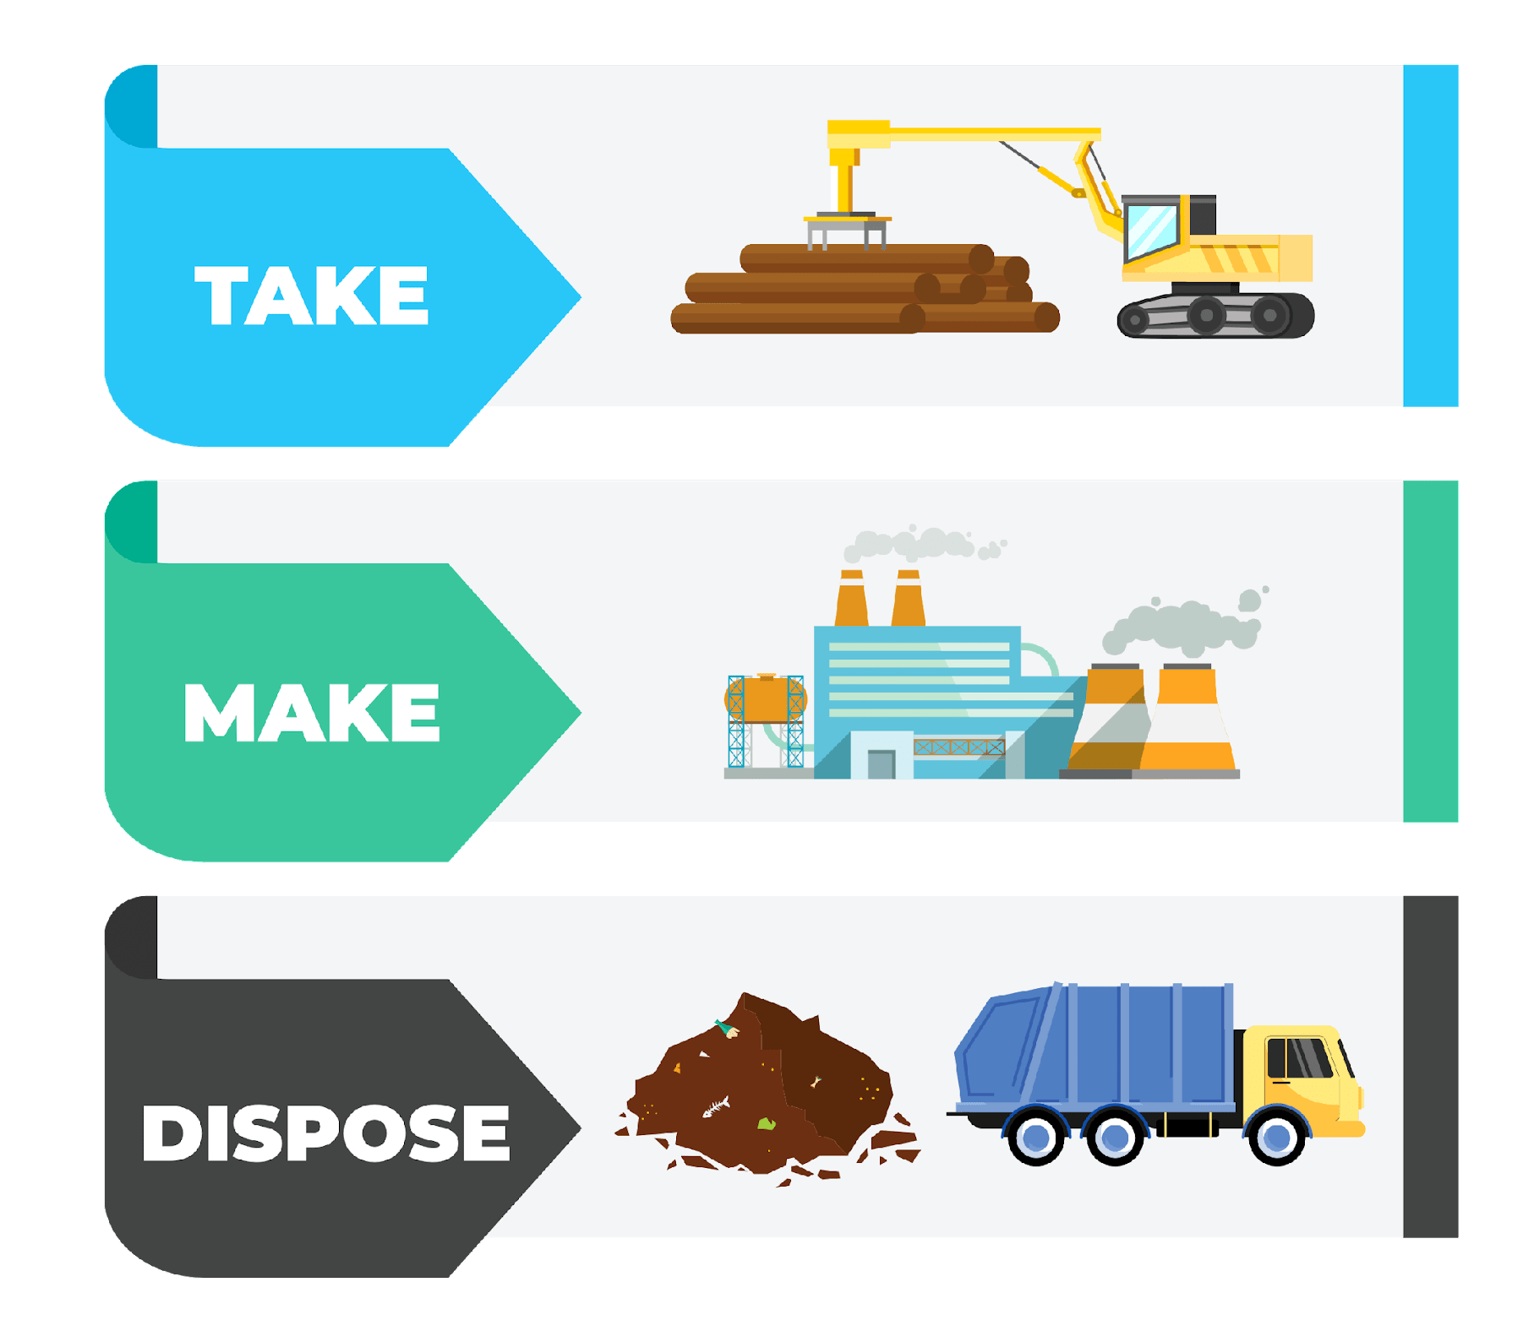
Linear Economy
VS
Circular Economy
Notes:
(Slide duration: 5min)
Tell students:
How we approach our systems of production and consumption is important to understand when discussing how to fight climate change and to become a more sustainable world. The planet’s resources are finite, so it is crucial that people, governments and companies work together to use them more responsibly.
A linear economy is our traditional model that follows the “take-make-dispose” model where raw materials are collected, then manufactured and transformed into products we use until they are finally discarded as waste either in a landfill or into our natural environment. This model gives no concern for their ecological footprint and its consequences. It prioritizes profit over sustainability, with products made to be thrown away once they have been used.
A circular economy (also referred to as circularity and CE) is a model of production and consumption which involves sharing, leasing, reusing, repairing, refurbishing and recycling existing materials and products for as long as possible. It is a model designed to have as little impact as possible on the environment by leaving less of a footprint through keeping items in a closed loop system.
Questions for Students:
1. What is an example of a product from the linear and circular economies?
ANSWER: Linear = Food packaging film on broccoli, Circular: Car ride-sharing or PET plastic bottle recycling.
2. How is the linear model harming the planet?
ANSWER: Waste accumulates in the landfills or leaks into the environment as litter. Finite natural resources are depleted.
3. How can the circular economy help fight climate change?
ANSWER: It keeps natural resources in use with no need to extract more. It also reduces waste leakage into the environment as litter.

Slide 7
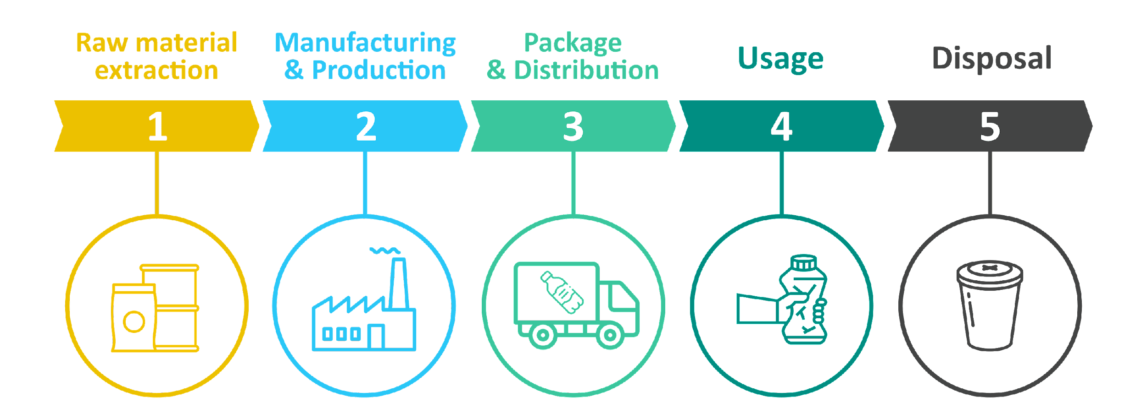
Linear Economy
Notes:
(Slide duration: 5min)
Tell students:
The linear economy is designed to extract raw materials from nature, process them into usable goods, and then discard them either into a landfill, burned in an incinerator or leaked somewhere in nature (usually by accident and considered litter). This linear system can be wasteful, and the losses result in negative environmental impacts, which is not currently accounted for in any of our economic measurement tools. When we consume a product we should consider the end-of-life options for it. If the product ends up in a landfill, is that a bad thing? Can it be recycled? Can I reuse this? Can I repurpose it in some way?
Questions for students:
Why would a system be designed in this way?
ANSWER: Value is created in the current economic system by producing and selling as many products as possible. Profit over the planet.
What is a problem with this model?
ANSWER: It creates a lot of waste which often enters the environment as litter. Landfills release large amounts of methane gas, which contribute to global warming.

Slide 8
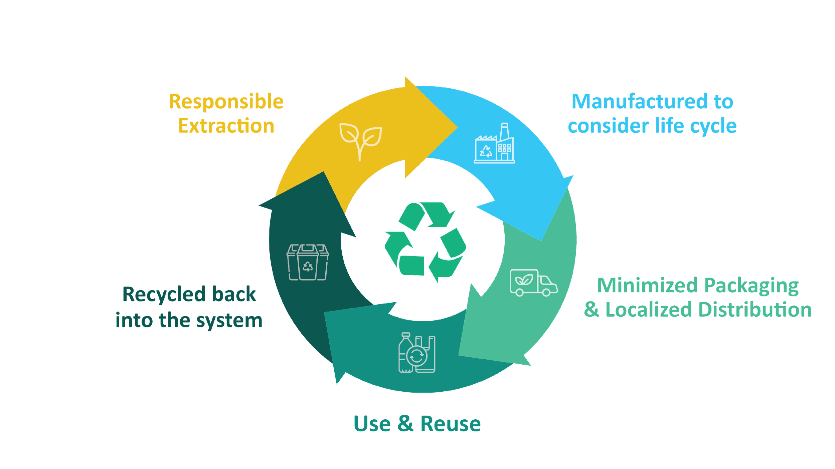
Circular Economy
Notes:
(Slide duration: 5min)
Tell students:
The circular economy is a systems solution framework that tackles global challenges like climate change, biodiversity loss, waste, and pollution. A model of production and consumption which involves sharing, leasing, reusing, repairing, refurbishing and recycling existing materials and products for as long as possible. Companies who want to be more circular should aim to design and make products that:
Eliminate waste
Keep materials in use
Regenerate natural systems
Ask students:
What is an example of a circular product or service?
Answer: Refill stations (shops where you bring your bottle to refill with shampoo or soap)

Slide 9
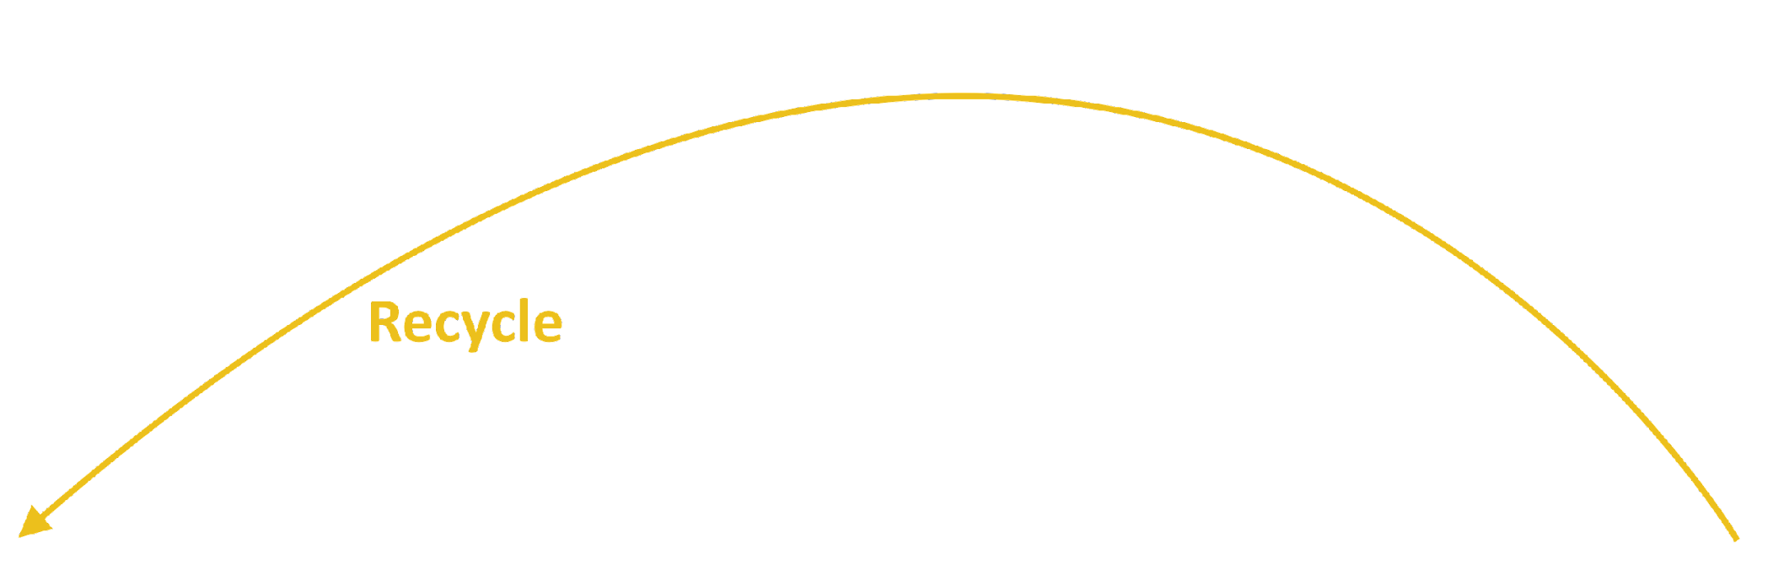
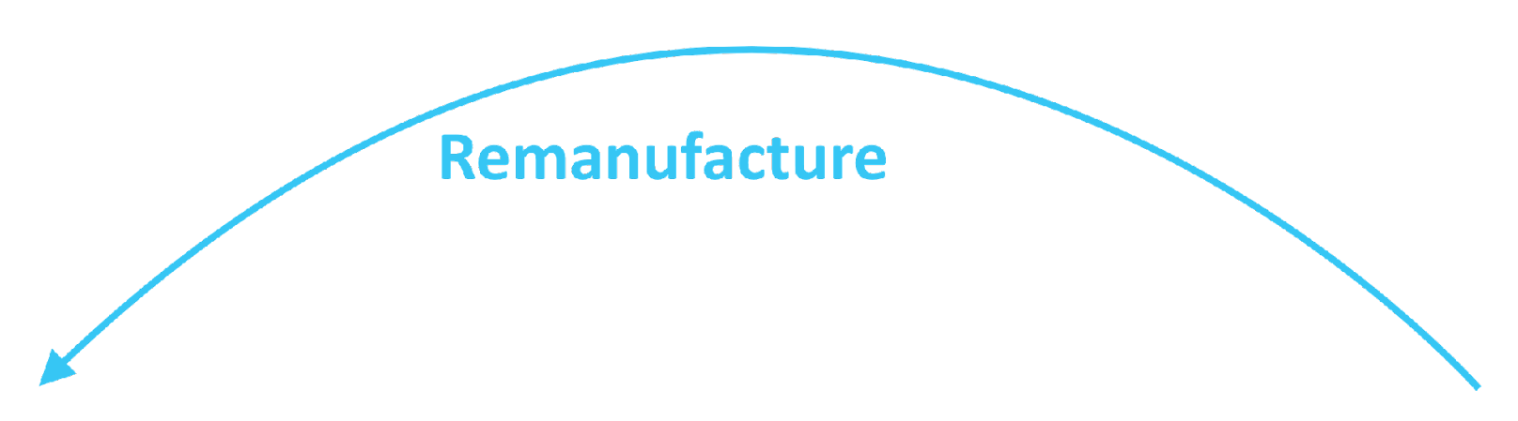
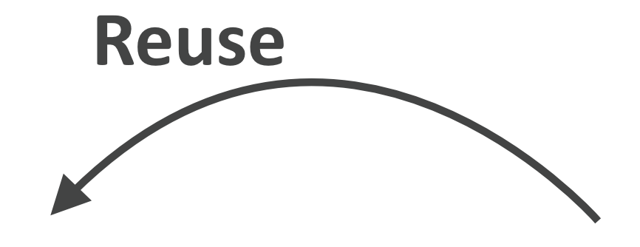
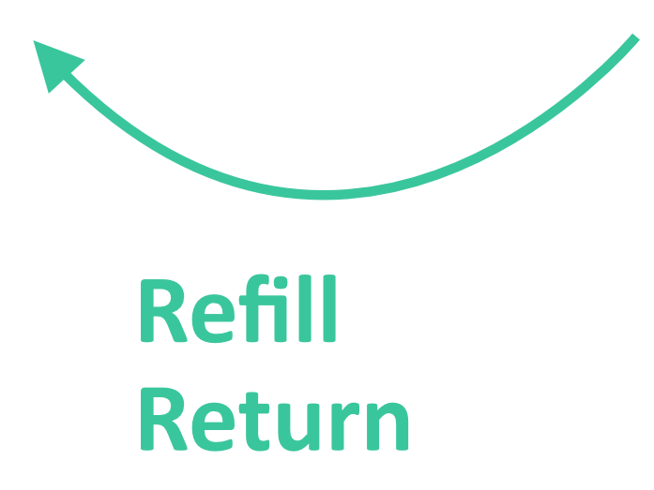
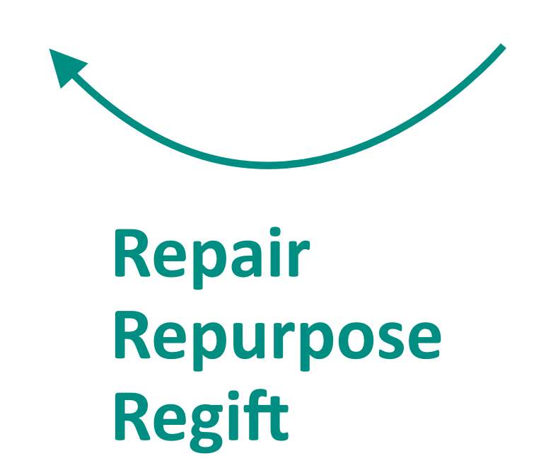
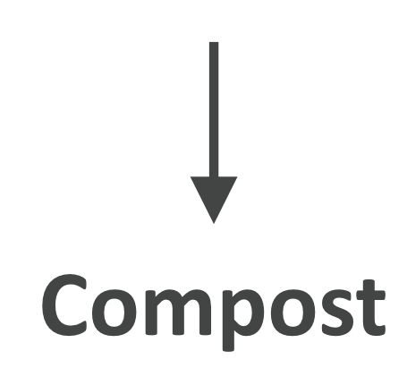
Life Cycle Mapping
Notes:
(Slide duration: 5min)
Tell students:
The major stages of a product’s life can be mapped in both linear and circular ways. We can assess the life cycle by identifying the 5 key stages of a product’s life:
Material extraction is how and where raw materials are removed from natural sources.
Production of the raw materials into a product.
Finished products are distributed to places where customers can purchase the product.
Customers use the product.
The product is then disposed of after use.
By looking at a product's entire life cycle, from materials extraction to end-of-life management, we can find new opportunities to reduce environmental impacts, conserve resources, and reduce costs. Instead of the linear “take-make-waste” system of the 5 stages, we can build in circularity through closed loops that keep these materials and products in use.
Circularity means rethinking the linear use cycle of a product or service with a beginning, middle, and end. If a product or service is truly circular, it will never actually have an end to its life, but continuously take a new form. Mapping this journey will ensure that your product is staying in a useful state for as long as possible and adds value at every stage.
It is not only about recycling; it is really about redesigning the entire product or service delivery model so that human beings get the things they need without negatively impacting the natural systems that sustain us all.
The exciting thing is that this is happening all around the world; people of all types are changing their lifestyles and companies are redesigning their products to be more circular. These types of changes mean designing products to be reused and rethinking the way we deliver functionality to the market. They also include encouraging repair through better support services, return or take-back programs, refill services that encourage the use of the same container more than once, and products being designed to be remanufactured to be returned to nature through composting.
Ask students:
Can you give me an example of a product designed under one of the “Re” models of a circular product or service?
Tell students:
Click 1:
-PET plastic bottles can be recycled back into the same plastic bottle over and over.
Click 2:
-Bed frames are designed into key main parts and if one breaks the manufacturer can easily disassemble the parts and replace that single part and remanufacture the bed, preventing the customer from having to buy a whole new one. The old part can be broken down and reused into a new part.
Click 3:
-Buying clothes secondhand is a way to reuse old discarded clothes giving new value and extending its life.
Click 4:
-Shops can offer refill options for household items like shampoo and soap, allowing customers to bring their own container instead of buying shampoo in a new bottle each time.
Click 5:
-Old jeans could be brought back to a store for a discount on their next purchase, in exchange the brand can repair and repurpose the material to be remade into new clothes.
Click 6:
-Using compostable seaweed-based film on fresh produce at the grocery store to replace single use packaging.

Slide 10
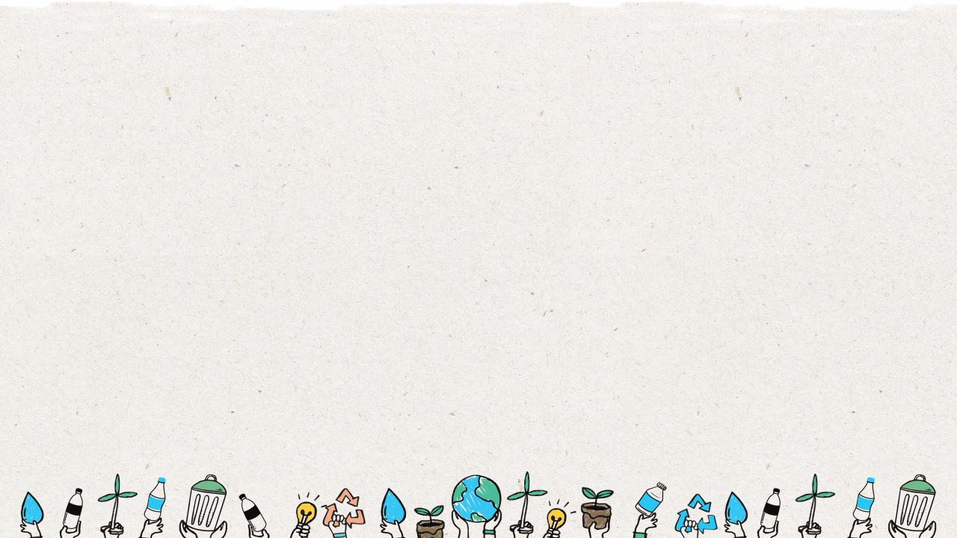
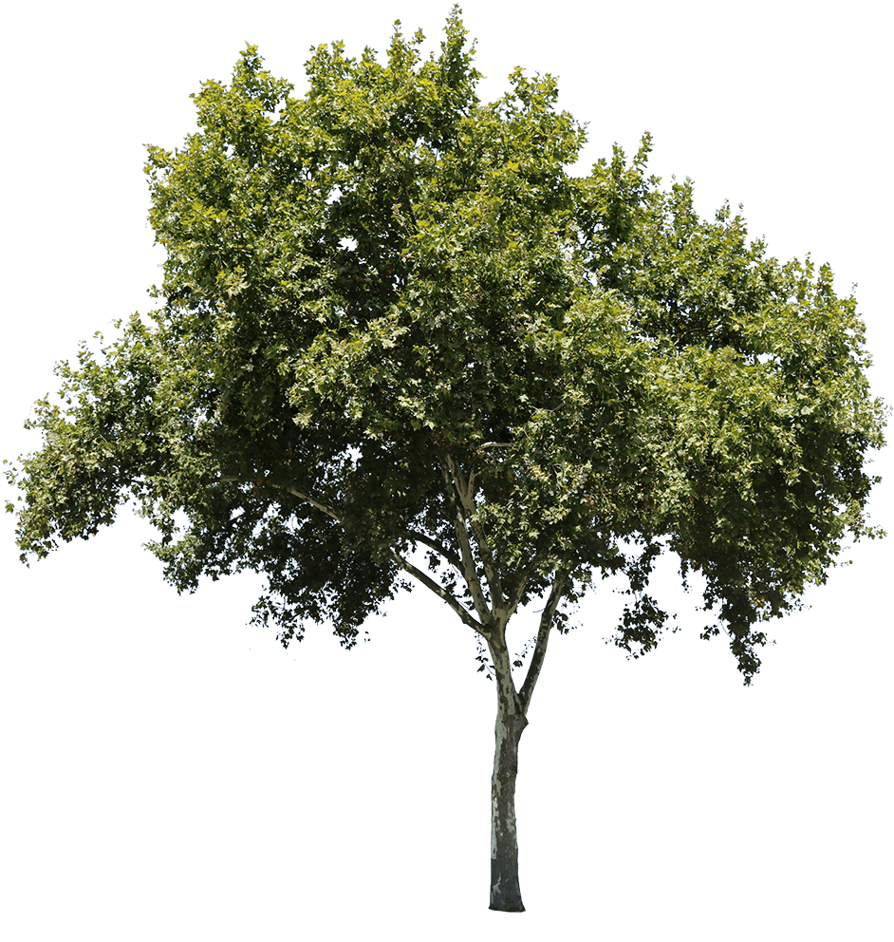

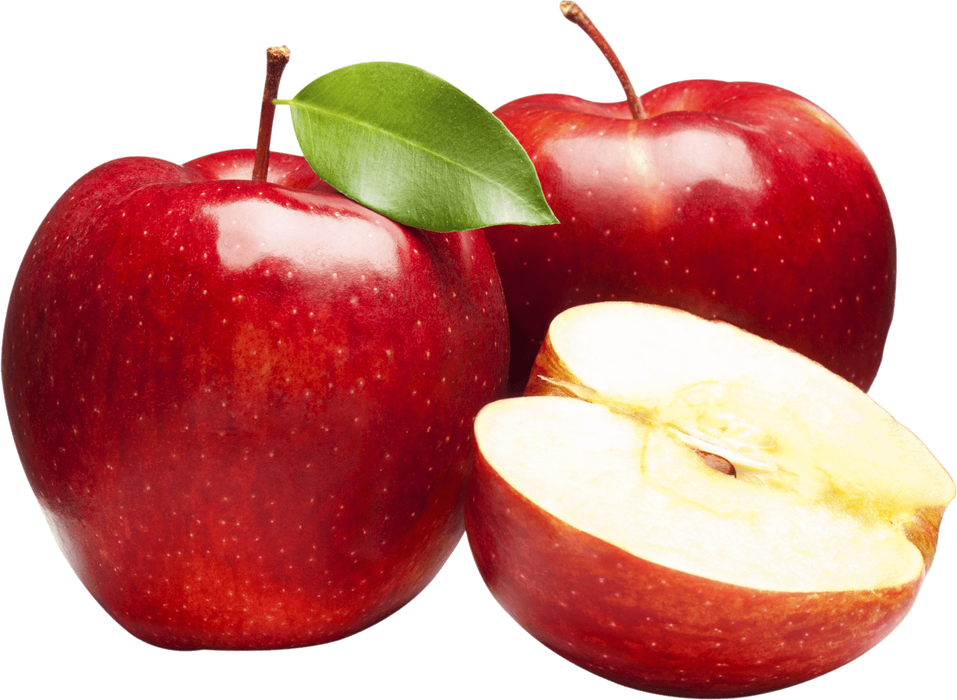
Natural cycles
The perfect circular economy
Notes:
(Slide duration: 3min)
Tell students:
So how do we create the circular economy? The answer is all around us. The natural world reproduces, grows and consumes while maintaining balance. Everything is reused or repurposed in nonhuman ecosystems. The natural world is the perfect circular economy, where everything, even after its lifetime, becomes a source for something else.
Lets use an apple as an example. An apple comes from a natural source, a tree. And that tree grew from another natural source, a seed.
Example:
The tree, like a factory, produces apples that contain seeds, the essential materials to make the apple product, that can be eaten by another animal for food. After it is consumed the waste material, which is not actually waste at all, but a resource that provides nutrients back into the soil as the necessary resources to grow other plant life.
Even if the apple is not eaten nothing goes to waste and continues the cycle. If an apple falls from a tree it eventually decomposes on the ground which feeds nutrients back into the soil, additionally the seeds from the apple can grow into another apple tree that will continue to produce apples. This cycle will continue until disrupted, serving as a fully circular system.
Ask students:
What is another example of a natural cycle that is fully circular?
Answer:
The water cycle

Slide 11
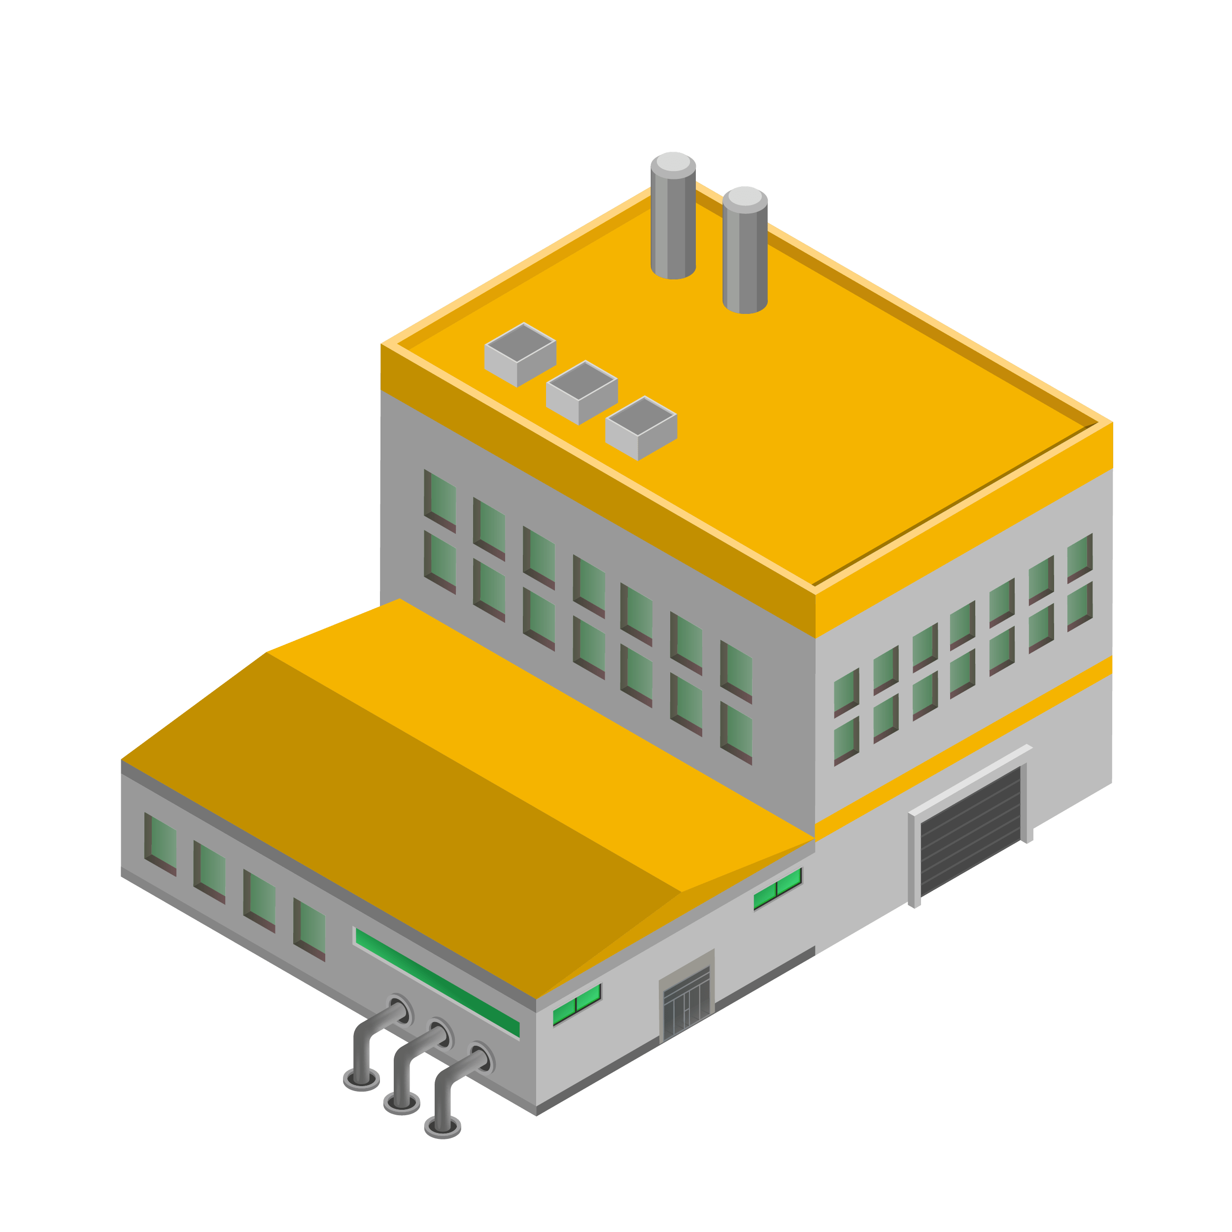

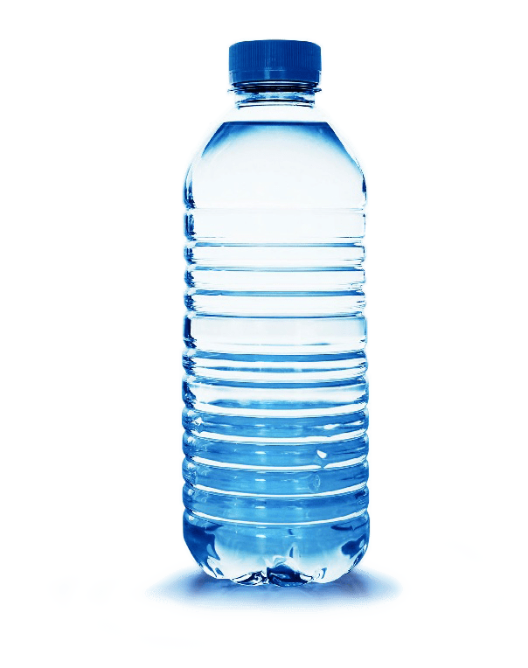
Learn from nature
Keep materials in cycles
Nothing becomes waste
Notes:
(Slide duration: 3min)
Tell students:
There are three main principles of the circular economy.
Keep materials in cycles
Nothing becomes waste
Regenerate natural systems
These principles of the circular economy are important when thinking about design. If we observe how natural cycles work, we see that materials flow in closed loops and nothing becomes waste as materials decompose to release nutrients with then nourish other forms of life. Similarly, if we can design products and services that mimic these natural cycles we can create eliminate waste and keep materials in a closed loop.

Slide 12
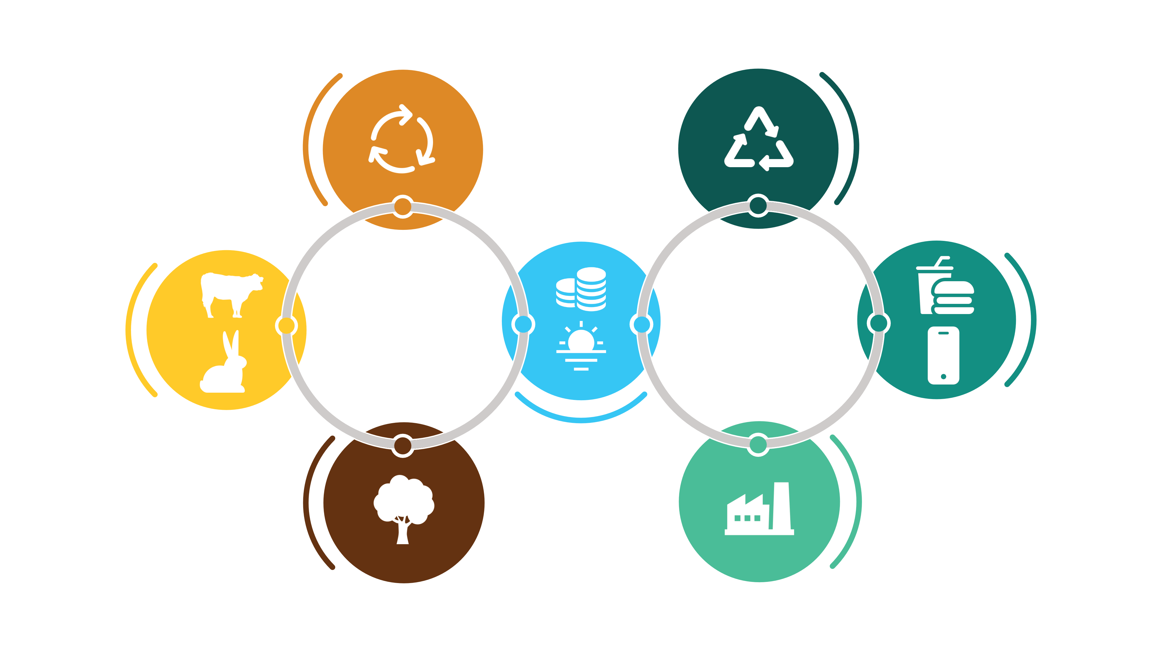
Biomimicry
Nature inspired design
Restoration
Decomposers restore the biological nutrients back and natural cycles restore the resources.
Waste Management
Reduction, recycling of waste and reusing resources for production.
Consumers
Animals depend on plants for food.
Circular
Economy
Consumption
Responsible consumption and reuse of products and services.
Nature
Resources
Nutrients for biological cycles and raw materials for manufacturing.
Natural Producers
Plants produce food using the biological nutrients from soil, water and sunlight.
Production
Redesigning processes, products, services to reduce the usage of resources and using harmless material & clean energy.
Notes:
(Slide duration: 5min)
Tell students:
Biomimicry is the imitation of the models, systems, and elements of nature for the purpose of solving complex human problems. Biomimicry learns from and mimics the cycles found in nature to solve our design challenges in a sustainable way.
Both humans and nature use resources that come from the environment. Humans create factories and assembly lines that use those resources to produce products for consumers. Nature also uses those resources to grow plants that produce food and nutrients for animals to consume. Once humans finish consuming those products they are disposed of as waste and apply one for the “R’s” of sustainability like recycling to keep materials in the loop, whereas animal waste from eating and consuming those plants return nutrient rich resources back to the earth to continue that cycle.

Slide 13
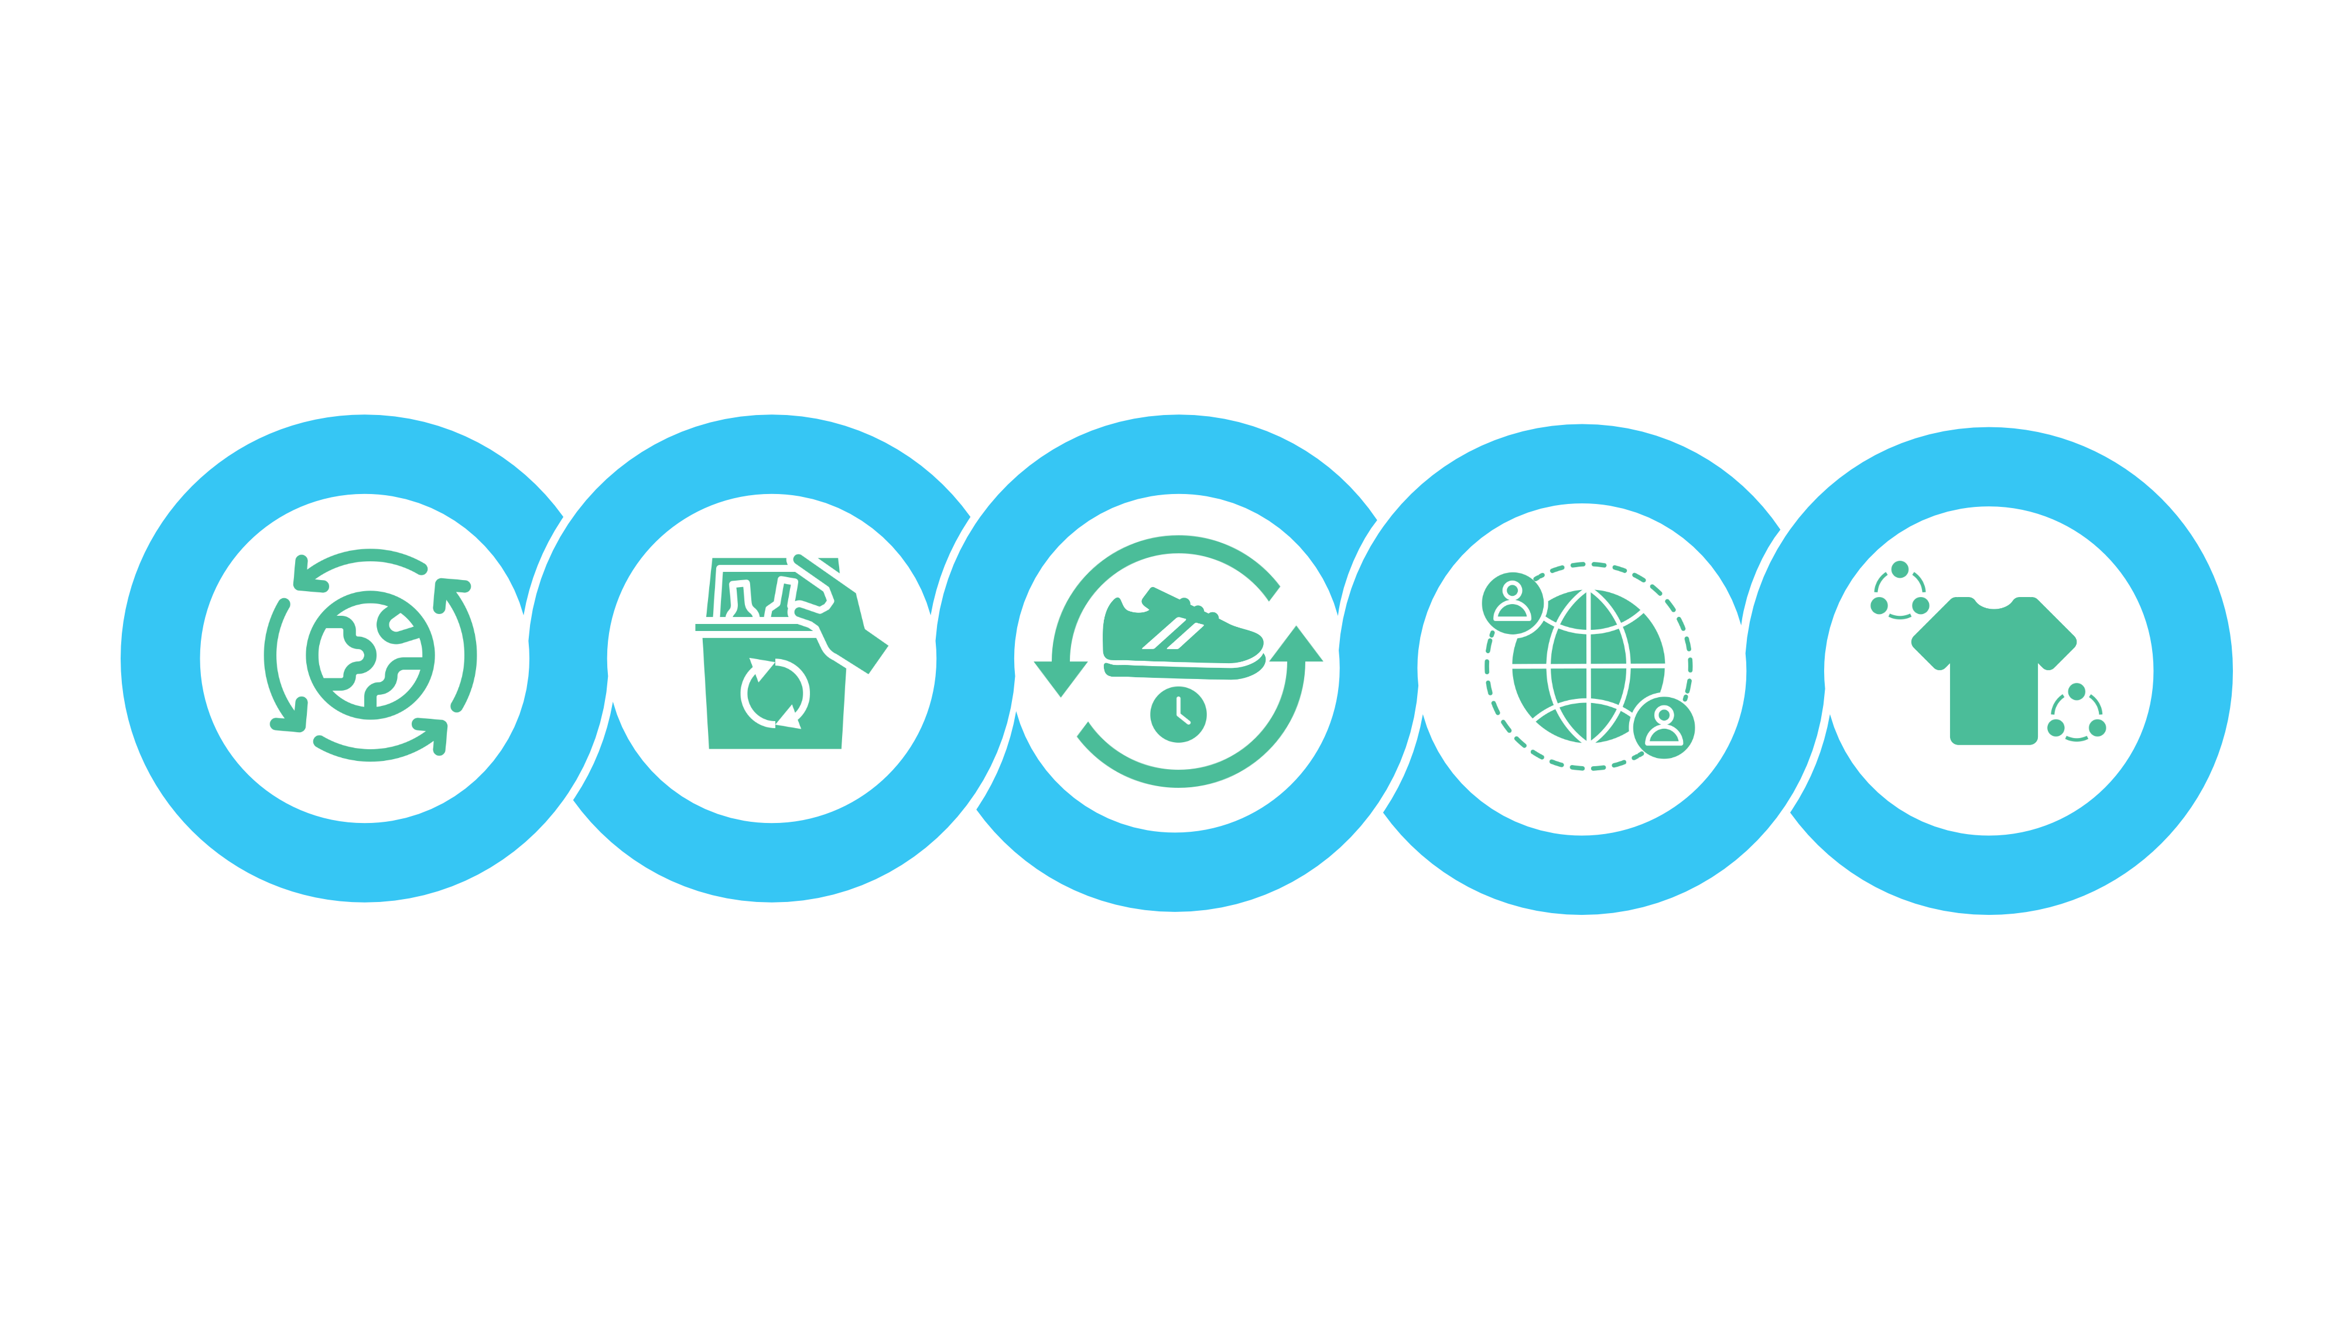
Five Business Models of Circularity
Circular
Supplies
Resource
Recovery
Product Life
Extension
Sharing
Platform
Product As
A Service
Products made from fully renewable, recyclable, or biodegradable resource inputs.
Services that work to eliminate resources, materials, or waste from leaking into the environment and maximizing the value of it to reenter the loop.
Services that offer to extend the life of an otherwise discarded product through repairing, upgrading, or reselling back into the loop.
Sharing platforms allow people to collaborate and share a product amongst themselves without singular ownership by the customer.
Products that are used by one or more customers as a pay-as-you-use arrangement.
Notes:
(Slide duration: 5min)
Ask students:
How are businesses creating more circularity?
Tell students:
There are five core business models that are creating the circular economy.
Circular Supplies: Products made from fully renewable, recyclable, or biodegradable resource inputs.
Resource Recovery: Services that work to eliminate resources, materials, or waste from leaking into the environment and maximizing the value of it to reenter the loop.
Product Life Extension: Services that offer to extend the life of an otherwise discarded product through repairing, upgrading, or reselling it back into the loop.
Sharing Platform: Sharing platforms allow people to collaborate and share a product amongst themselves without singular ownership by the customer.
Product As A Service: Products that are used by one or more customers through a pay-as-you-use arrangement.
The next slides will highlight some real-world examples of each circular business model in practice.

Slide 14
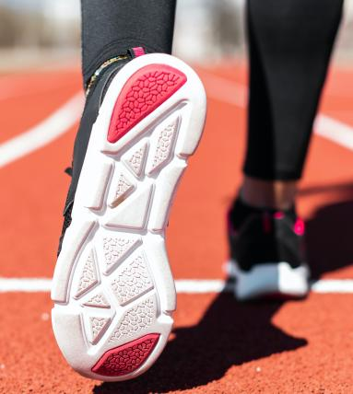
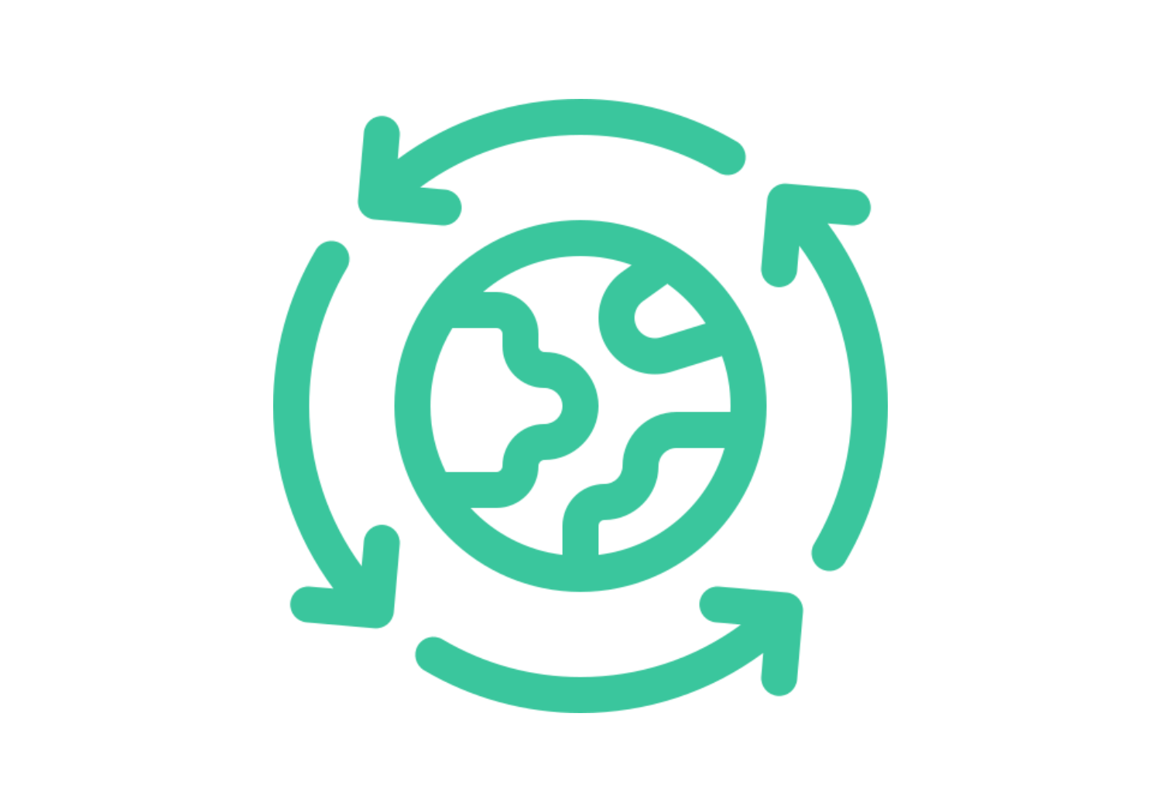
Circular Supplies: Shoes made from plastic
Notes:
(Slide duration: 2min)
Tell students:
A shoe company wants to make all their shoes using fully recycled materials. #1 PET plastic bottles can be recycled into polyester and made into thread or woven fabrics that can make performance gear such as athletic shoes. These shoes are made using recycled polyester (rPET), and after use the customer can return it to the company which is recycled again into other shoe parts.

Slide 15
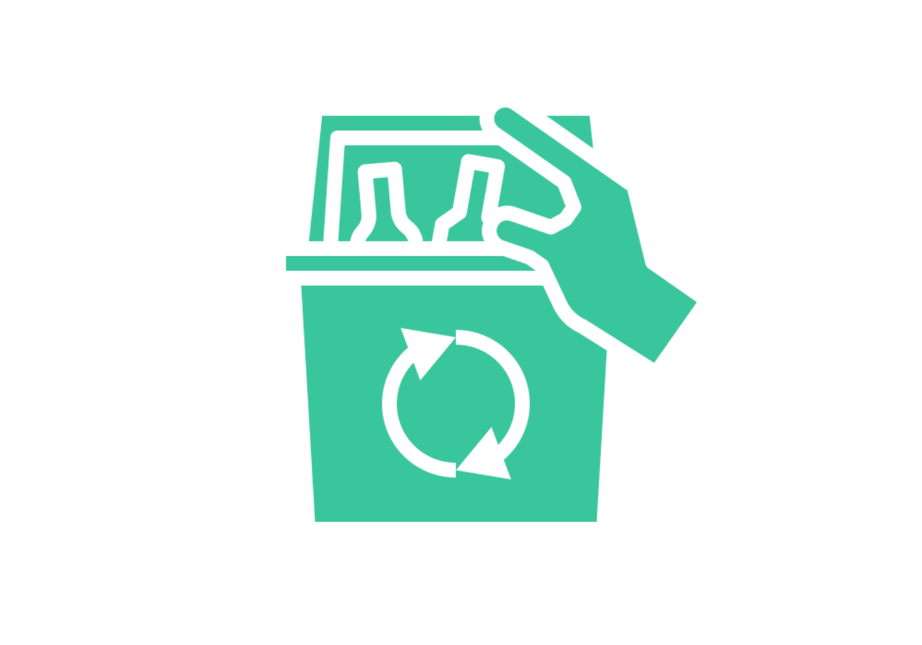
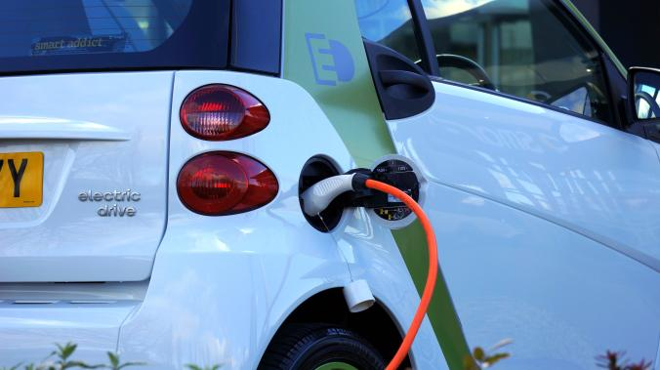
Resource Recovery: Waste to energy
Notes:
(Slide duration: 2min)
Tell students:
The methane produced in landfills can be recycled and used for the production of electricity and thermal energy, effectively diverting waste from landfills and eliminating tons of greenhouse gas emissions. The waste-to-energy operator may receive revenue for receiving waste as an alternative to the cost of disposing of waste in a landfill.

Slide 16
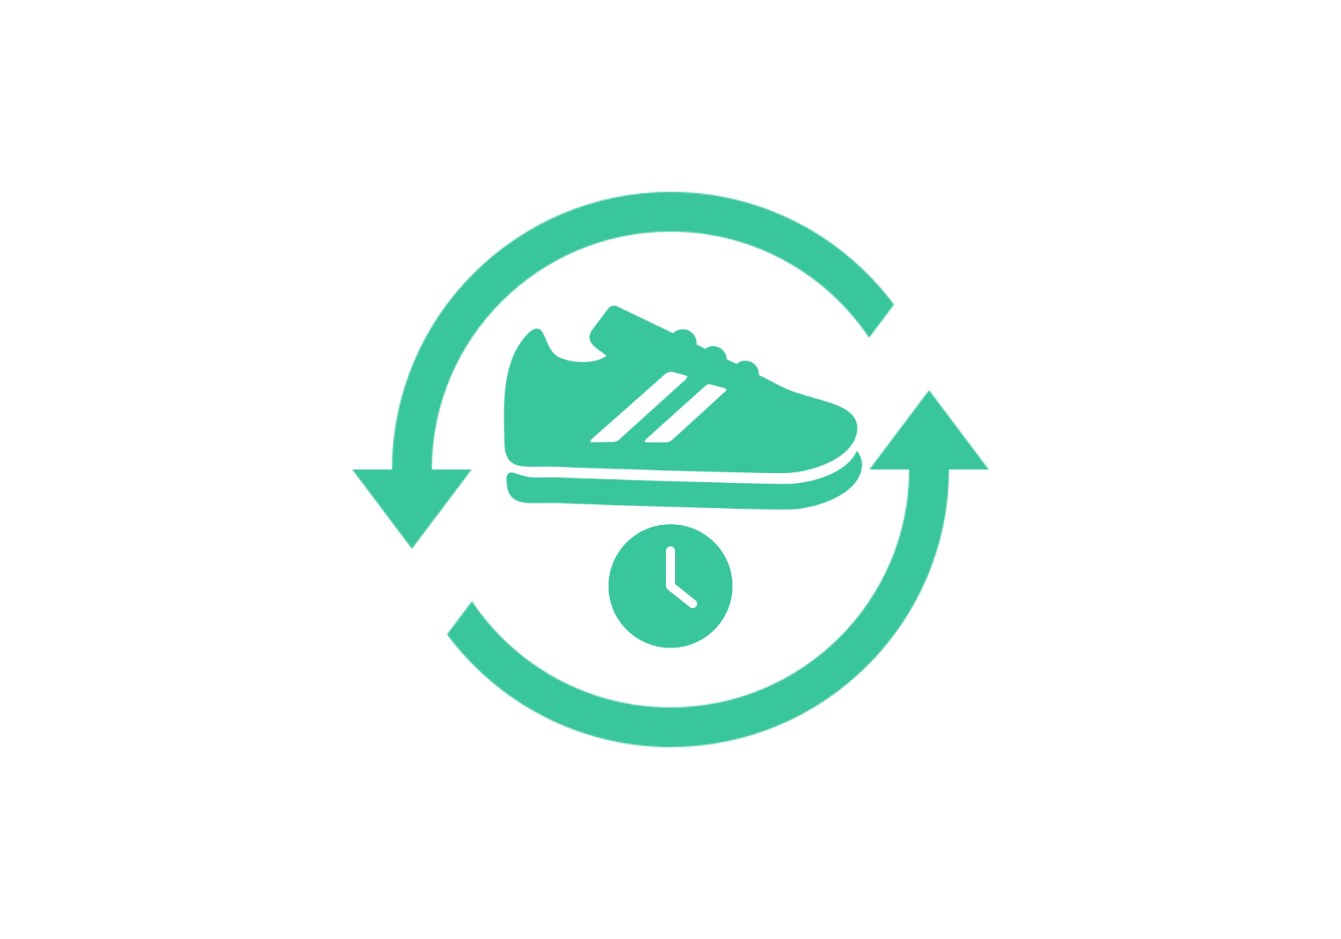
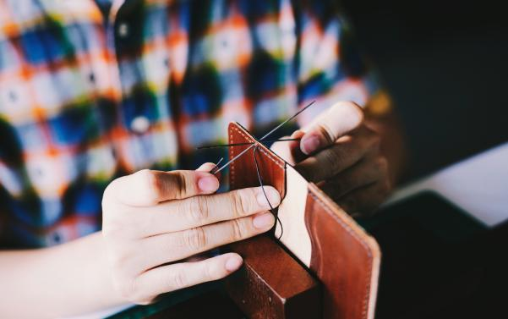
Product Life Extension: Takeback & repair service
Notes:
(Slide duration: 2min)
Tell students:
Customers can get a discount on future purchases by bringing their old gear back and the brand will then repair and restore before reselling it. This extends the life of the garment that would otherwise be disposed. More brands are taking responsibility for the end-of-life options for the products they sell.

Slide 17

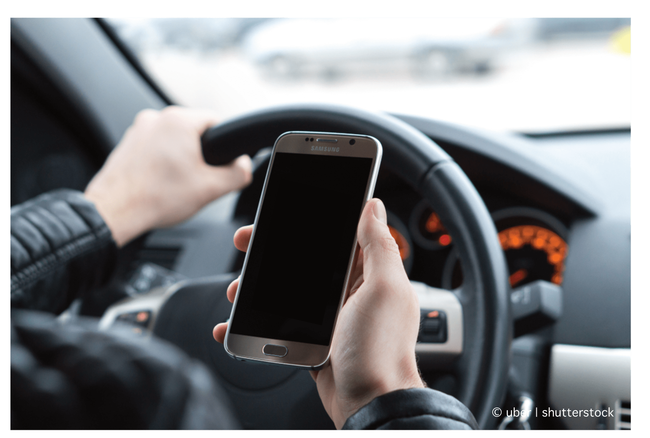
Sharing Platform: Ridesharing
Notes:
(Slide duration: 2min)
Tell students:
Ridesharing functions on the principle of owners sharing their assets, fuel, and time with others in exchange for money. A company provides a platform where private car owners can offer their car and a ride to people who need one. Sharing a vehicle maximizes utility from one unit produced while reducing the emissions from redundant manufacturing.

Slide 18
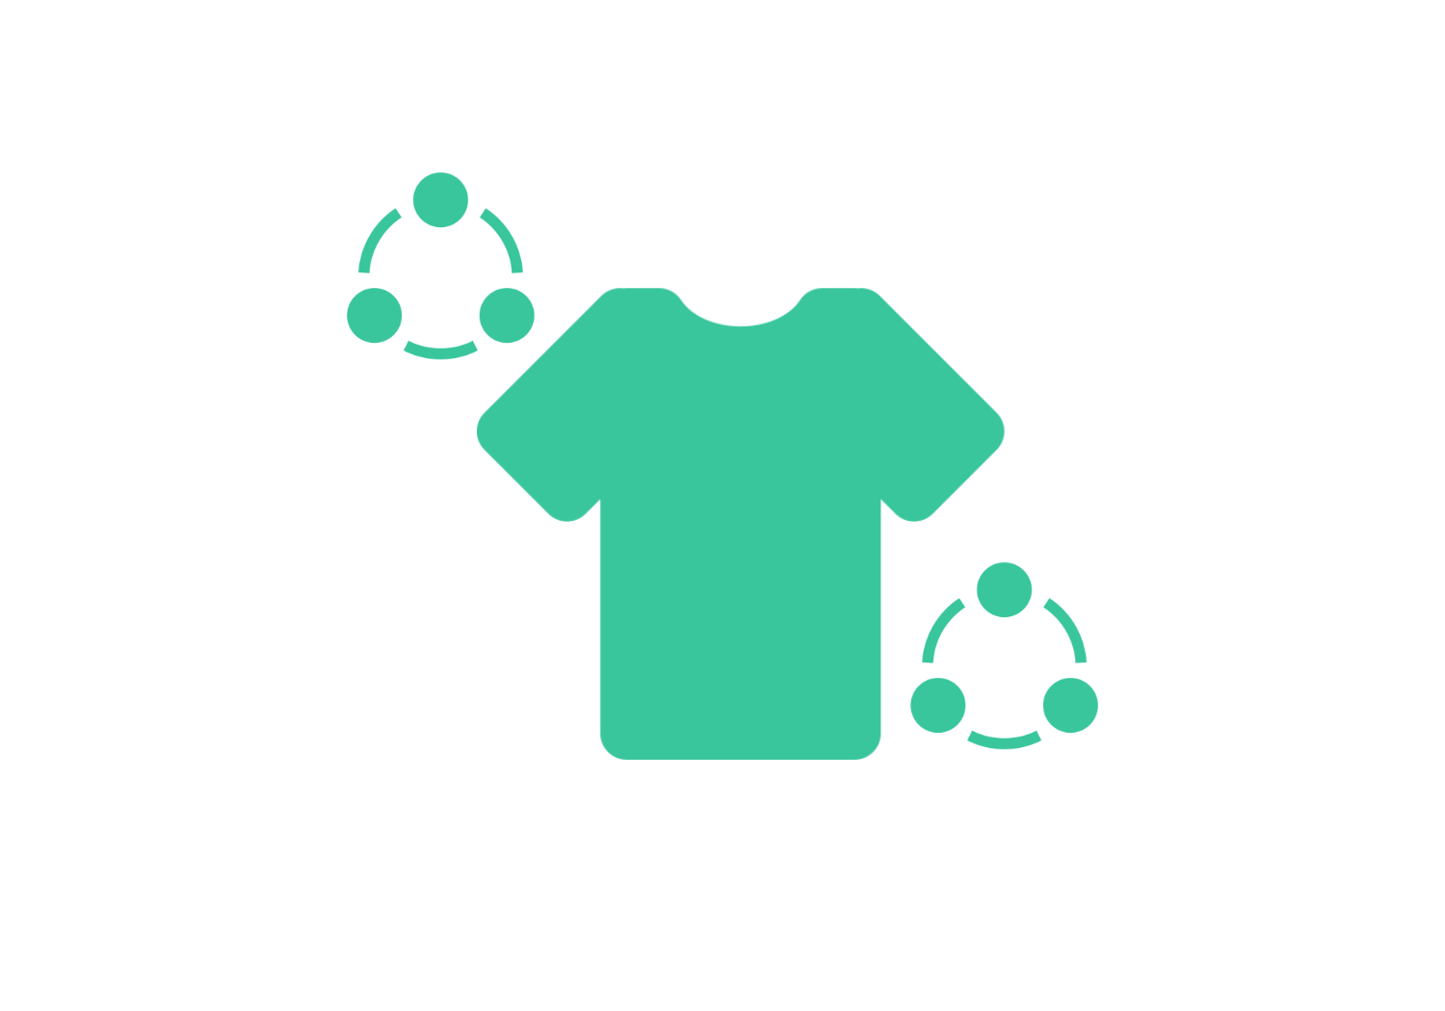
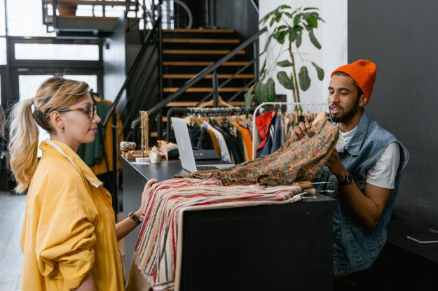
Product As A Service: Clothes rental
Notes:
(Slide duration: 2min)
Tell students:
Clothing rental models can provide customers with access to a variety of clothes while decreasing the demand for new clothing production. Short-term rental models offer a compelling value proposition, particularly when taking changing customer needs into consideration - examples include short term use, practical requirements, or fast evolving fashion preferences. New short-term and subscription rental models are already emerging within the industry.

Slide 19
Class Activity: Circular Business Case Study
1
What does the company do?
6
How do they reduce or eliminate waste?
2
Do they offer goods, services, or both to their customers?
7
Does their business model help regenerate natural systems?
3
Which of the 5 circular economy business models does the company utilize?
8
What added value do they offer customers and the
environment with their circular model?
4
What linear problem is the company trying to solve through circularity?
9
As a designer, how could you help make their business even more circular?
5
How do they keep materials in a closed loop system?
(e.g. recycle plastic bottles to make new products)
Notes:
Tell students:
For the class activity they will conduct a circular business case study.
They will receive the Circular Business Case Study handout with nine questions that they will answer based on the circular business card they choose. Allow them to do their own research online if they need.

Slide 20
Notes:
2. Distribute the 5 circular business card handout and have students select one of the five circular businesses they will use for their case analysis.

Slide 21
Circular Lifecycle Map
Notes:
3. Once they have answered all the questions for the case study they will map the areas of circularity found in their business case. The handout will consist of the 5 linear stages of a products lifecycle, have them draw in the arrows indicating the kinds of circularity used in their business case.

