Slide 1
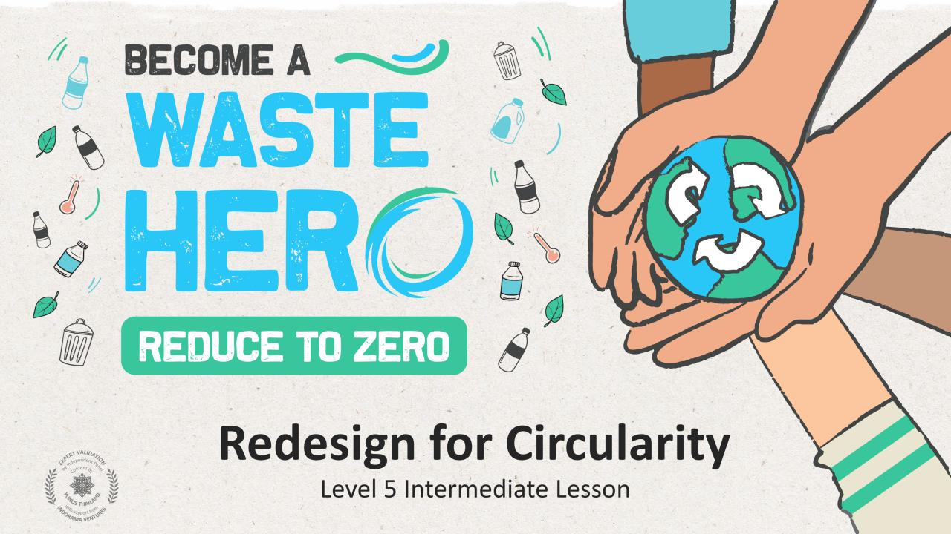

Slide 2
Lesson Prep & Curriculum Alignment
Prep time: 10 – 15 minutes
Students will apply circular strategies to solve a linear problem of an everyday business. They will work through a design thinking exercise to identify circular opportunities by reflecting on the functional and emotional needs of the customer.
1
Display the lesson slides for the class and create a discussion about what they already know about circular business models and introduce design thinking to identify solutions to customer problems. Ask students the guiding questions in the PowerPoint slide notes.
2
Print out the 5 handouts: 1. Redesign for Circularity; 2. Design Thinking; 3. Areas of Circularity; 4. Circular Lifecycle Map; and 5. Circular Solution.
3
Follow the steps on the next slide and in the teacher notes in slides 20 to 24 to conduct the class activity.

Slide 3
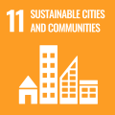
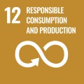
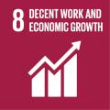
Lesson Prep & Curriculum Alignment
Prep time: 10 – 15 minutes
Key Learning Outcomes and Curriculum Alignment:
Science - Earth and Human Activity: Communicate solutions that will reduce the impact of humans on the land, water, air, and/or other living things in the local environment. Things that people do can affect the world around them. But they can make choices that reduce their impacts on the land, water, air, and other living things.
English Language Arts and Literacy: Participate in collaborative conversations with diverse partners about topics and texts. Follow agreed-upon rules for discussions. Use words and phrases acquired through conversations, reading and being read to, and responding to texts.
Social Studies - People, Places, and Environments: The study of people, places, and environments enables us to understand the relationship between human populations and the physical world.
SDG Alignment
Flexible and adaptive lesson
Lesson plans are designed to be flexible and responsive to the evolving needs of your classroom. Lessons are editable and customizable to meet the different individual student and classroom contexts. A PowerPoint version with teacher instructions and a printable PDF lesson are available for download.

Slide 4
The Lesson
Lesson duration: 25 - 30 minutes
1
Split into groups of 3-5 and prepare a posterboard with sticky notes or use the design thinking handout.
2
Pick one of the following linear businesses
Washing Machine Manufacturer
Fashion Textiles
Lighting Manufacturer
Food Delivery Service
Grocery Store
Office Space
3
Use the design thinking handout to develop your circular solution for the business.
4
Apply one or more circular design models to your business. When finished encourage students to share their circular innovations with the class.

Slide 5
Prepare the PowerPoint presentation
When you are ready to present the lessons to your class click on Slide Show on the top menu bar then select Presenter View. In Presenter view, you can see your notes as you present while the audience see only your slides.
The notes appear in a pane on the right. The text should wrap automatically, and a vertical scroll bar appears if necessary. You can also change the size of the text in the Notes pane by using the two buttons at the lower left corner of the Notes pane.

Slide 6
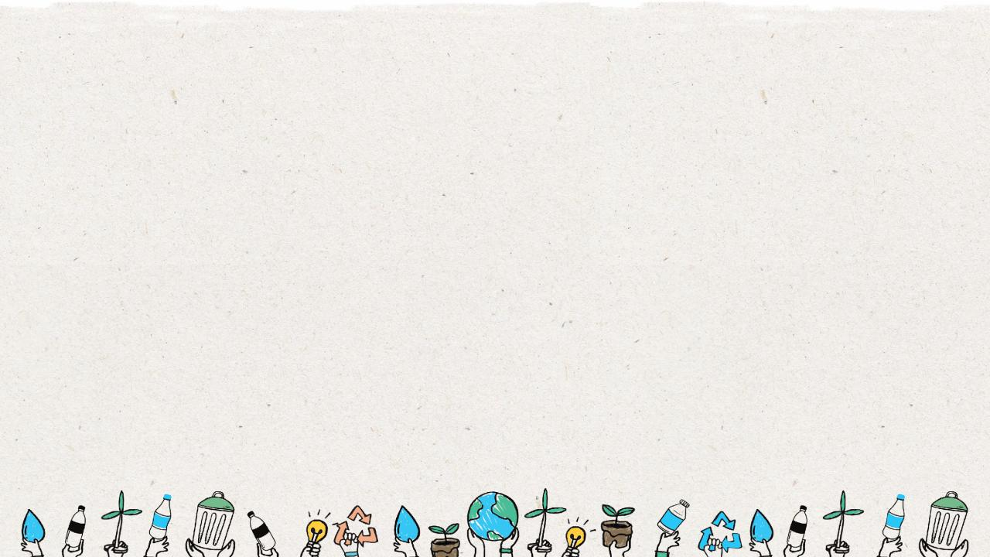
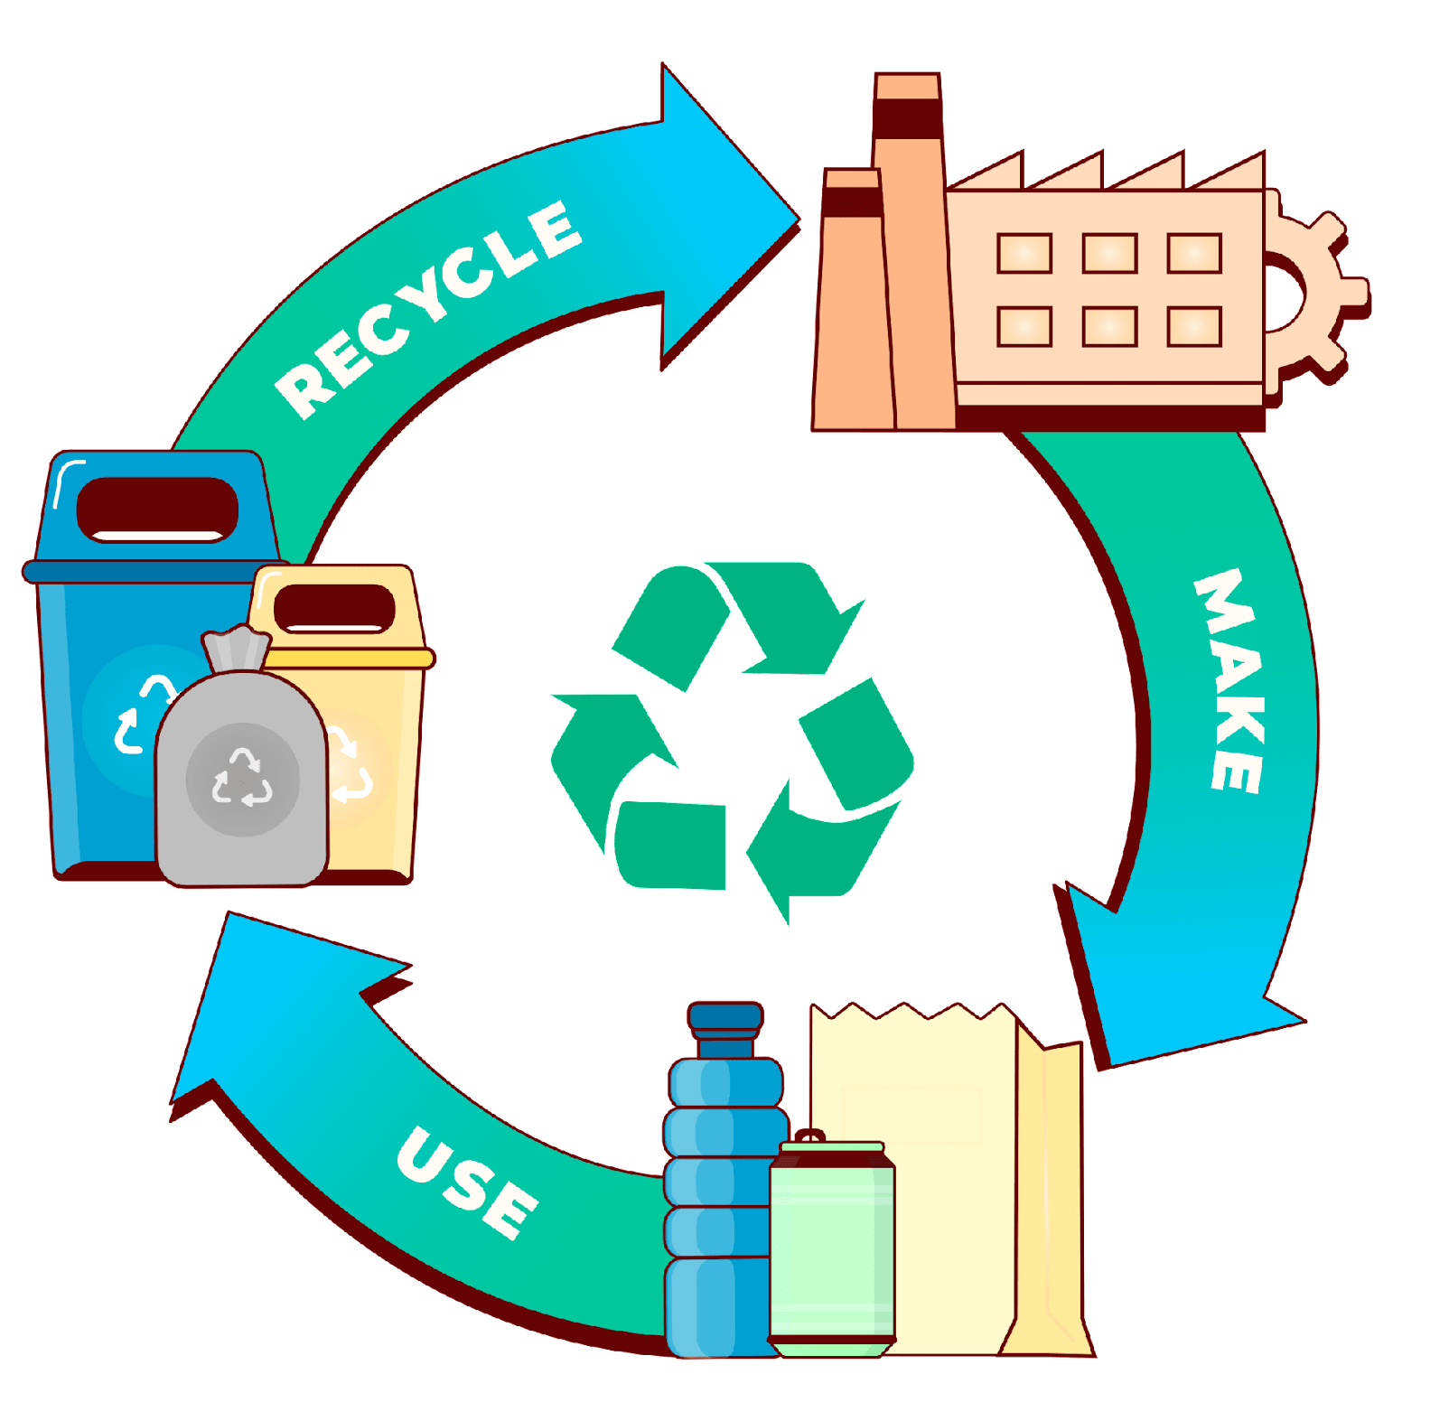
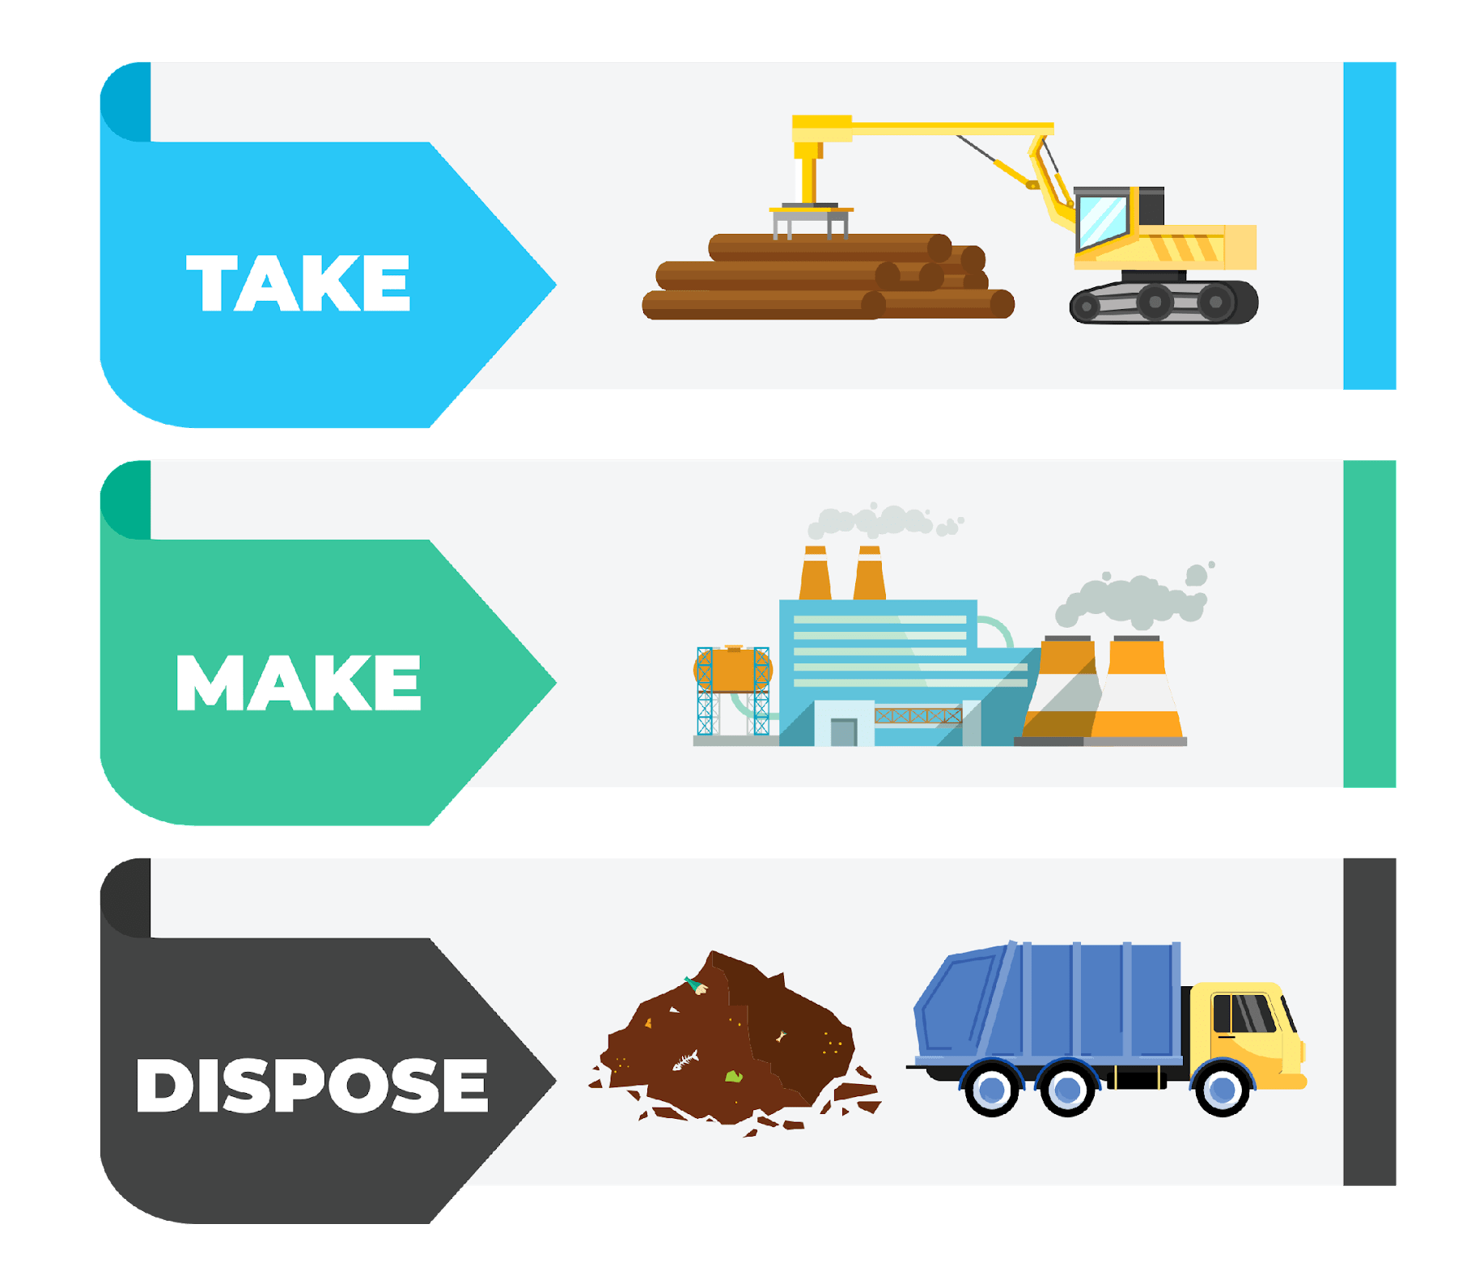
Linear Economy
VS
Circular Economy
Notes:
(Slide duration: 5min)
Tell students:
How we approach our systems of production and consumption is important to understand when discussing how to fight climate change and to become a more sustainable world. The planet’s resources are finite, so it is crucial that people, governments and companies work together to use them more responsibly.
A linear economy is our traditional model that follows the “take-make-dispose” model where raw materials are collected, then manufactured and transformed into products we use until they are finally discarded as waste either in a landfill or into our natural environment. This model gives no concern for their ecological footprint and its consequences. It prioritizes profit over sustainability, with products made to be thrown away once they have been used.
A circular economy (also referred to as circularity and CE) is a model of production and consumption which involves sharing, leasing, reusing, repairing, refurbishing and recycling existing materials and products for as long as possible. It is a model designed to have as little impact as possible on the environment by leaving less of a footprint through keeping items in a closed loop system.
Questions for Students:
1. What is an example of a product from the linear and circular economies?
ANSWER: Linear = Food packaging film on broccoli, Circular: Car ride-sharing or PET plastic bottle recycling.
2. How is the linear model harming the planet?
ANSWER: Waste accumulates in the landfills or leaks into the environment as litter. Finite natural resources are depleted.
3. How can the circular economy help fight climate change?
ANSWER: It keeps natural resources in use with no need to extract more. It also reduces waste leakage into the environment as litter.

Slide 7
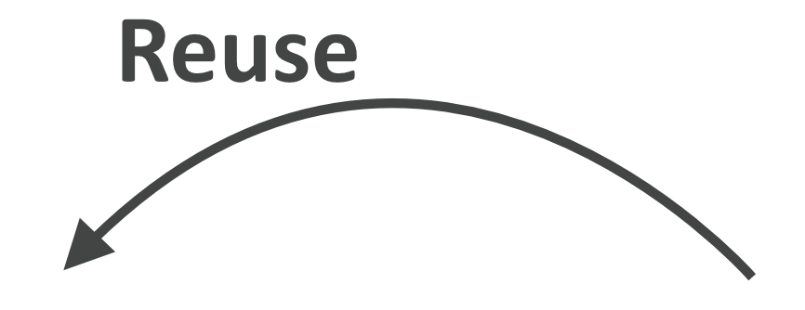
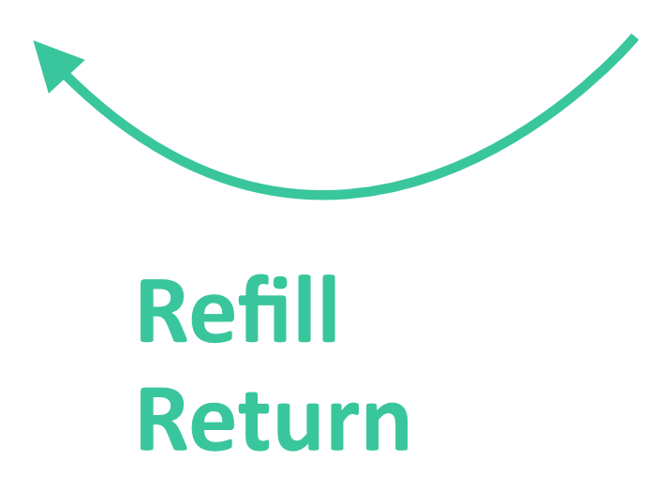
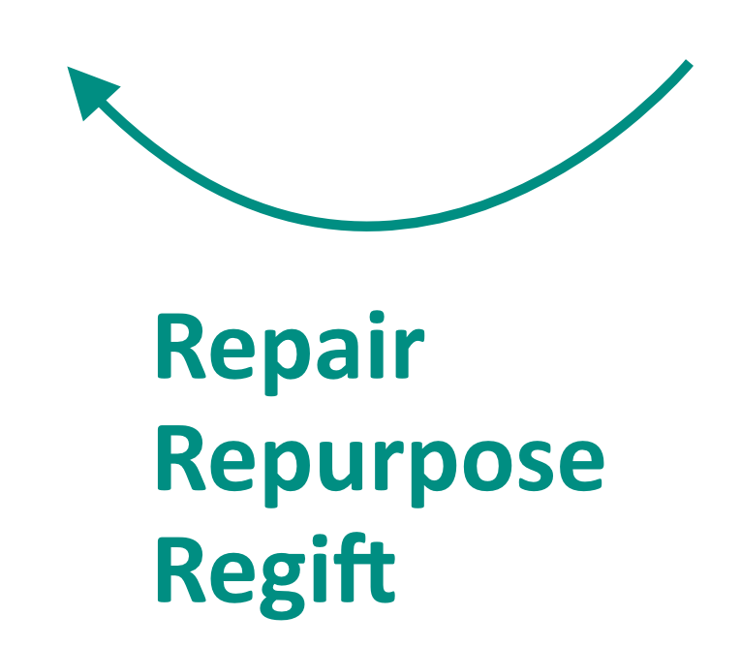
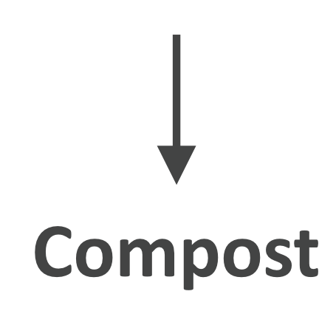
Life Cycle Mapping
Notes:
(Slide duration: 5min)
Tell students:
The major stages of a product’s life can be mapped in both linear and circular ways. We can assess the life cycle by identifying the 5 key stages of a product’s life:
Material extraction is how and where raw materials are removed from natural sources.
Production of the raw materials into a product.
Finished products are distributed to places where customers can purchase the product.
Customers use the product.
The product is then disposed of after use.
By looking at a product's entire life cycle, from materials extraction to end-of-life management, we can find new opportunities to reduce environmental impacts, conserve resources, and reduce costs. Instead of the linear “take-make-waste” system of the 5 stages, we can build in circularity through closed loops that keep these materials and products in use.
Circularity means rethinking the linear use cycle of a product or service with a beginning, middle, and end. If a product or service is truly circular, it will never actually have an end to its life, but continuously take a new form. Mapping this journey will ensure that your product is staying in a useful state for as long as possible and adds value at every stage.
It is not only about recycling; it is really about redesigning the entire product or service delivery model so that human beings get the things they need without negatively impacting the natural systems that sustain us all.
The exciting thing is that this is happening all around the world; people of all types are changing their lifestyles and companies are redesigning their products to be more circular. These types of changes mean designing products to be reused and rethinking the way we deliver functionality to the market. They also include encouraging repair through better support services, return or take-back programs, refill services that encourage the use of the same container more than once, and products being designed to be remanufactured to be returned to nature through composting.
Ask students:
Can you give me an example of a product designed under one of the “Re” models of a circular product or service?
Tell students:
Click 1: -PET plastic bottles can be recycled back into the same plastic bottle over and over.
Click 2:
-Bed frames are designed into key main parts and if one breaks the manufacturer can easily disassemble the parts and replace that single part and remanufacture the bed, preventing the customer from having to buy a whole new one. The old part can be broken down and reused into a new part.
Click 3:
-Buying clothes secondhand is a way to reuse old discarded clothes giving new value and extending its life.
Click 4:
-Shops can offer refill options for household items like shampoo and soap, allowing customers to bring their own container instead of buying shampoo in a new bottle each time.
Click 5:
-Old jeans could be brought back to a store for a discount on their next purchase, in exchange the brand can repair and repurpose the material to be remade into new clothes.
Click 6:
-Using compostable seaweed-based film on fresh produce at the grocery store to replace single use packaging.

Slide 8
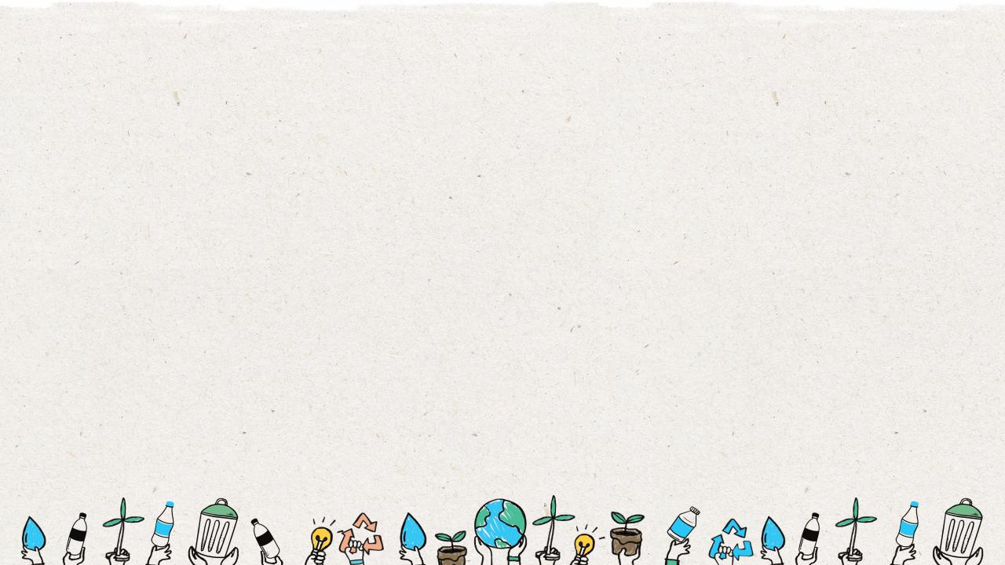
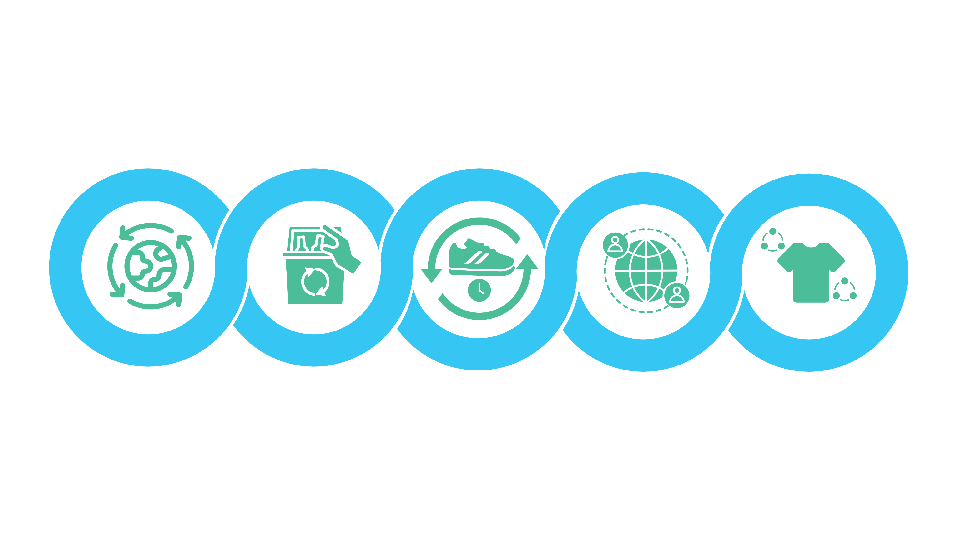
Five Business Models of Circularity
Circular
Supplies
Resource
Recovery
Product Life
Extension
Sharing
Platform
Product As
A Service
Products made from fully renewable, recyclable, or biodegradable resource inputs.
Services that work to eliminate resources, materials, or waste from leaking into the environment and maximizing the value of it to reenter the loop.
Services that offer to extend the life of an otherwise discarded product through repairing, upgrading, or reselling back into the loop.
Sharing platforms allow people to collaborate and share a product amongst themselves without singular ownership by the customer.
Products that are used by one or more customers as a pay-as-you-use arrangement.
Notes:
(Slide duration: 5min)
Ask students:
How are businesses creating more circularity?
Tell students:
There are five core business models that are creating the circular economy.
Circular Supplies: Products made from fully renewable, recyclable, or biodegradable resource inputs.
Resource Recovery: Services that work to eliminate resources, materials, or waste from leaking into the environment and maximizing the value of it to reenter the loop.
Product Life Extension: Services that offer to extend the life of an otherwise discarded product through repairing, upgrading, or reselling it back into the loop.
Sharing Platform: Sharing platforms allow people to collaborate and share a product amongst themselves without singular ownership by the customer.
Product As A Service: Products that are used by one or more customers through a pay-as-you-use arrangement.
The next slides will highlight some real-world examples of each circular business model in practice.

Slide 9
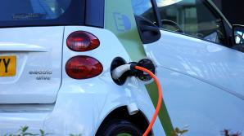
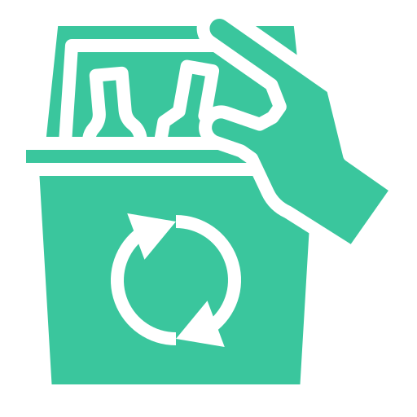
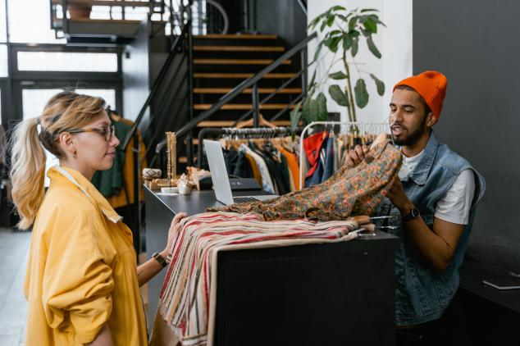
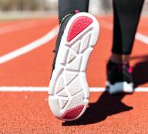
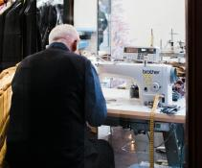
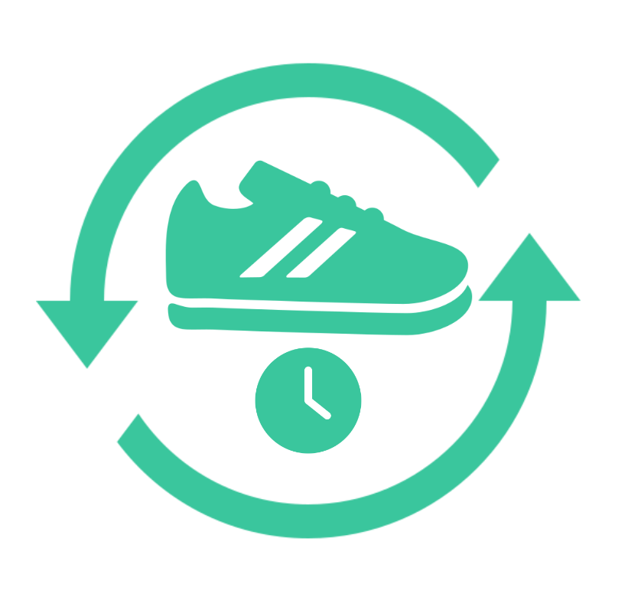
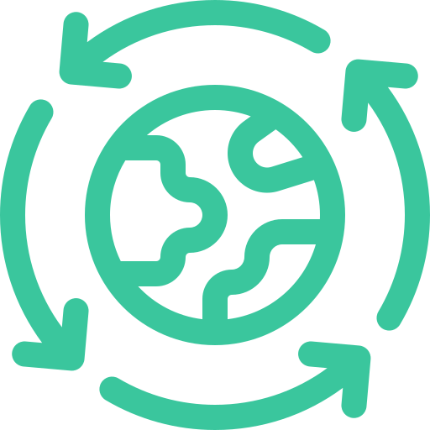
Five Business Models of Circularity
Sharing Platform: Ridesharing
Resource Recovery: Waste to energy
Product As A Service: Clothing rental
Circular Supplies: Shoes made from plastic
Product Life
Extension:
Takeback & repair service
Notes:
(Slide duration: 3min)
Ask students:
What are some real examples of each business model? Can you think of any companies practicing any of these circular principles?
Answers:
Circular Supplies:. Shoes made from fully recycled PET plastic.
Resource Recovery: Waste that cannot be recycled is diverted from the landfill to a waste to energy plant where it is processed into energy.
Product Life Extension: A company will repair your clothes or accept them as donations and those items are then repaired and sold again.
Sharing Platform: An online platform where homeowners can rent their homes to short term renters for a fee, allowing them to make money from unused living space and providing renters with alternatives to a hotel.
Product As A Service: Renting clothes gives customers the flexibility to affordably wear the fashion they want without having to buy the item and own it themselves.

Slide 10
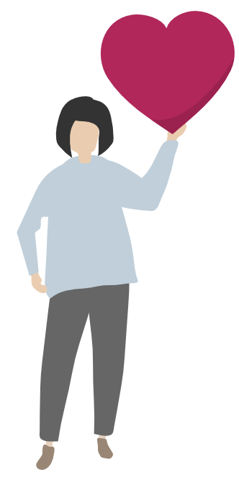
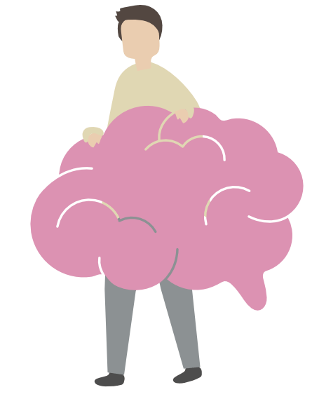
Emotional vs Functional
Functional benefits are based on a product attribute that provides the customer with functional utility.
Emotional benefits provide customers with a positive feeling when they purchase or use a particular brand.
Notes:
(Slide duration: 5min)
Tell students:
When designing a new product or service we need to understand the target audience. People buy and use products for a variety of reasons, and it is our job as designers to understand their problems and help resolve them. Their motivation to buy a product or use a service will fall into two aspects: emotional and functional. Identifying their needs and desires help shape the benefits we will create for them.
Emotional benefits provide customers with a positive feeling when they purchase or use a particular brand. They add richness and depth to the experience of owning and using the brand.
-Examples of emotional benefits include the “feel-good” factor when purchasing groceries carrying a fair-trade label or when donating to charities such as the Red Cross Foundation. Buying local has also started to carry emotional benefits, although most brands in these areas are niche brands that are currently not well known other than to their enthusiasts.
Functional benefits are based on a product attribute that provides the customer with functional utility. The goal is to select functional benefits that have the greatest impact with customers and support a strong position relative to competitors. However, it is important to keep in mind that functional benefits often fail to differentiate, can be easy to copy, and may reduce strategic flexibility.
-Examples of functional benefits include the computing capability of a smartphone, the thirst-quenching offered by a bottle of water, and the warmth of a wool sweater.

Slide 11
Design For Circularity
Design Thinking
Learn about
the audience.
Brainstorm and create solutions.
Test idea and gain user feedback.
Empathize
Define
Ideate
Prototype
Test
Sharpen key questions.
Build representations of one or more ideas.
Notes:
(Slide duration: 5min)
Tell students:
So how do we design new products and services for people? Innovative solutions help resolve customer pain points related to their emotional and functional needs. In creating these new solutions for customers, we can use a design process called “design thinking”.
Design thinking is a design methodology that provides a solution-based approach to solving problems. It is extremely useful in tackling complex problems by understanding the human needs involved, by re-framing the problem in human-centric ways, by creating many ideas in brainstorming sessions, and by adopting a hands-on approach in prototyping and testing.
The five stages:
Emphasize: This is the stage where we learn about our target audience. Who will use our product or service?
Define: Identify the key questions and problems you plan to address in your design process.
Ideate: With your target audience in mind, freely brainstorm your ideas to help solve their problems.
Prototype: Put together a minimum viable product you can test.
Test: Test your ideas and get feedback directly from the customers whose problems you are trying to solve.

Slide 12
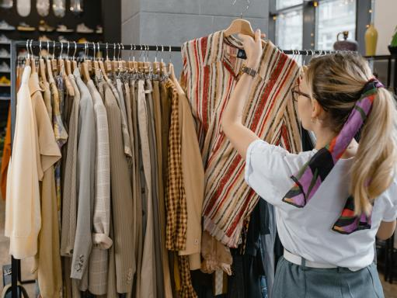
Product As A Service: Clothing rental
Notes:
(Slide duration: 5min)
Tell students:
Let us examine a circular business model of (clothing rental) and move through the 5 stages of the design thinking process to understand it a little better.
Example: Clothing rental
Nearly half of young people said they would like to be more eco-friendly in their approach to fashion, yet most said prices are a priority. Users in the United States typically buy at least one item per week from high-street fashion and spend $35. By combining a rental model at an accessible price point allows customers to spend less while preventing them from having a wardrobe filled with unused clothes. The service gives customers flexibility by allowing them to select multiple outfits and decide how long to keep them.
Ask students:
What are the emotional aspects and functional aspects of this service?
Answers:
People want to be more eco-friendly but also dress the way they want without spending too much money. A rental service allows them to gain access to the clothes they wish to wear without the price tag or having to buy more clothes they will use only a few times. This also reduces clutter in their wardrobe.

Slide 13
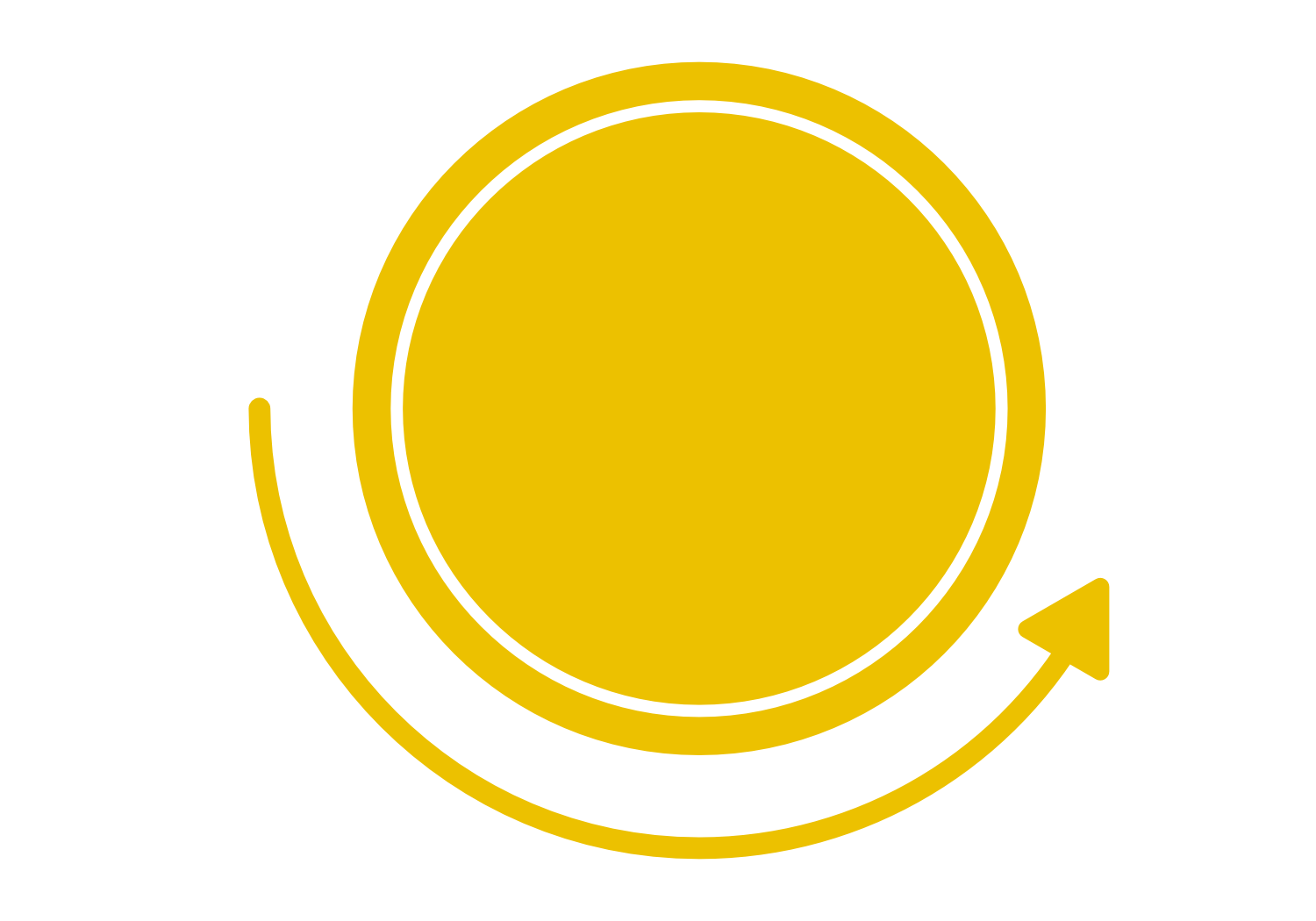
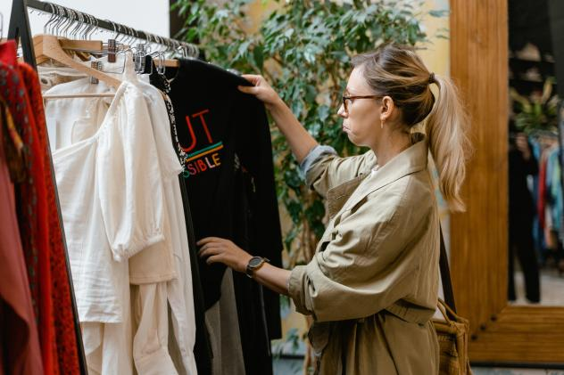
Learn about the audience for whom you are designing, by observation and interview.
Who is my user?
What matters to this person?
Empathize
Stage
Notes:
(Slide duration: 3min)
Tell students:
The first stage of the design thinking process is to gain an empathetic understanding of the problem you are trying to solve. This involves consulting experts to find out more about the area of concern through observing, engaging and empathizing with people to understand their experiences and motivations, as well as immersing yourself in the physical environment so you can gain a deeper personal understanding of the issues involved. Empathy is crucial to a human-centered design process such as design thinking, and empathy allows design thinkers to set aside their own assumptions about the world in order to gain insight into users and their needs.
Depending on time constraints, a substantial amount of information is gathered at this stage to use during the next stage and to develop the best possible understanding of the users, their needs, and the problems that underlie the development of that product.
Ask students:
For our clothing rental example, who would be the ideal customer and what is their motivation to use this service?
Answers:
They are motivated to save money and gain access to the clothes they want to wear that make them feel good. This type of customer also is cost sensitive and does not want to constantly spend a lot of money to buy new clothes and clutter their wardrobe.

Slide 14
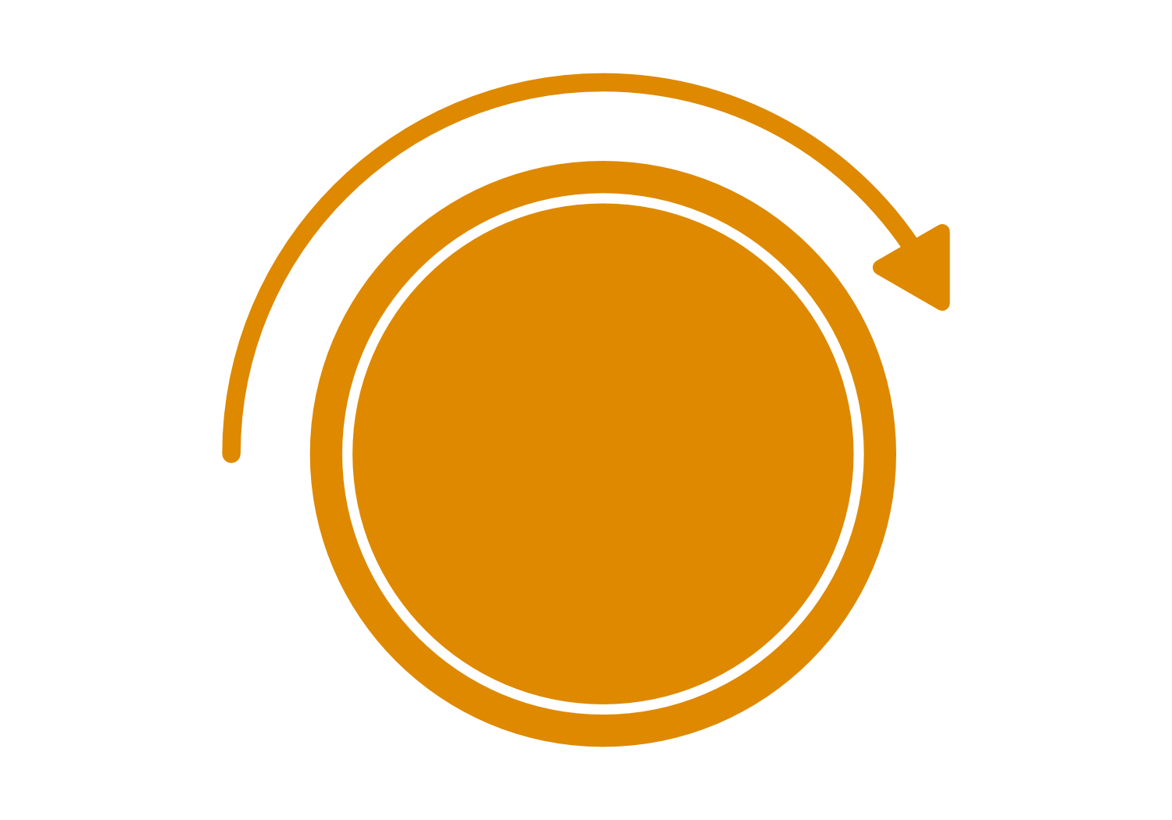
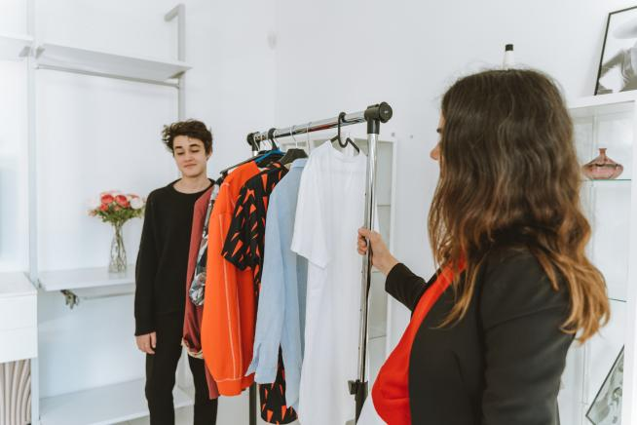
Create a point of view that is based on user needs and insights.
What are their needs?
Define
Stage
Notes:
(Slide duration: 3min)
Tell students:
In the Define stage you put together the information you have created and gathered during the Empathize stage. This is where you will analyze your observations and synthesize them in order to define the core problems that you and your team have identified up to this point. You should seek to define the problem as a single problem statement in a human-centered manner that is not too complicated.
The Define stage will help designers gather great ideas to establish features, functions, and any other elements that will allow them to solve the problems or, at the very least, allow users to resolve issues themselves with minimal difficulty. In the Define stage you will start to progress to the third stage, Ideate, by asking questions which can help you look for ideas for solutions by asking some guiding questions.
Ask students
What are their needs?
Answers:
Want access to trendy clothes on a budget without having to own them.

Slide 15
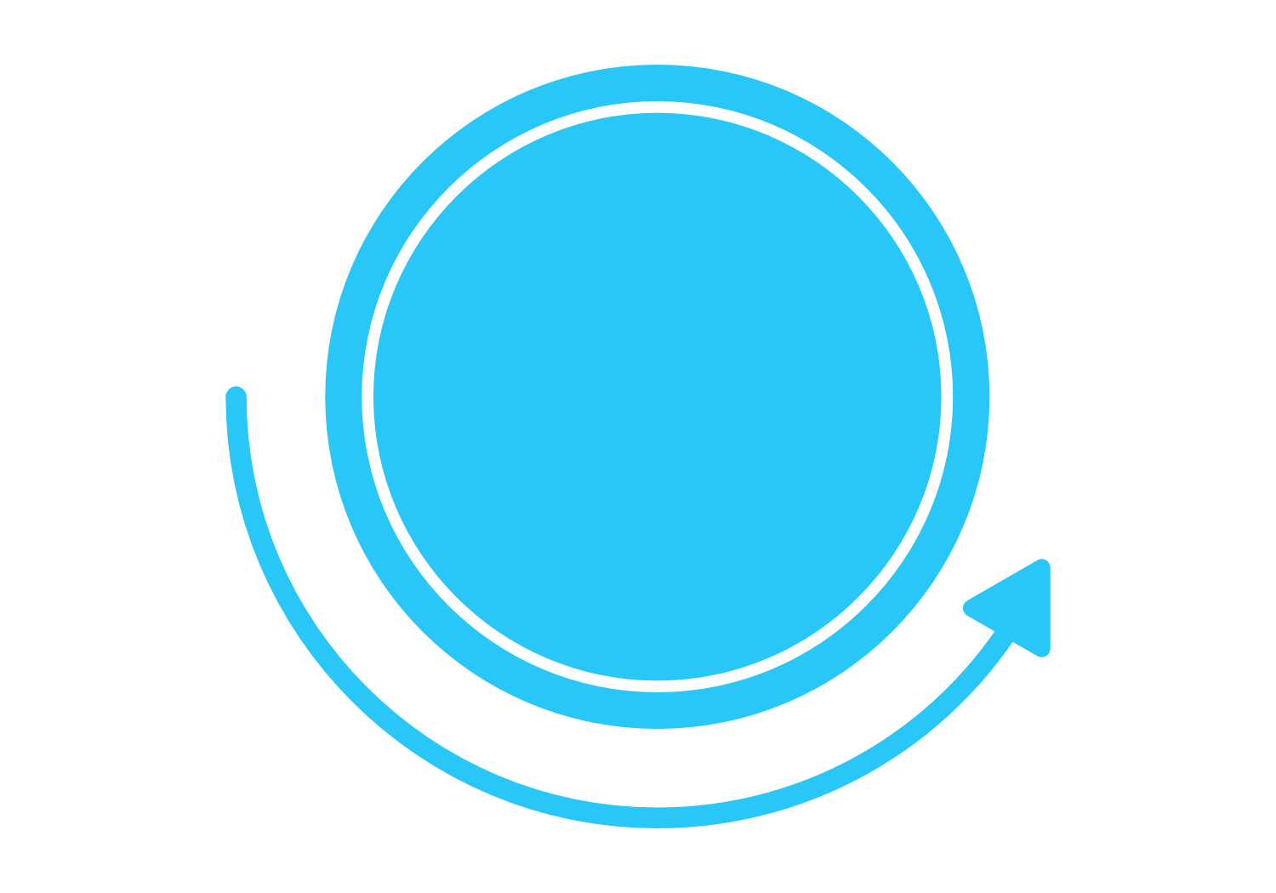
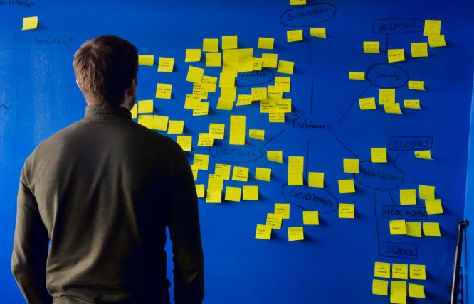
Brainstorm and come up with as many creative solutions as possible.
Wild ideas encouraged!
Ideate
Stage
Notes:
(Slide duration: 3min)
Tell students:
Now, you as designers are ready to start generating ideas. You have grown to understand your users and their needs in the Empathize stage, and you have analyzed and synthesized your observations in the Define stage and ended up with a human-centered problem statement. With this solid background, you and your team members can start to "think outside the box" to identify new solutions to the problem statement you have created, and you can start to look for alternative ways of viewing the problem.
It is important to get as many ideas or problem solutions as possible at the beginning of the Ideation phase. All ideas are good and will help get the brainstorm flowing. There are no bad ideas, and any one idea can lead to the winning idea.
It is helpful to do this with sticky notes on a posterboard.

Slide 16
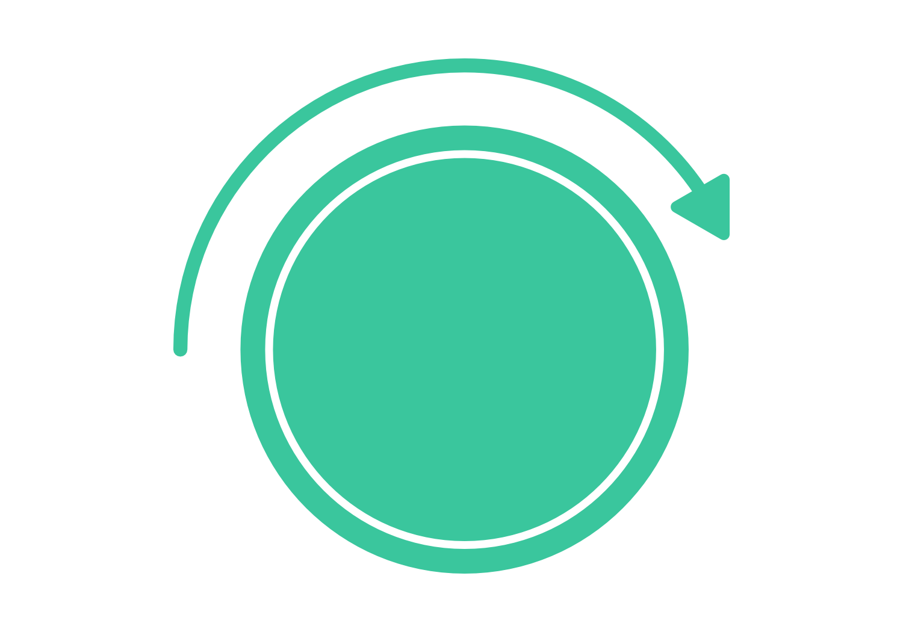
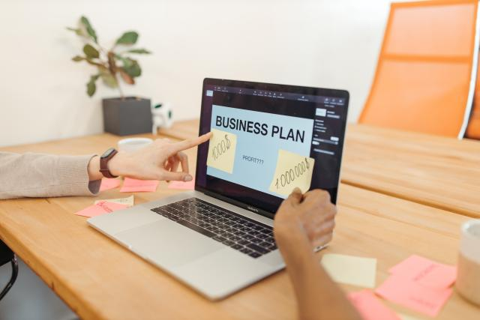
Build a representation of one or more of your ideas to show to others.
How can I show my idea?
Remember: A prototype is just a rough draft!
Prototype
Stage
Notes:
(Slide duration: 3min)
Tell students:
The design team will now produce a number of inexpensive, scaled down versions of the product or specific features found within the product, so they can investigate the problem solutions generated in the previous stage. Prototypes may be shared and tested within the team and with small groups of people outside the design team. For our exercise we can present these ideas to the class to get feedback.
This is an experimental phase and the aim is to identify the best possible solution for each of the problems identified during the first three stages. The solutions are implemented within the prototypes and, one by one, they are investigated and either accepted, improved and re-examined, or rejected on the basis of the users’ experiences. By the end of this stage, the design team will have a better idea of the constraints inherent to the product and the problems that are present and have a clearer view of how real users would behave, think, and feel when interacting with the end product.

Slide 17
Share your prototyped ideas with your original users for feedback.
What worked?
What did not?
Testing
Stage
Notes:
(Slide duration: 5min)
Tell students:
Designers or evaluators rigorously test the complete product using the best solutions identified during the prototyping phase. This is the final stage of the 5 stage-model, but it is an iterative process and the results generated during the testing phase are often used to redefine one or more problems and inform the understanding of the users, the conditions of use, how people think, behave, and feel, and to empathize. Even during this phase, alterations and refinements are made in order to rule out problem solutions and derive as deep an understanding of the product and its users as possible. This is where we really need to bridge the product/market fit.

Slide 18
Empathize
Stage
Ideate
Stage
Testing
Stage
Define
Stage
Prototype
Stage
Borrow clothes from friends to rent to other friends and charge a small fee
Budget conscious shopper
Does not want to clutter their wardrobe with unused items
Rent clothes to customers
Wears the latest fashion trends
Wants access to trendy clothes
Create a small offline clothes rental shop amongst friends and family
Sell cheap trendy clothes
Notes:
(Slide duration: 5min)
Tell students:
From our design thinking exercise, we were able to determine some key points at each stage of the design thinking process.
Ask students:
Can you add some more points to the blank sticky notes:
Answers:
Empathize: Has a cluttered wardrobe with too many clothes
Define: Does not want to own clothes for long periods of time
Ideate: Repair and resell program
Prototype: Create a micro shop out of your bedroom, on social media, or for as cheap as possible
Testing: Try to sell your prototype product or service to real potential customers and get real feedback

Slide 19
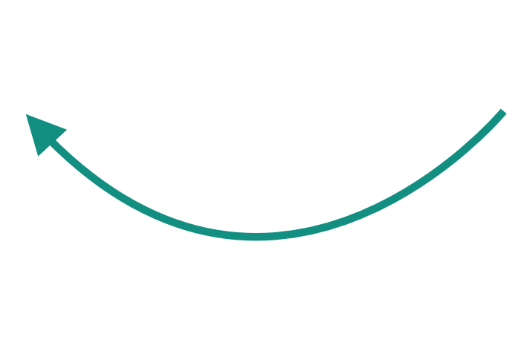
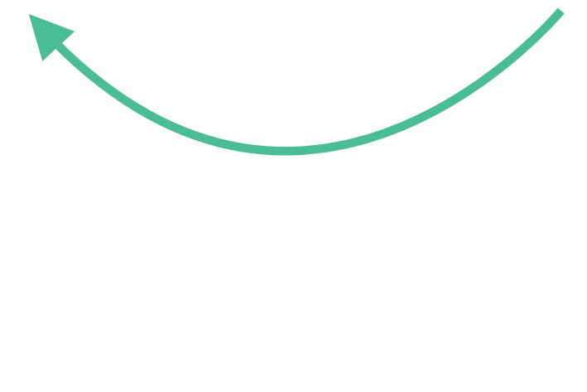
Clothing rental areas of circularity
Rent
Return
Repair
Repurpose
Notes:
(Slide duration: 3min)
Tell students:
Where along the lifecycle map has our clothing rental company created circularity?
Ask students:
What circular models are used with our clothing company?
Clothing owners repurpose their old clothes by selling or donating to the store and not disposing of them.
The store offers the clothes available for rent to customers.
After the customer is finished using the clothes, they return them to the store for the store to rent to another customer.

Slide 20
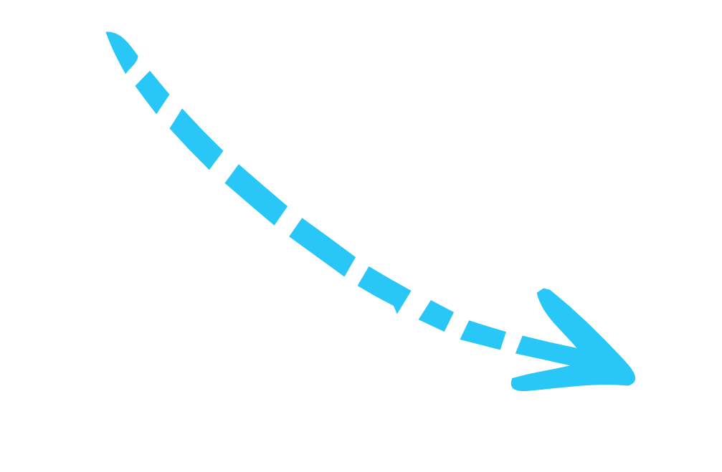
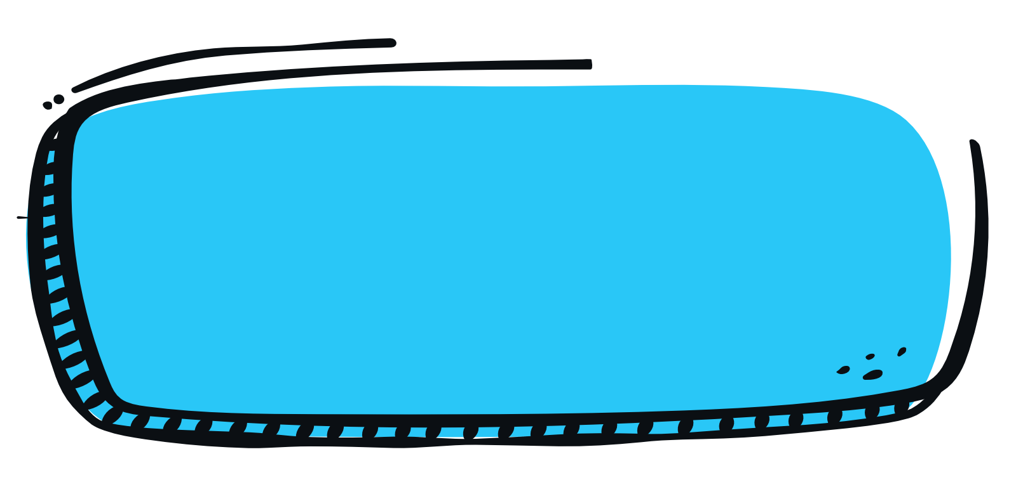
1
Split into groups of 3-5 and prepare a posterboard or use the design thinking handout.
3
Use the design thinking handout
to develop your circular solution
for the business.
Class Activity
4
Apply one or more circular design models to the business.
2
Pick one of the following businesses:
Washing machine company
Fashion textiles
Lighting manufacturer
Food delivery service
Grocery store
Office space
5
Share your ideas to redesign for the circular economy.
Notes:
Tell students:
For this exercise students will work in groups to redesign an existing business with a more circular solution. They will apply the design thinking process and use one of the circular design models to build a product or service solution for their business of choice. They will choose from one of the linear businesses and consider how to redesign it to be more circular.

Slide 21
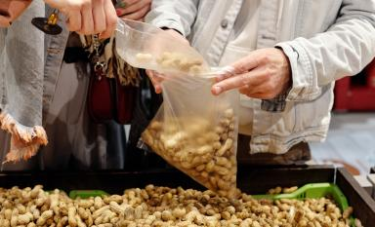
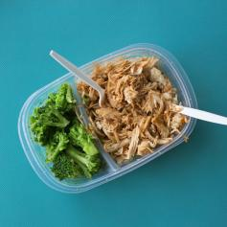
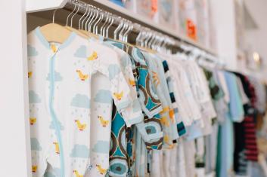
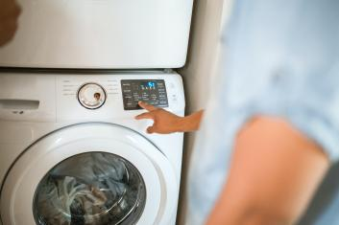
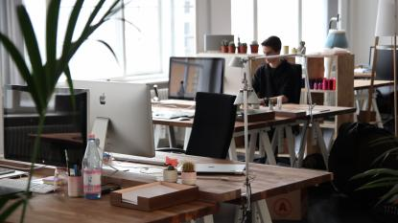
Choose a company to redesign for circularity
Notes:
Tell students:
Have students choose one of the following businesses that needs a circular solution. Explain the linear problem of each business.
-Washing machine company:
Problem: Heating the water and running the machines can consume enormous amounts of energy, and that means plenty of greenhouse gas emissions. Tiny fibers are shed from your clothes, bed sheets, or other garments every time you wash a load of laundry. Those particles often end up in our waterways.
Guiding question: Is there a better way to wash our clothes that is still convenient but does not create microfiber waste and uses less energy?
-Fashion textiles:
Problem: Some textile manufacturers use large amounts of water and dyeing chemicals that may be mismanaged and can end up in our waterways. Due to fashion trends and low prices, clothes are consumed at a much higher rate resulting in a lot of old, unused clothes that will eventually be thrown away and end up in a landfill.
Guiding question: Is there a better way we can still access the fashion of our choice at a cheap price without continuously having to buy new items? Is there a better way to consume clothes without needing to manufacture more through a wasteful and resource-intensive production process?
-Lighting manufacturer:
Problem: Lightbulbs are used for a set period of time requiring customers to buy new bulbs after each use. Also, bulbs cannot be recycled due to the metal wiring inside creating a lot of waste in landfills.
Guiding question: Is there a way we can access lighting without having to buy new lightbulbs that are not recyclable, and which result in more landfill waste?
-Food delivery service:
Problem: When you order food online it is delivered to your door and often served with a lot of single use packaging. Single use packaging makes it easy for the service to bring you food but creates a lot of waste that may not be recycled.
Guiding question: Is there a better way a company could deliver food to you without all the single use packaging?
-Grocery stores:
Problem: Stores sell produce, nuts, and seeds in single use packaging that make it easy to buy in the quantity of our choice. The packaging used for this kind of purchase at the grocery store is not recyclable and will likely end up as waste.
Guiding question: Is there a better way to sell items in bulk without the need for single use packaging?
-Office space:
Problem: Some business professionals need an office to work but rent can be very expensive and cost prohibitive. Even if they could afford the rent, they would still need to purchase a desk, office supplies, and pay the utility bills.
Guiding question: Is there a better way working professionals could access a flexible workspace with office amenities like presentation rooms, printing, and a kitchen, without having to pay high rents and committing to a lease over a long period of time?

Slide 22
Empathize
Stage
Ideate
Stage
Testing
Stage
Define
Stage
Prototype
Stage
Notes:
Tell students:
They will get a design thinking handout but, if possible, create the design thinking layout on a large posterboard and use sticky notes for this part of the exercise.

Slide 23
Circular Lifecycle Map
Notes:
Tell students:
Use the linear life cycle map to draw in the arrows of circularity you create with your proposed business model.

Slide 24
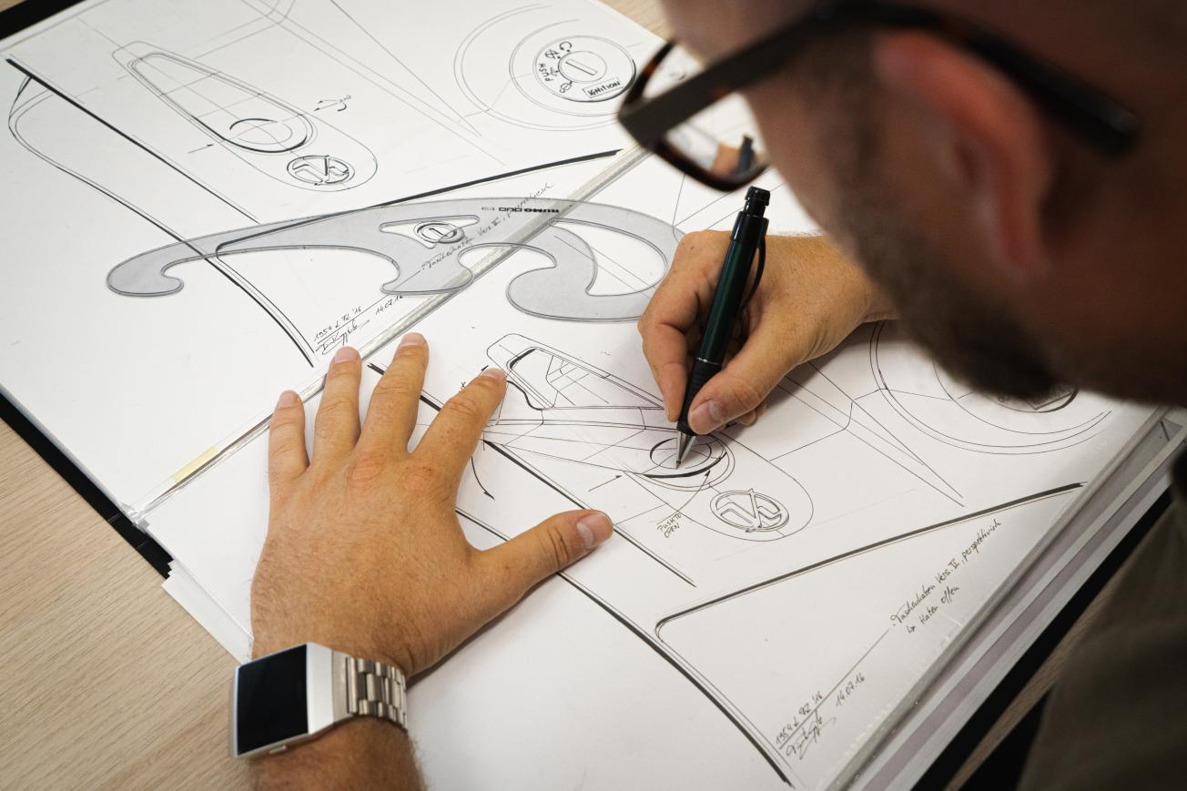
Notes:
Tell students:
Sketch your final circular business model idea on the Circular Solutions handout. Present your new business model to the class.

