Slide 1
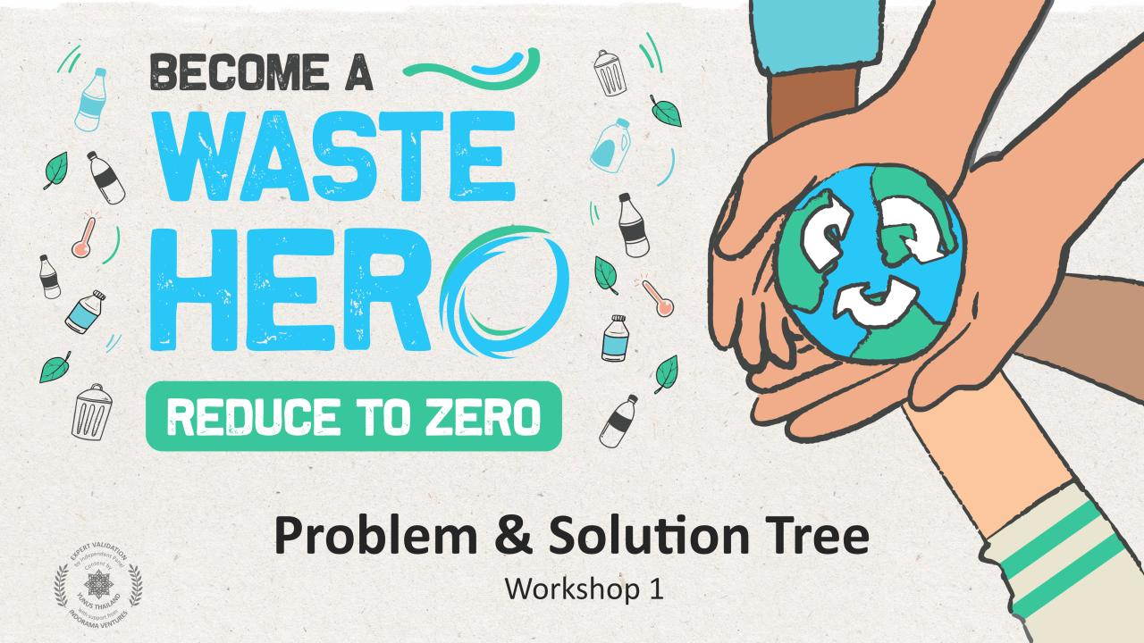

Slide 2
Workshop Prep & Objectives
Prep time: 10 – 15 minutes
The workshop aims to provide guidance on how to frame problems and solutions using practical and user-friendly tools to help solve complex and interconnected problems. The workshop will focus students on transformative thinking, teamwork and results oriented thinking through the utilization of mapping tools that help identify, define, and solve for the greater sustainability challenges of our time.
1
Display the lesson slides for the class and create a discussion about what they already know about how to solve complex problems and introduce the problem/solutions tree.
2
The workshop activity is best done on a large whiteboard or a posterboard using sticky notes that can easily be displayed for groups to work together in open discussion.
3
Follow the instructions in the lesson on how to create a problem/solutions tree from an aspect related to the ”Waste Challenge”. The slide notes at the bottom of each slide will have instructions on how to create the problem/solutions tree.

Slide 3
SDG & Curriculum Alignment
Prep time: 10 – 15 minutes
Key Learning Outcomes and Curriculum Alignment:
English Language Arts and Literacy: Participate in collaborative conversations with diverse partners about topics and texts. Follow agreed-upon rules for discussions. Use words and phrases acquired through conversations, reading and being read to, and responding to texts. Present information, findings, and supporting evidence clearly, concisely, and logically such that listeners can follow the line of reasoning.
Social Studies - People, Places, and Environments: The study of people, places, and environments enables us to understand the relationship between human populations and the physical world.
Science - Earth and Human Activity: Communicate solutions that will reduce the impact of humans on the land, water, air, and/or other living things in the local environment. Things that people do can affect the world around them. But they can make choices that reduce their impacts on the land, water, air, and other living things.
SDG Alignment

Slide 4
The Workshop
Workshop duration: 45 – 60 minutes
1
Split into groups of 3-5 and prepare a posterboard or whiteboard with sticky notes for the exercise.
2
Read the “Waste Challenge ” handout to use for the problem/solutions tree exercise. Students will decide on an aspect from the waste challenge scenario to work from (e.g., recycling, waste workers, collection and sorting, etc.).
3
Groups will map out the problem/solutions tree to examine the interrelated aspects of their problem, and the means and ends of a potential solution pathway.
4
When finished with the problem/solutions tree have the groups define their solutions pathway with a “solutions statement” they think will best solve the core problem. Have the groups present their findings to the rest of the class.
Flexible and adaptive lesson
Lesson plans are designed to be flexible and responsive to the evolving needs of your classroom. Lessons are editable and customizable to meet the different individual student and classroom contexts. A PowerPoint version with teacher instructions and a printable PDF lesson are available for download.

Slide 5
Prepare the PowerPoint presentation
When you are ready to present the lessons to your class click on Slide Show on the top menu bar then select Presenter View. In Presenter view, you can see your notes as you present while the audience see only your slides.
The notes appear in a pane on the right. The text should wrap automatically, and a vertical scroll bar appears if necessary. You can also change the size of the text in the Notes pane by using the two buttons at the lower left corner of the Notes pane.

Slide 6
Notes:
Tell students:
Problem solving is the process of using innovation and creative solutions to resolve societal, environmental, business, or technological problems. Sometimes, personal problems can lead to opportunities if validated in the market. The designer visualizes the prospect of filling the gap with an innovative solution that might entail the revision of a product or the creation of an entirely new product or service. Designers need the necessary tools to understand, analyze, visualize and communicate the problem. Understanding the problem is the key to coming up with the solution, which will in turn attract and retain investment, partners, and customers.

Slide 7
The Problem Tree
Effects
Problem
Causes
Notes:
(Slide duration: 5 minutes)
Tell students:
In order to begin thinking about finding solutions to problems we need to identify the negative aspects of an existing situation and deal with the present issues rather than apparent, future or past issues. It is often this first step that can help us find solutions, by analyzing and mapping out the relationships of causes and effects around a main problem or issue. This gives us the depth of understanding from which we can build successful solutions.
A Problem Tree can be defined as a visualization of the problems in the form of a diagram, or “hierarchy of problems”, to help analyze and clarify cause–effect relationships, or as a tree that provides an overview of all the known causes and effects to an identified problem. A problem tree analysis examines the negative aspects of an existing situation and establishes the cause-and-effect relationships between the identified problems.
The anatomy of the problem tree: The trunk of the tree is the core problem we are looking to solve. The roots of the tree are the causes of the core problem, and the branches and leaves of the tree are the effects of the core problem, which will more than likely lead to additional problems.

Slide 8
The Problem Tree
Animals harmed
Threat to ecosystems
Impacts on climate change
Impact on tourism and coastal economies
Humans can ingest waste
Unknown side effects of human consumption of waste
Effects
Ingestion, suffocation and entanglement of hundreds of land and marine species
Increase in waste leaking into the environment
Waste enters our food chain
Low rate of recycling
Problem
Mismanagement of waste at the source
Waste workers cannot collect and sort waste efficiently or meet the larger demand
Government does not fund recycling
Causes
People do not properly separate waste at home
Community lacks proper recycling bins
Fluctuating prices for recycling discourage collection, unstable income
Waste workers lack organization or support, inefficient
No formal Gov. recycling department
Lack of modern recycling infrastructure
Notes:
(Slide duration: 5-10 minutes)
Tell students:
Let’s see how to use the problem tree using a real problem scenario: Low rate of recycling
*It is helpful to do the problem tree exercise in a group on a large posterboard or on a whiteboard using sticky notes to allow ideas to be displayed for everyone to discuss, modify or rearrange as the problem analysis process evolves.
Example:
Have a look at the cause-and-effect pathway highlighted in red. Start at the bottom and move up through the tree making a statement about the causes and effects of the problem of low rate of recycling.
Pathway 1 (In red): Fluctuating prices for recycling discourage collection by waste workers who cannot efficiently operate and service the large supply of waste. This causes and increase in waste not being collected and leaked into the environment that ultimately has a negative impact on climate change.
Each “cause” indicated at the bottom of the tree feeds into another effect that causes the problem of ”low rate of recycling”. The effects indicated above the problem statement cause subsequent effects and so on. This can continue until no other cause or effect can be identified within the scope of the main problem.

Slide 9
The Problem Tree
Animals harmed
Threat to ecosystems
Impacts on climate change
Impact on tourism and coastal economies
Humans can ingest waste
Unknown side effects of human consumption of waste
Effects
Ingestion, suffocation and entanglement of hundreds of land and marine species
Increase in waste leaking into the environment
Waste enters our food chain
Low rate of recycling
Problem
Mismanagement of waste at the source
Waste workers cannot collect and sort waste efficiently or meet the larger demand
Government does not fund recycling
Causes
People do not properly separate waste at home
Community lacks proper recycling bins
Fluctuating prices for recycling discourage collection, unstable income
Waste workers lack organization or support, inefficient
No formal Gov. recycling department
Lack of modern recycling infrastructure
Notes:
(Slide duration: 5-10 minutes)
Tell students:
The first step is to discuss and agree on the problem or issue to be analyzed. The more specific the problem is, the more useful the exercise will be. However, the process does also help you make everything more detailed as well. The core problem is written in the center of the map and becomes the 'trunk' of the tree. The wording does not need to be exact as the roots and branches will further define it, but it should describe an actual issue that everyone feels passionate about.
Core problem is defined: Low rate of recycling

Slide 10
The Problem Tree
Animals harmed
Threat to ecosystems
Impacts on climate change
Impact on tourism and coastal economies
Humans can ingest waste
Unknown side effects of human consumption of waste
Effects
Ingestion, suffocation and entanglement of hundreds of land and marine species
Increase in waste leaking into the environment
Waste enters our food chain
Low rate of recycling
Problem
Mismanagement of waste at the source
Waste workers cannot collect and sort waste efficiently or meet the larger demand
Government does not fund recycling
Causes
People do not properly separate waste at home
Community lacks proper recycling bins
Fluctuating prices for recycling discourage collection, unstable income
Waste workers lack organization or support, inefficient
No formal Gov. recycling department
Lack of modern recycling infrastructure
Notes:
(Slide duration: 5-10 minutes)
Tell students:
Next, a group identifies the causes of the core problem we just defined - these become the roots of our tree.
What are the main contributors to our core problem?
And what are the causes of those main contributors that lead to our core problem?
The heart of the exercise is the discussion, debate and dialogue that is generated as factors are arranged and re-arranged, often forming sub-dividing roots into more specific causes of the causes of our core problem. Take time to allow others to explain their feelings and reasoning and record related ideas and points that come up on separate paper under titles such as solutions, concerns and decisions.
Examples:
People do not properly separate waste at home which results in the mismanagement of waste at the source and leads to a low rate of recycling.
Waste workers lack organization and support meaning waste workers cannot collect and sort waste efficiently resulting in a low rate of recycling.

Slide 11
The Problem Tree
Animals harmed
Threat to ecosystems
Impacts on climate change
Impact on tourism and coastal economies
Humans can ingest waste
Unknown side effects of human consumption of waste
Effects
Ingestion, suffocation and entanglement of hundreds of land and marine species
Increase in waste leaking into the environment
Waste enters our food chain
Low rate of recycling
Problem
Mismanagement of waste at the source
Waste workers cannot collect and sort waste efficiently or meet the larger demand
Government does not fund recycling
Causes
People do not properly separate waste at home
Community lacks proper recycling bins
Fluctuating prices for recycling discourage collection, unstable income
Waste workers lack organization or support, inefficient
No formal Gov. recycling department
Lack of modern recycling infrastructure
Notes:
(Slide duration: 5-10 minutes)
Tell students:
Once the causes of the core problem are determined, the next step is to identify the effects of the problem, which are the branches of the problem tree.
What are the effects of our core problem?
What are the impacts of those immediate effects, as a result of our core problem?
Example:
1. A low rate of recycling can increase the amount of waste that leaks into the environment, which can enter the food chain and then result in humans ingesting waste.

Slide 12
Solution Tree
Reduced impacts on climate change
Ends
Decrease in waste leaking into the environment
Solution
Increased rate of recycling
Waste is properly managed at the source
Means
People properly separate waste at home
Notes:
(Slide duration: 5 minutes)
Tell students:
A Solutions Tree (aka Objective Tree) is a problem tree that is transformed into a set of future solutions to the problems. Each negative statement is converted into a solution by rewriting it as a positive future statement. The positive statements are in fact solution statements that can be presented in the map showing a means (the roots) – ends (branches) solutions hierarchy. The analysis of the solution tree aims to provide a clear overview of the desired future situation once problems have been identified and reformulated into solutions. The map helps us illustrate and communicate the means-ends relationship.
Our Problem Example as a Solution:
From the previous slide one major cause of our problem is that people don’t properly separate waste at home. Click 1: People properly separate waste at home.
From the previous slide people not separating waste resulted in waste being mismanaged at the source. Click 2: Waste is properly managed at the source.
Our problem was low rate of recycling. Click 3: Our solution is now increased rate of recycling.
From the previous slide one major effect of our problem was an increase in waste leaking into the environment. Click 4: A decrease in waste leaking into the environment.
From the previous slide there is an increased impact of climate change. Click 5: Reduced impact on climate change.

Slide 13
1.
Choose an aspect from the “waste challenge” scenario
2.
Create a problem tree and define the core problem
Effect
Negative Statements
Causes
Select a preferred intervention and create a final Problem & Solutions Statement
3.
Create a solutions tree and define the solution
4.
Ends
Positive
Statements
Means
Notes:
Tell students:
For the group activity follow the next steps:
Step 1 Choose an aspect from the “waste challenge” scenario to analyze for the problem/solution tree exercise.
Step 2 Create a problem tree with a negative problem statement defining the core issue.
Step 3 Create a solutions tree with a positive statement defining the solution path to the core problem identified in Step 2.
Step 4 Select your preferred intervention to solve the problem and create a final Problem & Solutions Statement.

