Slide 1
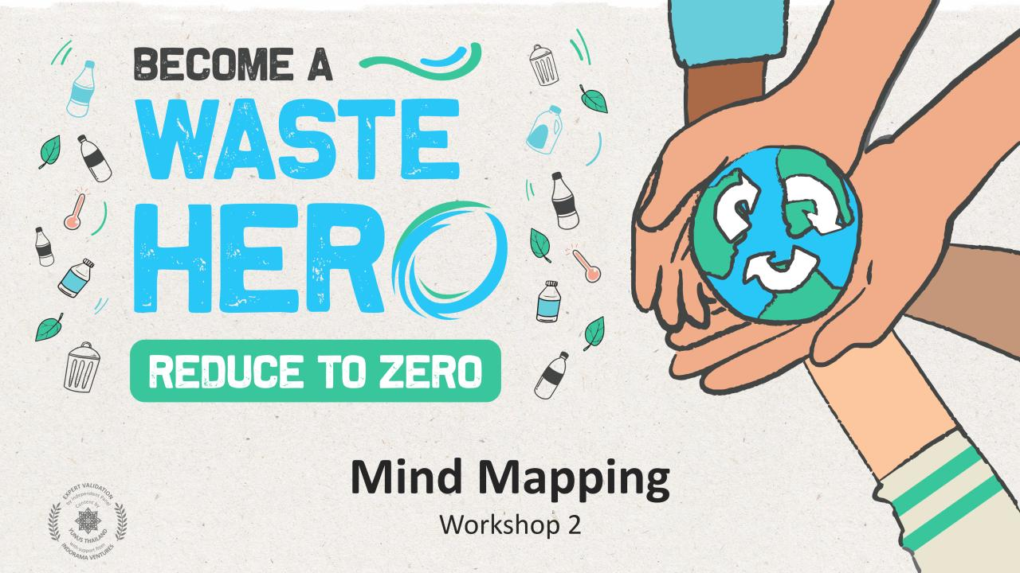

Slide 2
Workshop Prep & Objectives
Prep time: 10 – 15 minutes
The workshop aims to explore how teams can use mapping tools to identify key opportunities or solution pathways to problems, and visualize the complexity and interconnectedness of them. Students will learn how to utilize decision making tools like “down selection” to weigh the value of an idea against another, and to identify and select the best solutions pathway for a problem.
1
Display the lesson slides for the class and create a discussion about what they already know about mind maps and introduce “down selection” as a decision-making tool.
2
The workshop activity is best done on a large whiteboard or a posterboard using sticky notes that can easily be displayed for groups to work together in open discussion.
3
Follow the instructions in the lesson on how to create a mind map and how to decide on a winning idea. The slide notes at the bottom of each slide will have instructions on how to do each step.

Slide 3
SDG & Curriculum Alignment
Prep time: 10 – 15 minutes
Key Learning Outcomes and Curriculum Alignment:
Science - Earth and Human Activity: Communicate solutions that will reduce the impact of humans on the land, water, air, and/or other living things in the local environment. Things that people do can affect the world around them. But they can make choices that reduce their impacts on the land, water, air, and other living things.
English Language Arts and Literacy: Participate in collaborative conversations with diverse partners about topics and texts. Follow agreed-upon rules for discussions. Use words and phrases acquired through conversations, reading and being read to, and responding to texts. Present information, findings, and supporting evidence clearly, concisely, and logically such that listeners can follow the line of reasoning.
Social Studies - People, Places, and Environments: The study of people, places, and environments enables us to understand the relationship between human populations and the physical world.
SDG Alignment
Flexible and adaptive lesson
Lesson plans are designed to be flexible and responsive to the evolving needs of your classroom. Lessons are editable and customizable to meet the different individual student and classroom contexts. A PowerPoint version with teacher instructions and a printable PDF lesson are available for download.

Slide 4
The Workshop
Lesson duration: 45 – 60 minutes
1
Split into groups of 3-5 and prepare a posterboard or whiteboard with sticky notes for the exercise.
2
Read the “Waste Challenge ” handout and select a problem aspect for the mind mapping exercise or continue with the topic from Workshop 1 (recycling, waste workers, collection and sorting, etc.).
3
Groups will create a mind map to examine the interrelated aspects of the problem they are looking to solve, and all potential ideas for solution pathways.
4
When finished with the mind map, groups will write their solution ideas on sticky notes and work through a selection exercise to weigh the value of ideas against another, and to identify and select the best solution pathway for a problem. Have the groups present their findings to the rest of the workshop.

Slide 5
Prepare the PowerPoint presentation
When you are ready to present the lessons to your class click on Slide Show on the top menu bar then select Presenter View. In Presenter view, you can see your notes as you present while the audience see only your slides.
The notes appear in a pane on the right. The text should wrap automatically, and a vertical scroll bar appears if necessary. You can also change the size of the text in the Notes pane by using the two buttons at the lower left corner of the Notes pane.

Slide 6
Notes:
(Slide duration: 3 minutes)
Tell students:
Once we have determined the problem we are looking to solve and the potential solution, it is time to ideate all the possible business opportunities we can think of that can achieve the best solution pathway to solve the problem.
Groups will bring to the table as many ideas as possible, there are no wrong answers. While brainstorming ideas, it is not checked whether the idea is possible, feasible, and viable or not. The only task of thinkers is to think of as many ideas as possible.
In this process, groups will resort to the use of posterboards, sticky notes, sketching, chart papers, etc. We will take a look at mind maps and a few scoring tools to help down select our ideas to finally choose the best one to prototype after this process. Groups will also build on the ideas of others, and all solutions suggested by one are brought to the table and thought over. Let's examine the mind map and how to use this tool to generate some business ideas.

Slide 7
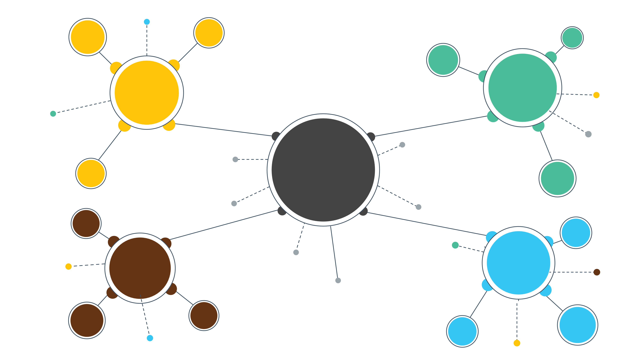
What is a mind map?
Second
Idea
First
Idea
MINDMAP
Third
Idea
Fourth
Idea
Notes:
(Slide duration: 3 minutes)
Tell students:
A mind map is a diagram that helps to observe and study information in a visual manner to organize thoughts, generate new ideas, and improve creativity. A mind map is created around a single statement of focus, generally a problem or desired outcome, and all the ideas to solve the problem or achieve the outcome are written around it. The desired outcome statement is usually written at the center of a blank page as a hub, and branches shoot out in all directions representing potential solutions.

Slide 8
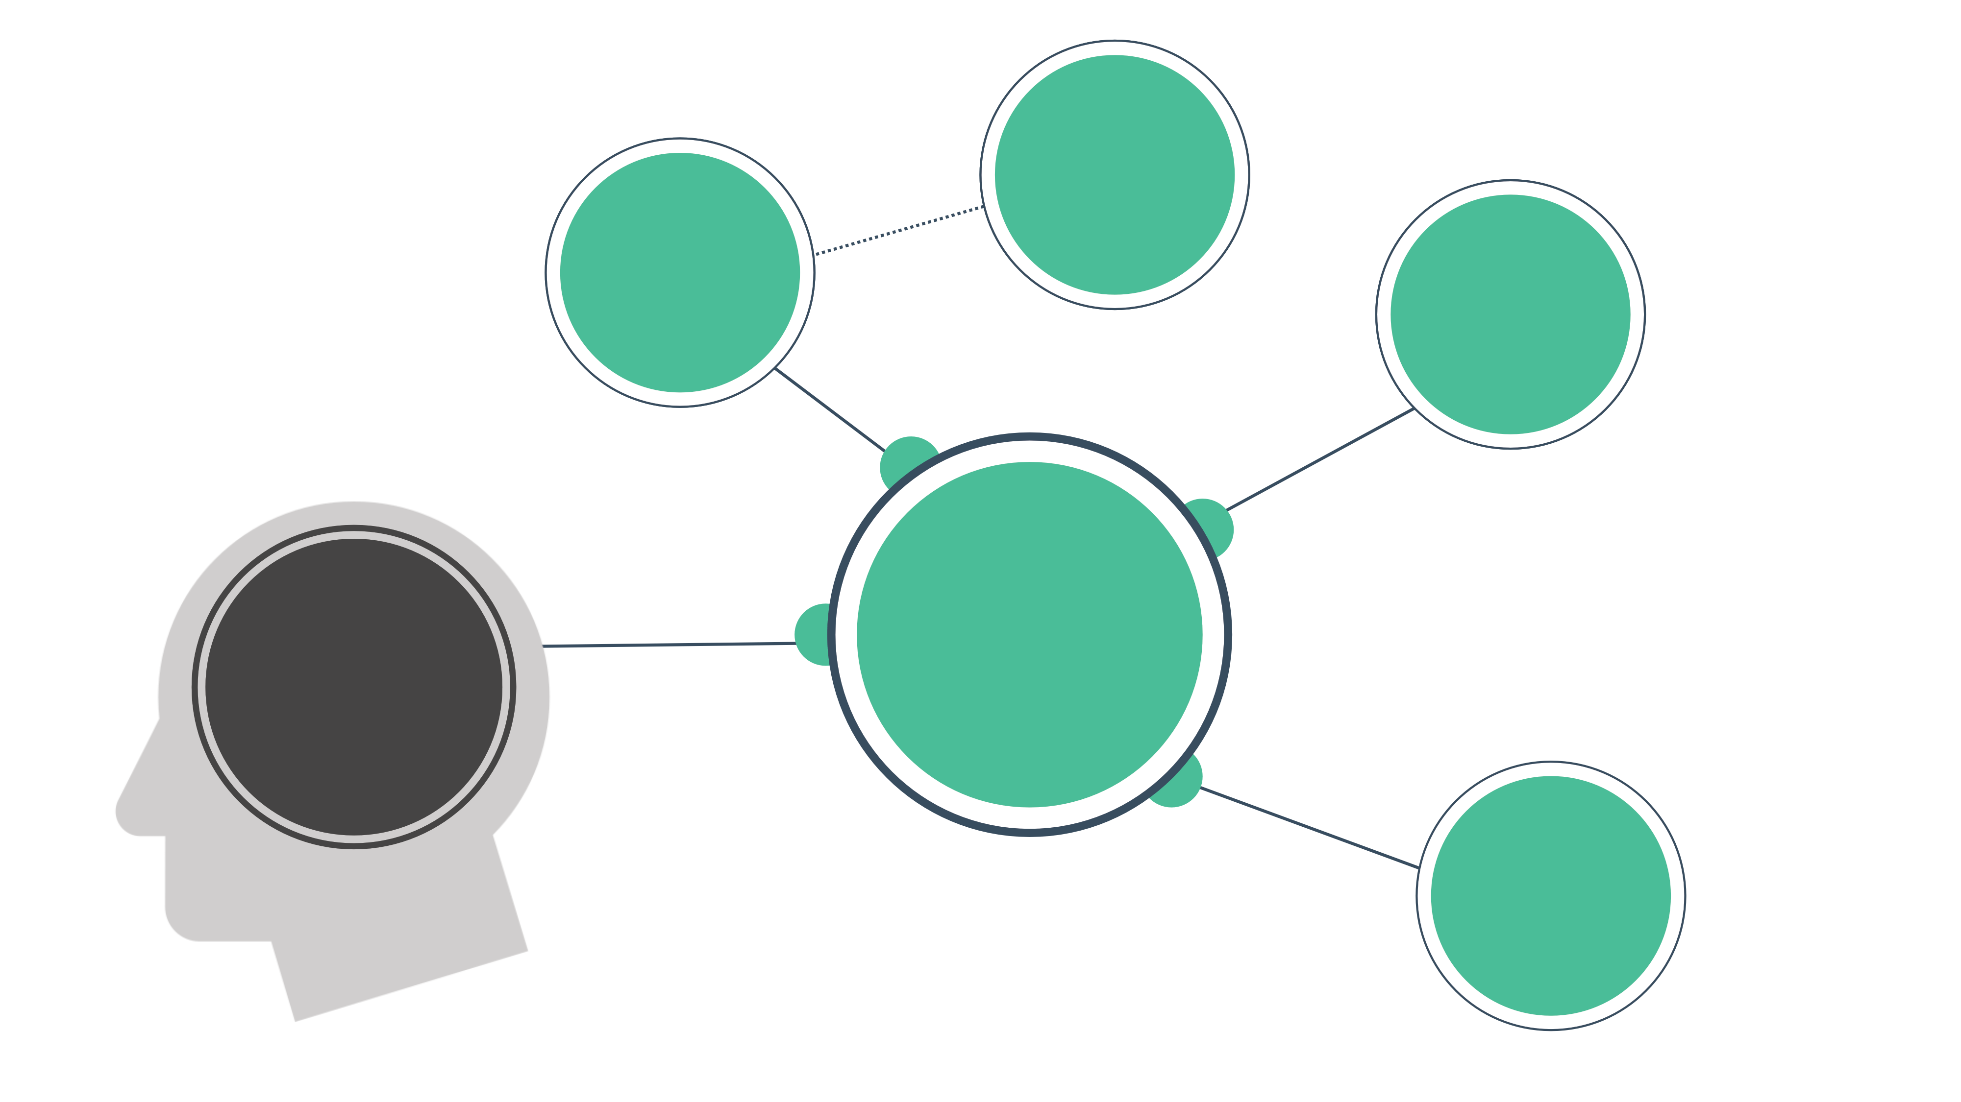
Create a new waste bin that makes separating at home easy
Easy way for households to separate organic waste
Create a collection and sorting business
Better collection
and sorting at the source
Increase rate of recycling
Create an Uber-style “waste” app so people can request waste pickup
Notes:
(Slide duration: 5 minutes)
Tell students:
First determine the main purpose of your mind map and write it down in the middle. Since mind maps start from the inside and expand outward, your central idea will become the core topic of the diagram.
Your main concept could be:
-A problem you are trying to work through
-The project you are brainstorming
-A difficult concept that you are trying to learn
For our example we are addressing the issue of the low rate of recycling. One solution we identified in our problem/solution tree exercise is that to increase recycling rates we need better collection and sorting of waste at the source. What business opportunities are there for better collecting and sorting of waste at the source?
We could create a new kind of waste bin that makes it easier to sort waste such as organic and recyclable items, therefore making it easier for the correct items to be collected and recycled, resulting in an increase rate of recycling.

Slide 9
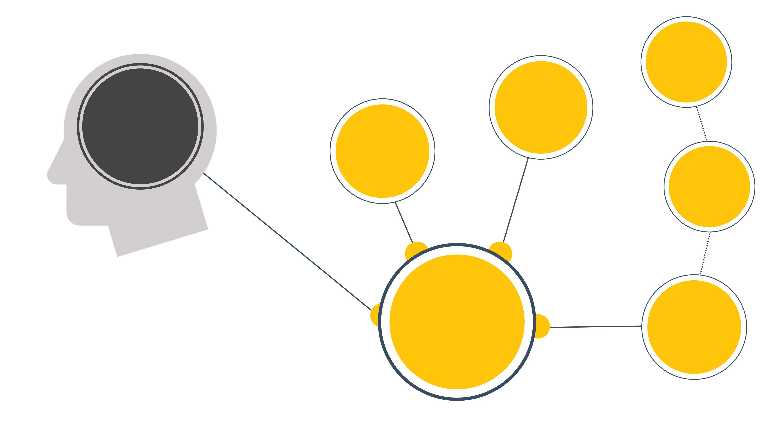
Motivated to work
Uber style “waste” app works directly with informal waste workers
Increase rate of recycling
Create an informal waste worker Co-Op
Pay a fair wage and incentivize collection
Empower informal waste workers
Hire as employees
Notes:
(Slide duration: 5 minutes)
Tell students:
Next, we know that empowering informal waste workers will help increase their working capacity to collect and sort recyclables more efficiently, resulting in an increase in the rate of recycling. What business opportunities are there to empower the informal waste sector?
We could help them organize into a cooperative to help make them operate more efficiently in teams. We could start an Uber style “waste” app where people can request a waste worker to come and pick up their recyclables. Another option would be to form a company and hire the informal workers paying them a fair wage with an incentive to collect and sort more waste, which in turn will result in an increased rate of recycling.

Slide 10
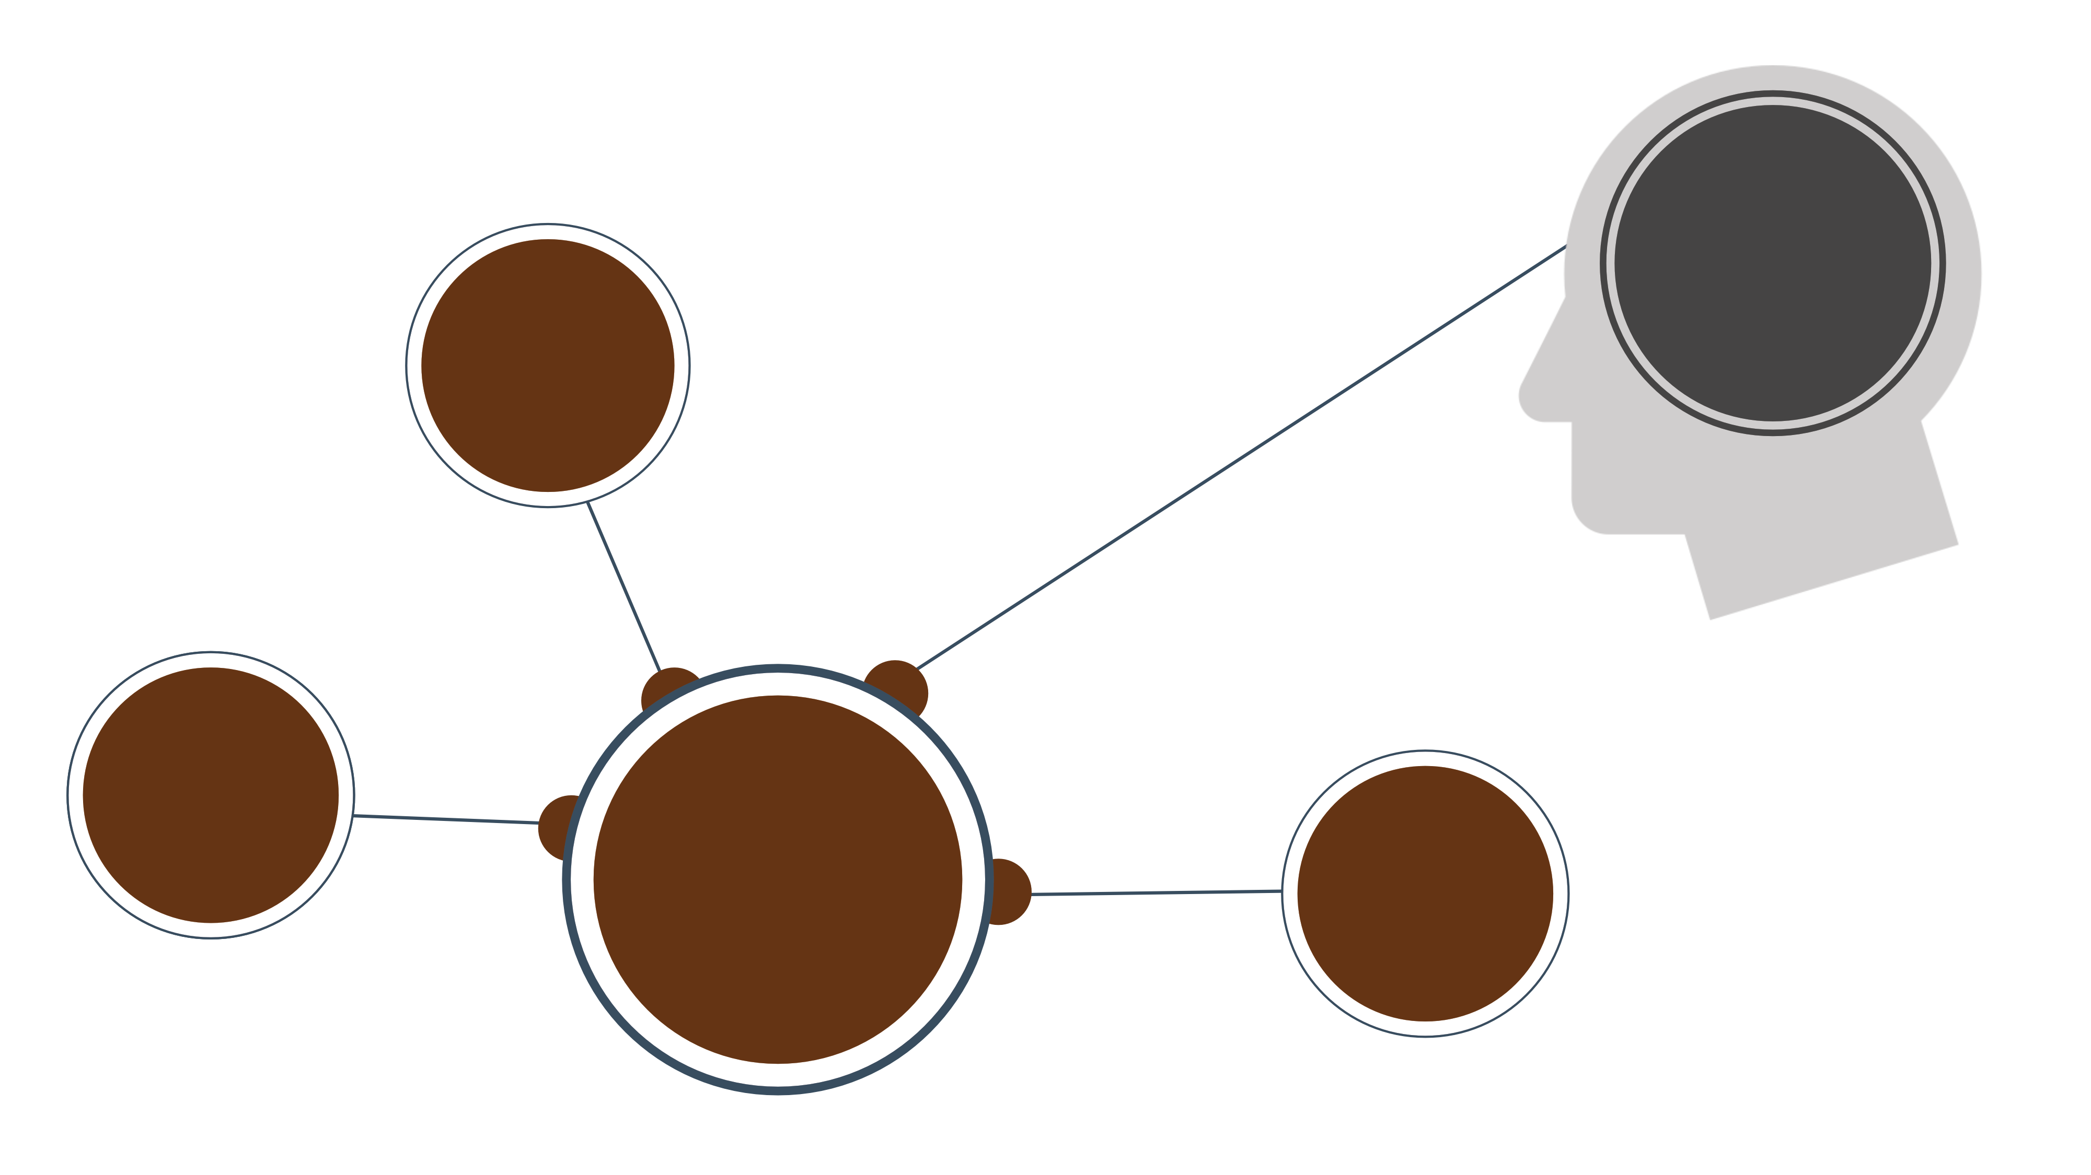
Increase rate of recycling
Create a business processing low grade plastic into products
Make cement using low grade multilayered packaging
Add value to low grade recyclables
Certified Fair-Trade plastics – ethically sourced
Notes:
(Slide duration: 5 minutes)
Tell students:
Next, we identified that adding value to low grade recyclables, items that typically would not be picked up due to their low resell value, is a way to increase the amount collected and sorted, resulting in an increase rate of recycling.
Multilayered packaging can be broken down and used in the processing of cement creating entirely new products like concrete blocks for construction. This adds value to otherwise non-recyclable items, therefore incentivizing collection for a wider array of items, resulting in an increased rate of recycling.

Slide 11
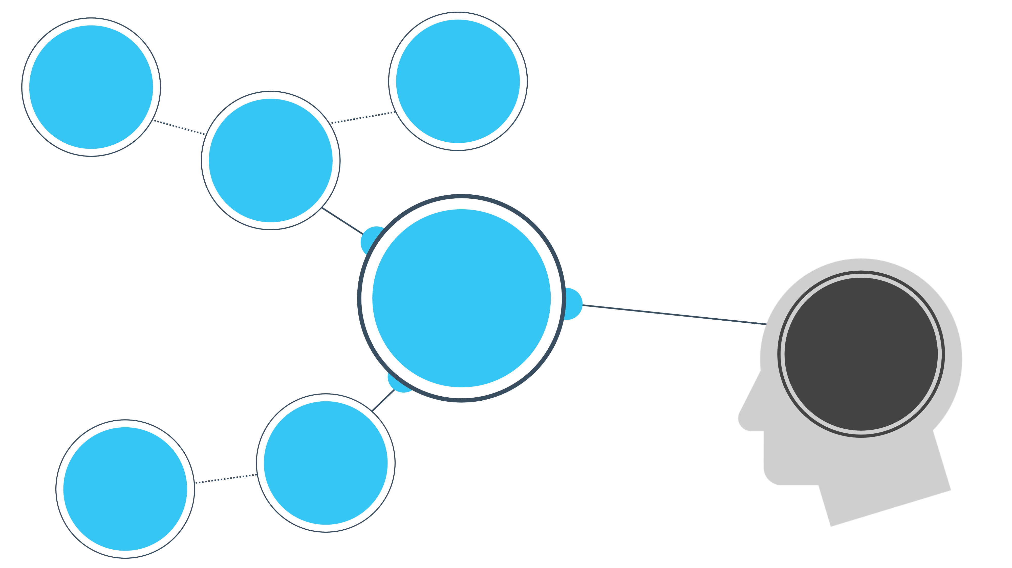
Hire
truck drivers
Uber style “waste” app
Smart
Fleet
Innovative
recycling
technology
Increase rate of recycling
Digital Tracking
Technology
Track and Trace
recyclables
Notes:
(Slide duration: 5 minutes)
Tell students:
We also identified that innovative recycling technology can help with recycling capacity and efficiency. Digital tracking technology could be used to track and trace recyclable materials and products to help improve the efficiency of its collection and sorting, help verify if it has been ethically sourced or not providing additional opportunities for value creation, which may result in an increase rate in recycling.

Slide 12
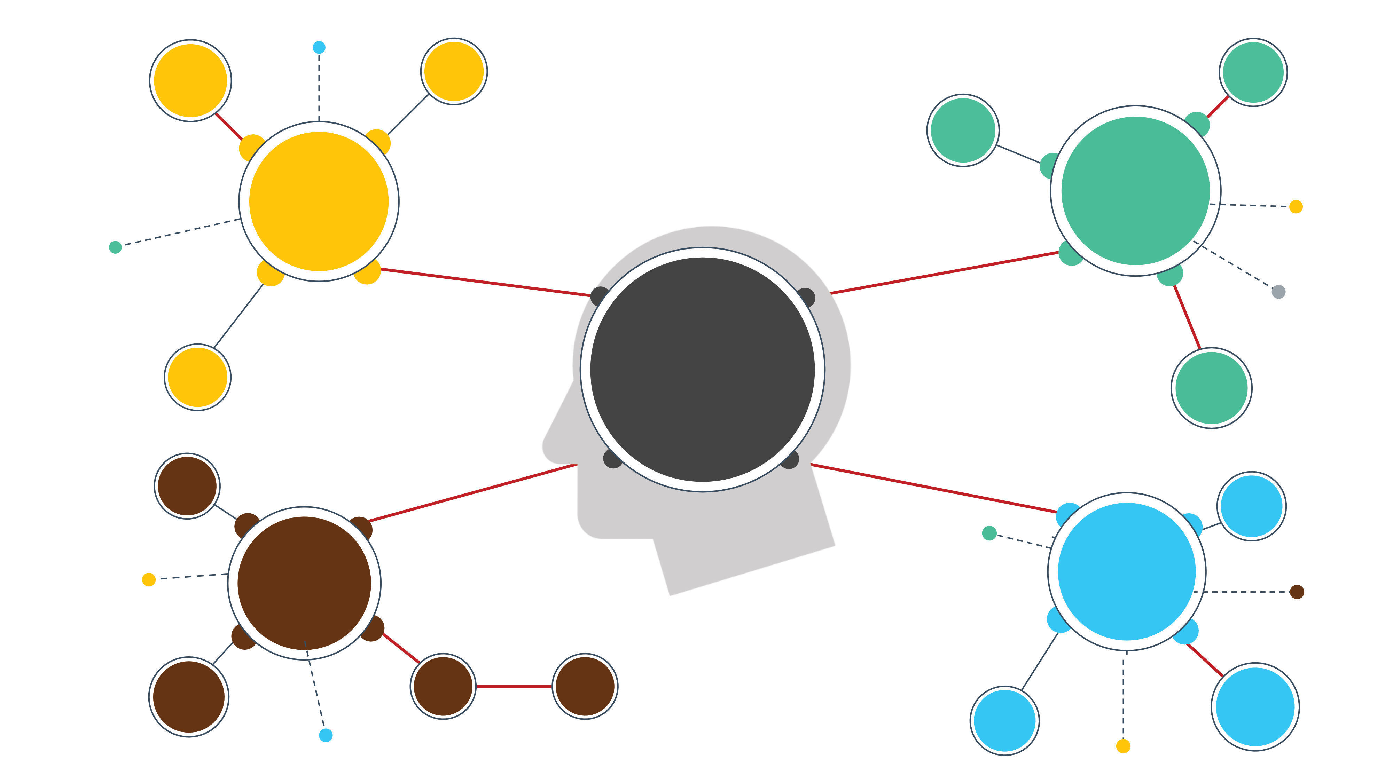
Idea 2
Idea 1
Idea 3
Idea 5
Idea 6
Idea 4
Notes:
(Slide duration: 3 minutes)
Tell students:
The final step in our mind map exercise is to identify the business opportunity ideas and to write them down on sticky notes.

Slide 13
Down Selection Exercise
IDEA #1
IDEA #2
IDEA #3
Notes:
(Slide duration: 3 minutes)
Tell students:
Now each group will take all the ideas from the mind map and will go through a “down selecting” exercise to choose the best ideas, ultimately selecting one final idea for their business. Take all the sticky notes with the individual ideas written on them from the previous step and stick them on a whiteboard or posterboard for everyone to see. Groups will give each idea a score so leave room at the bottom of the sticky note for the score.

Slide 14
Rate 1-5
IDEA #1
Total Score: 12
D=4 F=3 V=5
Desirability Feasibility Viability
Notes:
(Slide duration: 3 minutes)
Tell students:
Give each idea a score from 1 to 5, 1 being low and 5 being high, in the following areas: Desirability, Feasibility, and Viability.
Use the guiding questions to help determine your scoring for each aspect of your idea.
Desirability: Do people want this? Does it fill a need? Is it appealing? Can it fit into people’s lives?
Feasibility: Can we do it? Is the technology needed within reach? Can the organization make it happen?
Viability: Should we do this? Does it align with our goals? Can we develop, fund, and sustain this?

Slide 15
Choose the highest score
IDEA #1
IDEA #2
IDEA #3
Total Score: 12
Total Score: 10
Total Score: 7
D=4 F=3 V=5
D=3 F=2 V=5
D=3 F=2 V=2
Notes:
(Slide duration: 3 minutes)
Tell students:
Total the scores for each idea and select the idea with the highest score.

Slide 16
Win Zone
IDEA #1
IDEA #2
1 2 3 4 5
Is it worthwhile?
(Impact Score)
IDEA #3
1 2 3 4 5
Is it real? + is it a win?
(Capability + Motivation Score)
Notes:
(Slide duration: 3 minutes)
Tell students:
If there is still a debate in your group about which idea is best, try one additional scoring tool for further analysis.
Give each idea a score of 1 to 5, where 1 is low and 5 is high, in the following two areas:
Is it a win? Should we do this? Do we have the capabilities?
Is it worthwhile? Is it creating the impact we want?
Next plot the “worthwhile” (aka impact) score vs. the “real + win” score on a graph. Choose the idea that is in the upper right quadrant of the chart.

Slide 17
1.
Choose an aspect from the “waste challenge” scenario
2.
Create a mind map to visualize potential solution pathways
3.
Identify the key ideas in the mind map and write them all down on sticky notes
4.
Work through a ”down selection” exercise to choose the best solution
Win Zone
IDEA #1
IDEA #2
IDEA #3
Notes:
Tell students:
For the group activity follow the next steps:
Step 1 Choose an aspect from the “waste challenge” scenario to analyze for the mind mapping exercise, or continue with the aspect used in Workshop 1
Step 2 Create a mind map to visualize potential solution pathways
Step 3 Identify the key ideas in the mind map and write them all down on sticky notes
Step 4 Work through a ”down selection” exercise to choose the best solution

