Slide 1
Solving for the SDGs

Slide 2
Workshop Prep & Objectives
Prep time: 10 – 15 minutes
The workshop aims to analyze the indivisible whole of the United Nations Sustainable Development Goals, understand the nature of the interlinkages, and then provide practical and user-friendly tools to help achieve the goals. The workshop will focus students on transformative thinking, momentum, and action through the utilization of framing tools that help identify, define, and solve for the greater sustainability challenges of our time.
1
Display the lesson slides for the class and create a discussion about what they already know about the UN SDGs and introduce key framing tools to identify and define problems and their solutions. Ask students the guiding questions in the PowerPoint slide notes.
2
The workshop activity is best to do on a large whiteboard or a posterboard using sticky notes and can easily be displayed to allow for groups to work together in an open discussion.
3
Follow the instructions in the lesson on how to create a problem/solutions tree and how the situation relates to the SDGs. The slide notes at the bottom of each slide will have instructions on how to create the problem/solutions tree.

Slide 3
SDG & Curriculum Alignment
Prep time: 10 – 15 minutes
Key Learning Outcomes and Curriculum Alignment:
English Language Arts and Literacy: Participate in collaborative conversations with diverse partners about topics and texts. Follow agreed-upon rules for discussions. Use words and phrases acquired through conversations, reading and being read to, and responding to texts. Present information, findings, and supporting evidence clearly, concisely, and logically such that listeners can follow the line of reasoning.
Social Studies - People, Places, and Environments: The study of people, places, and environments enables us to understand the relationship between human populations and the physical world.
Science - Earth and Human Activity: Communicate solutions that will reduce the impact of humans on the land, water, air, and/or other living things in the local environment. Things that people do can affect the world around them. But they can make choices that reduce their impacts on the land, water, air, and other living things.
SDG Alignment
Flexible and adaptive lesson
Lesson plans are designed to be flexible and responsive to the evolving needs of your classroom. Lessons are editable and customizable to meet the different individual student and classroom contexts. A PowerPoint version with teacher instructions and a printable PDF lesson are available for download.

Slide 4
The Workshop
Lesson duration: 45 - 60 minutes
1
Split into groups of 3-5 and prepare a posterboard or whiteboard with sticky notes for the exercise.
2
Pick one of the scenarios from the “SDG Challenges” form to use for the problem/solution tree exercise.
3
Begin to map out the problem/solution tree in groups and apply one or more of the SDGs to the problem/solution they identify for their SDG challenge.
4
When finished with the problem/solutions tree have the groups define their solutions pathway with a “solutions statement” they think will best solve for the core problem and contribute to the SDGs. Have the groups present their findings to the rest of the class.

Slide 5
Prepare the PowerPoint presentation
When you are ready to present the lessons to your class click on Slide Show on the top menu bar then select Presenter View. In Presenter view, you can see your notes as you present while the audience see only your slides.
The notes appear in a pane on the right. The text should wrap automatically, and a vertical scroll bar appears if necessary. You can also change the size of the text in the Notes pane by using the two buttons at the lower left corner of the Notes pane.

Slide 6
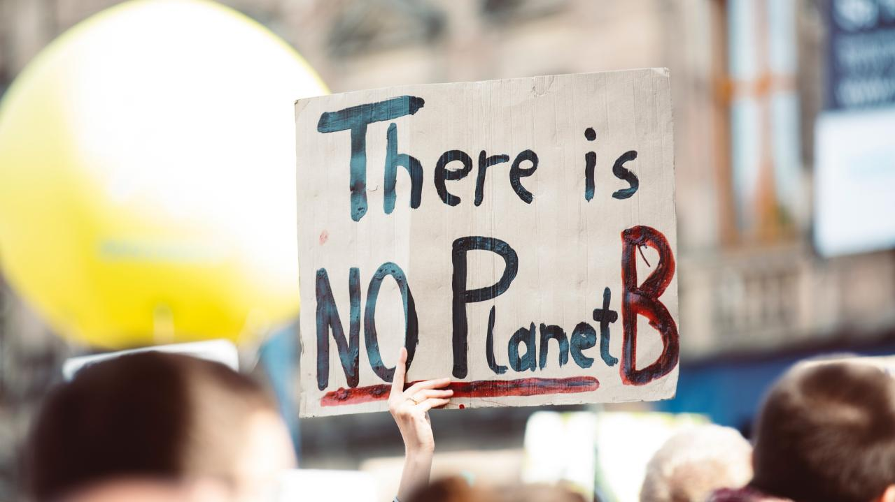
Notes:
(Slide duration: 3 minutes)
Tell students:
We live in an increasingly complex world. While recent decades have seen us achieve unprecedented economic growth and make real progress on a number of key development issues, these successes have masked major fault lines in our current development model. These faults are giving rise to a swelling list of environmental and social burdens; burdens that pose increasing threats to our way of life and are turning the world into a much less viable place in which to live and make a living. We only have one planet. There is no “Planet B”.

Slide 7
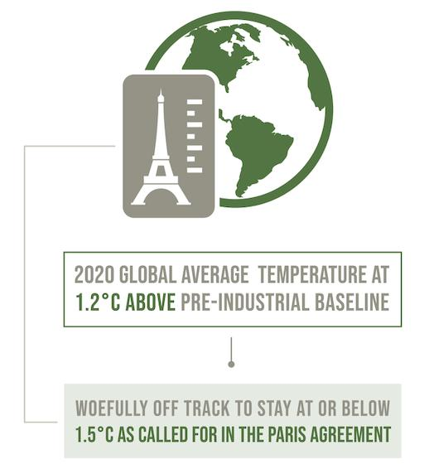
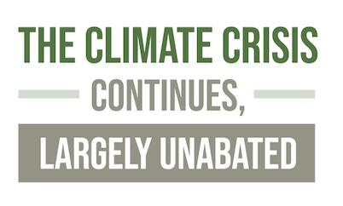
Notes:
(Slide duration: 3 minutes)
Tell students:
The climate crisis continues unabated. For the first time ever, the Brazilian portion of the Amazon Rainforest, the world’s largest forest, now emits more CO2 than it captures, due to human activities such as logging. Concentrations of greenhouse gases continued to increase in 2020, reaching new record highs. It was one of the three warmest years on record, with the global average temperature about 1.2°C above the 1850–1900 baseline. The world remains woefully off track in meeting the Paris Agreement target of limiting global warming to 2°C above pre-industrial levels and reaching net-zero carbon dioxide CO² emissions globally by 2050.

Slide 8
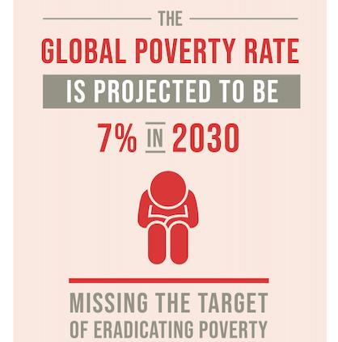
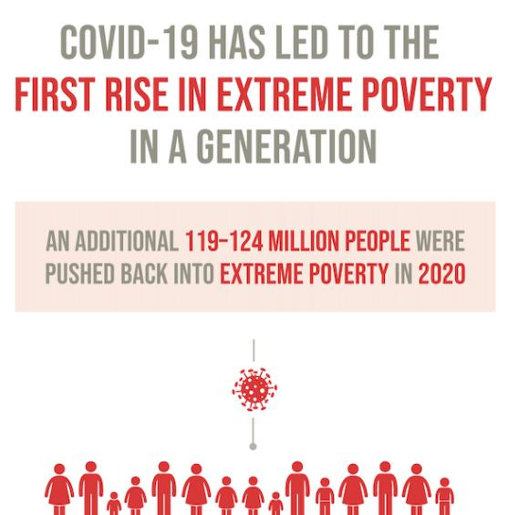
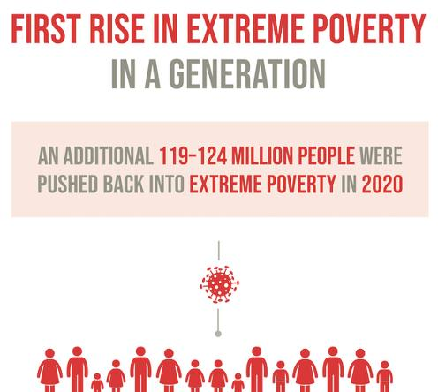
Notes:
(Slide duration: 3 minutes)
Tell students:
The share of the world’s population living in extreme poverty fell from 10.1 per cent in 2015 to 9.3 per cent in 2017. This means that the number of people living on less than $1.90 per day dropped from 741 million to 689 million.
However, the rate of reduction had slowed to less than half a percentage point annually between 2015 and 2017, compared with one percentage point annually between 1990 and 2015. Estimates suggest that 2020 saw an increase of between 119 million and 124 million global poor, of whom 60 per cent are in Southern Asia.
Based on current projections, the global poverty rate is expected to be 7 per cent (around 600 million people) in 2030, missing the target of eradicating poverty.

Slide 9
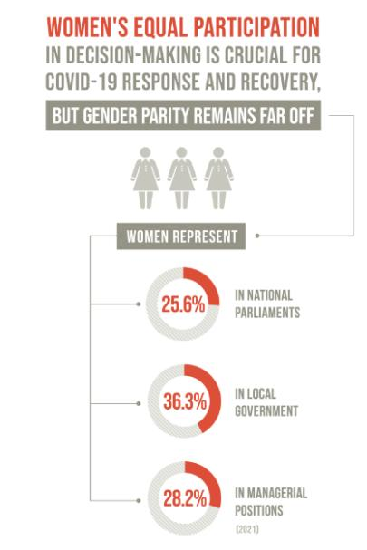
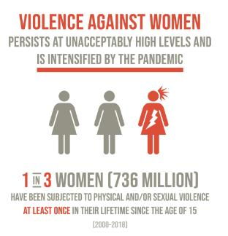
Notes:
(Slide duration: 3 minutes)
Tell students:
Nearly one in three women (736 million) have been subjected to physical and/or sexual violence at least once since the age of 15, usually by an intimate partner. Intimate partner violence starts early. Among girls and women who have ever been married or had a partner, nearly 24 per cent of those aged 15 to 19 years have been subjected to such violence, as have 26 per cent of those aged 20 to 24.
Disparities in intimate partner violence are found across regions, with consistently higher prevalence in low- and lower-middle-income regions compared with high-income regions. These variations are likely to reflect the challenges that women often face in leaving abusive relationships, such as insufficient economic resources, limited availability and access to formal support services, weak social support networks, and fear of repercussions associated with social stigma.

Slide 10
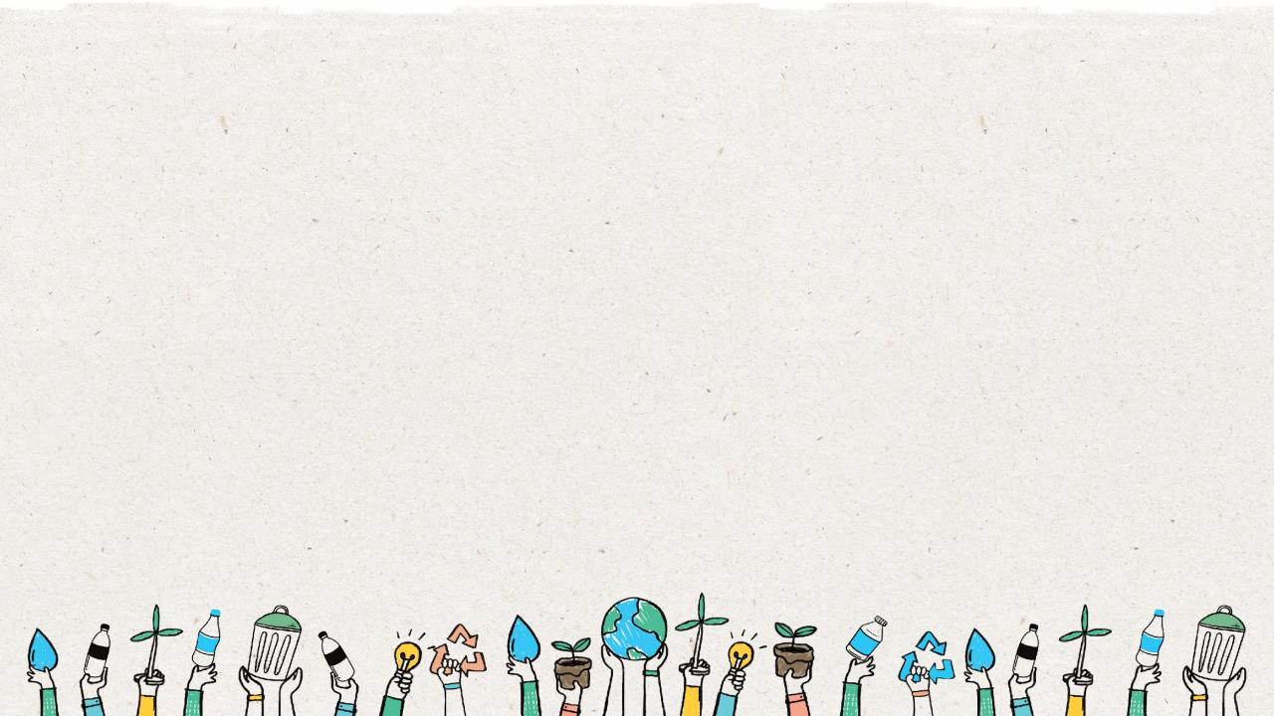
HOW TO
CHANGE
Notes:
(Slide duration: 2 minutes)
Ask students:
How do we as global citizens create the needed change for a more sustainable future?

Slide 11
Notes:
(Slide duration: 3 minutes)
Tell students:
The Sustainable Development Goals (SDGs), also known as the Global Goals, were adopted by the United Nations in 2015 as a universal call to action to end poverty, protect the planet, and ensure that by 2030 all people enjoy peace and prosperity. 193 countries together have committed to prioritize progress for those who are furthest behind. The SDGs are designed to end poverty, hunger, AIDS, and discrimination against women and girls. The creativity, knowhow, technology and financial resources from all of society is necessary to achieve the SDGs in every context.

Slide 12
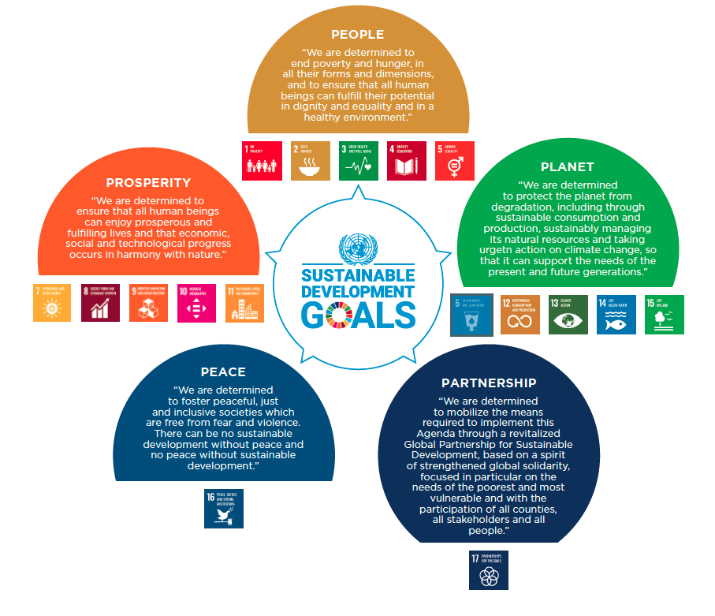
Notes:
(Slide duration: 3 minutes)
Tell students:
Each of the 17 SDGs falls into one of the five pillars of Agenda 2030 – people, prosperity, planet, peace, and partnership. These are the 5 P’s of the SDGs.
People We are determined to end poverty and hunger, in all their forms and dimensions, and to ensure that all human beings can fulfil their potential in dignity, equality and in a healthy environment.
Planet We are determined to protect the planet from degradation, including through sustainable consumption and production, sustainably managing its natural resources and taking urgent action on climate change, so that it can support the needs of the present and future generations.
Prosperity We are determined to ensure that all human beings can enjoy prosperous and fulfilling lives and that economic, social, and technological progress occurs in harmony with nature.
Peace We are determined to foster peaceful, just and inclusive societies which are free from fear and violence. There can be no sustainable development without peace and no peace without sustainable development.
Partnership We are determined to mobilize the means required to implement this Agenda through a revitalized Global Partnership for Sustainable Development, based on a spirit of strengthened global solidarity, focused on the needs of the poorest and most vulnerable and with the participation of all countries, all stakeholders and all people.

Slide 13
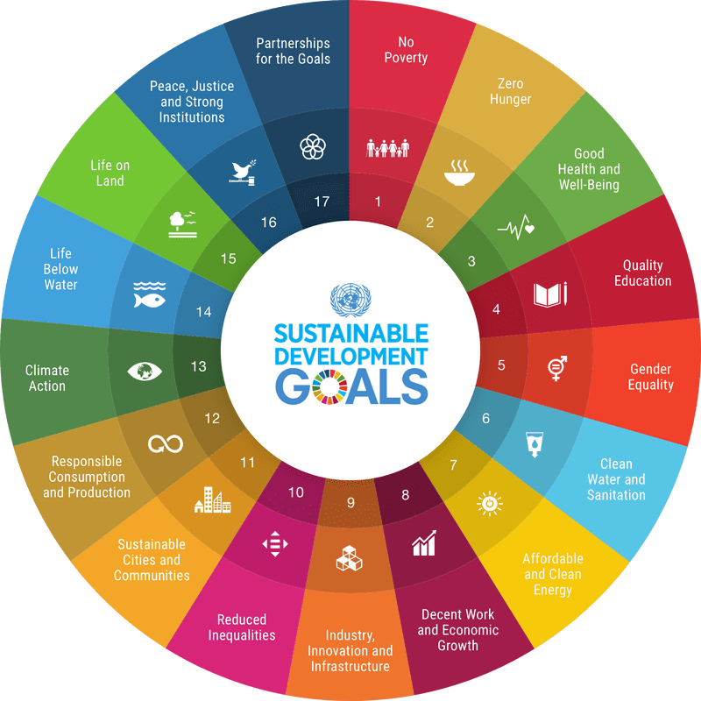
169 Targets
Go into detail on exactly what needs to be achieved across social, environmental, and economic aspects
230 Indicators
Highlight key data sets for governments to monitor with a view to achieving the goals
Notes:
(Slide duration: 2 minutes)
Tell students:
The real power of the SDGs lies in the details that sit beneath the 17 headline goals. The SDGs are underpinned by 169 specific targets and over 200 indicators that provide highly prescriptive guidance on how to put the world onto a more sustainable path.

Slide 14
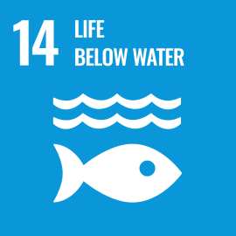
14.1
By 2025, prevent and significantly reduce marine pollution of all kinds.
14.2
By 2020, sustainably manage and protect marine and coastal ecosystems to avoid significant adverse impacts.
14.3
Minimize and address the impacts of ocean acidification including through enhanced scientific cooperation at all levels.
14.4
By 2020, effectively regulate harvesting and end overfishing, illegal, unreported and unregulated fishing and destructive fishing practices.
14.5
By 2020, conserve at least 10 per cent of coastal and marine areas.
14.6
By 2020, prohibit certain forms of fisheries subsidies which contribute to overcapacity and overfishing.
14.7
By 2030, increase the economic benefits to Small Island developing States and least developed countries from the sustainable use of marine resources.
14.a
Increase scientific knowledge, develop research capacity and transfer marine technology
14.b
Provide access for small-scale artisanal fishers to marine resources and markets
Enhance the conservation and sustainable use of oceans and their resources by implementing international law as reflected in United Nations Convention on the Law of the Sea
14.c
Notes:
(Slide duration: 3 minutes)
Tell students:
Let's examine one of the SDGs, #14 “Life Below Water”.
There are 10 targets for Goal #14 that include specific, measurable, achievable, relevant, and time-based criteria to guide the overall achievement of the goal to improve “Life Below Water”.

Slide 15
14.1.1
Index of coastal eutrophication and floating plastic debris density
14.2.1
Proportion of national exclusive economic zones managed using ecosystem-based approaches
14.3.1
Average marine acidity (pH) measured at agreed suite of representative sampling stations
14.4.1
Proportion of fish stocks within biologically sustainable levels
14.5.1
Coverage of protected areas in relation to marine areas
14.6.1
Progress by countries in the degree of implementation of international instruments aiming to combat illegal, unreported and unregulated fishing
14.7.1
Sustainable fisheries as a percentage of GDP in small island developing States, least developed countries and all countries
14.A.1
Proportion of total research budget allocated to research in the field of marine technology
14.B.1
Progress by countries in the degree of application of a legal/regulatory/policy/institutional framework which recognizes and protects access rights for small-scale fisheries
14.C.1
Number of countries making progress in ratifying, accepting and implementing through legal, policy and institutional frameworks, ocean-related instruments that implement international law, as reflected in the United Nation Convention on the Law of the Sea, for the conservation and sustainable use of the oceans and their resources.
Notes:
(Slide duration: 2 minutes)
Tell students:
To ensure that the targets are being met to achieve SDG #14, a framework of indicators and statistical data are highlighted to monitor progress, inform policy, and ensure accountability of all stakeholders.

Slide 16
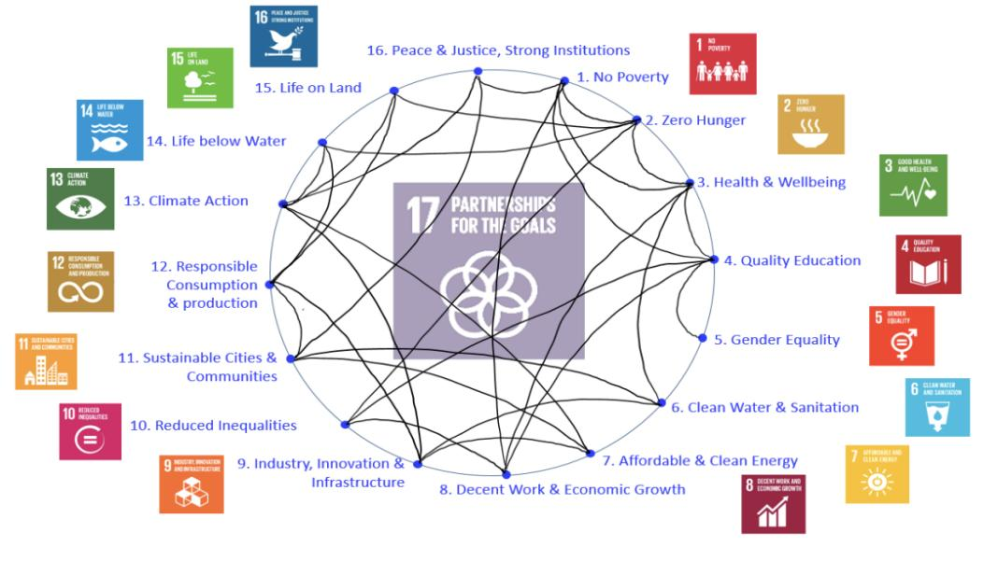
Notes:
(Slide duration: 3 minutes)
Tell students:
The SDGs are deeply interconnected – a lack of progress on one goal hinders progress on others. The 17 goals, which collectively aim to “end poverty, and ensure prosperity for all” cannot be tackled one-by-one or in a piecemeal fashion. We cannot ensure the health and wellbeing (SDG 3) of all the world’s citizens without eliminating poverty (SDG 1) and hunger (SDG 2), for example. We cannot achieve gender equality (SDG 5) without decent work and economic growth for all (SDG 8). And we cannot take climate action (SDG 13) without delivering affordable and clean energy (SDG 7).

Slide 17
Environmental
Social
Economic
Notes:
(Slide duration: 3 minutes)
Tell students:
Sustainable development is a balance between social, environmental and economic objectives. All the 17 SGDs live in one of the regions of the three aspects of development or at the intersection of them.

Slide 18
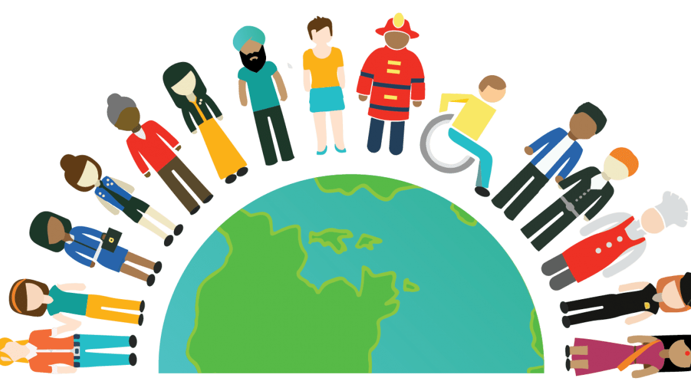
How do we achieve the SDGs and ensure no one is left behind?
Notes:
(Slide duration: 2 minutes)
Tell students:
So how do we reach these goals and achieve a more sustainable future?
We need to rethink the problems, solutions, and systems that currently exist in order to deeply and meaningfully understand the nature of the problems and the context of our current situation before we can begin implementing solutions.
Mapping tools are a great way to frame the causes and effects of problems, and how certain activities and objectives can help lead us to solutions. Let's examine the problem/solution tree and begin analyzing problems and their potential solutions.

Slide 19
The Problem Tree
Solutions Tree
Effect
Ends
Causes
Means
Negative Statements
Positive Statements
Notes:
(Slide duration: 3 minutes)
Tell students:
The problem/solution tree analysis is a tool which helps to understand complex challenges and to find appropriate solutions by mapping out the cause and effect of each particular issue in detail.
What is a problem/solution tree? A problem tree provides an overview of the known causes and effects of an identified problem. The analysis is structured so that causes and effects are laid out visually, showing linkages between different factors. Causes form the roots of the tree, the core problem is the trunk, and the consequences/effects are the branches of the tree. A solution tree outlines the initiatives, actions, and projects which develop as logical solutions in response to the initial problem tree.

Slide 20
The Problem Tree
Unknown side effects of human consumption
Threat to ecosystems
Effect
Effect
Waste enters food chain
Increase in waste leaking into the environment
Low rate of recycling
Problems
Problem
Mismanagement of waste at the source
Government does not fund recycling
Causes
Causes
People do not properly separate waste at home
Lack of modern recycling infrastructure
Problem Statement (Negative): There is a low rate of recycling.
Notes:
(Slide duration: 5 minutes)
Tell students:
A problem tree provides an overview of all the known causes and effect to an identified problem. This is important in planning community engagement or a behavior change project as it establishes the context in which a project is to occur. A problem tree involves mapping out the causes of the problem we have identified and want to solve, as well as identifying the effects the problem, and how it causes more problems.
The first step is to discuss and agree the problem or issue to be analyzed. This will be your “problem statement”. Try to make your problem statement as specific as possible, as this will help make your problem tree as actionable as possible. The problem or issue is written in the center of the diagram and becomes the 'trunk' of the tree. This becomes the 'focal problem'. The wording does not need to be exact as the roots and branches will further define it, but it should describe an actual issue that everyone feels passionately about.
Next, the group identifies the causes of the focal problem - these become the roots - and then identify the consequences, which become the branches. These causes and consequences can be created on post-it notes or cards, perhaps individually or in pairs, so that they can be arranged in a cause-and-effect logic.

Slide 21
Solutions Tree
No side effects to human health
No threat to ecosystems
Ends
Goal / Overall Objective
Waste does not enter food chain
No waste leakage into the environment
High rate of recycling
Purpose / Outcomes
Solutions
Proper management of waste at the source
Government funded recycling
Means
Objectives
People properly separate waste at home
Adequate modern recycling infrastructure
Solution Statement (Positive): There is a high rate of recycling.
Notes:
(Slide duration: 5 minutes)
Tell students:
A solution (also called objectives) tree is developed by reversing the negative statements that form the problem tree into positive ones. For example, a cause (problem tree) such as “lack of knowledge” would become a means such as “increased knowledge”. The objectives tree demonstrates the means-end relationship between objectives.
Step 1: Reformulate all negative statements of the problem analysis into positive statements that are desirable and realistically achievable.
Step 2: Check the means-ends relationships to ensure the validity and completeness of the hierarchy; cause-effect relationships in the problem tree are turned into means-ends linkages in the objective tree.
Step 3: If necessary, revise statements and add new statements if these seem to be relevant and necessary to achieve the objective at the next higher level or delete objectives which are not apparently suitable or necessary.

Slide 22
The Problem Tree
Solutions Tree
Threat to ecosystems
Unknown side effects of human consumption
Poor health of population
Low farming land use
Good health of population
High farming land use
No threat to ecosystems
No side effects to human health
Effect
Ends
Increase in waste leaking into the environment
Waste enters food chain
Inadequate nutrition
Low income farmer
Adequate nutrition
High income farmer
No waste leakage into the environment
Waste does not enter food chain
Low rate of recycling
Low farm productivity
High farm productivity
High rate of recycling
Problem
Solutions
Government does not fund recycling
Mismanagement of waste at the source
High post-harvest losses
Low soil fertility
Low post-harvest losses
High soil fertility
Government funded recycling
Proper management of waste at the source
Causes
Means
Lack of modern recycling infrastructure
People do not properly separate waste at home
Insufficient storage
High erosion
Sufficient storage
Low erosion
Adequate modern recycling infrastructure
People properly separate waste at home
Problem Statement (Negative):
There is a low rate of recycling.
Solution Statement (Positive): There is a high rate of recycling.
Notes:
(Slide duration: 5 minutes)
Tell students:
Reformulating the problems into objectives should be done very carefully. If a statement makes no sense after rewording, write a replacement statement, or delete it, or leave the problem unchanged. It is important to review the formulated objectives and the resulting objective tree.
Problem statement: “river water quality is deteriorating” can be reformulated into “quality of river water is improved”.
Problem statement: “loss of confidence in public services” can be transformed into “people’s confidence in public services is restored”.
Problem statement: “public transportation is in a bad condition” can be reformulated into “public transportation is kept in good condition”.

Slide 23
1.
Choose a sustainability challenge scenario from the handout
2.
Create a problem tree and define the problem
Effect
Negative Statements
Causes
3.
Create an objective tree and define the solution
4.
Select a preferred intervention and connect it to the SDGs it addresses
Ends
Positive
Statements
Means
Notes:
Tell students:
For the group activity follow the next steps:
Step 1 Choose a sustainability challenge and identify the SDGs connected to the challenge.
Step 2 Create a problem tree analyzing the causes and effects of the challenge.
Step 3 Create an objective tree and identify a solution pathway to overcome the challenge.
Step 4 Select the preferred intervention, create a (Problem Statement & Solutions Statement) and link your statement to the SDGs. Try to connect your statements to SDG targets and indicators.

